Slide 1
Chapter 1
Psychological Science

Slide 2
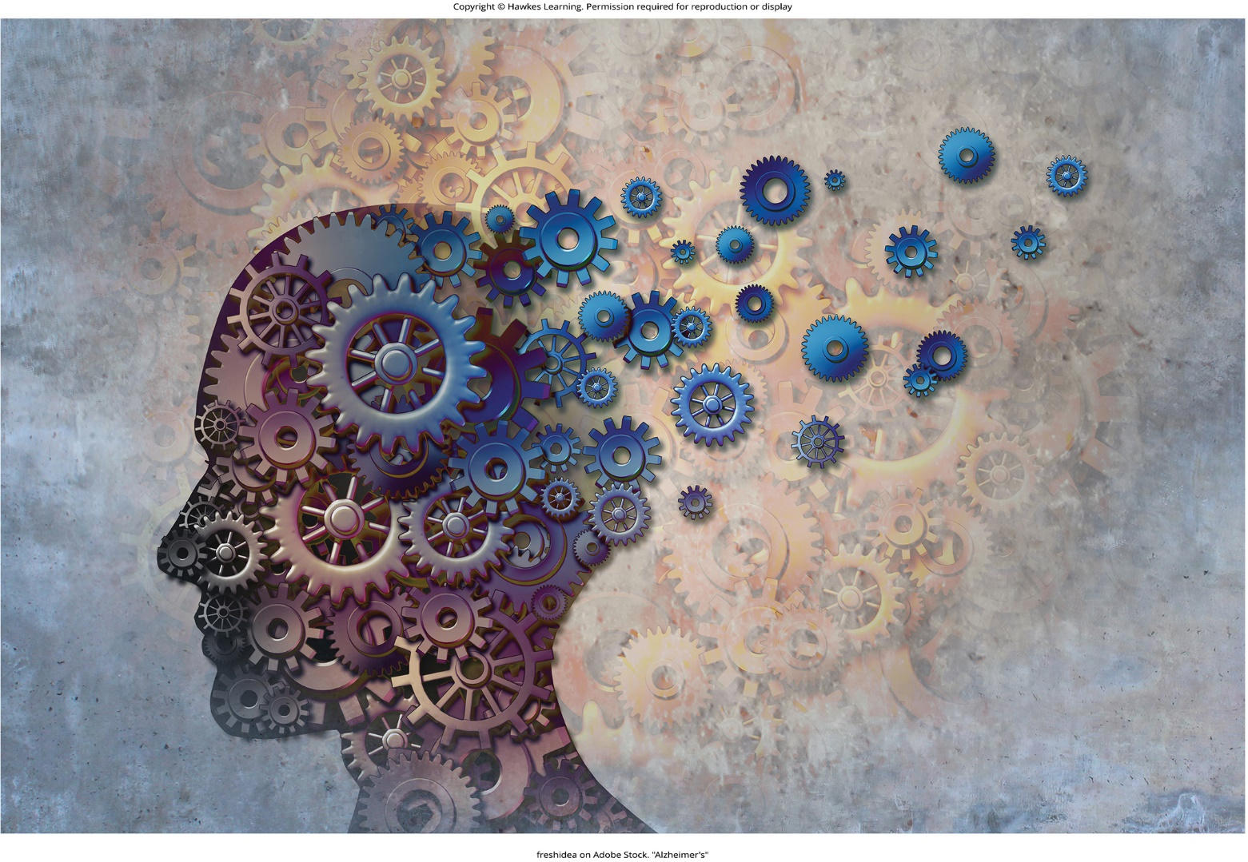
Lesson 1.1 Figure 1

Slide 3
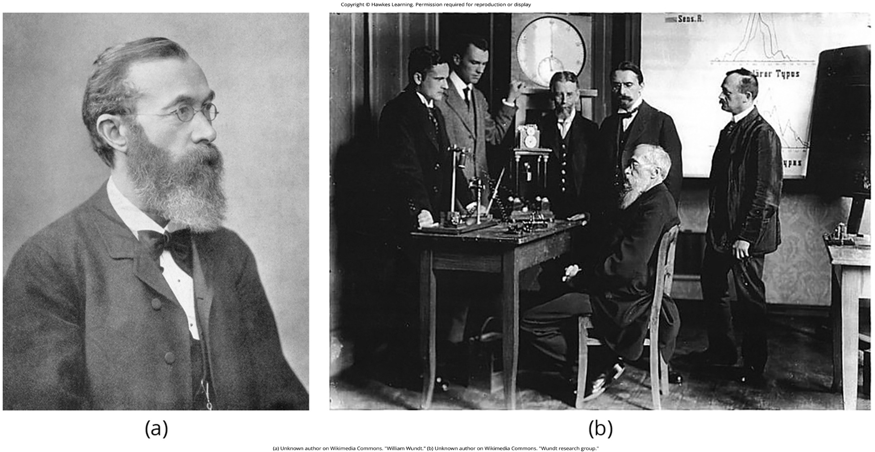
Lesson 1.1 Figure 2

Slide 4
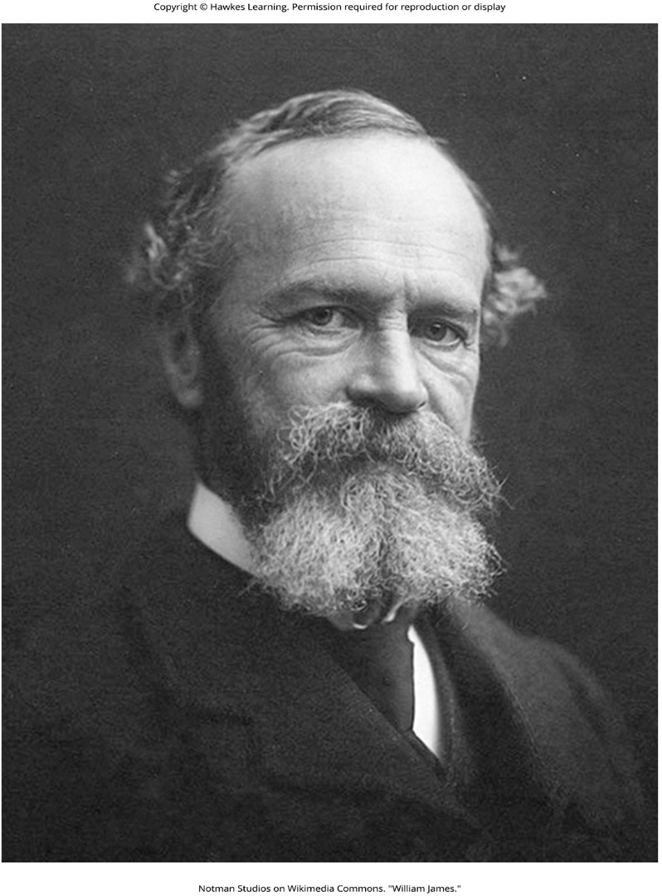
Lesson 1.1 Figure 3

Slide 5

Lesson 1.1 Figure 4

Slide 6

Lesson 1.1 Figure 5

Slide 7
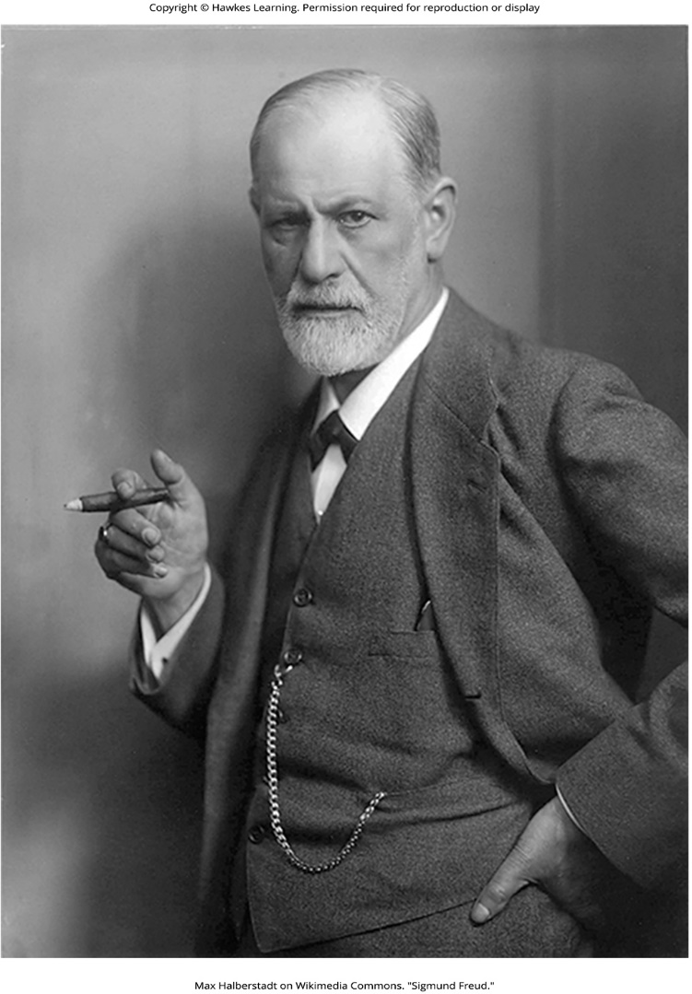
Lesson 1.1 Figure 6

Slide 8
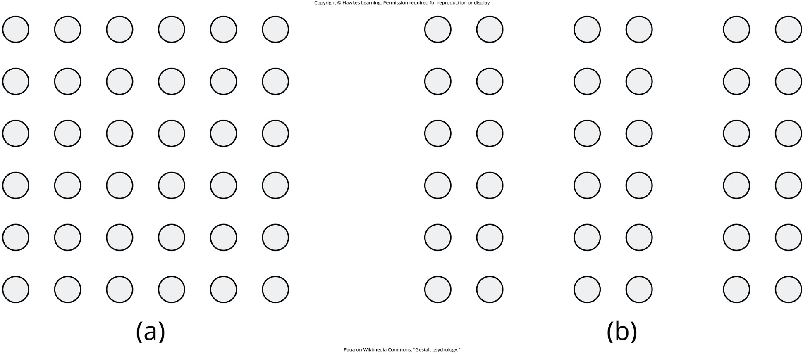
Lesson 1.1 Figure 7

Slide 9
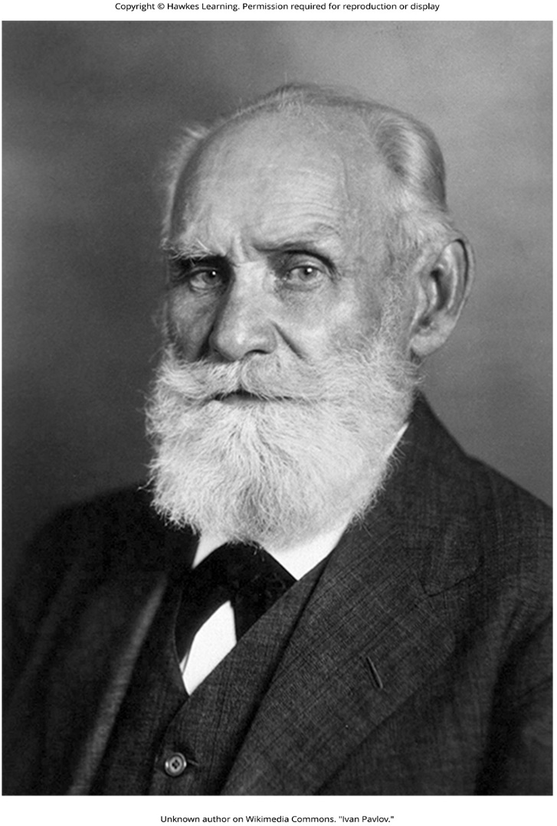
Lesson 1.1 Figure 8

Slide 10
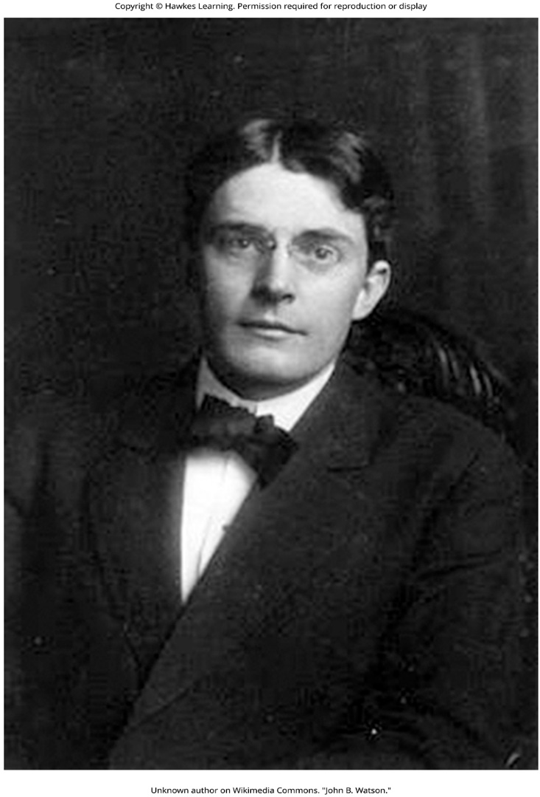
Lesson 1.1 Figure 9

Slide 11
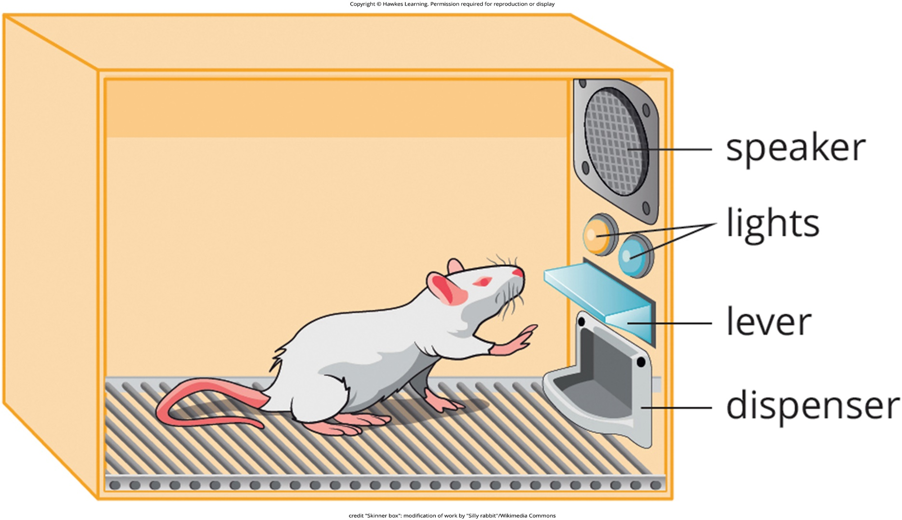
Lesson 1.1 Figure 10

Slide 12
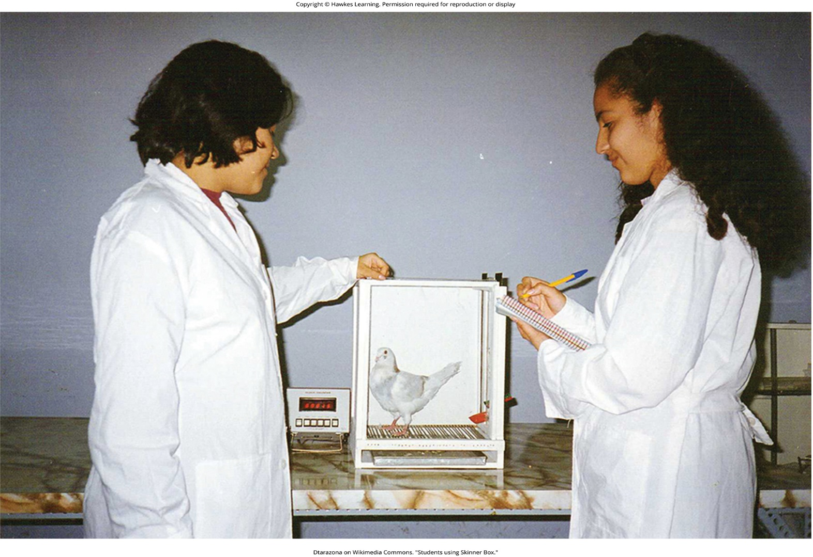
Lesson 1.1 Figure 11

Slide 13
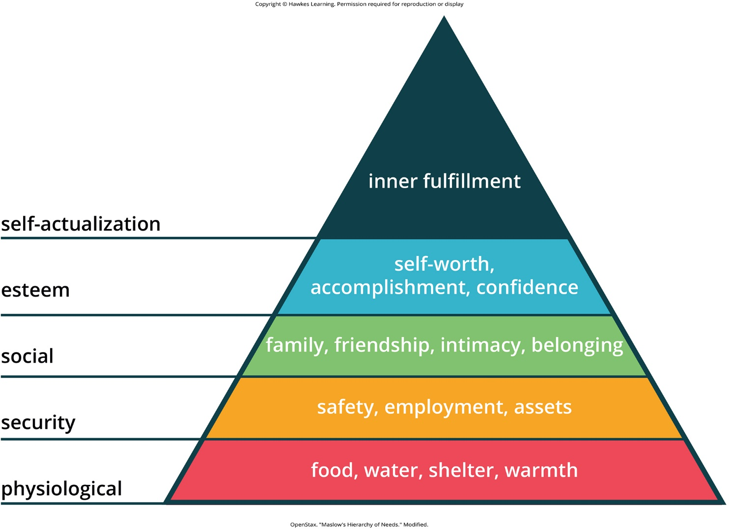
Lesson 1.1 Figure 12

Slide 14
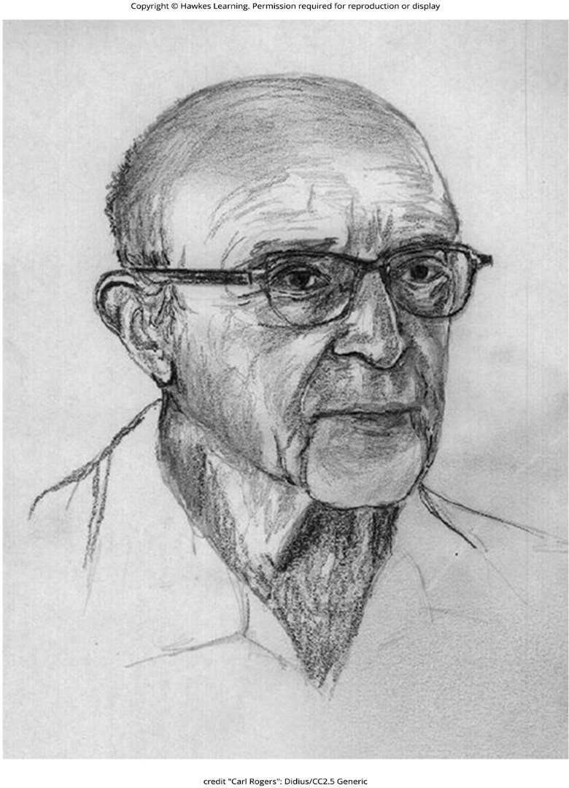
Lesson 1.1 Figure 13

Slide 15
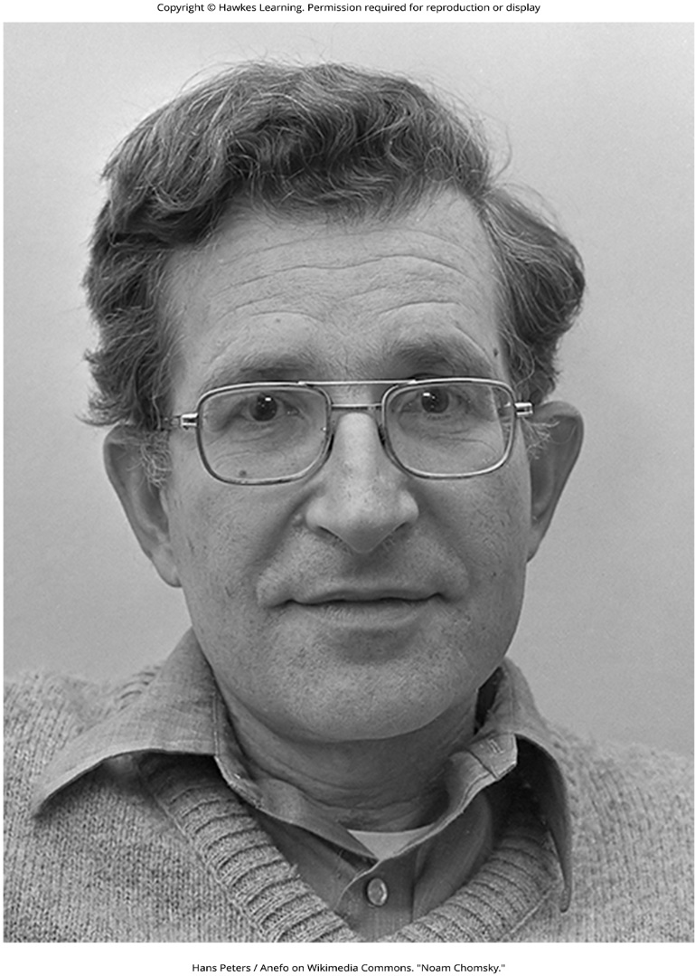
Lesson 1.1 Figure 14

Slide 16
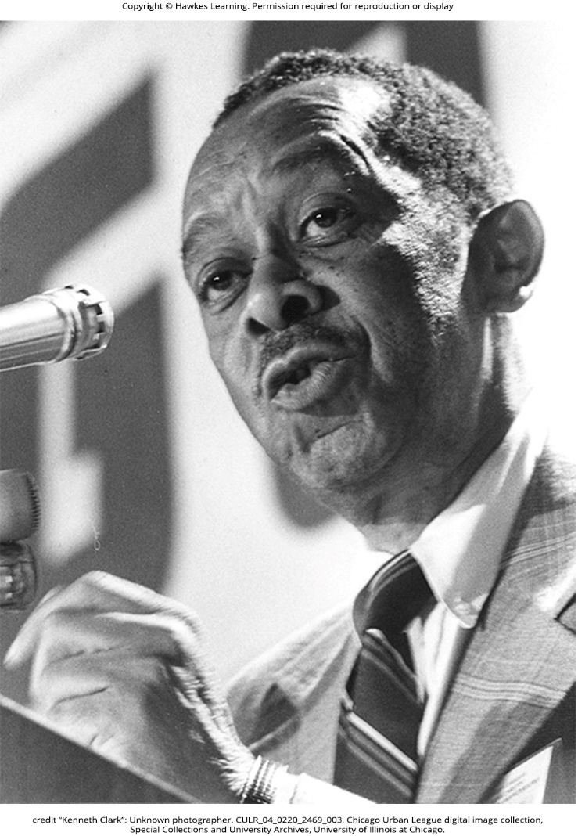
Lesson 1.1 Figure 15

Slide 17
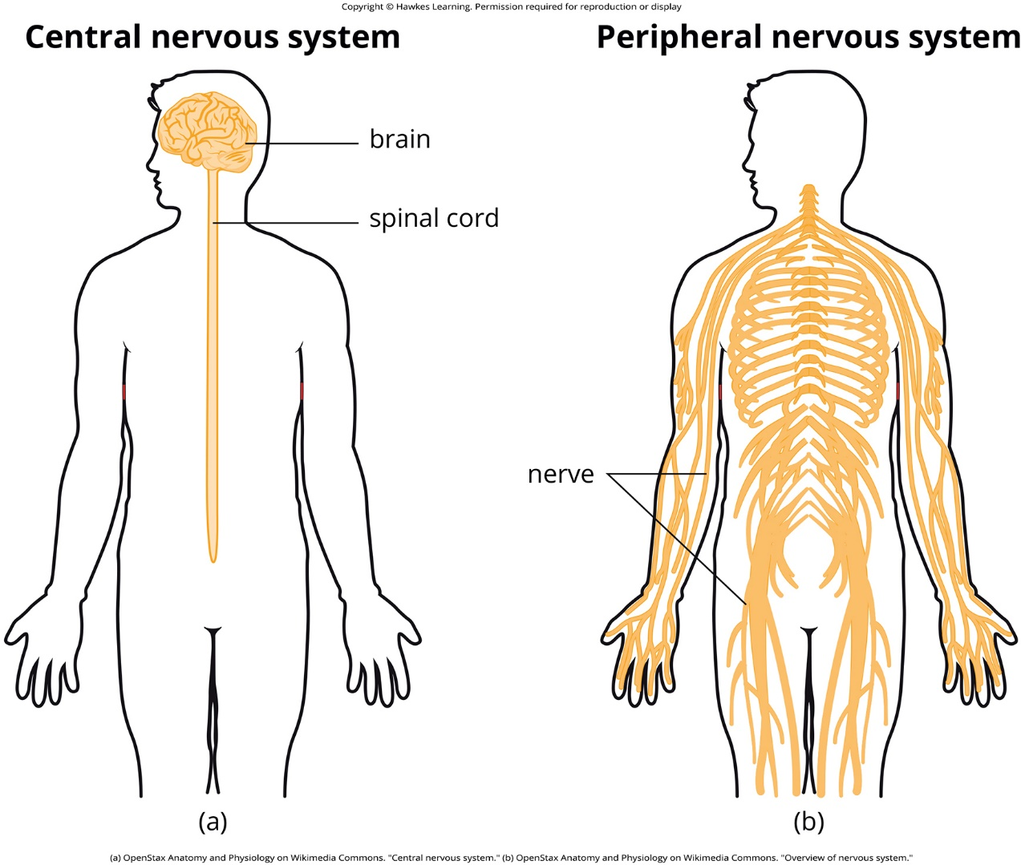
Lesson 1.2 Figure 1

Slide 18
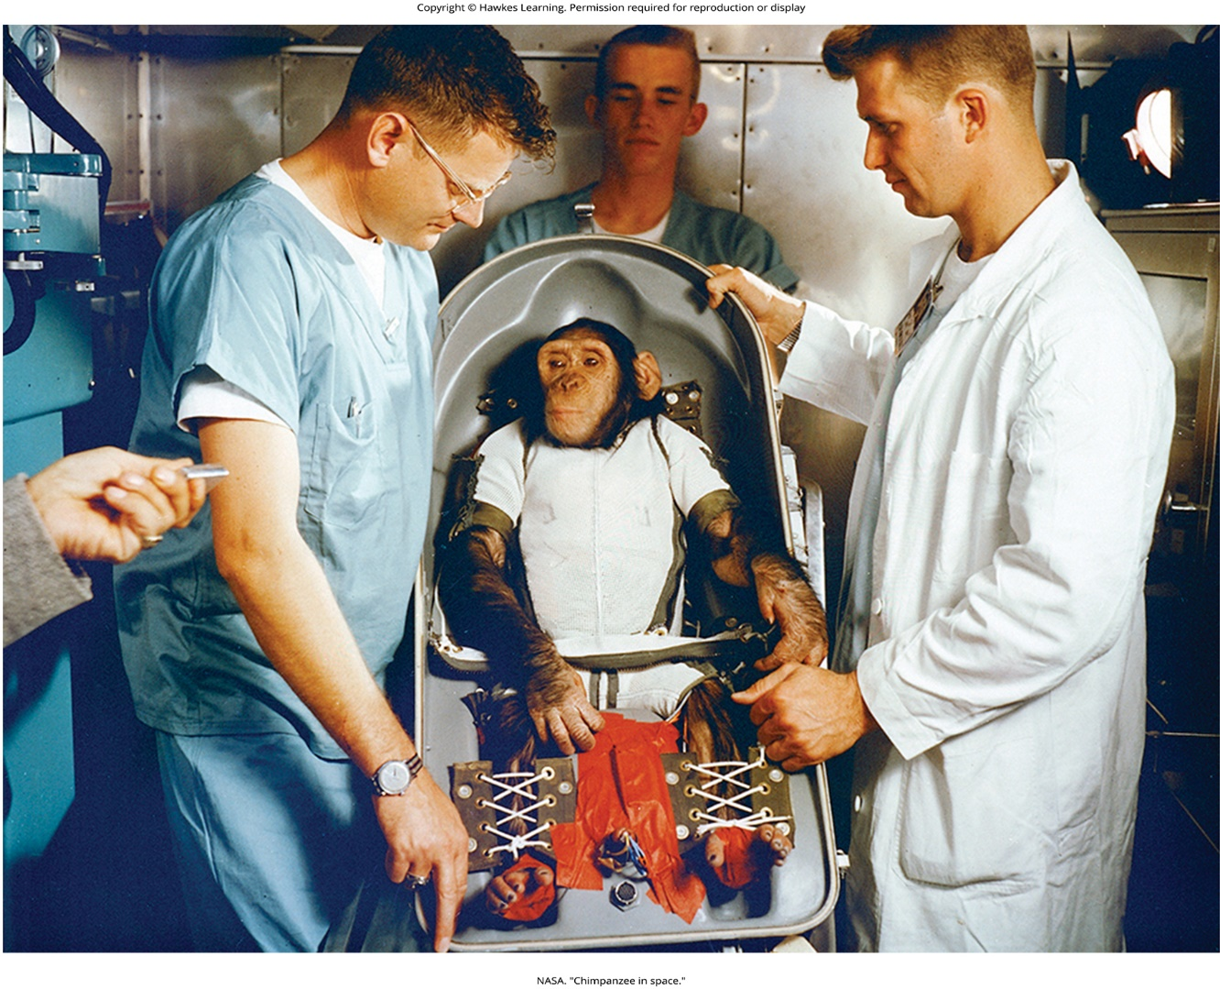
Lesson 1.2 Figure 2

Slide 19
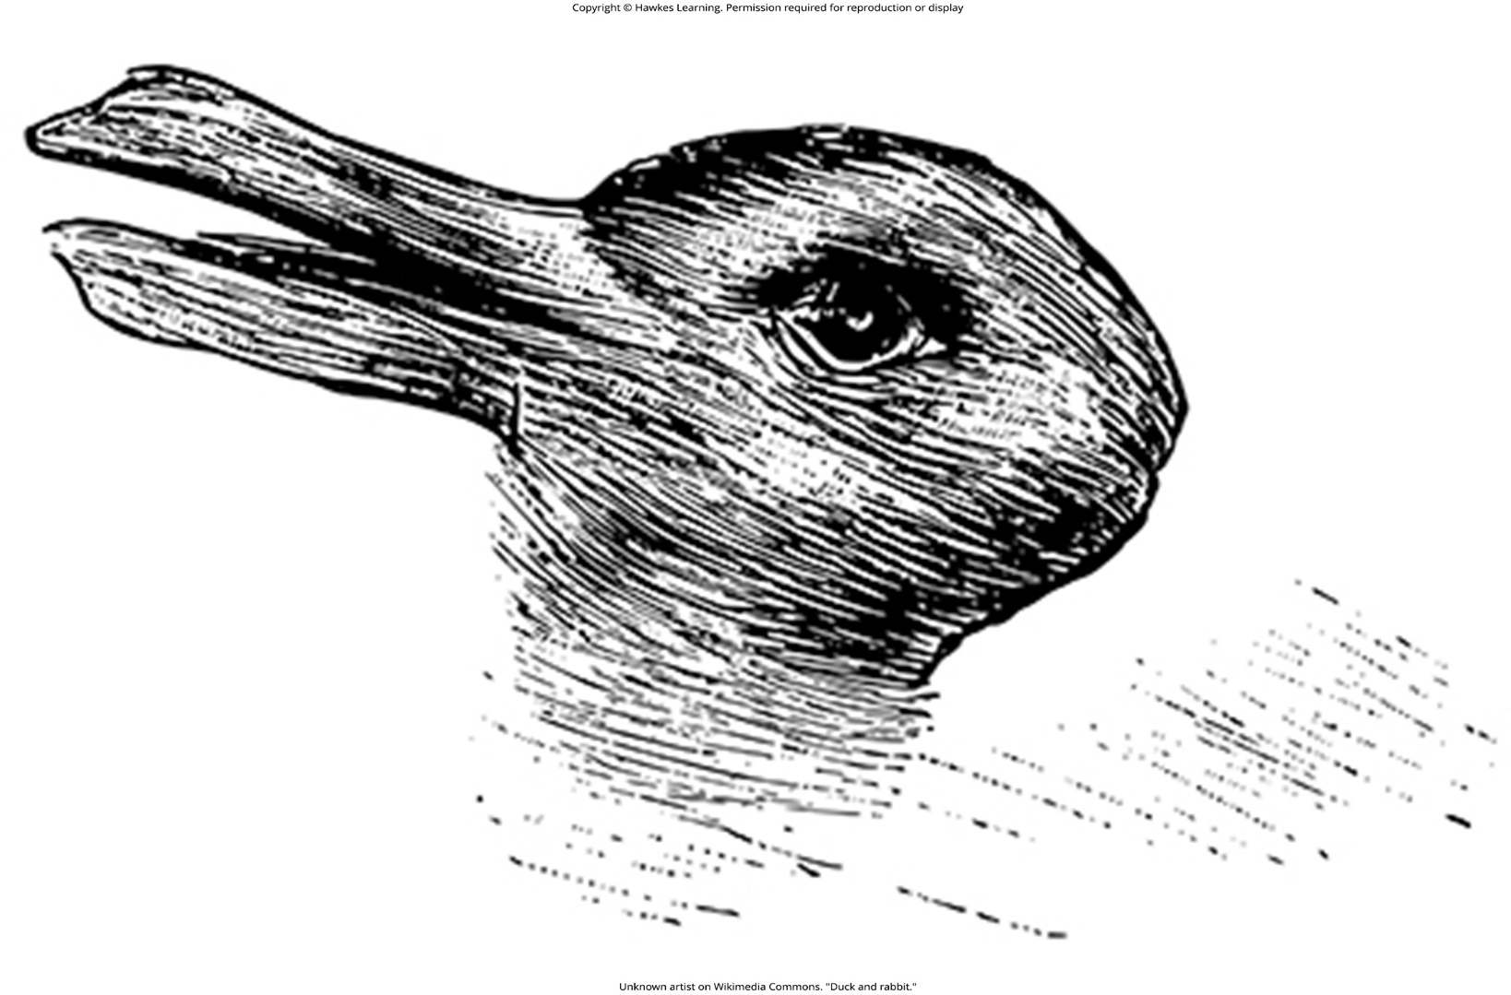
Lesson 1.2 Figure 3

Slide 20
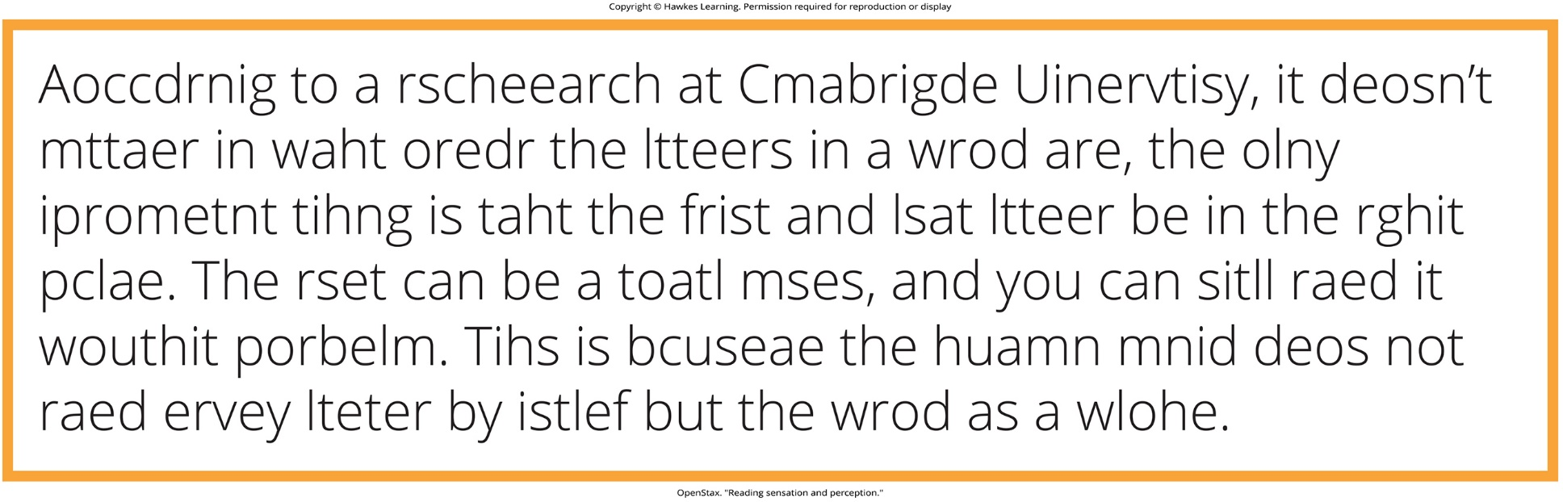
Lesson 1.2 Figure 4

Slide 21
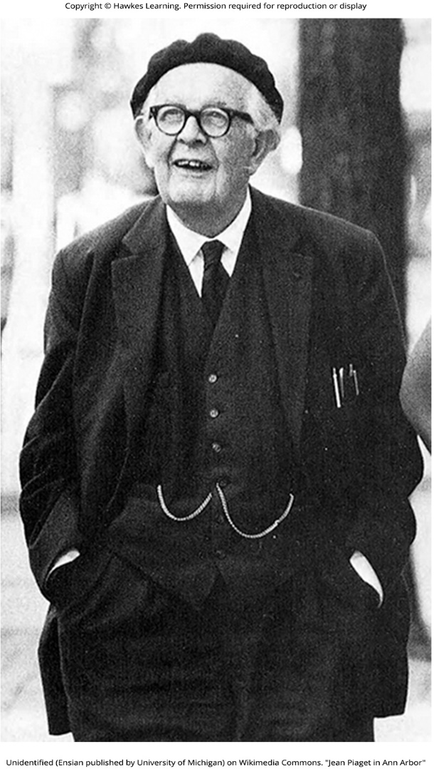
Lesson 1.2 Figure 5

Slide 22
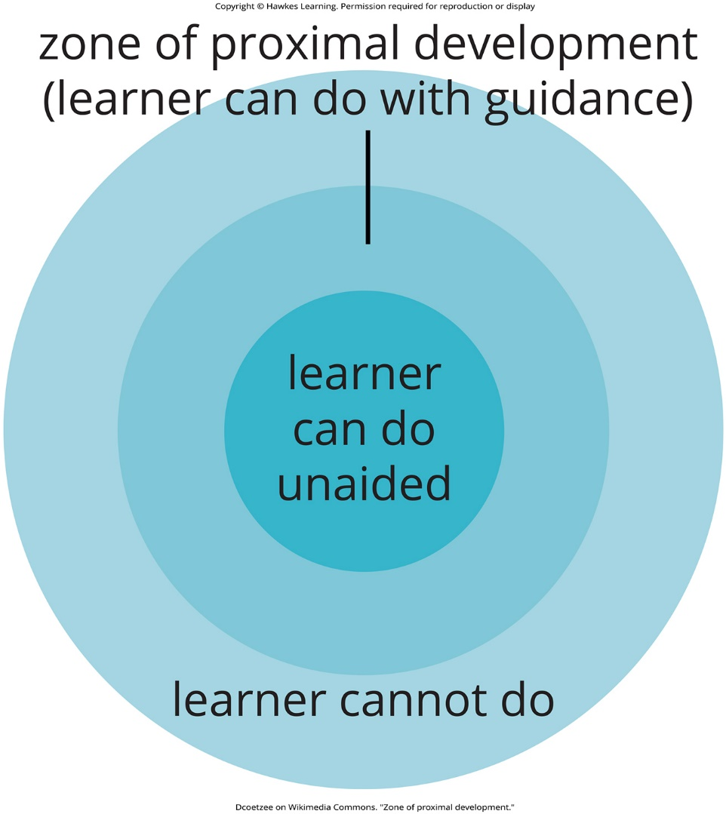
Lesson 1.2 Figure 6

Slide 23
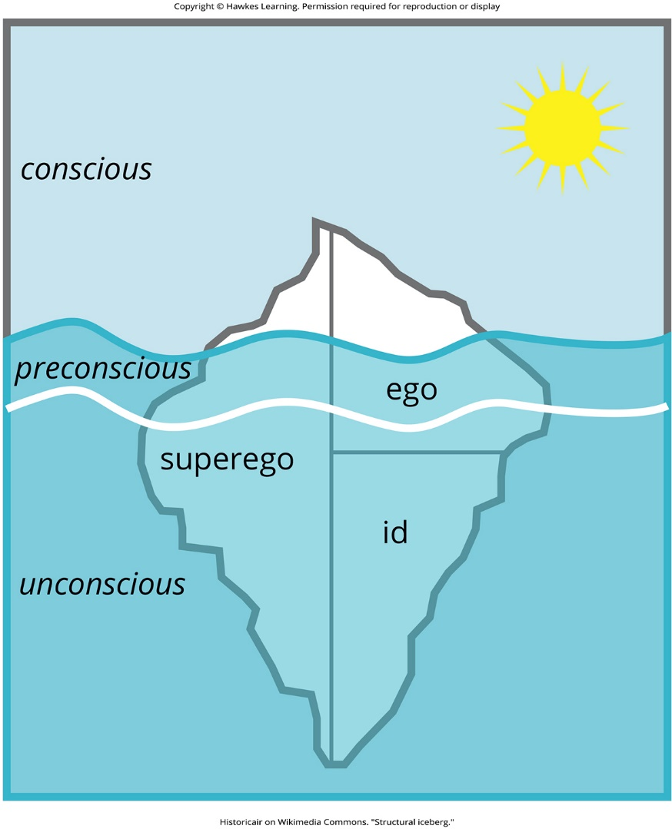
Lesson 1.2 Figure 7

Slide 24
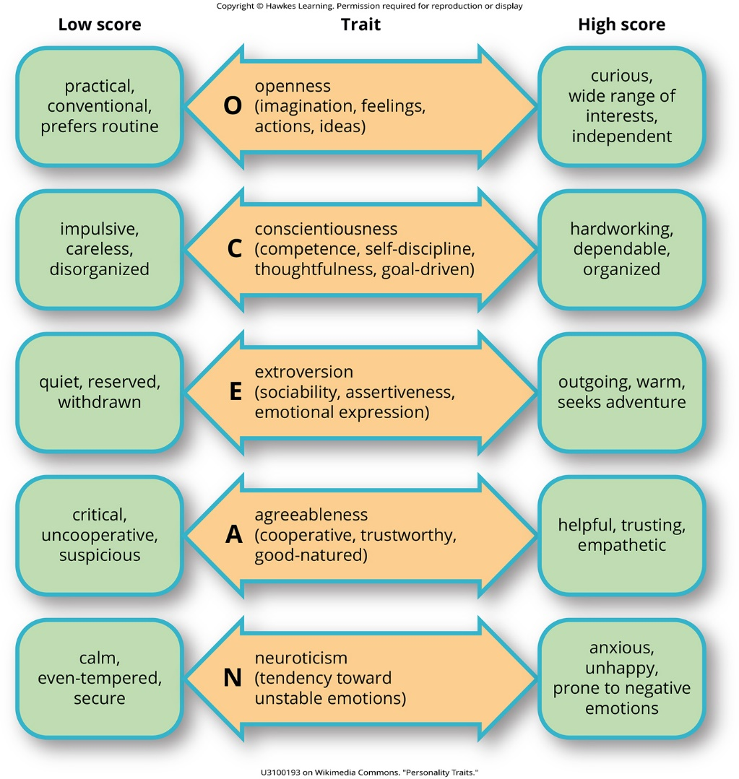
Lesson 1.2 Figure 8

Slide 25

Lesson 1.2 Figure 9

Slide 26
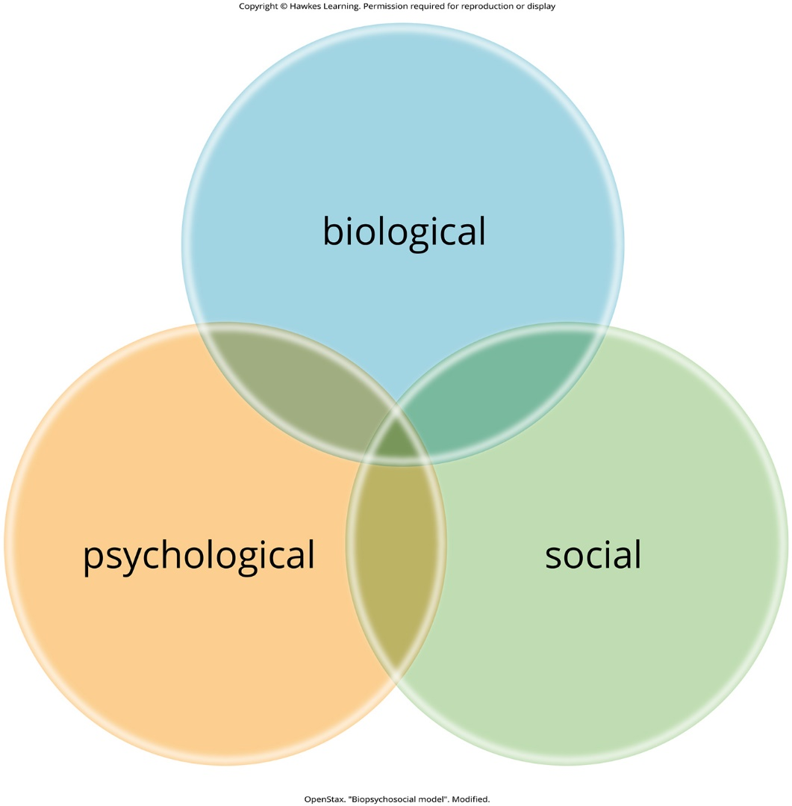
Lesson 1.2 Figure 10

Slide 27
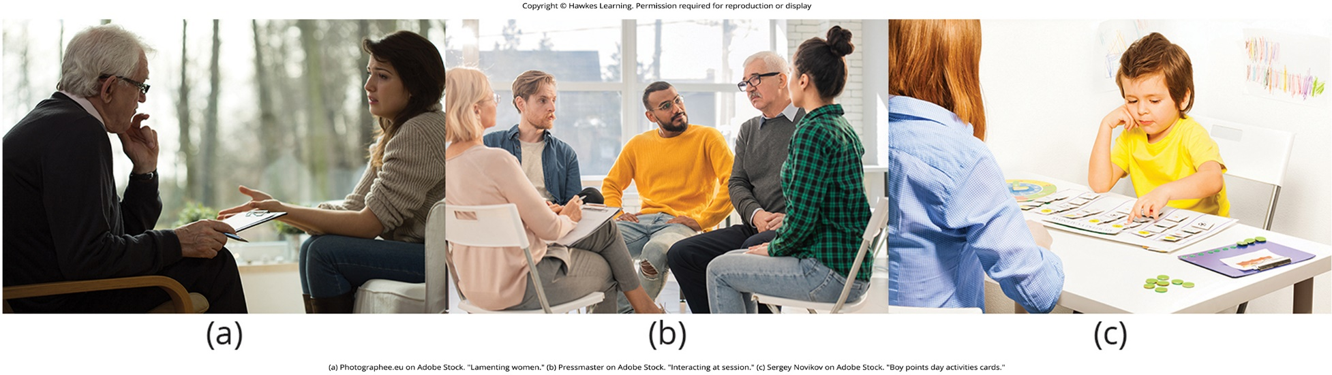
Lesson 1.2 Figure 11

Slide 28
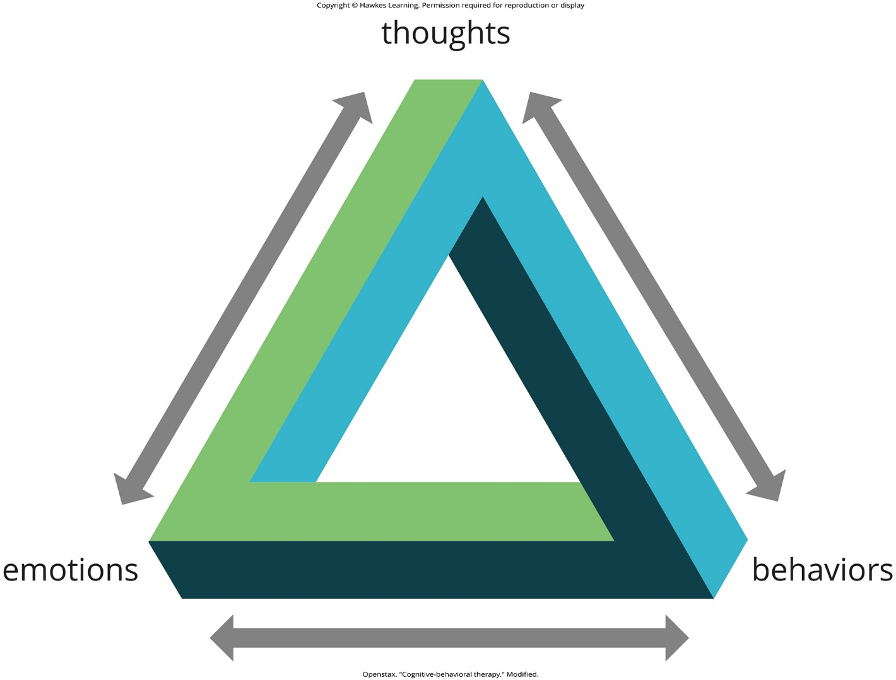
Lesson 1.2 Figure 12

Slide 29
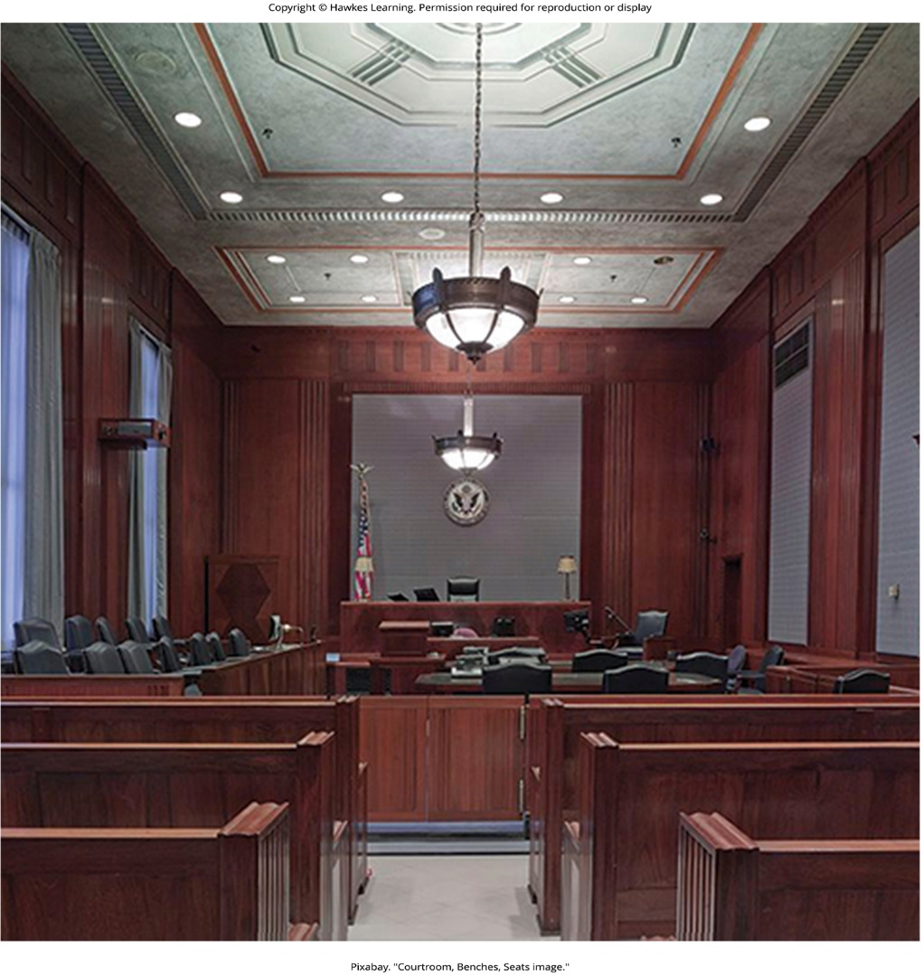
Lesson 1.2 Figure 13

Slide 30

Lesson 1.2 Figure 14

Slide 31
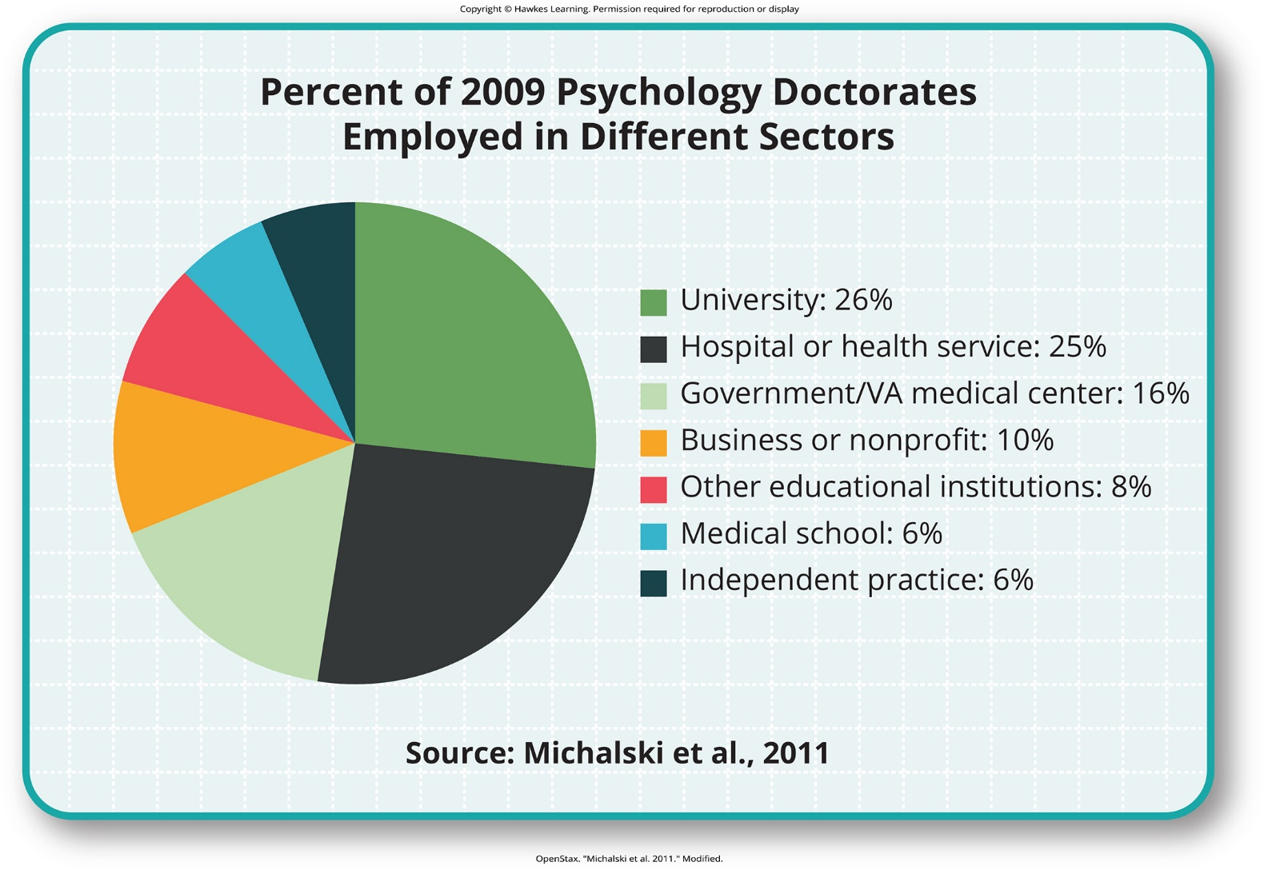
Lesson 1.2 Figure 15

Slide 32

Lesson 1.3 Figure 1

Slide 33
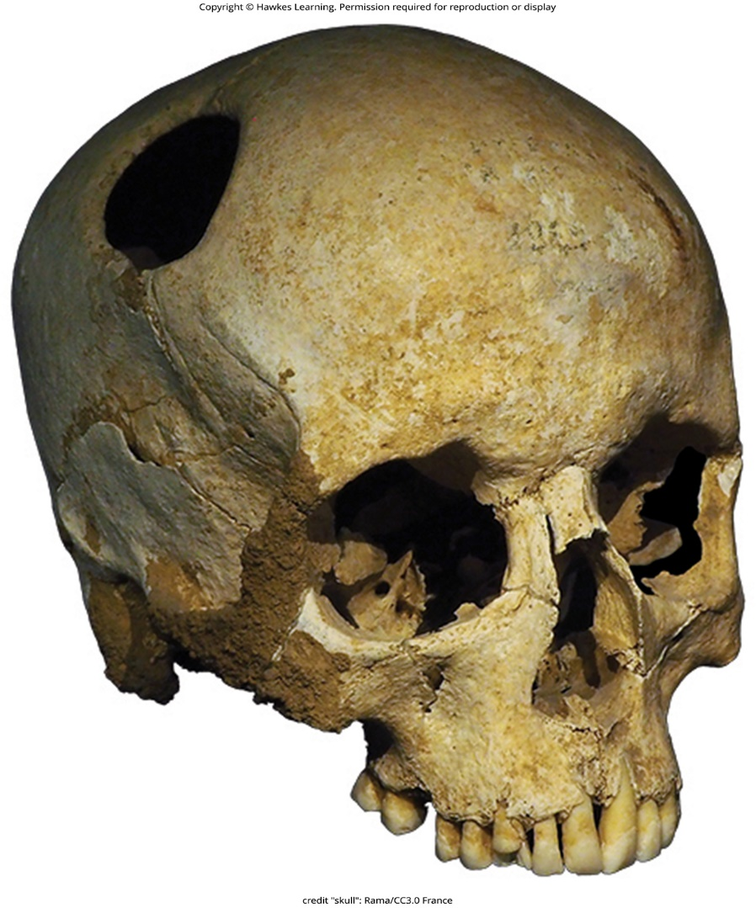
Lesson 1.3 Figure 2

Slide 34
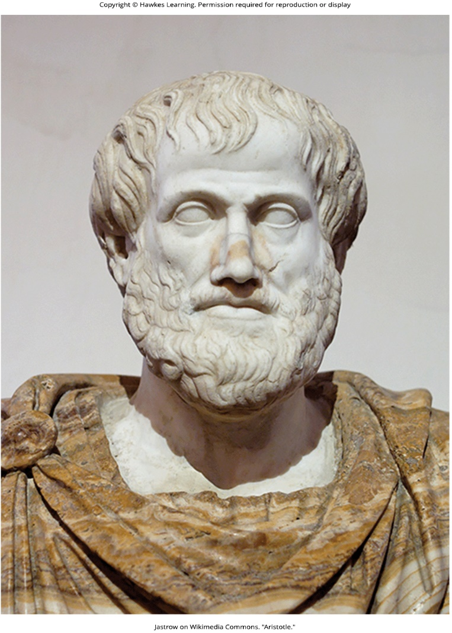
Lesson 1.3 Figure 3

Slide 35
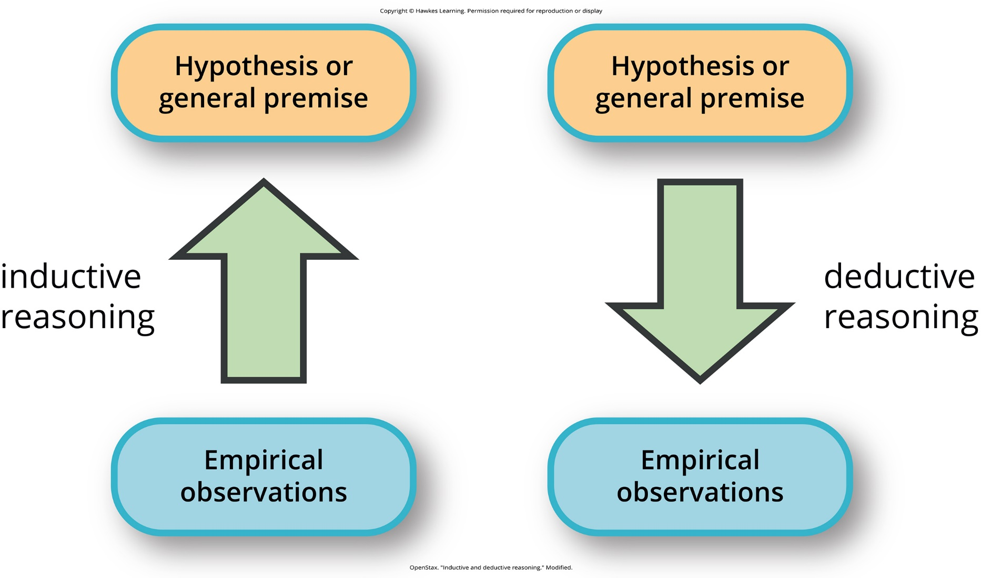
Lesson 1.3 Figure 4

Slide 36
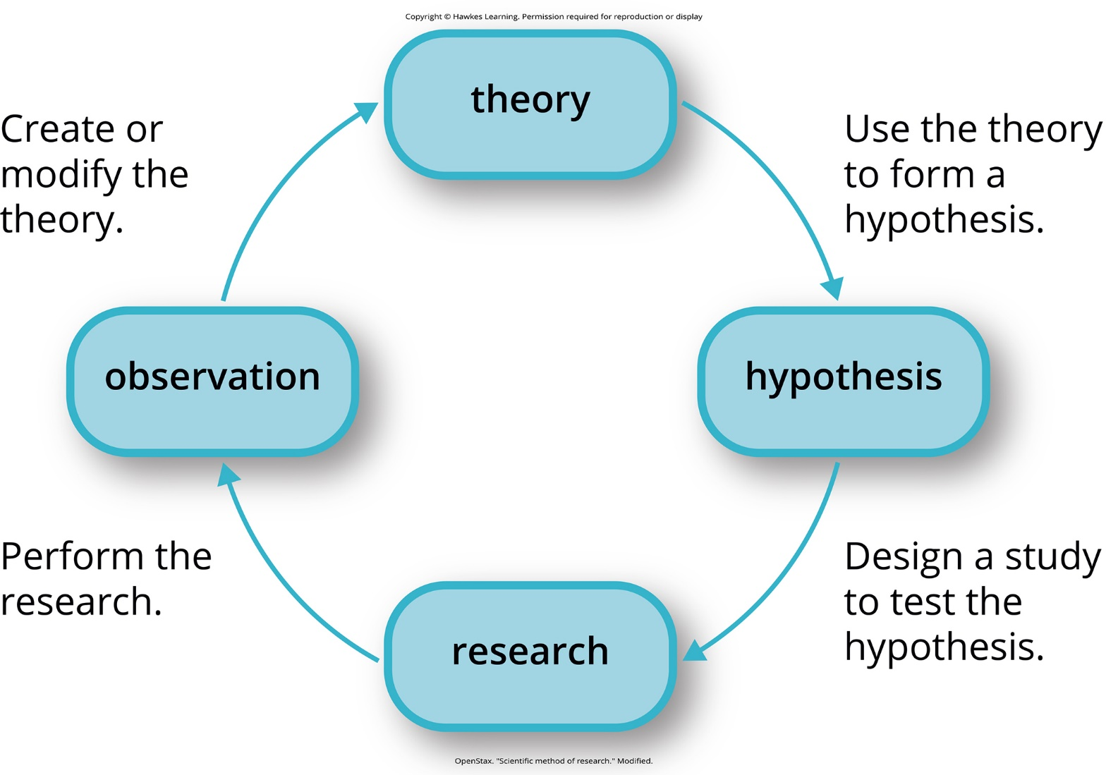
Lesson 1.3 Figure 5

Slide 37
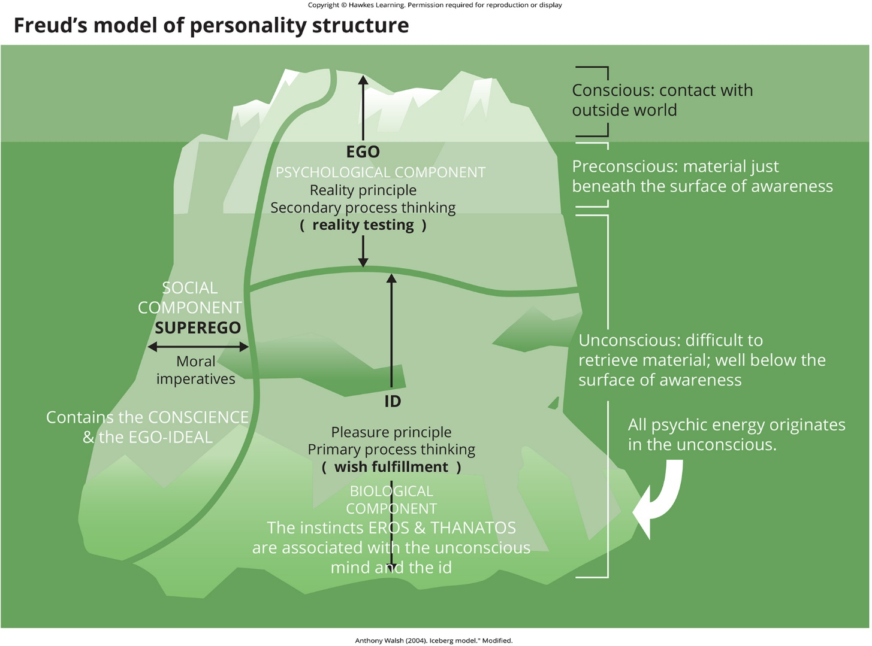
Lesson 1.3 Figure 6

Slide 38
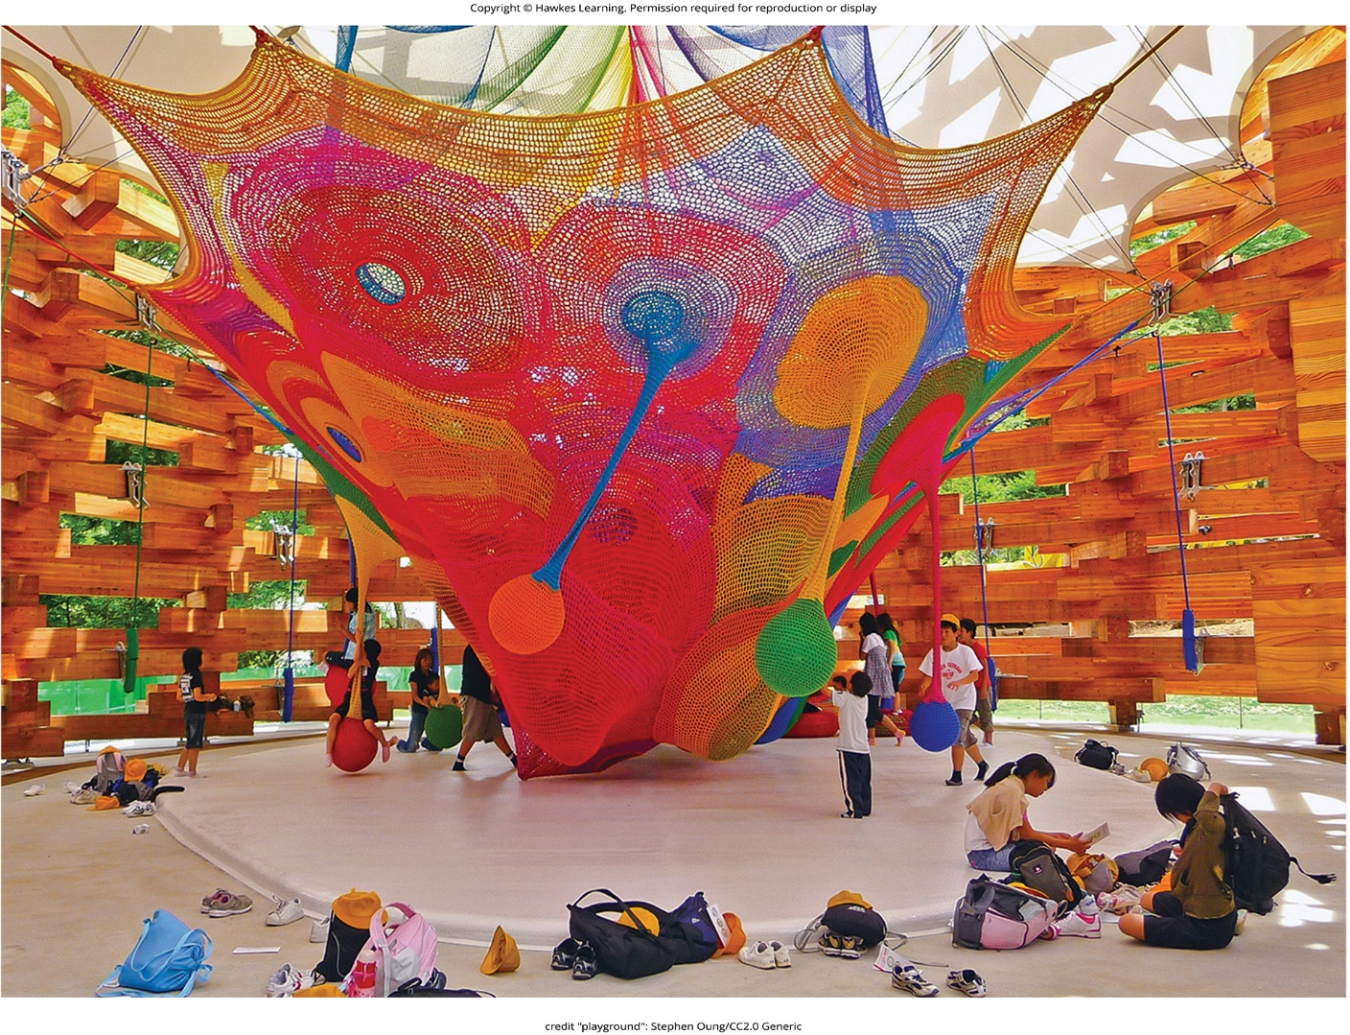
Lesson 1.4 Figure 1

Slide 39
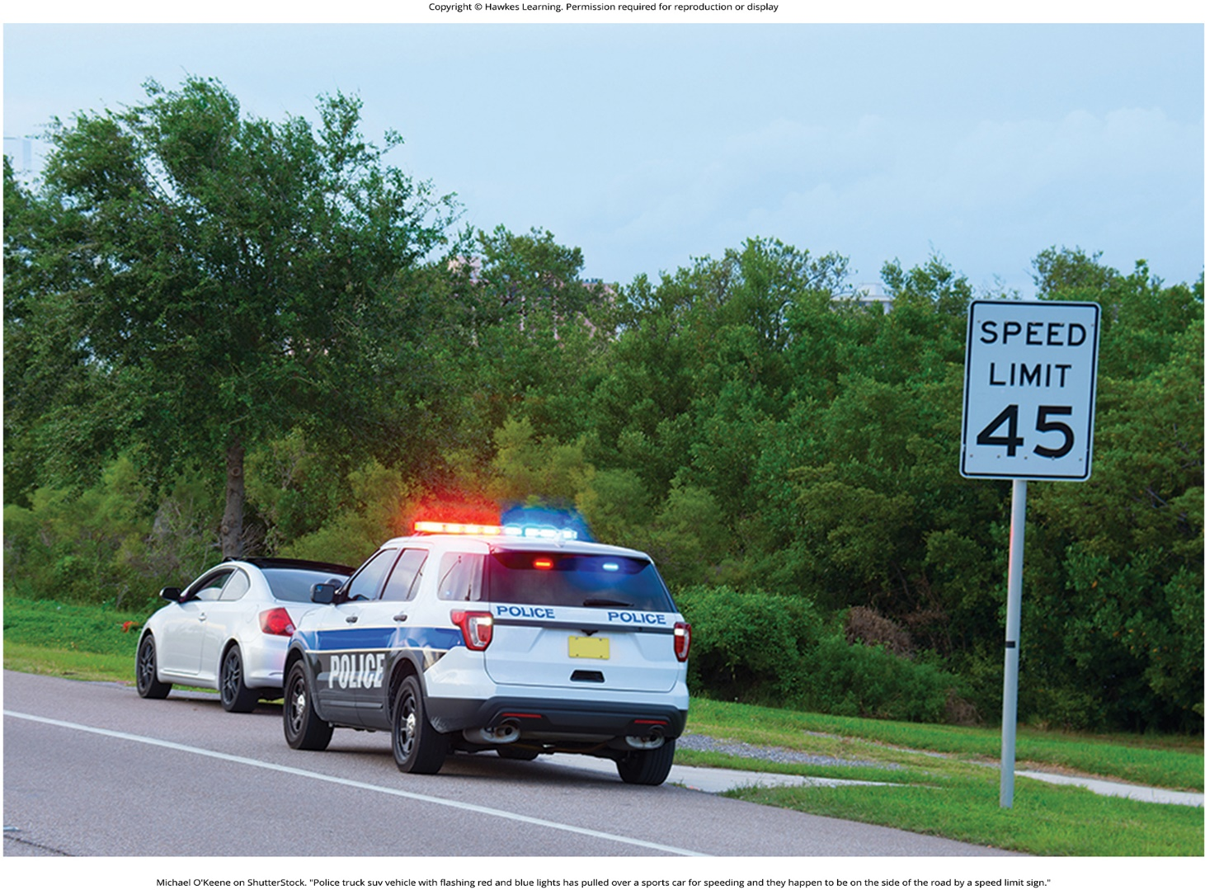
Lesson 1.4 Figure 2

Slide 40
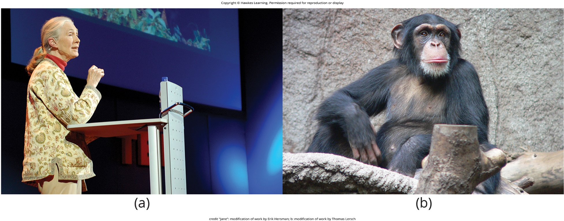
Lesson 1.4 Figure 3

Slide 41
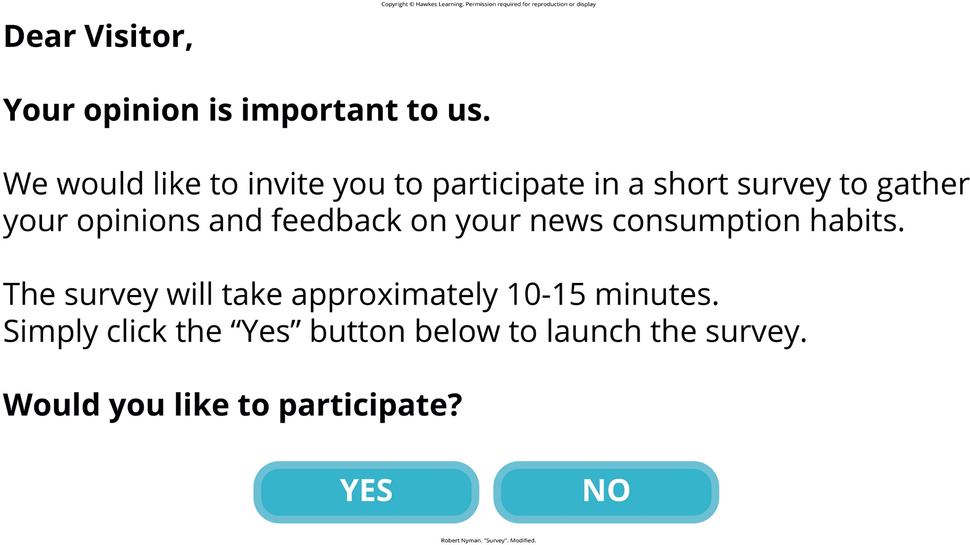
Lesson 1.4 Figure 4

Slide 42

Lesson 1.4 Figure 5

Slide 43
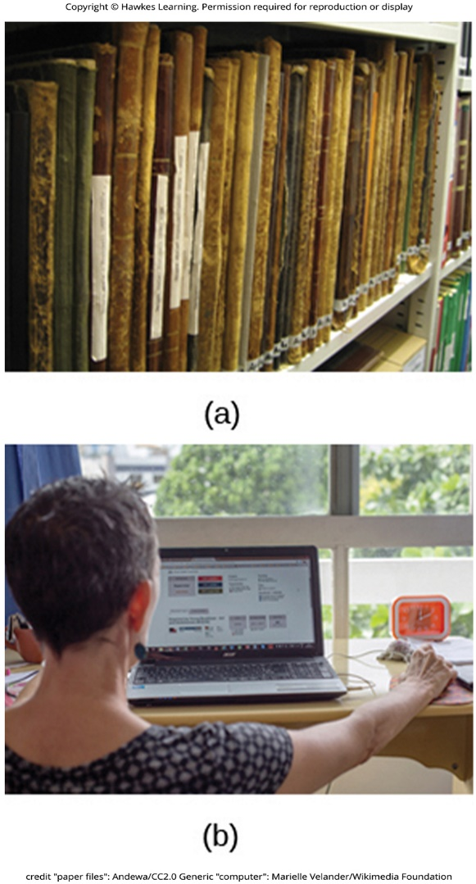
Lesson 1.4 Figure 6

Slide 44
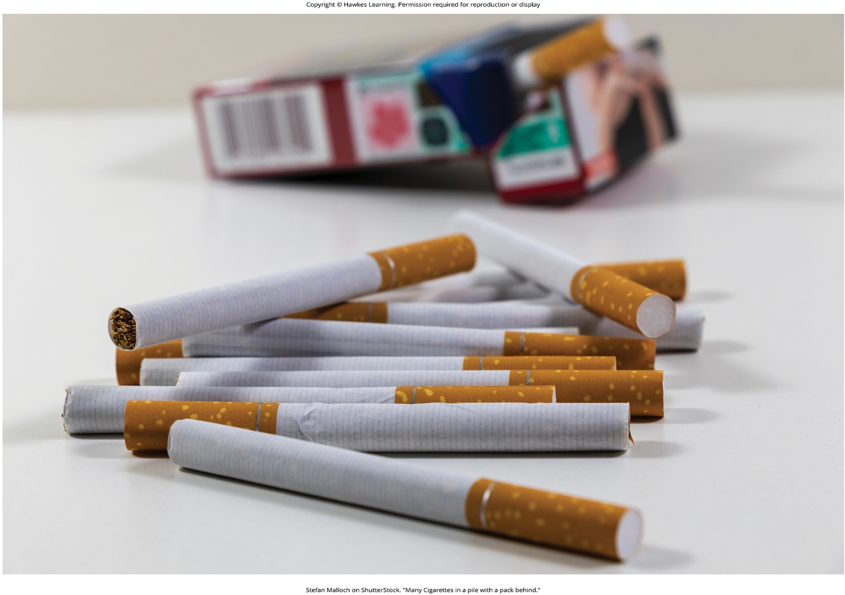
Lesson 1.4 Figure 7

Slide 45
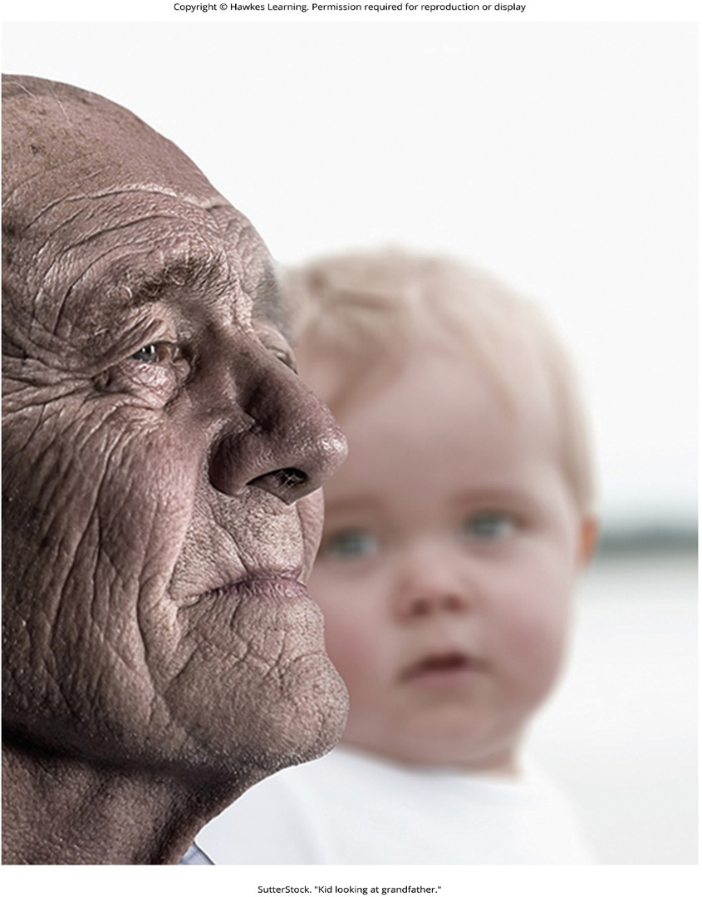
Lesson 1.4 Figure 8

Slide 46
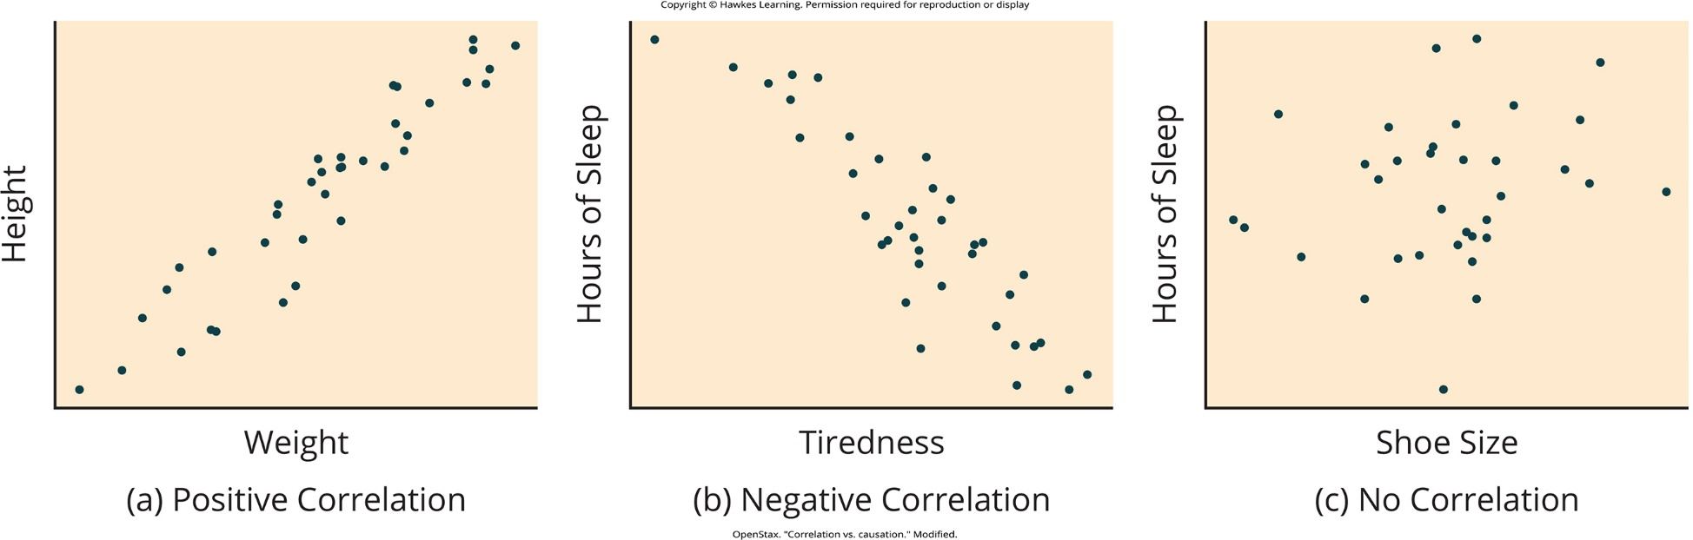
Lesson 1.5 Figure 1

Slide 47
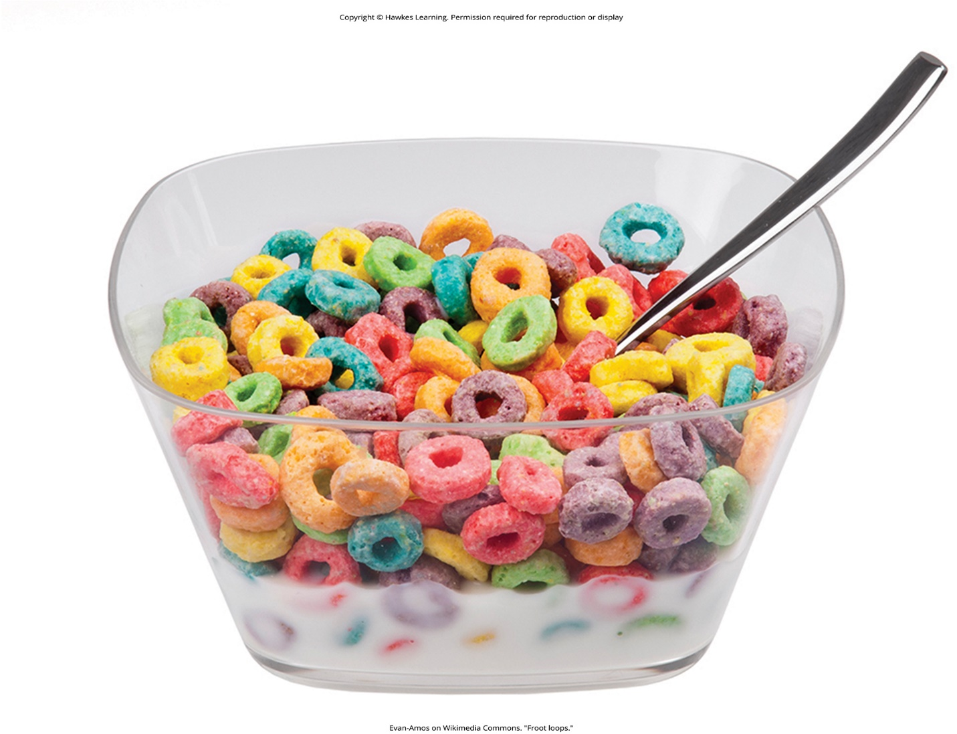
Lesson 1.5 Figure 2

Slide 48
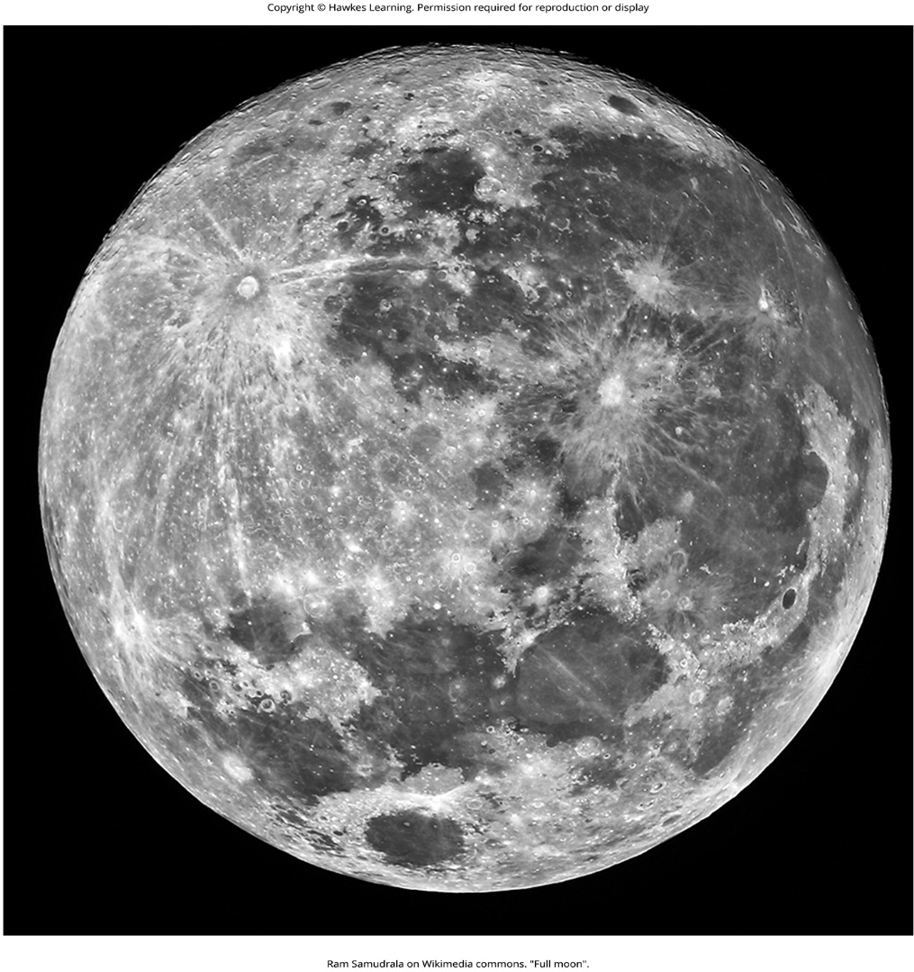
Lesson 1.5 Figure 3

Slide 49

Lesson 1.5 Figure 4

Slide 50
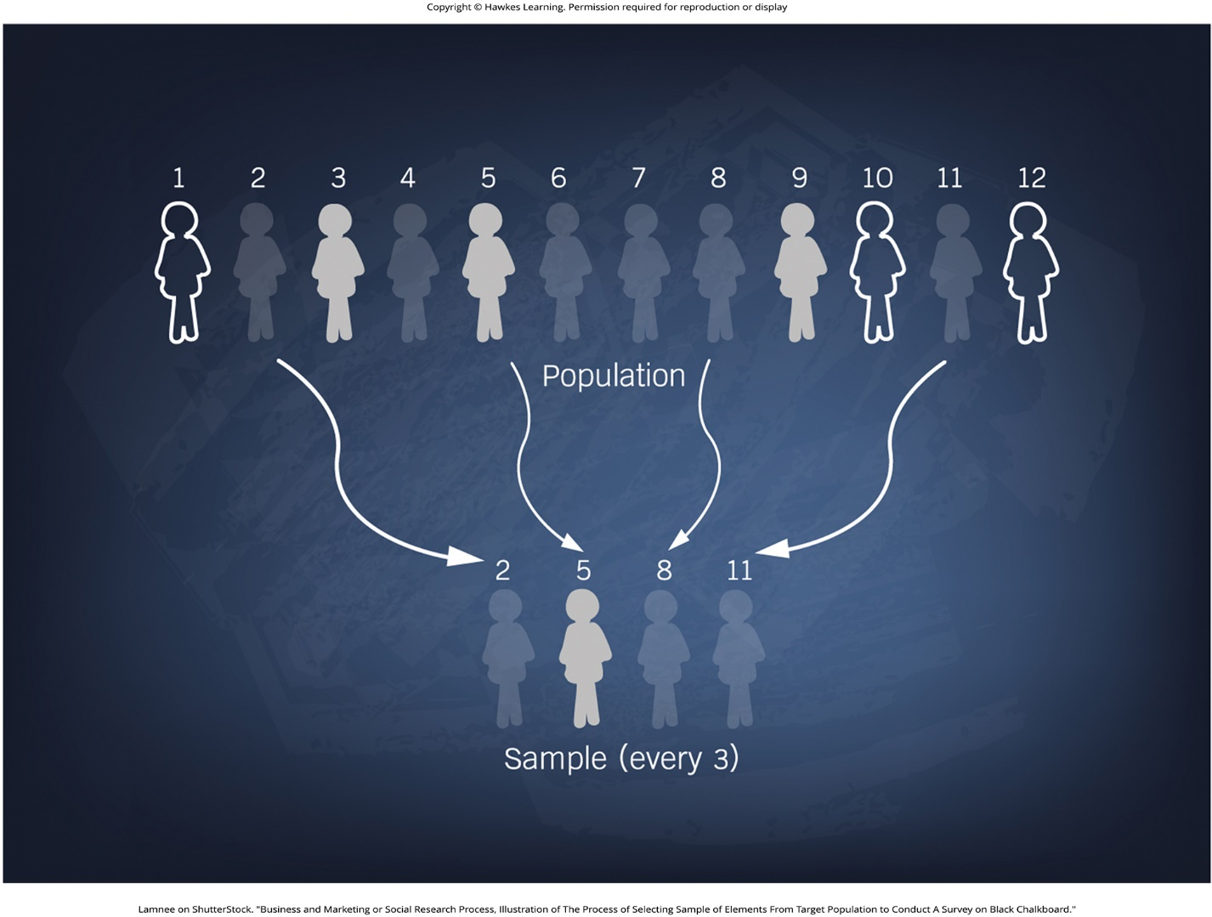
Lesson 1.5 Figure 5

Slide 51
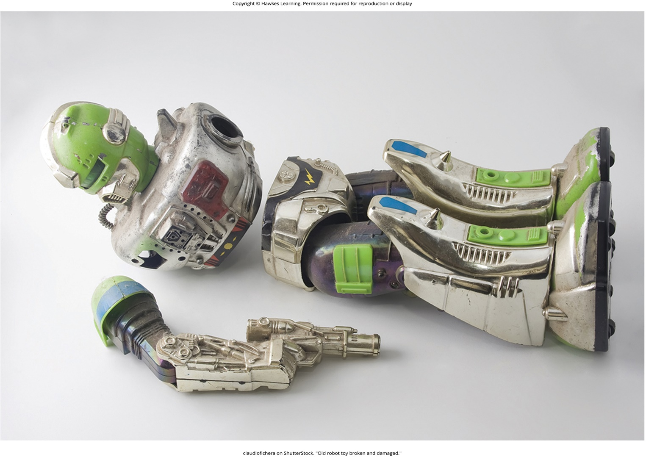
Lesson 1.5 Figure 6

Slide 52
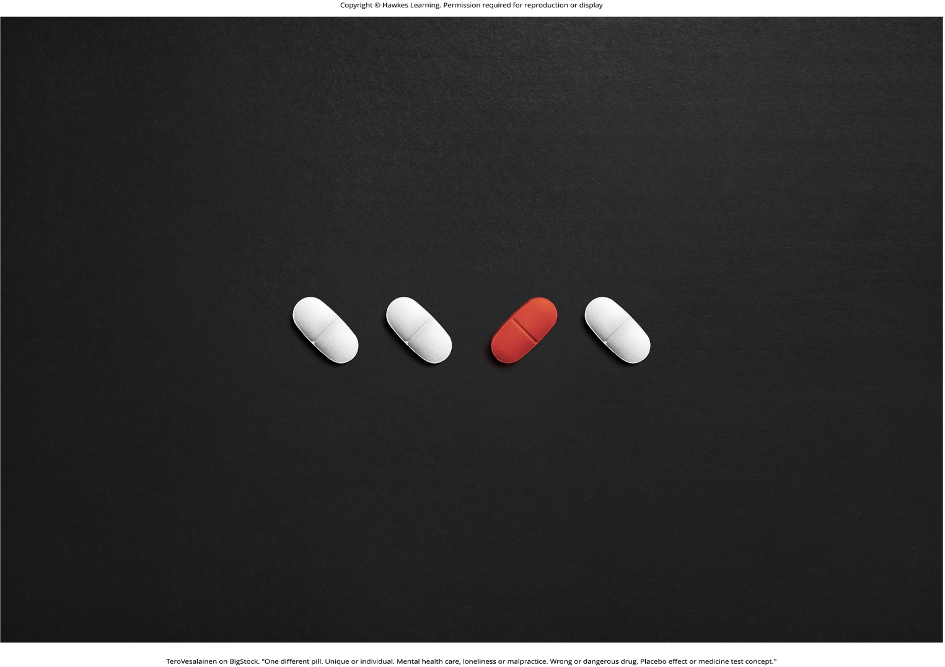
Lesson 1.5 Figure 7

Slide 53
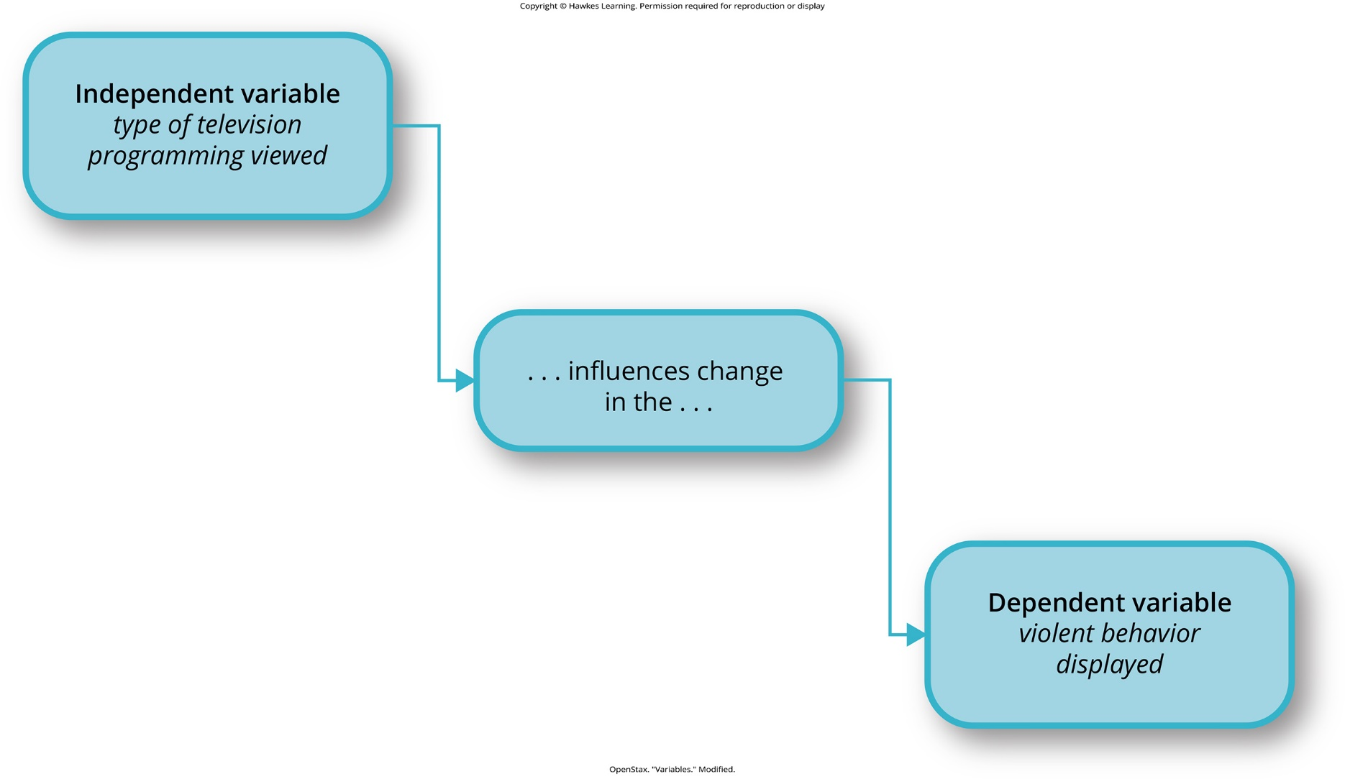
Lesson 1.5 Figure 8

Slide 54
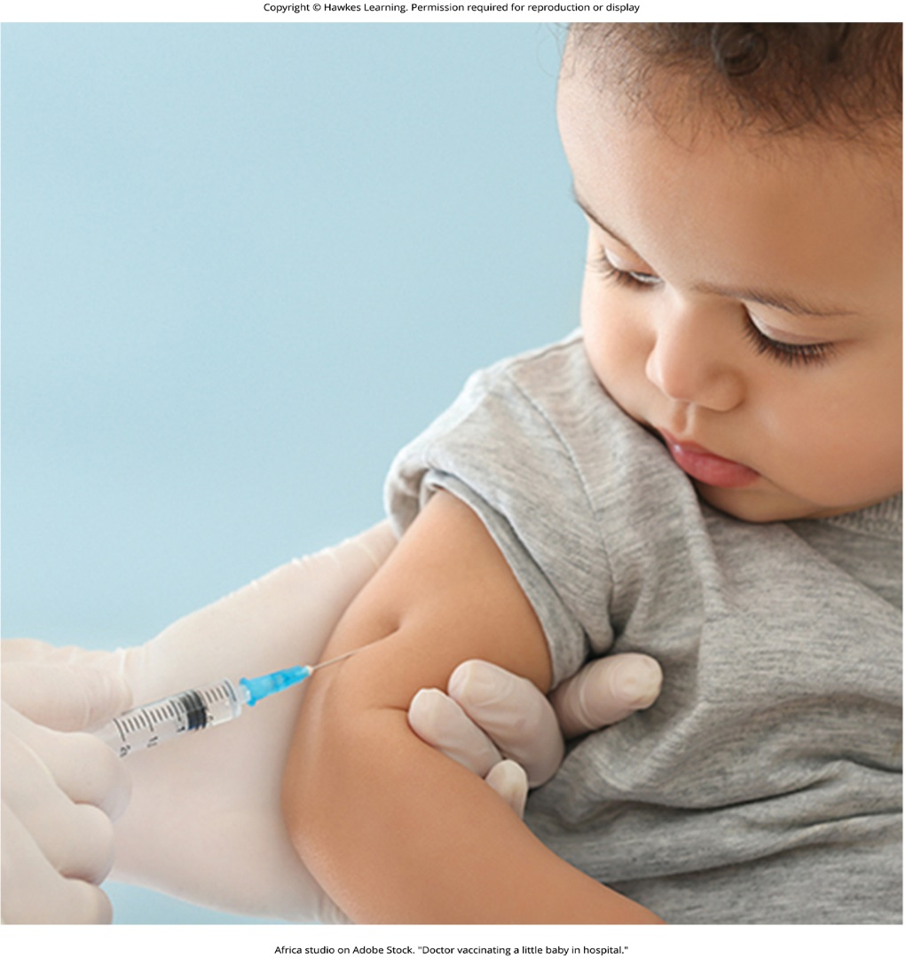
Lesson 1.5 Figure 9

Slide 55
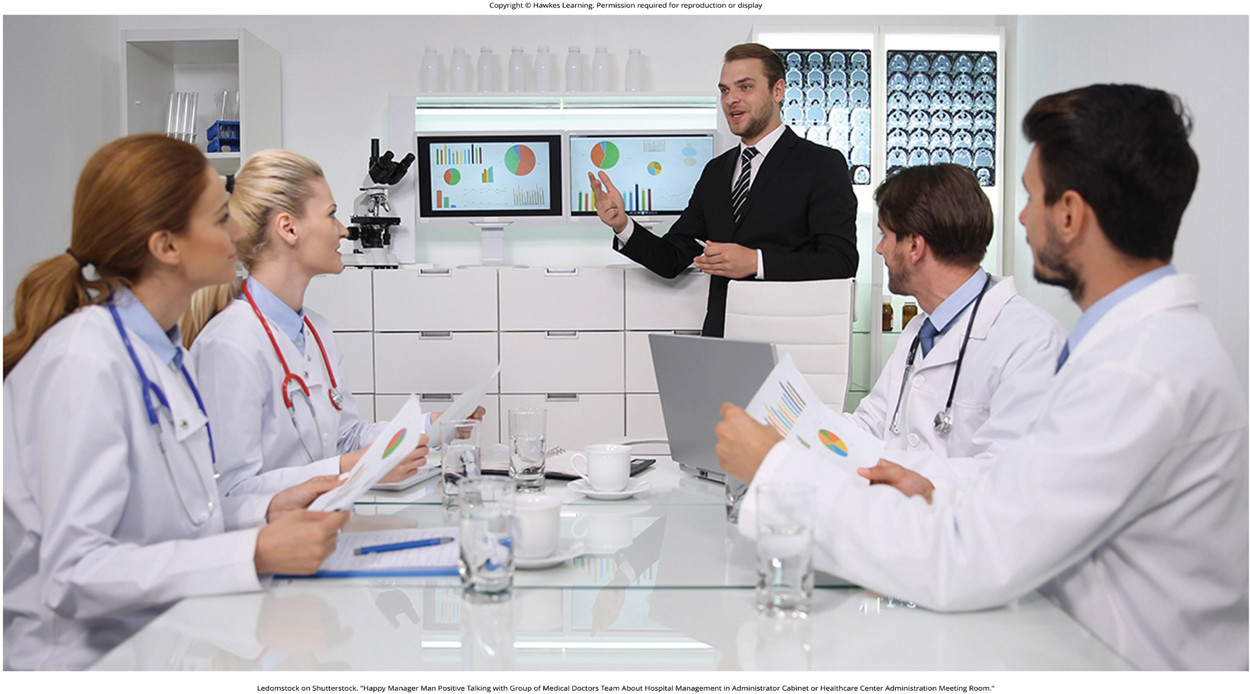
Lesson 1.6 Figure 1

Slide 56
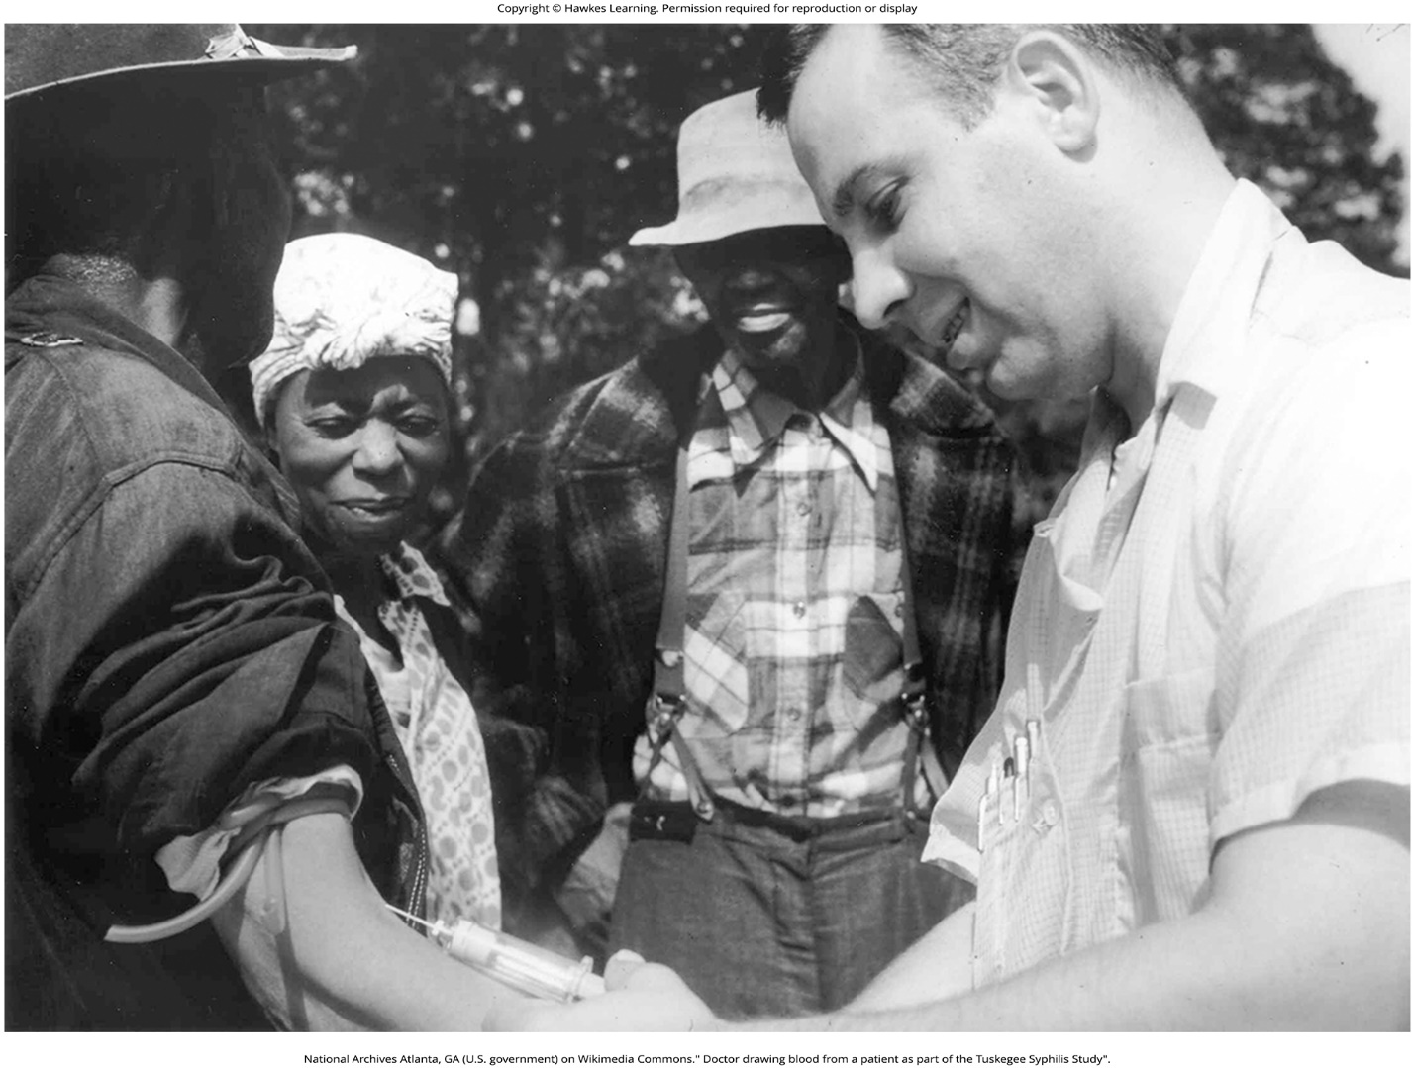
Lesson 1.6 Figure 2

Slide 57
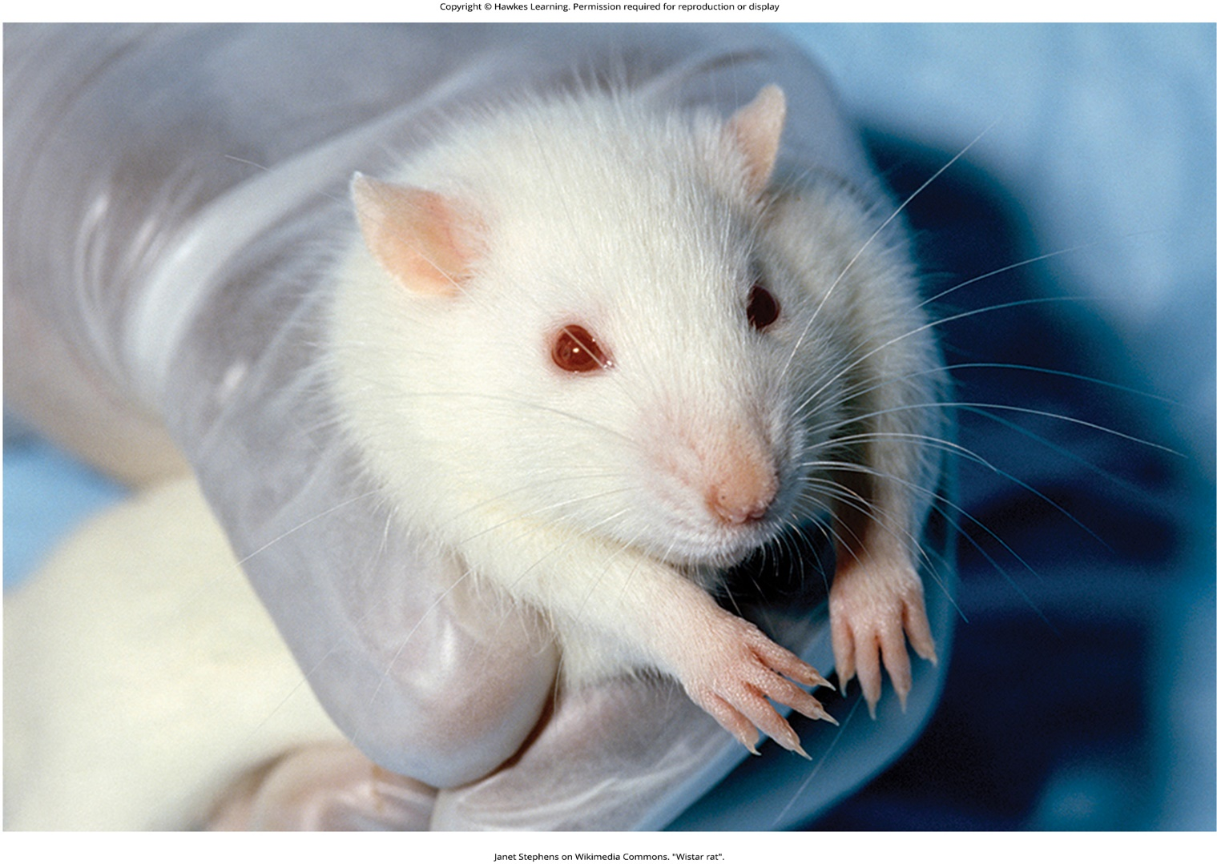
Lesson 1.6 Figure 3

Slide 58
Hawkes Learning – End of PowerPoint

