Slide 1
Chapter 2
Biopsychology

Slide 2
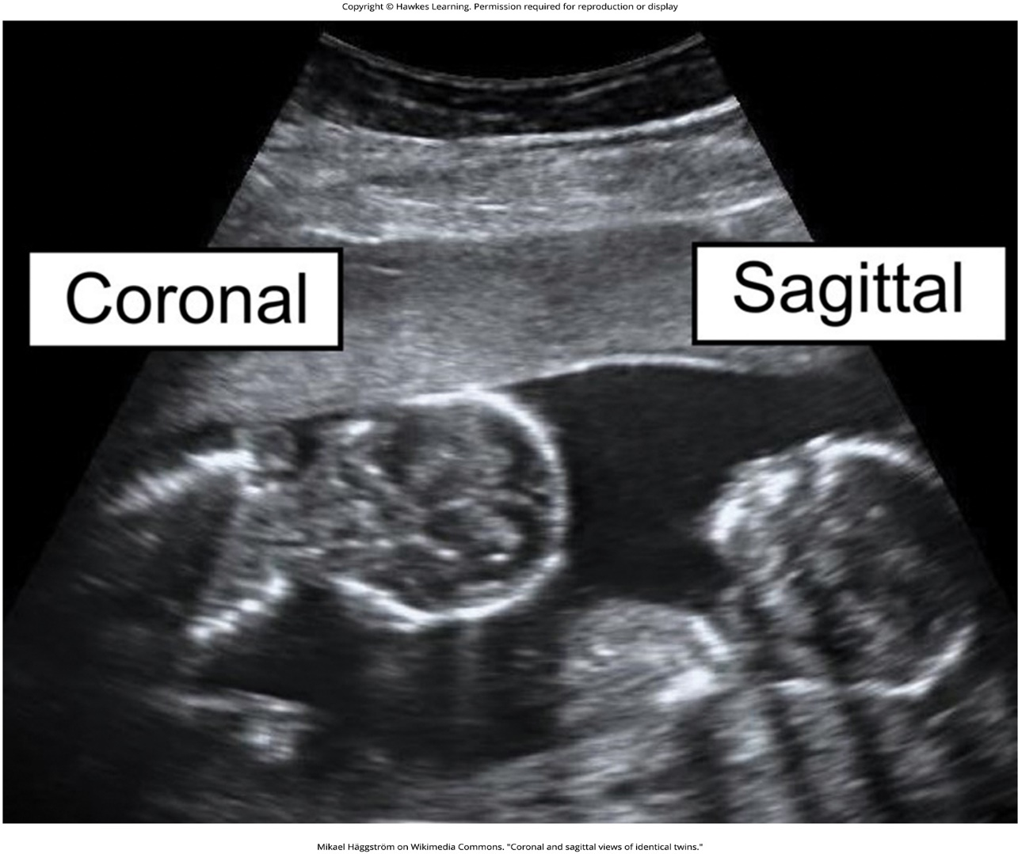
Lesson 2.1 Figure 1

Slide 3
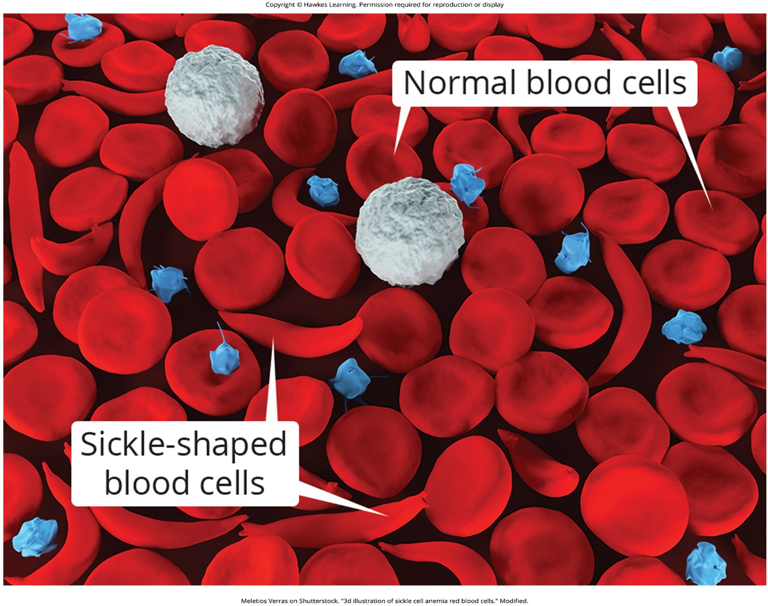
Lesson 2.1 Figure 2

Slide 4
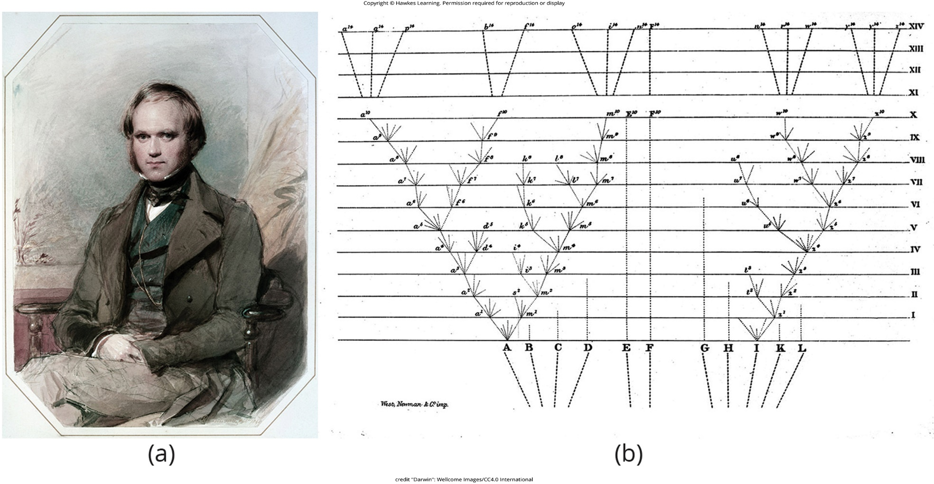
Lesson 2.1 Figure 3

Slide 5
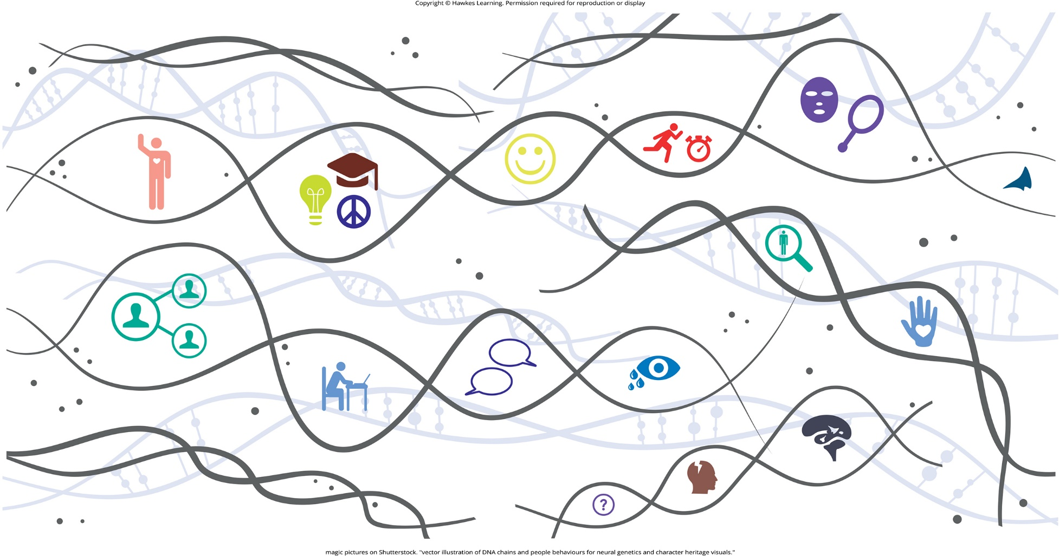
Lesson 2.1 Figure 4

Slide 6
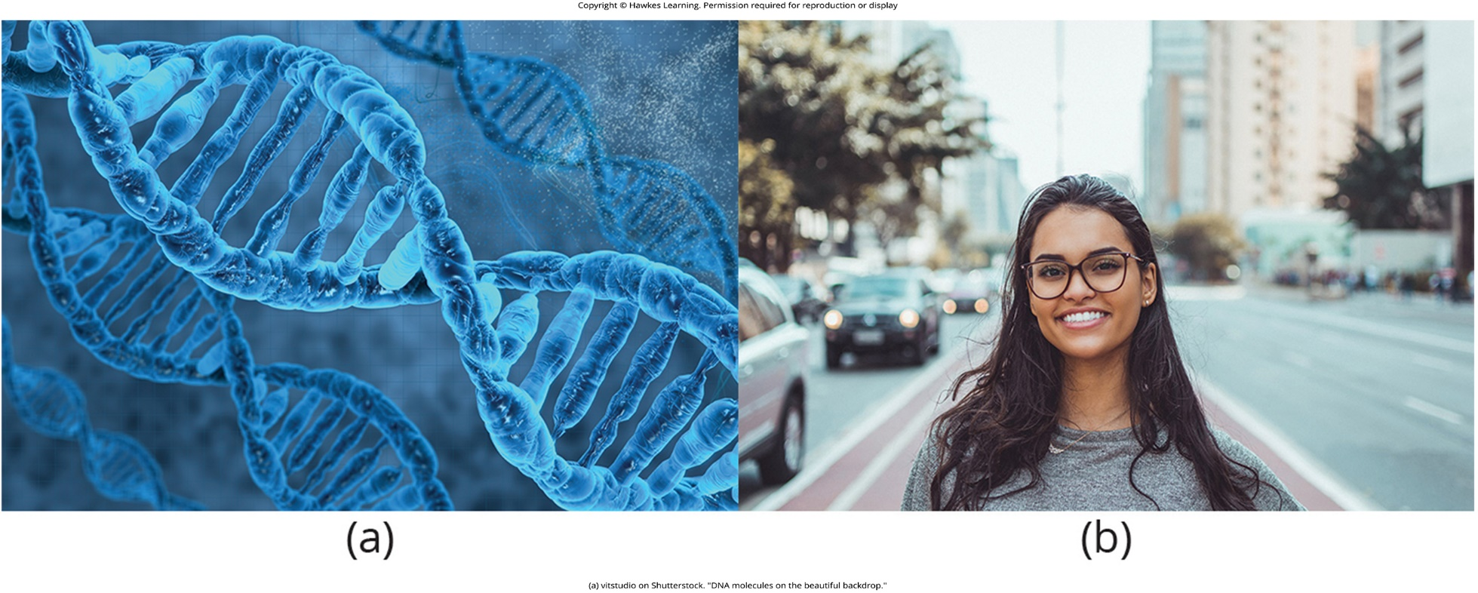
Lesson 2.1 Figure 5

Slide 7
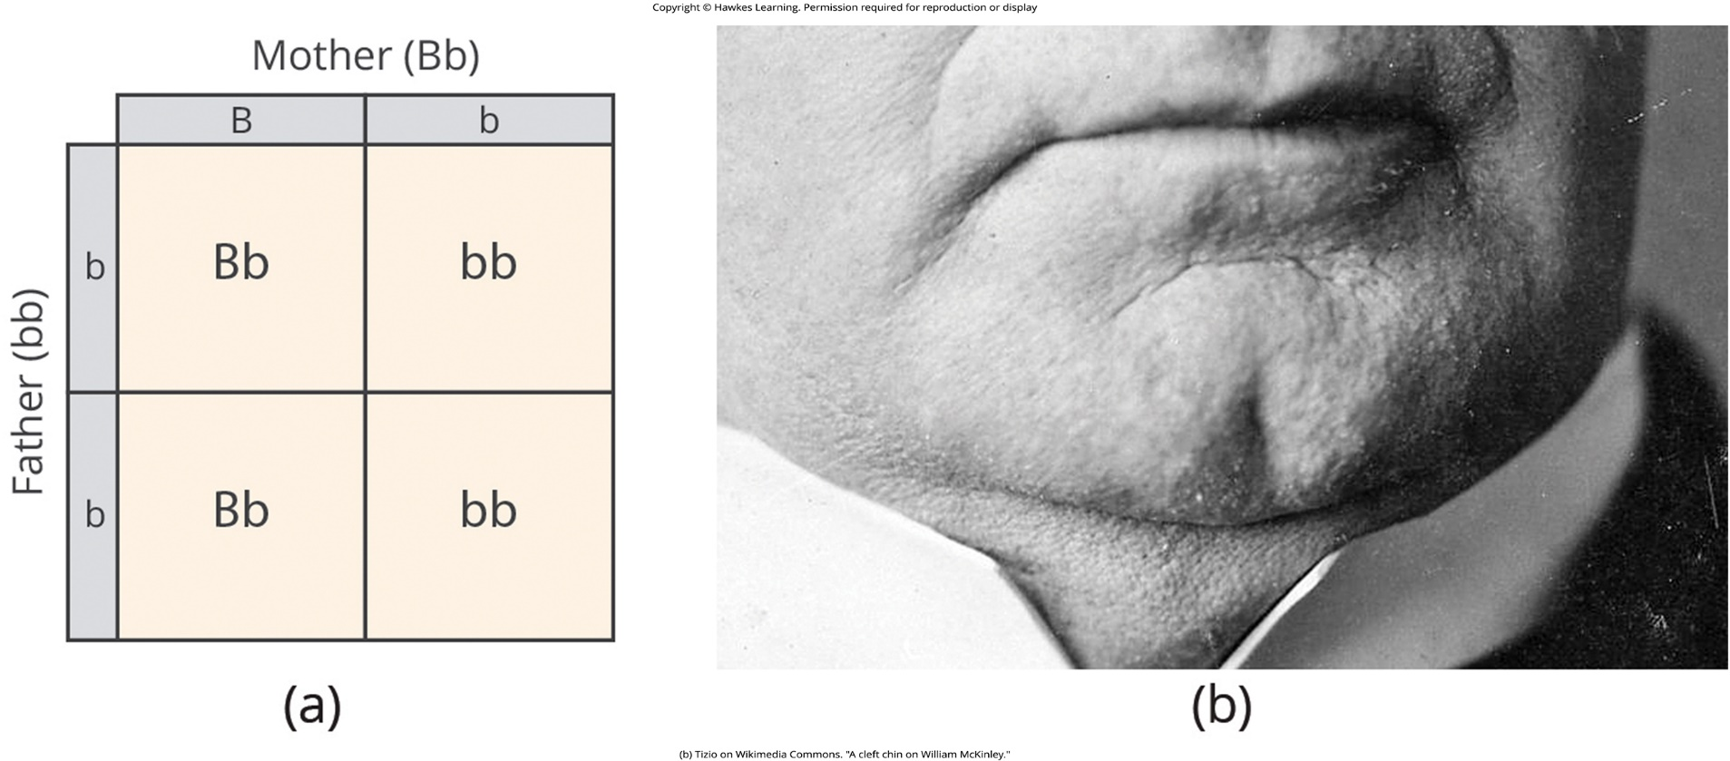
Lesson 2.1 Figure 6

Slide 8
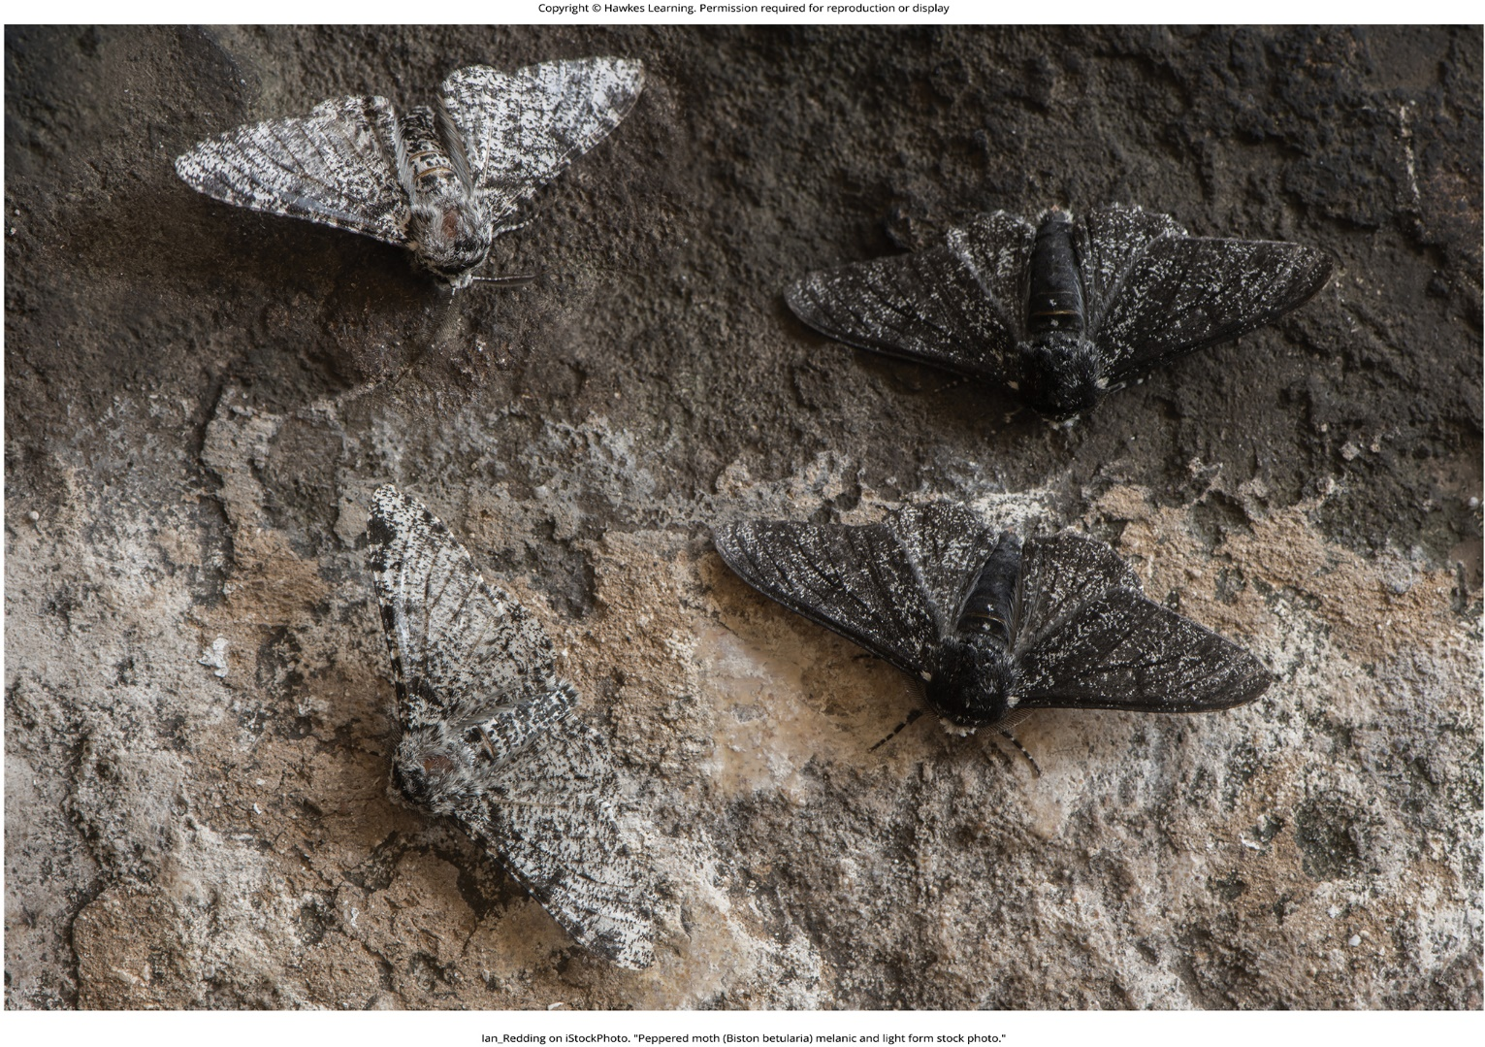
Lesson 2.1 Figure 7

Slide 9

Lesson 2.1 Figure 8

Slide 10
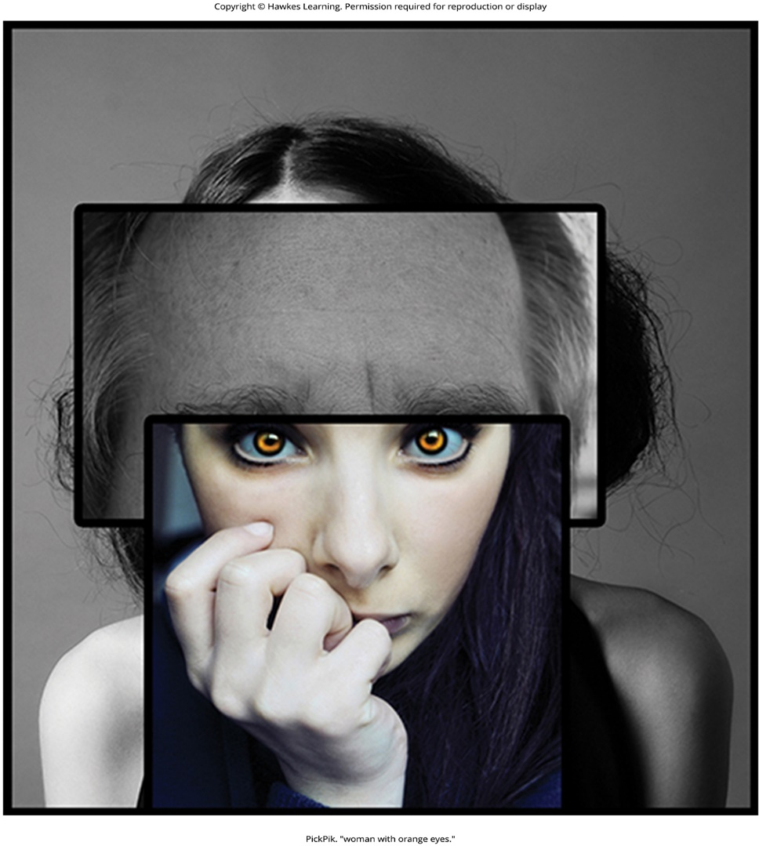
Lesson 2.1 Figure 9

Slide 11
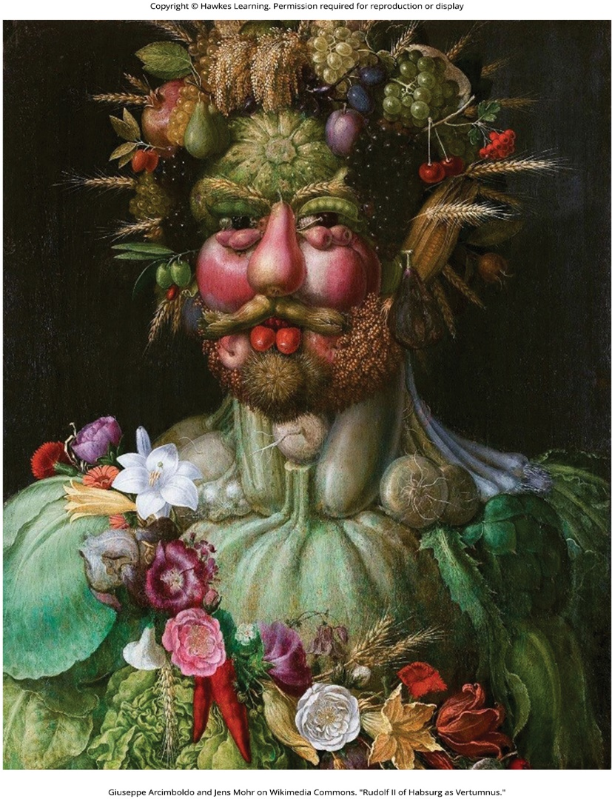
Lesson 2.2 Figure 1

Slide 12
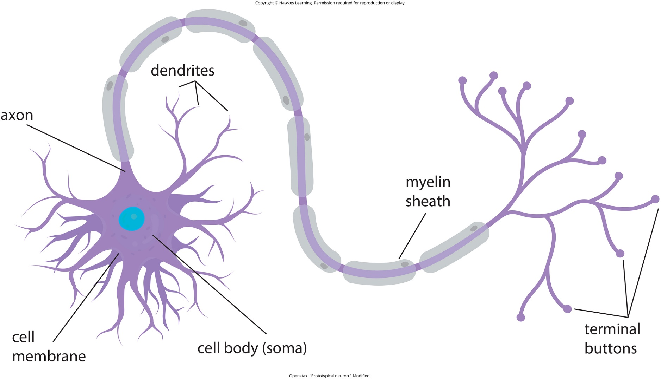
Lesson 2.2 Figure 2

Slide 13
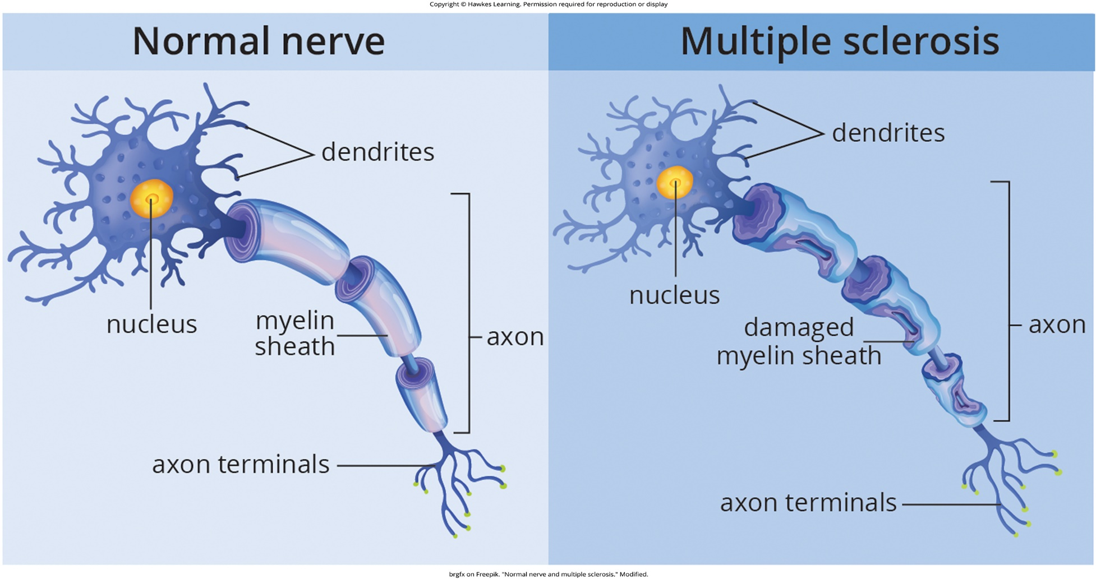
Lesson 2.2 Figure 3

Slide 14
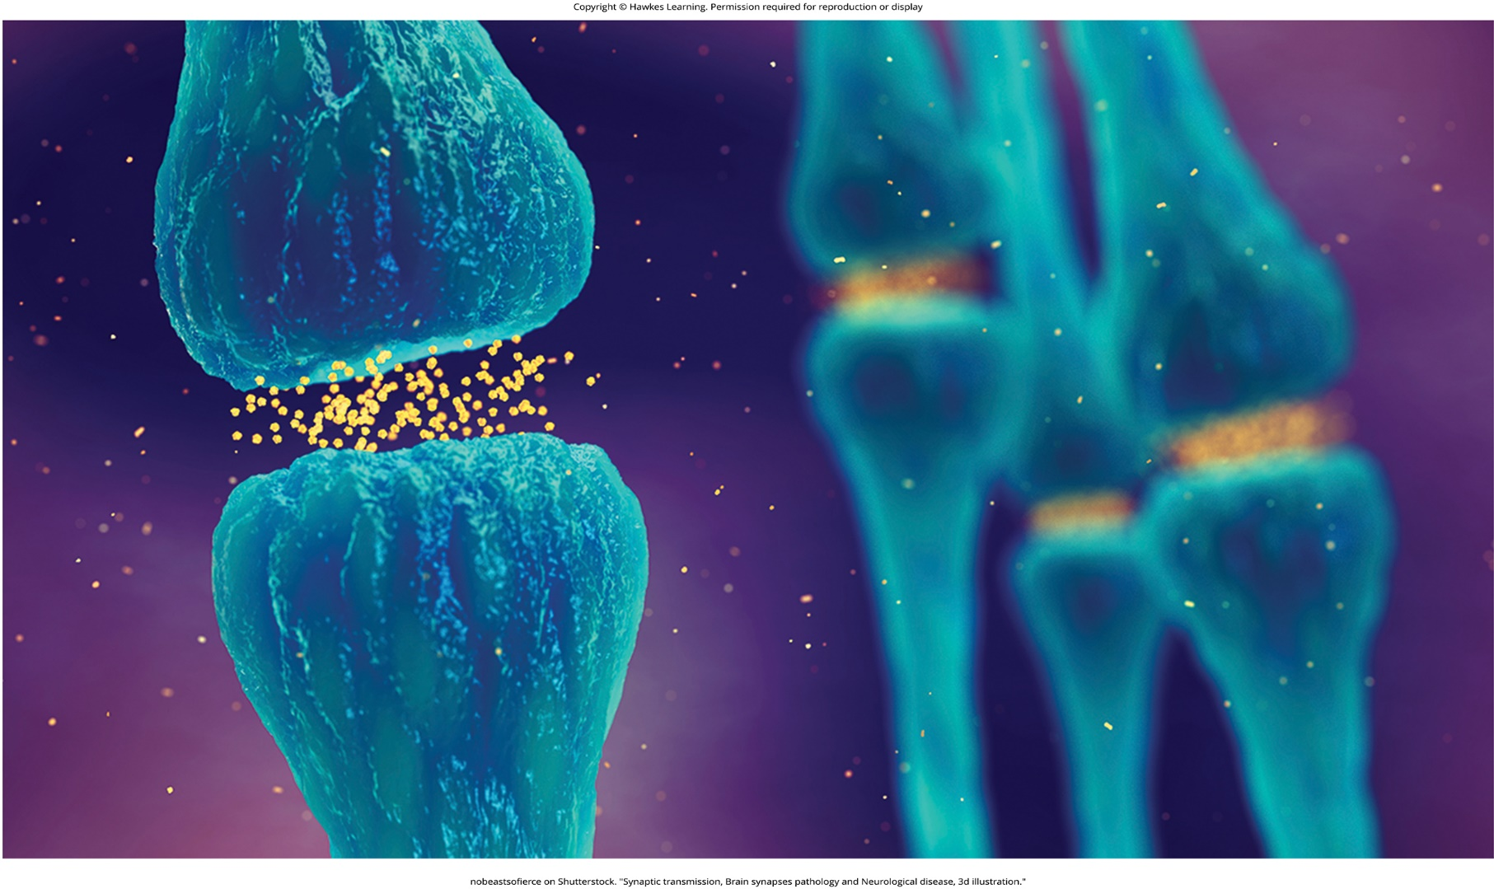
Lesson 2.2 Figure 4

Slide 15
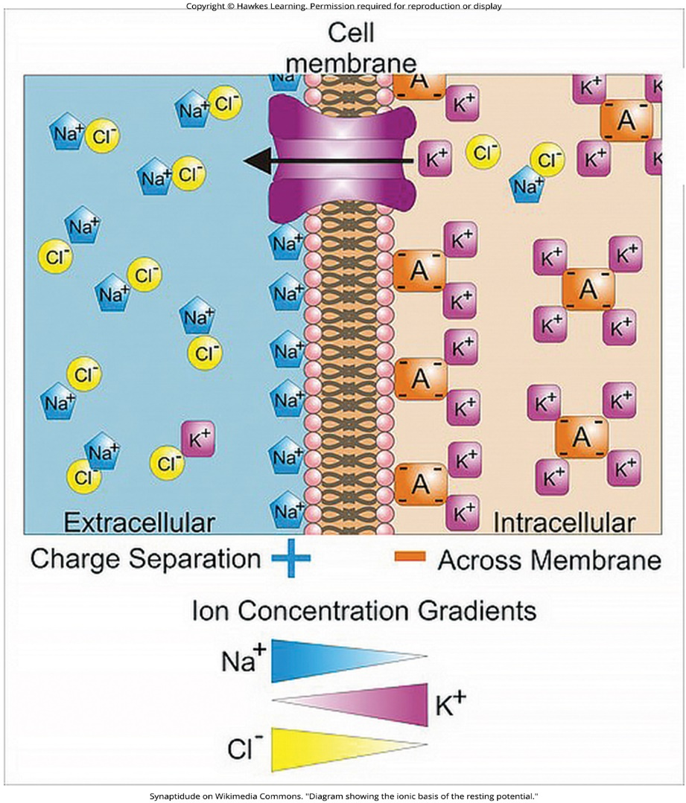
Lesson 2.2 Figure 5

Slide 16
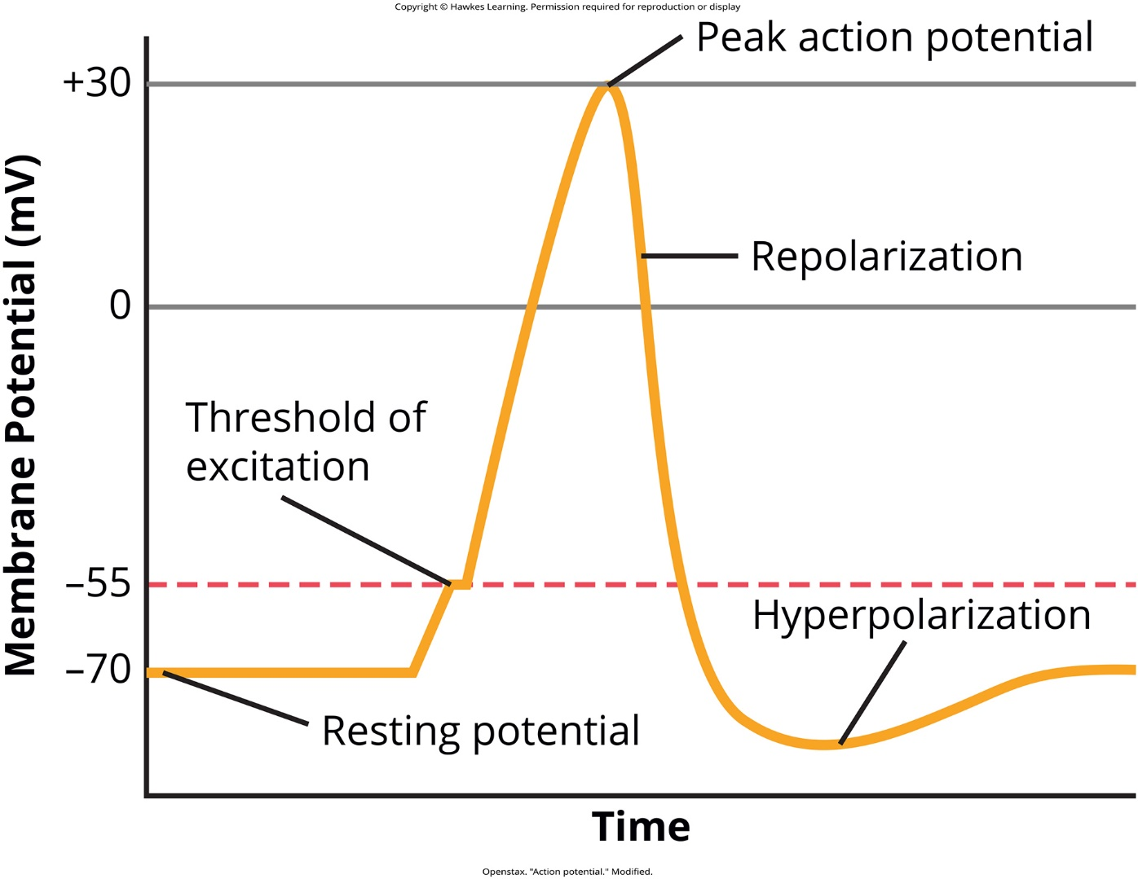
Lesson 2.2 Figure 6

Slide 17
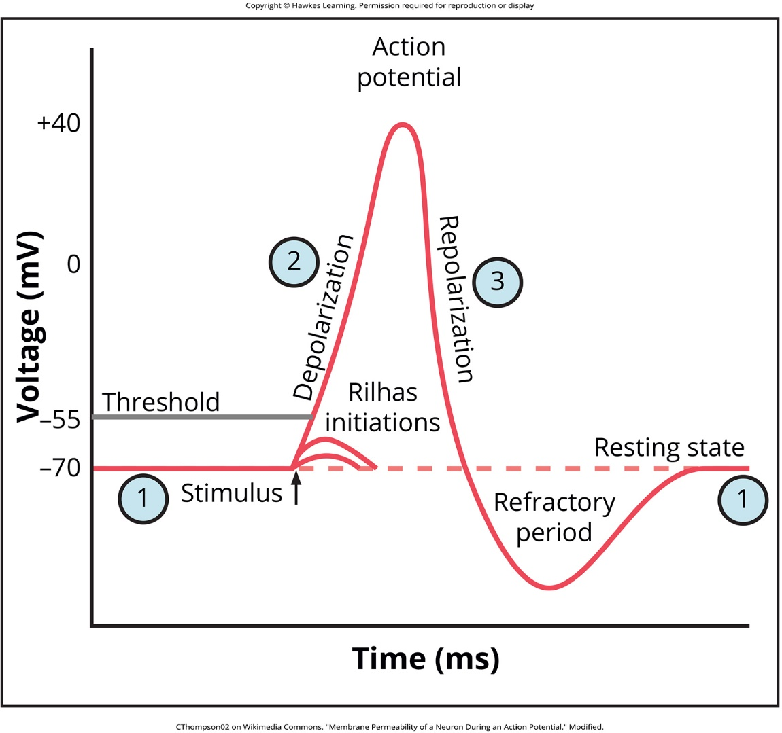
Lesson 2.2 Figure 7a

Slide 18
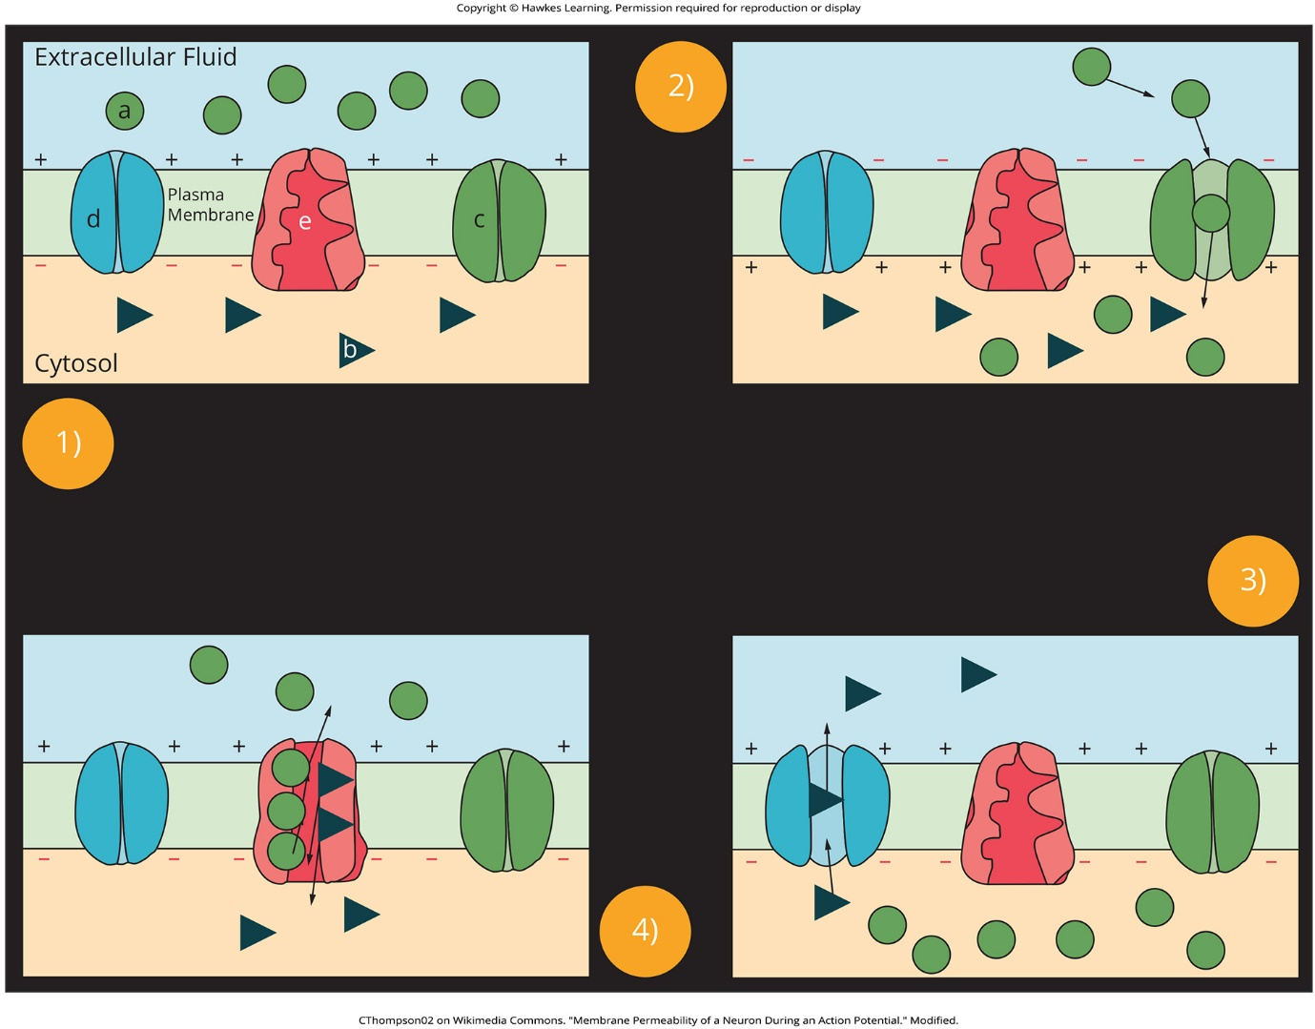
Lesson 2.2 Figure 7b

Slide 19
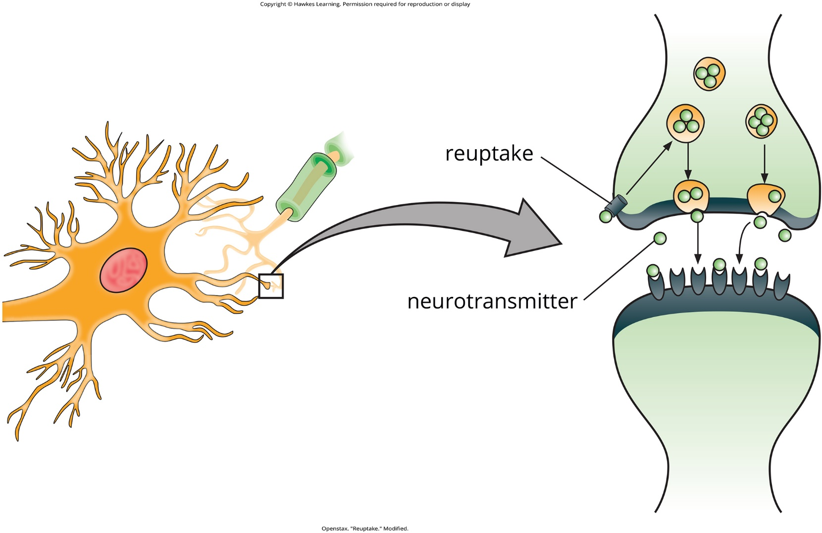
Lesson 2.2 Figure 8

Slide 20
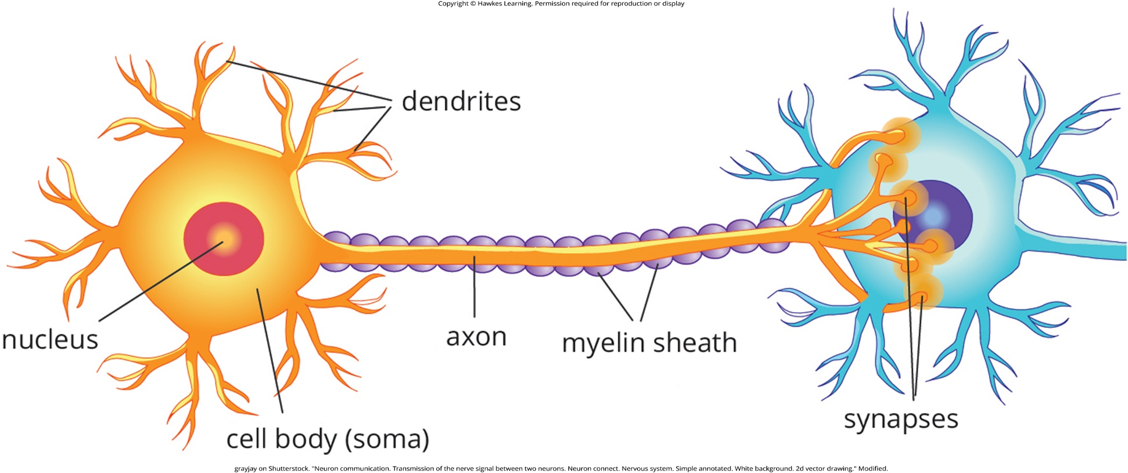
Lesson 2.2 Figure 9

Slide 21
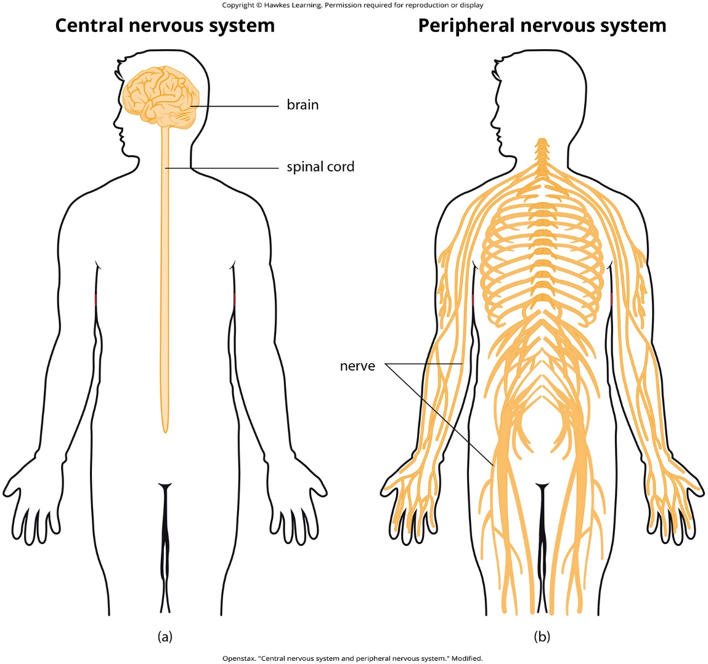
Lesson 2.3 Figure 1

Slide 22
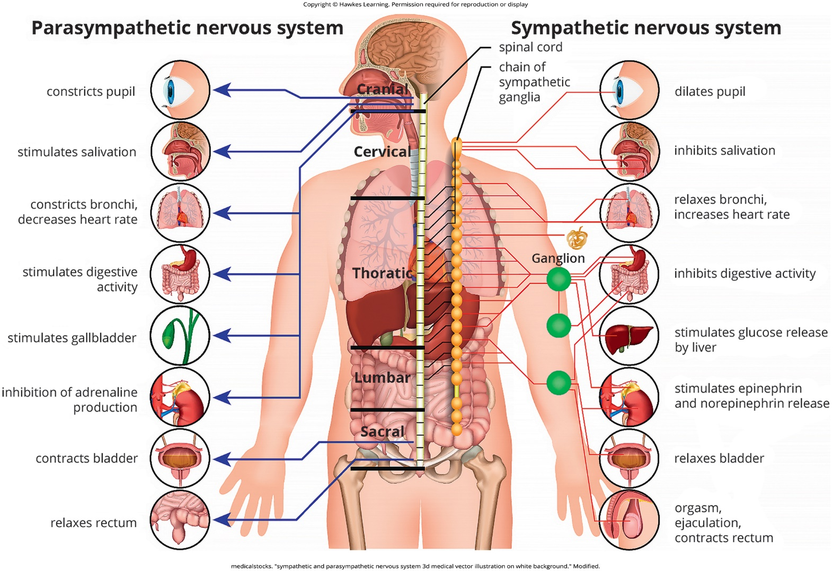
Lesson 2.3 Figure 2

Slide 23
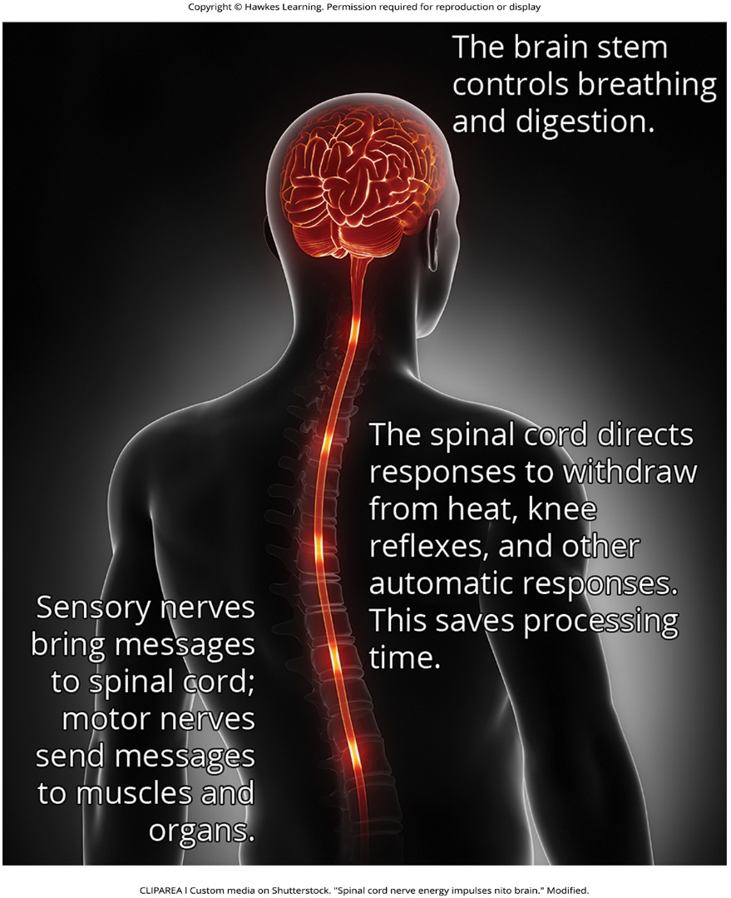
Lesson 2.4 Figure 1

Slide 24
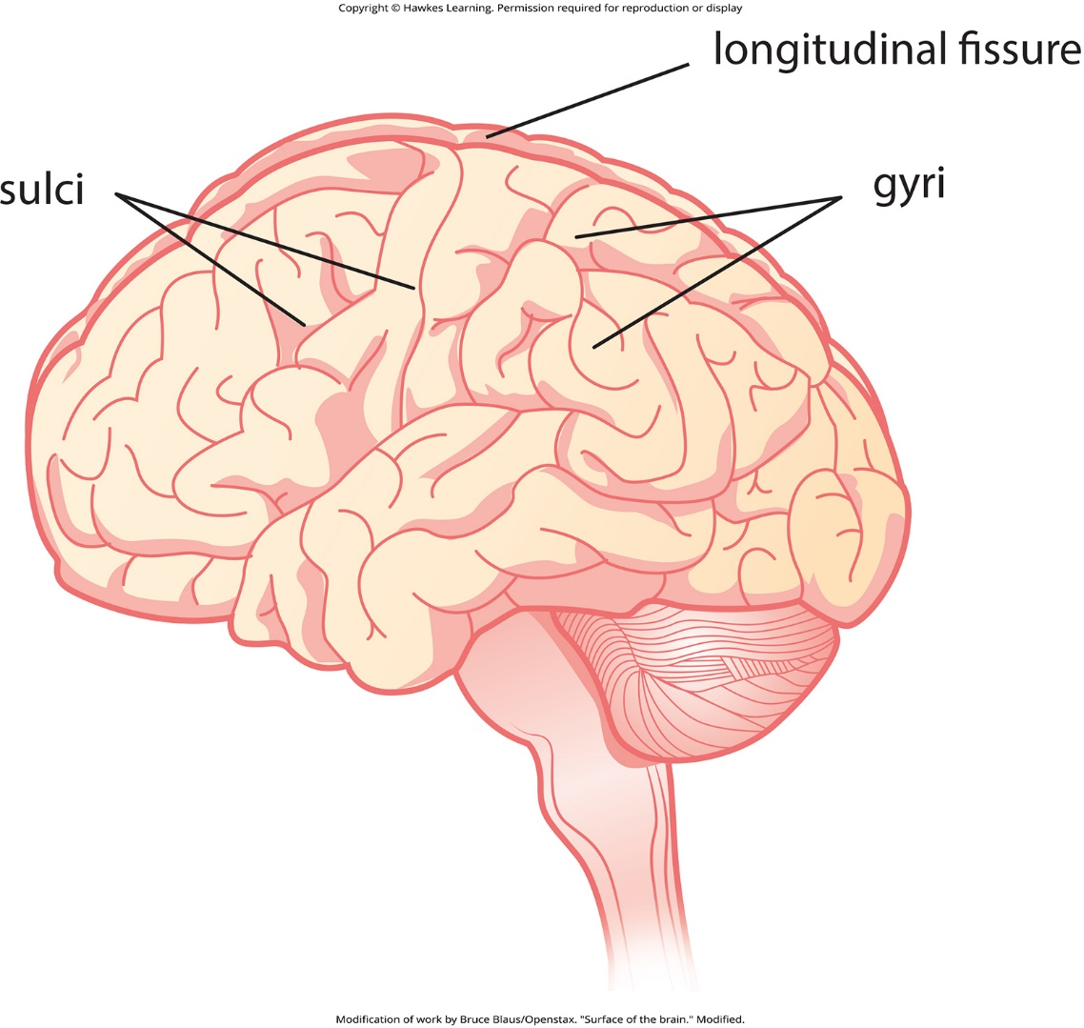
Lesson 2.4 Figure 2

Slide 25
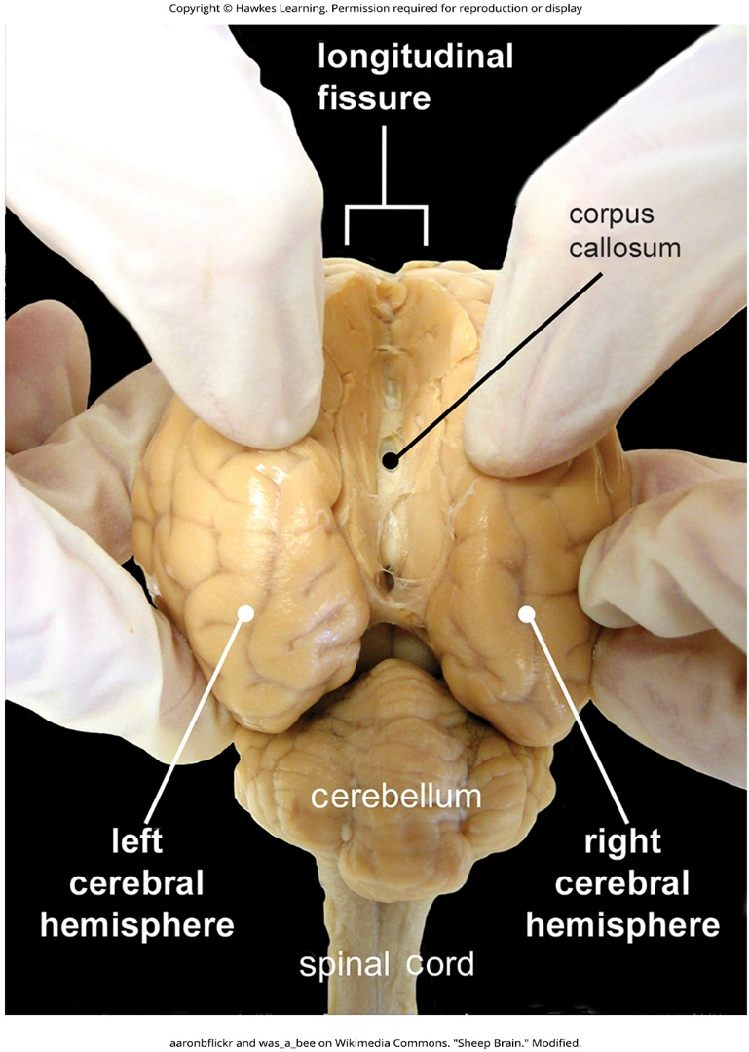
Lesson 2.4 Figure 3

Slide 26
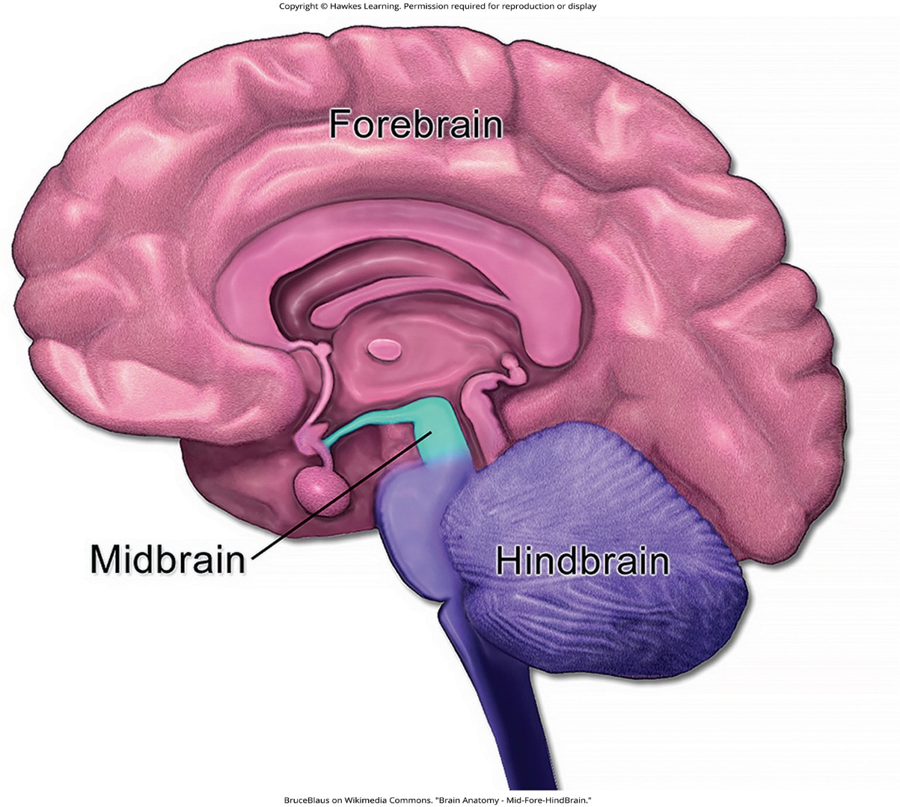
Lesson 2.4 Figure 4

Slide 27
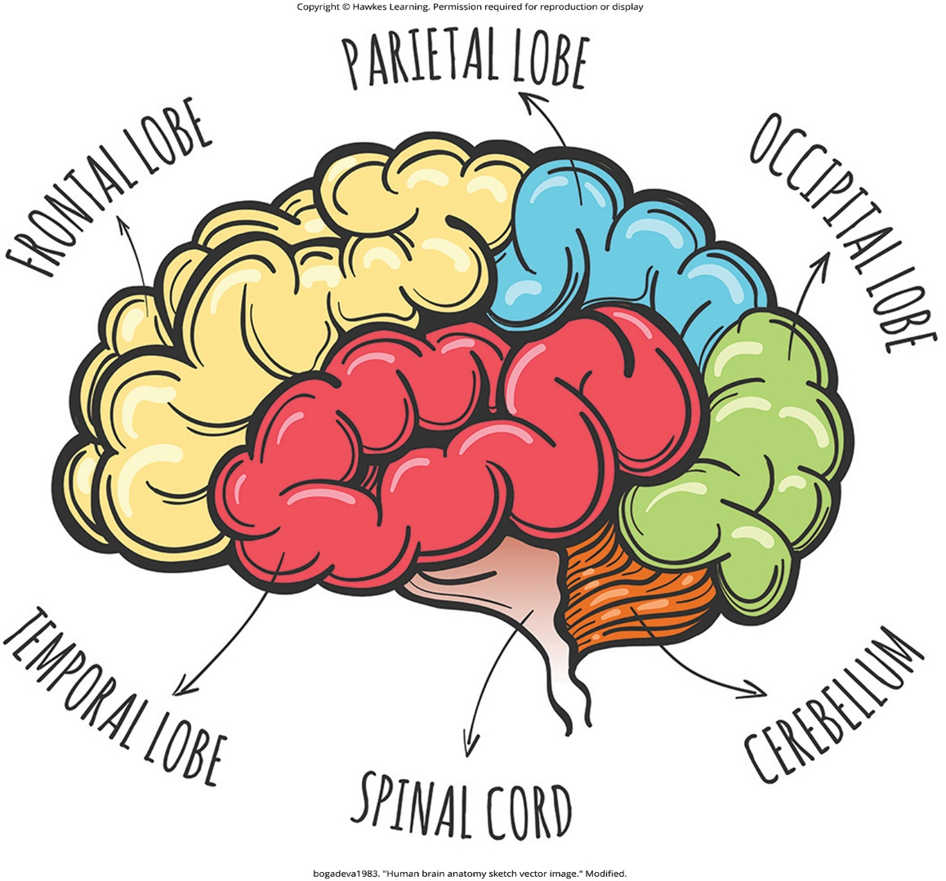
Lesson 2.4 Figure 5

Slide 28
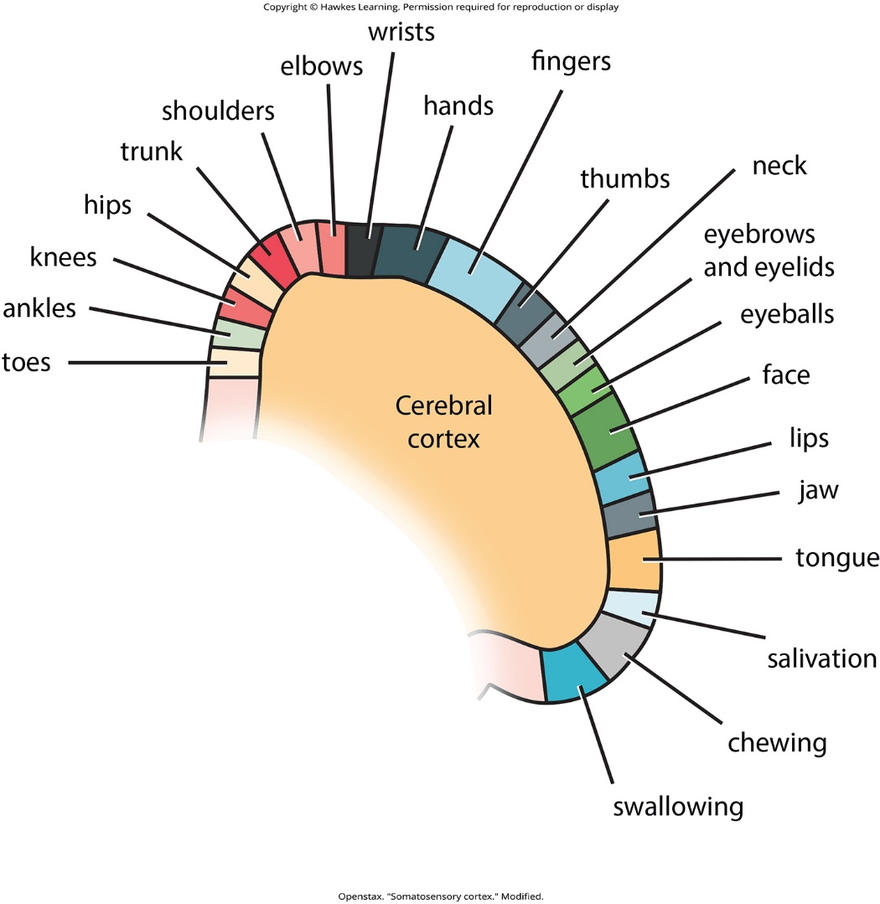
Lesson 2.4 Figure 6

Slide 29
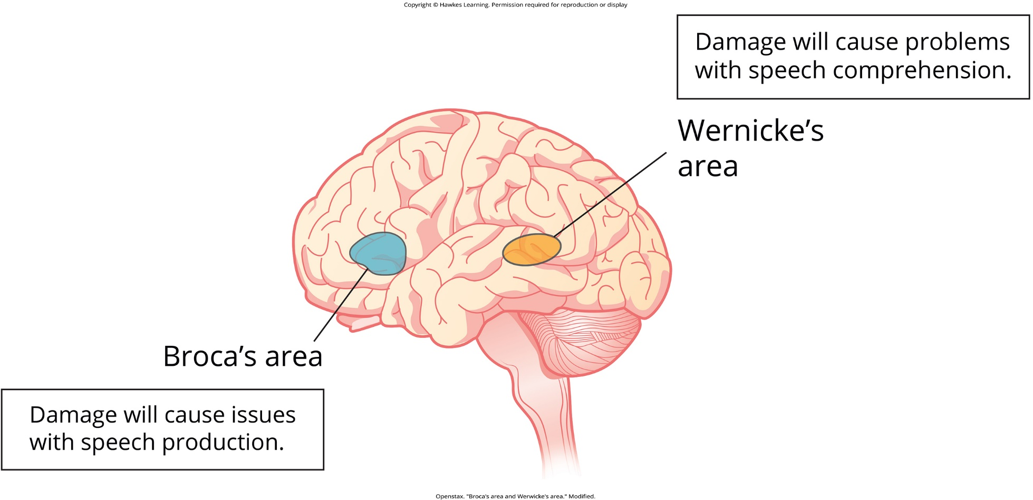
Lesson 2.4 Figure 7

Slide 30
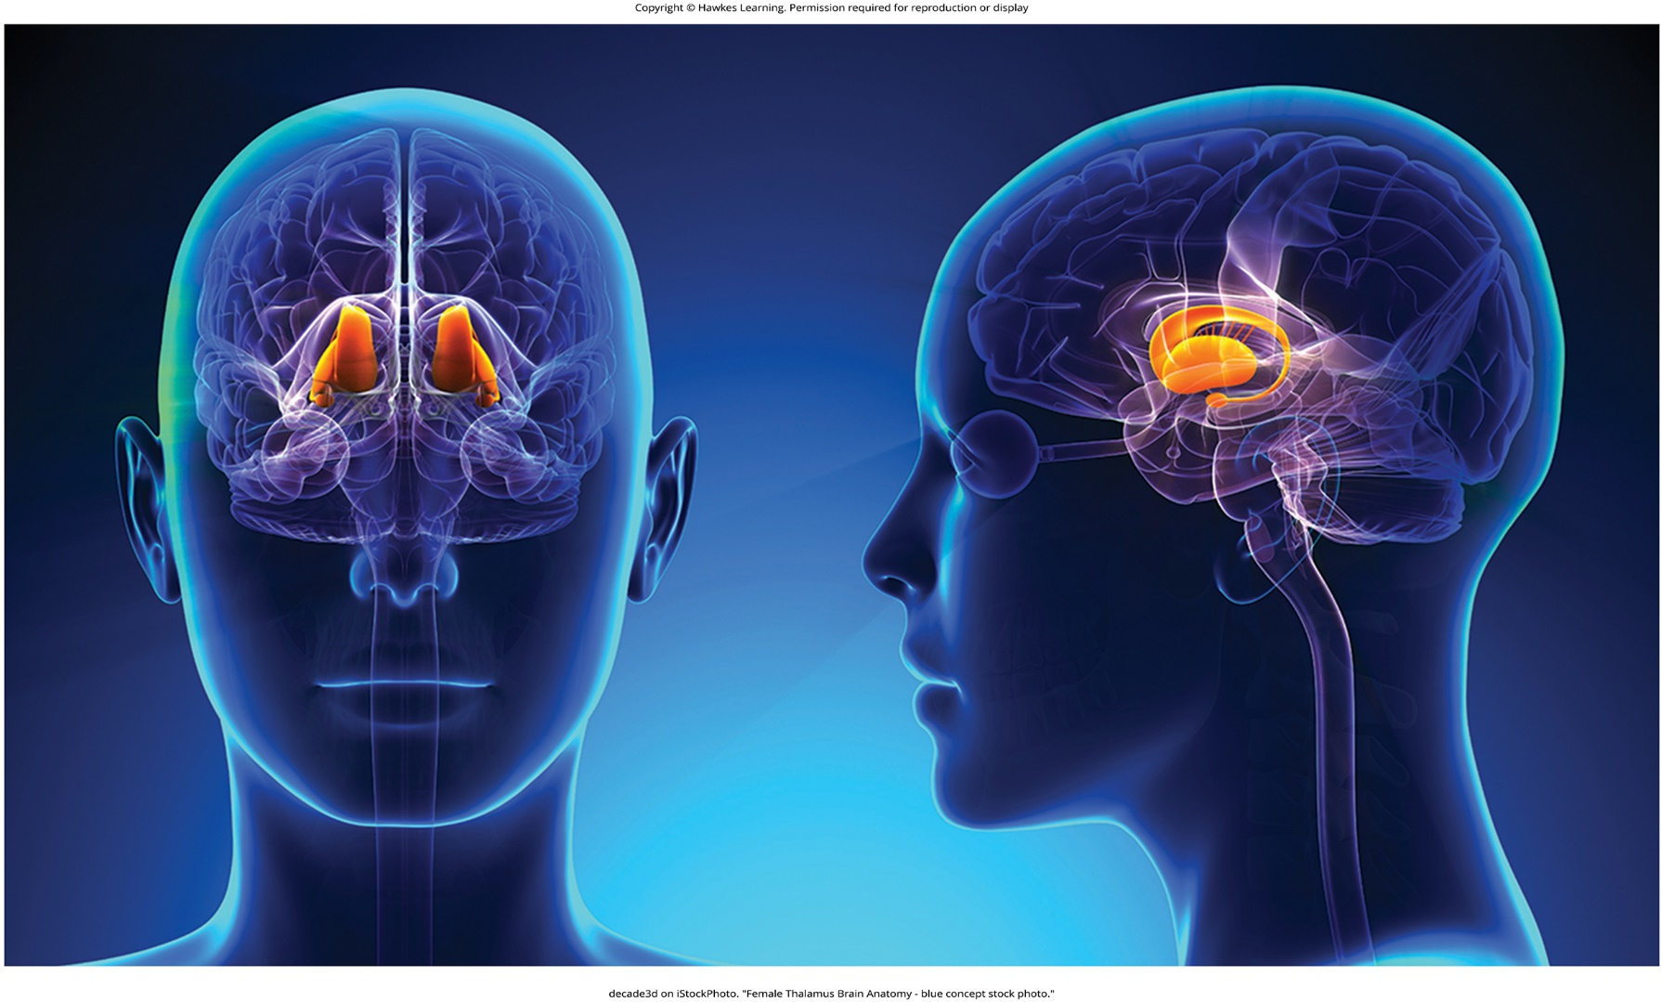
Lesson 2.4 Figure 8

Slide 31
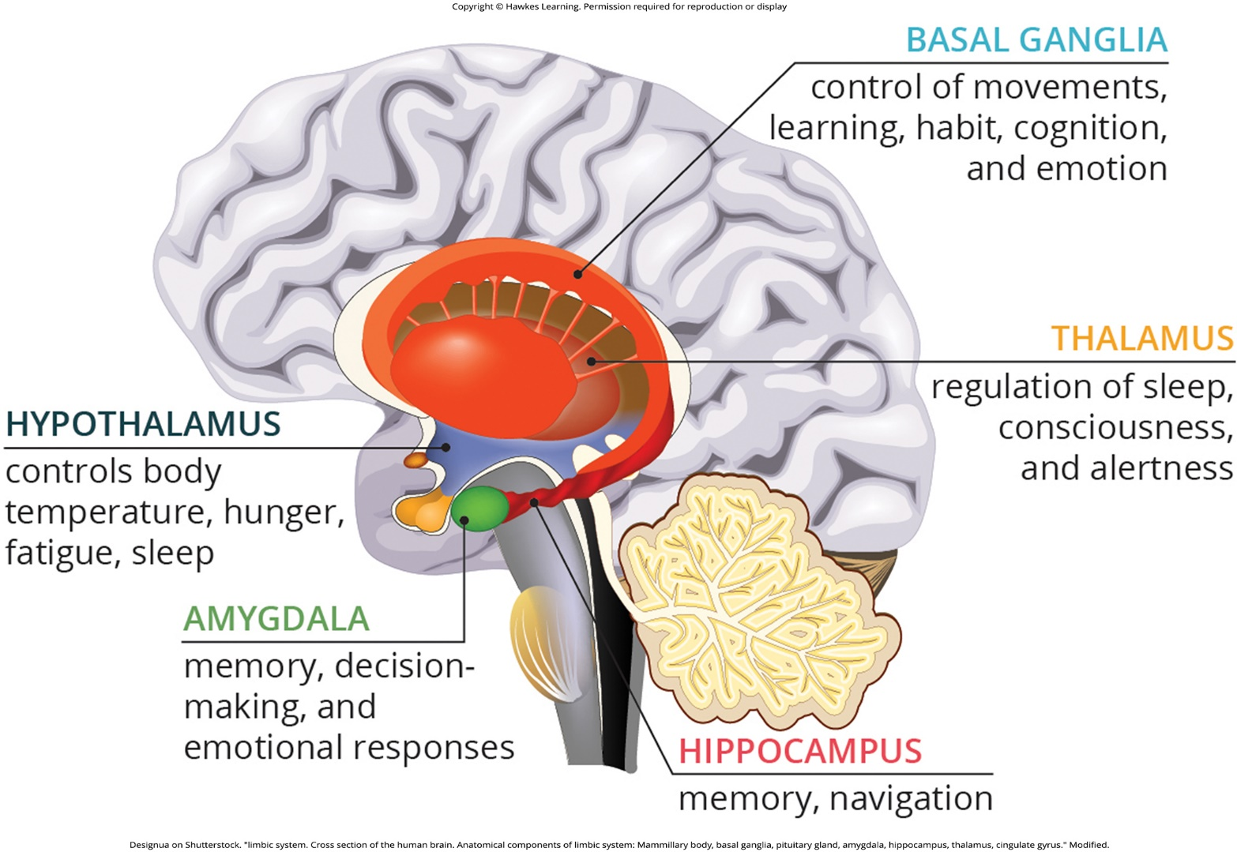
Lesson 2.4 Figure 9

Slide 32
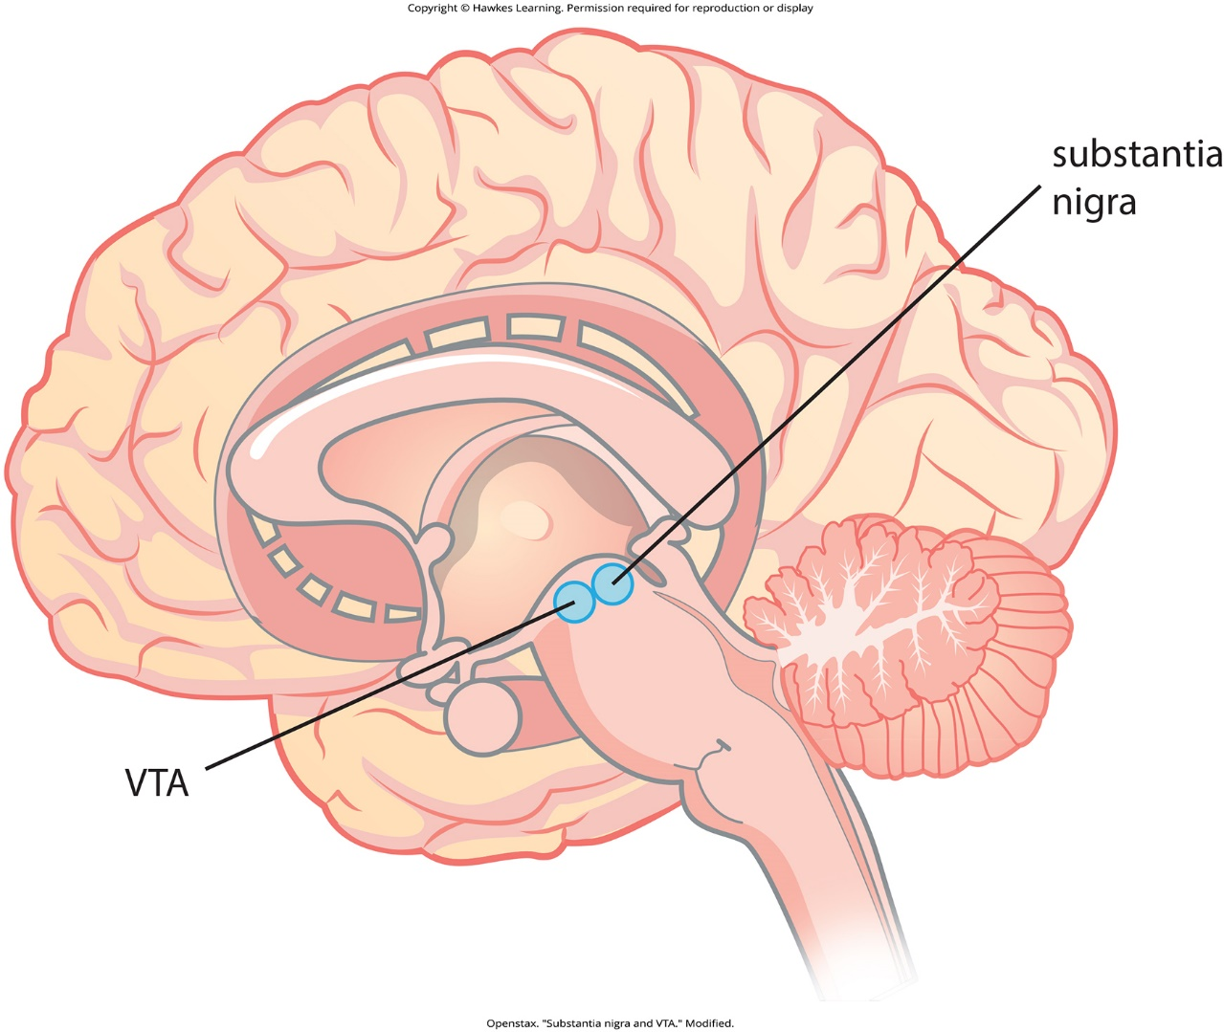
Lesson 2.4 Figure 10

Slide 33
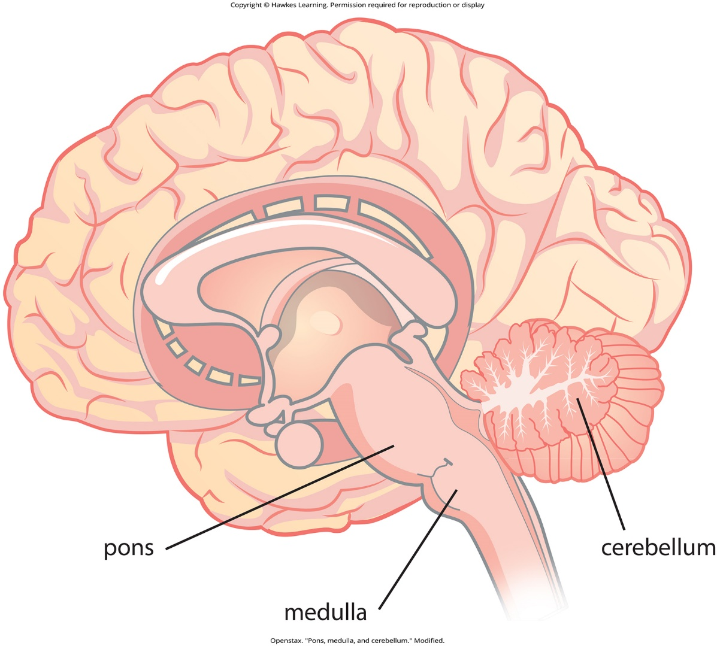
Lesson 2.4 Figure 11

Slide 34
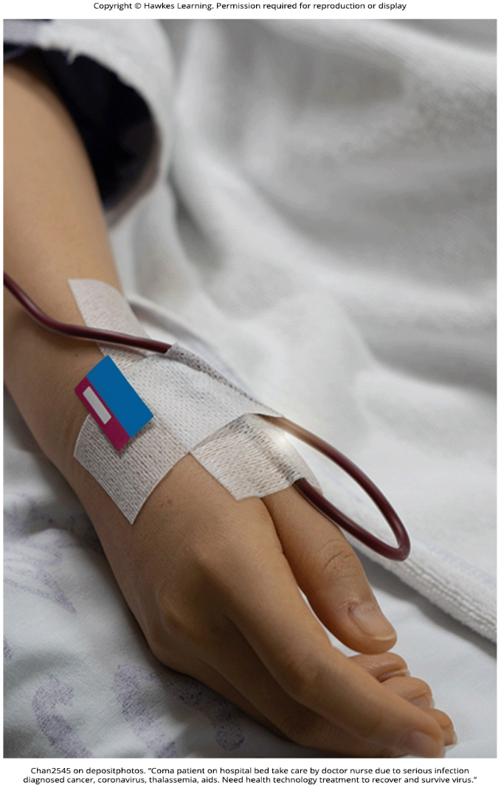
Lesson 2.4 Figure 12

Slide 35
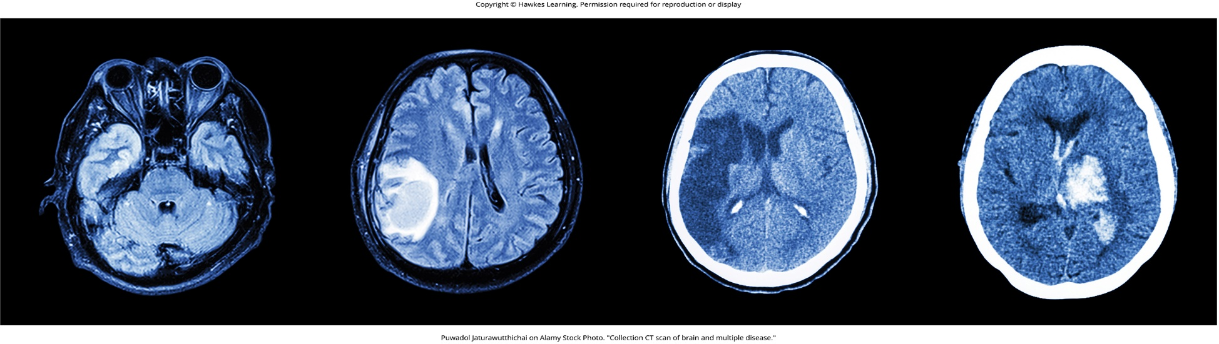
Lesson 2.4 Figure 13

Slide 36
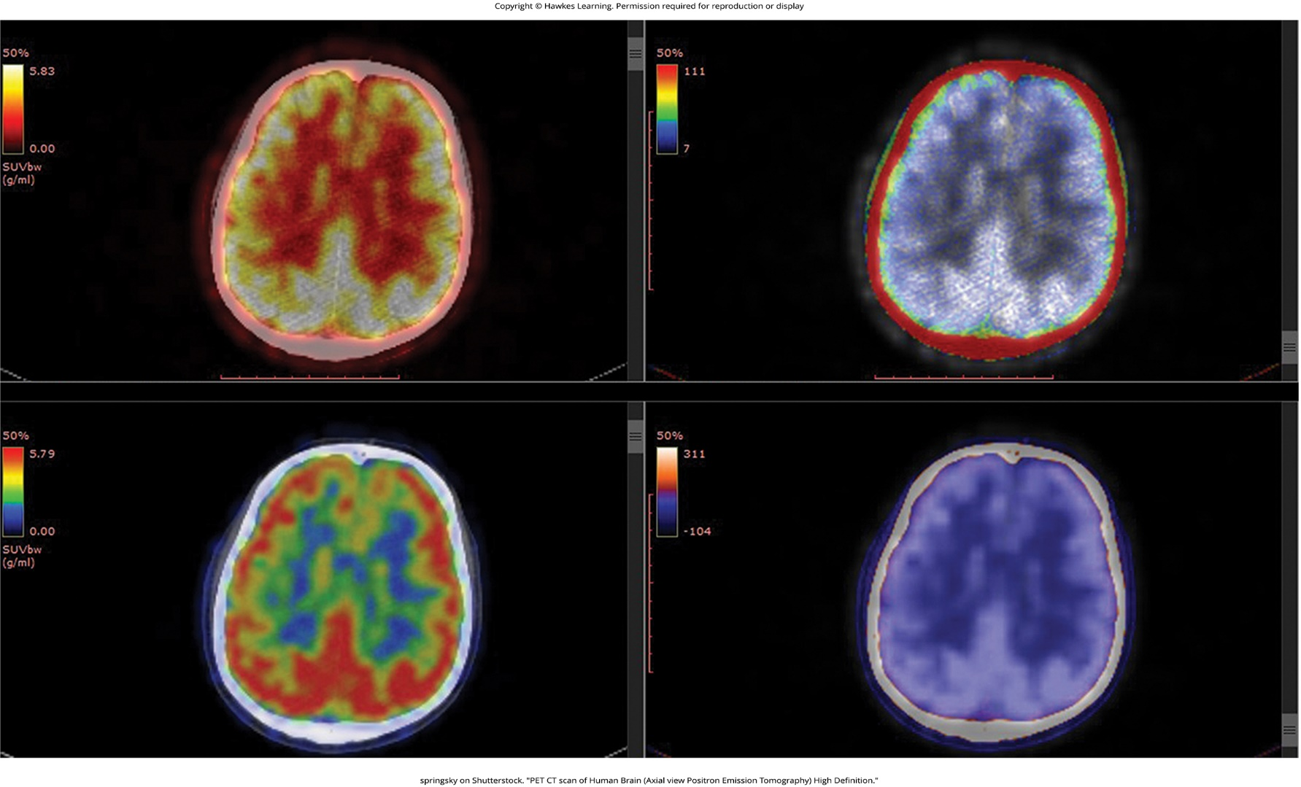
Lesson 2.4 Figure 14

Slide 37
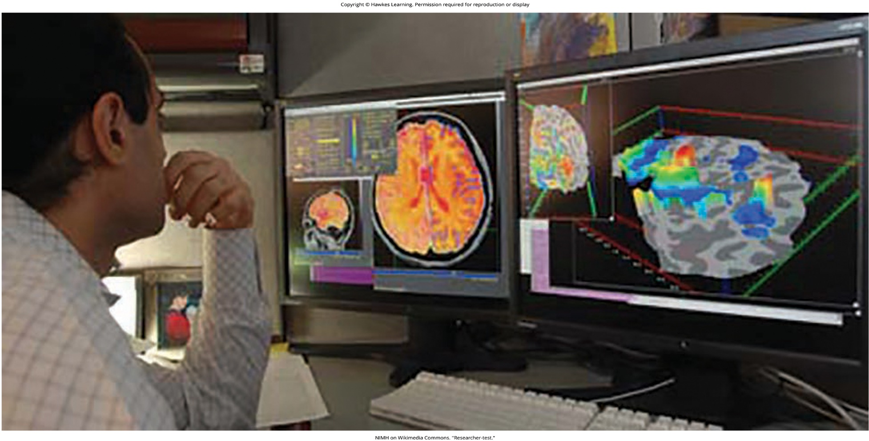
Lesson 2.4 Figure 15

Slide 38
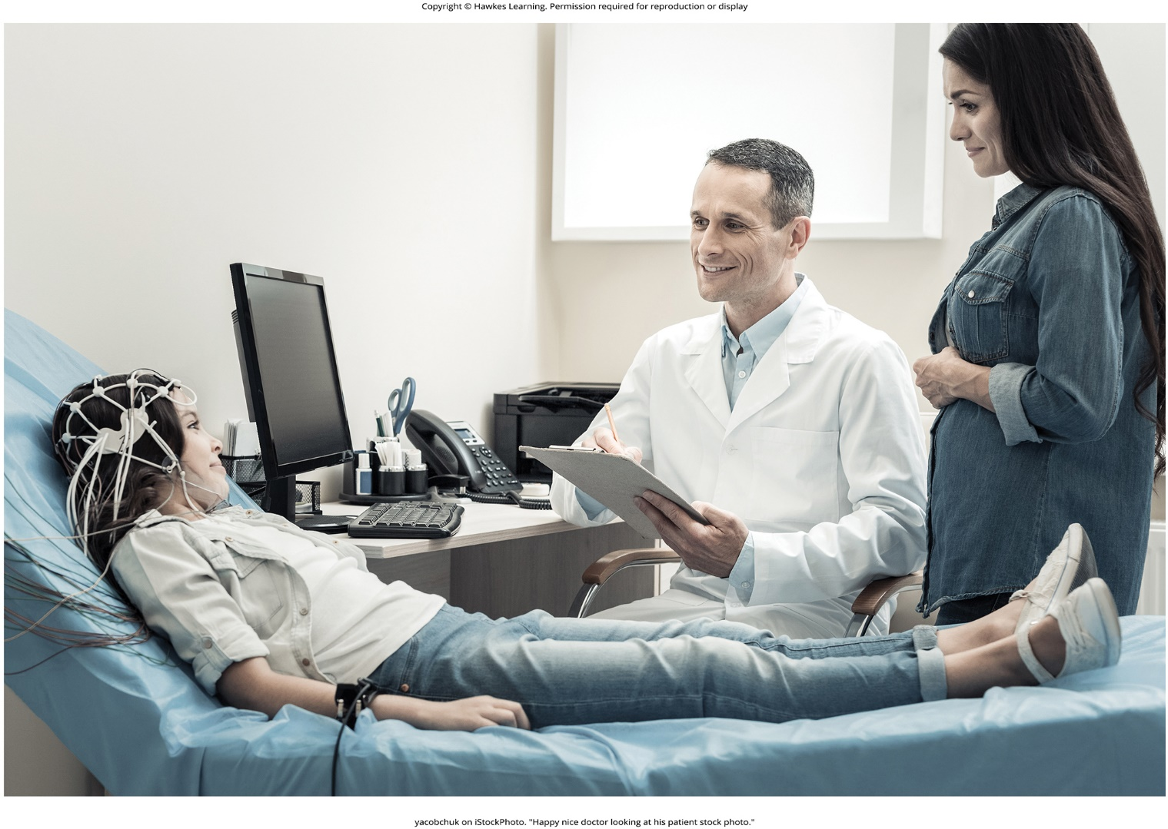
Lesson 2.4 Figure 16

Slide 39
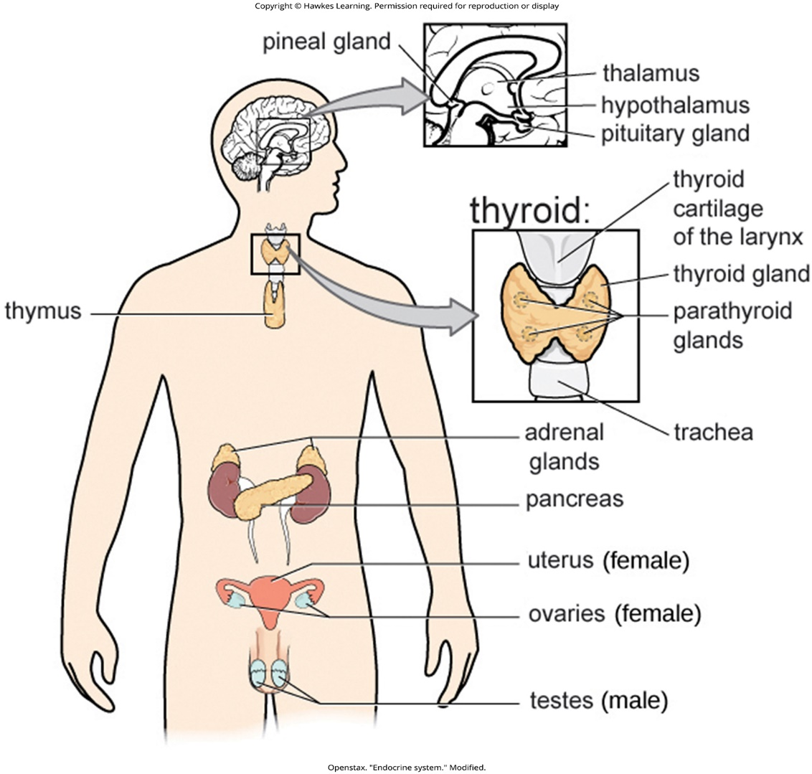
Lesson 2.5 Figure 1

Slide 40
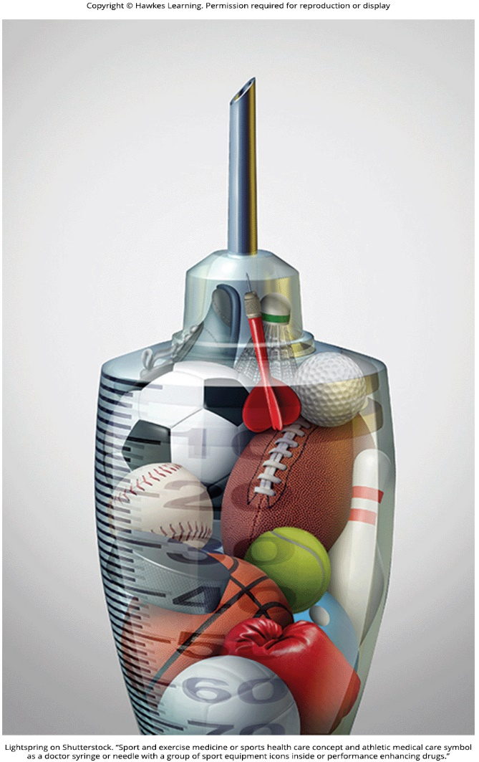
Lesson 2.5 Figure 2

Slide 41
Hawkes Learning – End of PowerPoint

