Slide 1
Chapter 3
States of Consciousness

Slide 2

Lesson 3.1 Figure 1

Slide 3
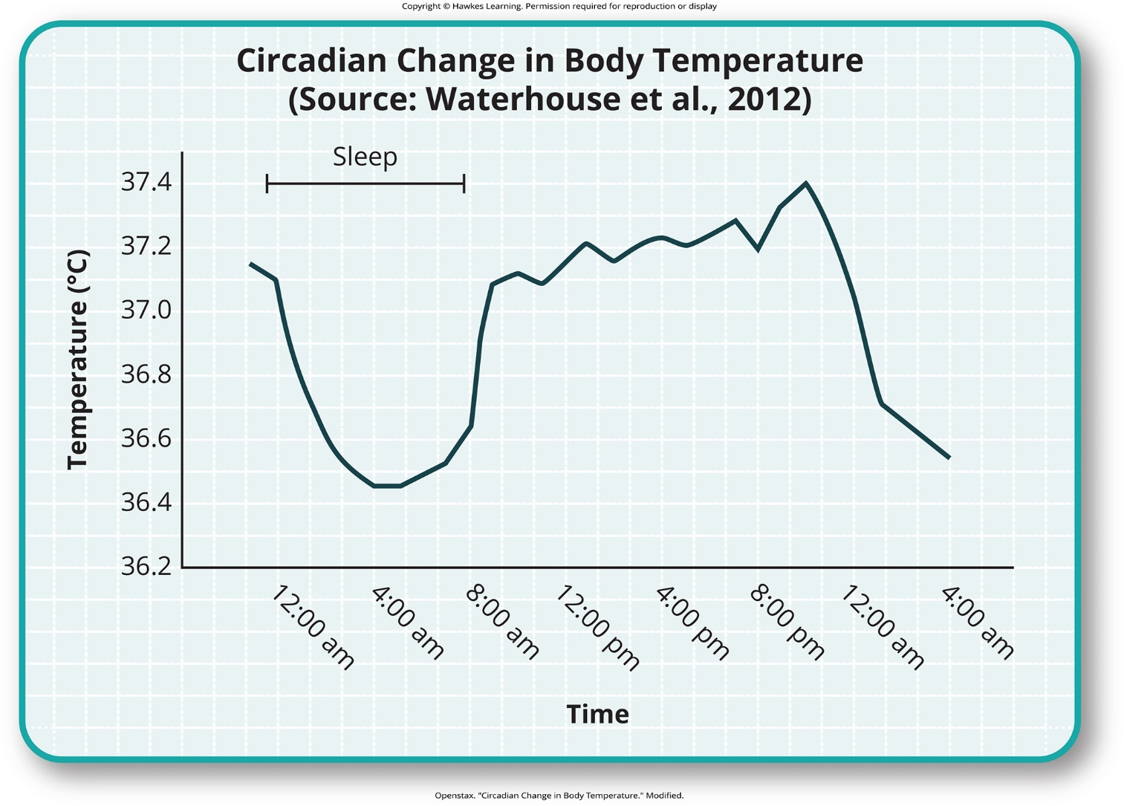
Lesson 3.1 Figure 2

Slide 4
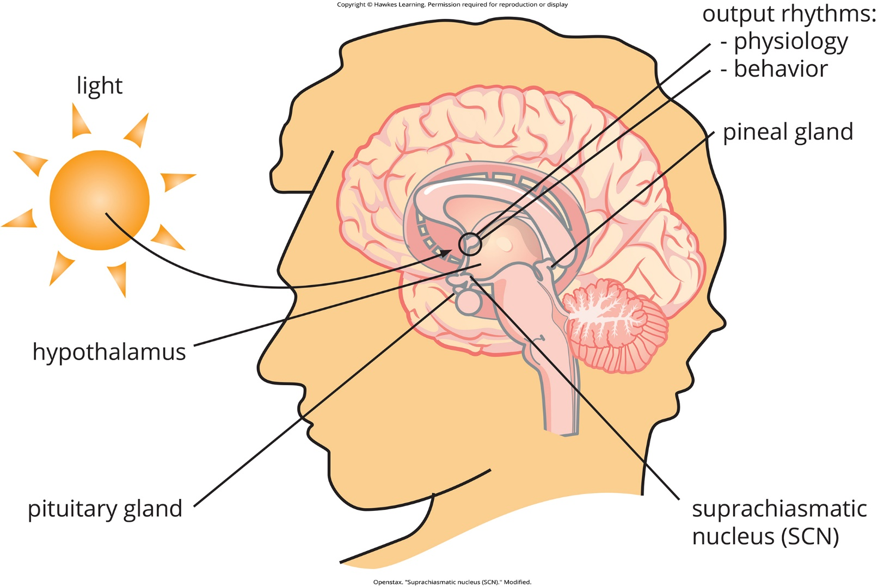
Lesson 3.1 Figure 3

Slide 5
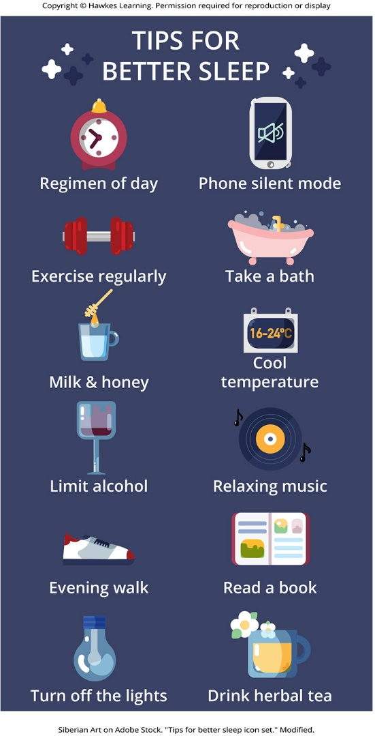
Lesson 3.1 Figure 4

Slide 6
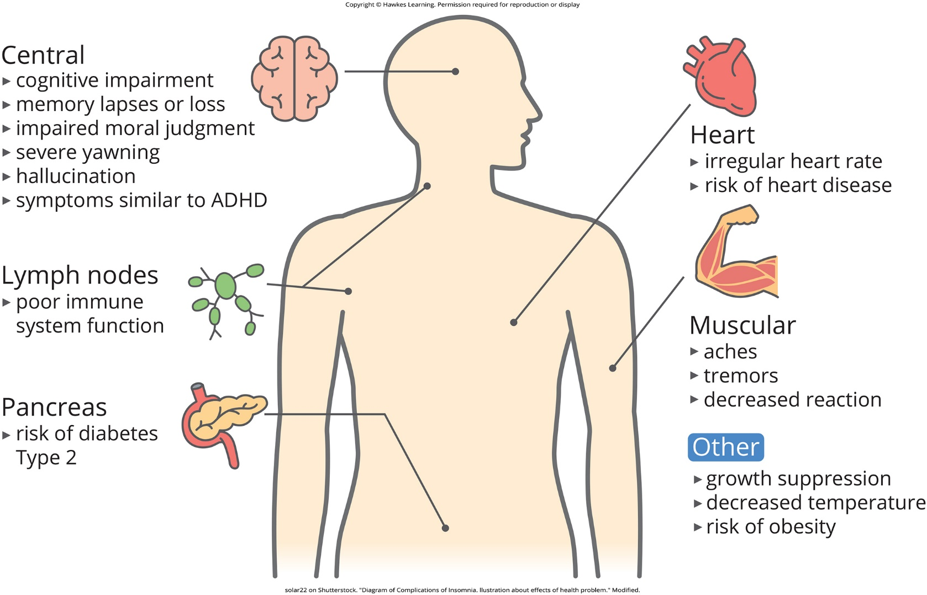
Lesson 3.1 Figure 5

Slide 7
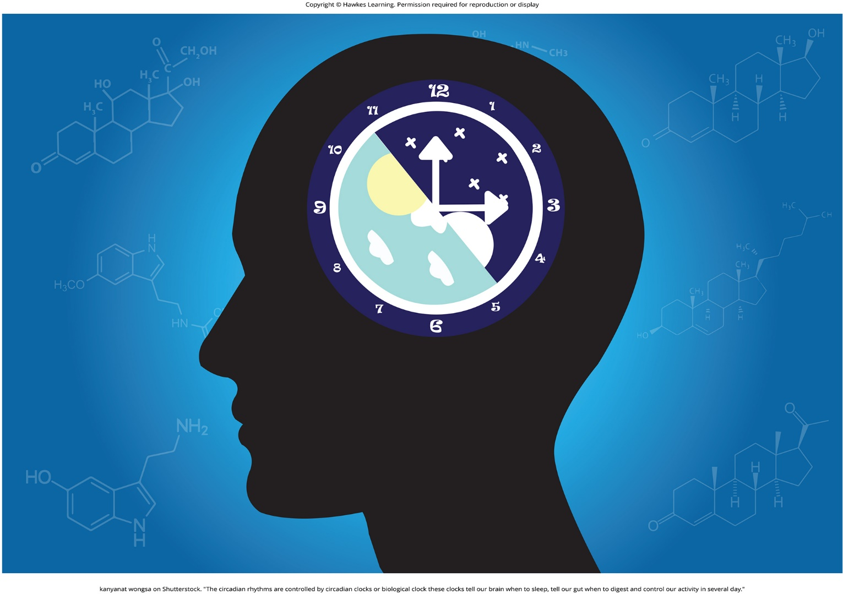
Lesson 3.2 Figure 1

Slide 8
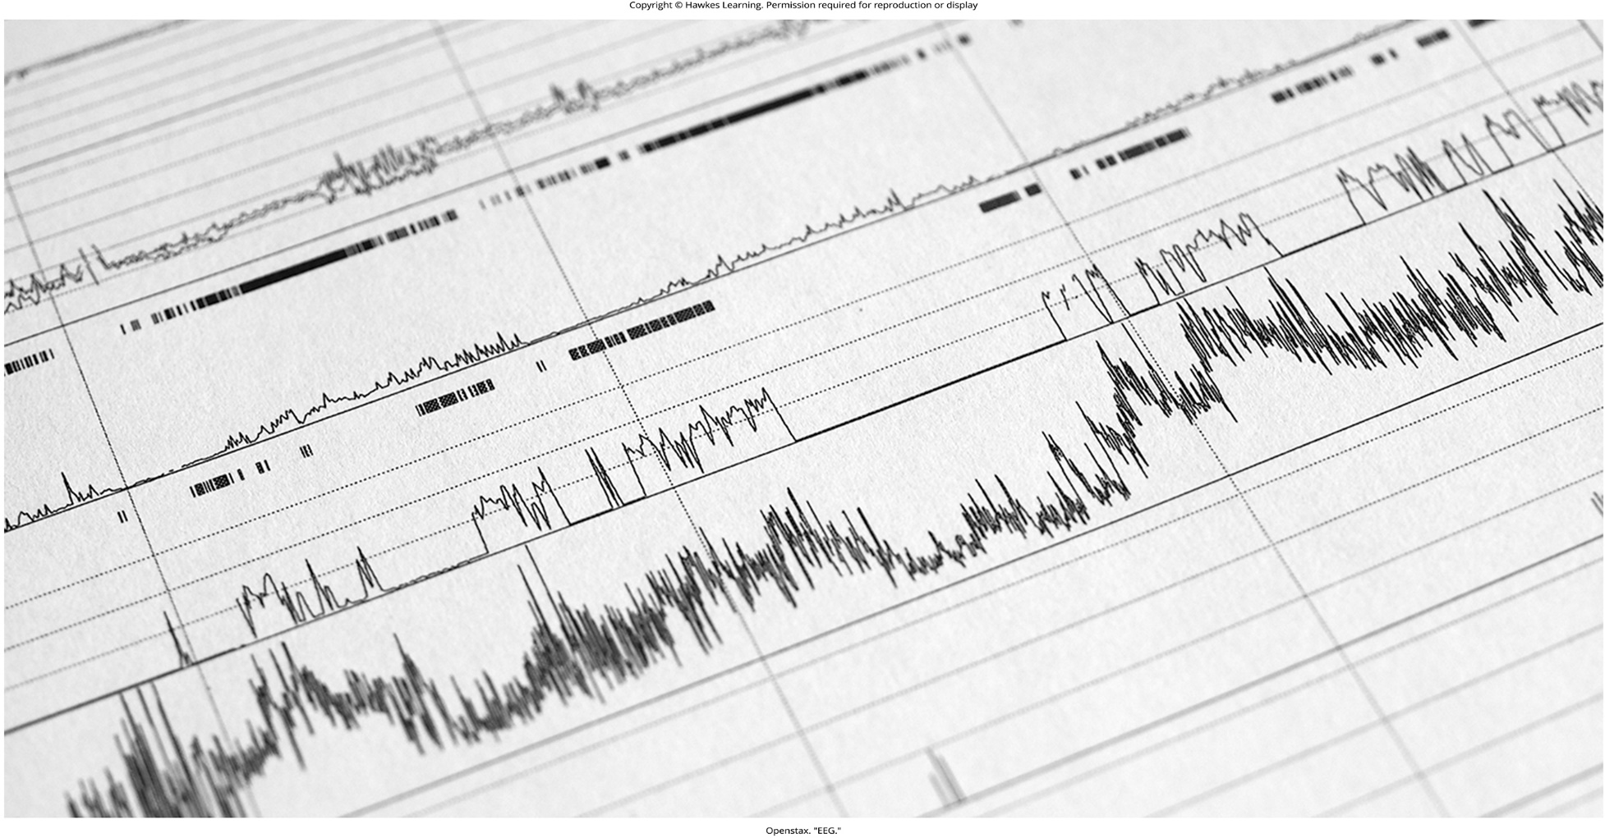
Lesson 3.2 Figure 2

Slide 9
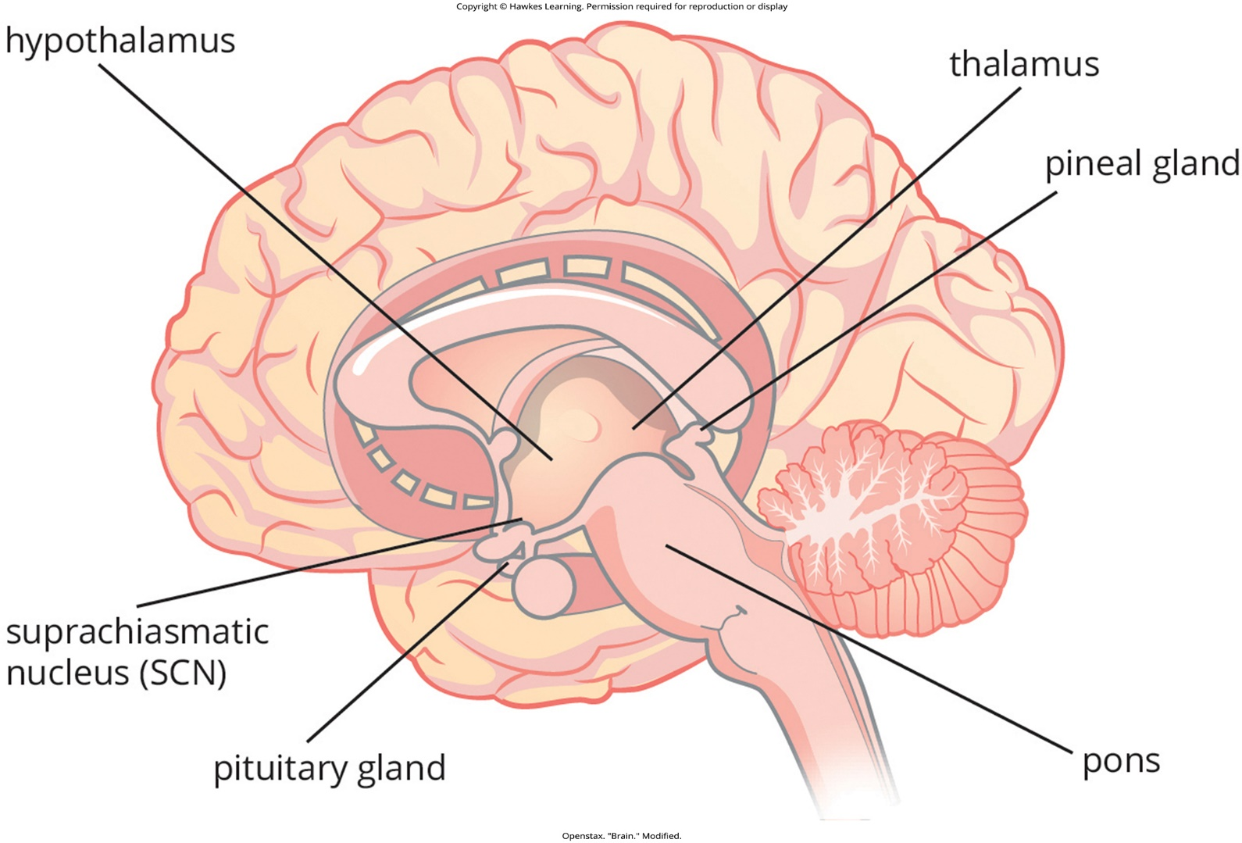
Lesson 3.2 Figure 3

Slide 10
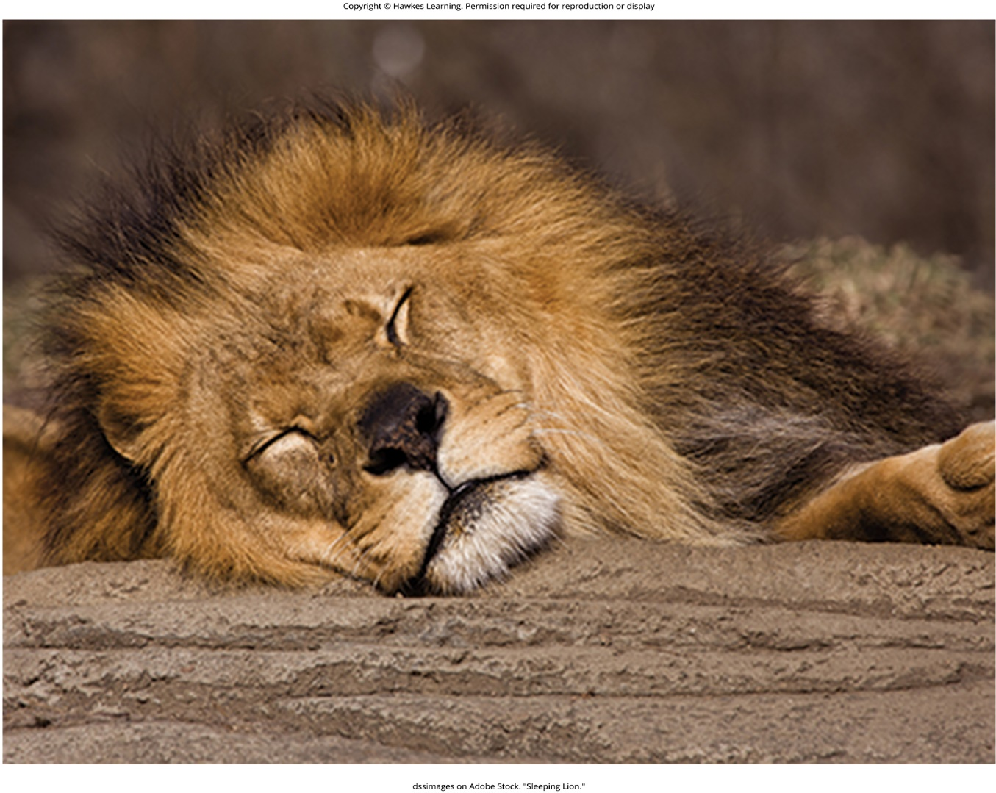
Lesson 3.2 Figure 4

Slide 11

Lesson 3.2 Figure 5

Slide 12
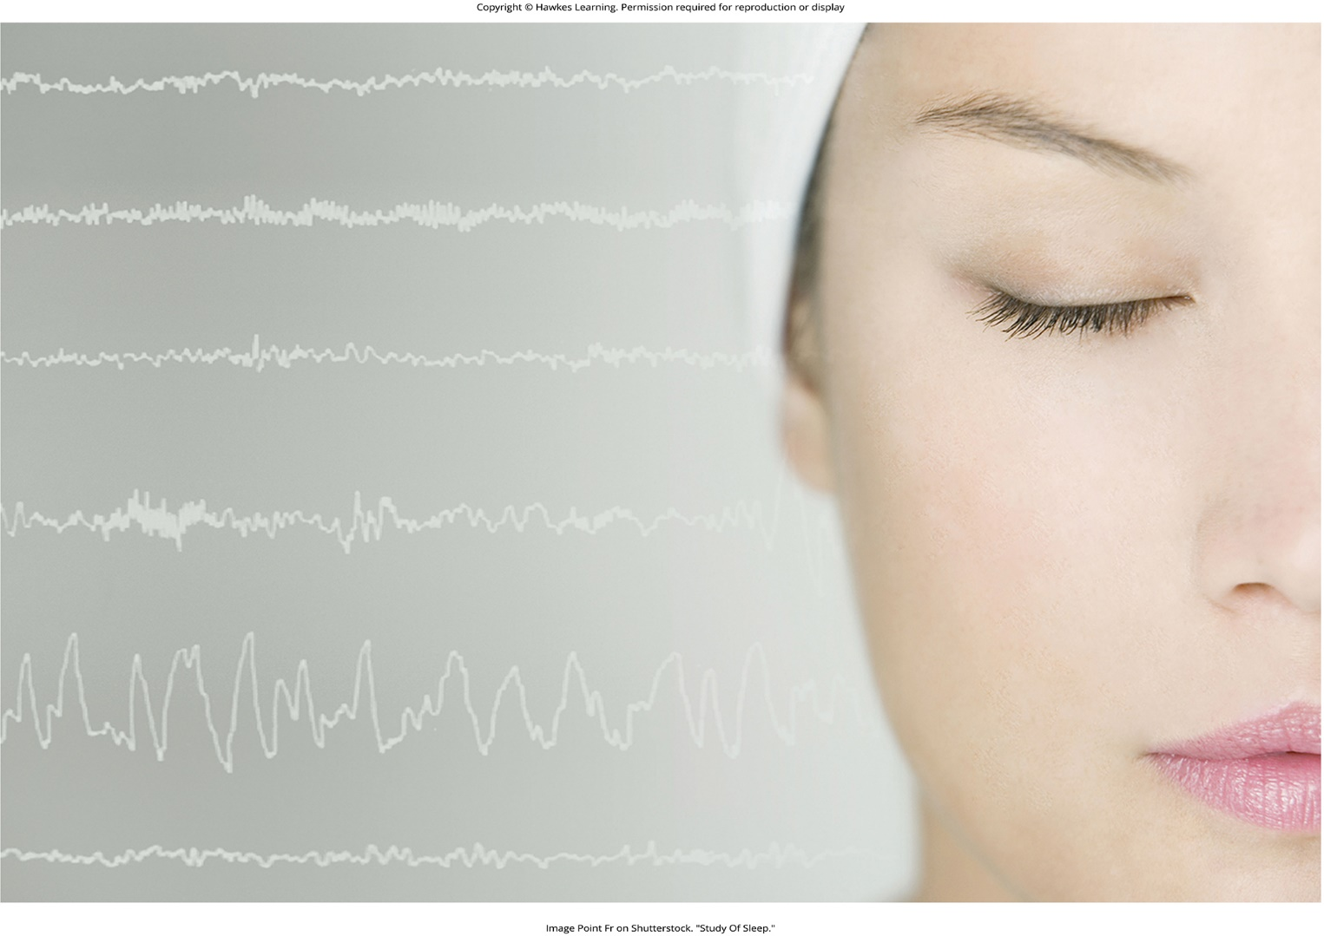
Lesson 3.3 Figure 1

Slide 13
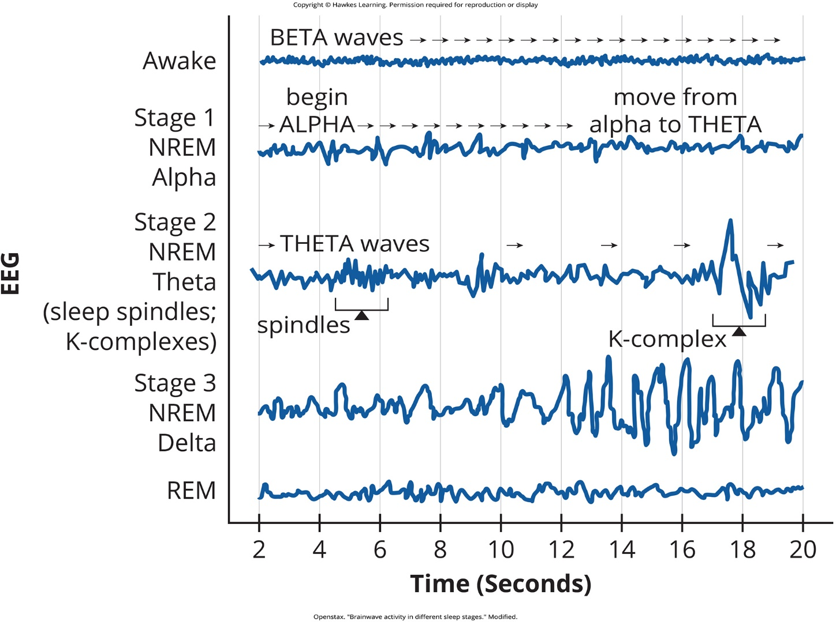
Lesson 3.3 Figure 2

Slide 14
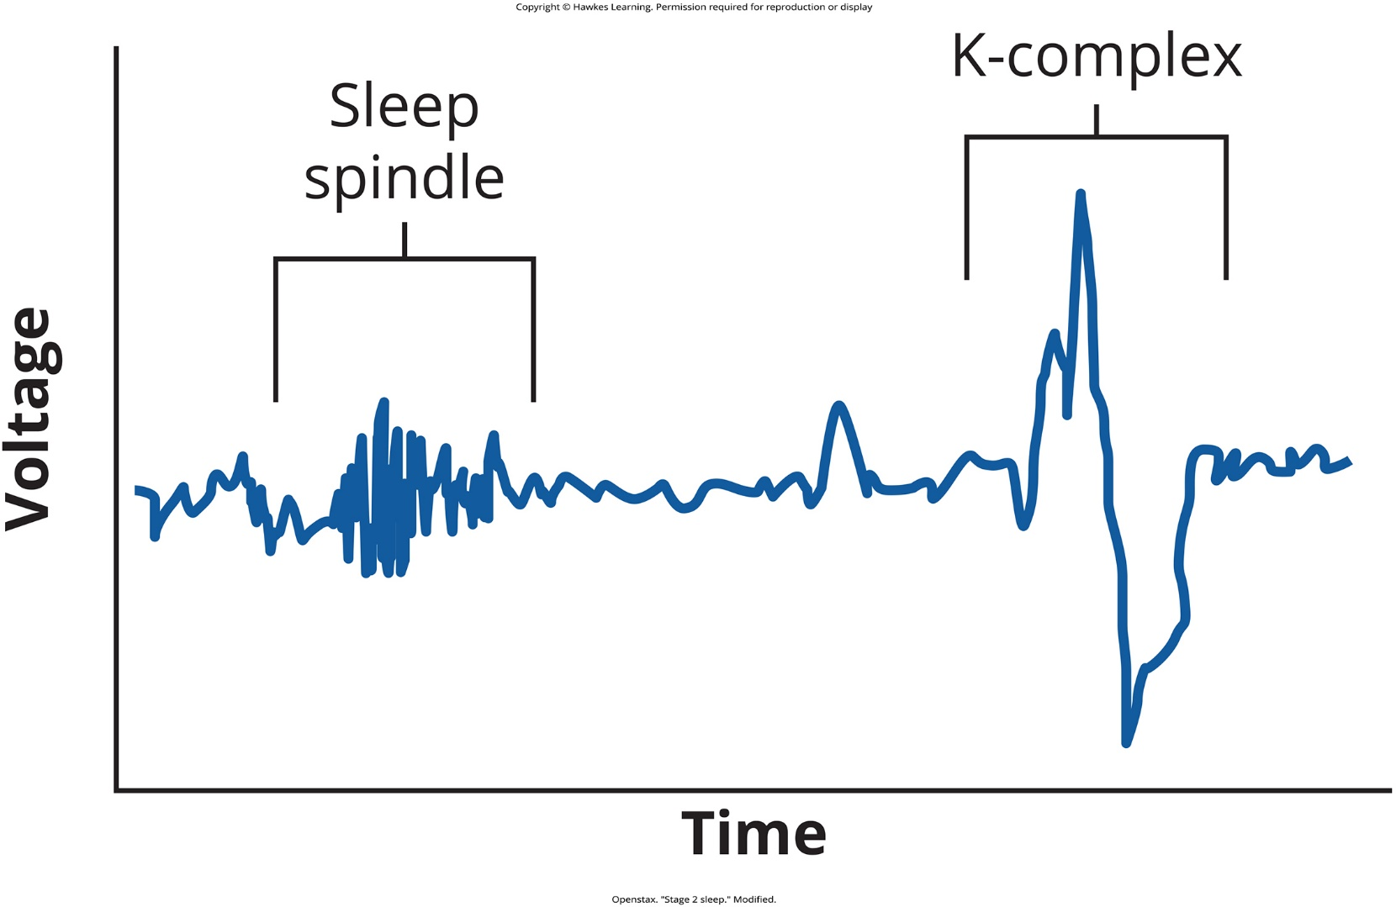
Lesson 3.3 Figure 3

Slide 15
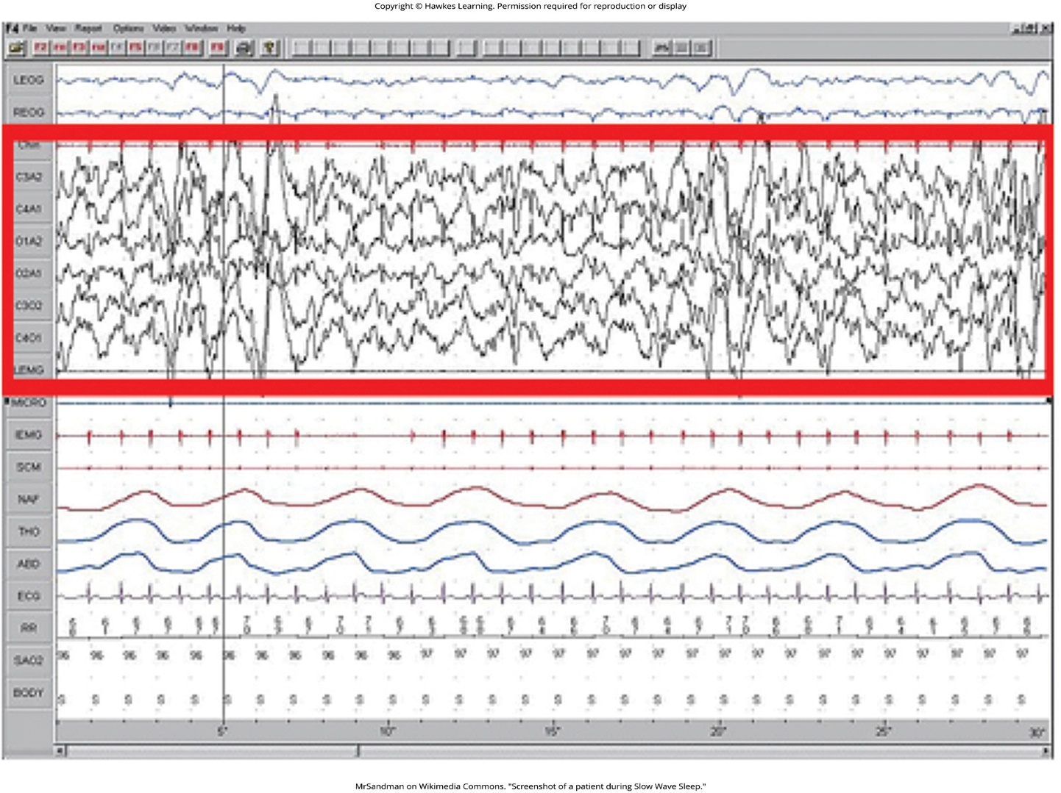
Lesson 3.3 Figure 4

Slide 16
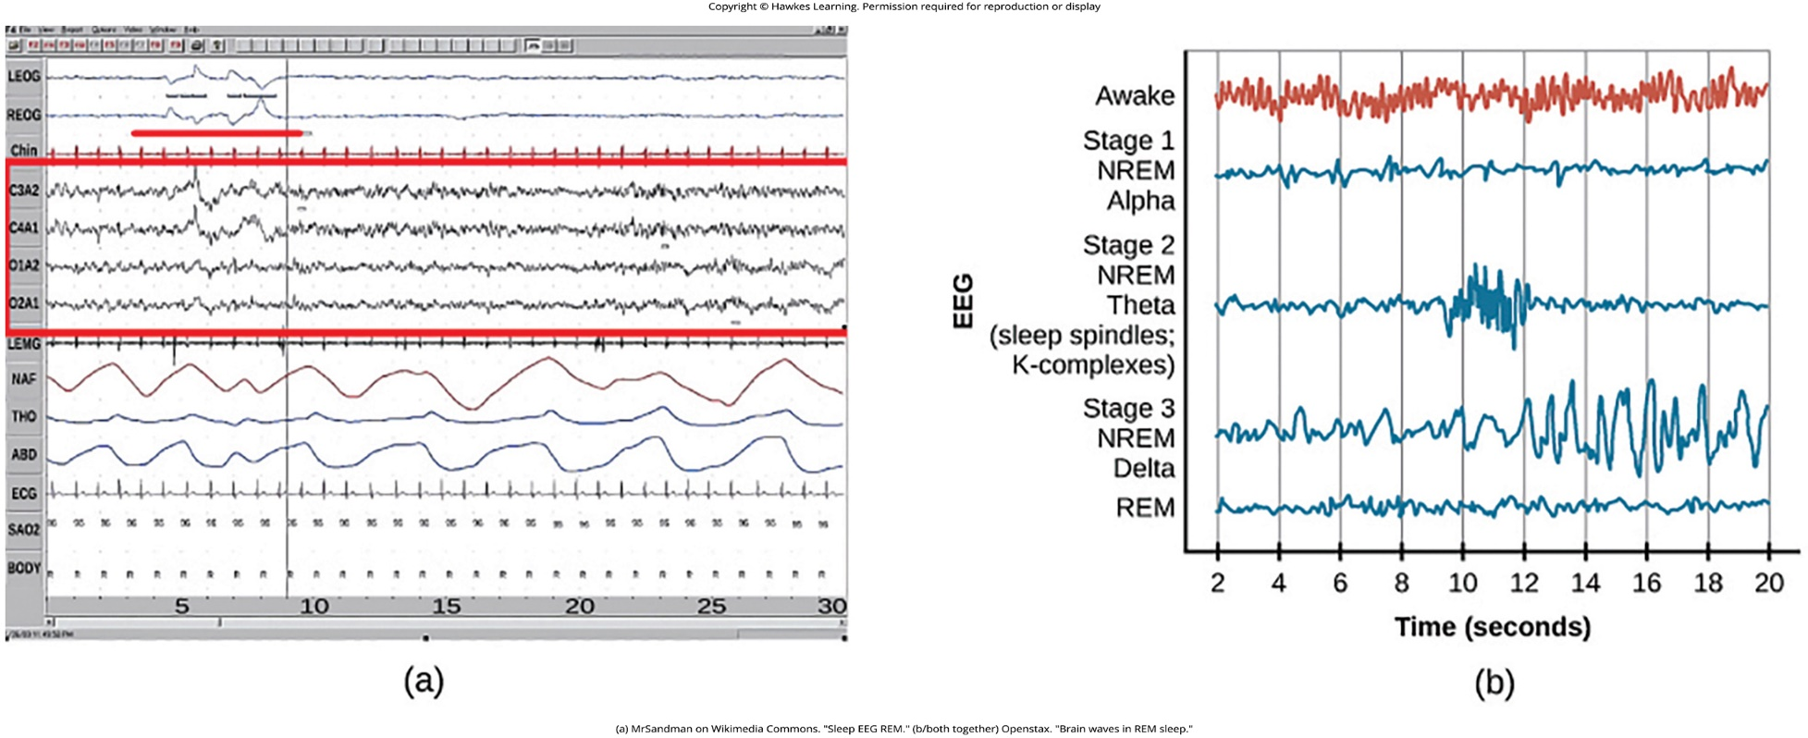
Lesson 3.3 Figure 5

Slide 17
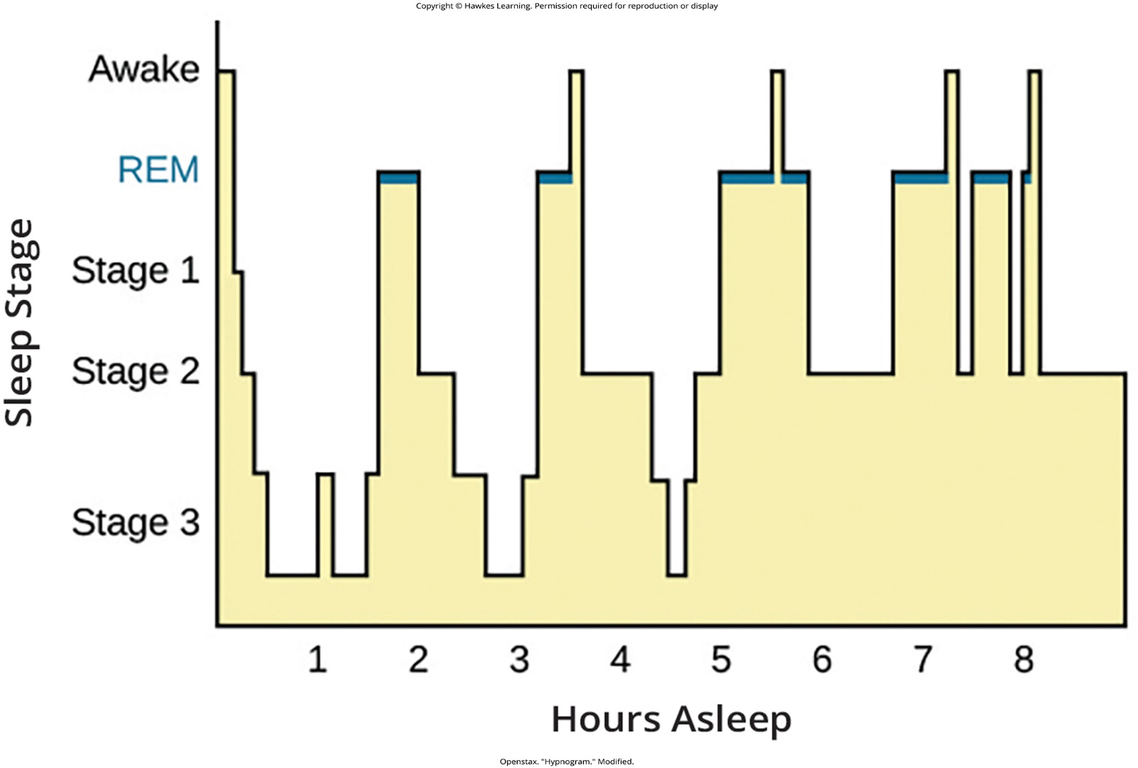
Lesson 3.3 Figure 6

Slide 18
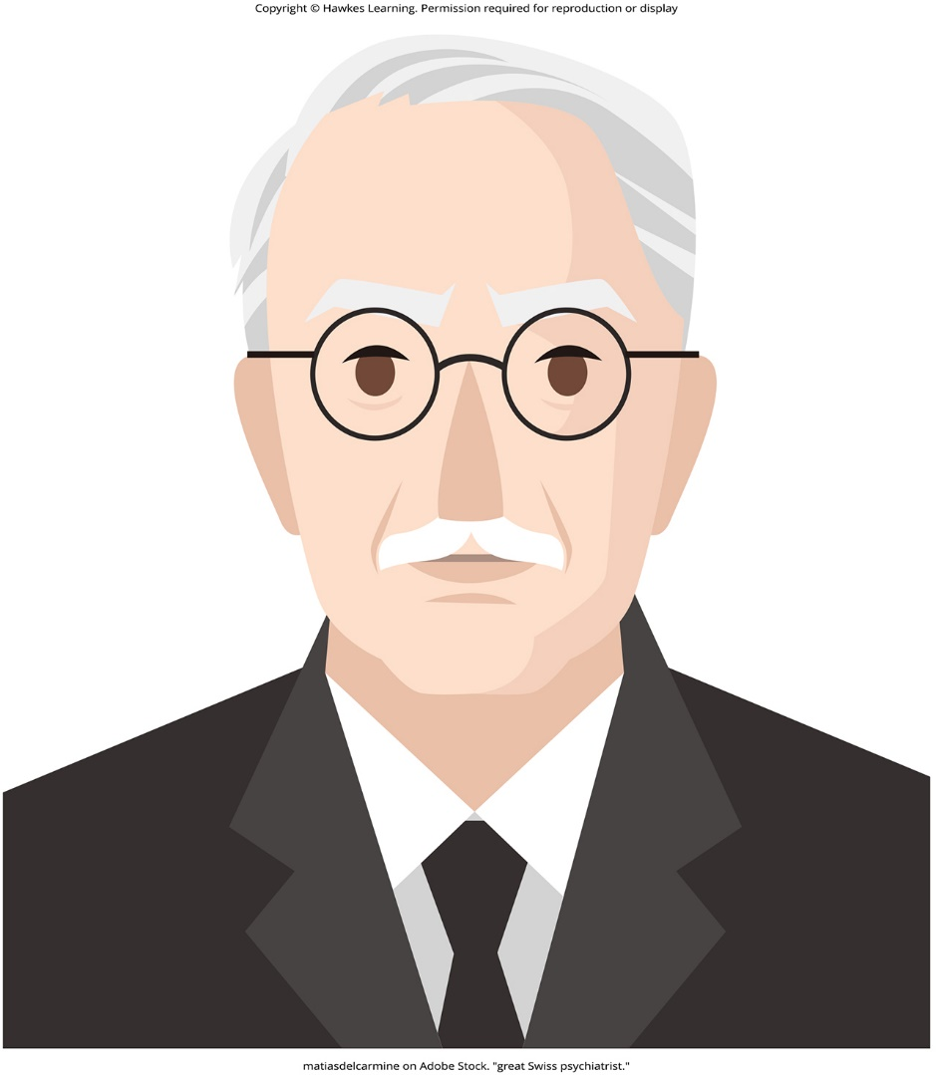
Lesson 3.3 Figure 7

Slide 19
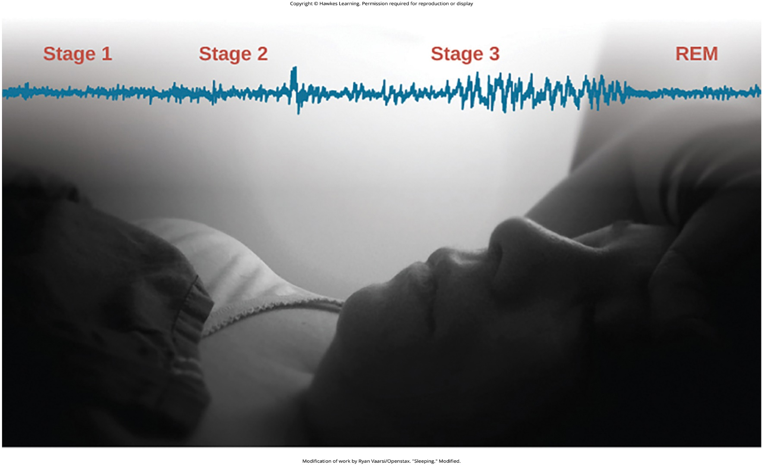
Lesson 3.3 Figure 8

Slide 20

Lesson 3.4 Figure 1

Slide 21
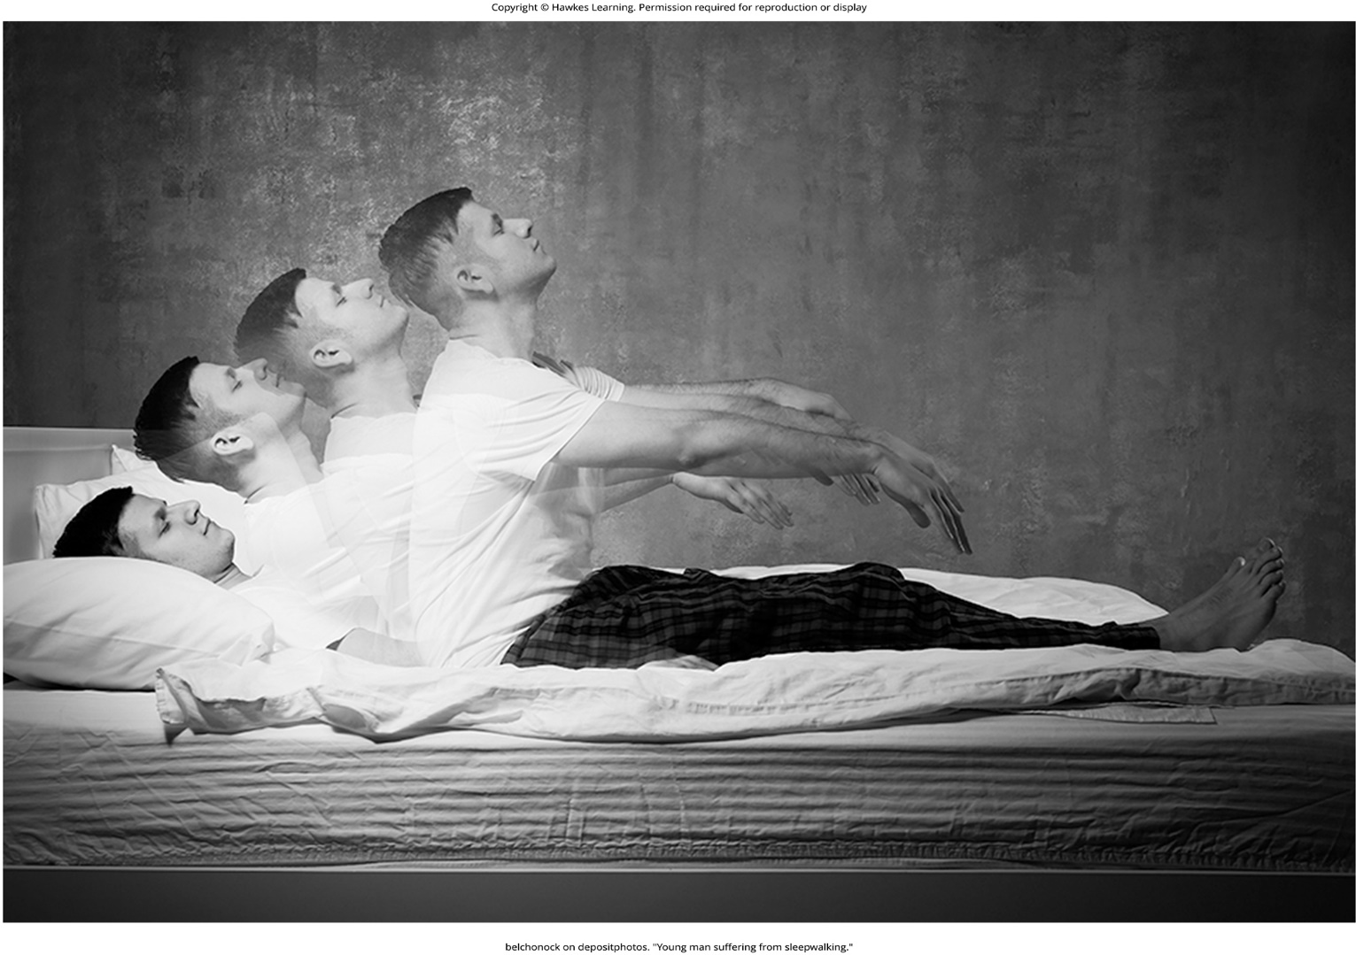
Lesson 3.4 Figure 2

Slide 22
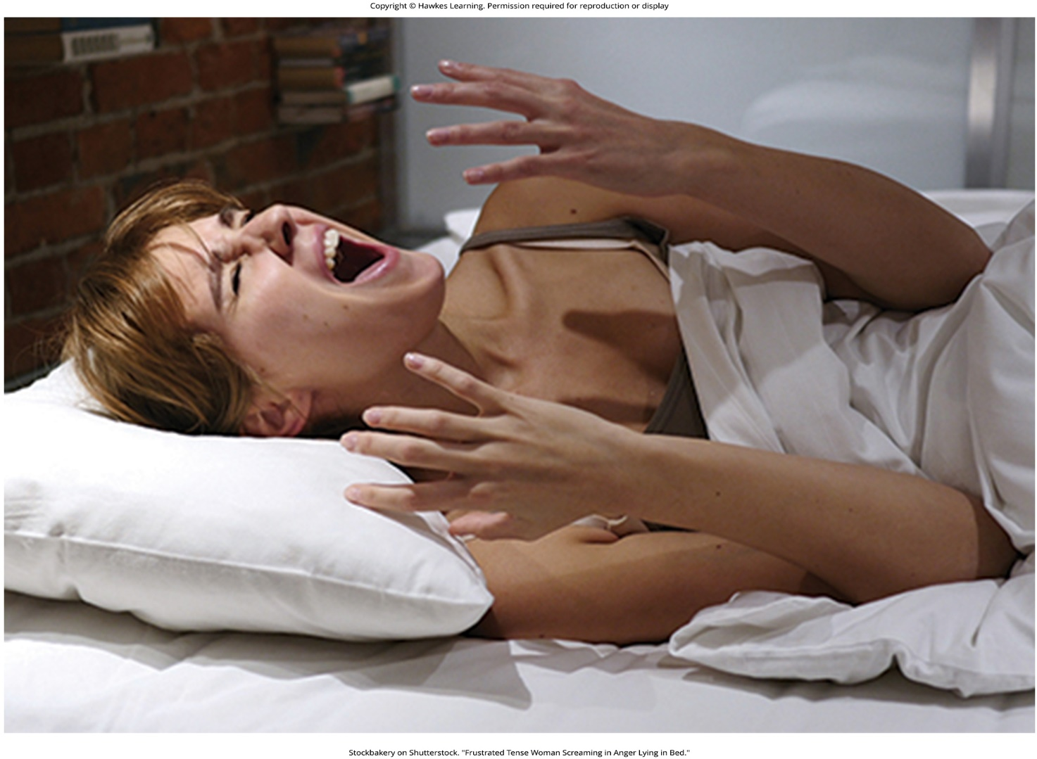
Lesson 3.4 Figure 3

Slide 23
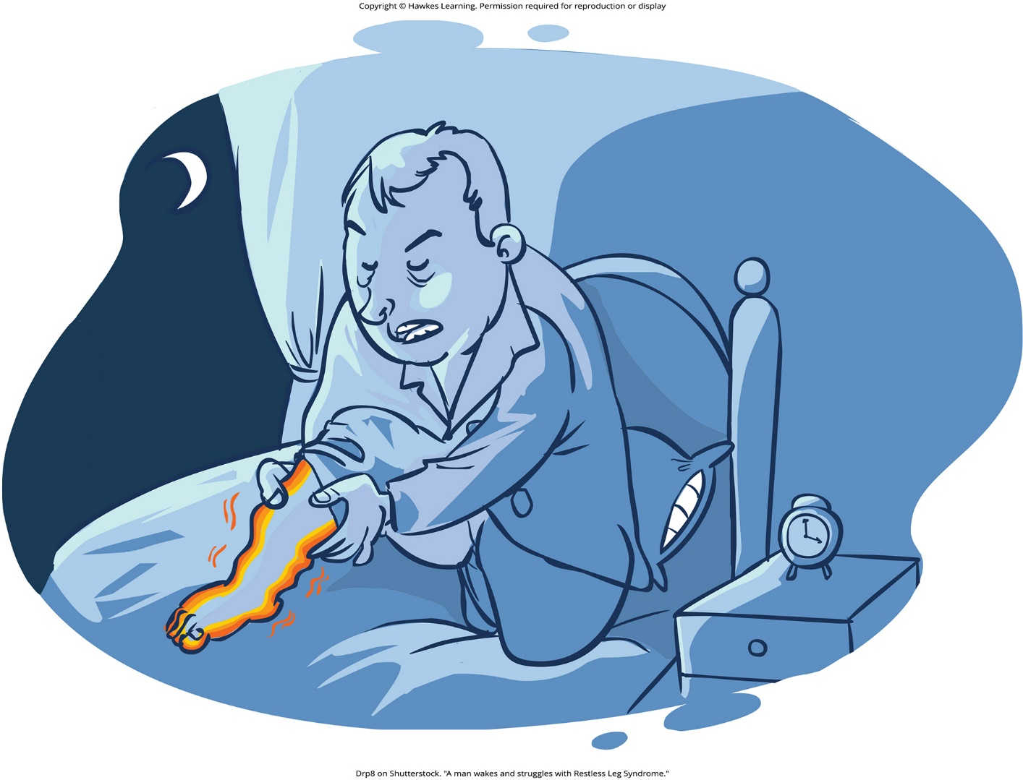
Lesson 3.4 Figure 4

Slide 24
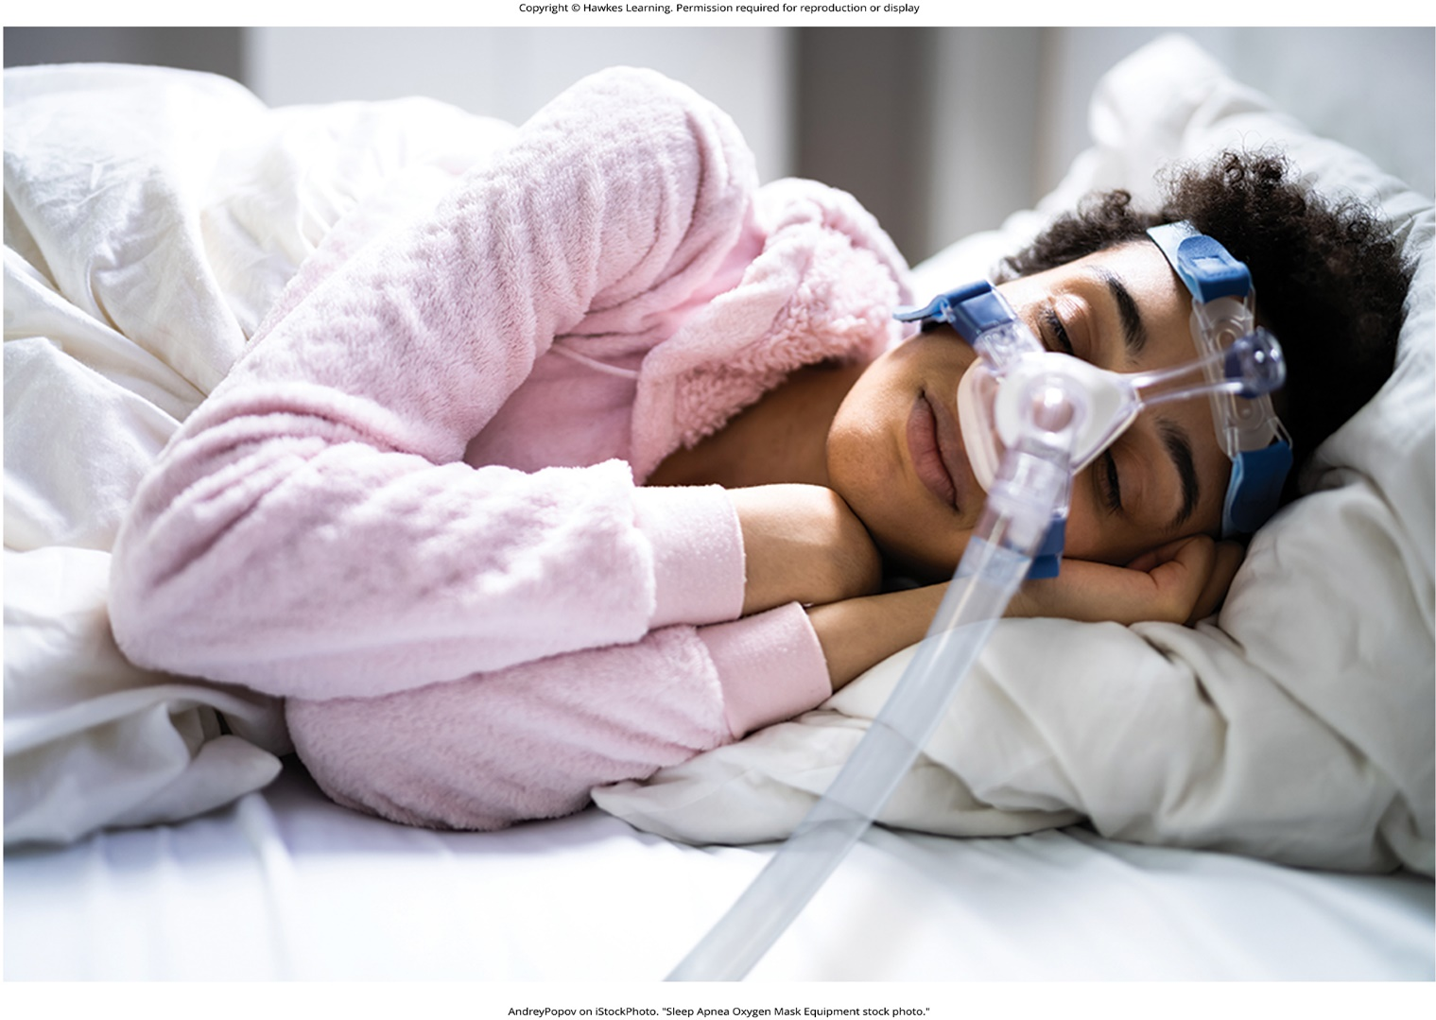
Lesson 3.4 Figure 5

Slide 25

Lesson 3.4 Figure 6

Slide 26
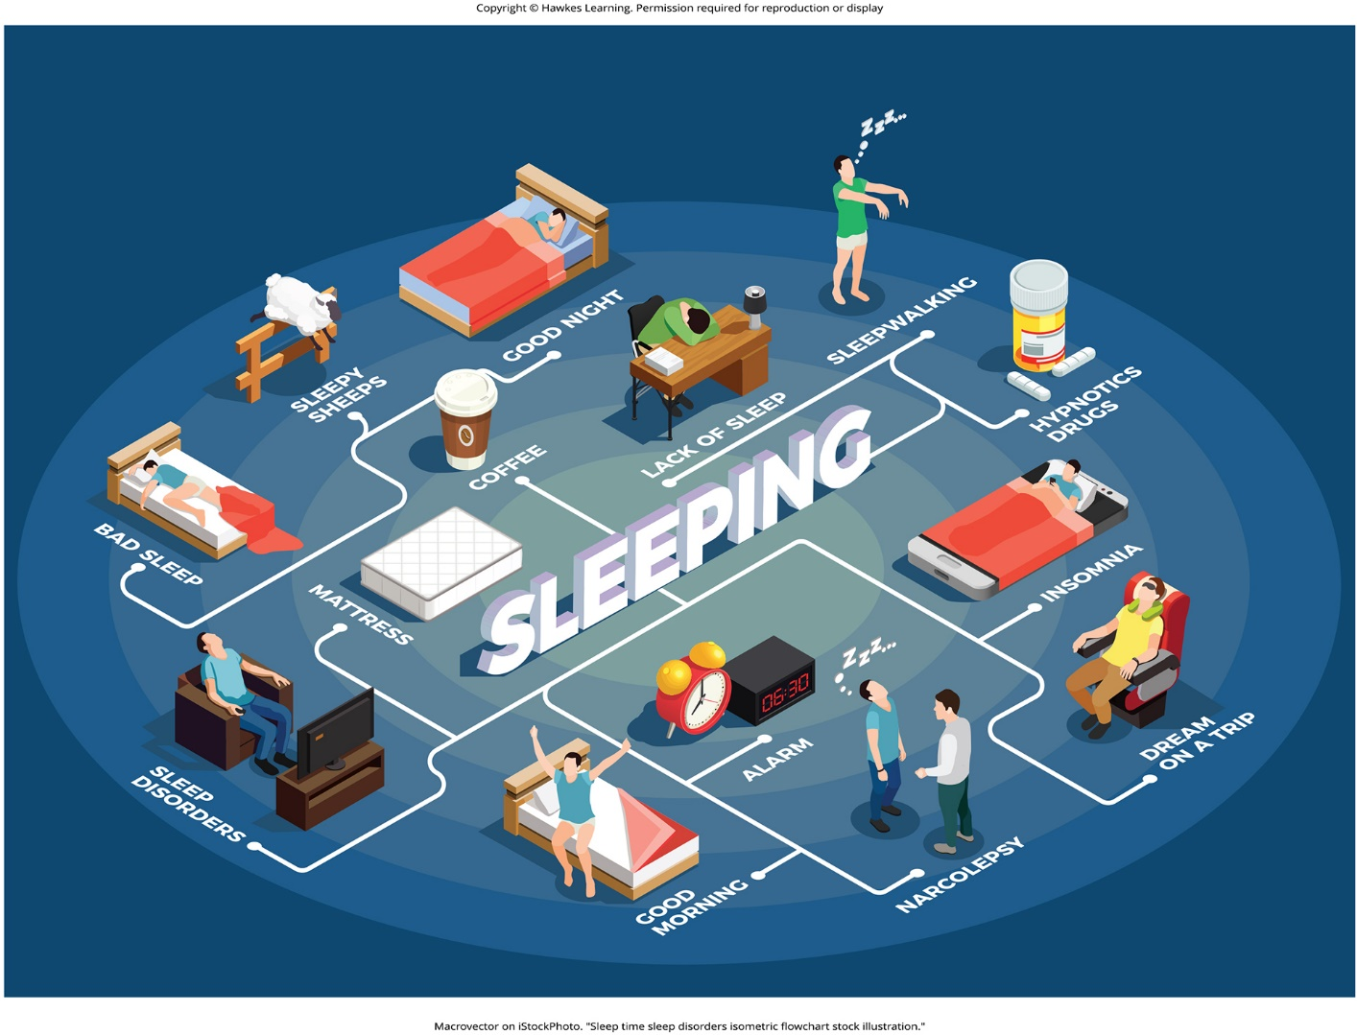
Lesson 3.4 Figure 7

Slide 27

Lesson 3.5 Figure 1

Slide 28
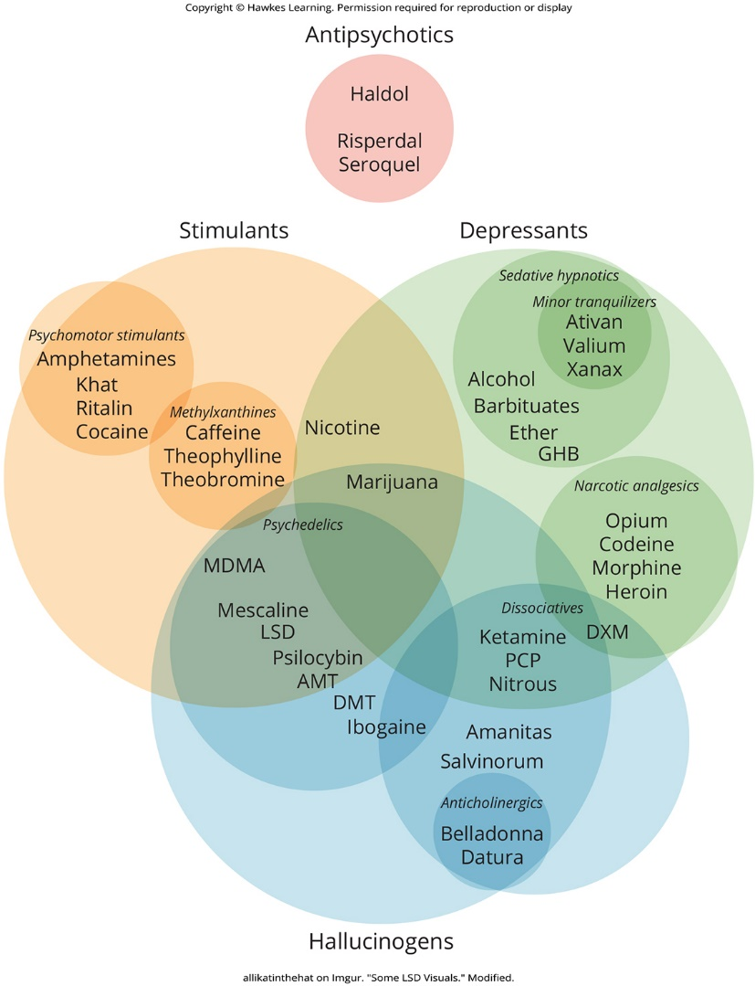
Lesson 3.5 Figure 2

Slide 29
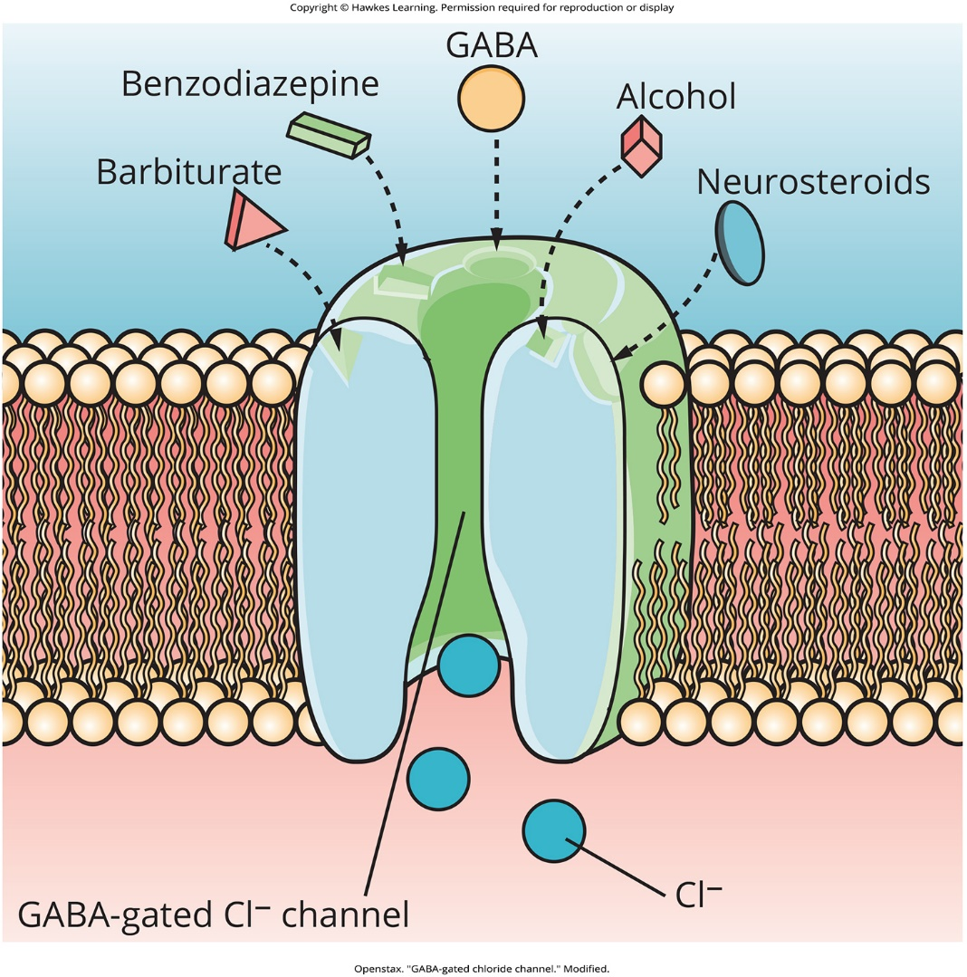
Lesson 3.5 Figure 3

Slide 30

Lesson 3.5 Figure 4

Slide 31
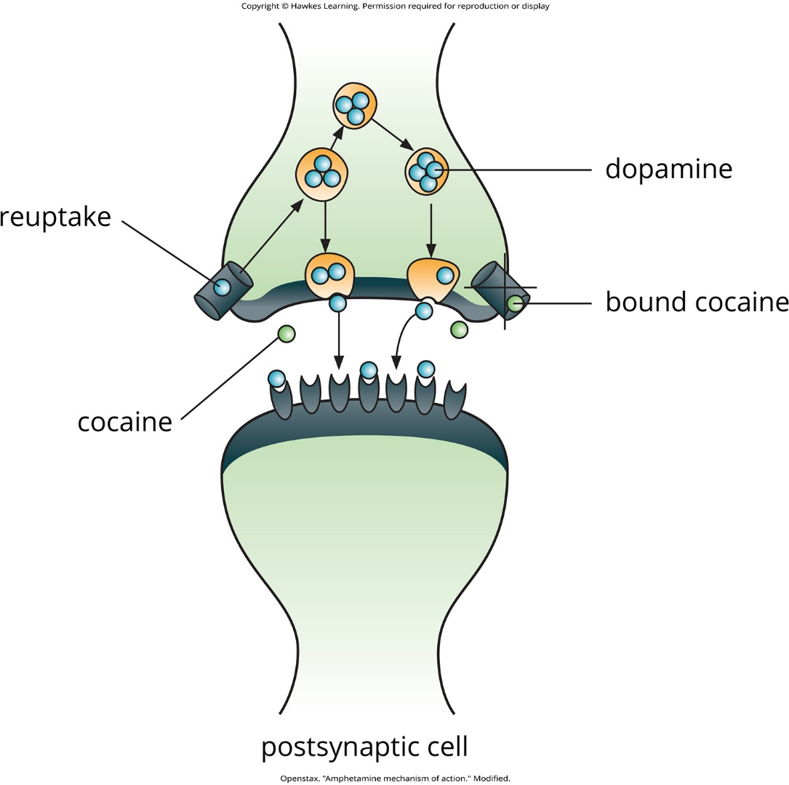
Lesson 3.5 Figure 5

Slide 32
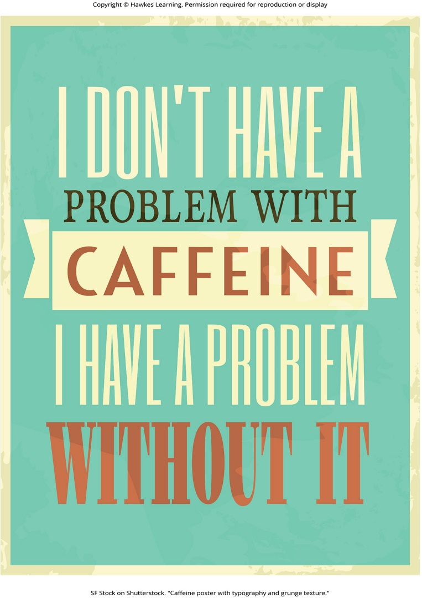
Lesson 3.5 Figure 6

Slide 33
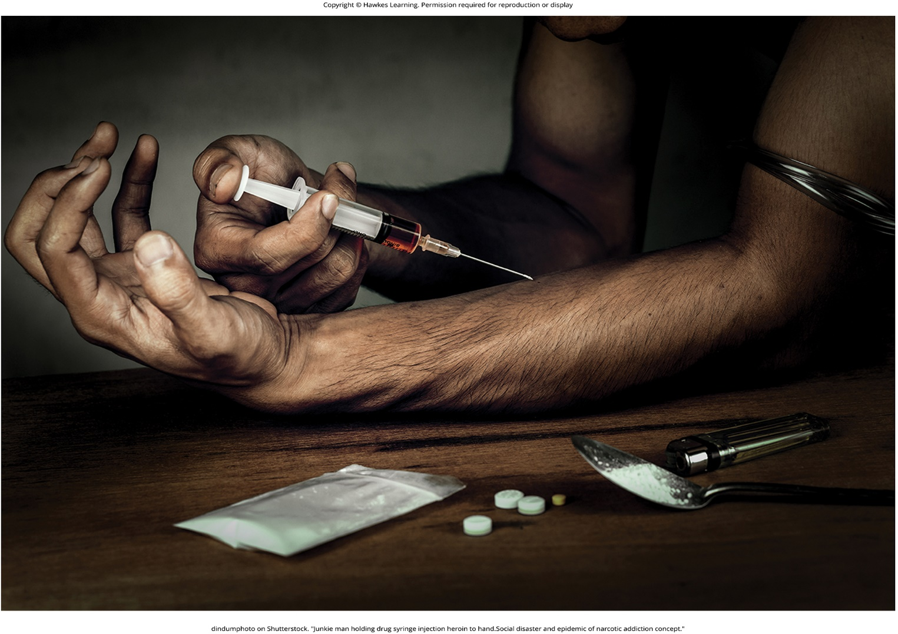
Lesson 3.5 Figure 7

Slide 34
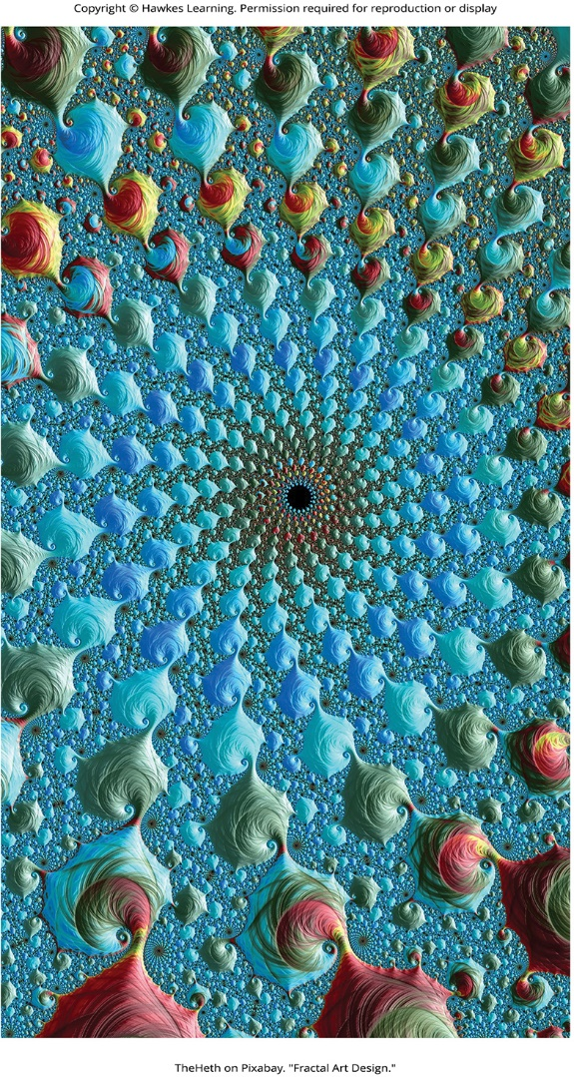
Lesson 3.5 Figure 8

Slide 35
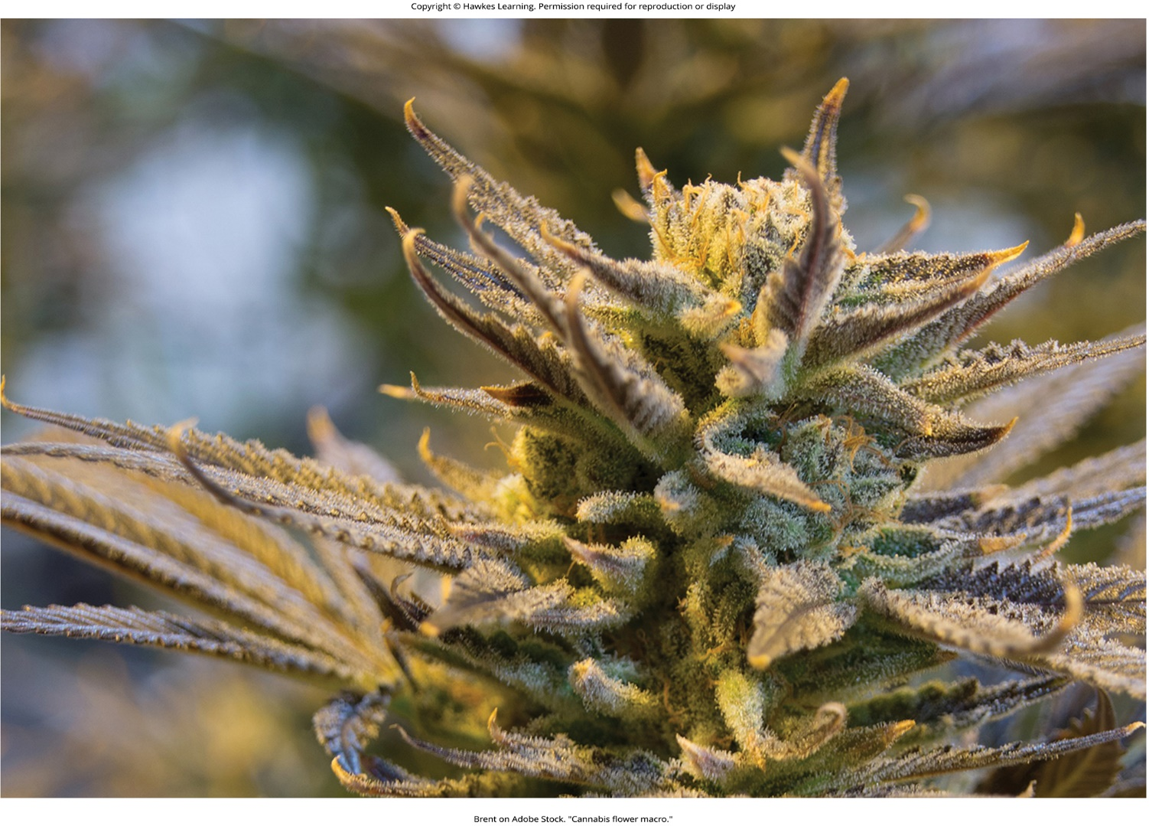
Lesson 3.5 Figure 9

Slide 36
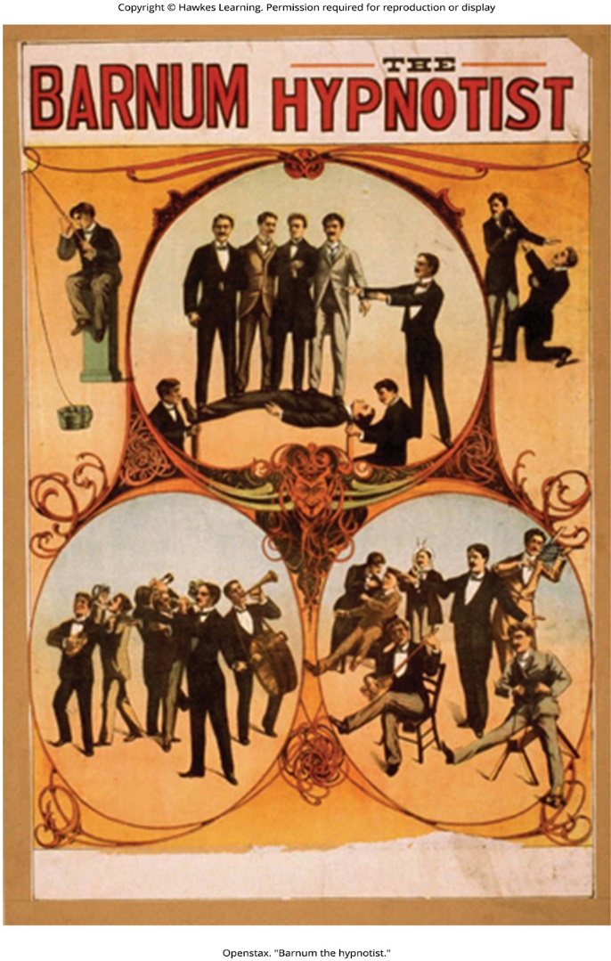
Lesson 3.6 Figure 1

Slide 37
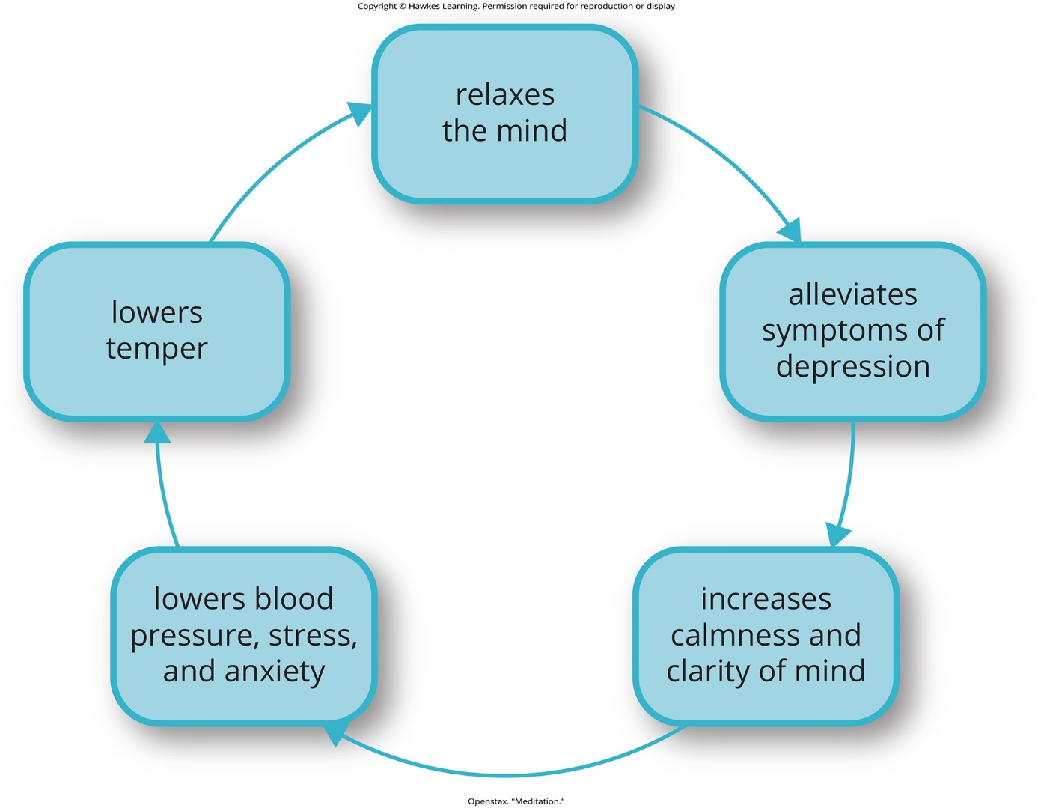
Lesson 3.6 Figure 2

Slide 38
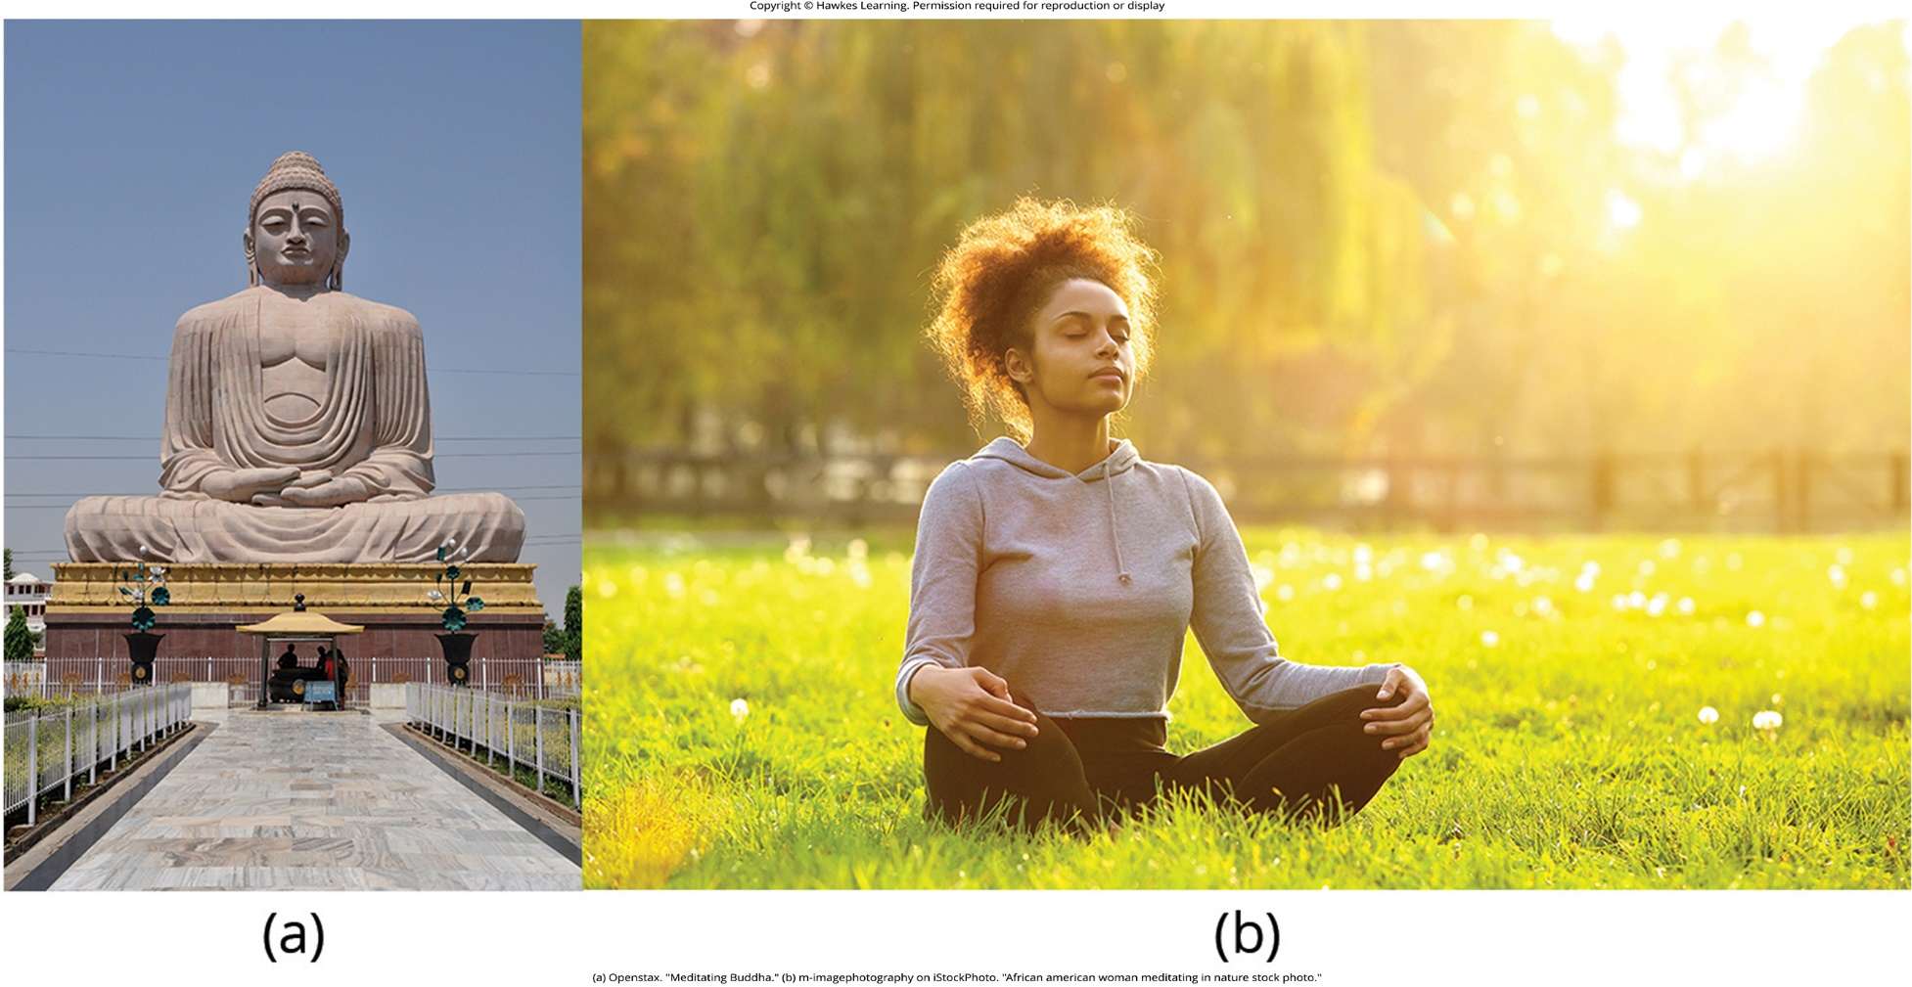
Lesson 3.6 Figure 3

Slide 39
Hawkes Learning – End of PowerPoint

