Slide 1
Chapter 4
Sensation and Perception

Slide 2
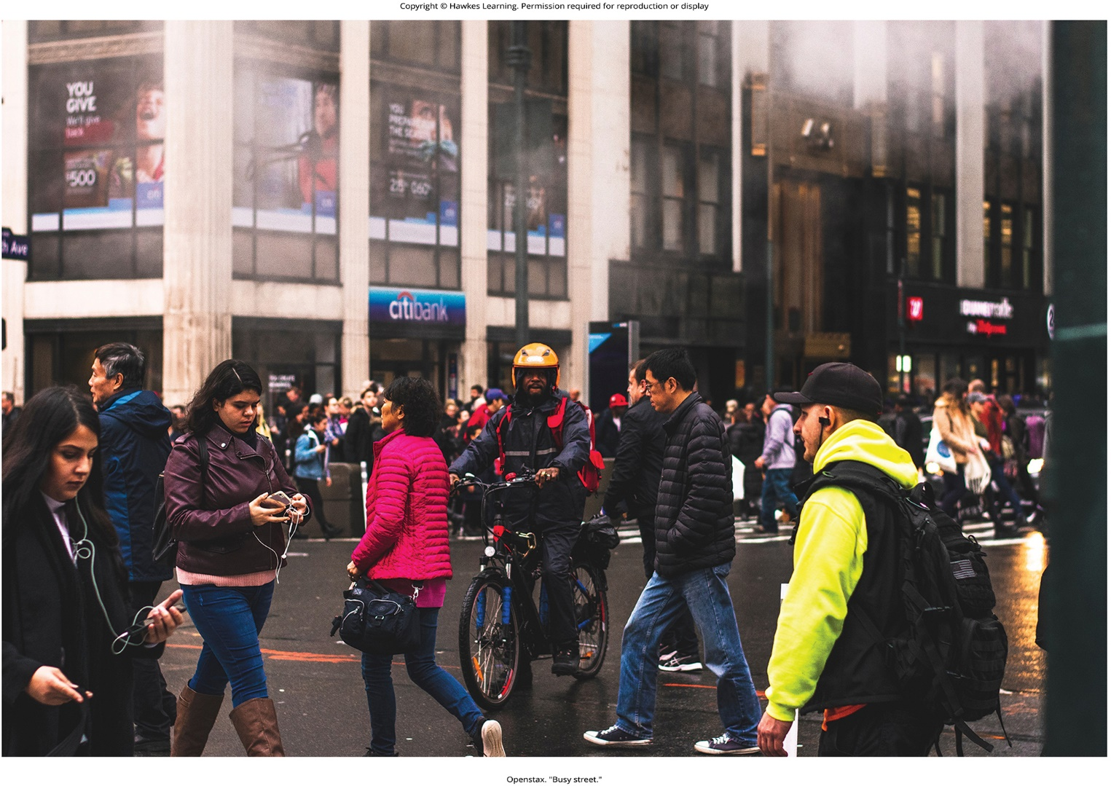
Lesson 4.1 Figure 1

Slide 3

Lesson 4.1 Figure 2

Slide 4

Lesson 4.1 Figure 3

Slide 5
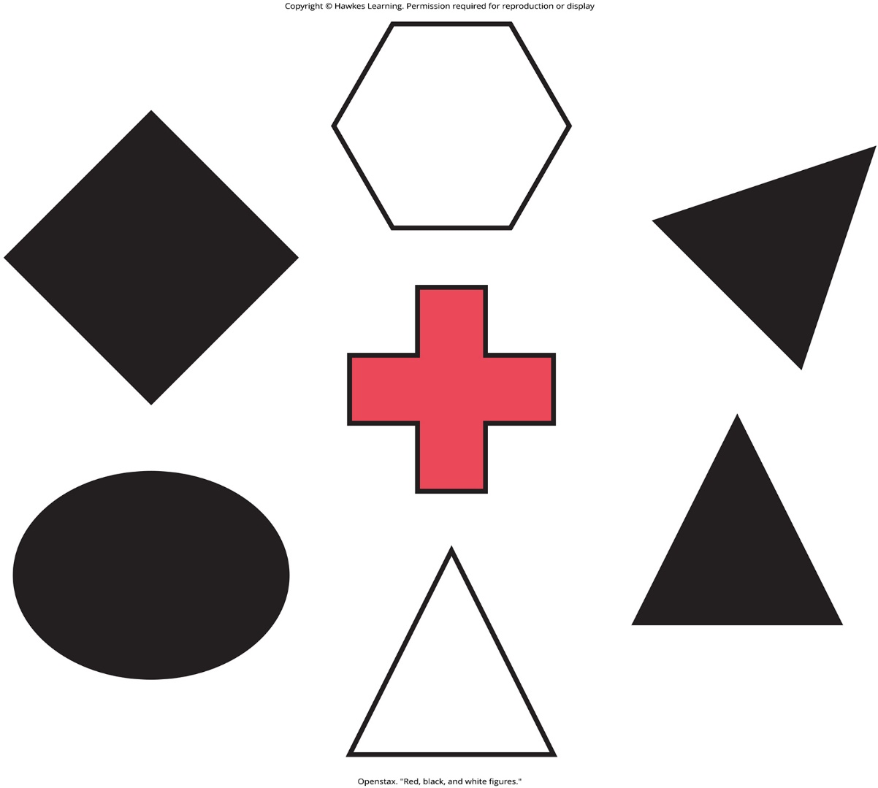
Lesson 4.1 Figure 4

Slide 6
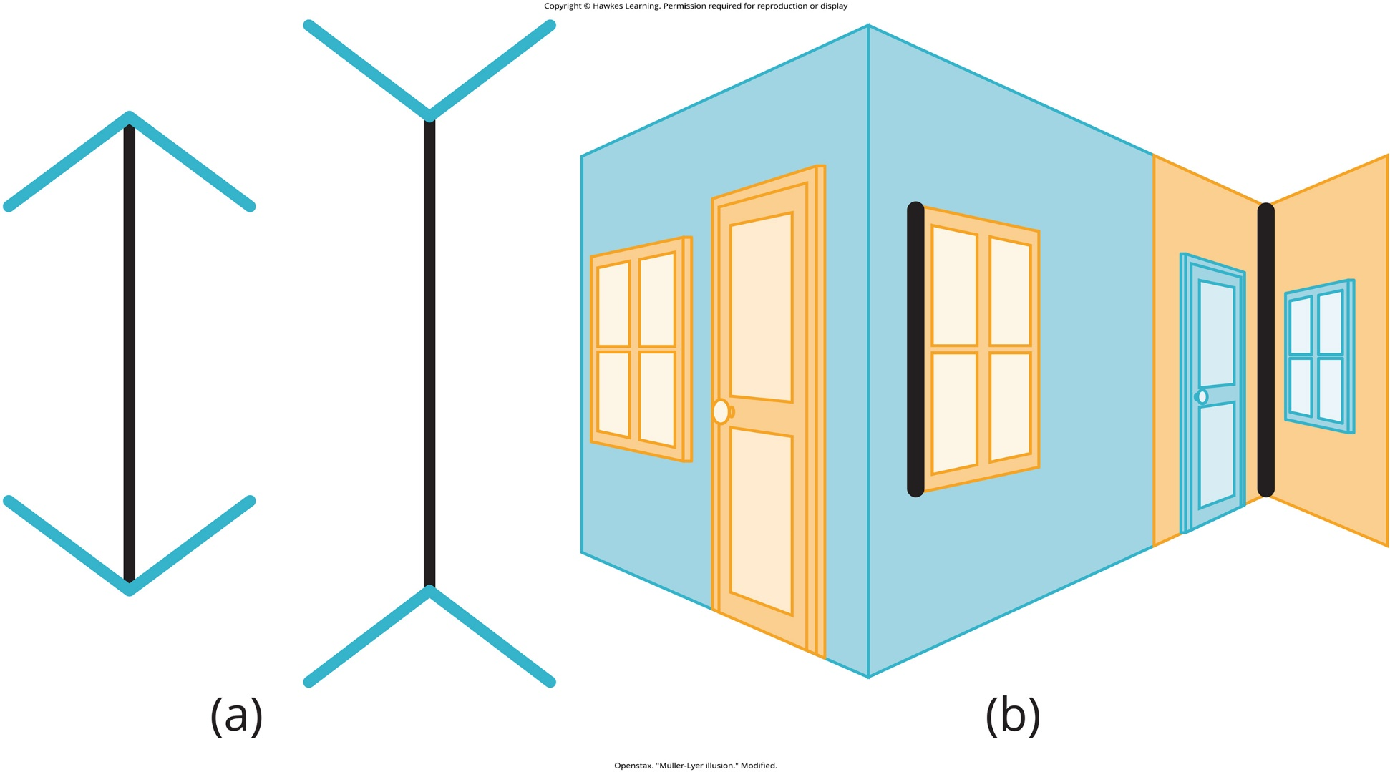
Lesson 4.1 Figure 5

Slide 7

Lesson 4.1 Perception

Slide 8
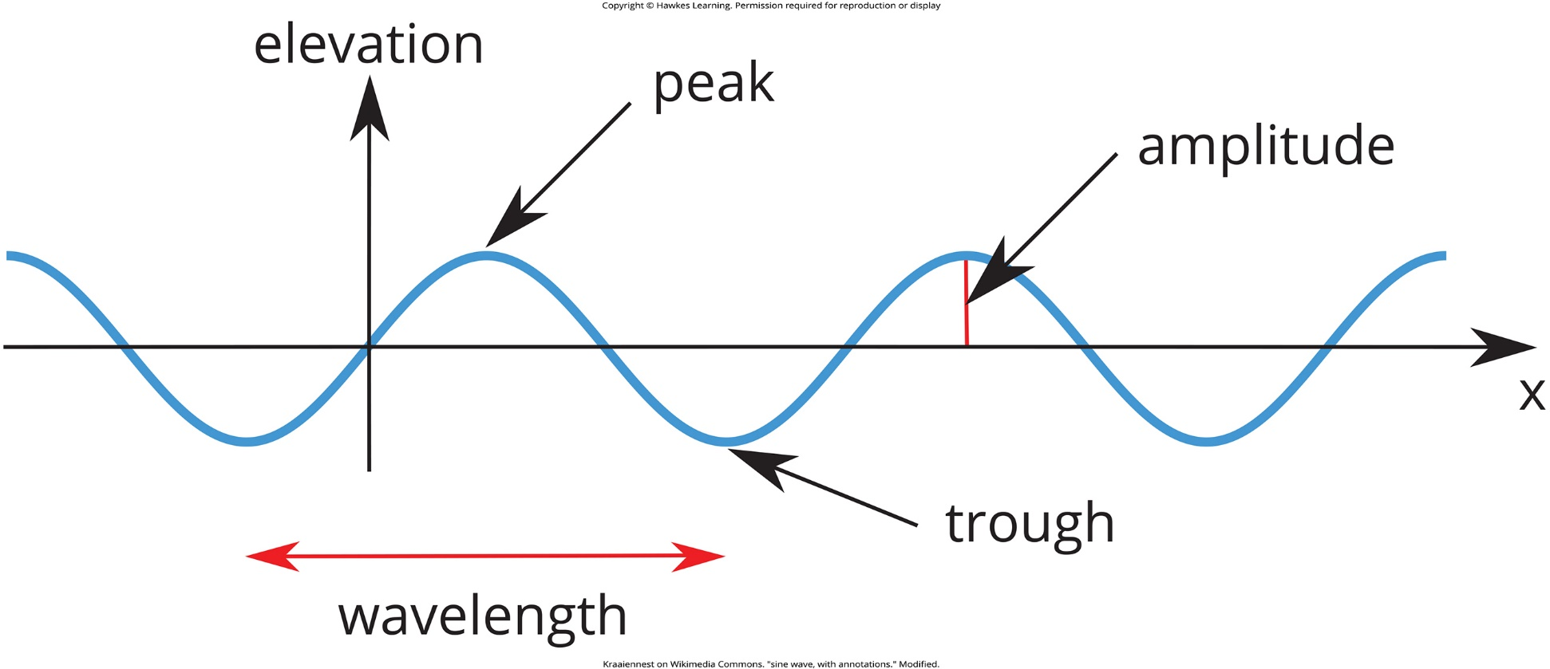
Lesson 4.2 Figure 1

Slide 9
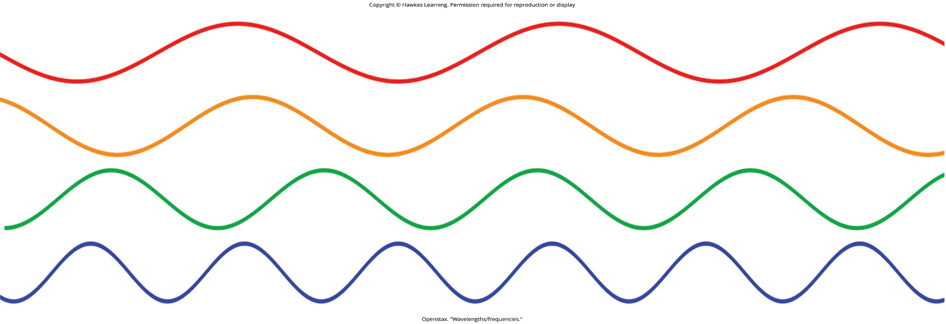
Lesson 4.2 Figure 2

Slide 10
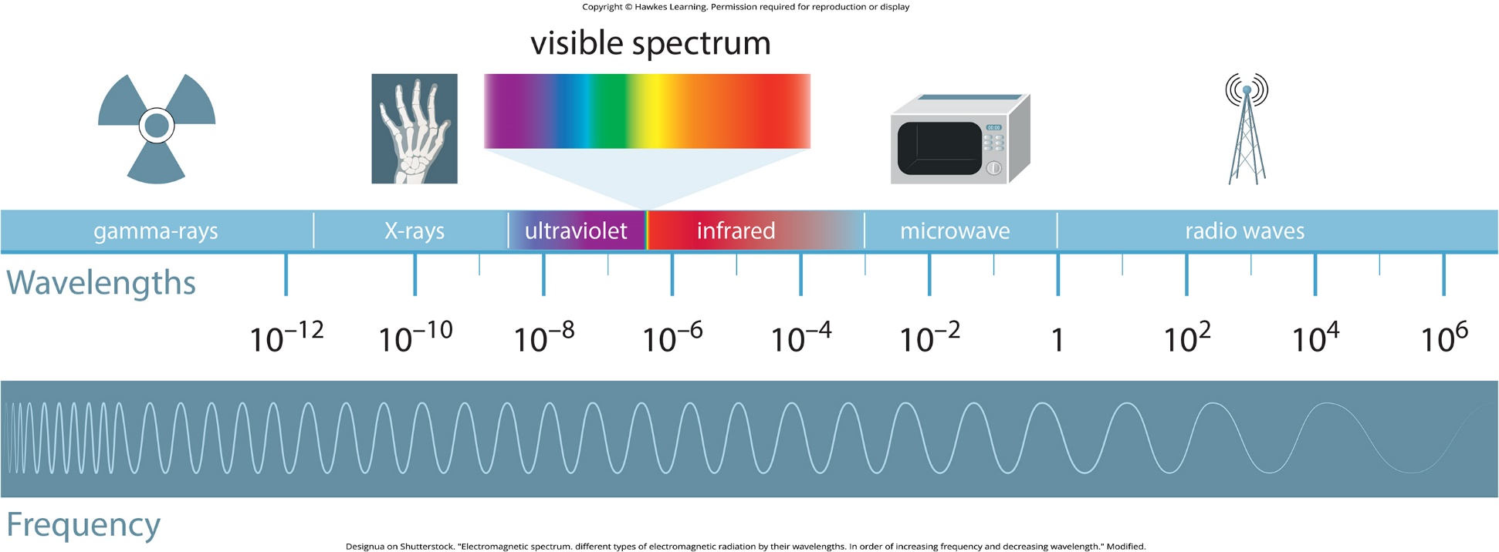
Lesson 4.2 Figure 3

Slide 11
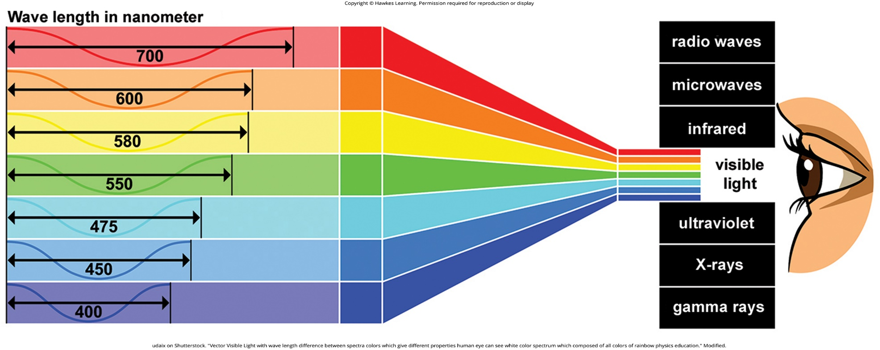
Lesson 4.2 Figure 4

Slide 12
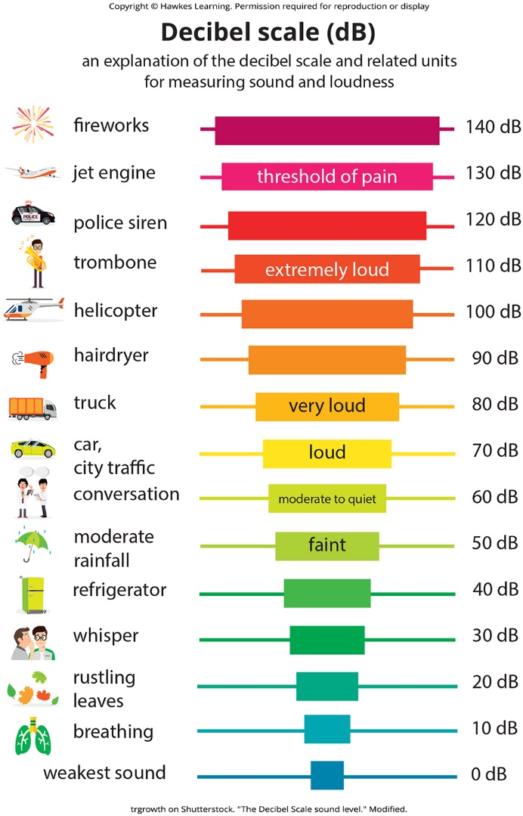
Lesson 4.2 Figure 5

Slide 13
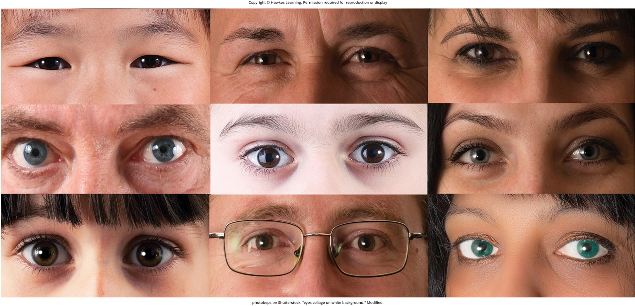
Lesson 4.3 Figure 1

Slide 14
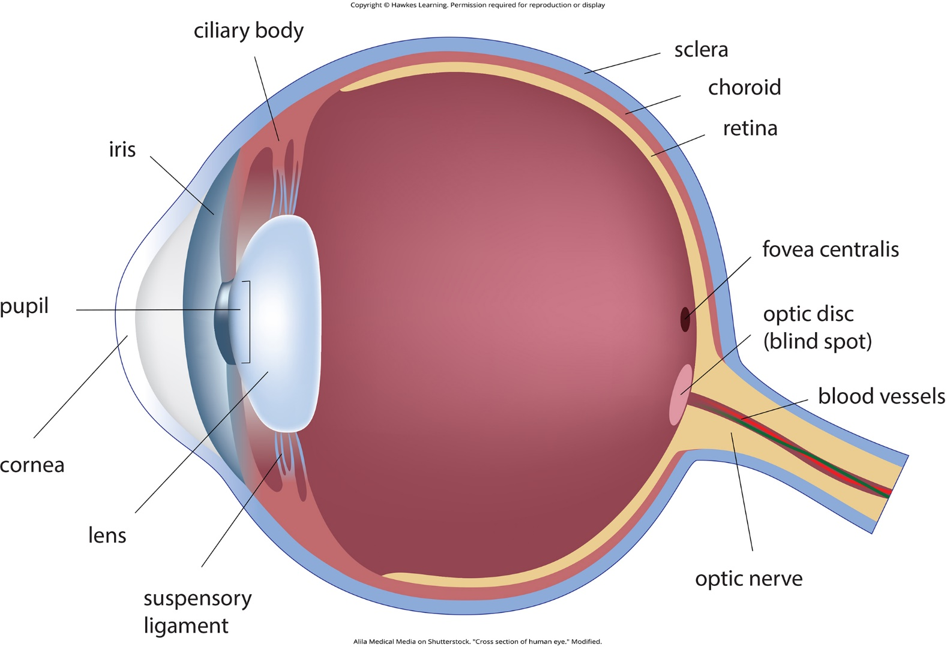
Lesson 4.3 Figure 2

Slide 15
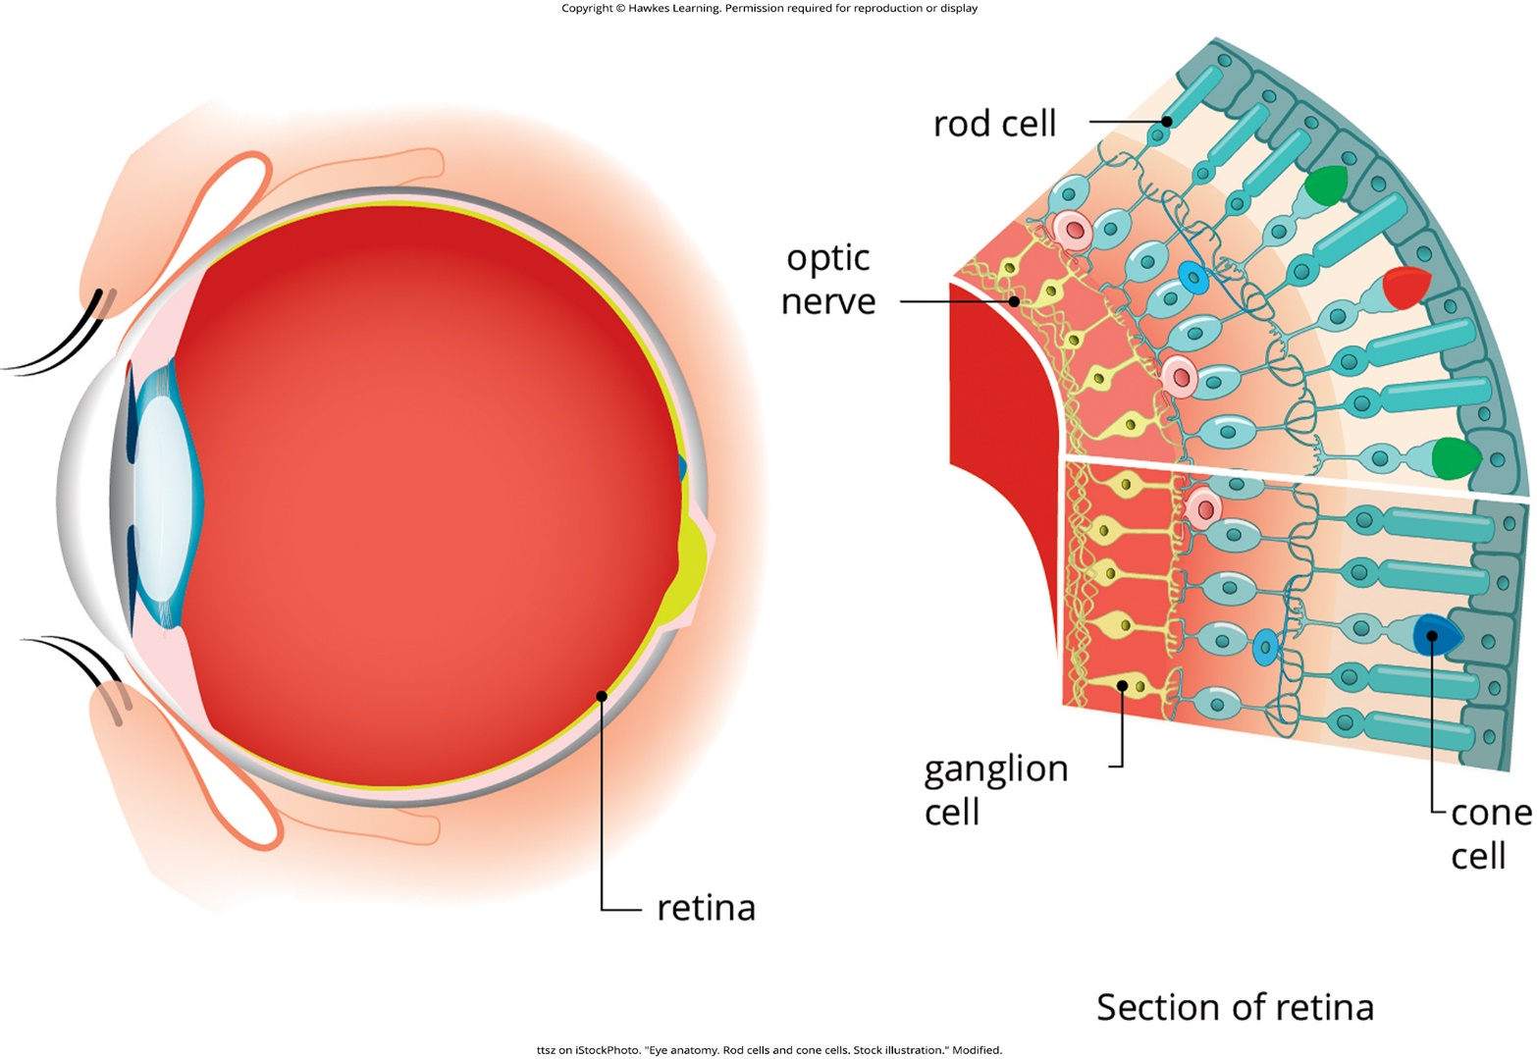
Lesson 4.3 Figure 3

Slide 16
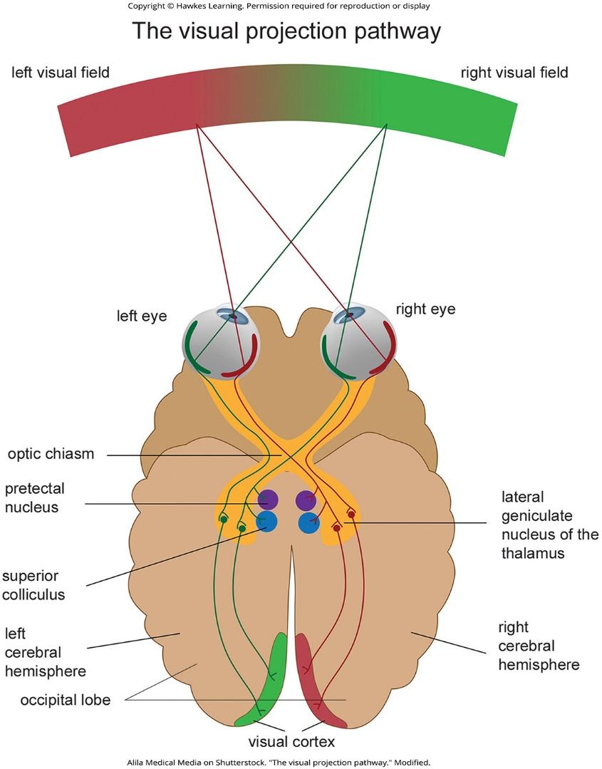
Lesson 4.3 Figure 4

Slide 17
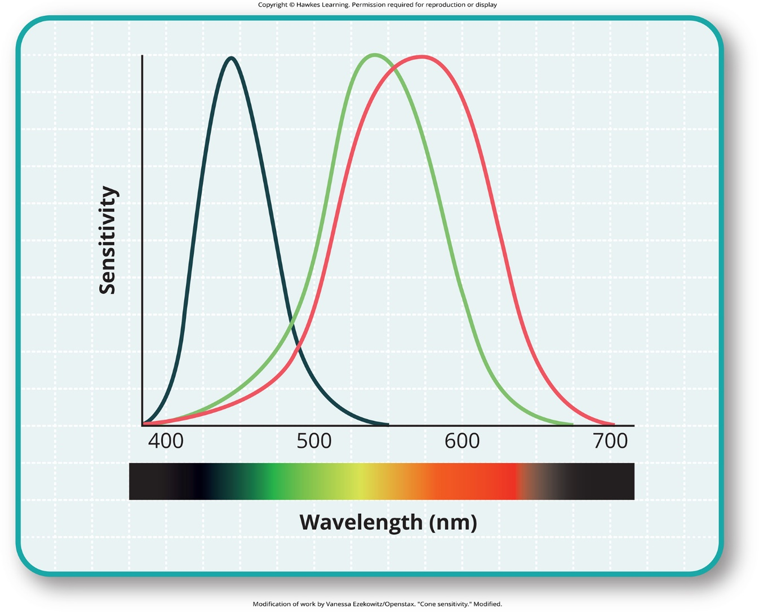
Lesson 4.3 Figure 5

Slide 18
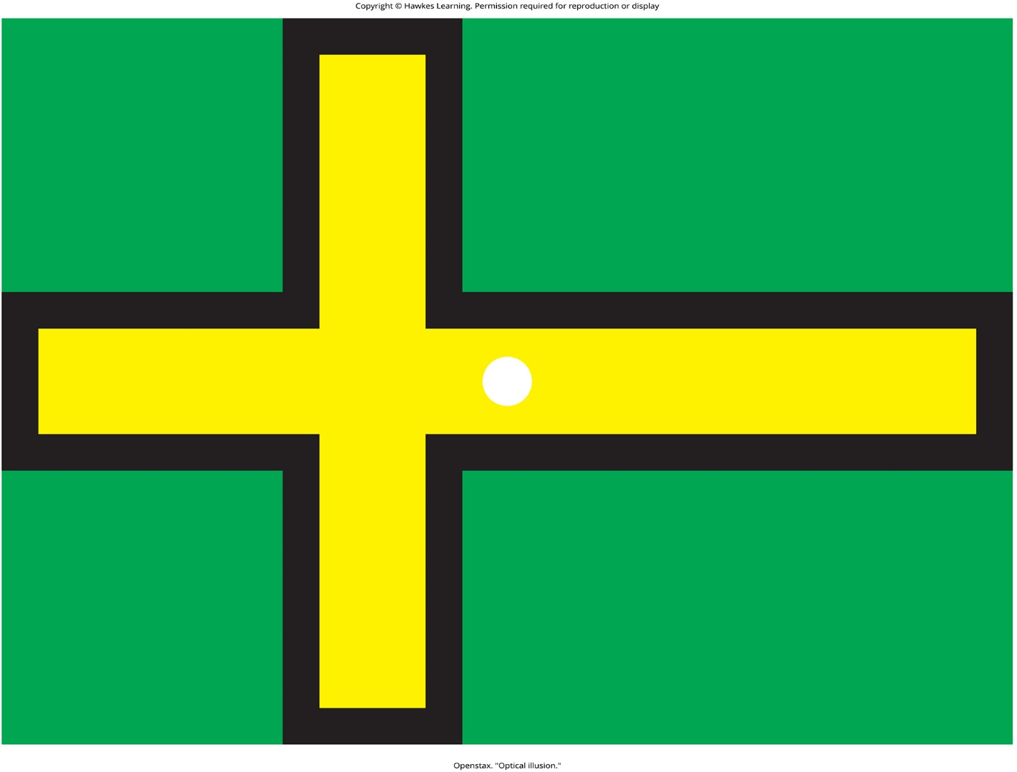
Lesson 4.3 Figure 6

Slide 19
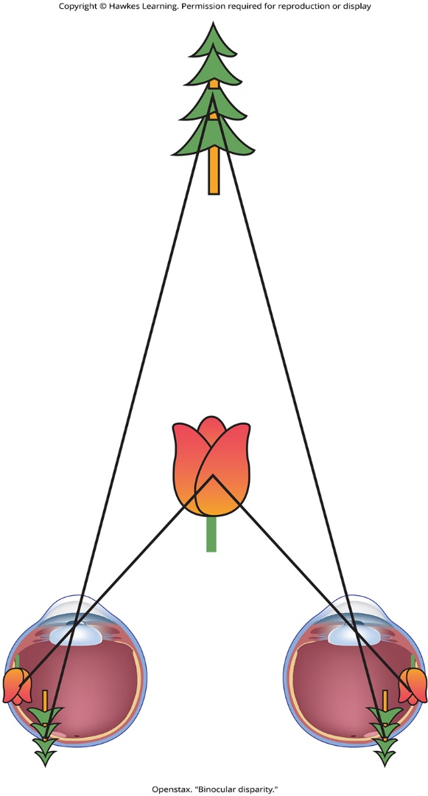
Lesson 4.3 Figure 7

Slide 20
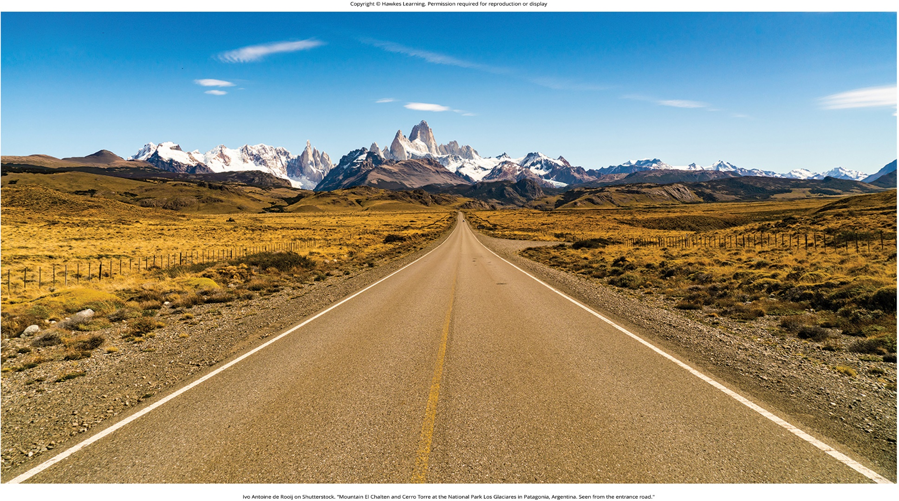
Lesson 4.3 Figure 8

Slide 21
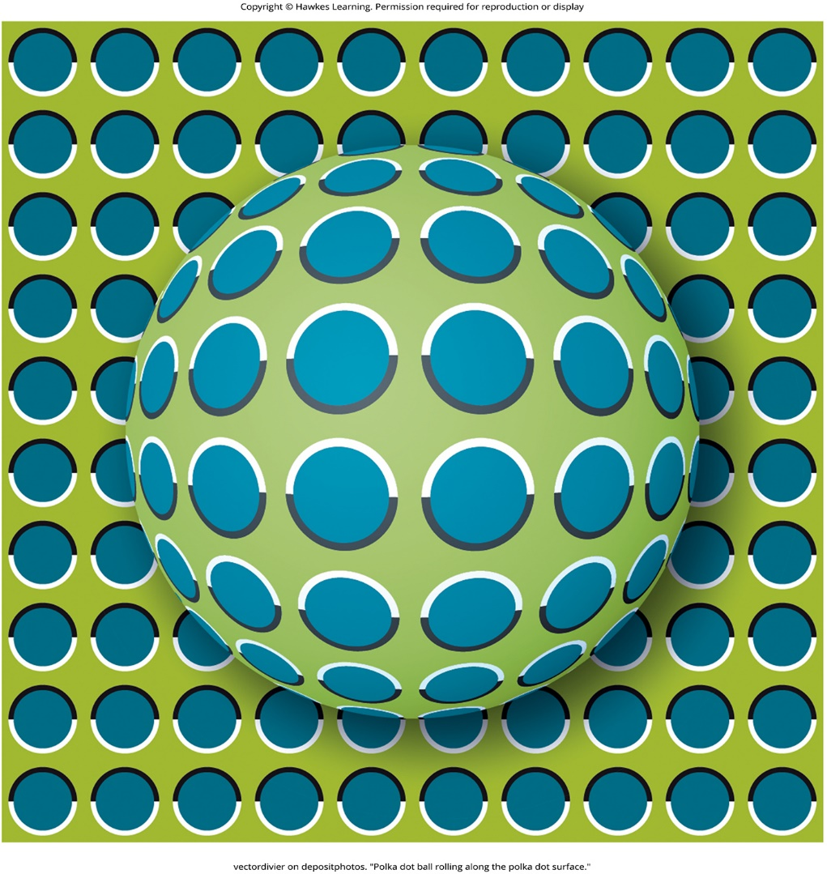
Lesson 4.3 Figure 9

Slide 22
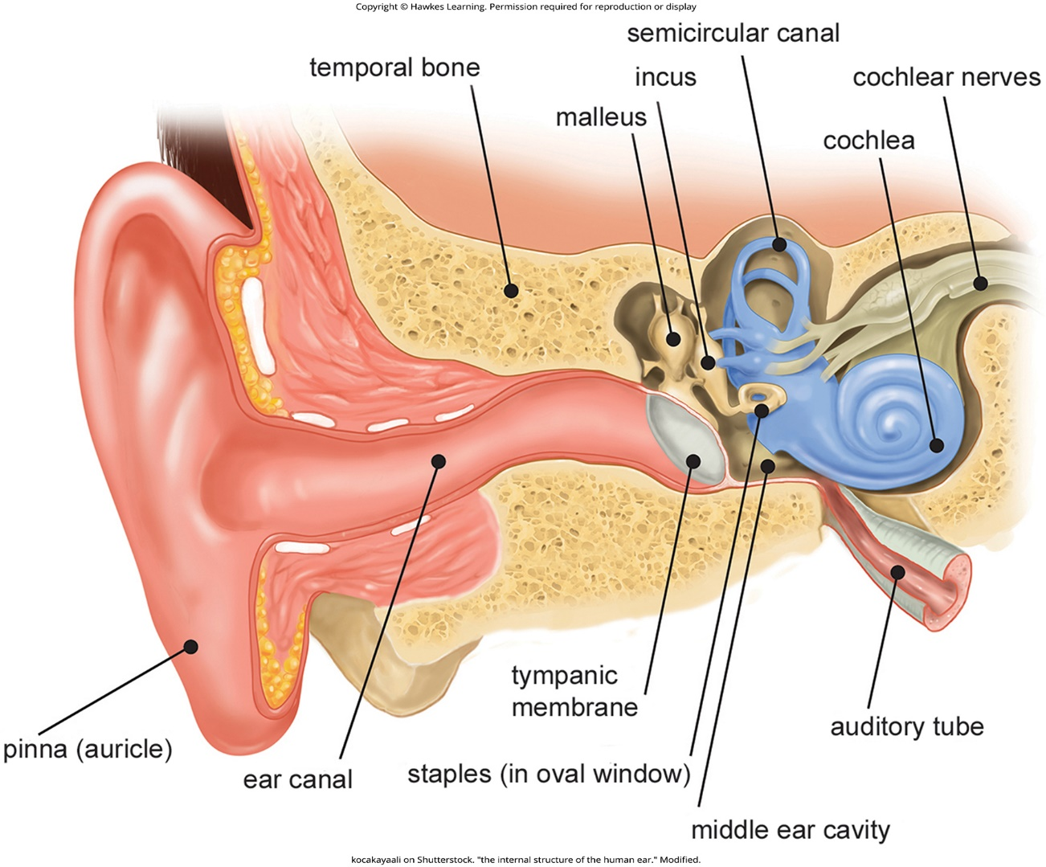
Lesson 4.4 Figure 1

Slide 23
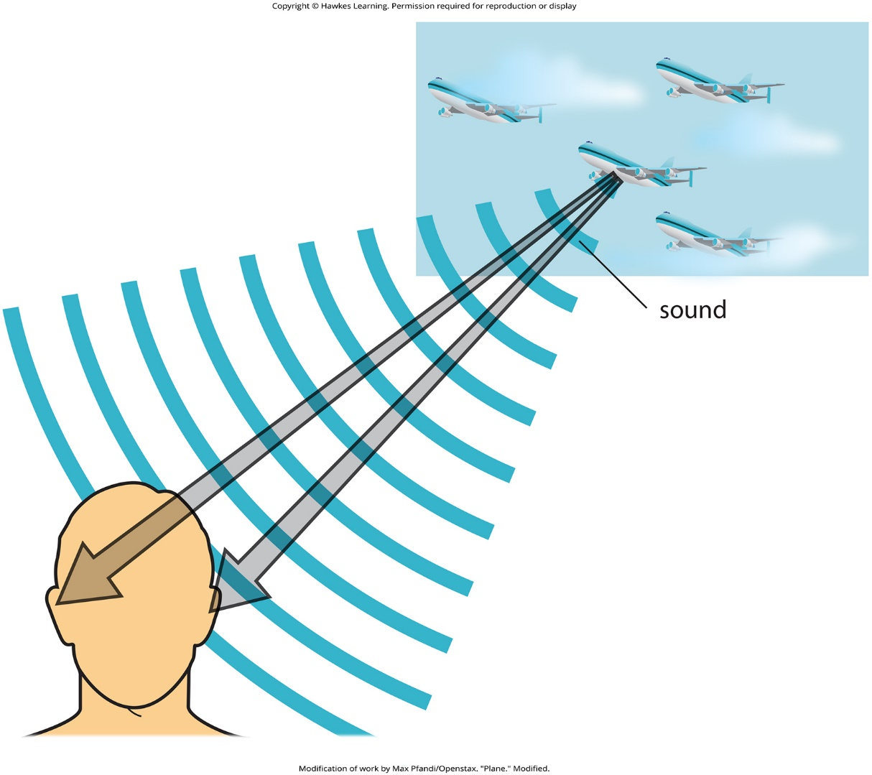
Lesson 4.4 Figure 2

Slide 24
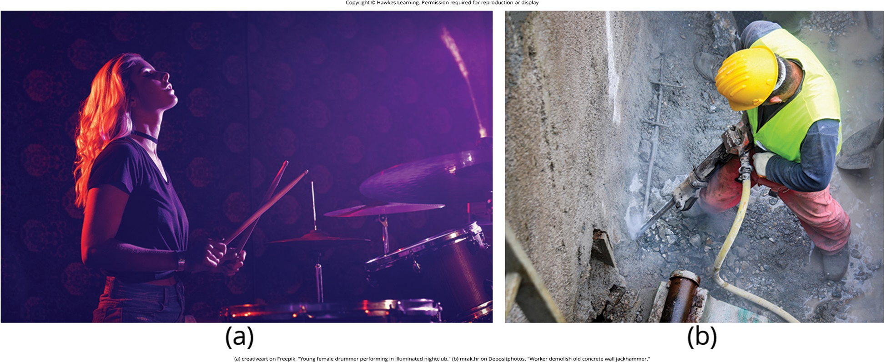
Lesson 4.4 Figure 3

Slide 25
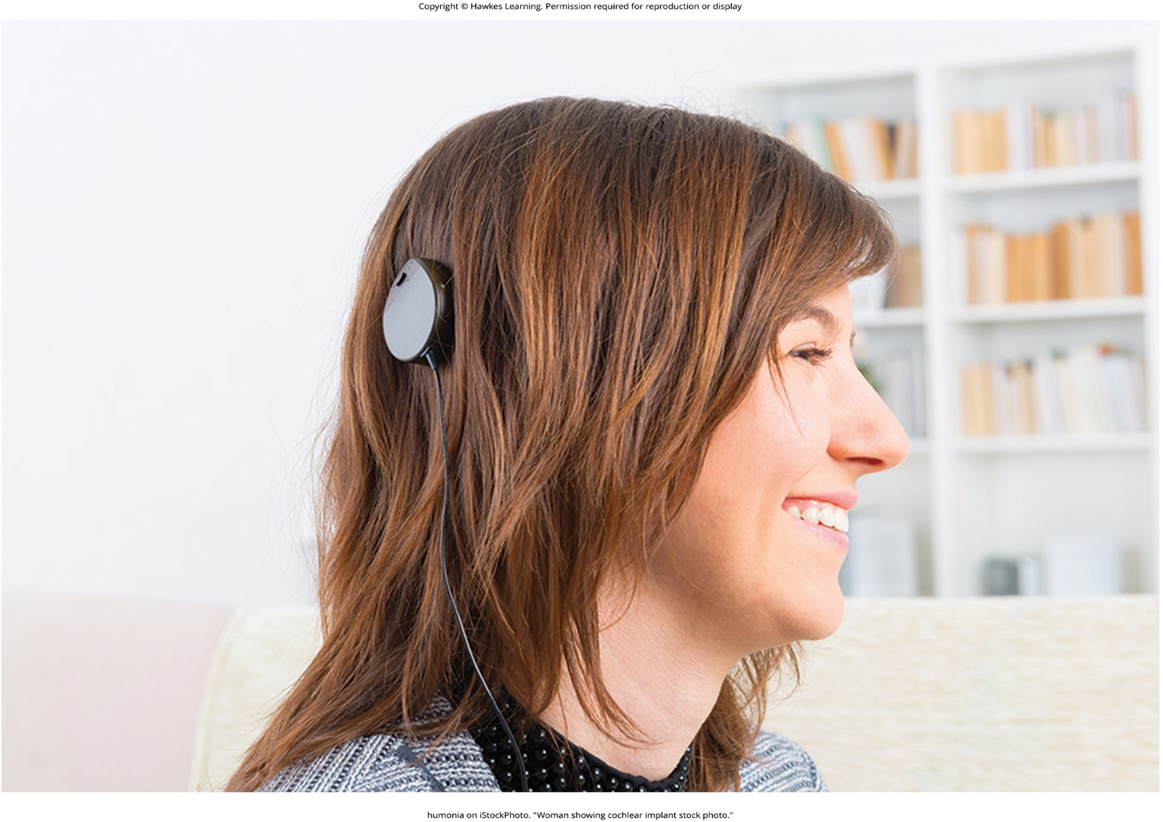
Lesson 4.4 Figure 4

Slide 26
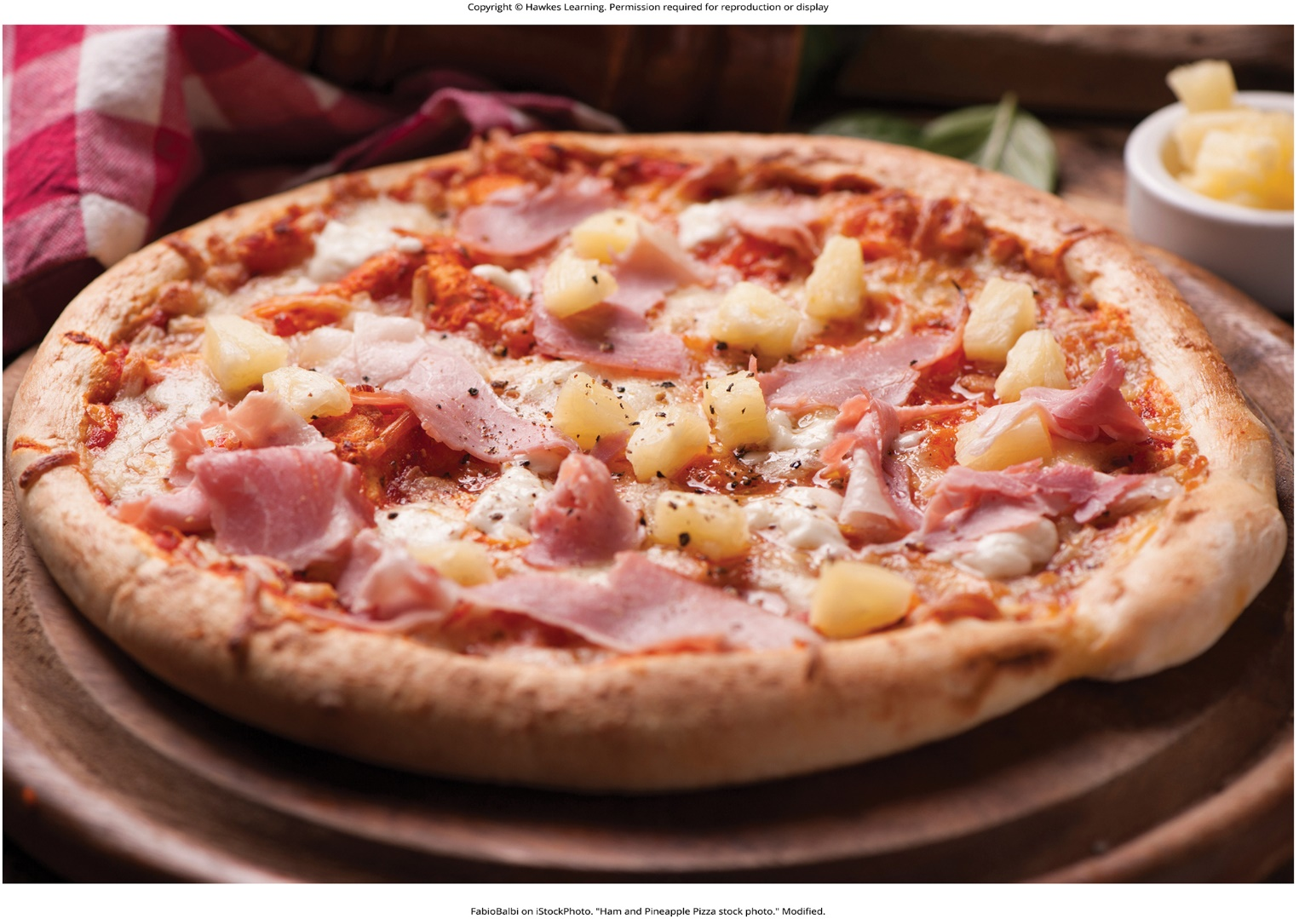
Lesson 4.5 Figure 1

Slide 27
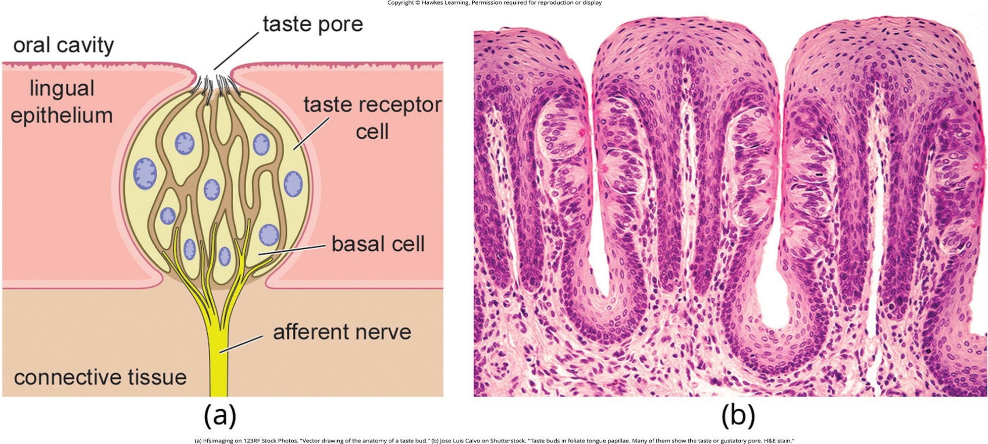
Lesson 4.5 Figure 2

Slide 28
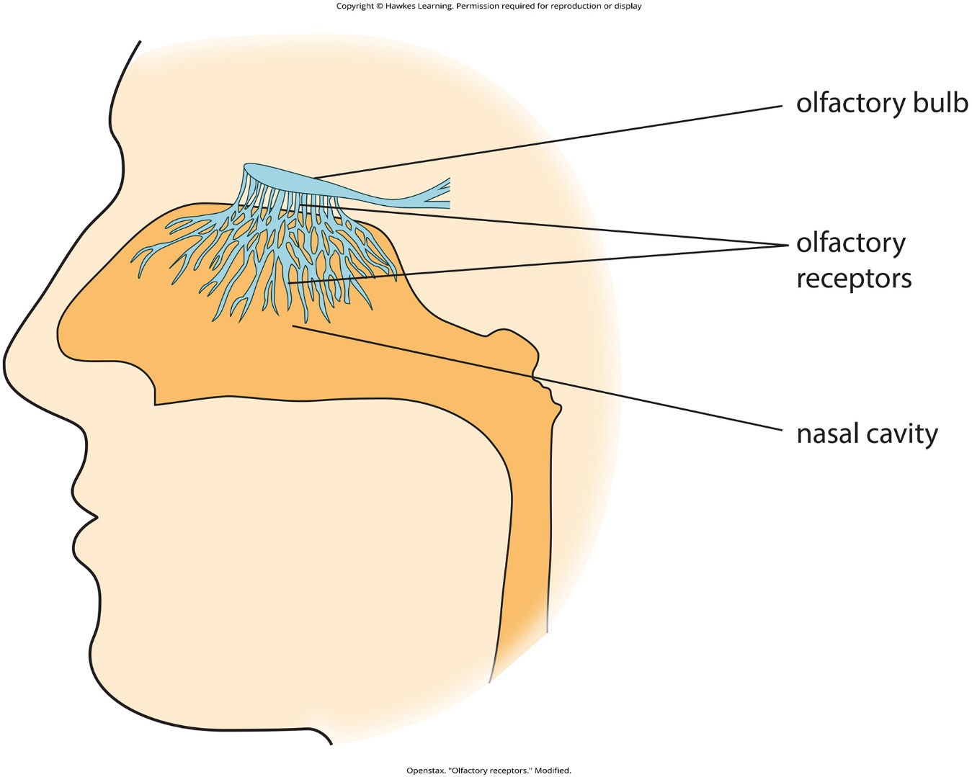
Lesson 4.5 Figure 3

Slide 29
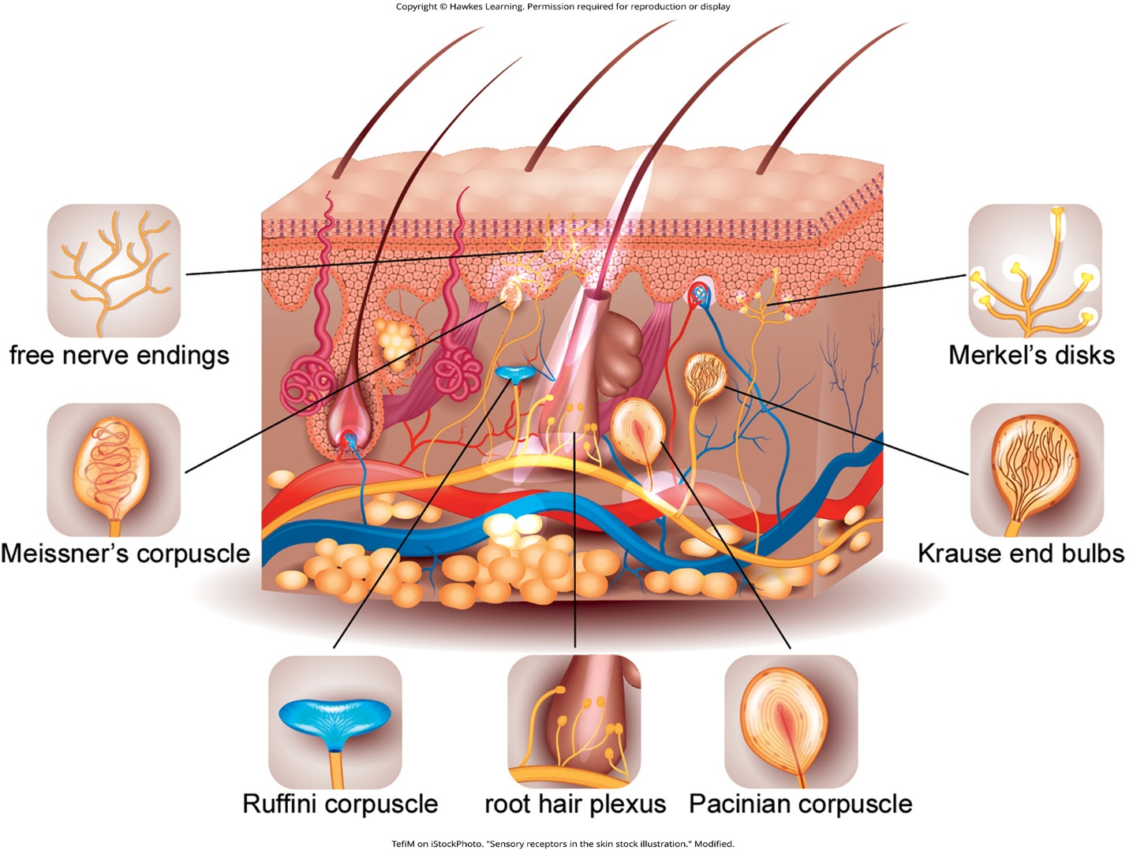
Lesson 4.5 Figure 4

Slide 30
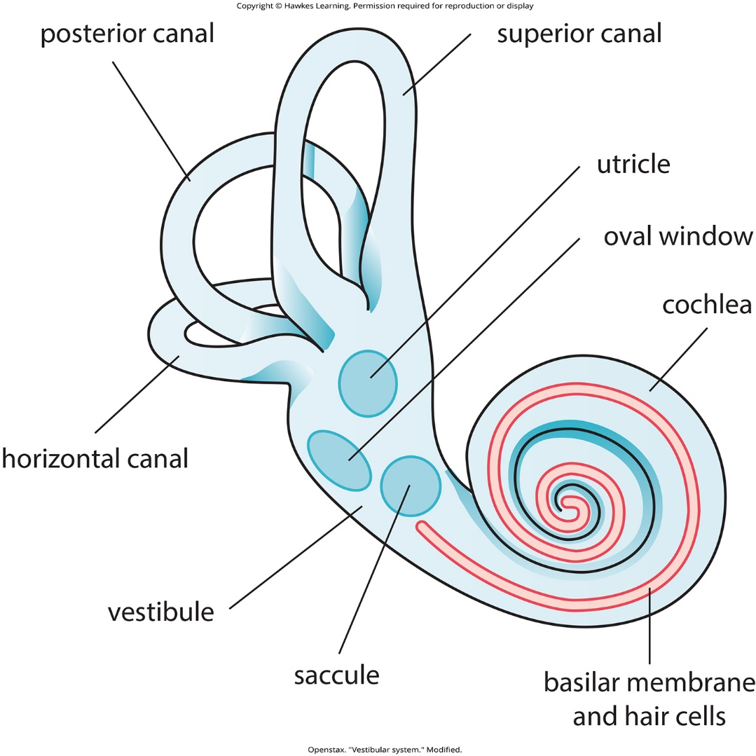
Lesson 4.5 Figure 5

Slide 31
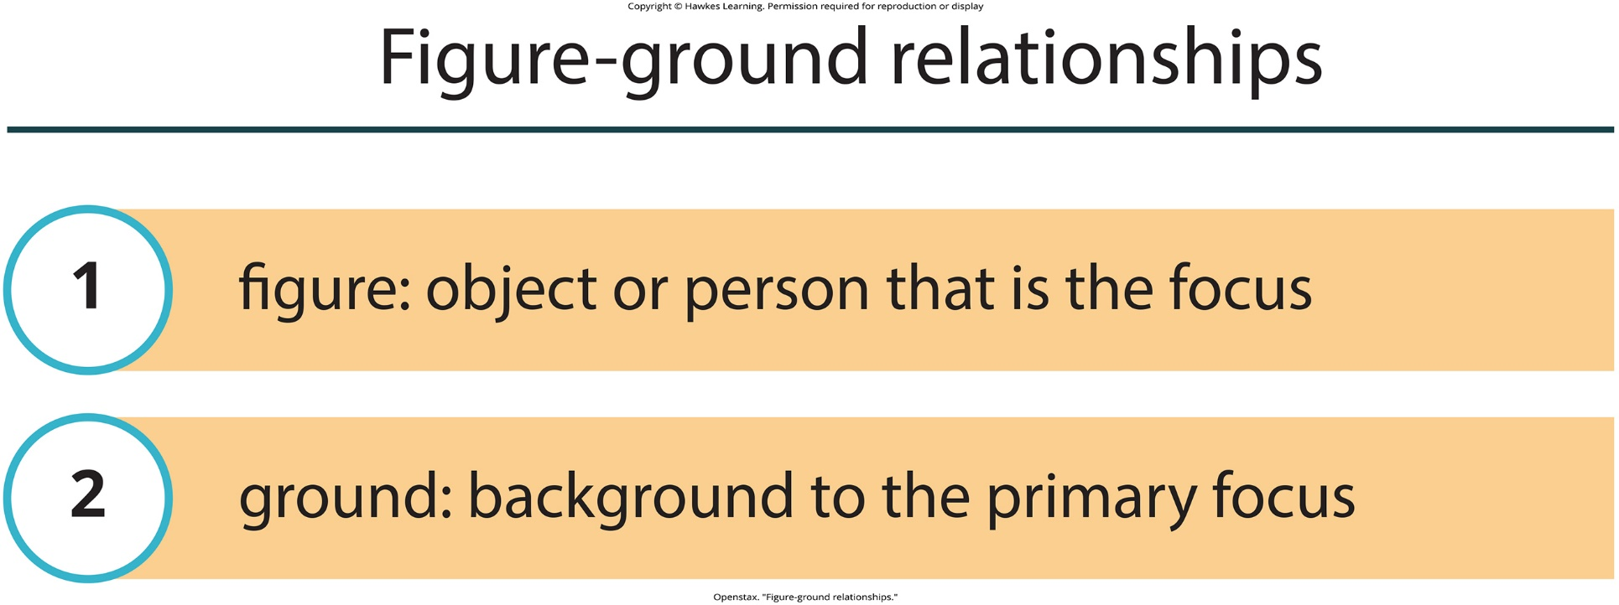
Lesson 4.6 Figure 1

Slide 32

Lesson 4.6 Figure 2

Slide 33
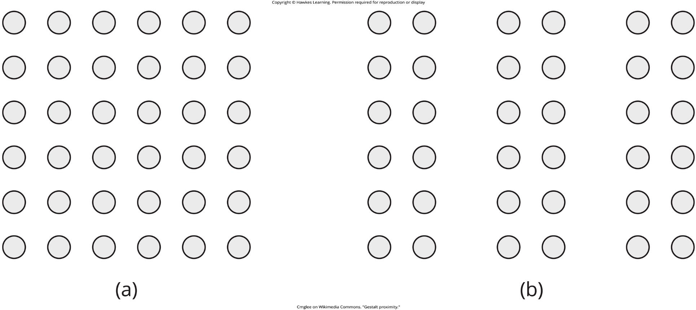
Lesson 4.6 Figure 3

Slide 34
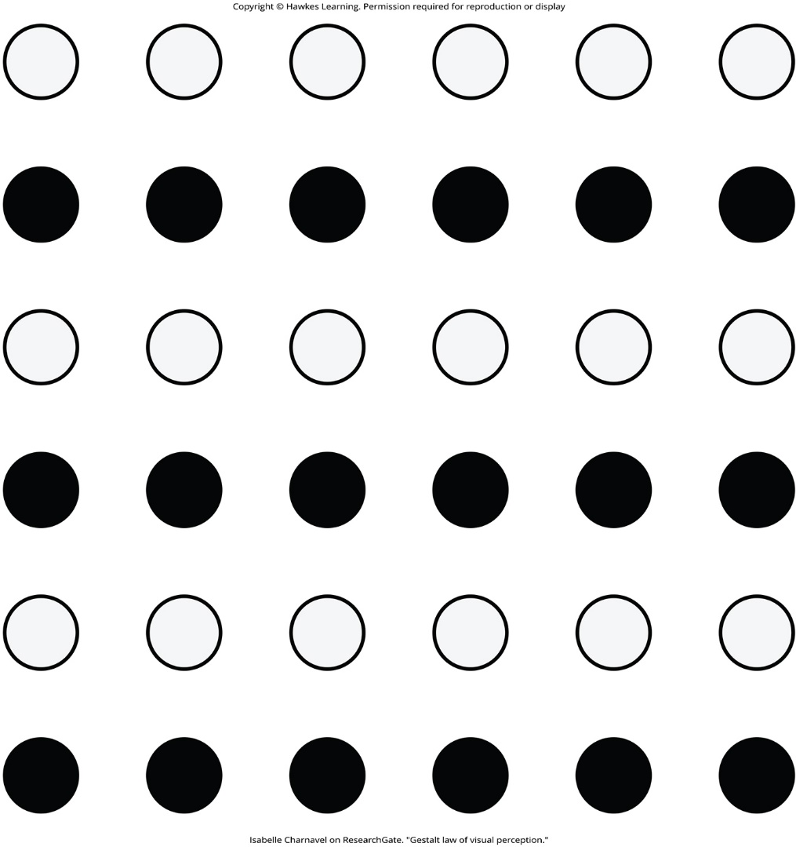
Lesson 4.6 Figure 4

Slide 35
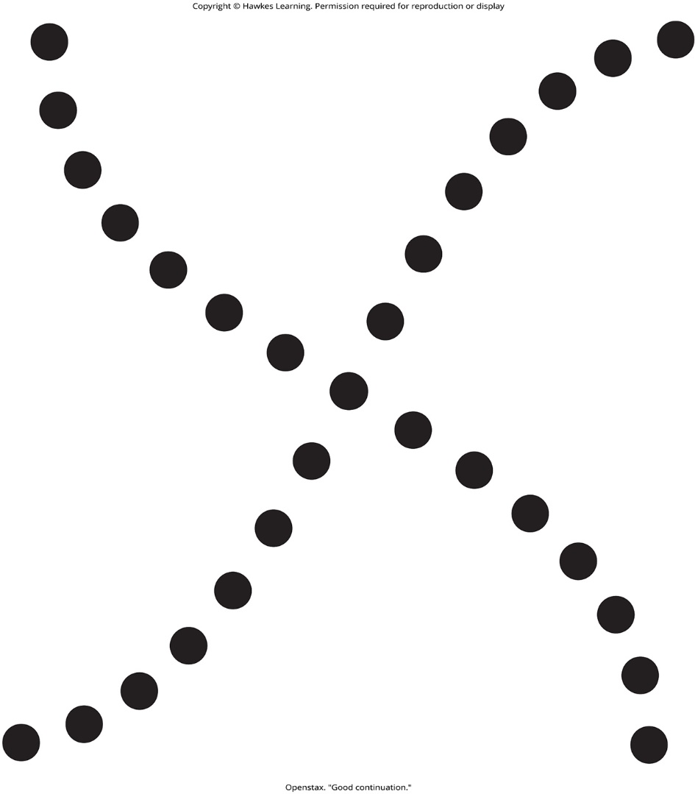
Lesson 4.6 Figure 5

Slide 36
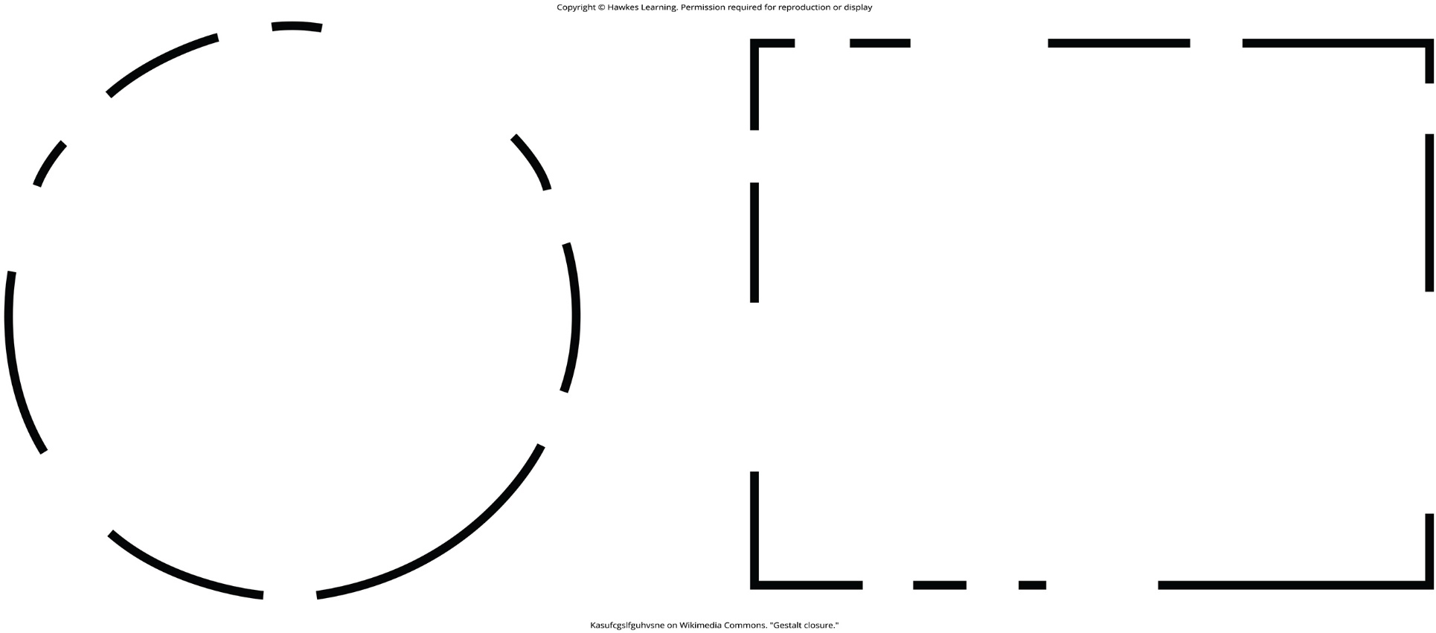
Lesson 4.6 Figure 6

Slide 37
Hawkes Learning – End of PowerPoint

