Slide 1
Chapter 5
Learning

Slide 2
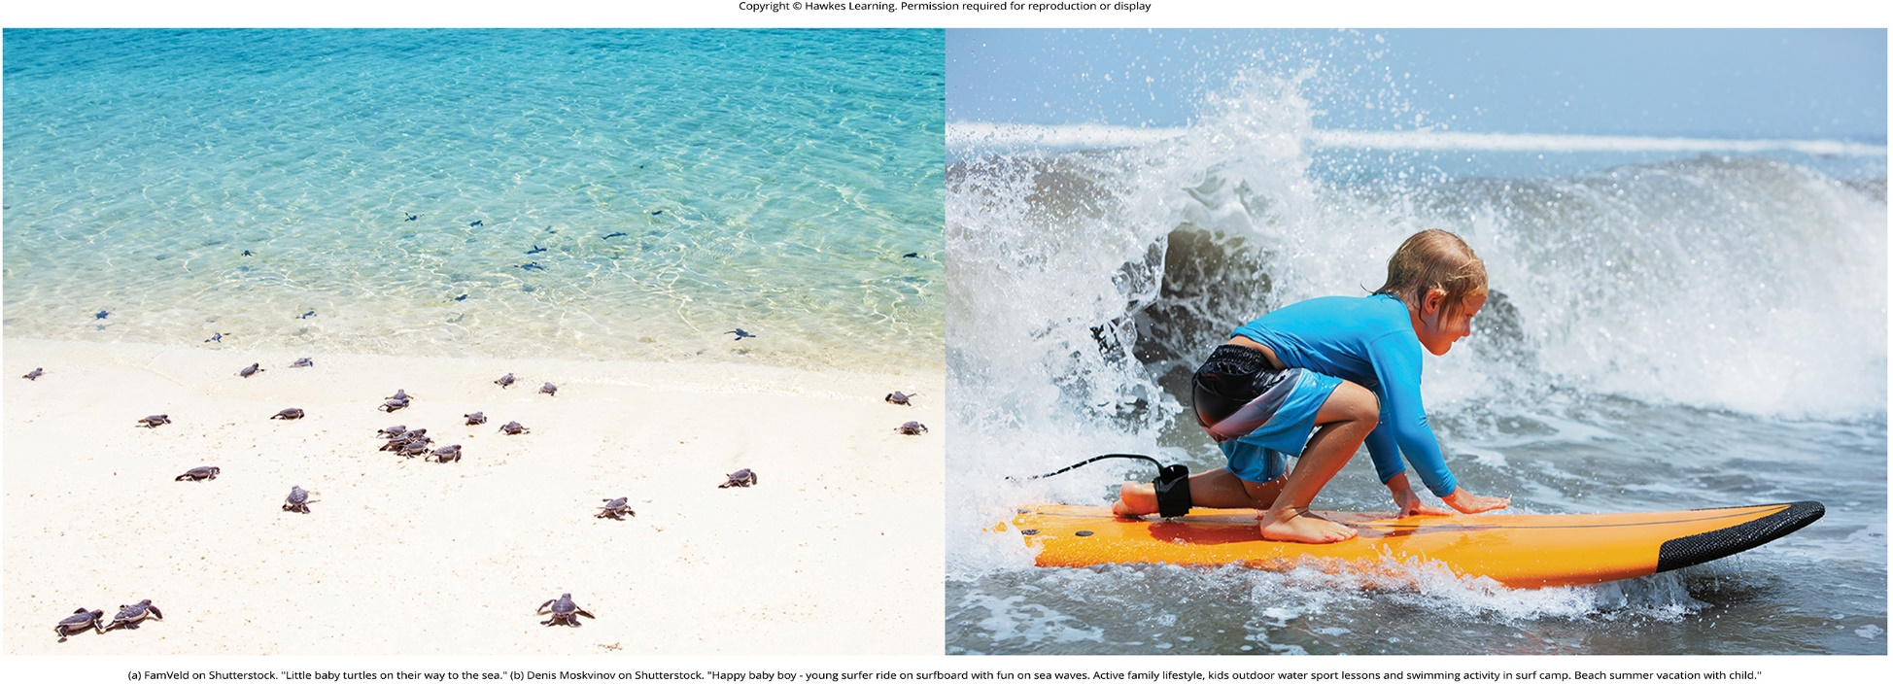
Lesson 5.1 Figure 1

Slide 3
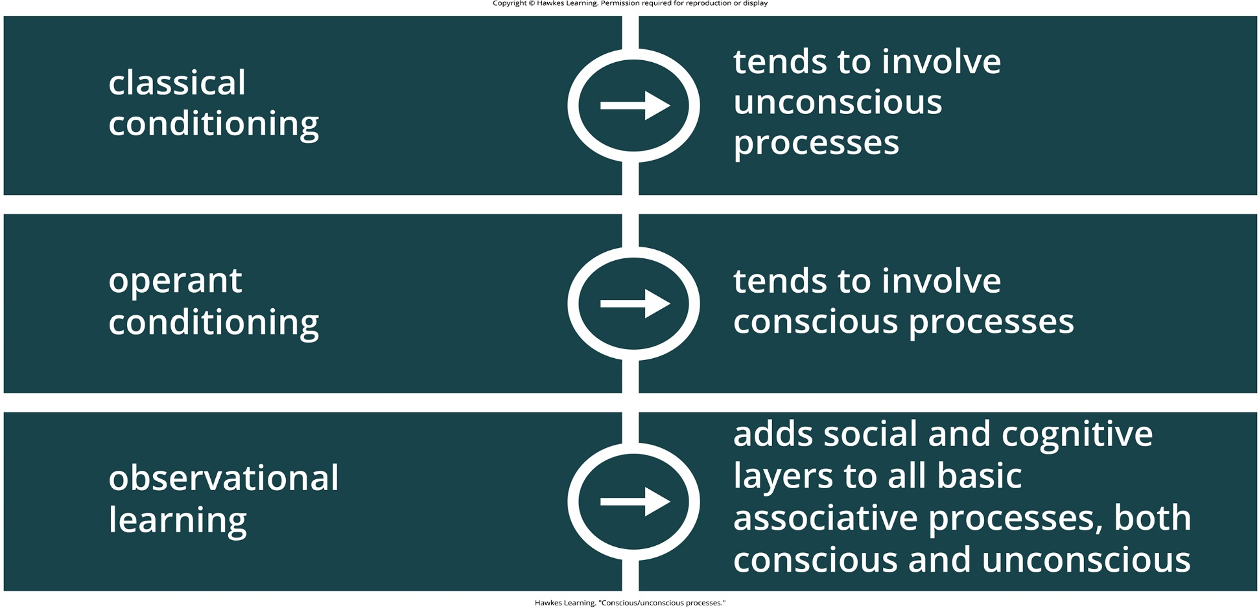
Lesson 5.1 Figure 2

Slide 4
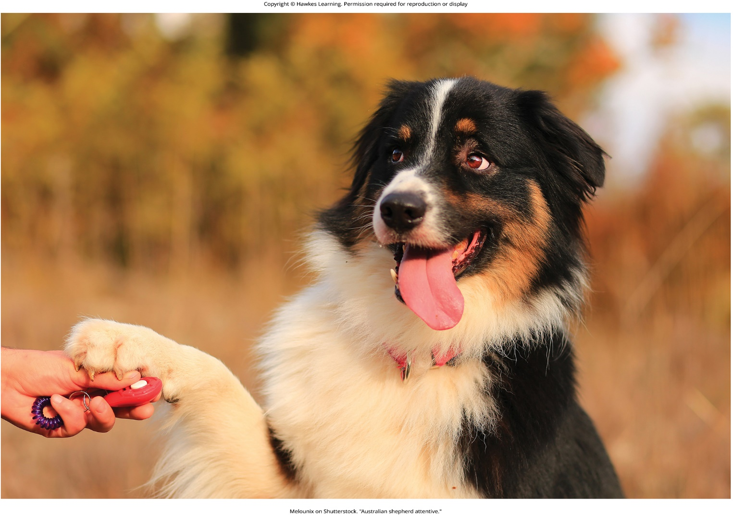
Lesson 5.1 Figure 3

Slide 5
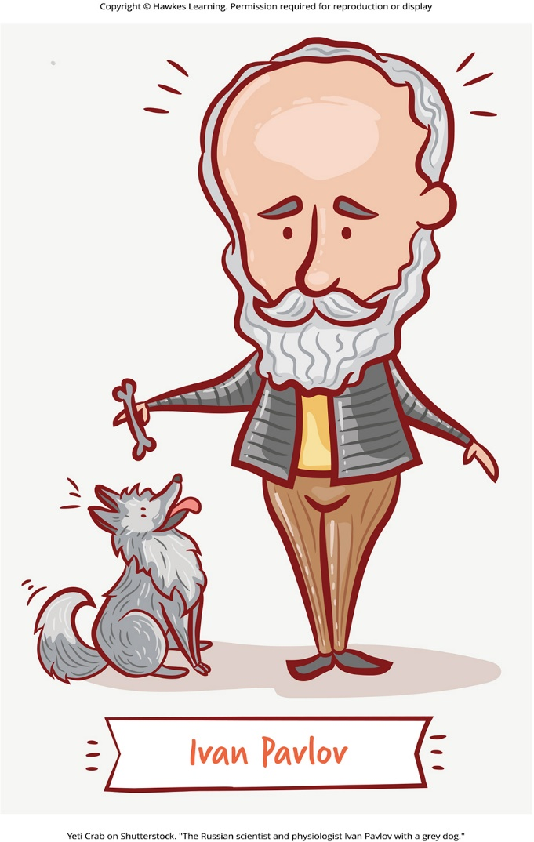
Lesson 5.2 Figure 1

Slide 6
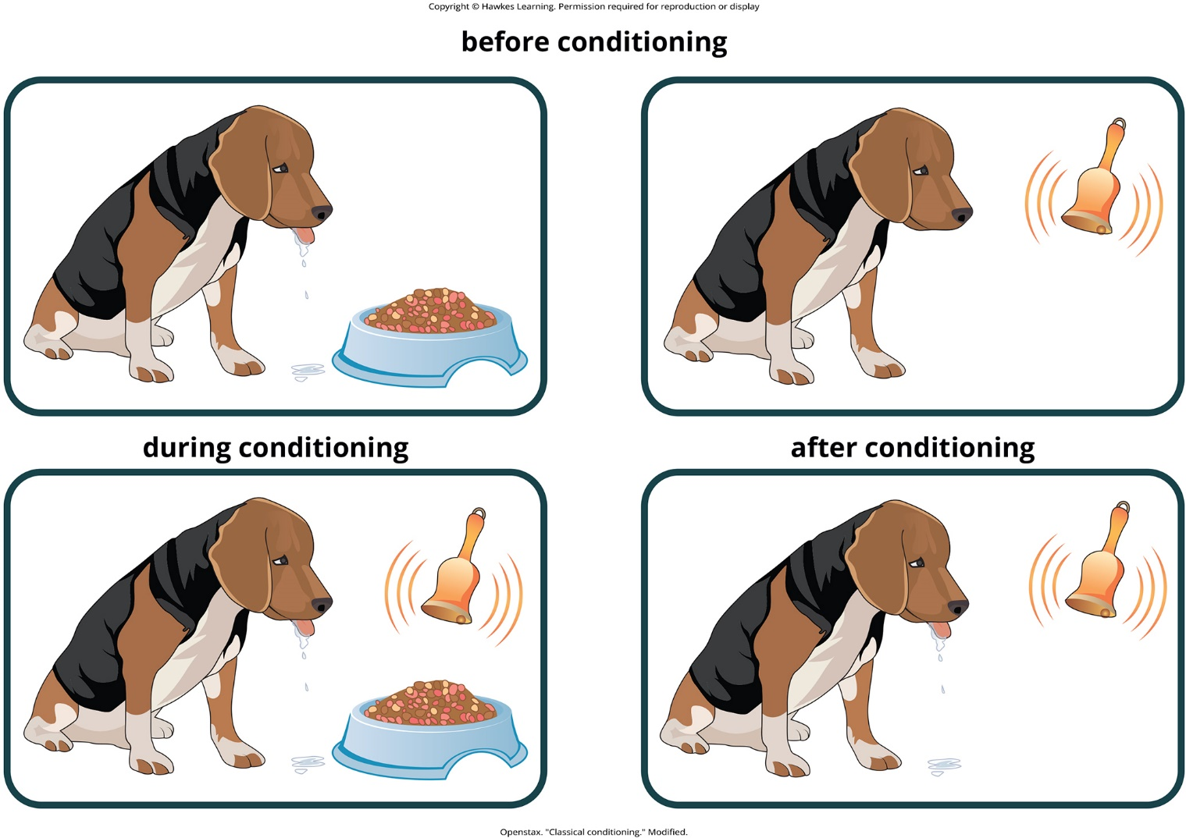
Lesson 5.2 Figure 2

Slide 7

Lesson 5.2 Pavlov’s Work

Slide 8
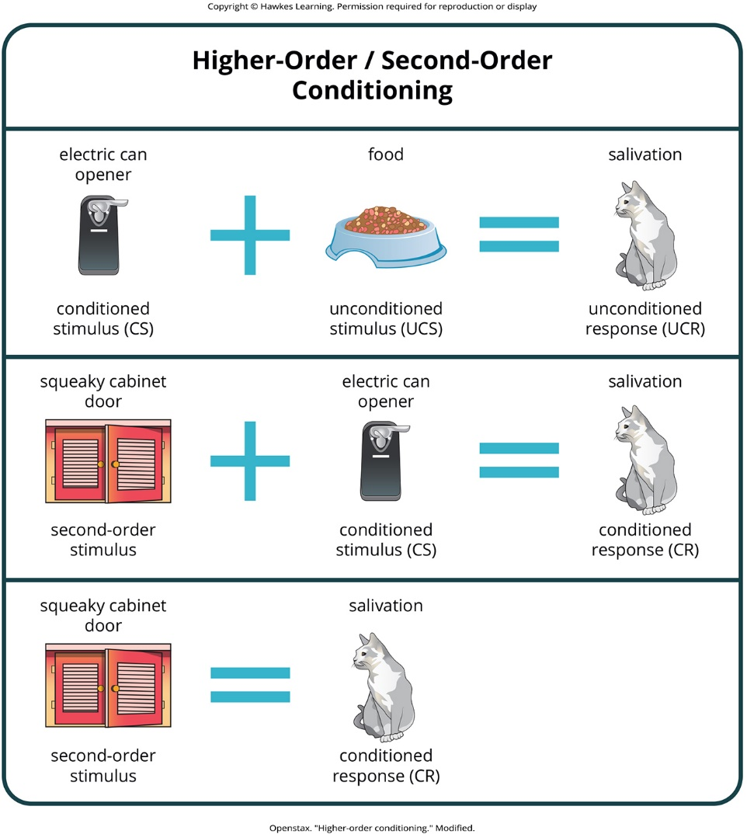
Lesson 5.2 Figure 3

Slide 9
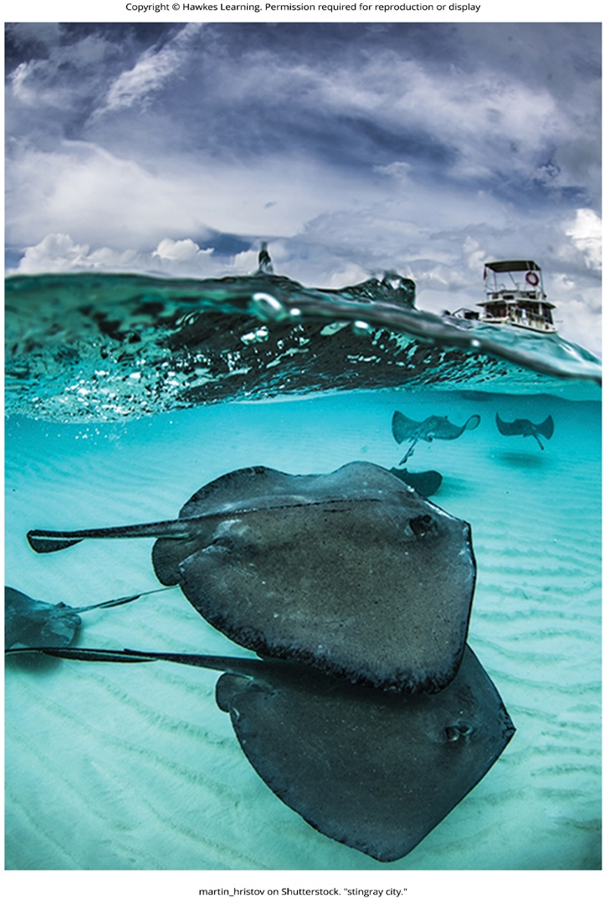
Lesson 5.2 Figure 4

Slide 10
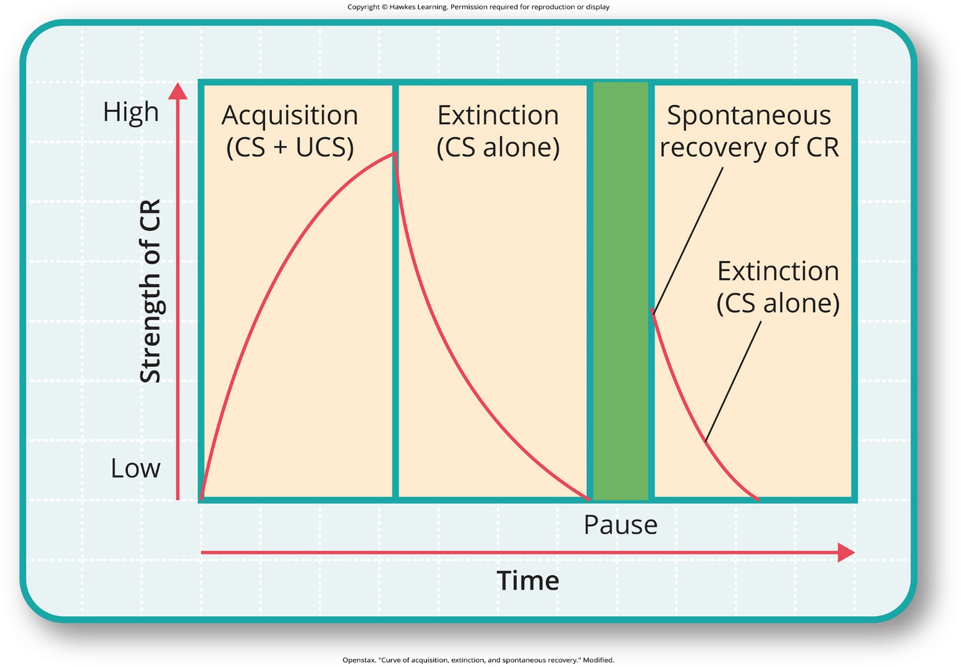
Lesson 5.2 Figure 5

Slide 11
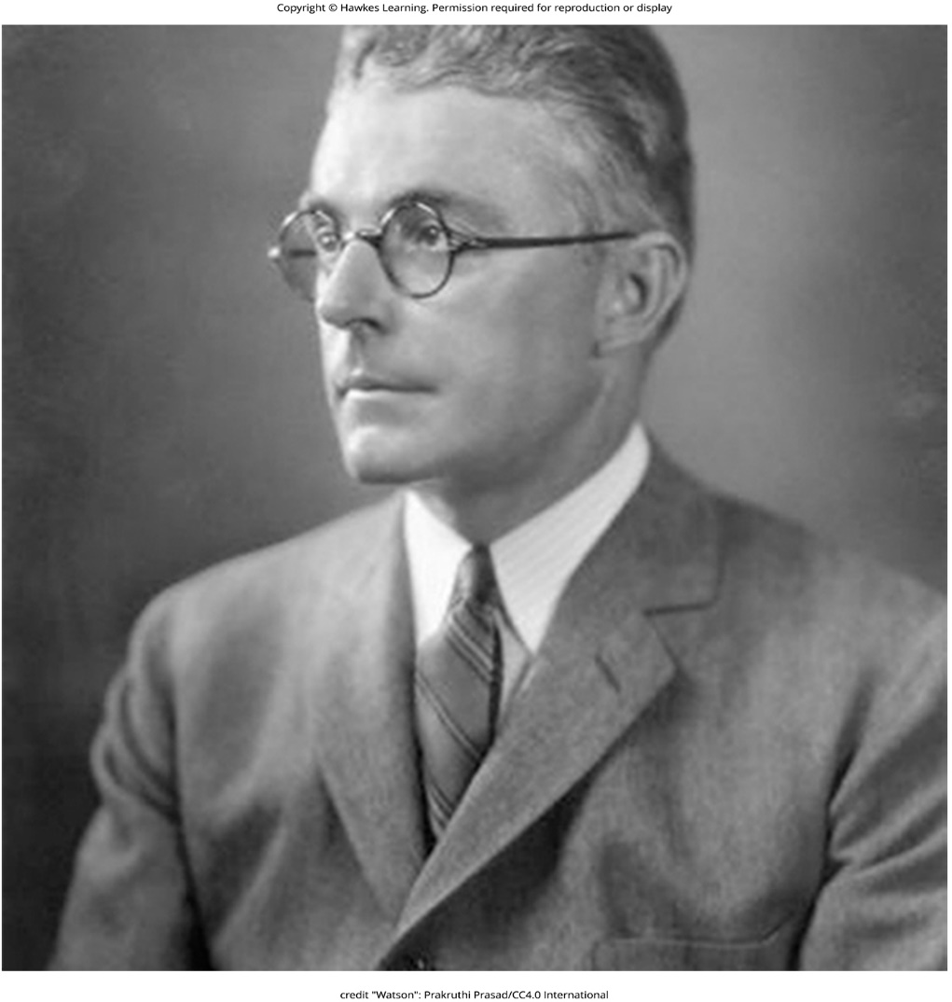
Lesson 5.2 Figure 6

Slide 12
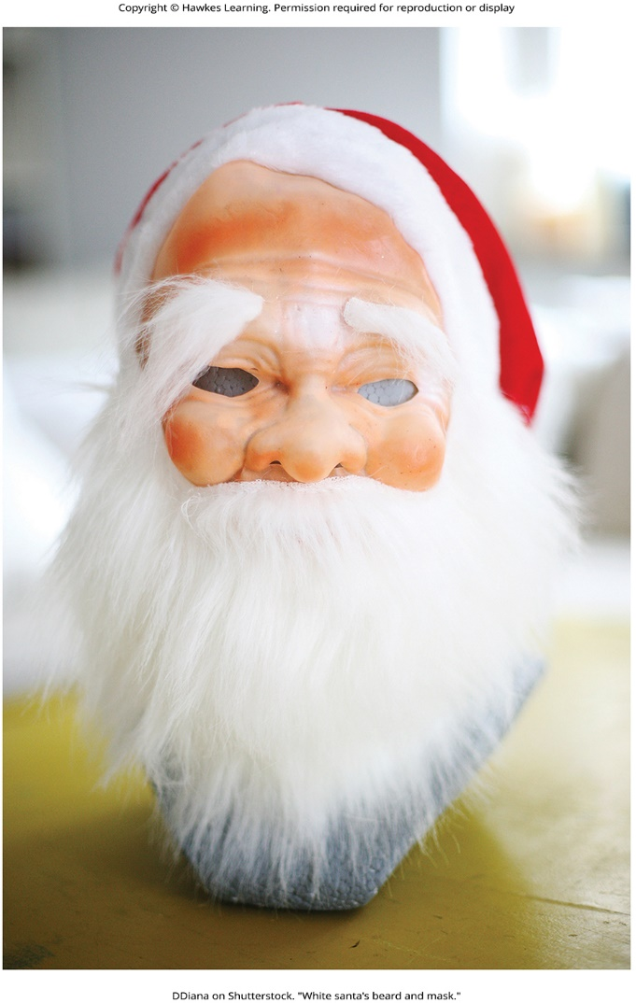
Lesson 5.2 Figure 7

Slide 13
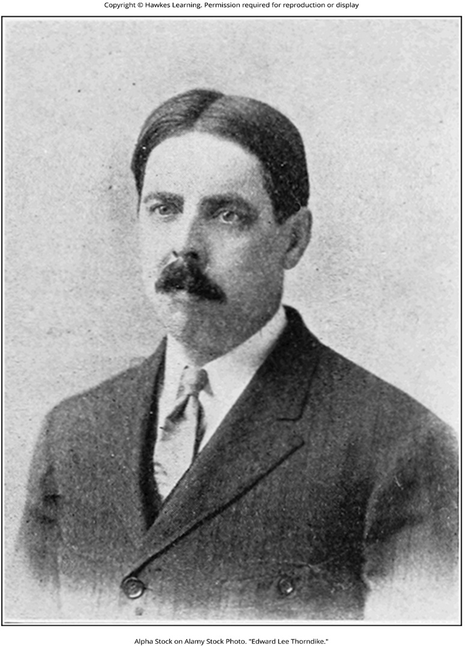
Lesson 5.3 Figure 1

Slide 14
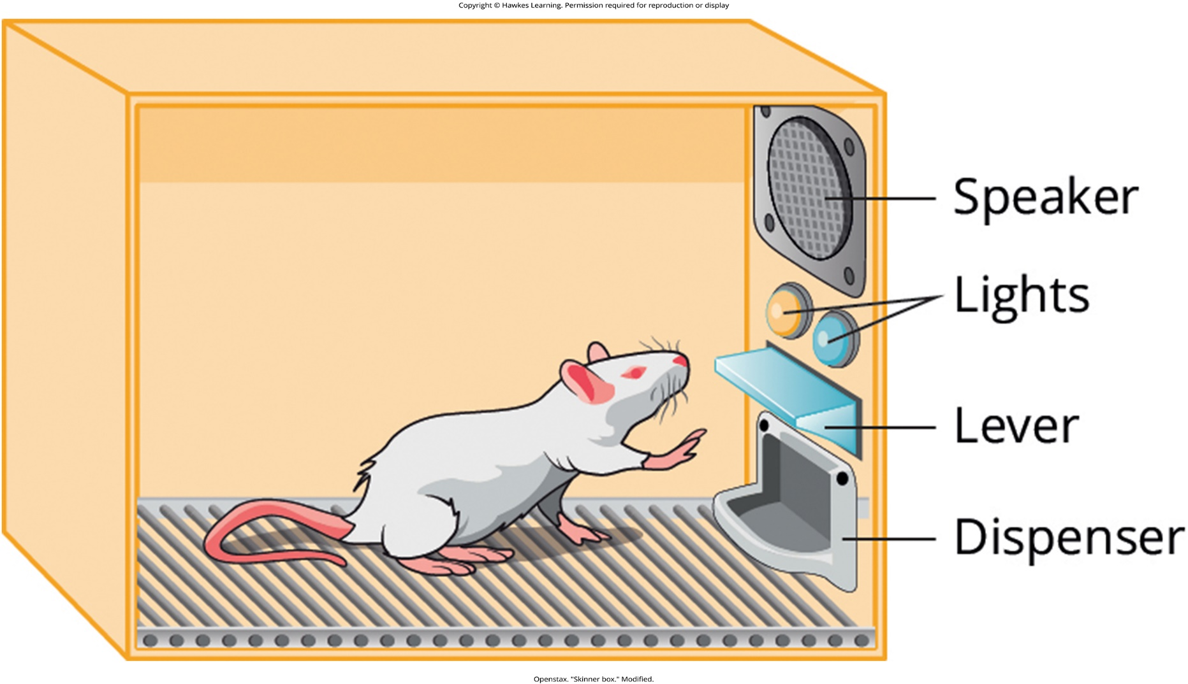
Lesson 5.3 Figure 2

Slide 15
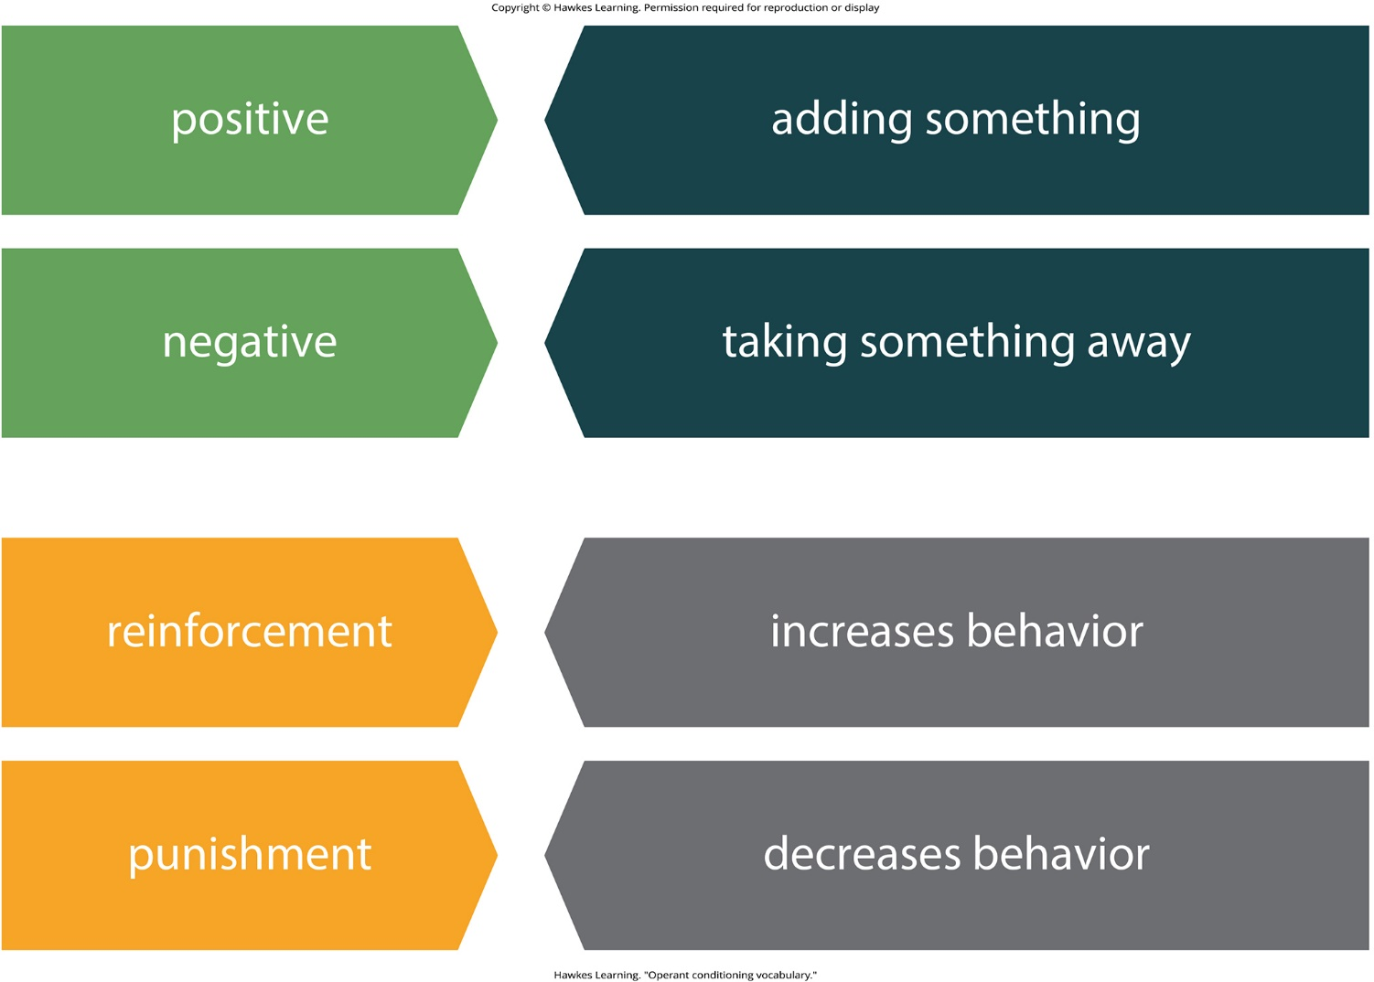
Lesson 5.3 Figure 3

Slide 16

Lesson 5.3 Figure 4

Slide 17

Lesson 5.3 Figure 5

Slide 18
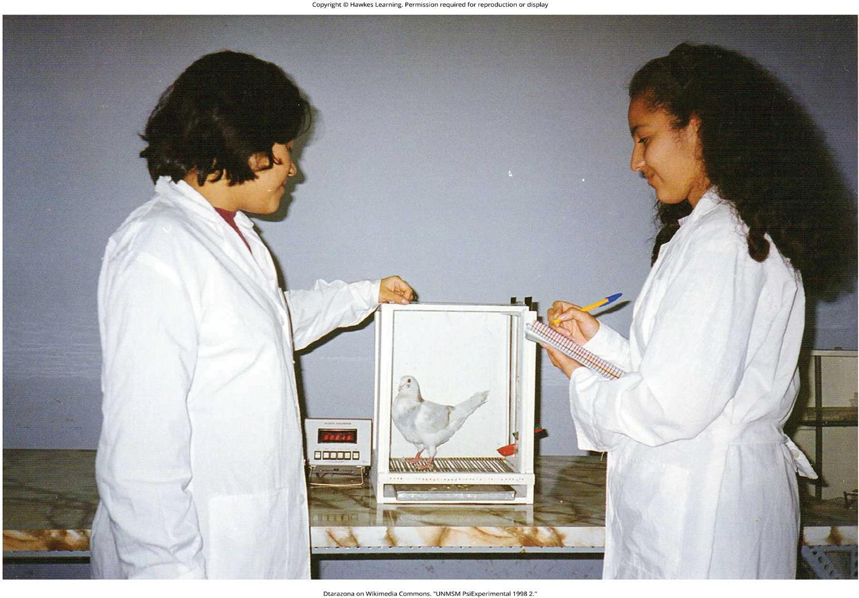
Lesson 5.3 Figure 6

Slide 19
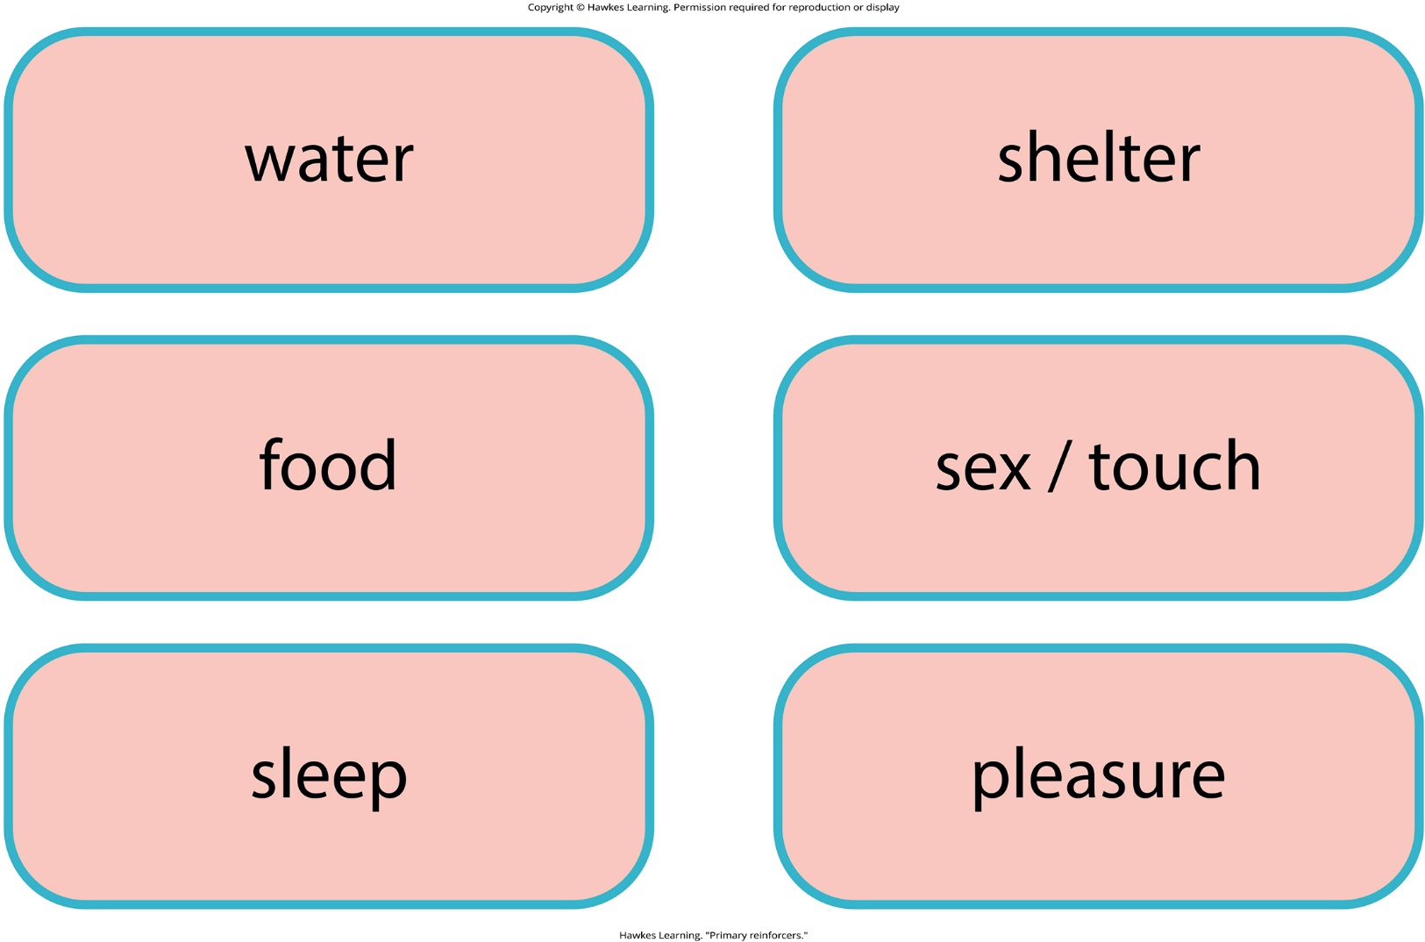
Lesson 5.3 Figure 7

Slide 20
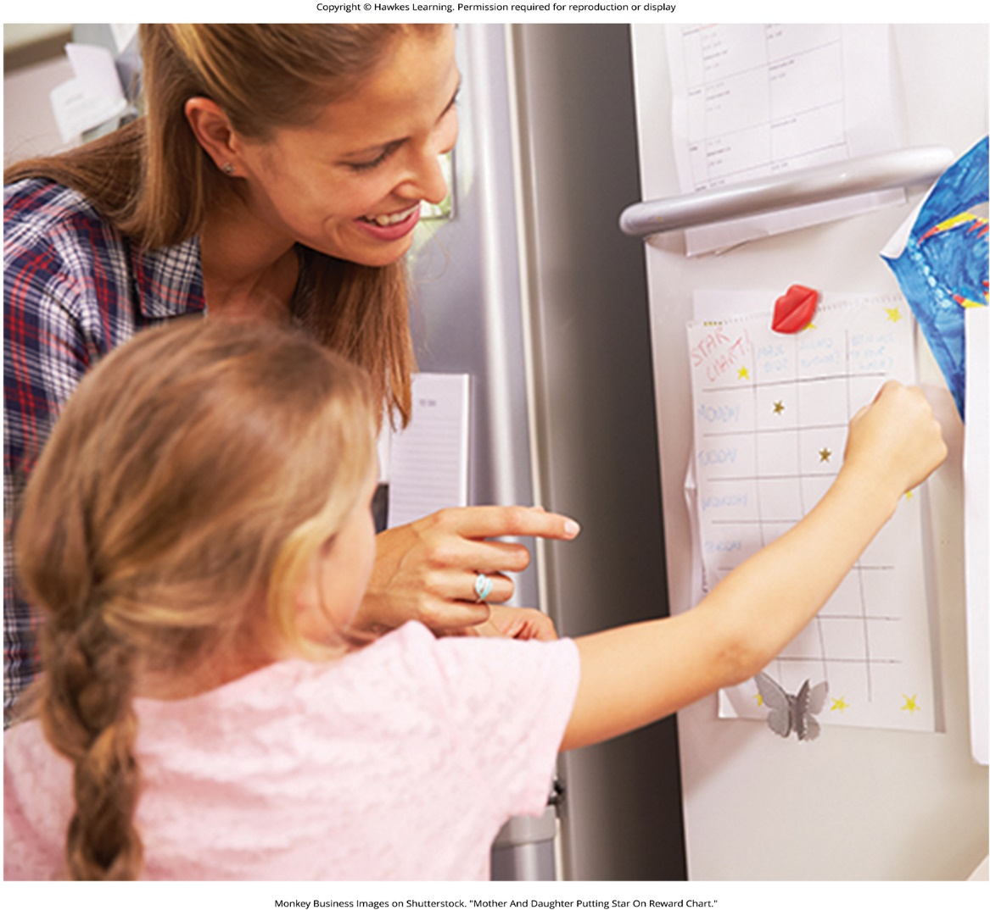
Lesson 5.3 Figure 8

Slide 21
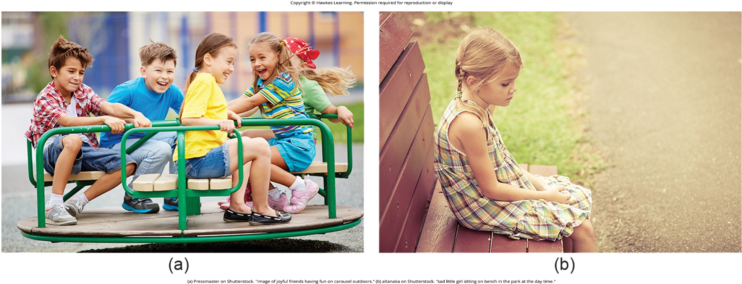
Lesson 5.3 Figure 9

Slide 22
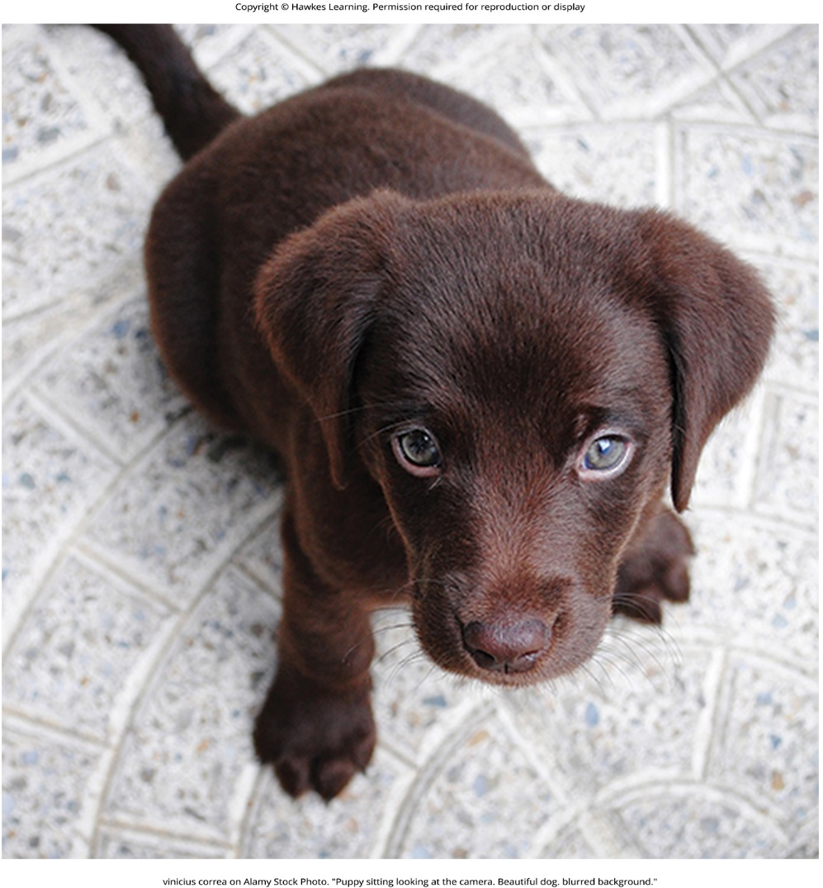
Lesson 5.3 Figure 10

Slide 23

Lesson 5.3 Figure 11

Slide 24

Lesson 5.3 Figure 12

Slide 25
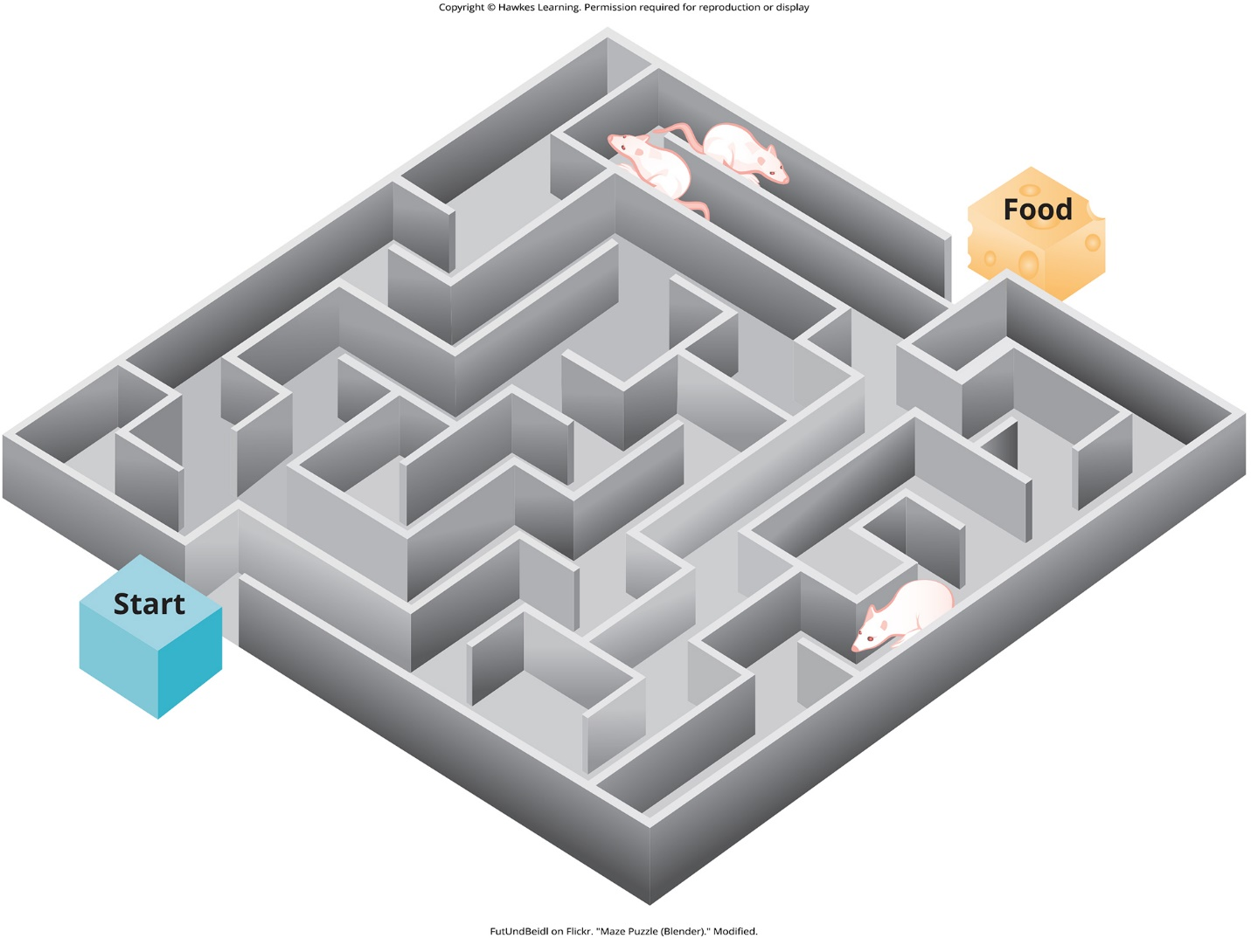
Lesson 5.3 Figure 13

Slide 26
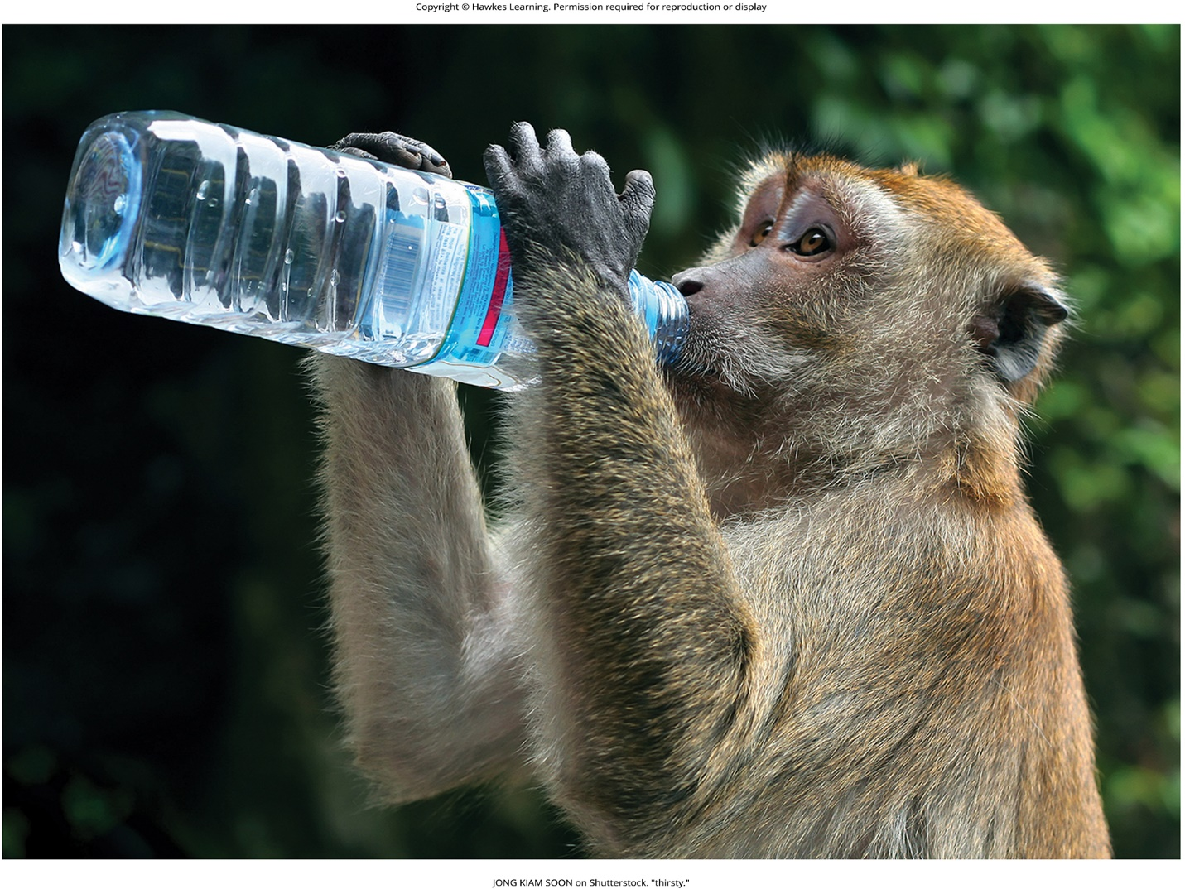
Lesson 5.4 Figure 1

Slide 27
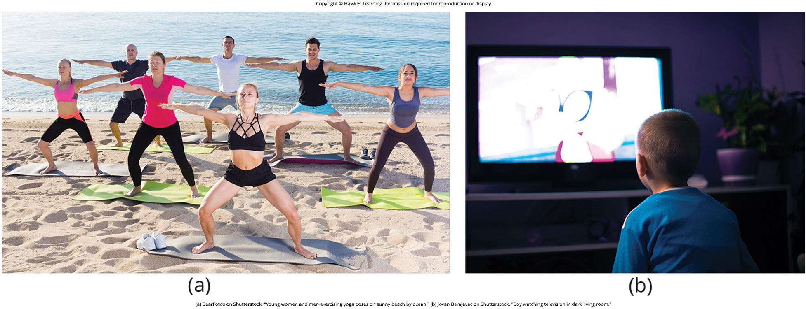
Lesson 5.4 Figure 2

Slide 28

Lesson 5.4 Figure 3

Slide 29

Lesson 5.4 Figure 4

Slide 30
Hawkes Learning – End of PowerPoint

