Slide 1
Chapter 6
Thinking and Intelligence

Slide 2
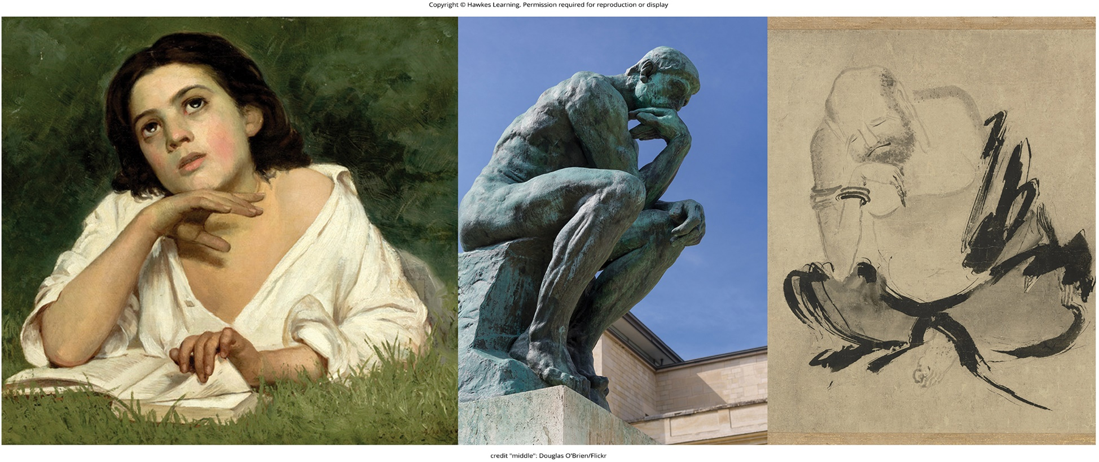
Lesson 6.1 Figure 1

Slide 3
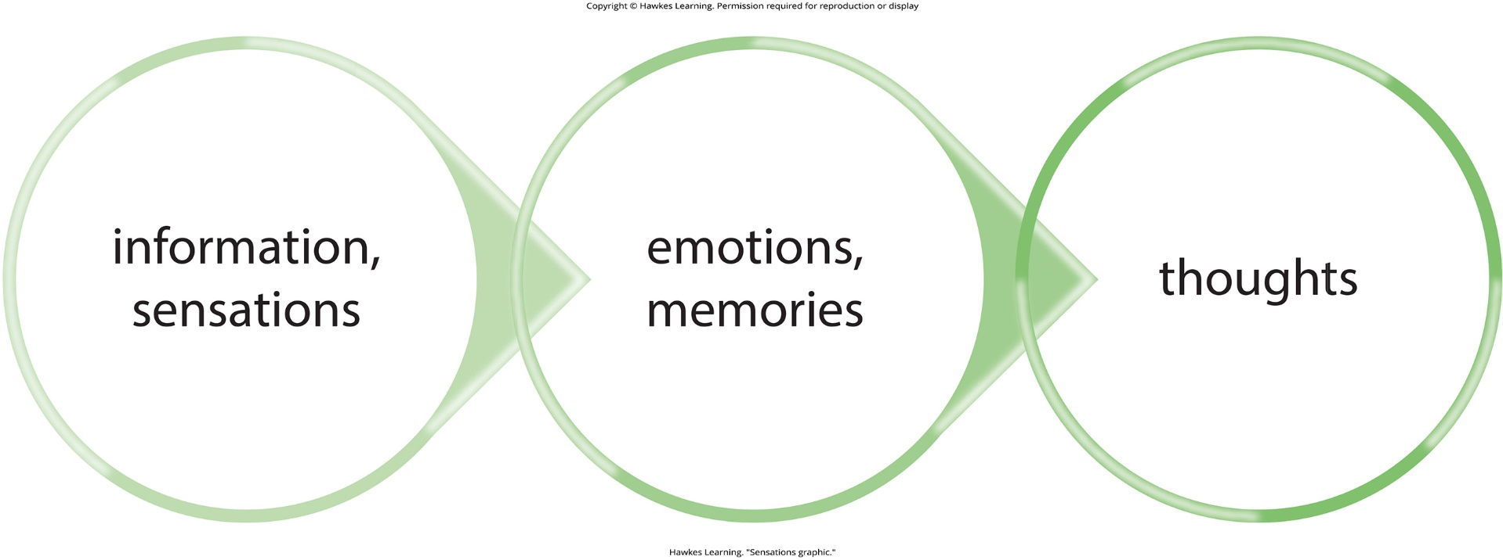
Lesson 6.1 Figure 2

Slide 4
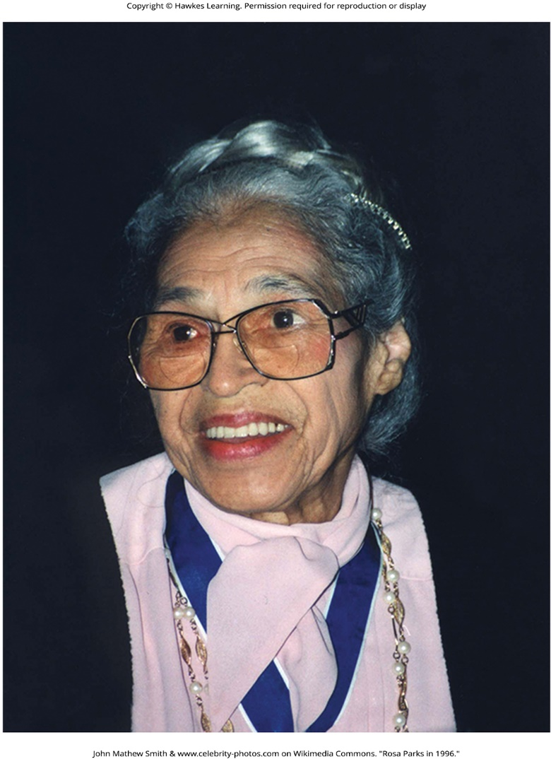
Lesson 6.1 Figure 3

Slide 5
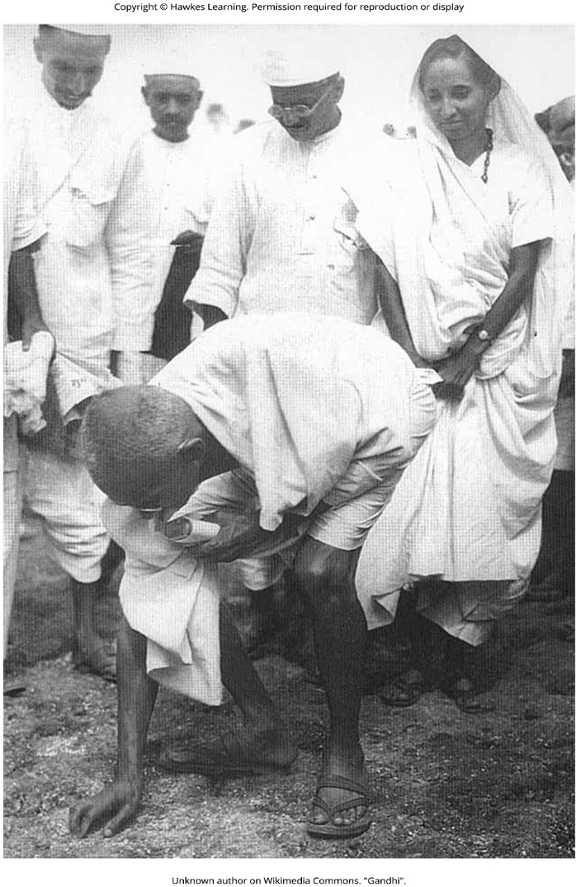
Lesson 6.1 Figure 4

Slide 6
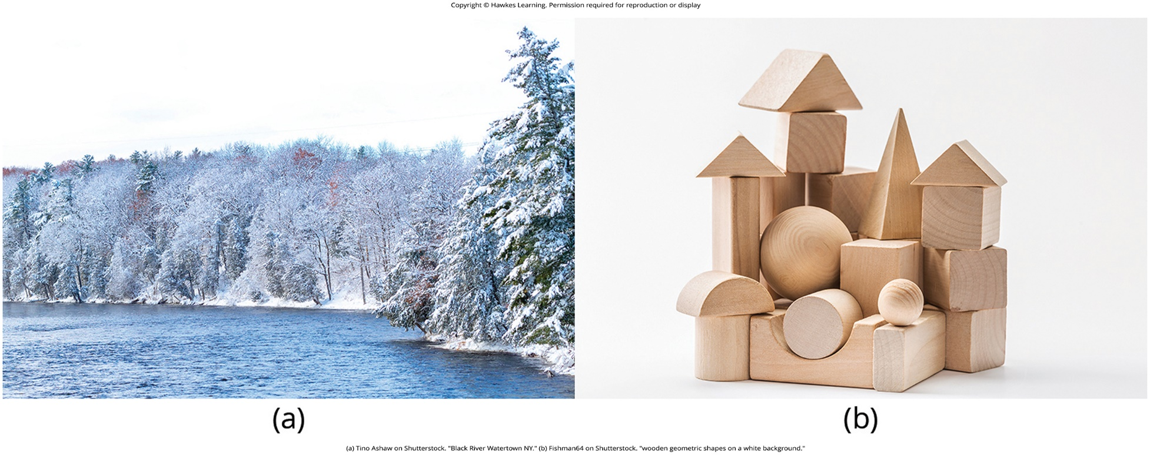
Lesson 6.1 Figure 5

Slide 7

Lesson 6.1 Figure 6

Slide 8
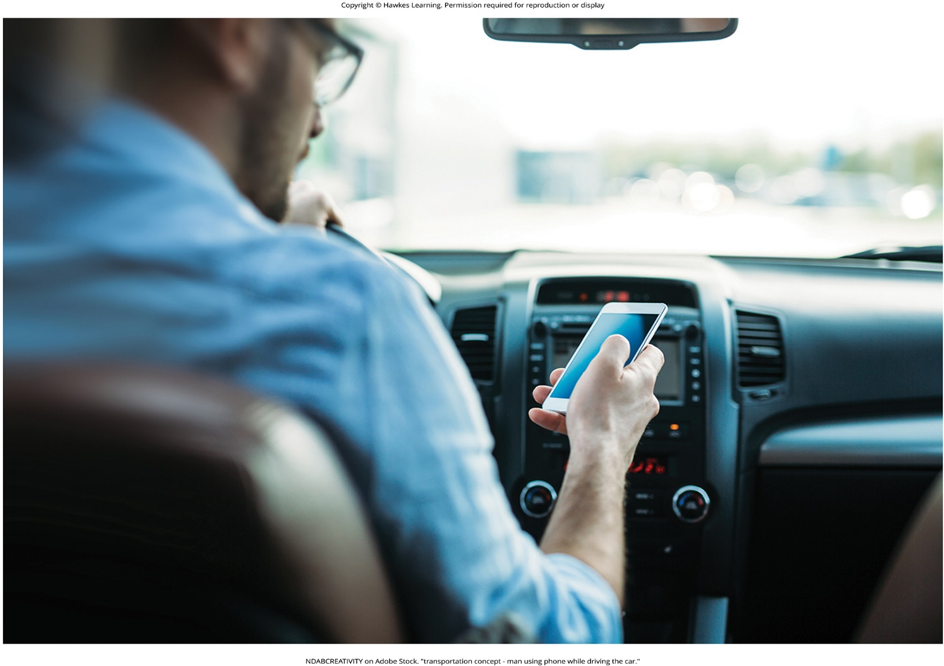
Lesson 6.1 Figure 7

Slide 9

Lesson 6.2 Figure 1

Slide 10

Lesson 6.2 Figure 2

Slide 11
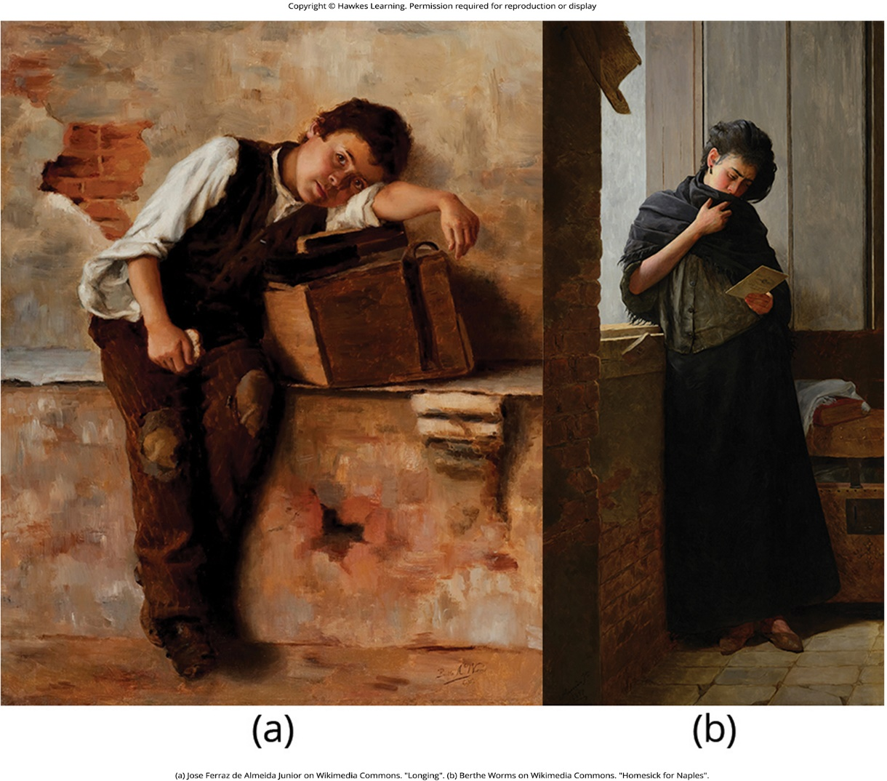
Lesson 6.2 Figure 3

Slide 12
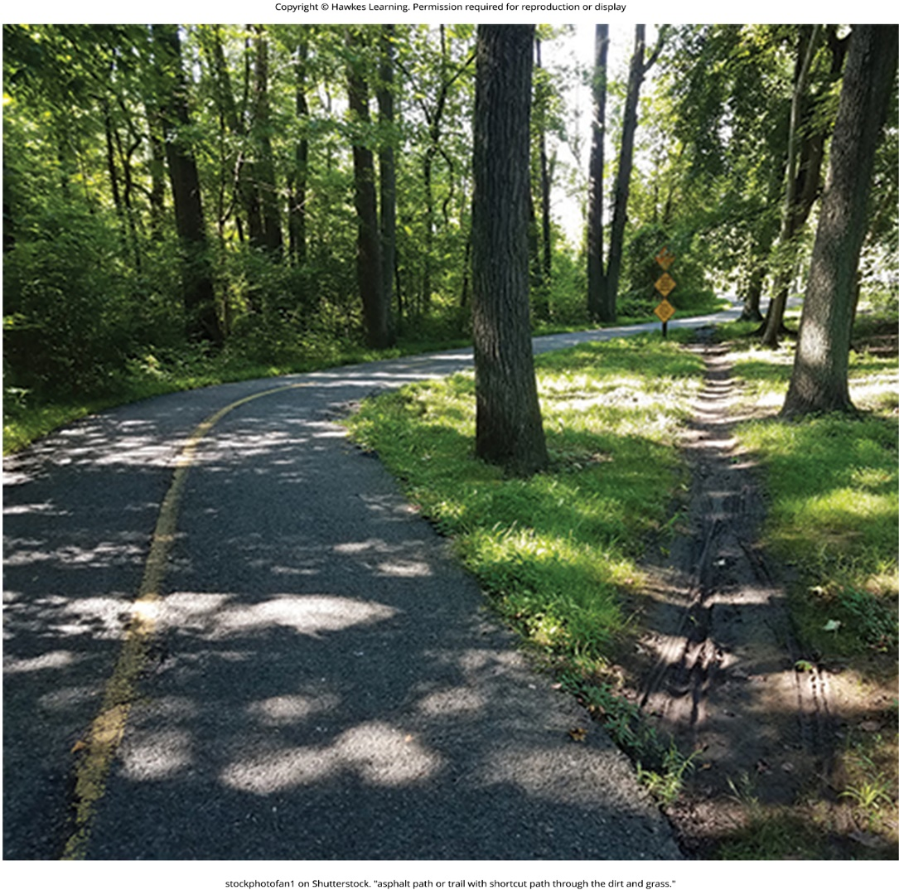
Lesson 6.3 Figure 1

Slide 13
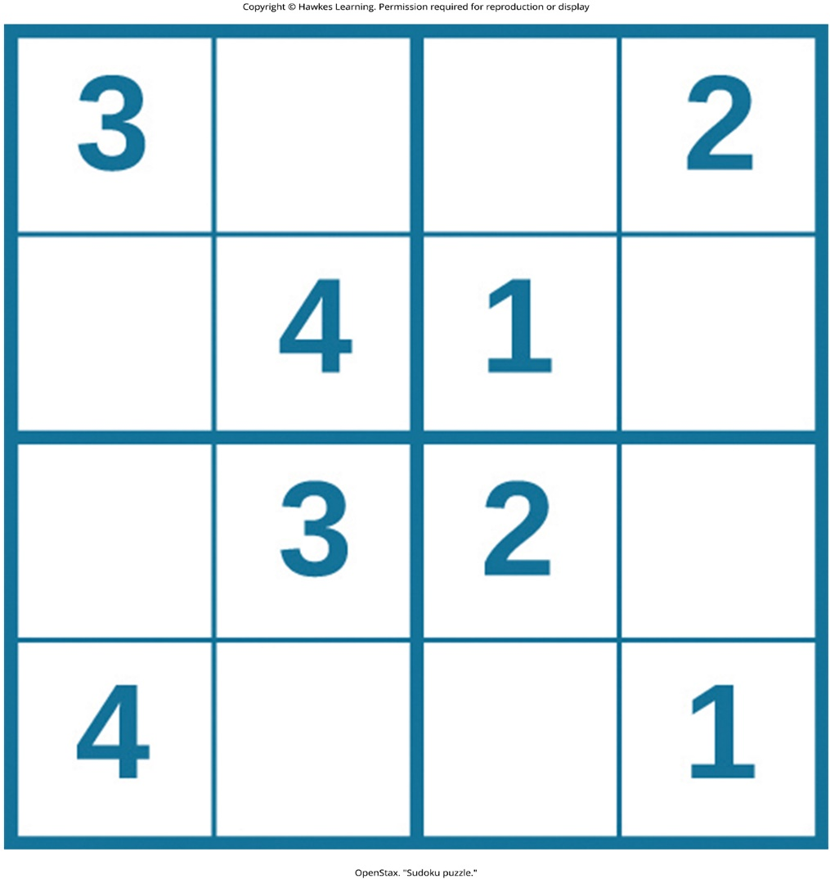
Lesson 6.3 Figure 2

Slide 14
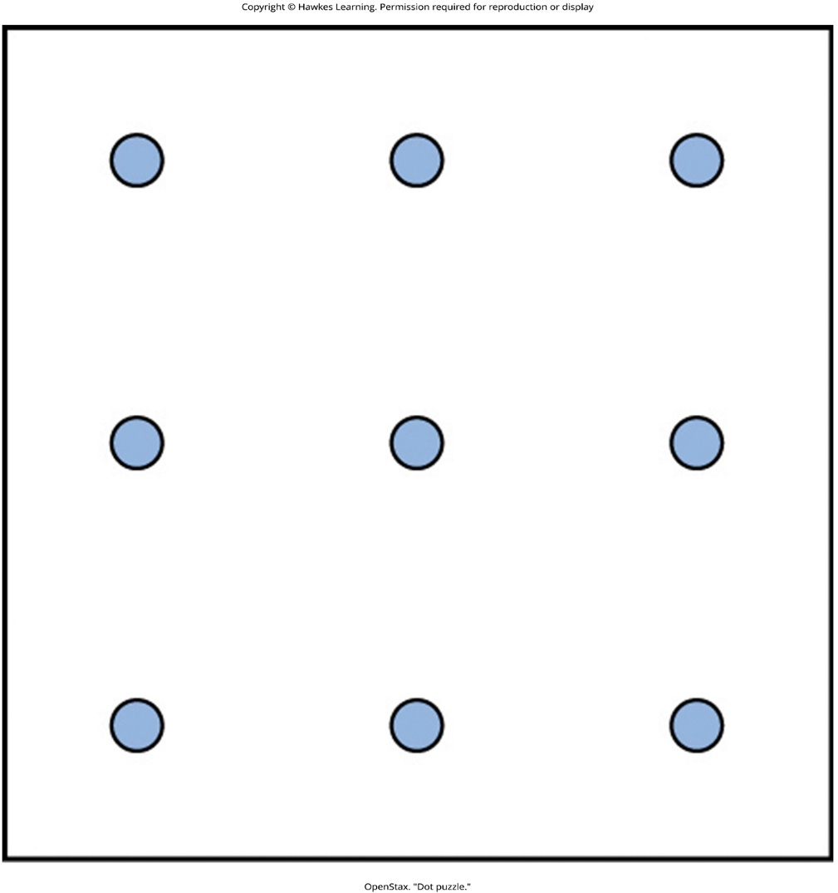
Lesson 6.3 Figure 3

Slide 15
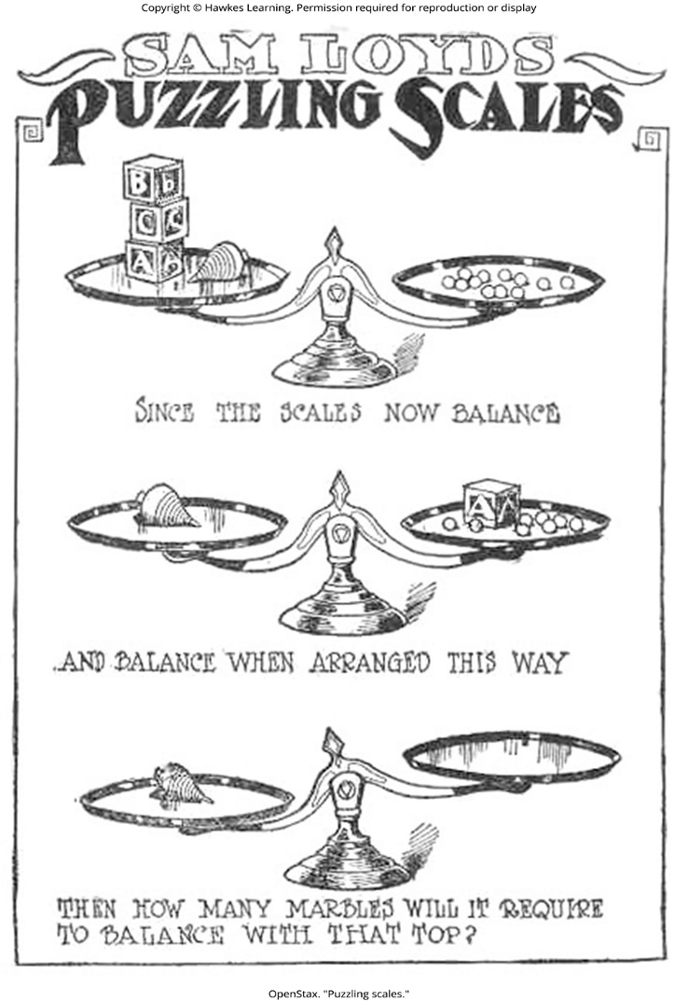
Lesson 6.3 Figure 4

Slide 16

Lesson 6.3 Figure 5

Slide 17
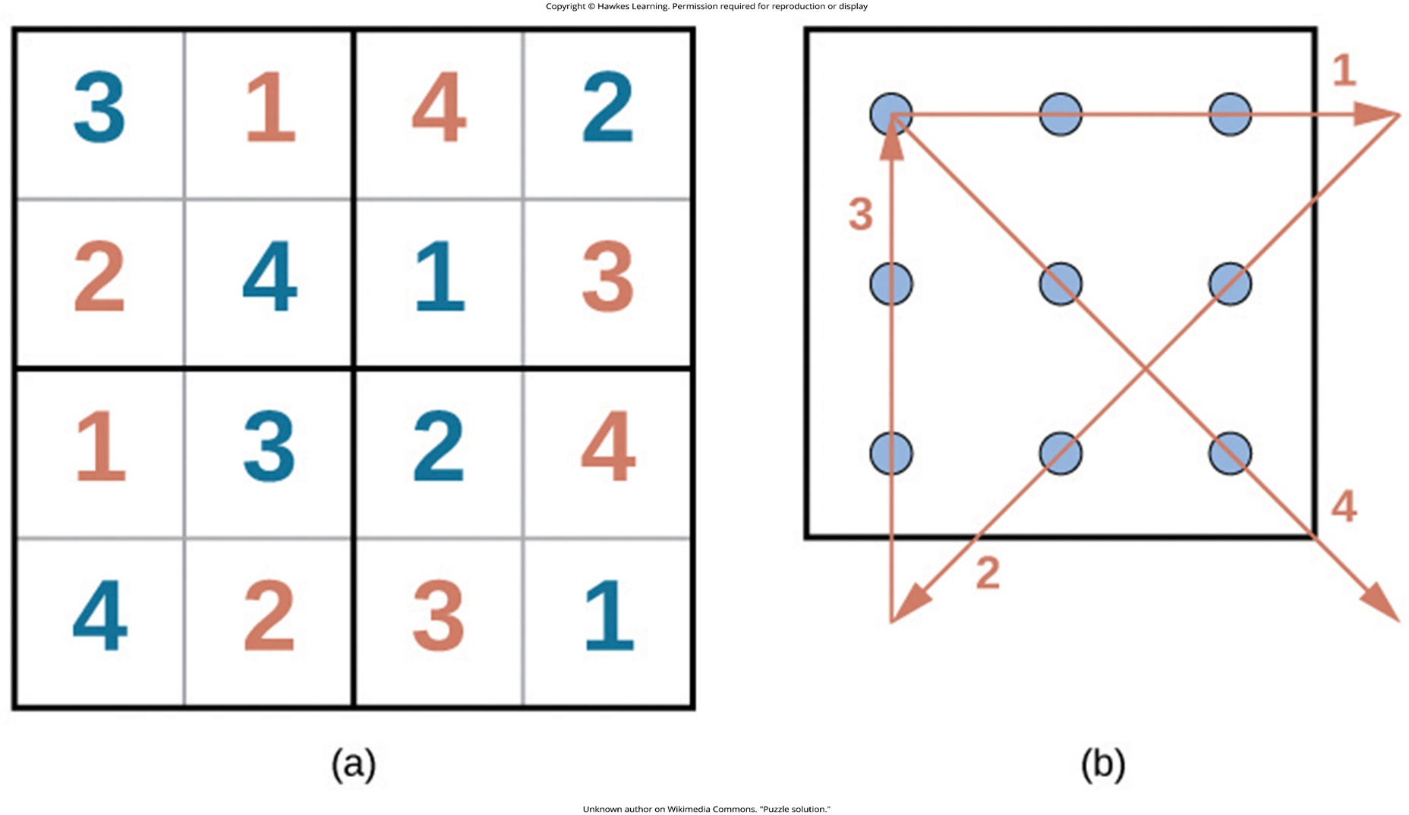
Lesson 6.3 Figure 6

Slide 18
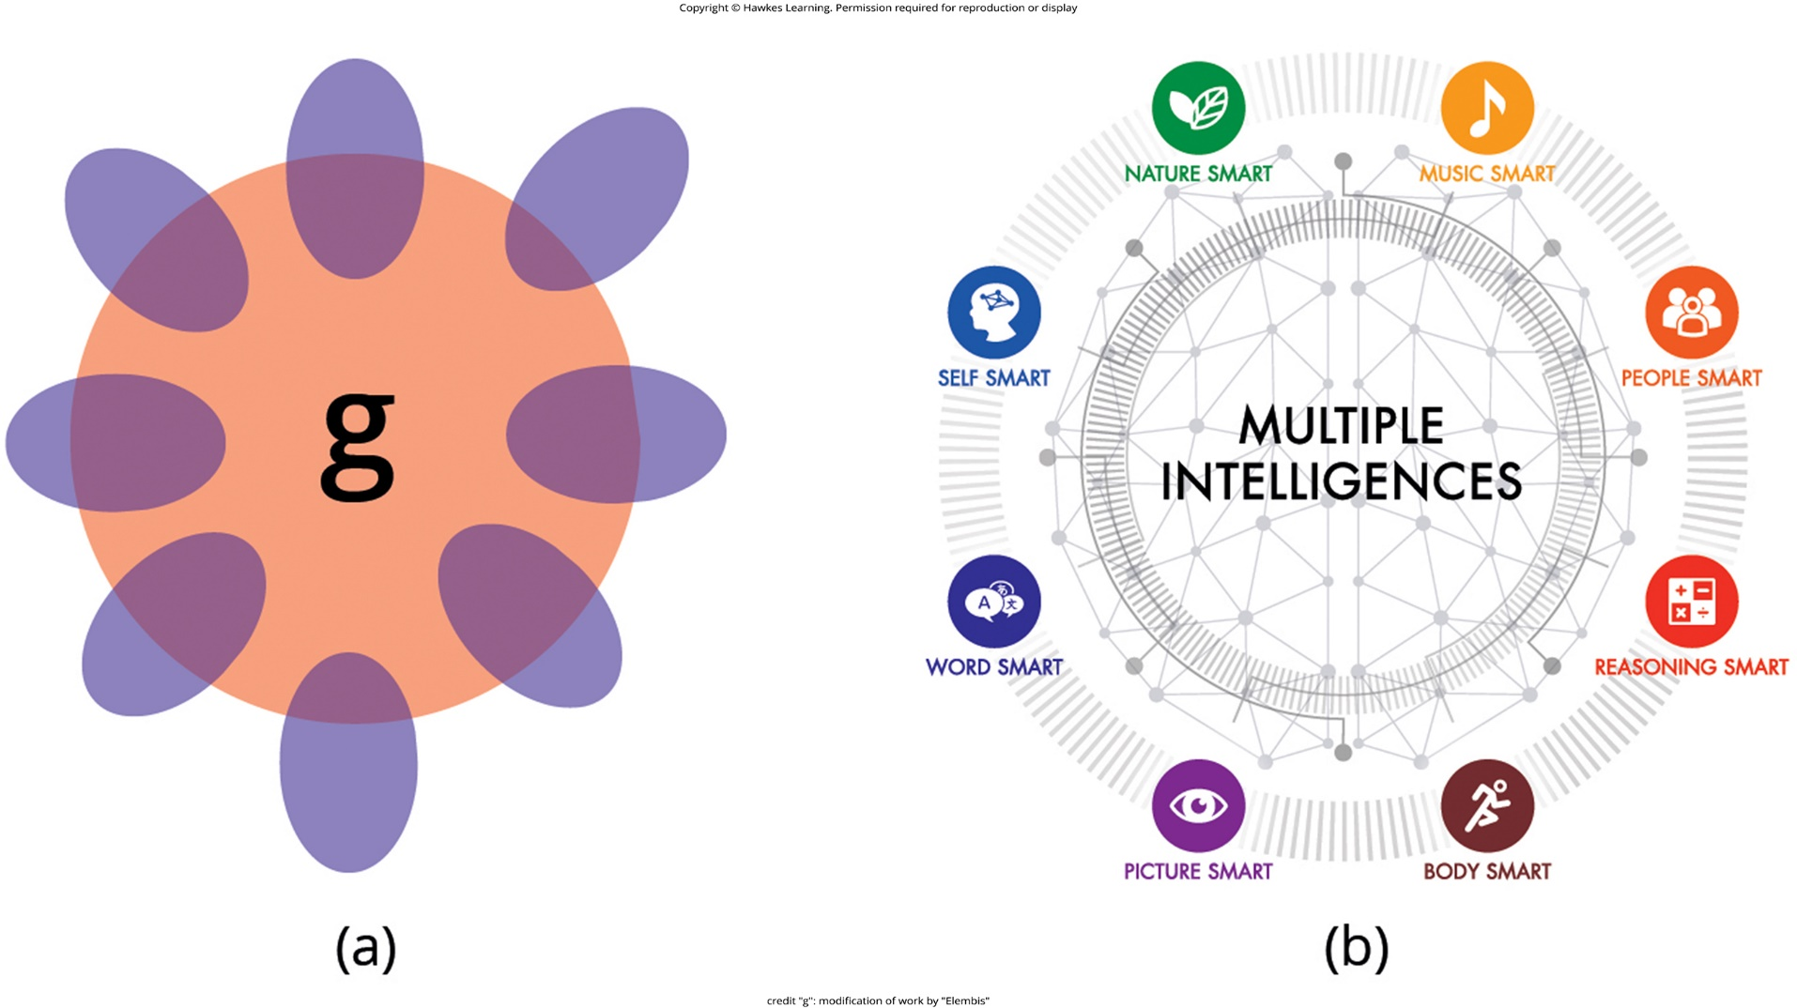
Lesson 6.4 Figure 1

Slide 19
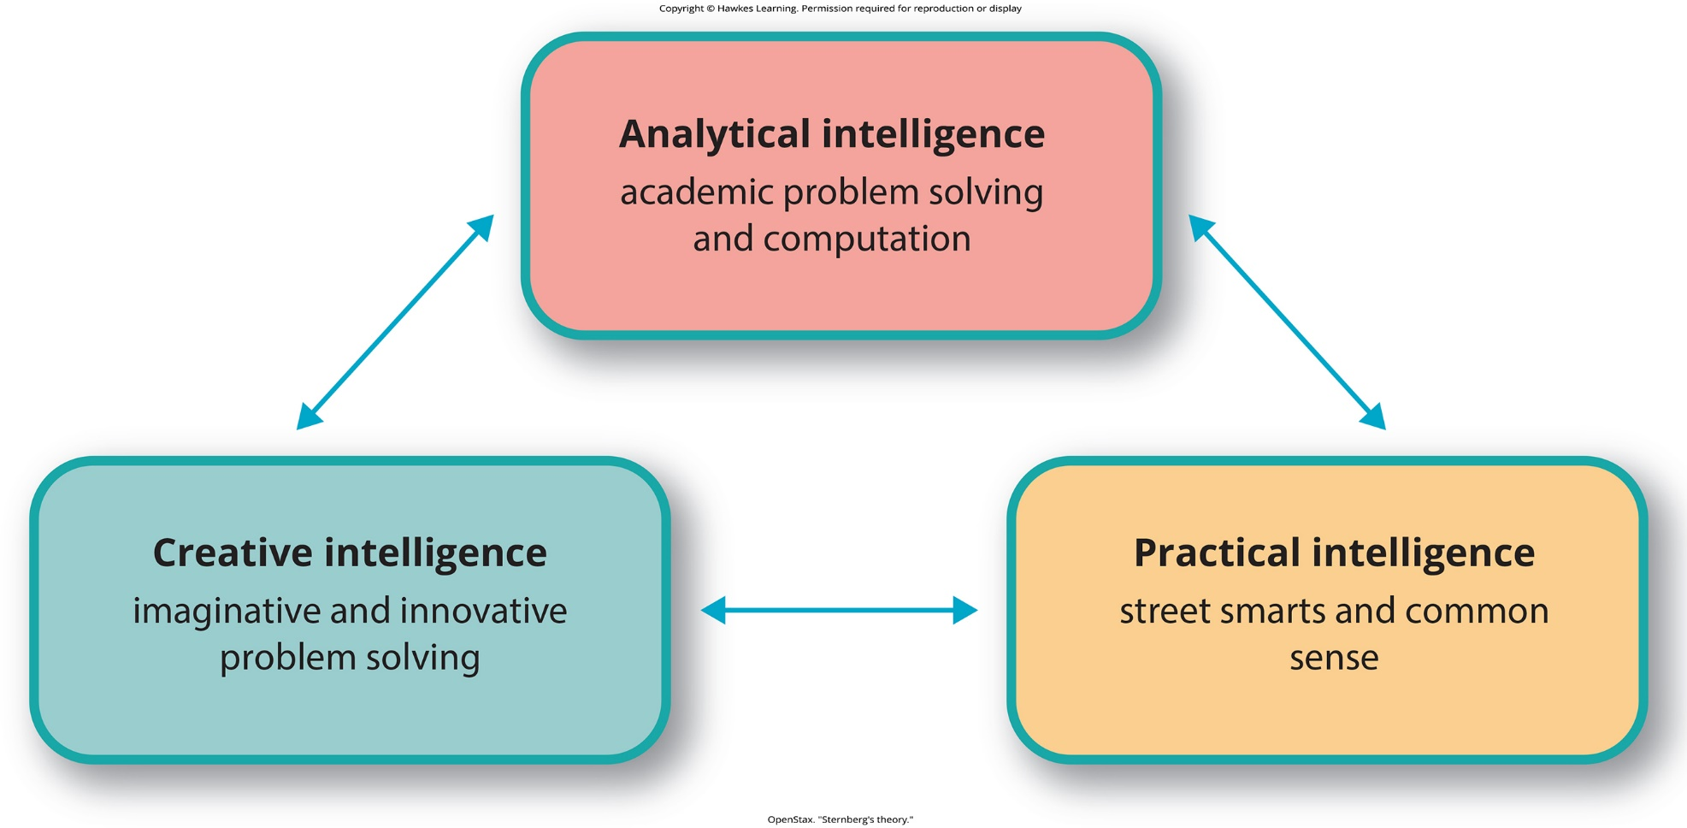
Lesson 6.4 Figure 2

Slide 20

Lesson 6.4 Figure 3

Slide 21
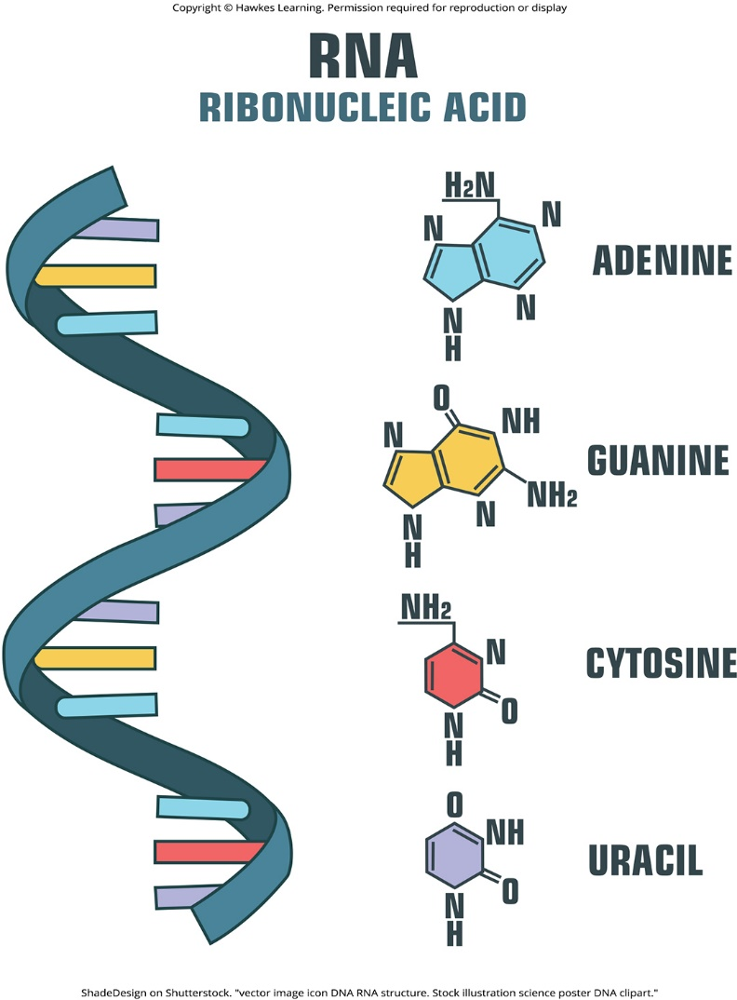
Lesson 6.4 Figure 4

Slide 22
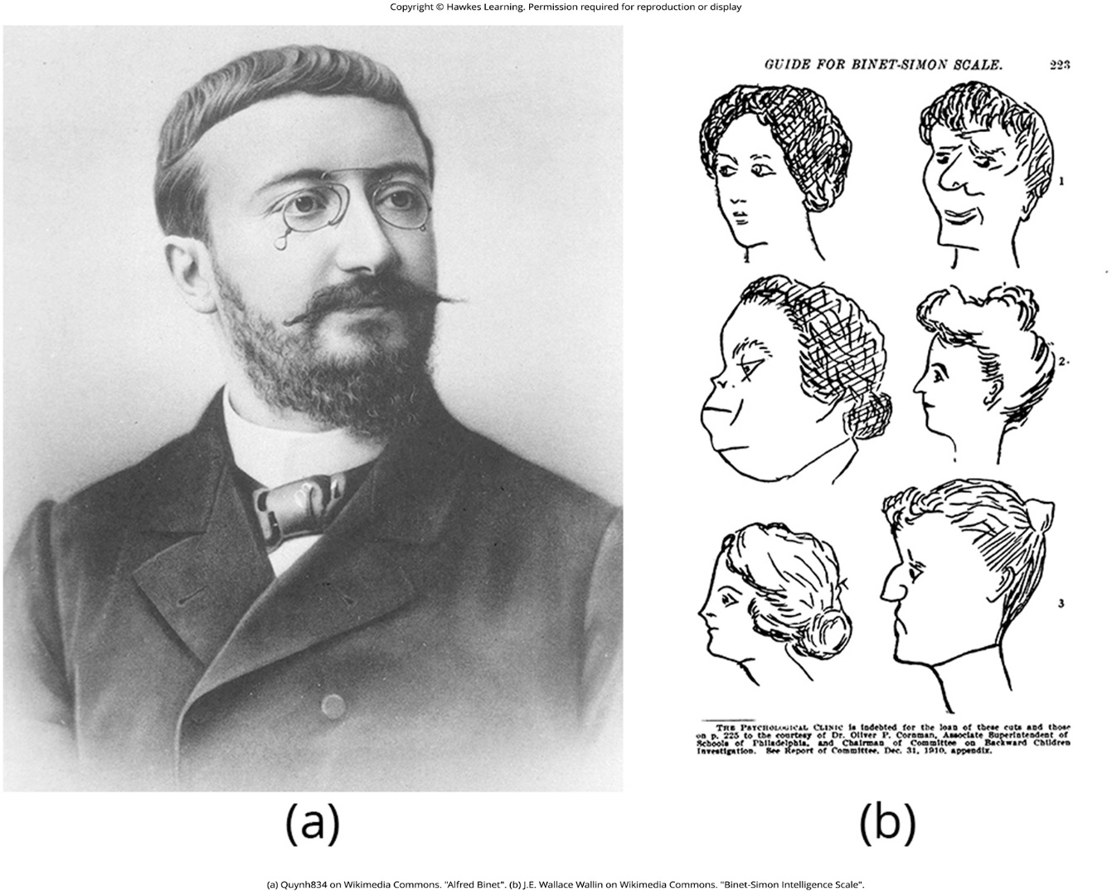
Lesson 6.5 Figure 1

Slide 23
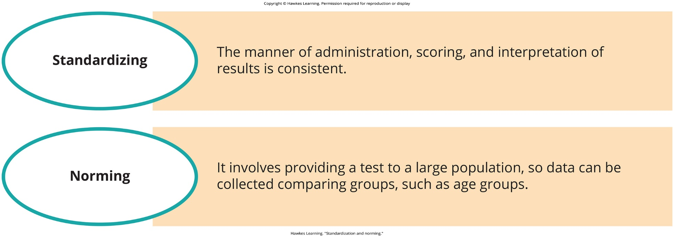
Lesson 6.5 Figure 2

Slide 24
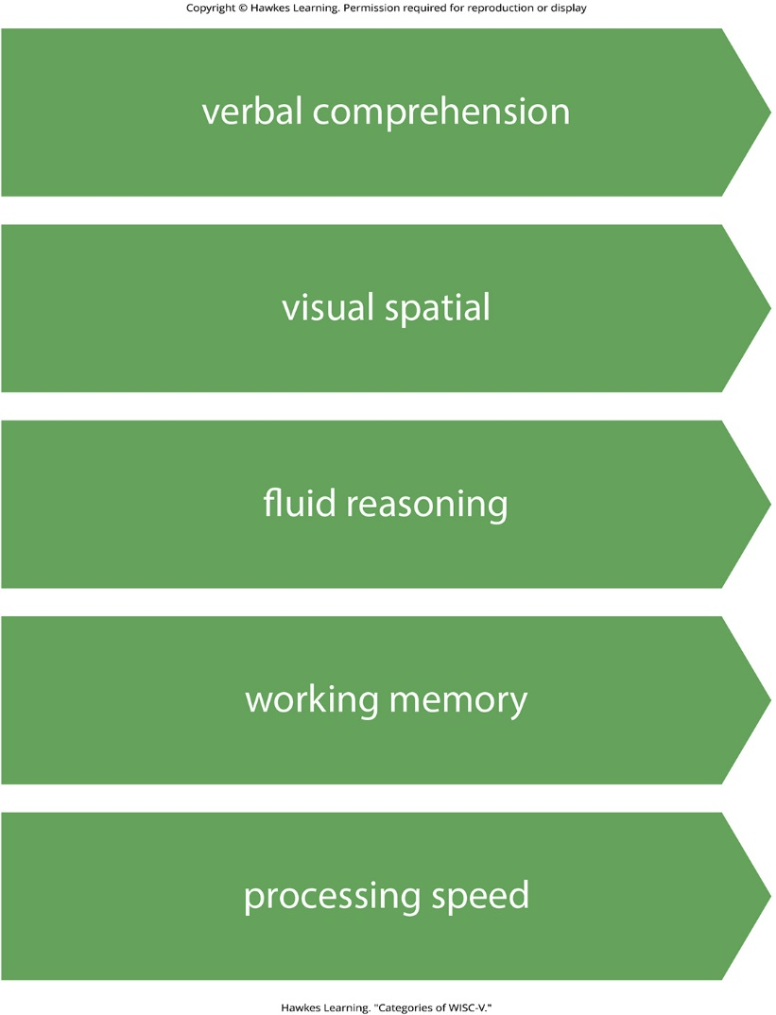
Lesson 6.5 Figure 3

Slide 25
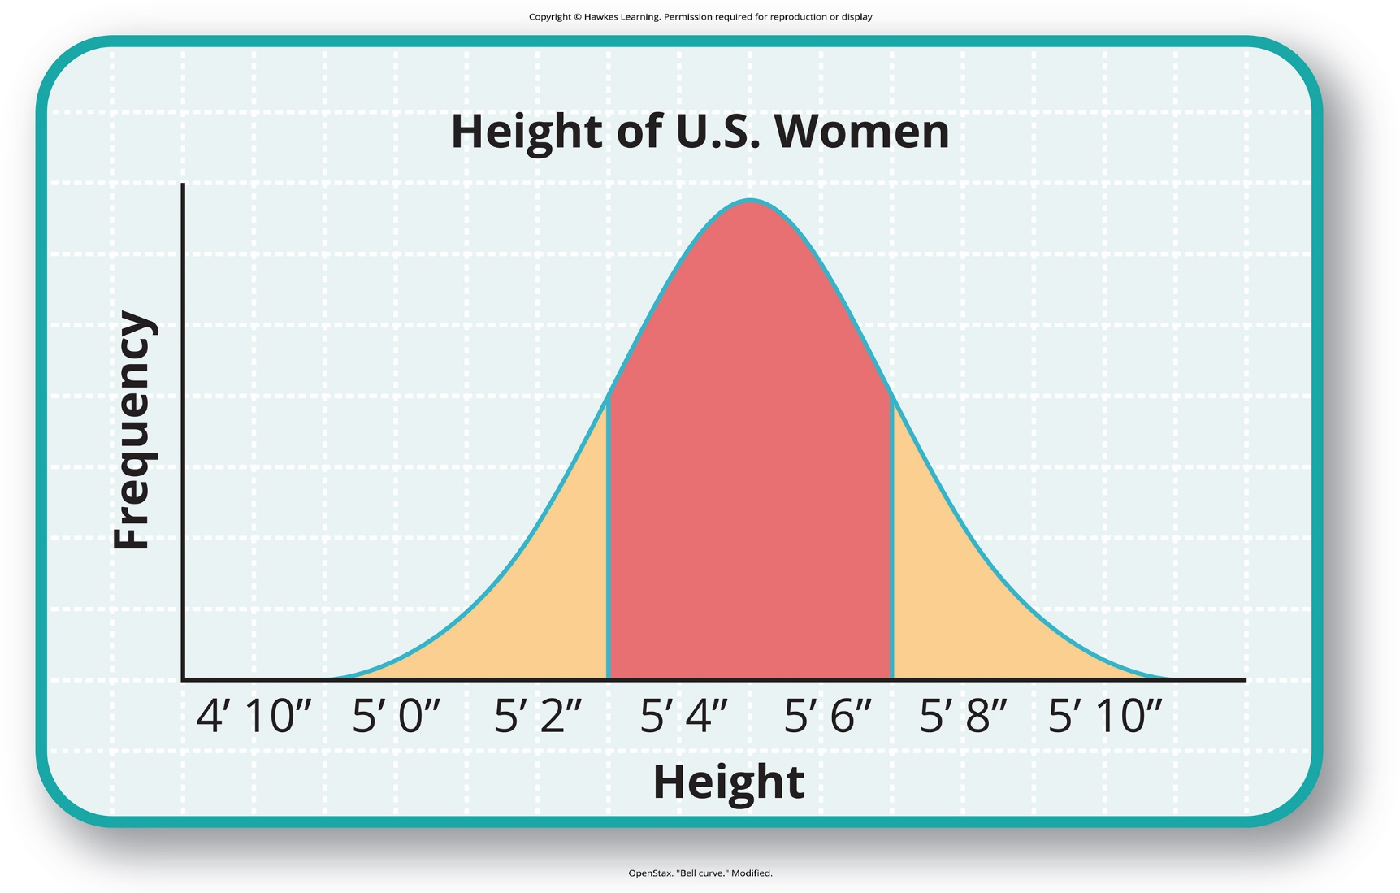
Lesson 6.5 Figure 4

Slide 26
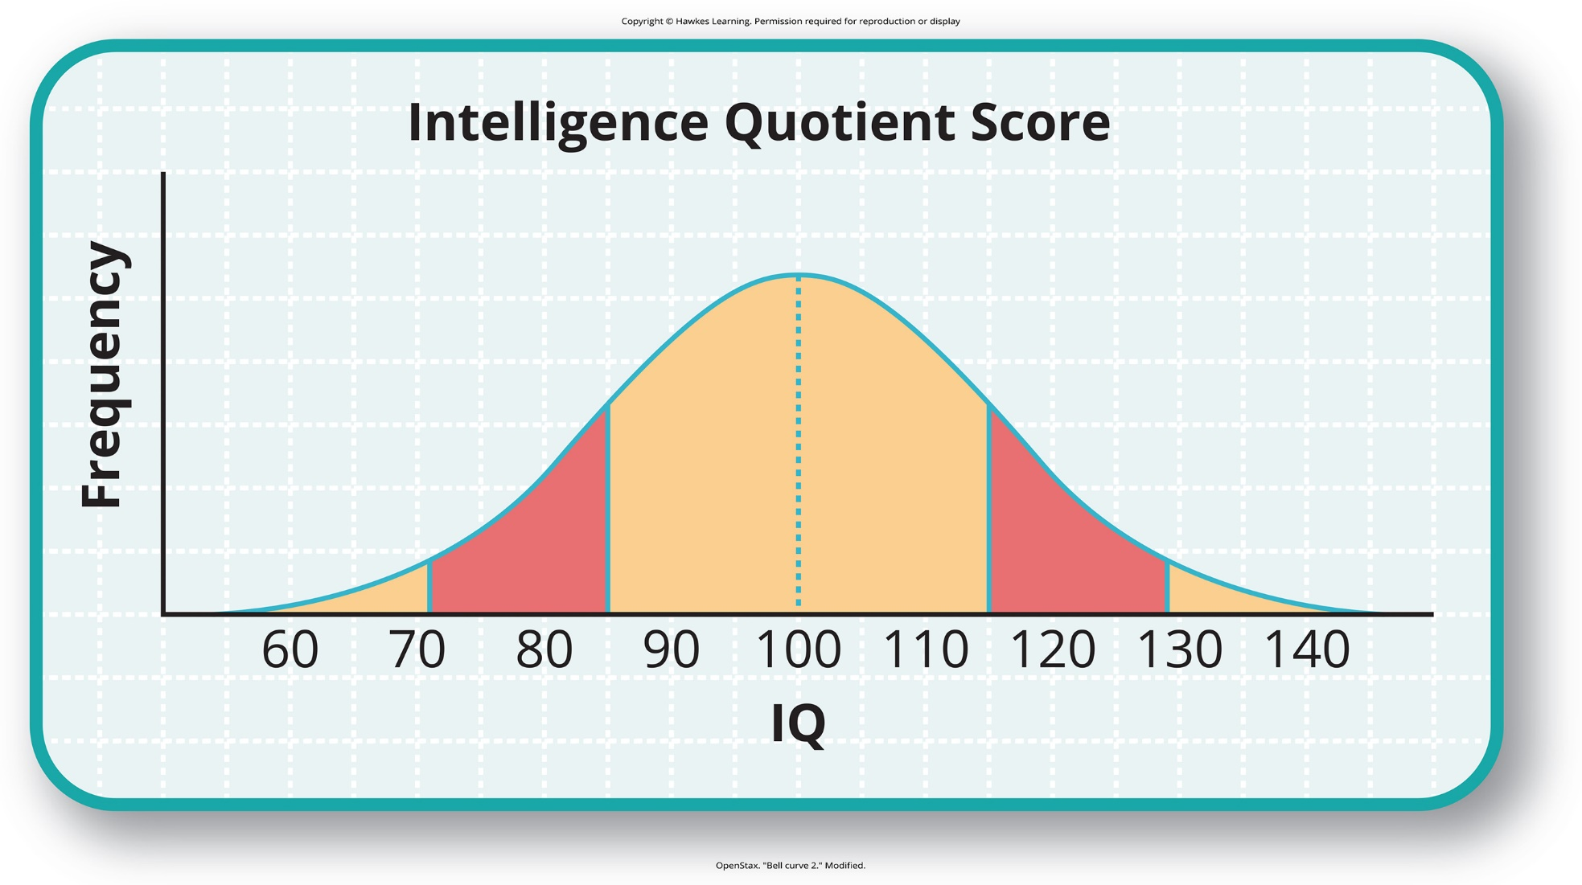
Lesson 6.5 Figure 5

Slide 27
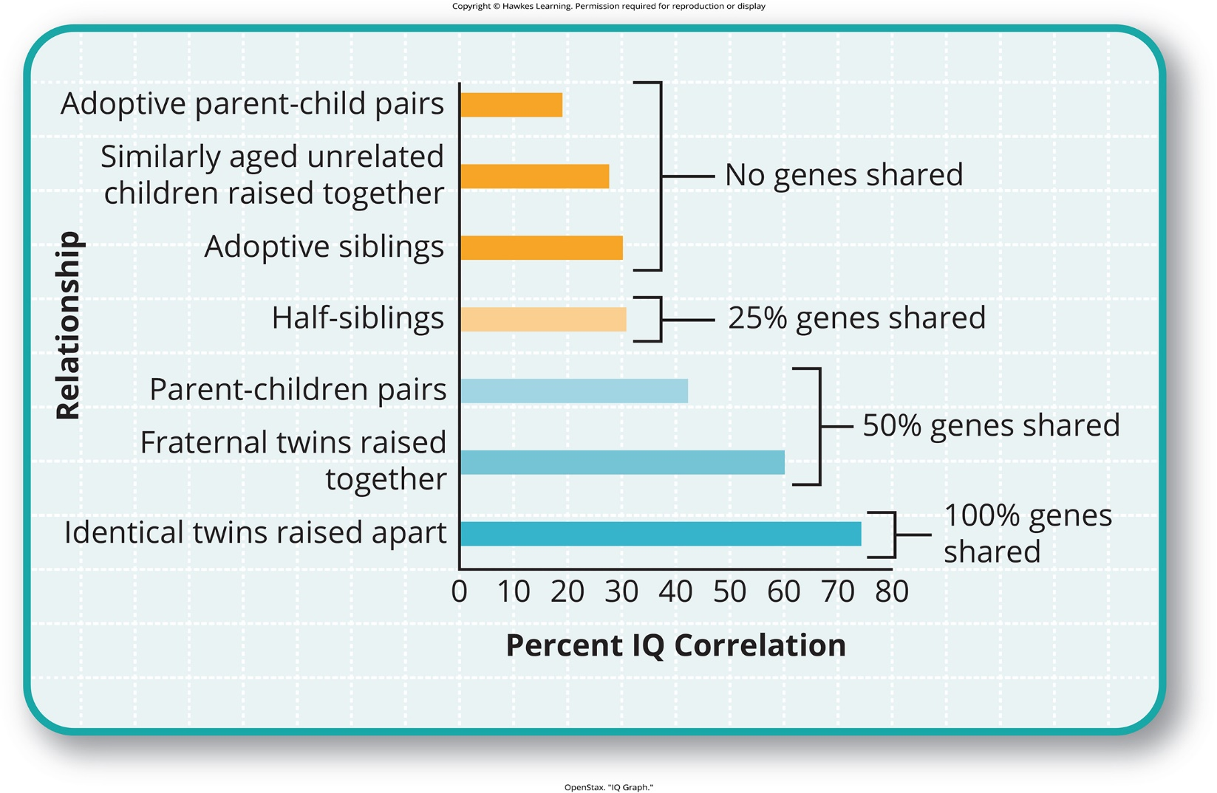
Lesson 6.6 Figure 1

Slide 28
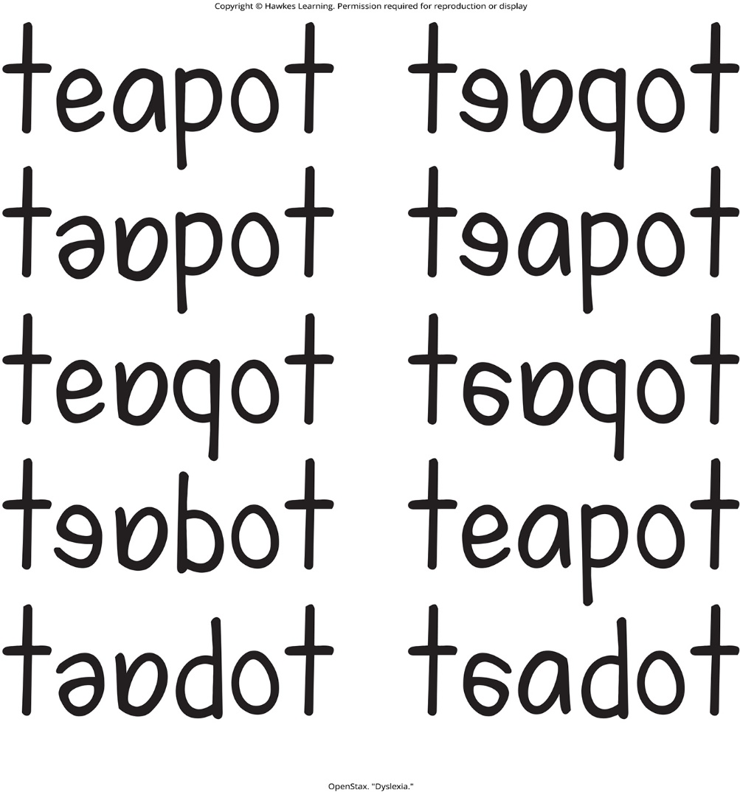
Lesson 6.6 Figure 2

Slide 29
Hawkes Learning – End of PowerPoint

