Slide 1
Chapter 7
Memory

Slide 2
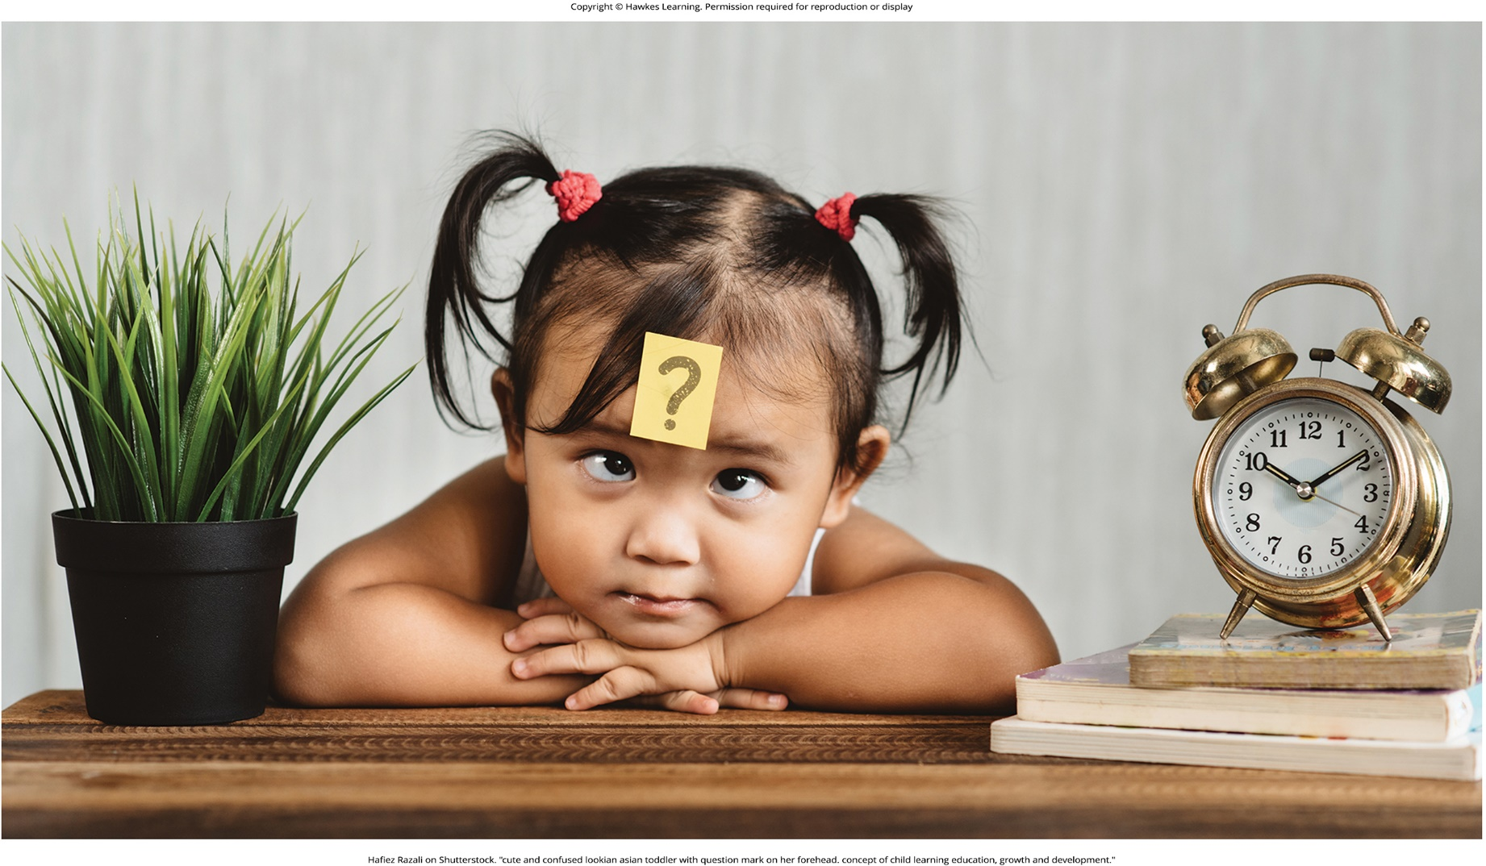
Lesson 7.1 Figure 1

Slide 3
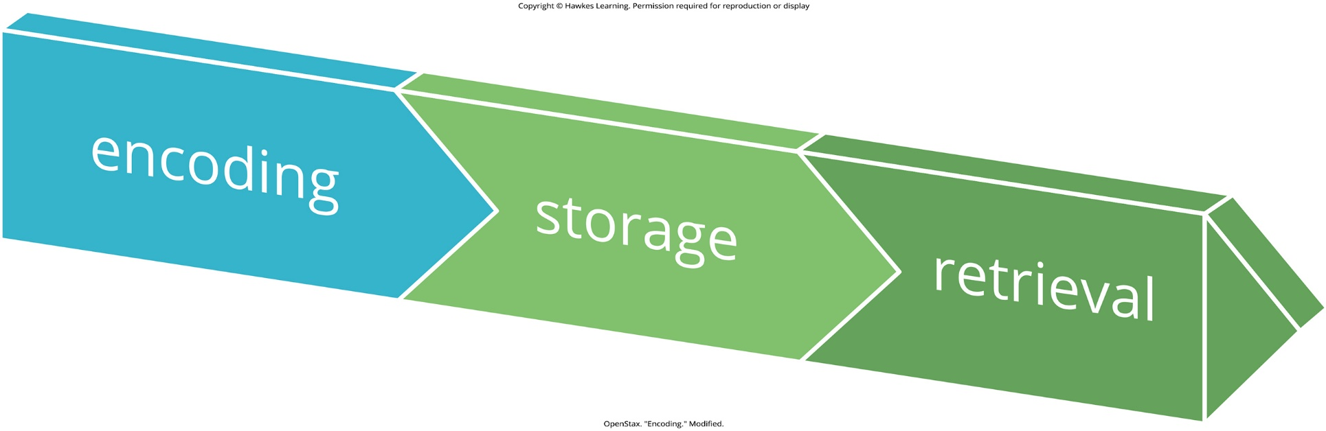
Lesson 7.1 Figure 2

Slide 4
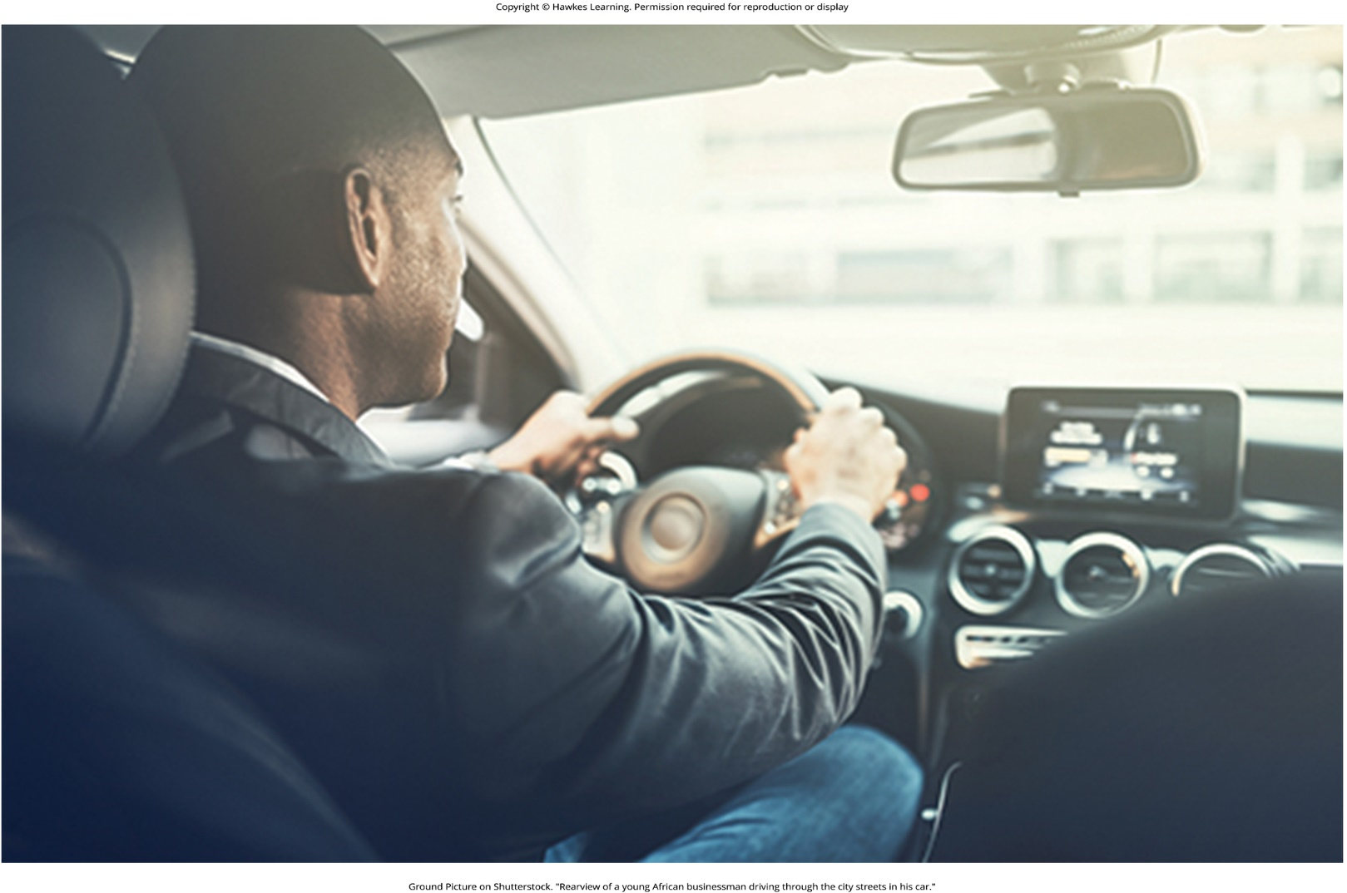
Lesson 7.1 Figure 3

Slide 5
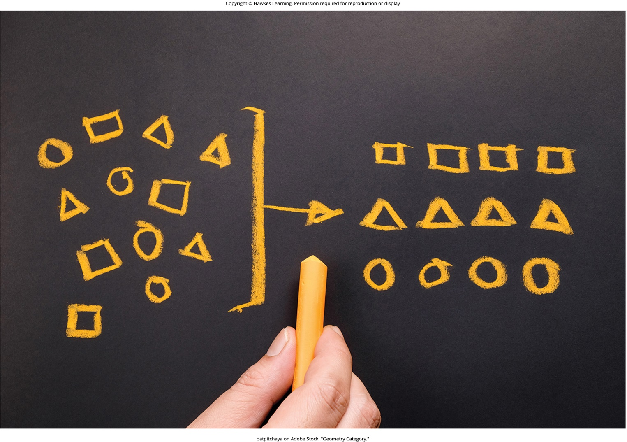
Lesson 7.1 Figure 4

Slide 6
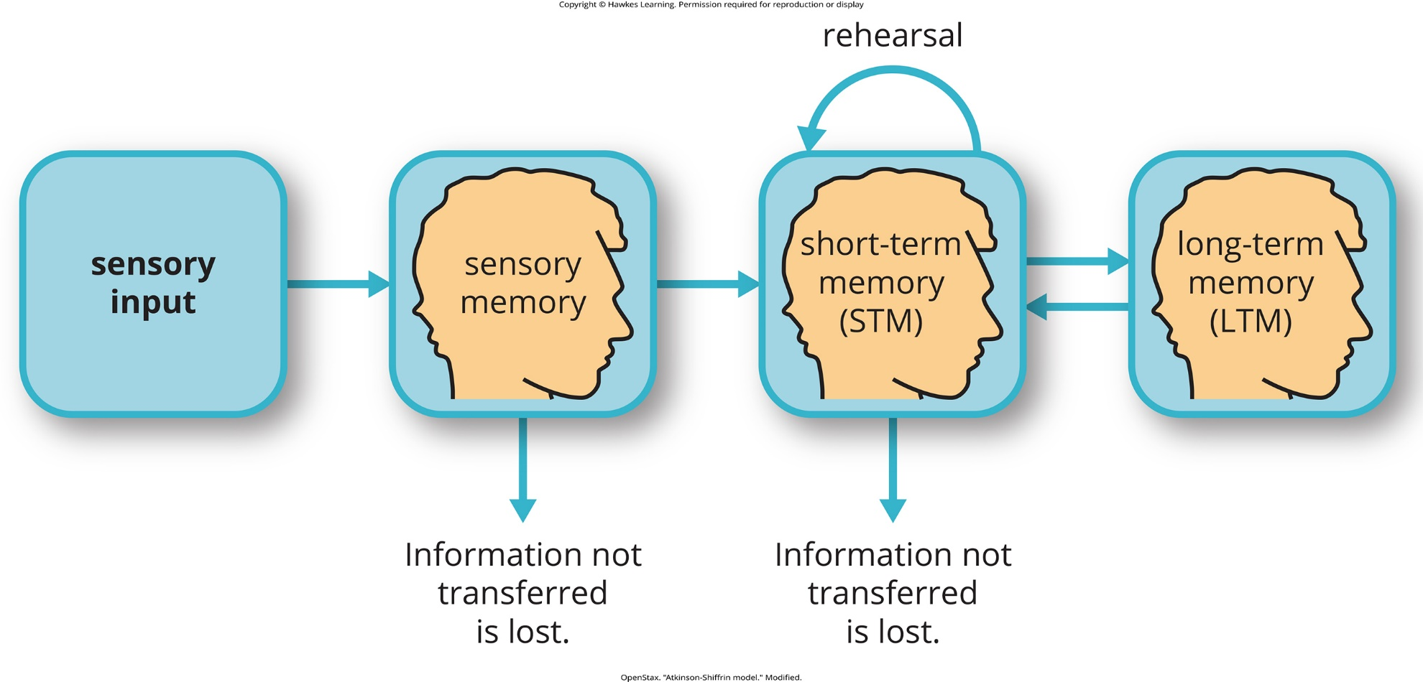
Lesson 7.1 Figure 5

Slide 7
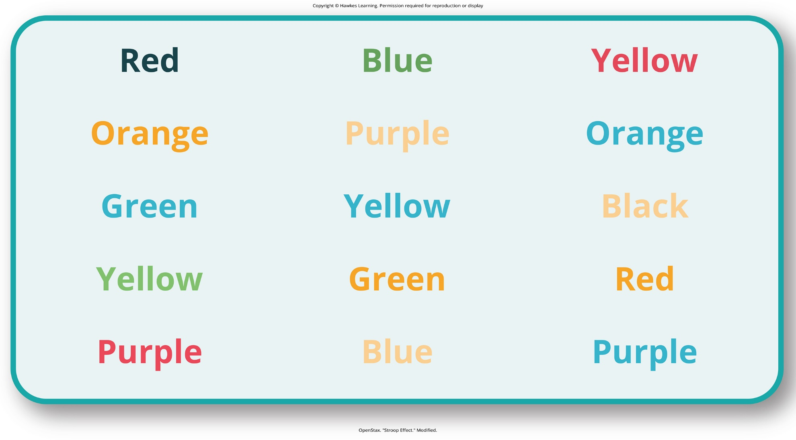
Lesson 7.1 Figure 6

Slide 8
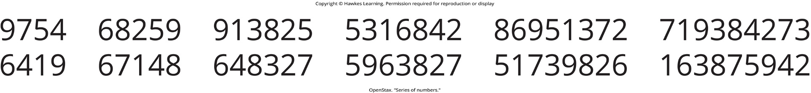
Lesson 7.1 Figure 7

Slide 9
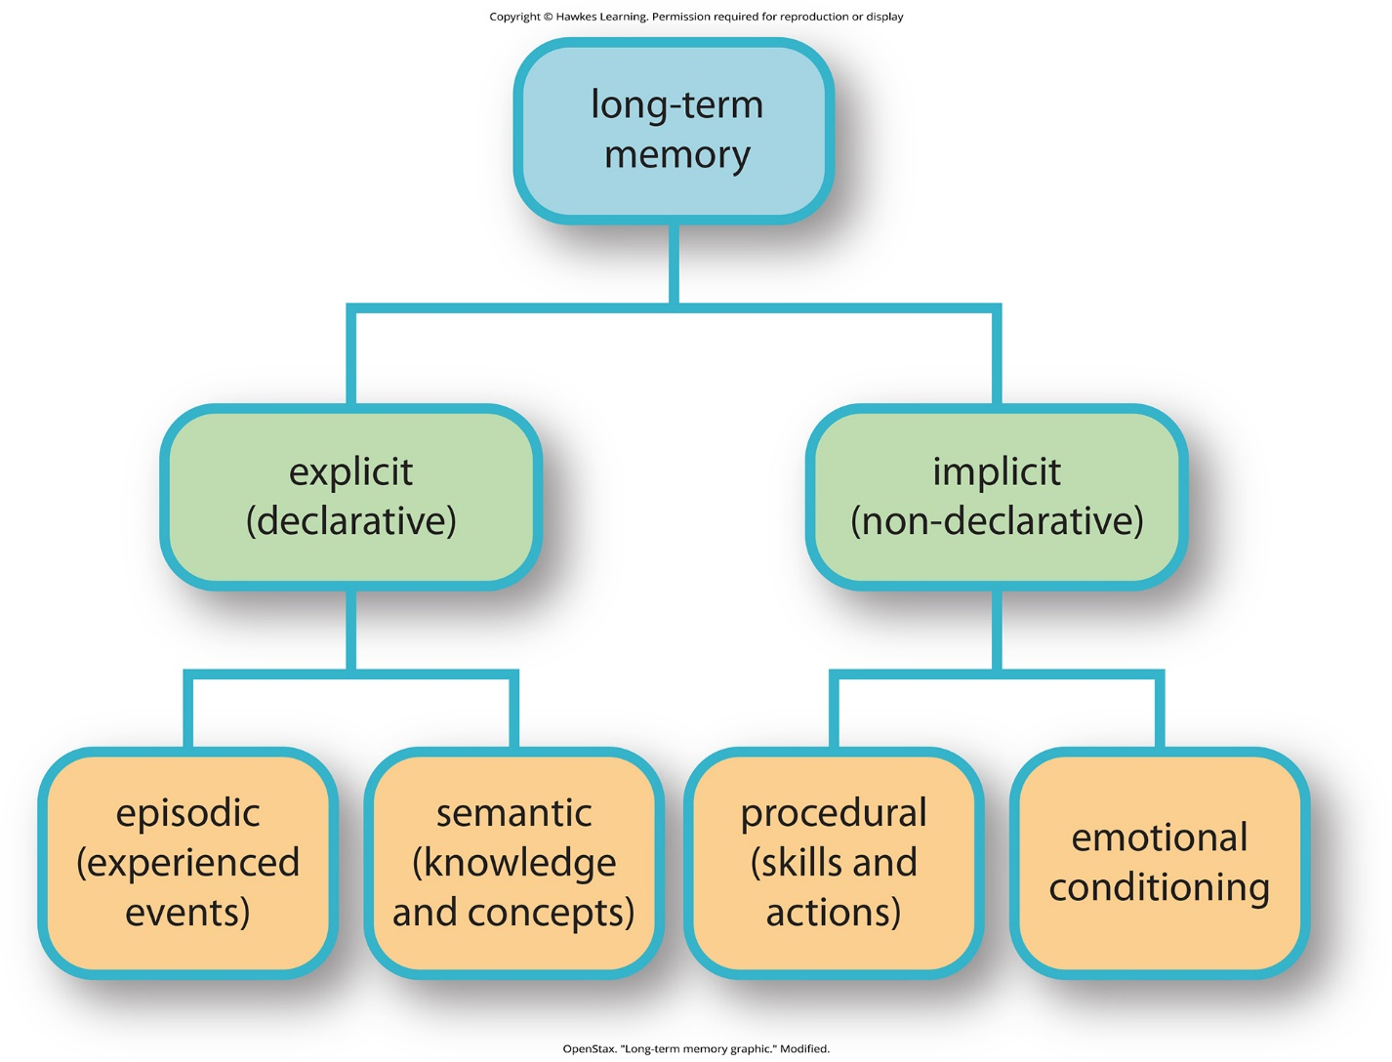
Lesson 7.1 Figure 8

Slide 10
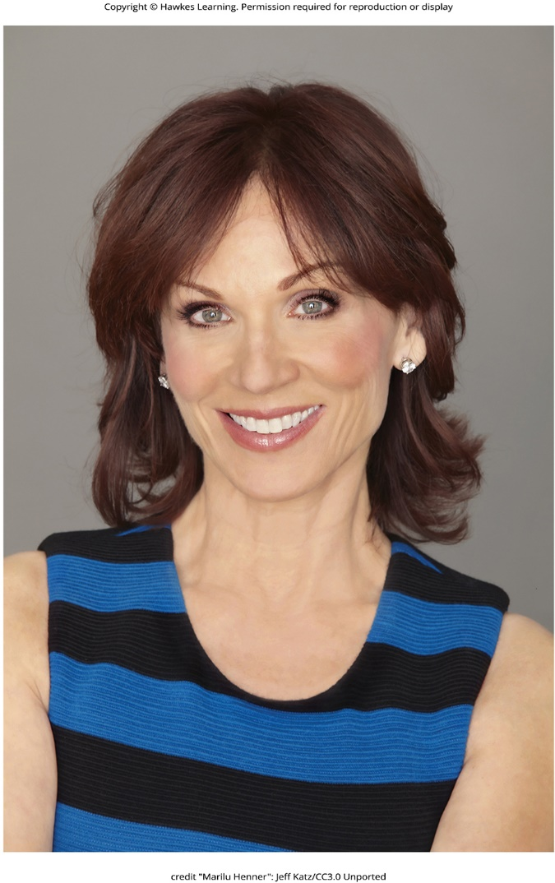
Lesson 7.1 Figure 9

Slide 11
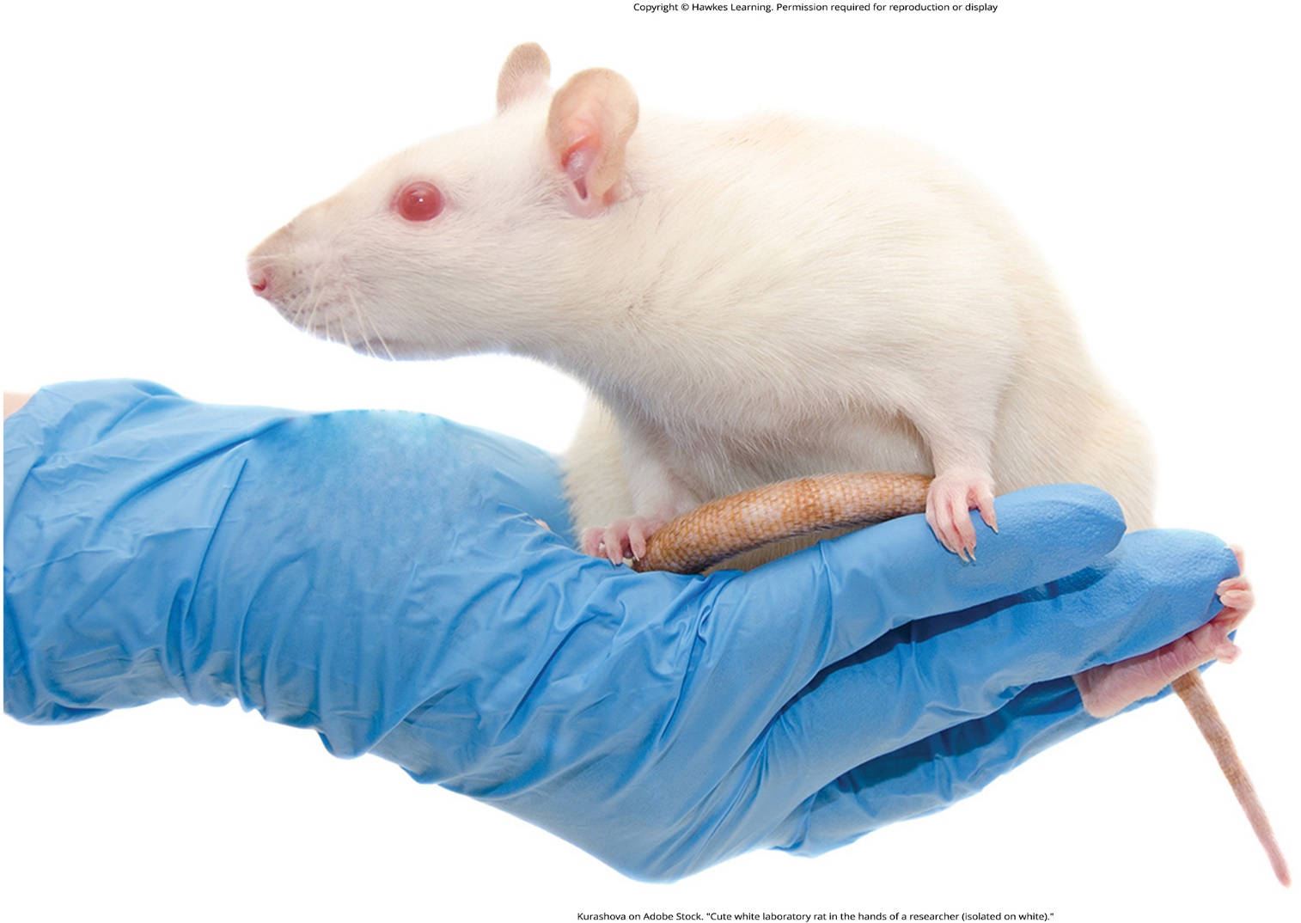
Lesson 7.2 Figure 1

Slide 12
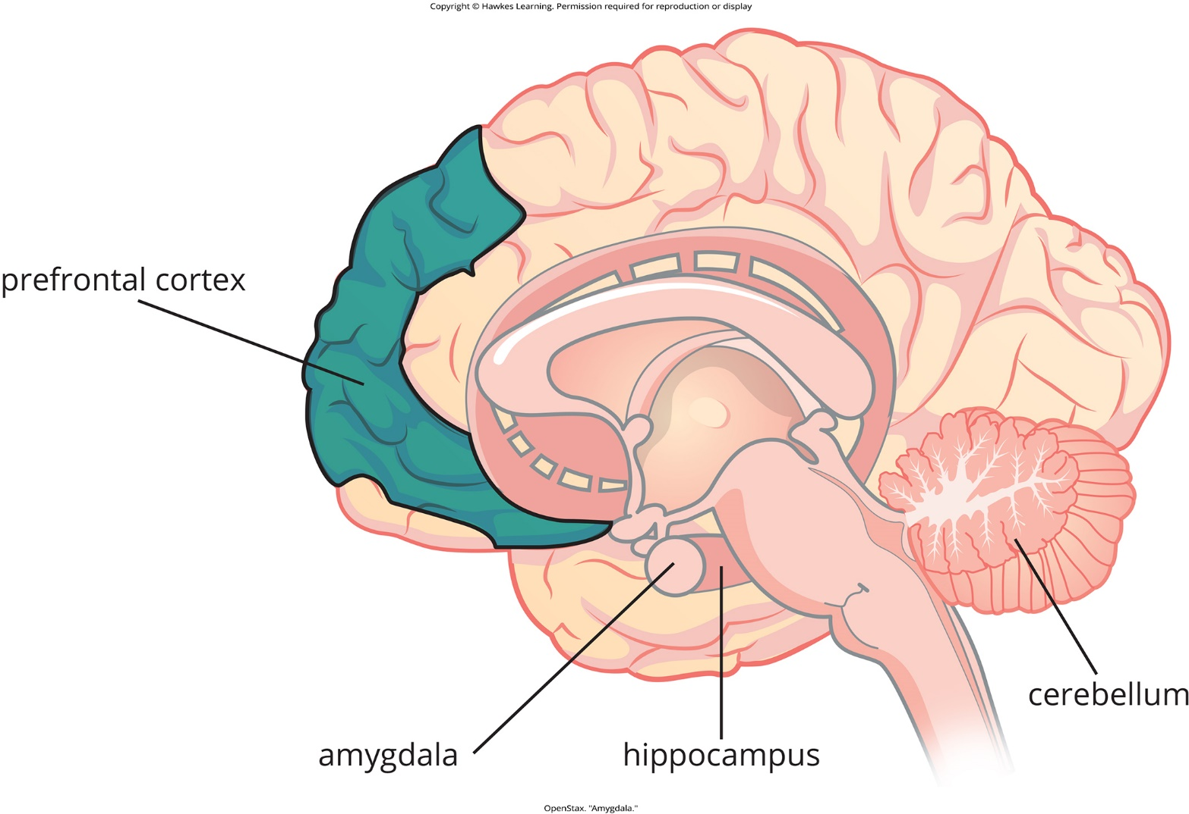
Lesson 7.2 Figure 2

Slide 13

Lesson 7.2 Figure 3

Slide 14
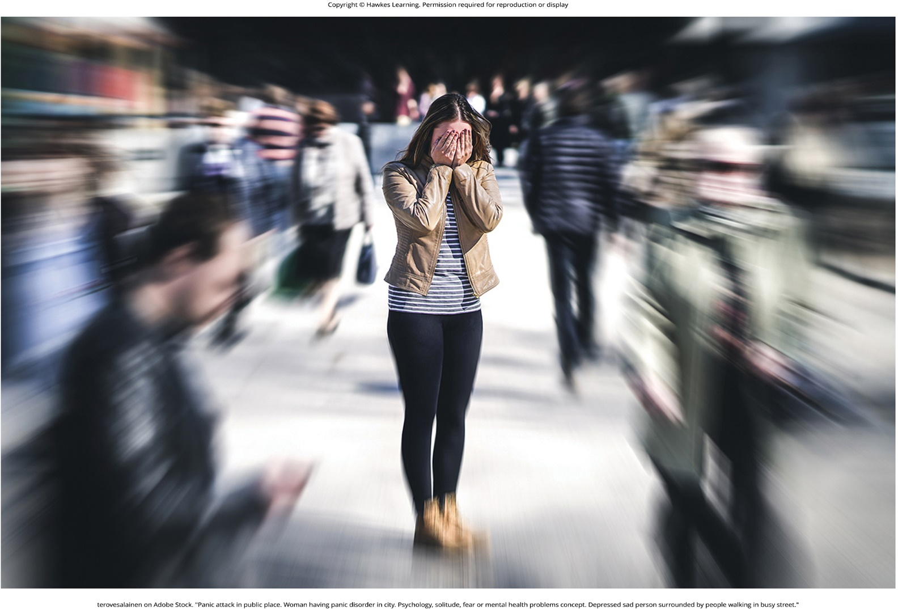
Lesson 7.2 Figure 4

Slide 15
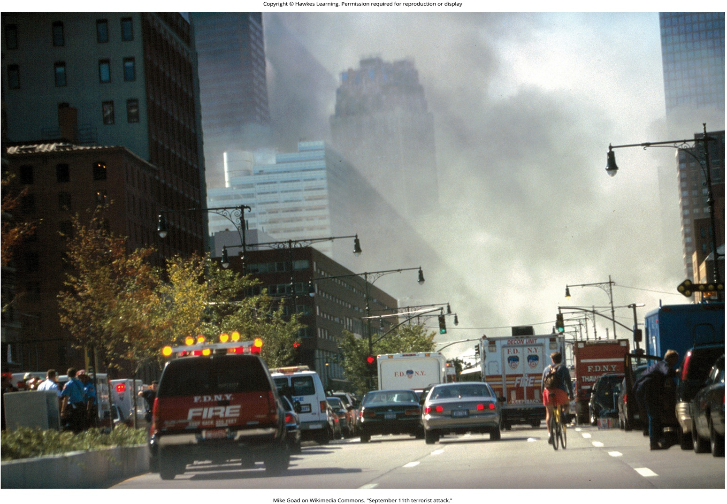
Lesson 7.2 Figure 5

Slide 16
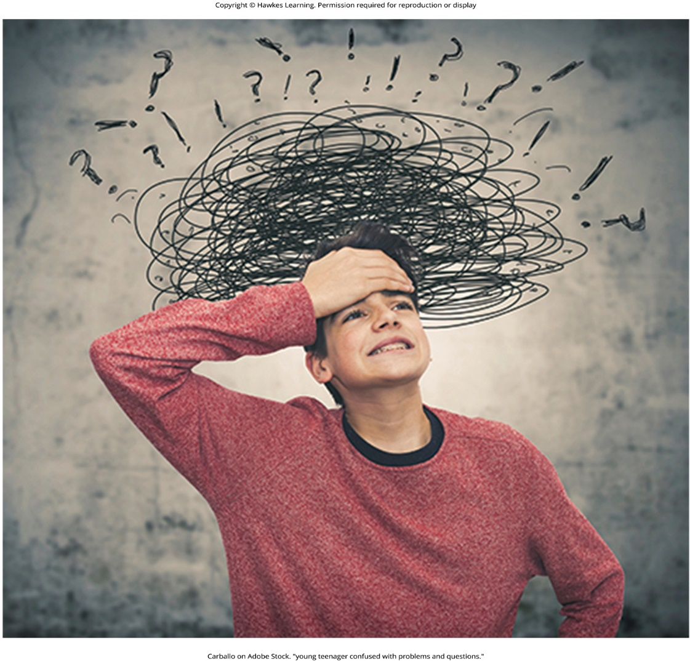
Lesson 7.3 Figure 1

Slide 17
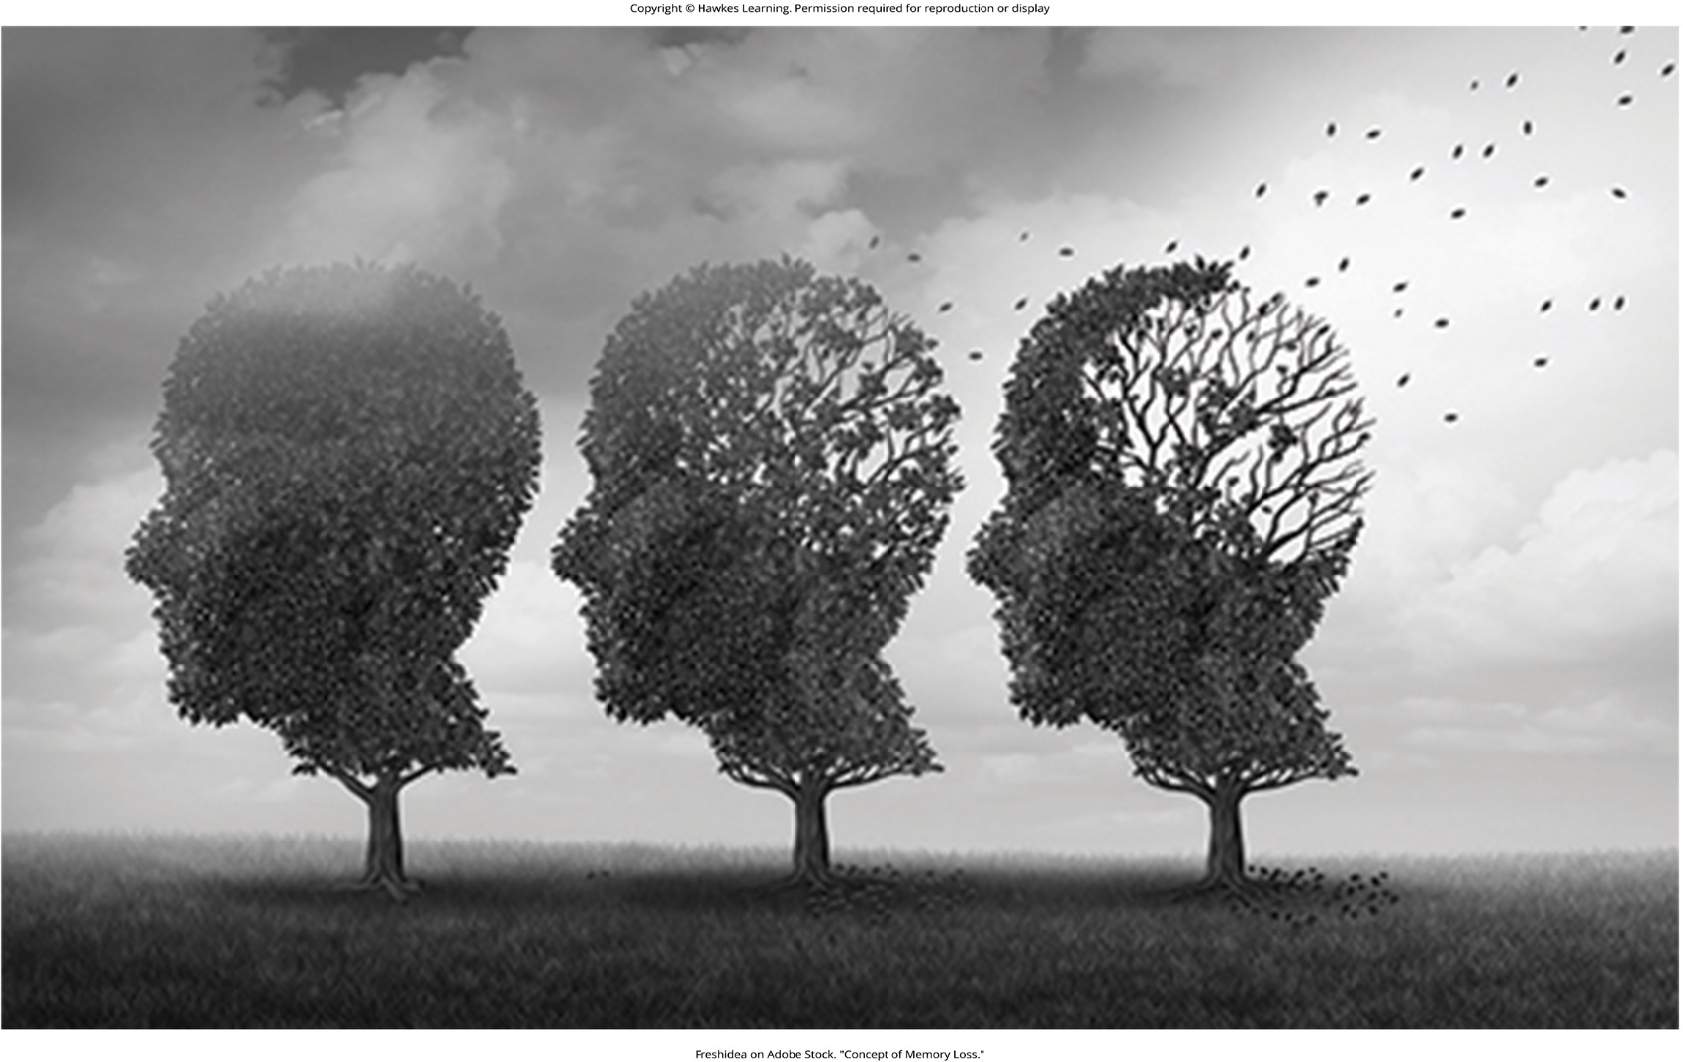
Lesson 7.3 Figure 2

Slide 18
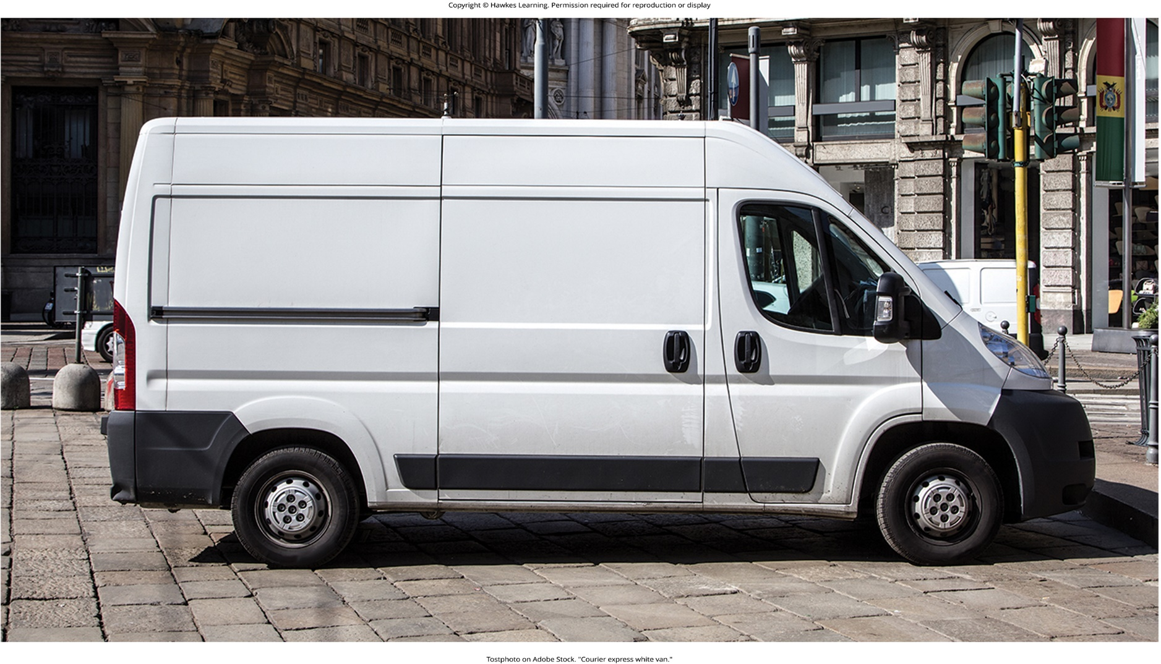
Lesson 7.3 Figure 3

Slide 19
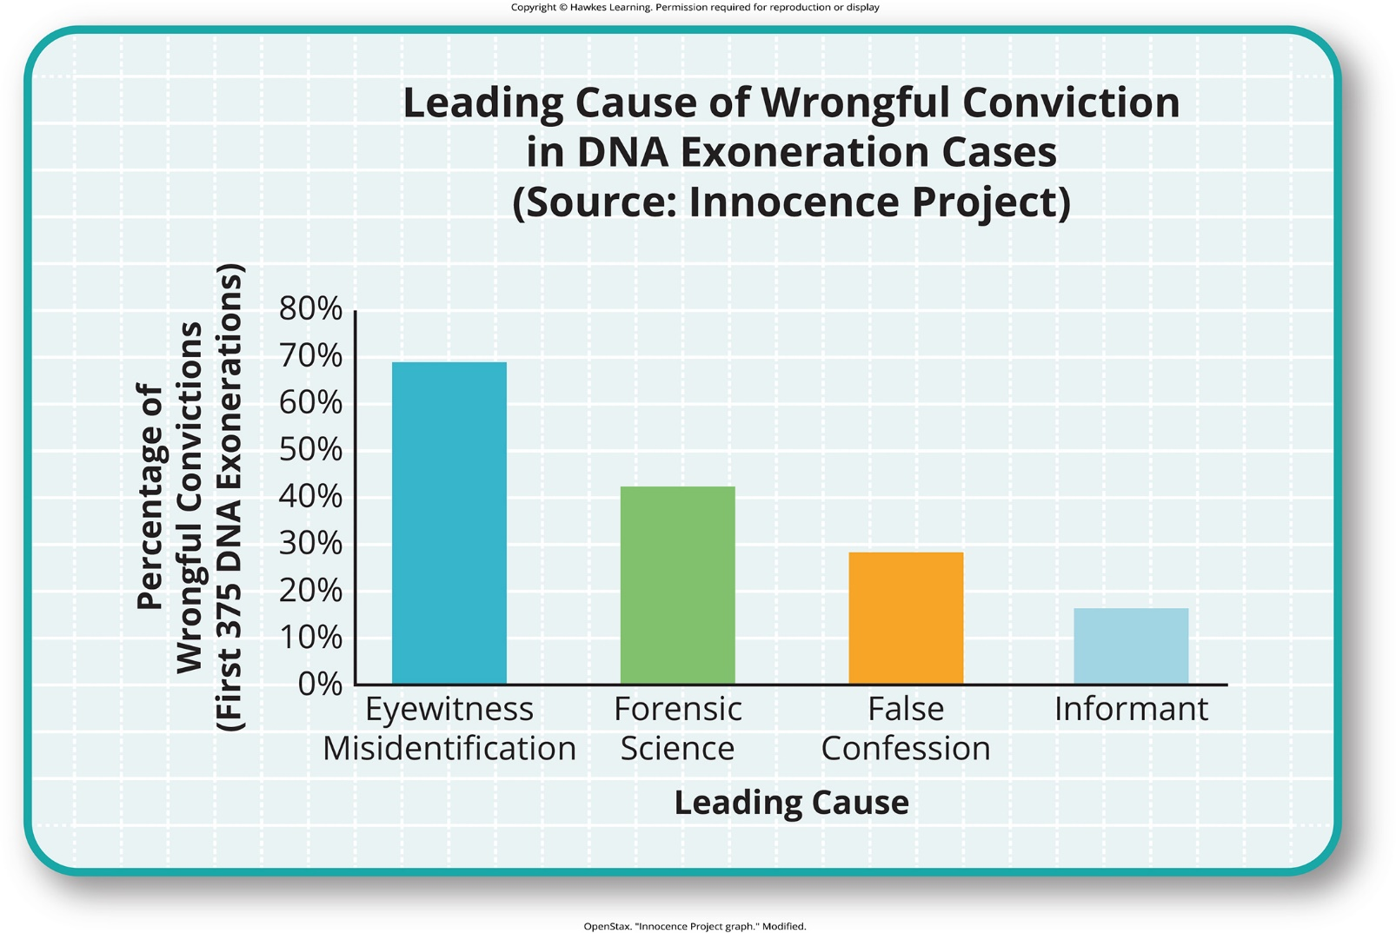
Lesson 7.3 Figure 4

Slide 20
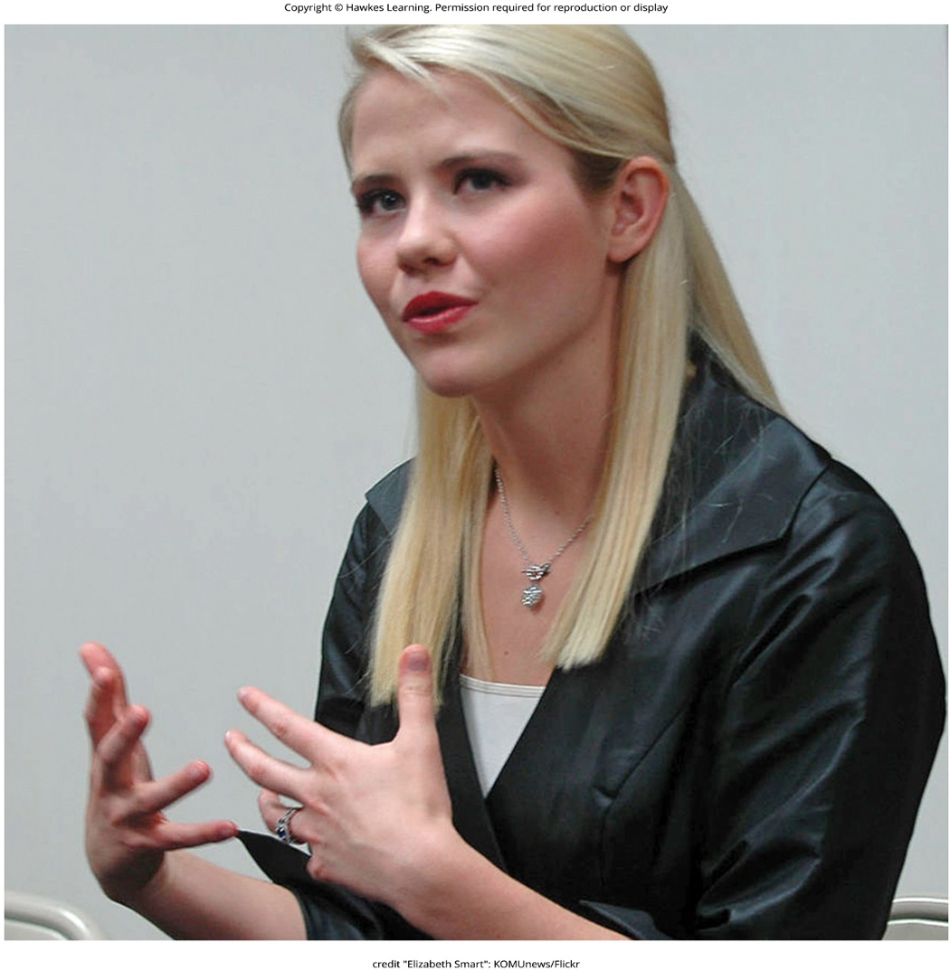
Lesson 7.3 Figure 5

Slide 21
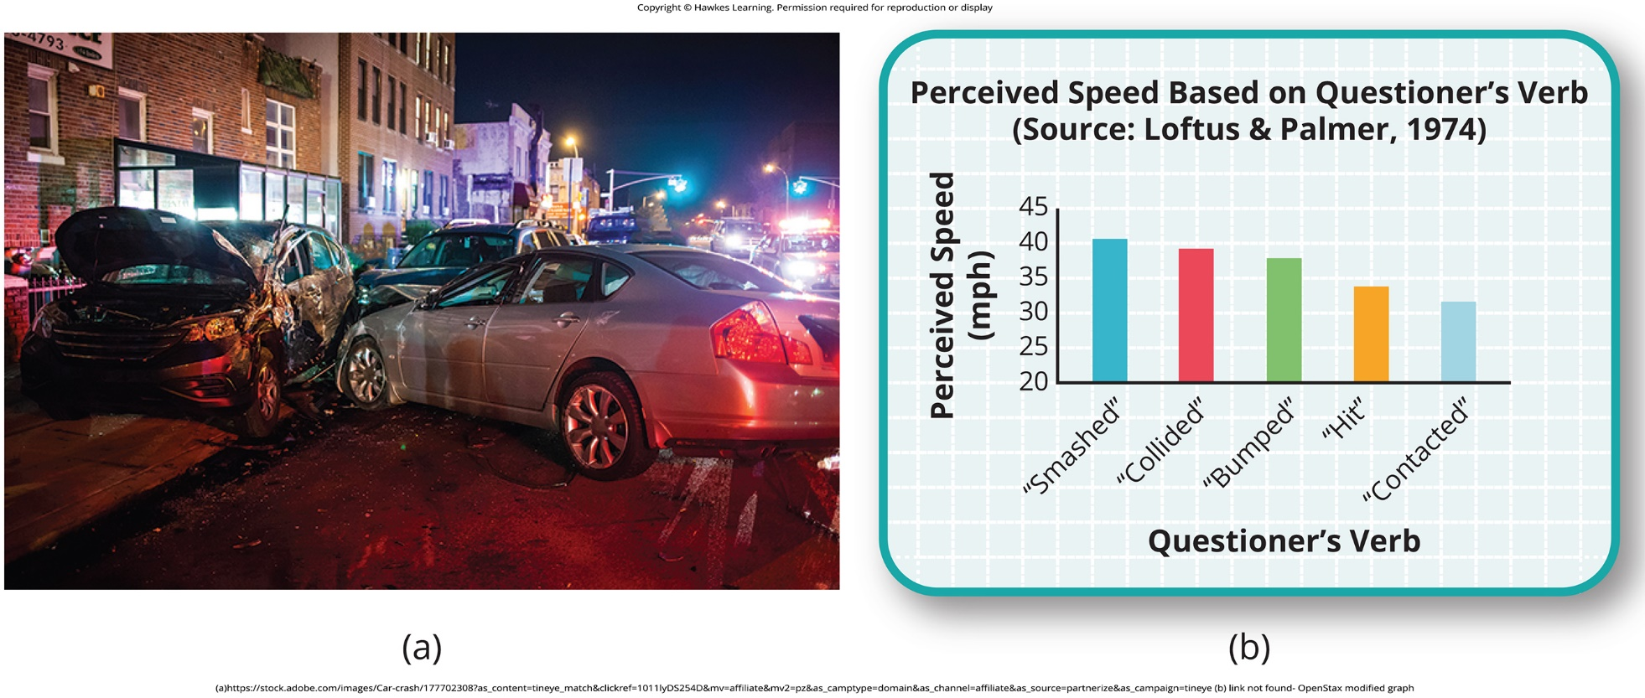
Lesson 7.3 Figure 6

Slide 22
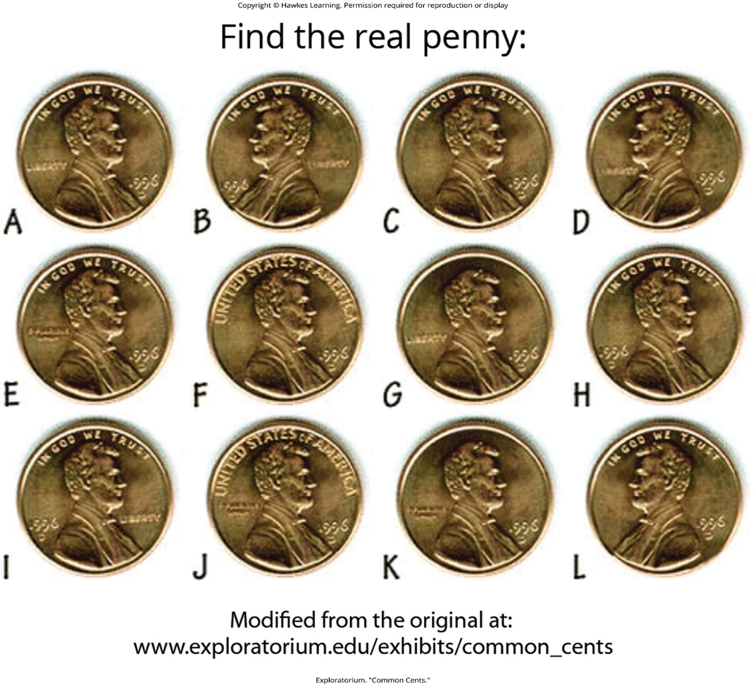
Lesson 7.3 Figure 7

Slide 23
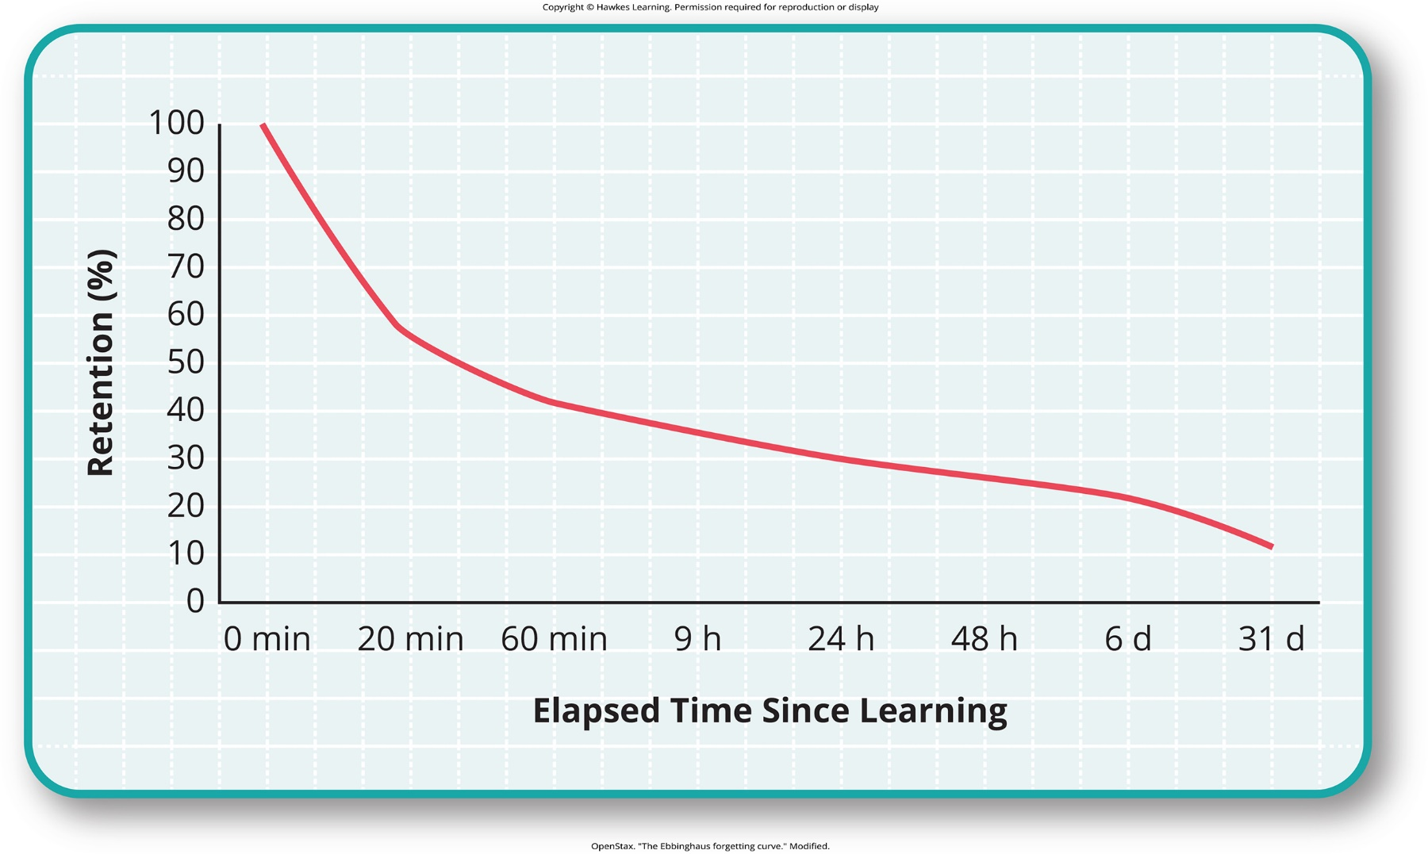
Lesson 7.3 Figure 8

Slide 24
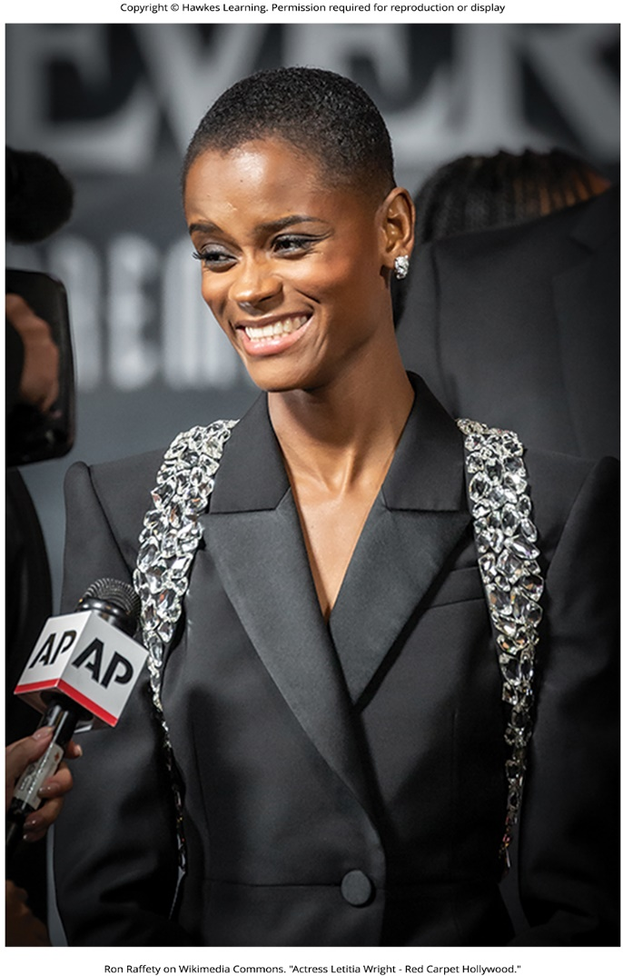
Lesson 7.3 Figure 9

Slide 25
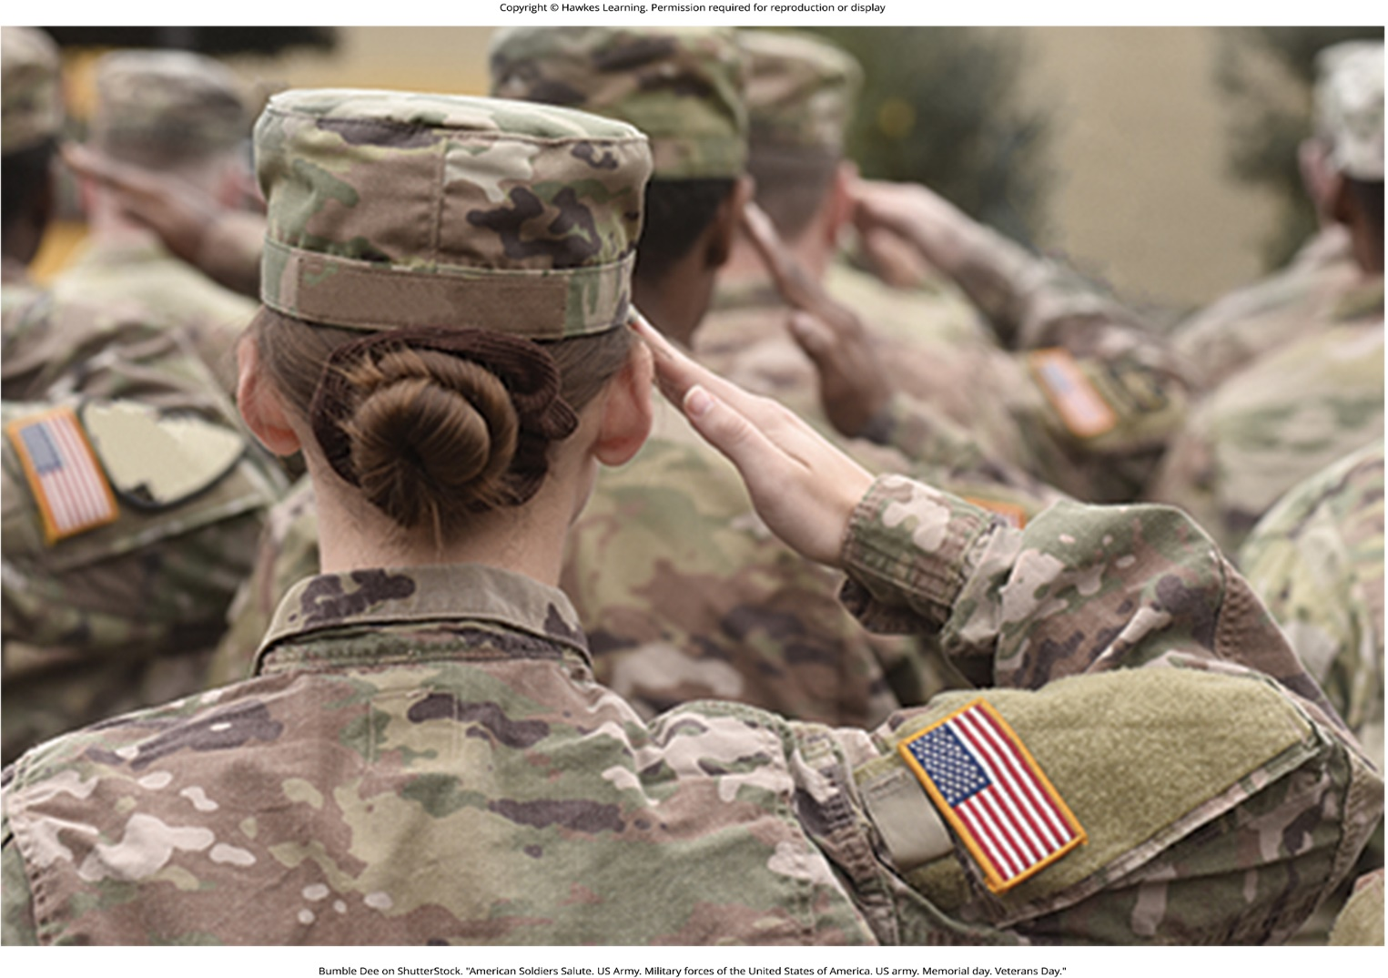
Lesson 7.3 Figure 10

Slide 26
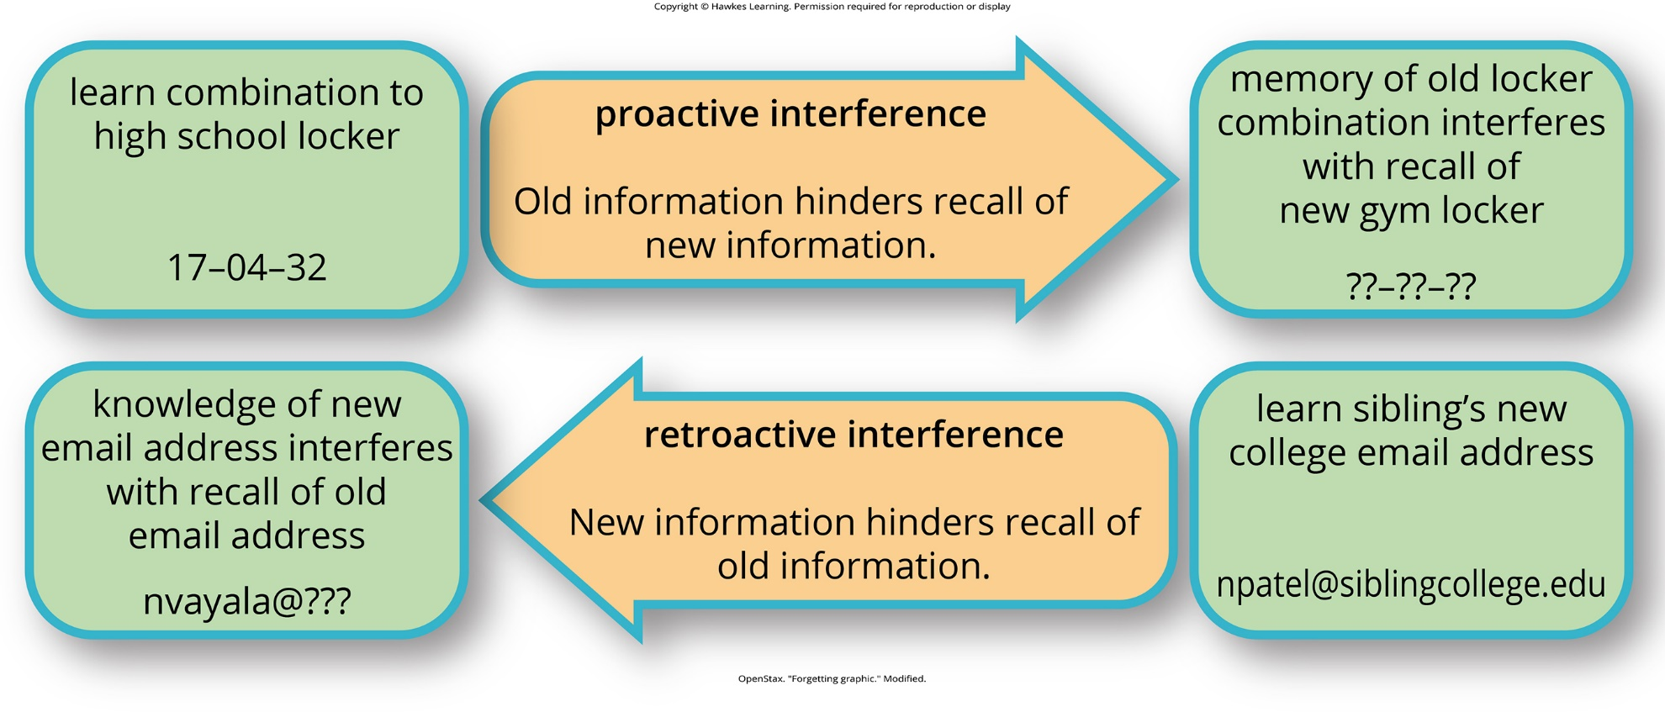
Lesson 7.3 Figure 11

Slide 27
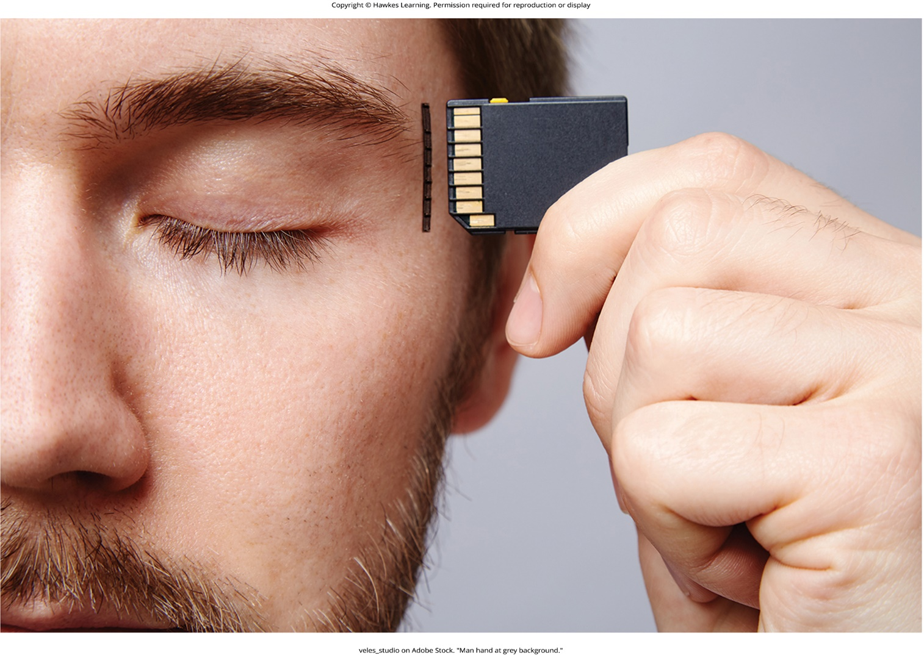
Lesson 7.4 Figure 1

Slide 28
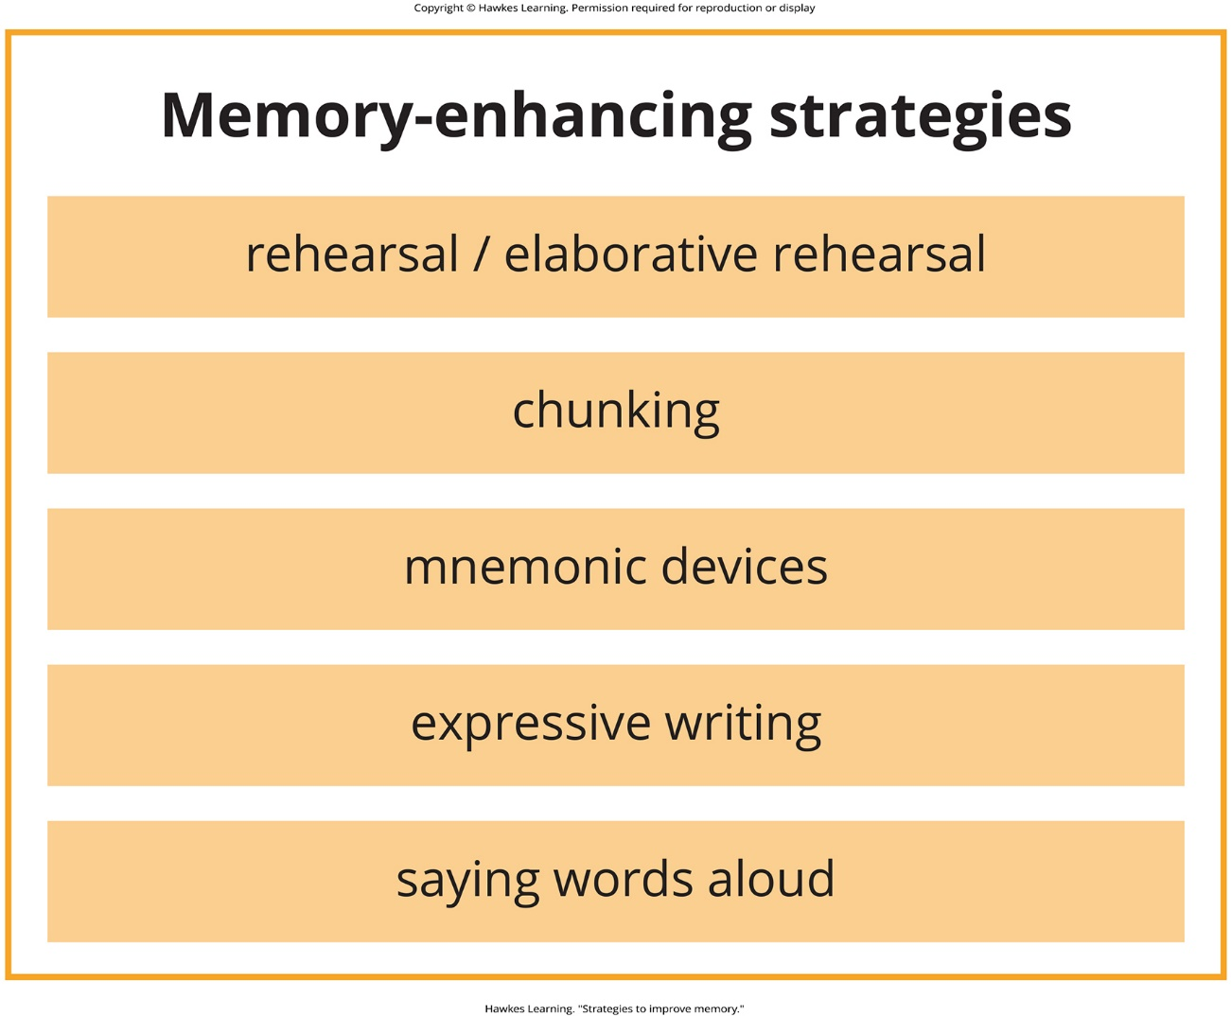
Lesson 7.4 Figure 2

Slide 29
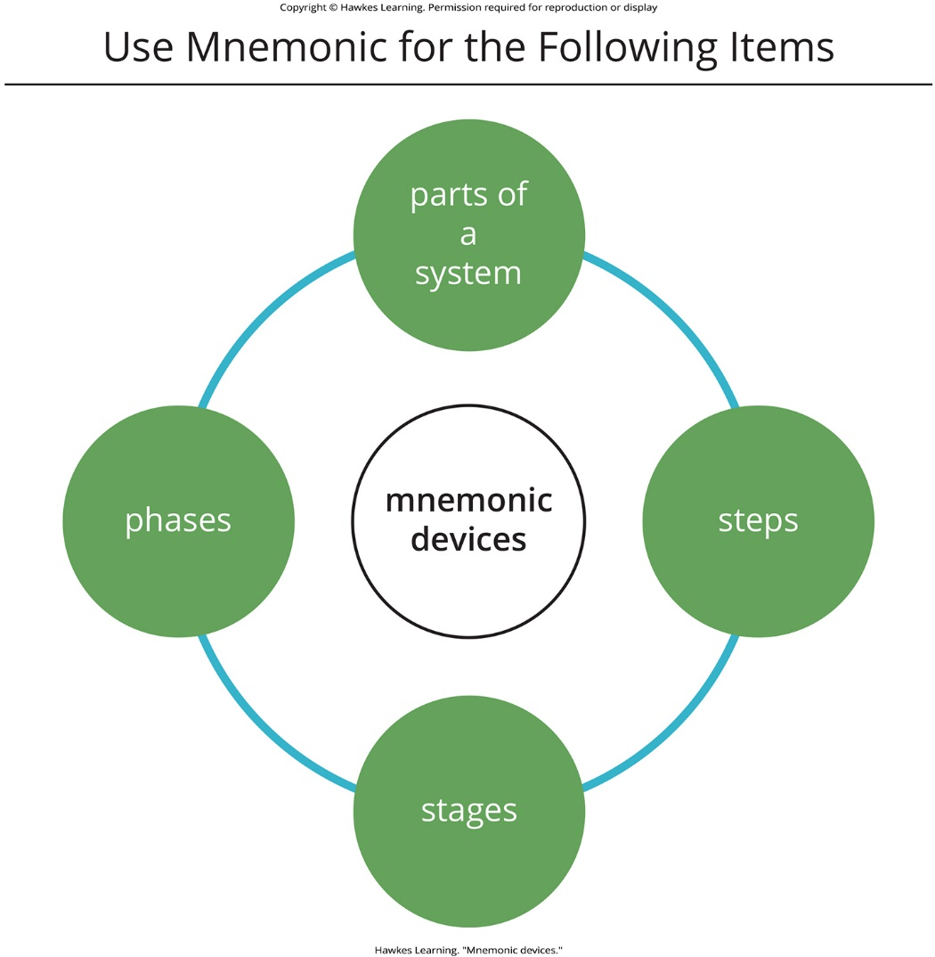
Lesson 7.4 Figure 3

Slide 30
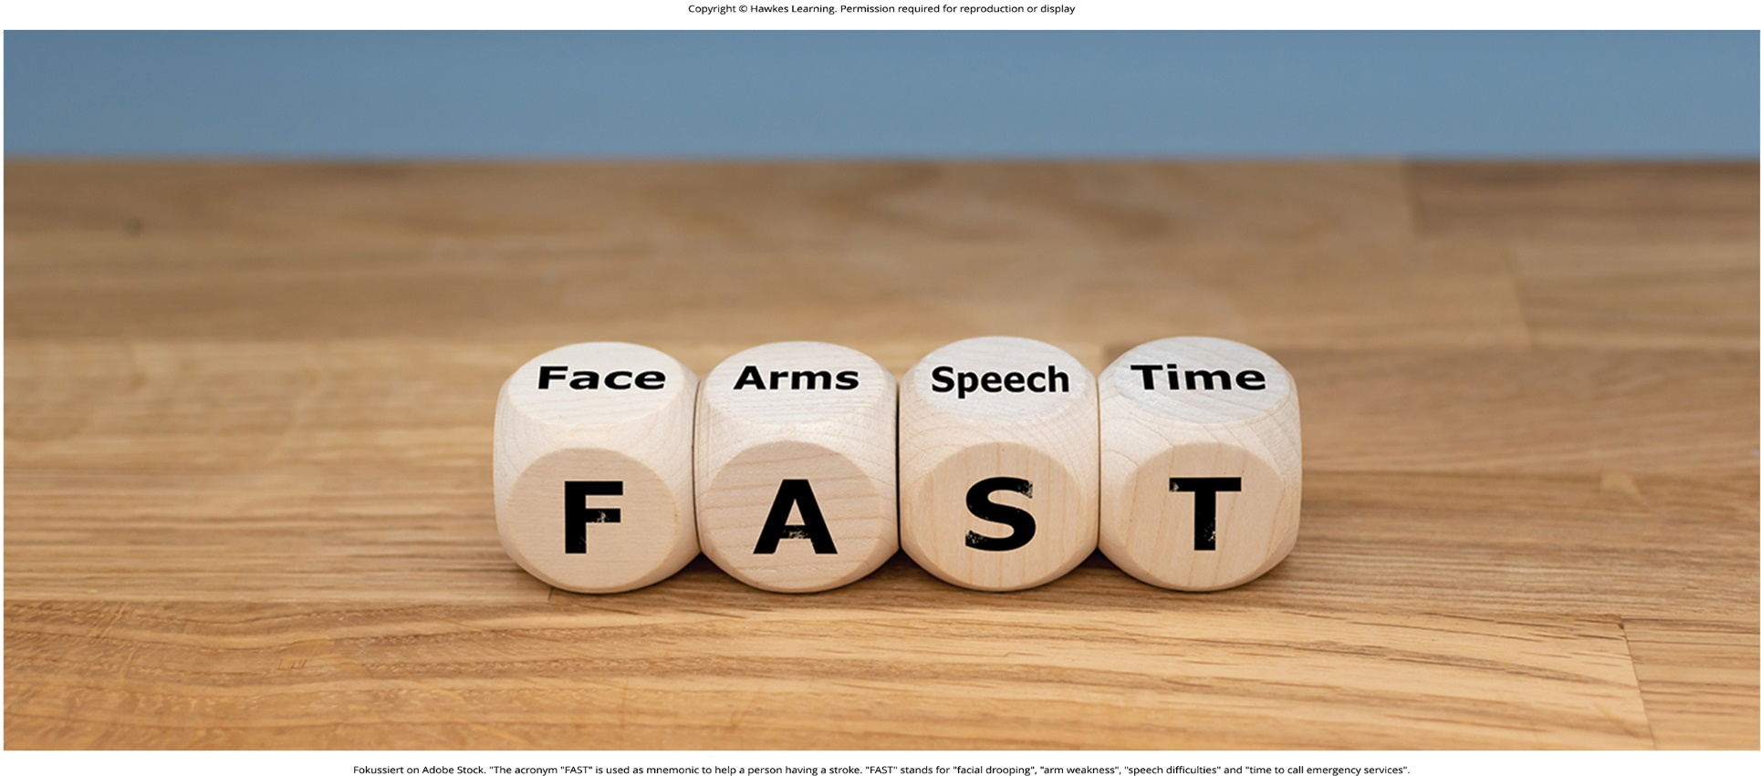
Lesson 7.4 Figure 4

Slide 31

Lesson 7.4 Figure 5

Slide 32
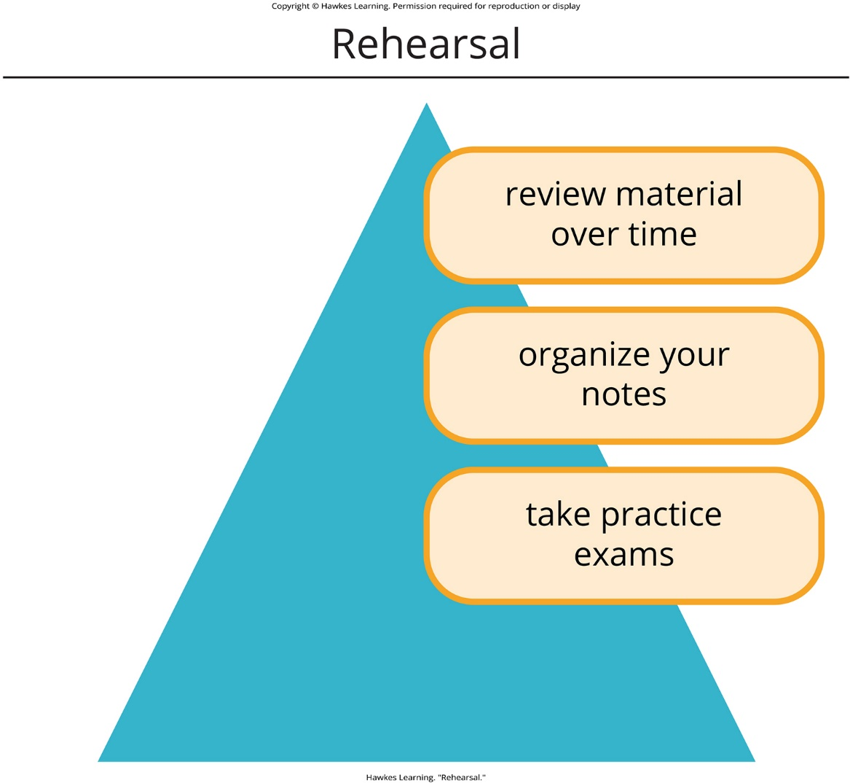
Lesson 7.4 Figure 6

Slide 33

Lesson 7.4 Figure 7

Slide 34

Lesson 7.4 Figure 8

Slide 35

Lesson 7.4 Figure 9

Slide 36
Hawkes Learning – End of PowerPoint

