Slide 1
Chapter 8
Lifespan Development

Slide 2
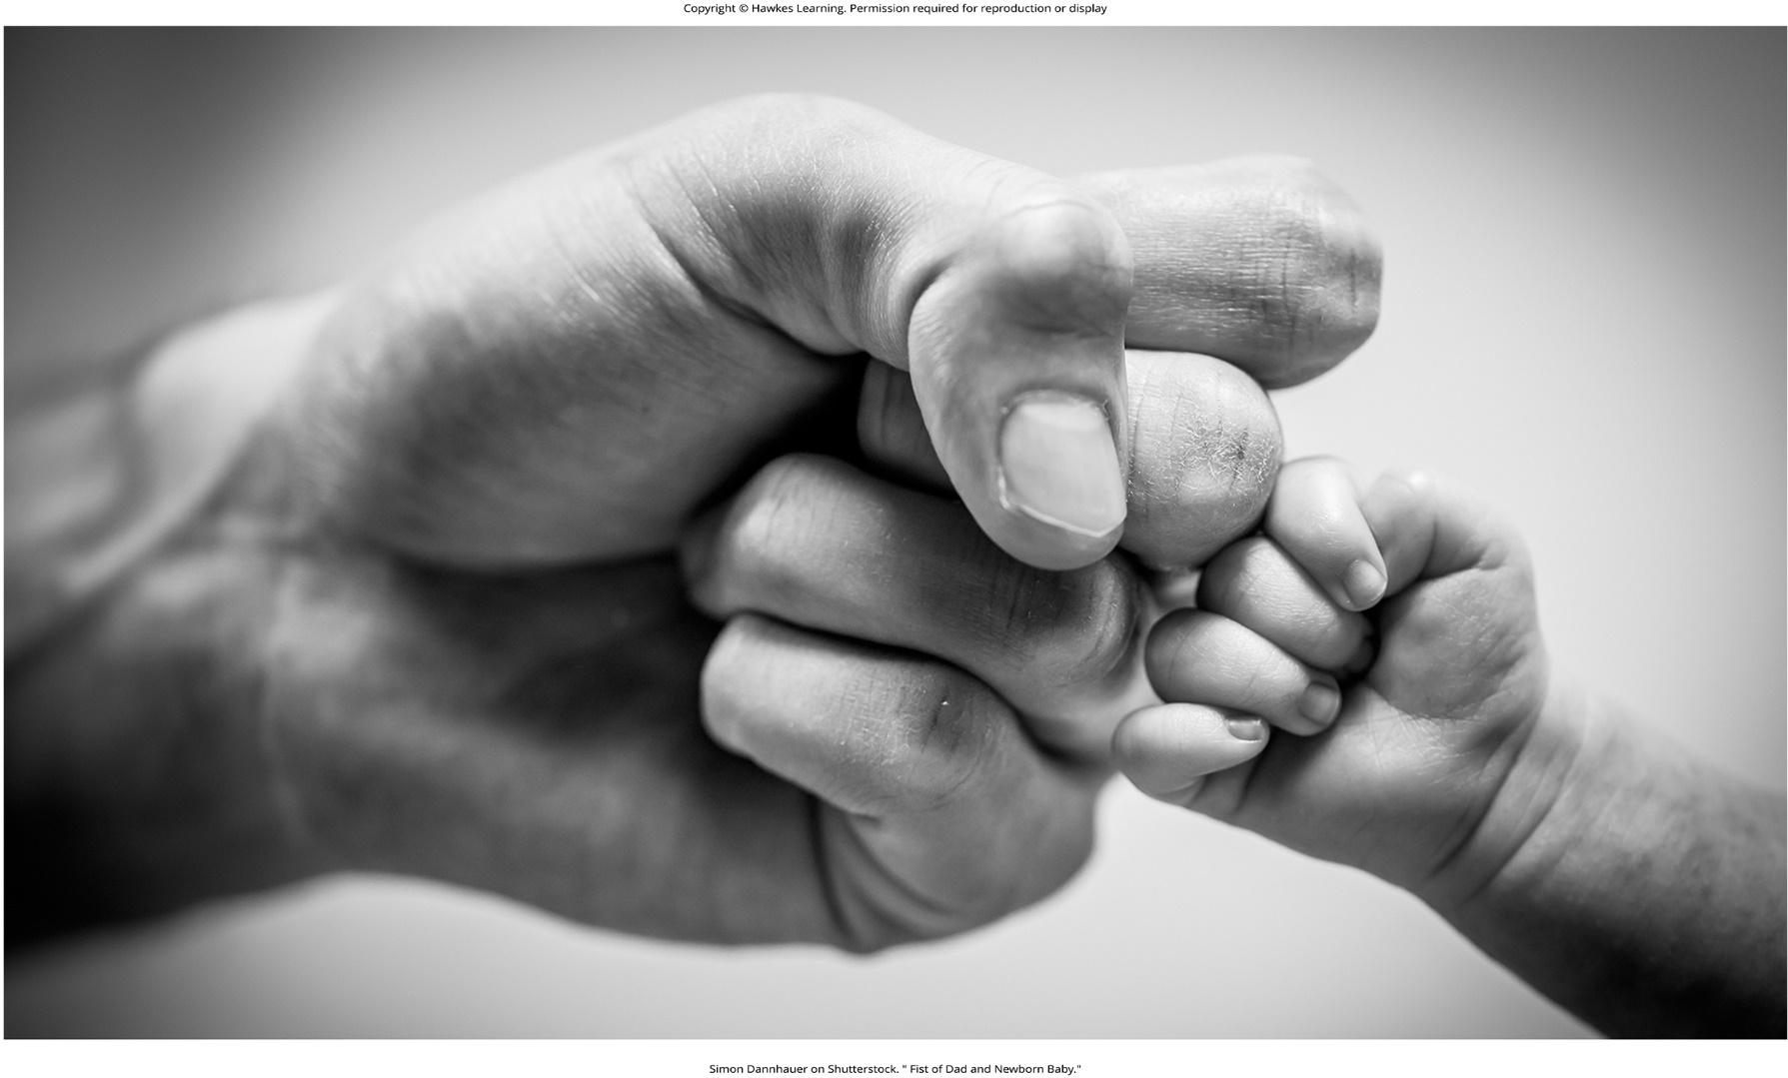
Lesson 8.1 Figure 1

Slide 3
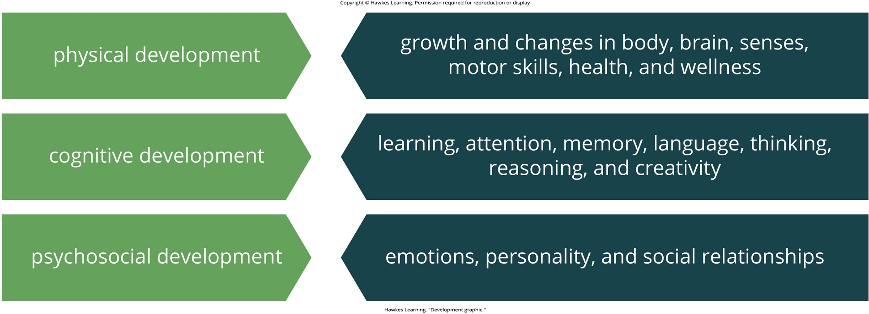
Lesson 8.1 Figure 2

Slide 4
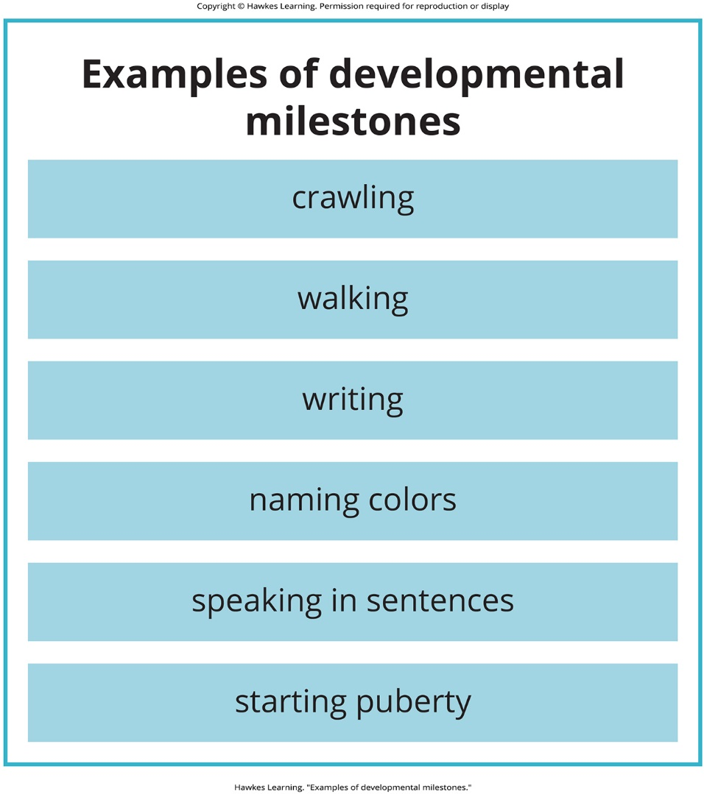
Lesson 8.1 Figure 3

Slide 5
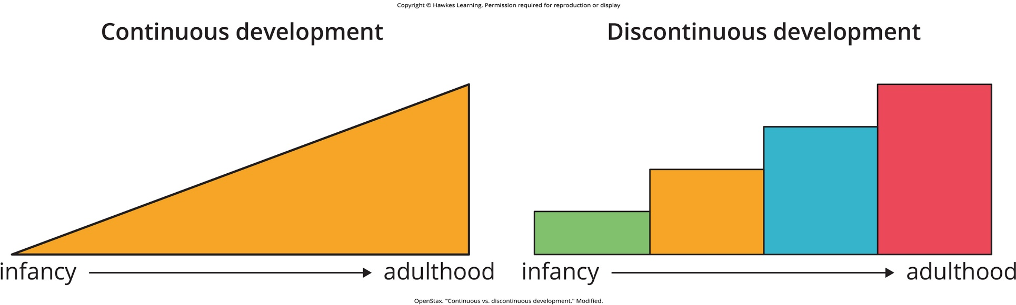
Lesson 8.1 Figure 4

Slide 6

Lesson 8.1 Figure 5

Slide 7
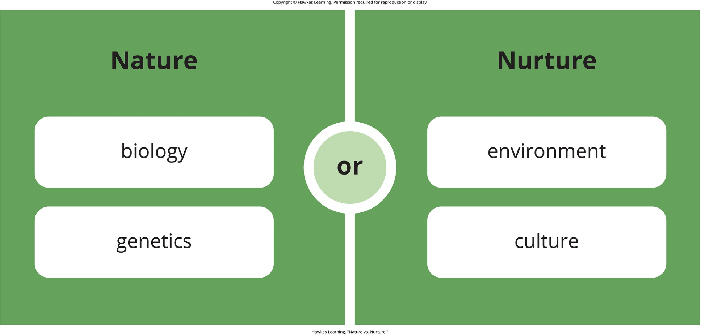
Lesson 8.1 Figure 6

Slide 8
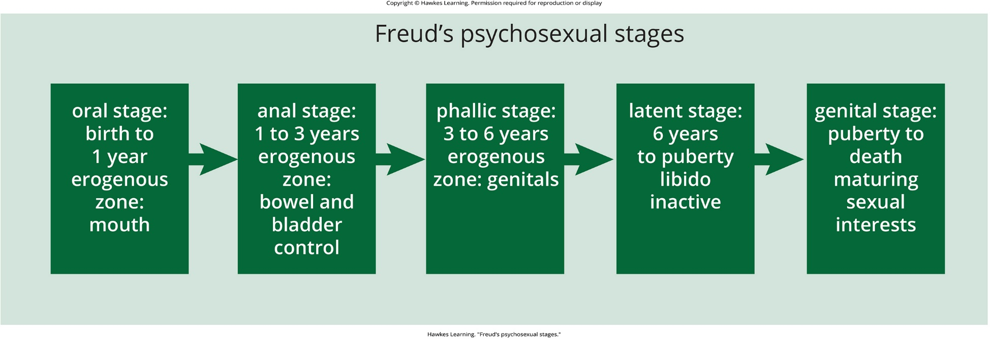
Lesson 8.2 Figure 1

Slide 9
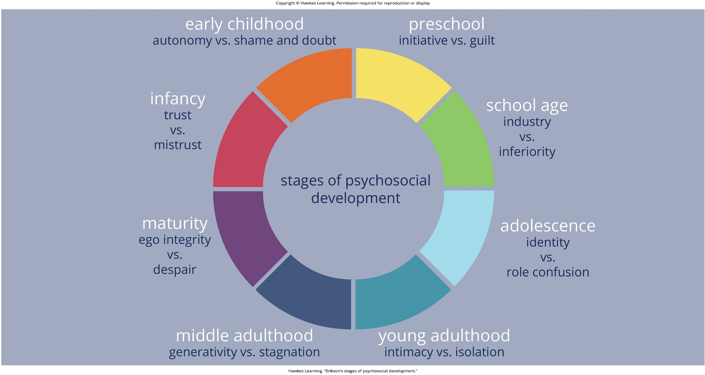
Lesson 8.2 Figure 2

Slide 10

Lesson 8.2 Figure 3

Slide 11

Lesson 8.2 Figure 4

Slide 12
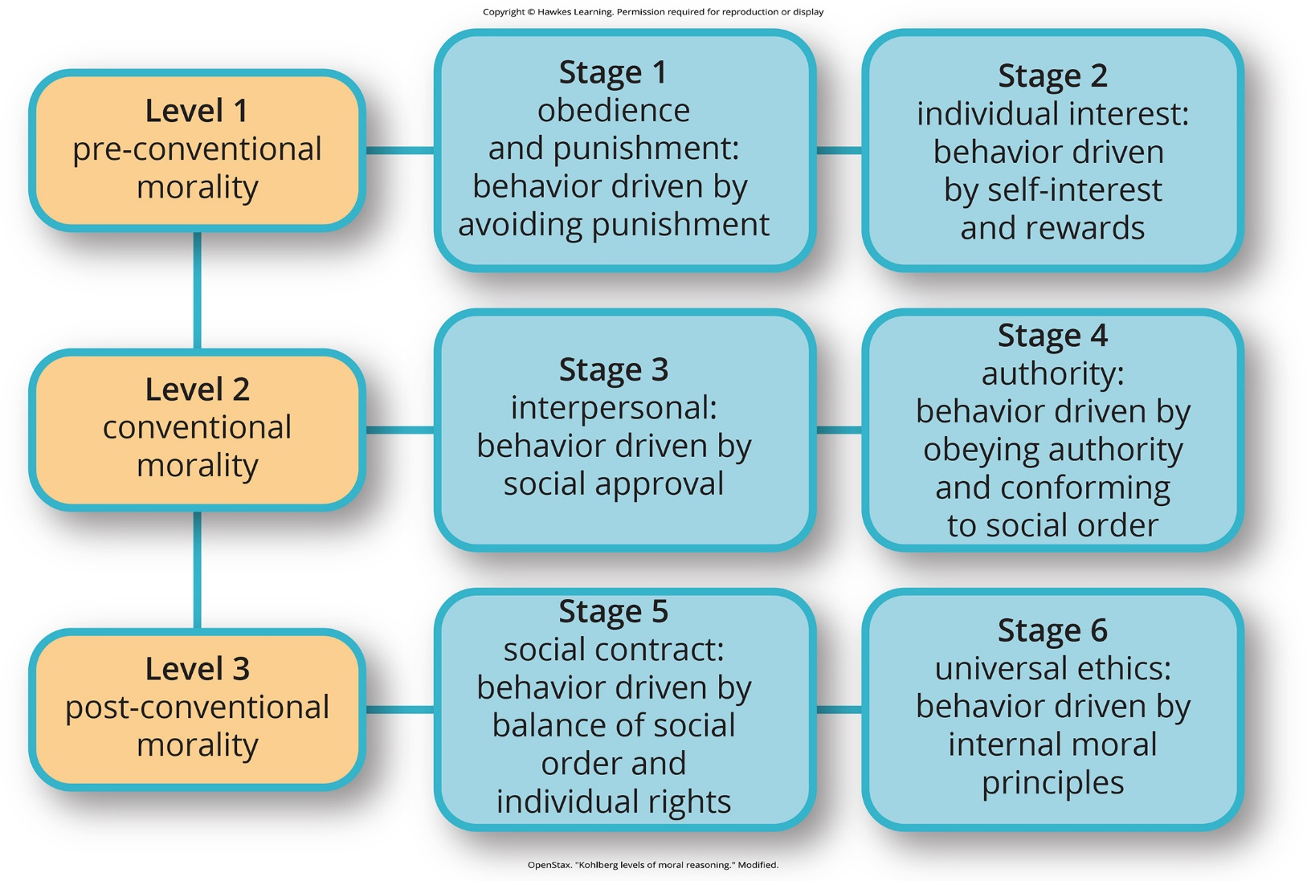
Lesson 8.2 Figure 5

Slide 13
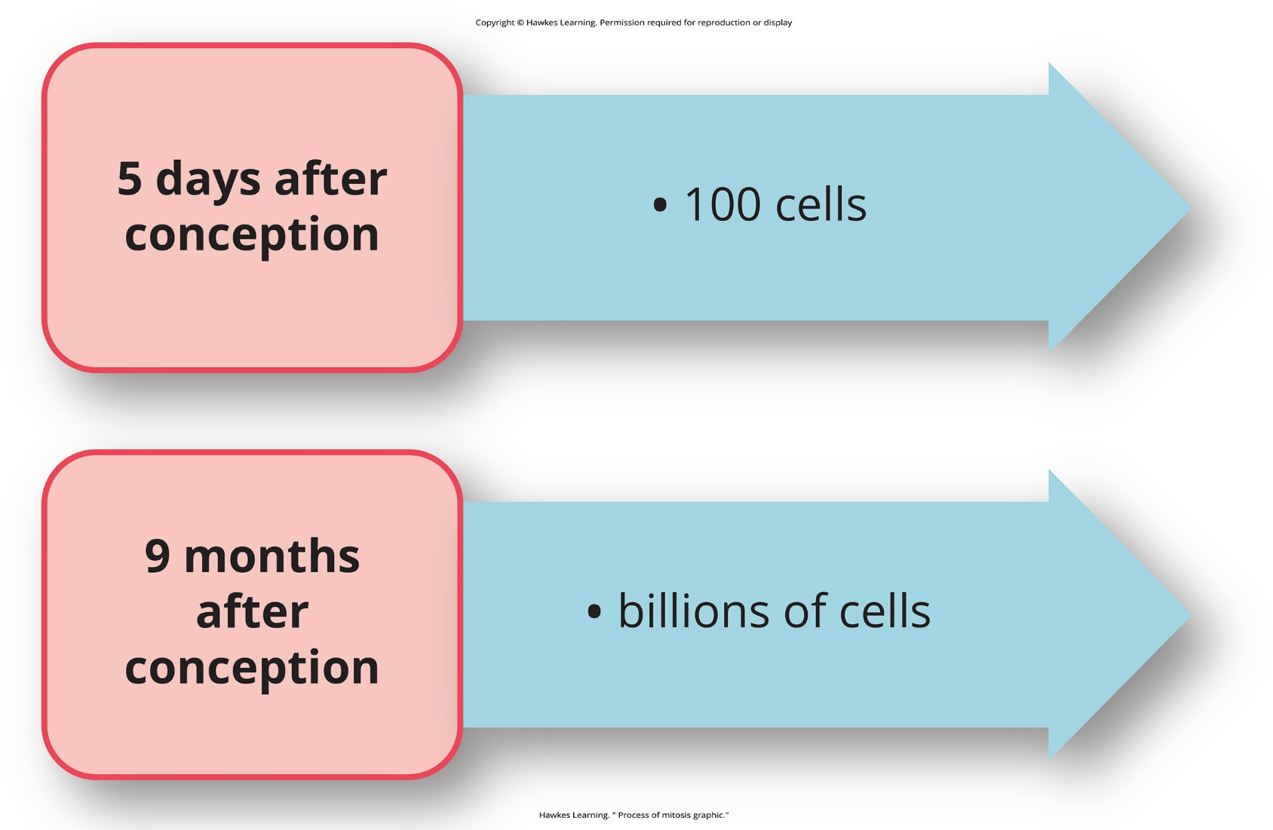
Lesson 8.3 Figure 1

Slide 14
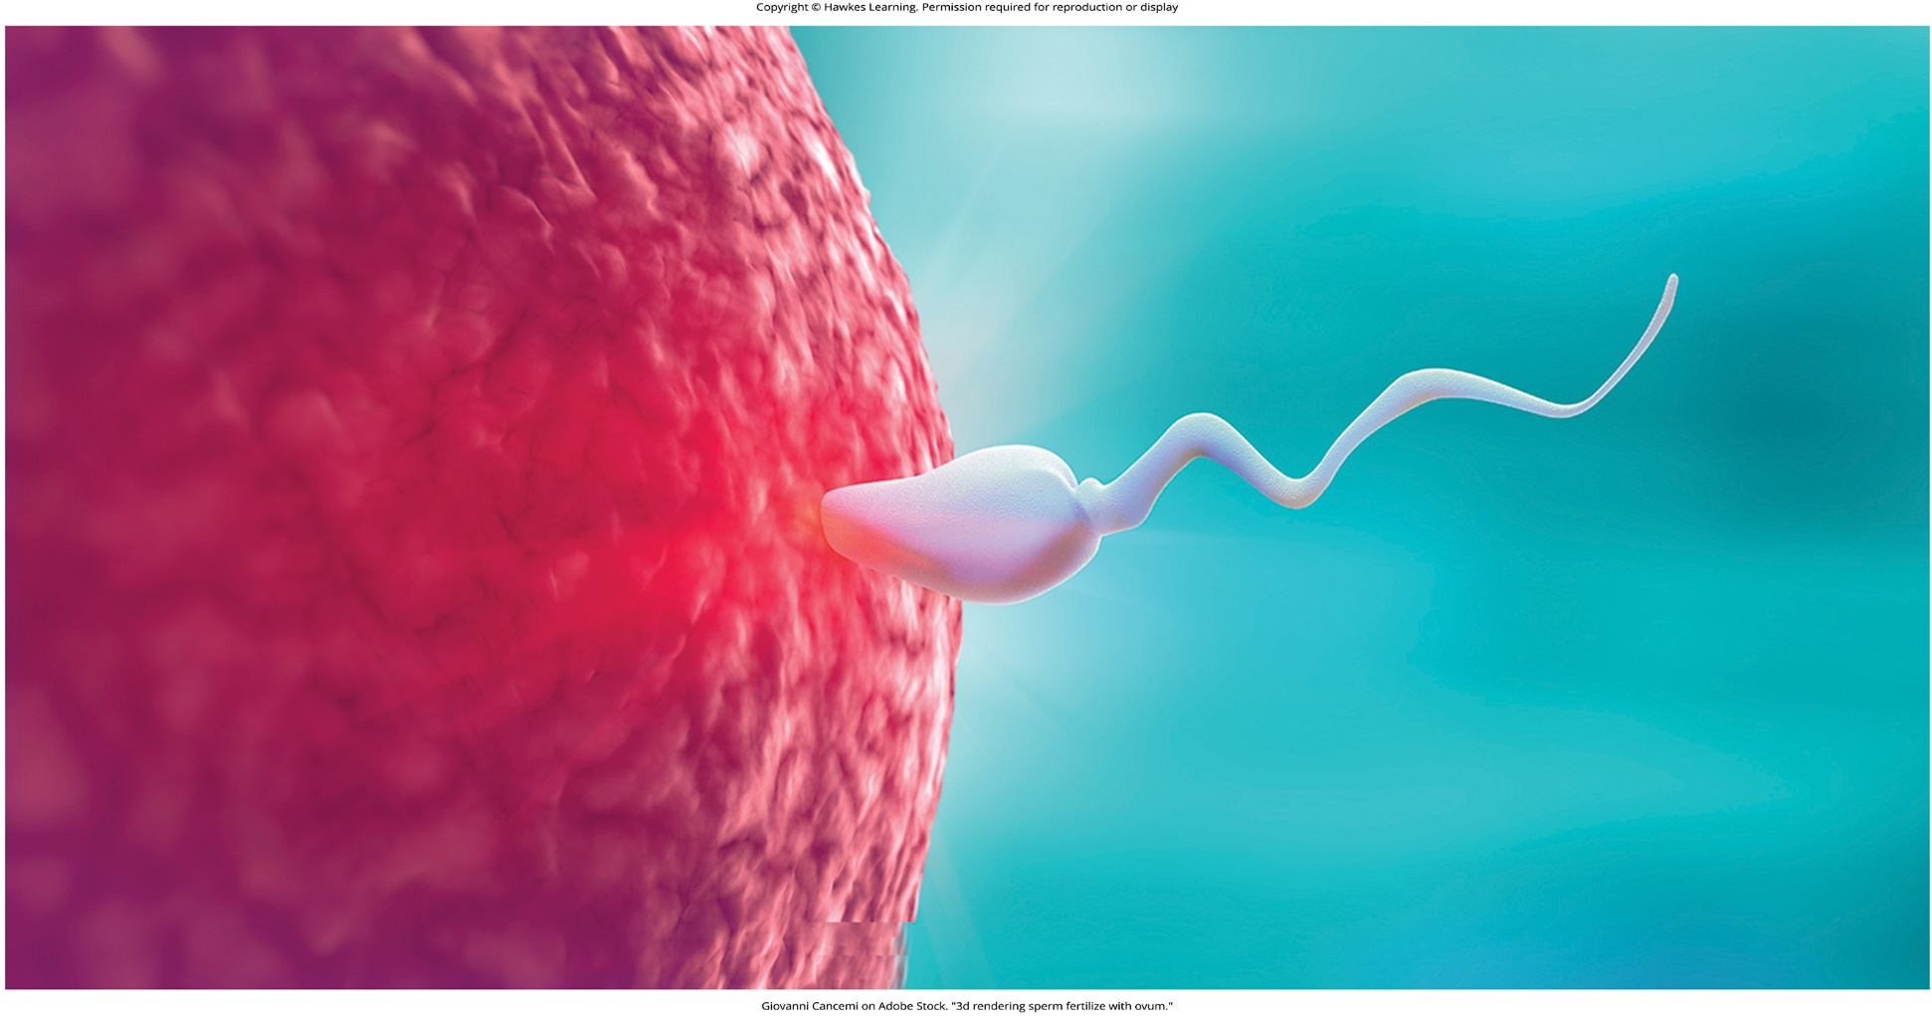
Lesson 8.3 Figure 2

Slide 15
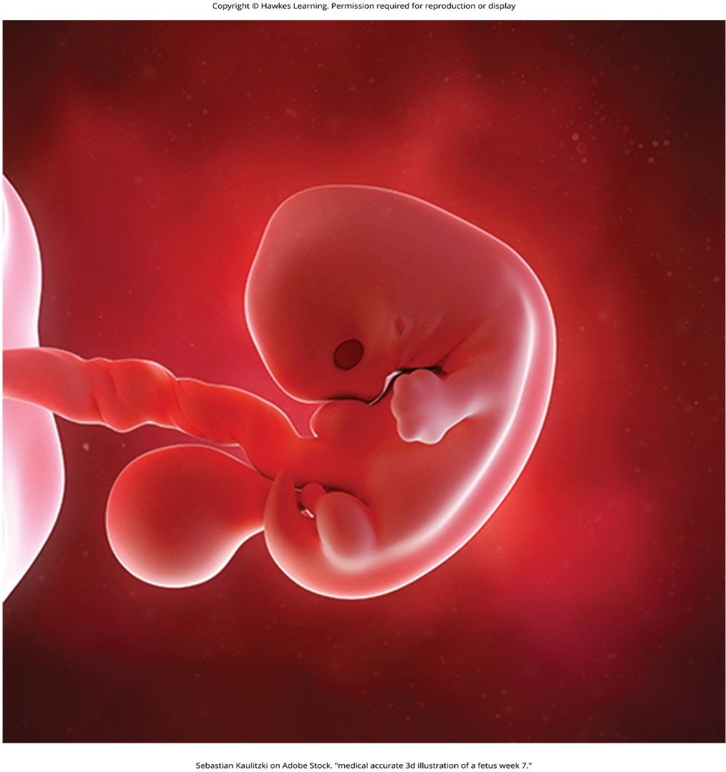
Lesson 8.3 Figure 3

Slide 16
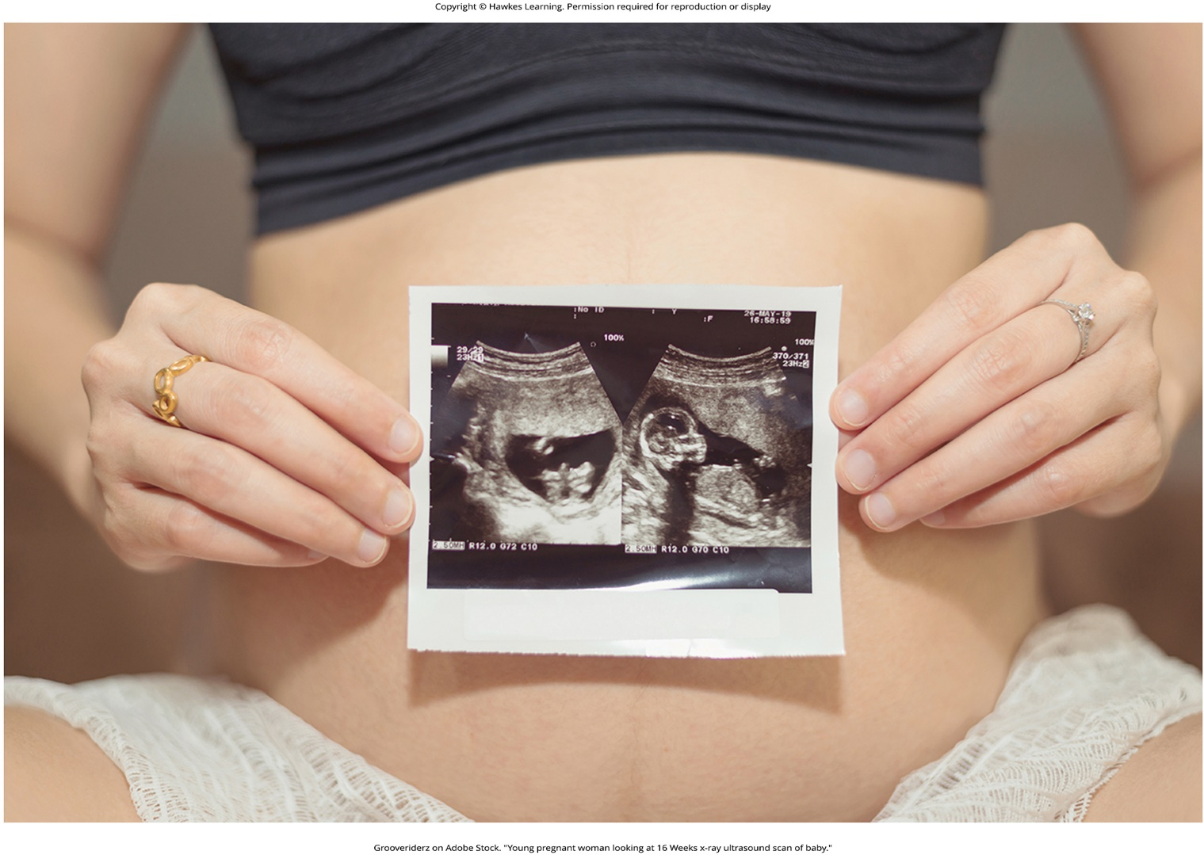
Lesson 8.3 Figure 4

Slide 17
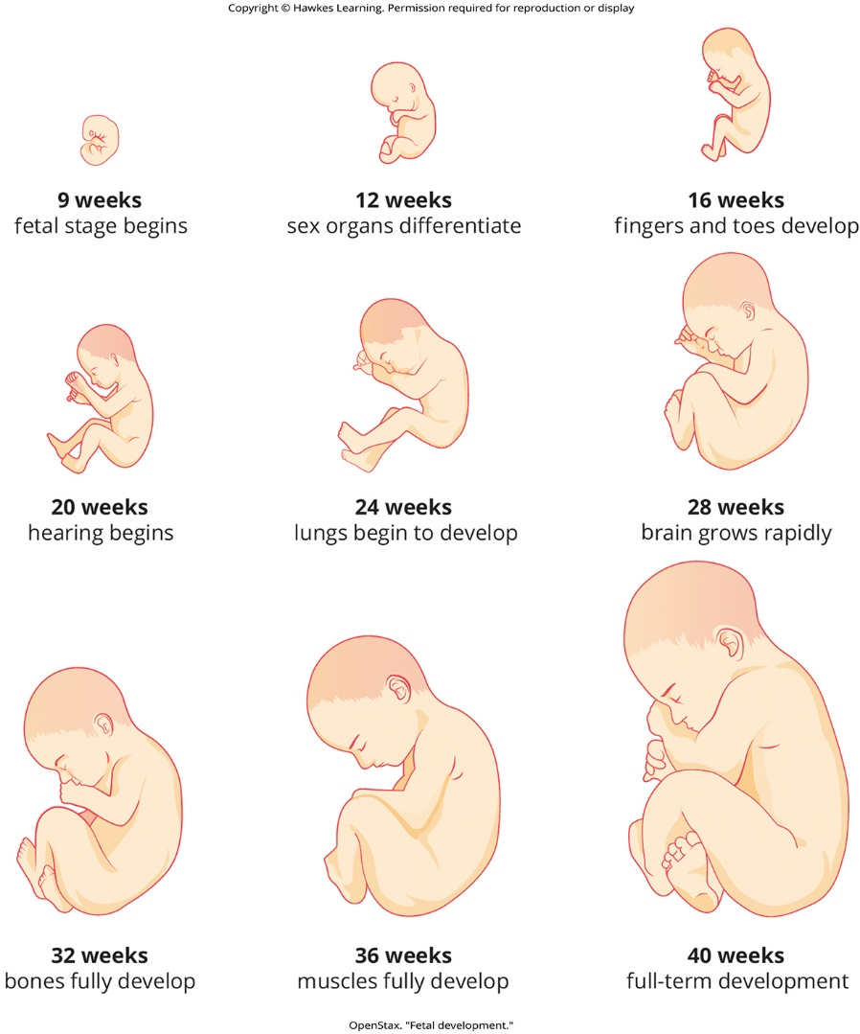
Lesson 8.3 Figure 5

Slide 18
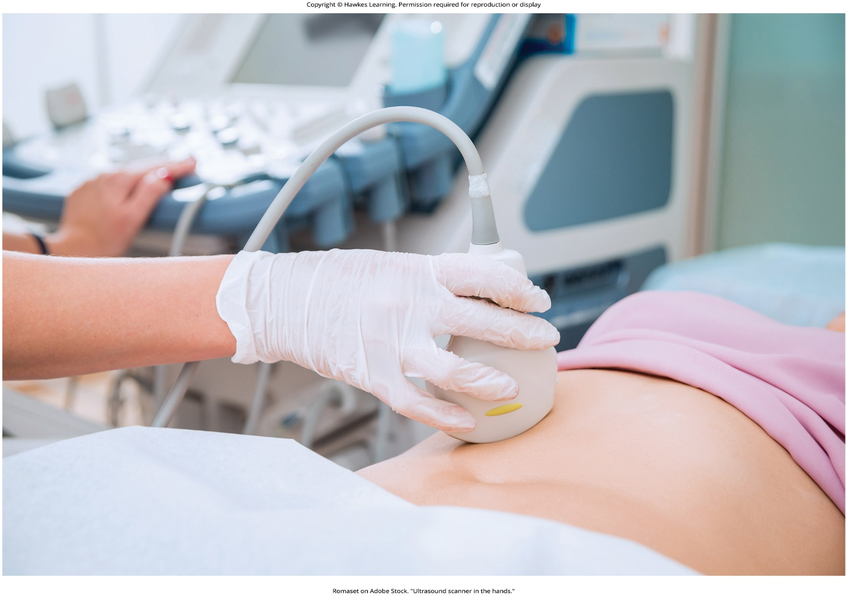
Lesson 8.3 Figure 6

Slide 19
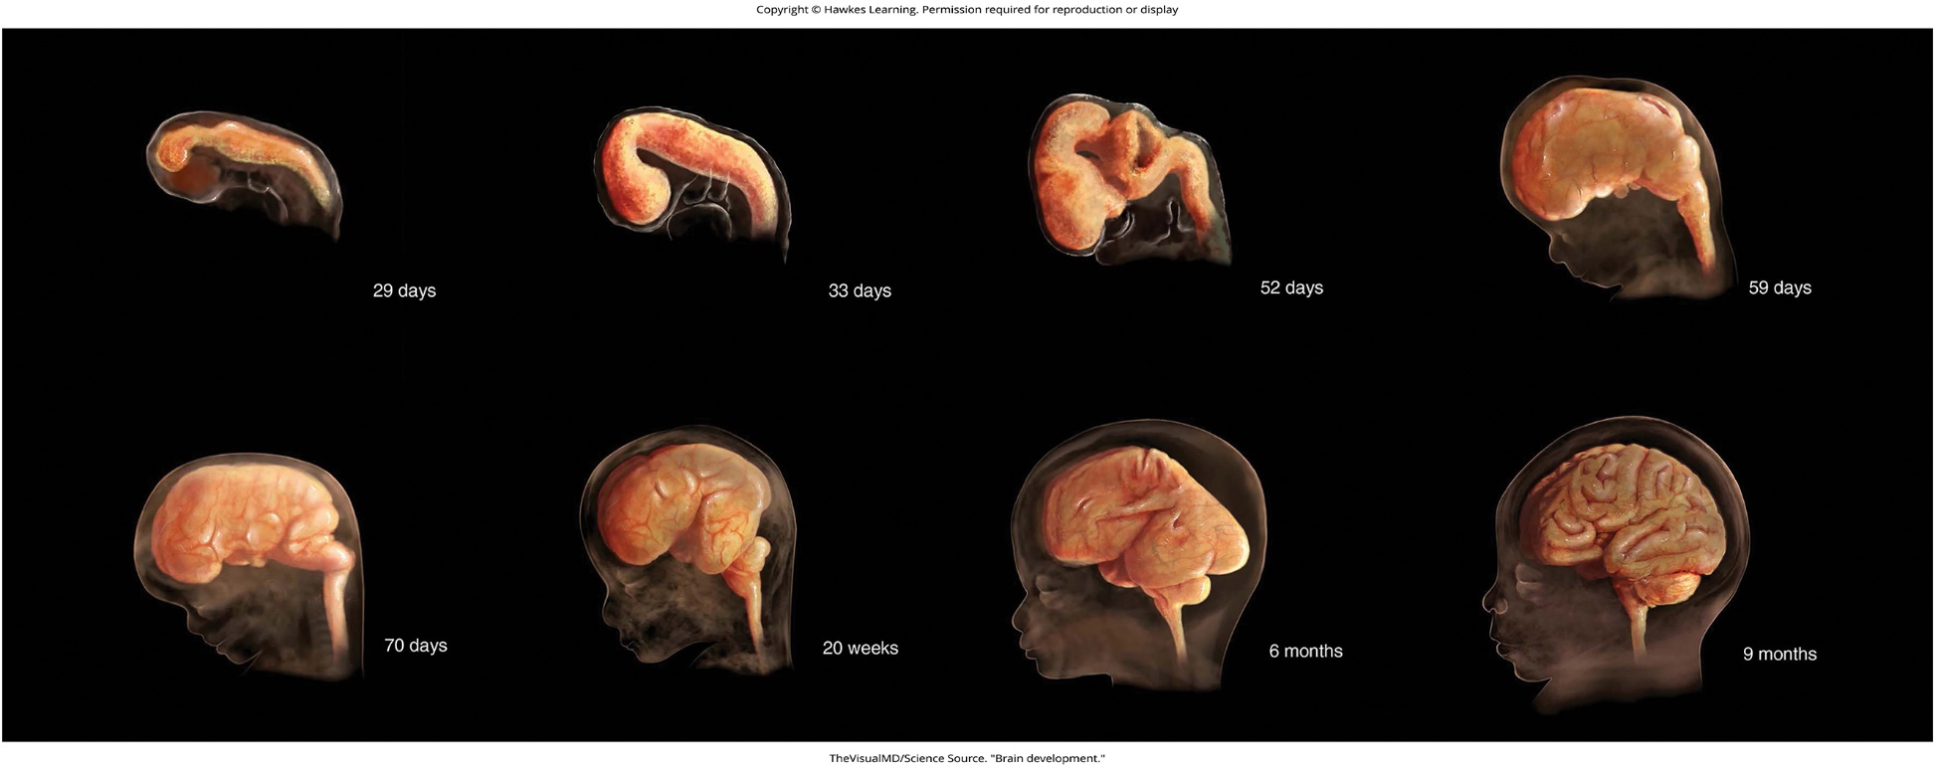
Lesson 8.3 Figure 7

Slide 20
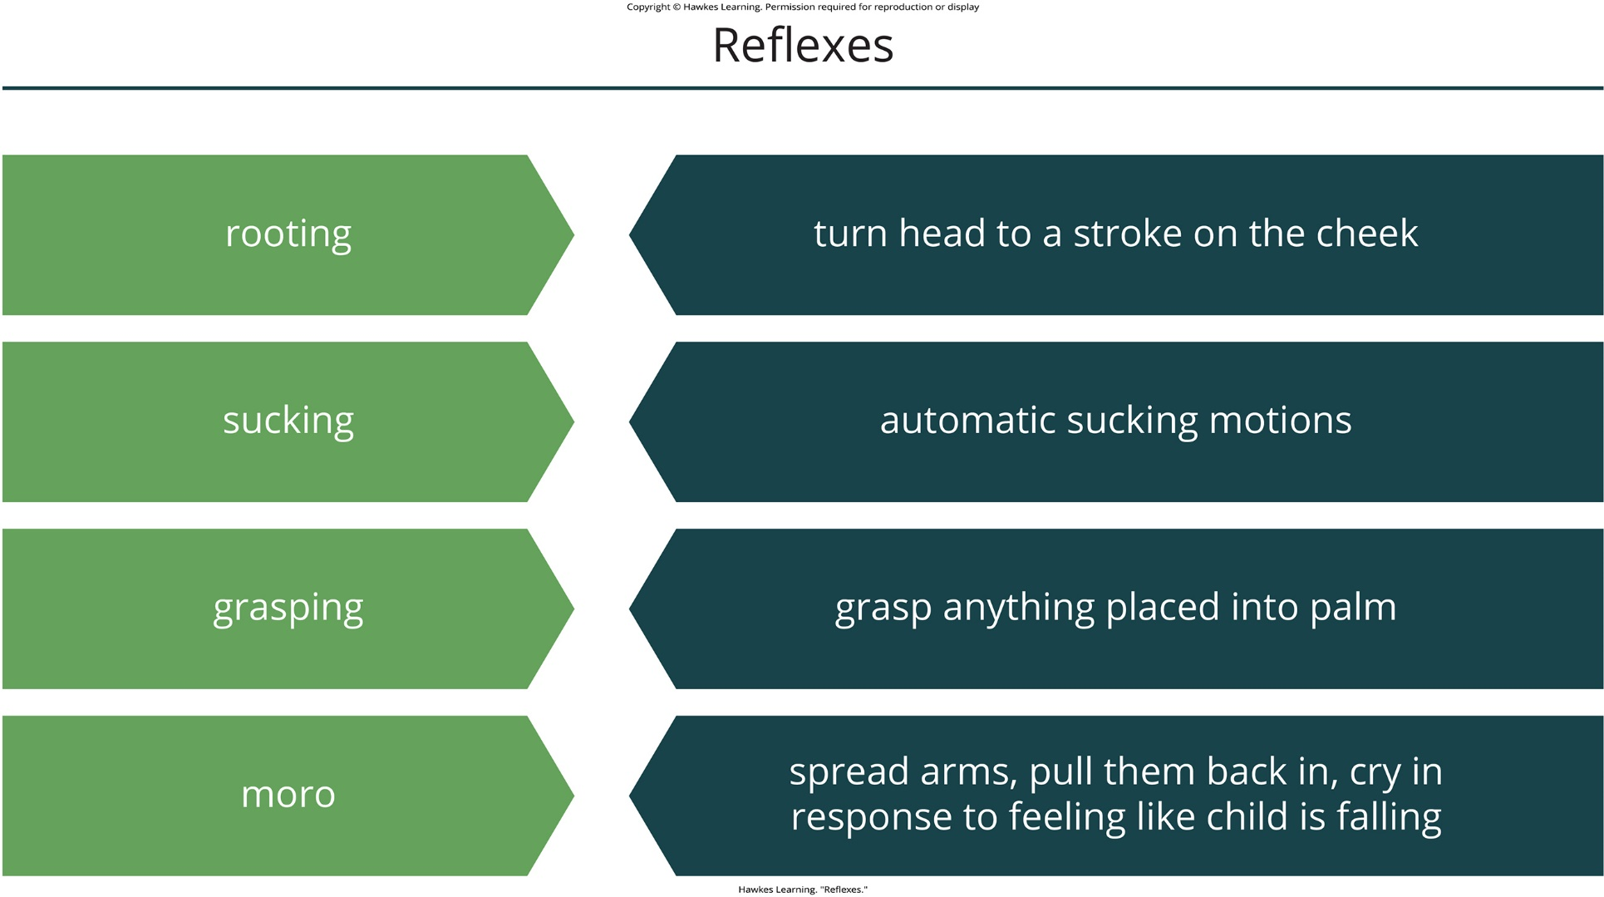
Lesson 8.3 Figure 8

Slide 21

Lesson 8.3 Figure 9

Slide 22
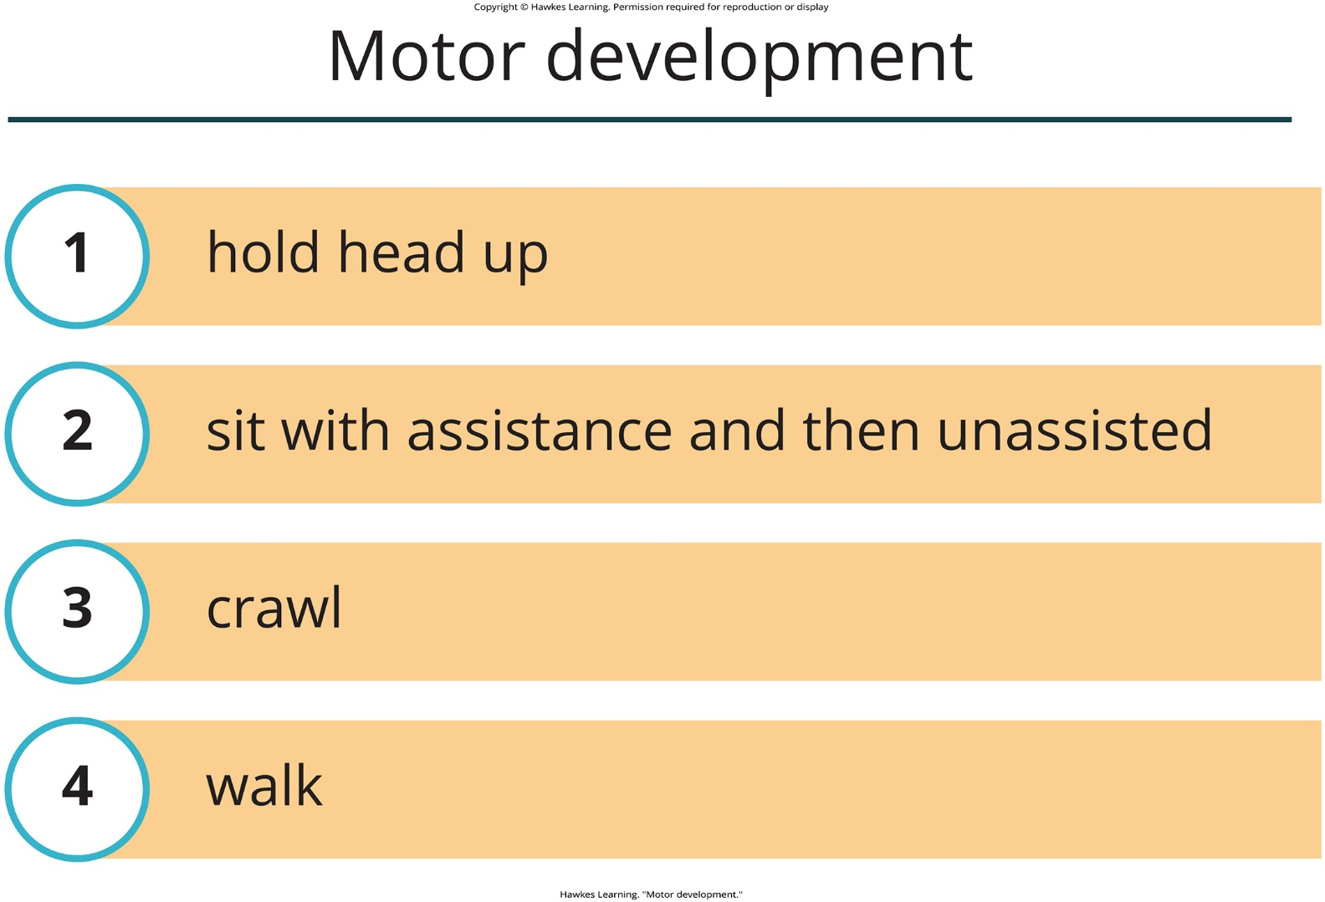
Lesson 8.3 Figure 10

Slide 23
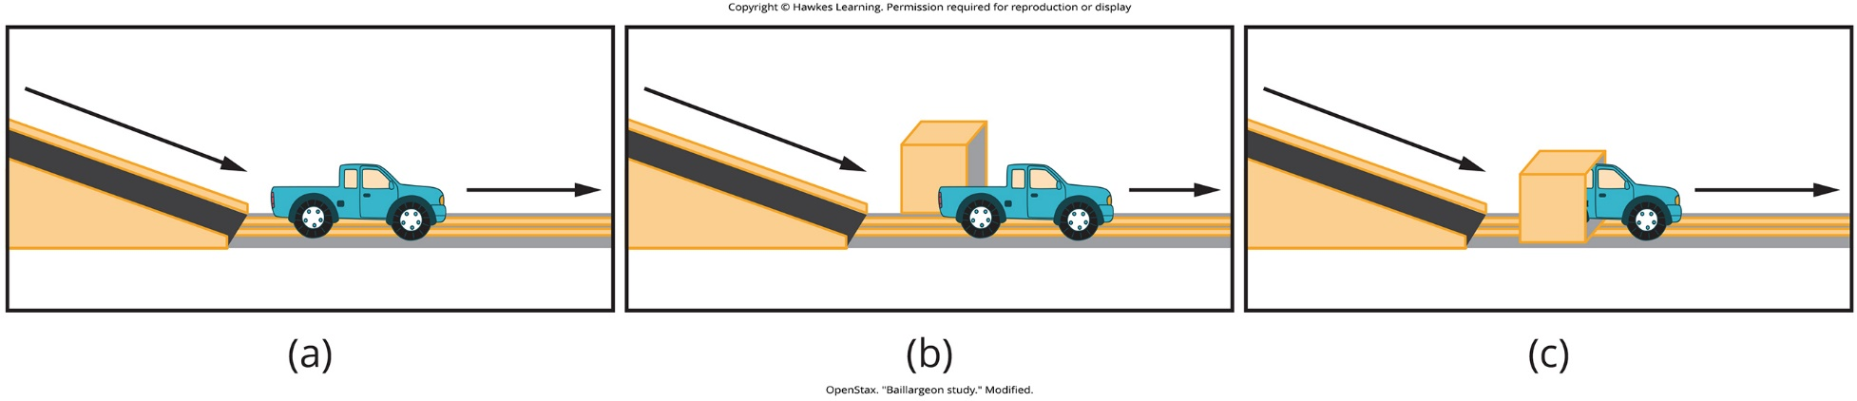
Lesson 8.3 Figure 11

Slide 24

Lesson 8.3 Figure 12

Slide 25
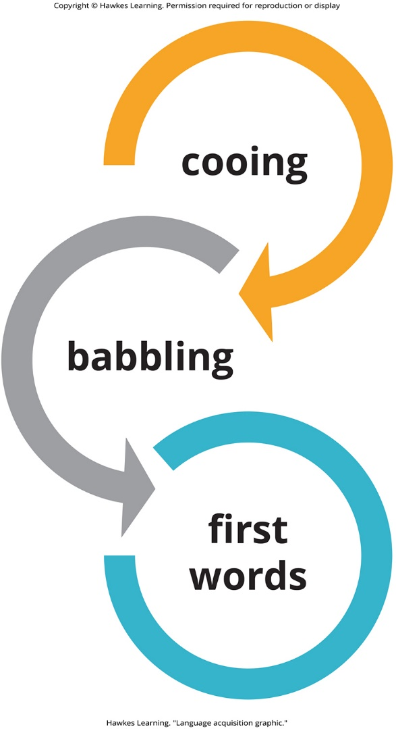
Lesson 8.3 Figure 13

Slide 26
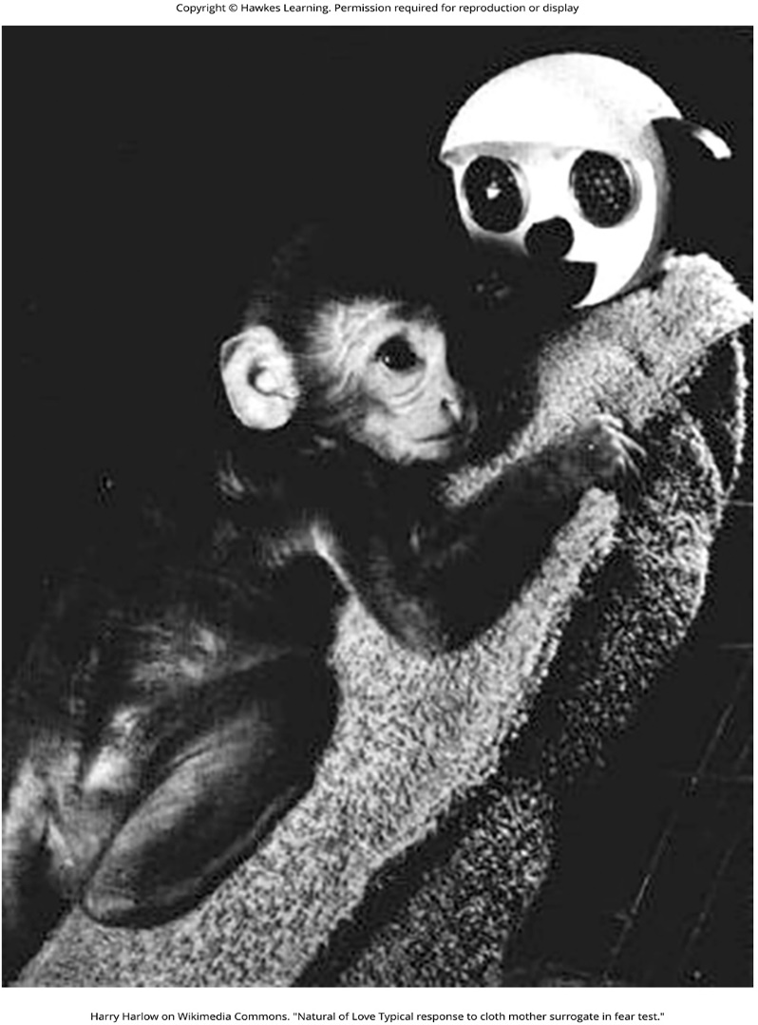
Lesson 8.3 Figure 14

Slide 27
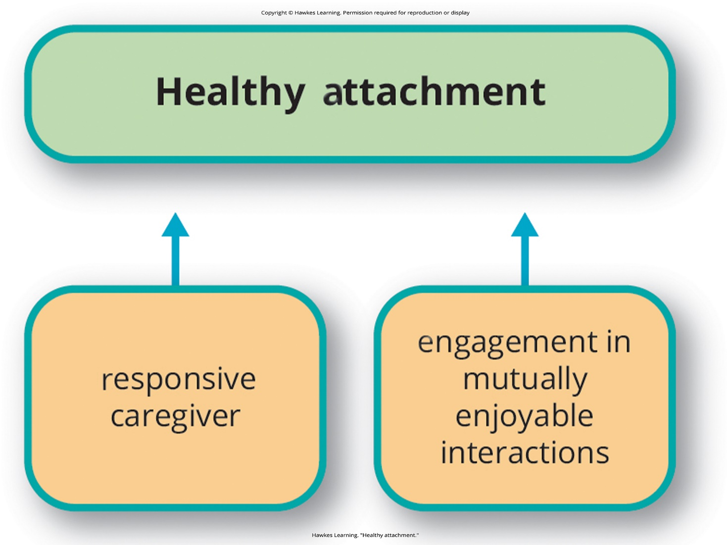
Lesson 8.3 Figure 15

Slide 28

Lesson 8.3 Figure 16

Slide 29

Lesson 8.3 Figure 17

Slide 30
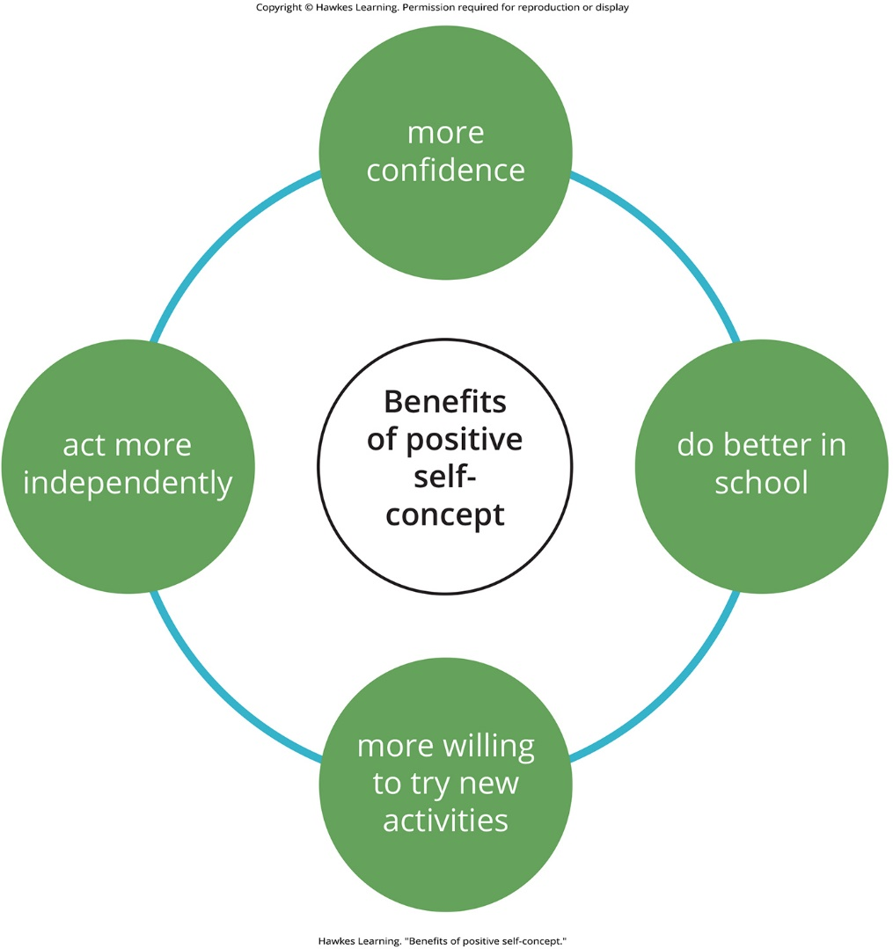
Lesson 8.3 Figure 18

Slide 31
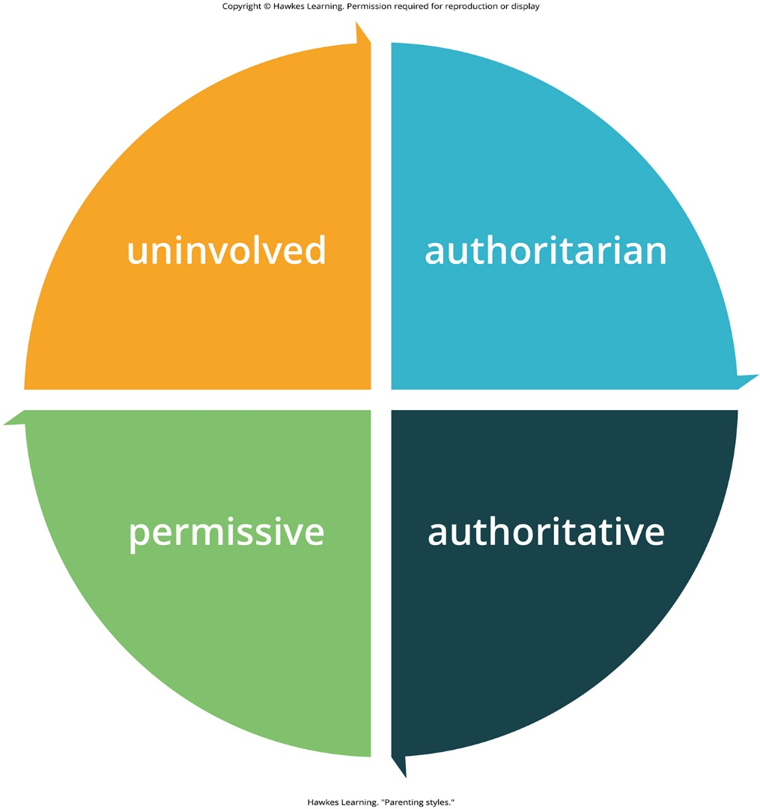
Lesson 8.3 Figure 19

Slide 32

Lesson 8.3 Figure 20

Slide 33

Lesson 8.3 Figure 21

Slide 34

Lesson 8.3 Figure 22

Slide 35
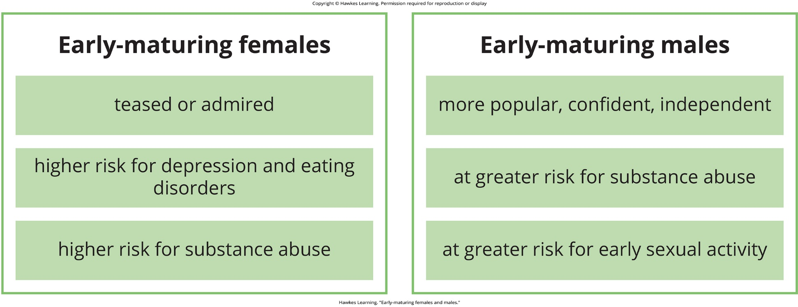
Lesson 8.3 Figure 23

Slide 36
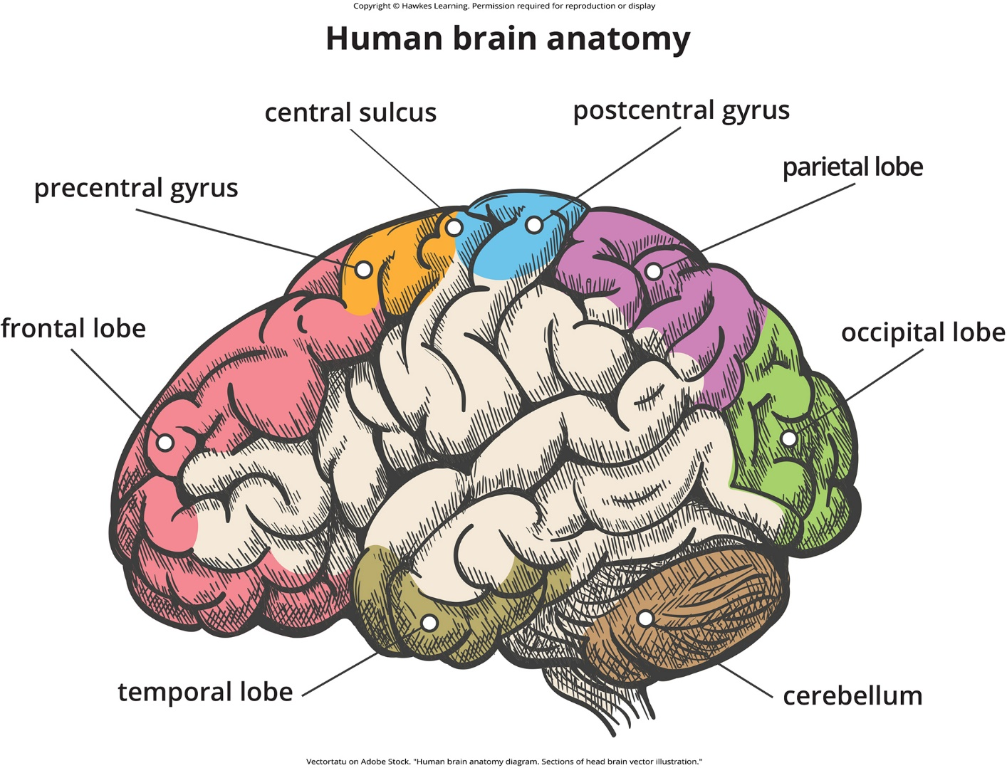
Lesson 8.3 Figure 24

Slide 37

Lesson 8.3 Figure 25

Slide 38

Lesson 8.3 Figure 26

Slide 39

Lesson 8.3 Figure 27

Slide 40

Lesson 8.3 Figure 28

Slide 41
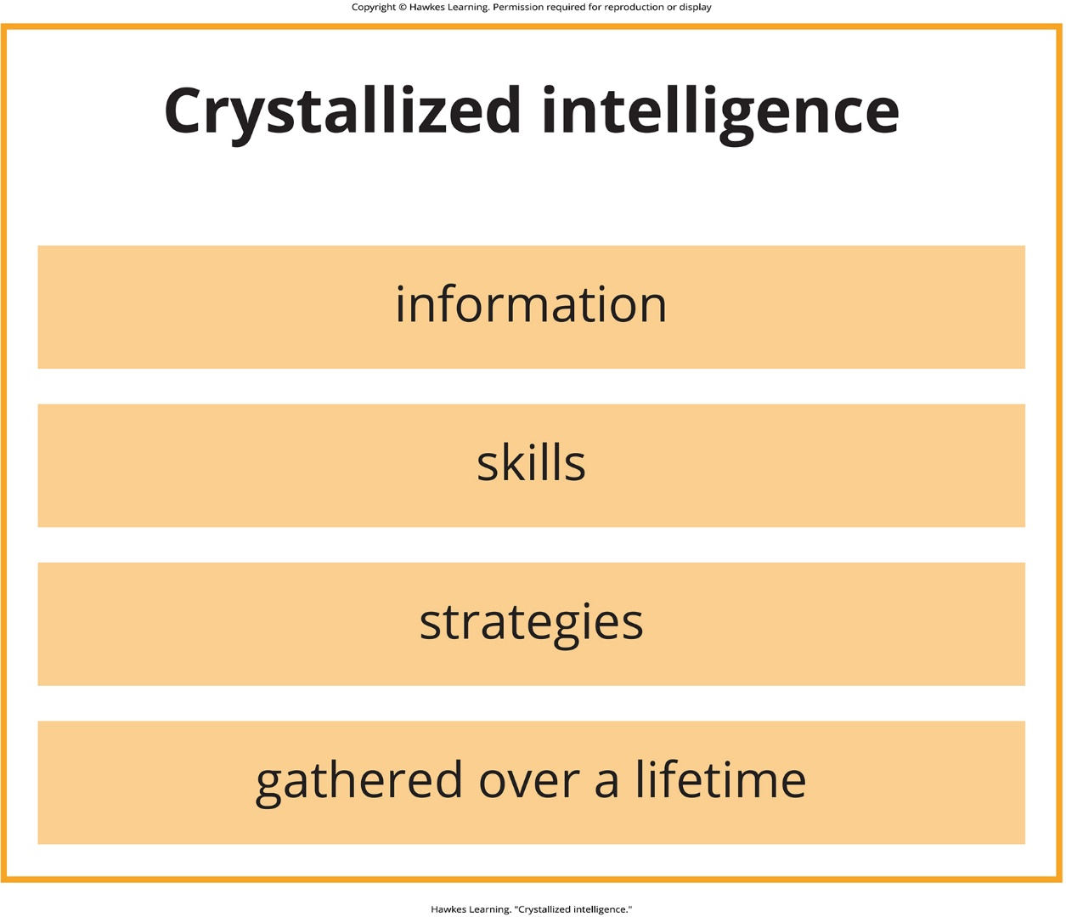
Lesson 8.3 Figure 29

Slide 42
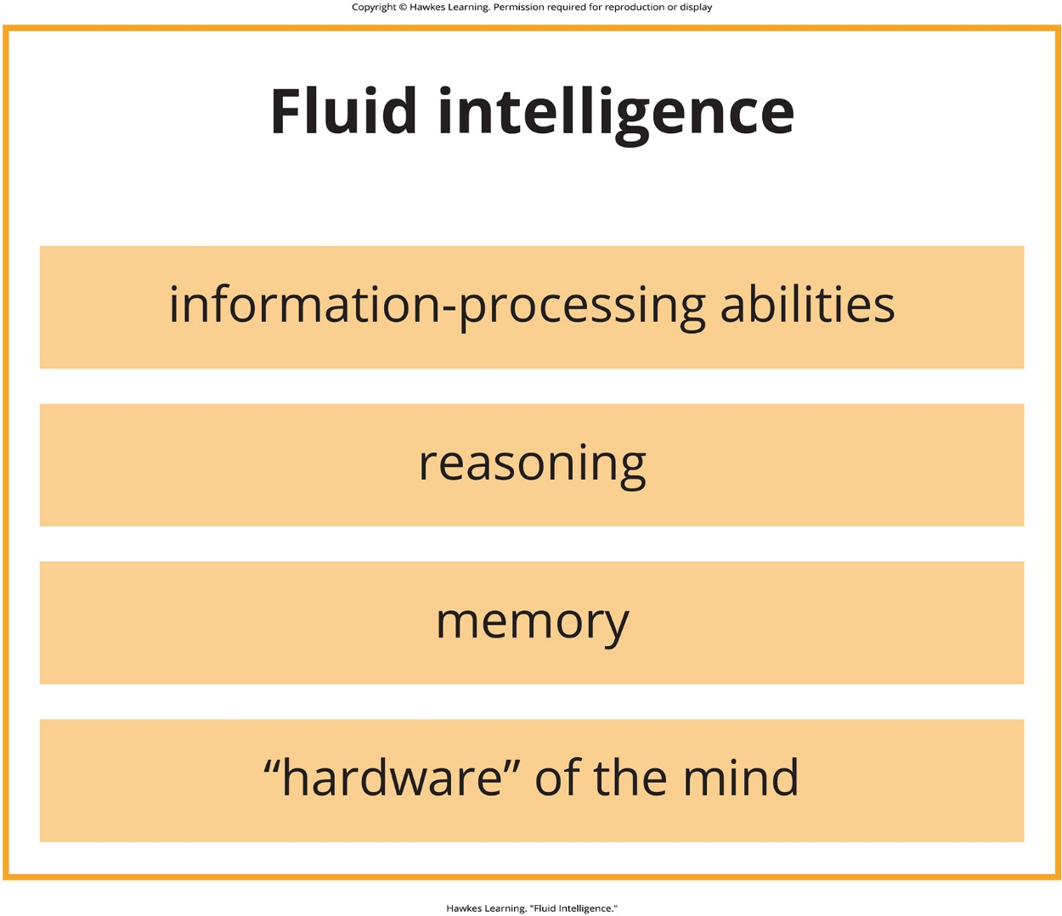
Lesson 8.3 Figure 30

Slide 43
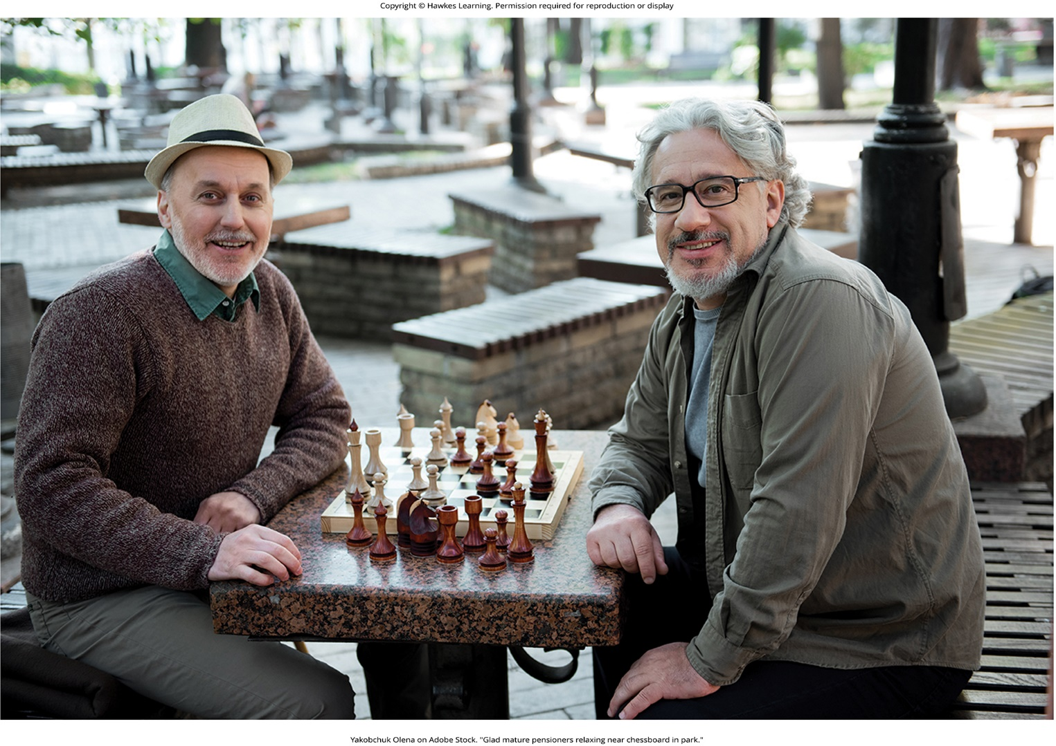
Lesson 8.3 Figure 31

Slide 44

Lesson 8.3 Figure 32

Slide 45

Lesson 8.4 Figure 1

Slide 46

Lesson 8.4 Figure 2

Slide 47
Hawkes Learning – End of PowerPoint

