Slide 1
Lesson 1.1
What is Psychology?

Slide 2
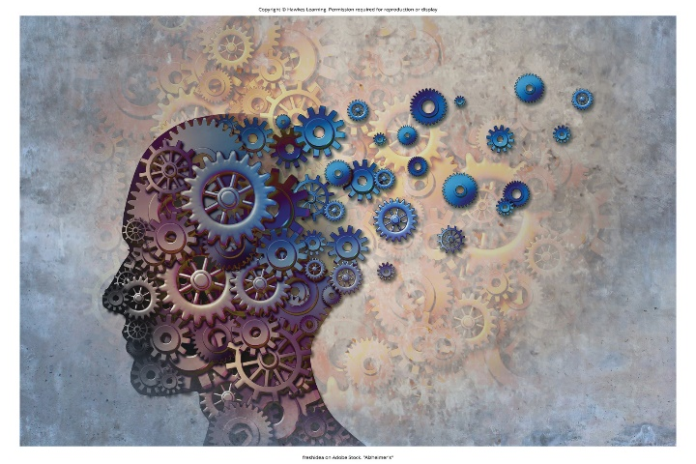
What Is Psychology?
Psychology: scientific study of the mind and behavior
  psyche means 'soul'
  ology denotes 'the study of'
Uses the scientific method to systematically investigate psychological phenomena through empirical research
Aims to describe, explain, predict, and influence behavior and cognitive/emotional processes
Psychologists study individuals and group behavior through naturalistic observation, case studies, experiments
Figure 1

Slide 3
Reflection Question₁
Based on what you already know about psychology, what do you think it means to study the mind and behavior?

Slide 4
Branches Of Psychology
Abnormal
Biological
Clinical
Cognitive
Counseling
Developmental
Educational Psychology

Slide 5
Scientific Method
Involves formulating theories and deriving testable hypotheses based on theories
  Designing controlled experiments or observational studies to test hypotheses and gather data
  Analyzing data using statistical techniques to identify significant patterns and relationships
  Drawing conclusions about whether findings support or refute the original hypotheses
  Results are peer-reviewed and published so other researchers can scrutinize and replicate studies

Slide 6
Merits Of An Education In Psychology
Develops strong analytical, research, data analysis, and communication skills valued across careers
Cultivates scientific literacy, objectivity, and critical thinking to evaluate claims/evidence
Provides understanding of factors influencing human behavior, cognition, emotion, and development
Applicable to fields like marketing, human resources, social services, education, and healthcare
Prepares students for psychology careers in clinical practice, counseling, and research

Slide 7
Group Activity
Discuss in a small group why you each decided to take a psychology course. What do you hope to get out of it?

Slide 8
History Of Psychology
Questions about the mind were historically studied through philosophy and physiology.
Wilhelm Wundt and William James established psychology as an independent empirical science.
  Empirical: grounded in objective, tangible evidence that can be observed time and time again, regardless of who is observing
Early psychological perspectives include structuralism, functionalism, psychoanalysis, behaviorism, Gestalt, humanism.
Psychology was transformed by the cognitive revolution, neuroscience, evolutionary/cross-cultural approaches.

Slide 9
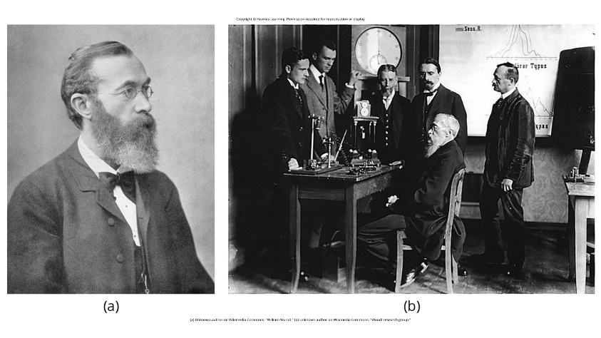
Wundt And Structuralism
Wilhelm Wundt founded the first psychology laboratory in 1879 at University of Leipzig.
Structuralism sought to break down conscious experience into basic elements like sensations.
He used introspection (self-observation) to identify the structure of the mind.
He employed tools like reaction time measurement devices in experimental studies.
Figure 2

Slide 10
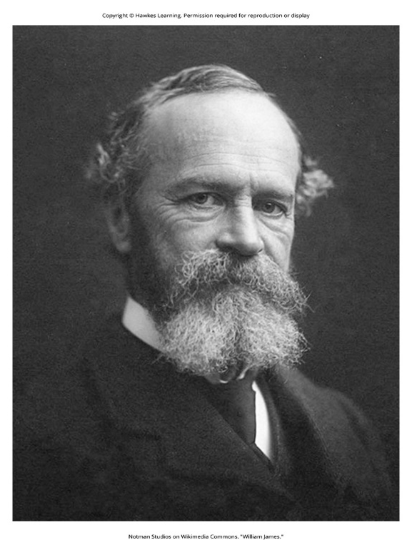
James And Functionalism
William James was a pioneering functionalist thinker rejecting Wundt's structuralism.
  Functionalism: focuses on how mental activities help an organism adapt to its environment
He emphasized the purpose and real-world function of consciousness/behavior over just structure.
Used versatile methods including introspection, naturalistic observation, physiological studies.
Functionalism was impacted by Darwin's theory of evolution by natural selection.
Figure 3

Slide 11

Pioneering Women
Mary Whiton Calkins completed Harvard requirements but was denied PhD due to gender.
  Became first female APA president in 1905, contributing concept of the self
Margaret Floy Washburn was the first woman to earn a PhD in psychology in 1894.
  Made early influential work in area of comparative/animal psychology
Inez Prosser studied effects of racial segregation despite systemic racism barriers.
Their pioneering work advanced equality and representation in the field.
Figure 4

Slide 12
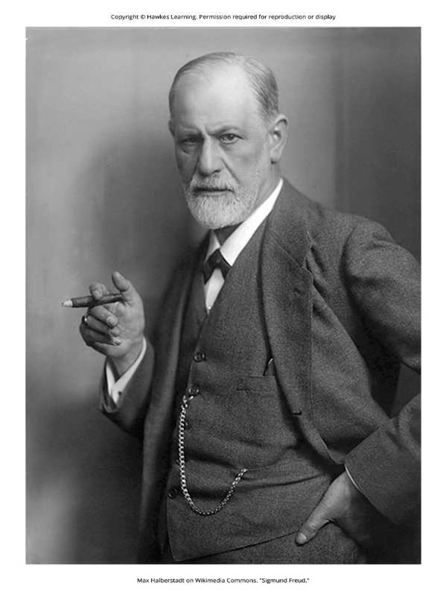
Freud And Psychoanalytic Theory
Sigmund Freud believed the unconscious mind's desires and conflicts drove behavior.
He developed the psychoanalytic theory about three levels of awareness: conscious, preconscious, unconscious
  Psychoanalytic theory: focus on the role of the unconscious in affecting conscious behavior
He used dream analysis, free association, interpreting slips to access unconscious.
He proposed controversial concepts like the Oedipus complex and penis envy.
Figure 5

Slide 13
Reflection Question₂
Do you agree with Freud that dreams have meaning in your day-to-day life? Why or why not?

Slide 14
Wertheimer, Koffka, Kohler, And Gestalt Psychology
Gestalt psychology focused on how the mind perceives complete patterns/configurations.
Köhler showcased insightful learning in problem-solving.
They studied perceptual organization principles like figure-ground, closure, and proximity.
Provided holistic counter to Wundt's elementalism, though limited in reach.

Slide 15
Ivan Pavlov, Watson, Skinner, And Behaviorism
Ivan Pavlov discovered principles of classical conditioning through his work on dogs.
John B. Watson founded behaviorism, rejecting study of unobservable mental states.
  Behaviorism: the study of observing and controlling behavior
B.F. Skinner pioneered study of operant conditioning using reinforcement schedules.
The Skinner box (Figure 10) allowed for careful study of modifying behavior through reinforcement/punishment.
Behaviorism established psychology as an objective experimental science.

Slide 16
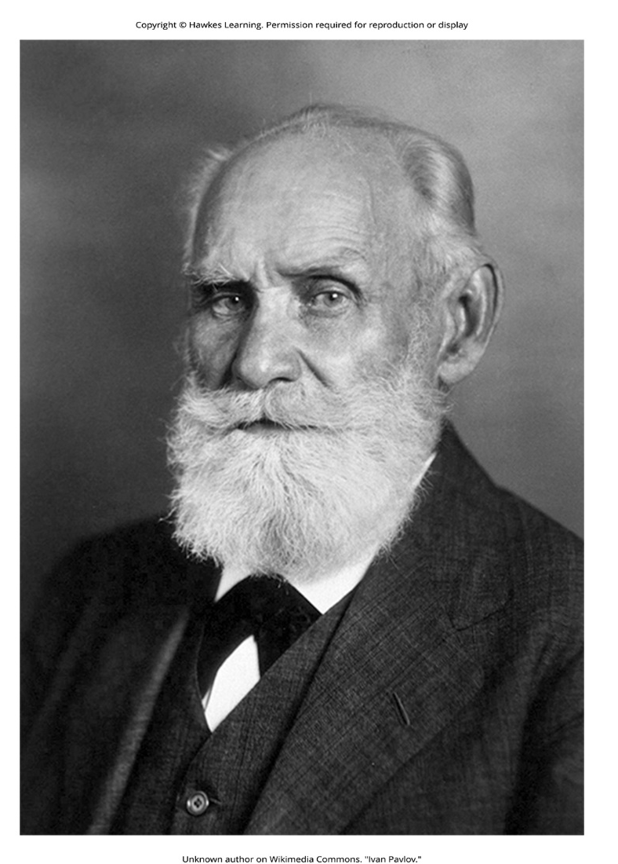
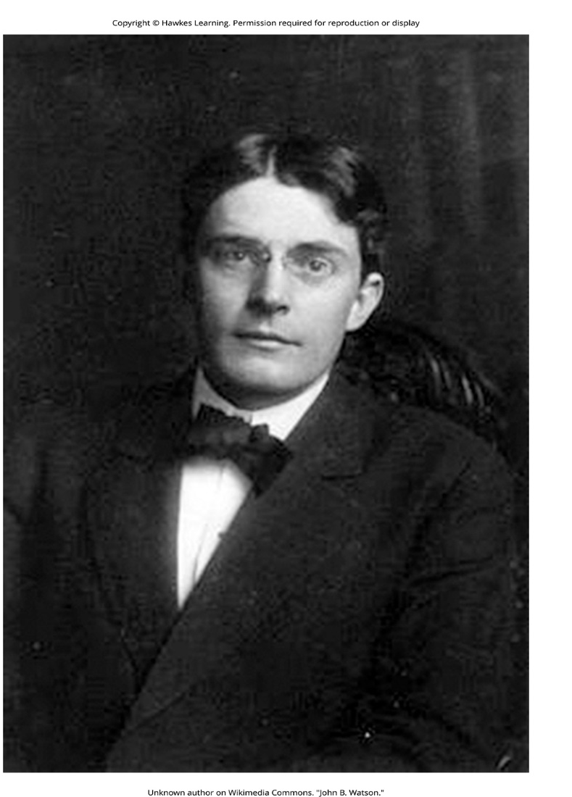
Behaviorism (Pavlov and Watson)
Figure 8
Figure 9

Slide 17
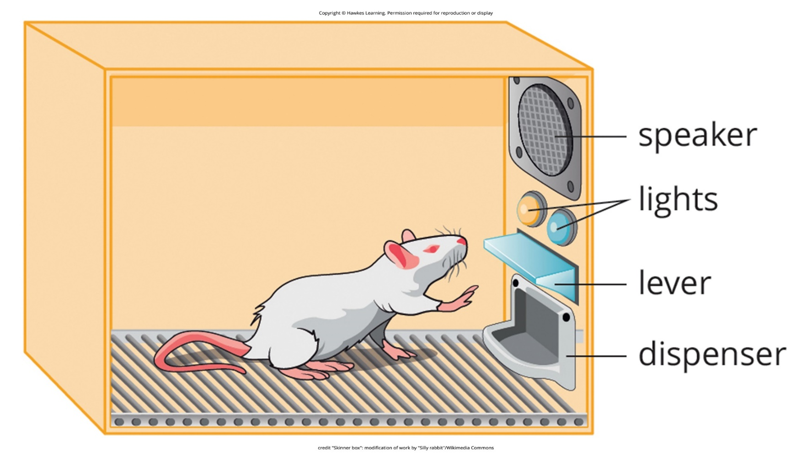
Lesson 1.1 Figure 10
Caption: B. F. Skinner is famous for his research on operant conditioning. Modified versions of the operant conditioning chamber, or Skinner box, are still widely used in research settings today.

Slide 18
Reflection Question₃
What factors do you think led Watson to believe that analysis of the mind of impossible?

Slide 19
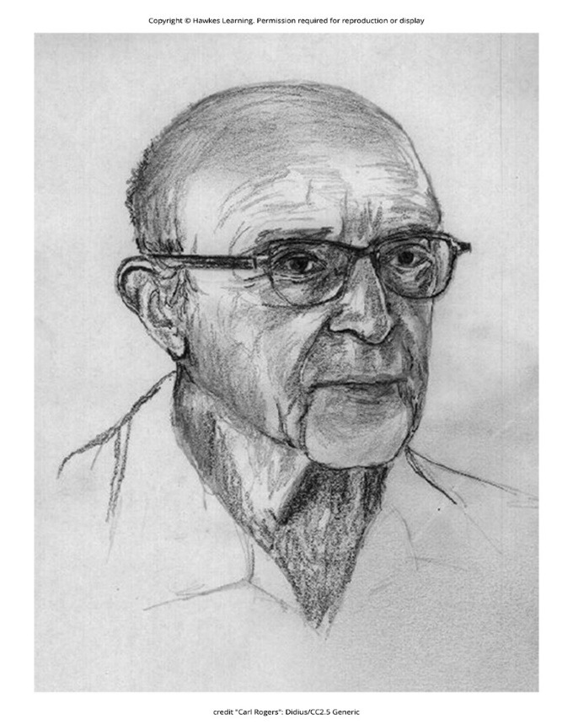
Maslow, Rogers, And Humanism
Humanism emphasized human potential for positive growth and self-actualization.
  Humanism: perspective within psychology that emphasizes the potential for good that is innate for all humans
Abraham Maslow's hierarchy outlined motivation progression from basic to self-actualization needs.
Carl Rogers' client-centered therapy provided unconditional acceptance and empathy.
The humanistic approach focused on conscious experiences - personal freedom over determinism.
Figure 13

Slide 20
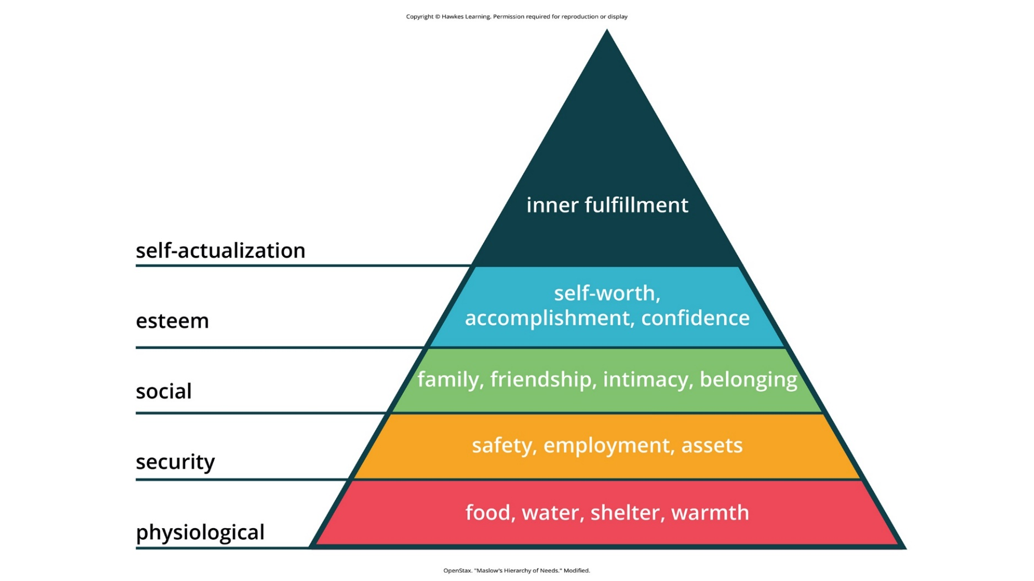
Lesson 1.1 Figure 12
Caption: Maslow's hierarchy of needs is shown.

Slide 21
Reflection Question₄
Do you favor humanism over psychoanalysis and behaviorism? Why or why not?

Slide 22
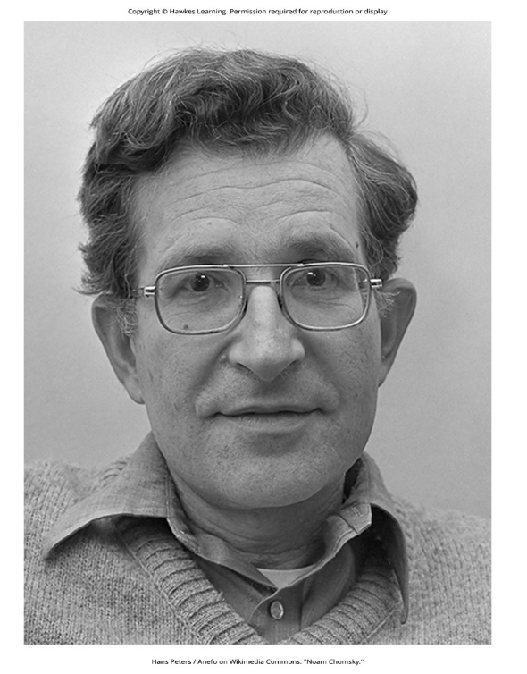
The Cognitive Revolution
Linguistics, neuroscience, computer science sparked new scientific study of the mind.
Noam Chomsky critiqued behaviorism's failure to explain depth of mental abilities.
Cognitive psychology examined mental processes like perception, learning, and memory.
  Cognitive psychology: study of cognitions, or thoughts, and their relationship to experiences and actions
Birth of cognitive science integrated insights across disciplines like AI and neuroscience.
Figure 14

Slide 23
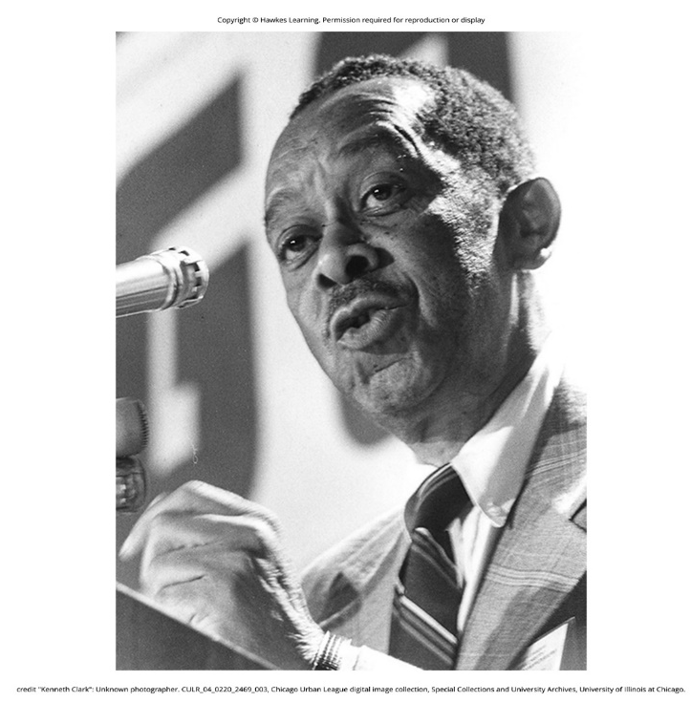
Multicultural Psychology
Cultural differences impact psychology but have been relatively neglected.
Francis C. Sumner pioneered studying racial biases as the first Black psychologist.
Mamie & Kenneth Clark's doll studies shaped desegregation ruling in Brown v. Board.
George Sanchez demonstrated cultural bias in intelligence testing for Latinos.
Ethnic psychological associations promote diverse voices and perspectives.
Figure 15

Slide 24
Summary
Psychology is the comprehensive science studying behavior and the mind.
Psychology emerged from philosophy and was shaped by major historical perspectives and new insights.
It is increasingly interdisciplinary and represents the diversity of human experiences.
Contemporary subfields analyze biological, cognitive, social, and cultural influences.

Slide 25
End of Hawkes Learning PowerPoint

