Slide 1
Lesson 1.2
Contemporary Psychology

Slide 2
Contemporary Psychology
Diverse field influenced by historical perspectives.
Its Interdisciplinary nature draws from fields like biology, philosophy, and more.
Involves the study of the mind, behavior, and mental processes.
It employs scientific methods and experimental approaches.
It applies knowledge to human issues and problems.

Slide 3
American Psychological Association (APA)
Professional organization representing diverse psychologists in the United States
Largest organization of psychologists in the world
Advances and disseminates psychological knowledge to improve understanding of the mind and behavior
There are 54 divisions, including religion, sports, behavioral neuroscience, and comparative psychology.
Members (including affiliate and associate members) span from students to doctoral-level psychologists and can be found in educational settings, criminal justice, hospitals, the armed forces, and other industries.
Source: American Psychological Association, 2022

Slide 4
Association For Psychological Science (APS)
Founded in 1988
Advanced the scientific orientation of psychology
Result of disagreements between members of the scientific and clinical branches of psychology within the APA
Publishes five research journals and engages in education and advocacy with funding agencies
Significant proportion of its members are international although the majority is located in the United States

Slide 5
Biopsychology
Biopsychology: study of how biology influences behavior
The focus is on studying the structure and function of nervous system related to behavior.
It is a combination of research strategies of psychologists and physiologists (Carlson, 2013).
It is an interdisciplinary approach involving biologists, medical professionals, physiologists, and chemists.
It is a component of the broader field of neuroscience (Carlson, 2013).

Slide 6
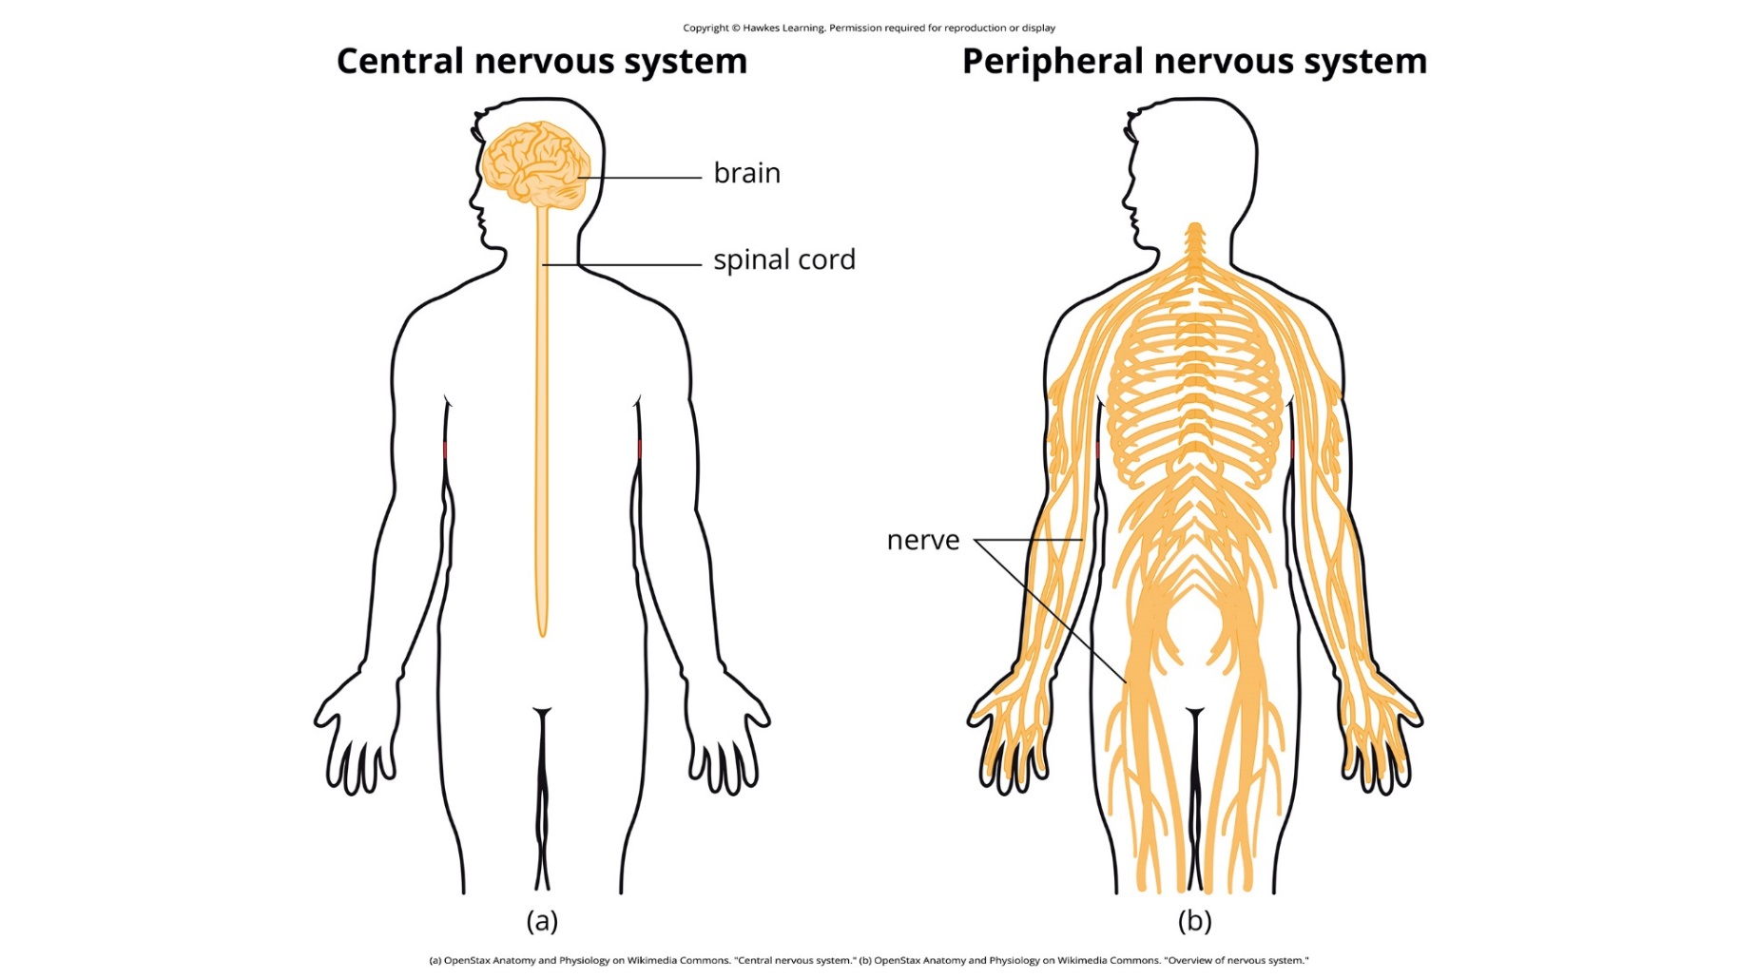
Lesson 1.2 Figure 1
Caption: Biological psychologists study how the structure and function of the nervous system generate behavior.

Slide 7
Broad Scope Of Topics
Biopsychology
Sensory and motor systems
Sleep
Drug use and abuse
Ingestive behavior
Reproductive behavior
Neurodevelopment
Biological connections to psychological disorders

Slide 8
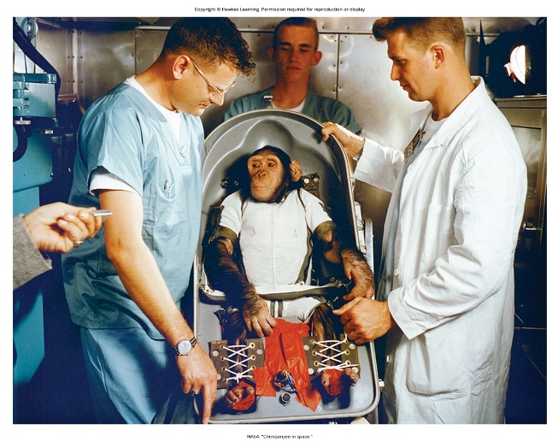
Evolutionary Psychology
Studies ultimate biological causes of behavior from the evolutionary perspective.
Focuses on how behaviors demonstrate adaptation to physical and social environments
Examines genetics and behaviors associated with species-specific survival
Applies evolutionary theory to predict and observe human behavior patterns
Explores areas like memory, mate choice, kinship, friendship, parenting, and social organization (Confer et al., 2010)
Figure 2

Slide 9
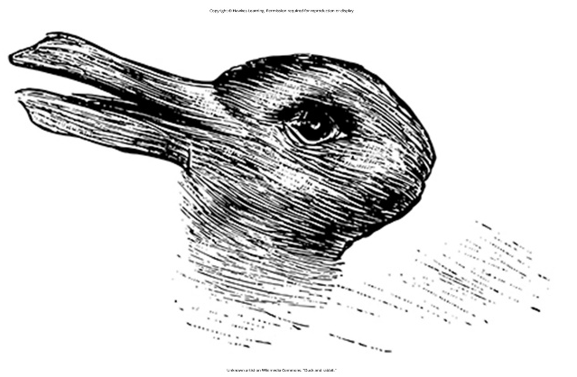
Sensation
Detection of physical stimuli by sensory receptors
Involves senses like sight, hearing, touch, taste, and smell
Transduces environmental energy into neural signals
Provides raw data for perception and experience
Relatively constant process across individuals
Figure 3

Slide 10
Perception
Interpretation and organization of sensory information
Influenced by attention, experiences, and cultural background
Gives meaning and subjective experience to sensations
Allows recognition of objects, sounds, smells, etc.
Varies among individuals for the same sensation

Slide 11
Cognitive Psychology
Cognitive psychology: study of cognitions, or thoughts, and their relationship to experiences and actions
Explores topics like attention, problem-solving, language, and memory
Utilizes diverse approaches and interdisciplinary collaborations
Concepts integrated throughout chapters on perception, thinking, memory, etc.

Slide 12
Cognitive Processes
Concepts
Attention
Problem solving
Decision making
Judgment
Language
Memory

Slide 13
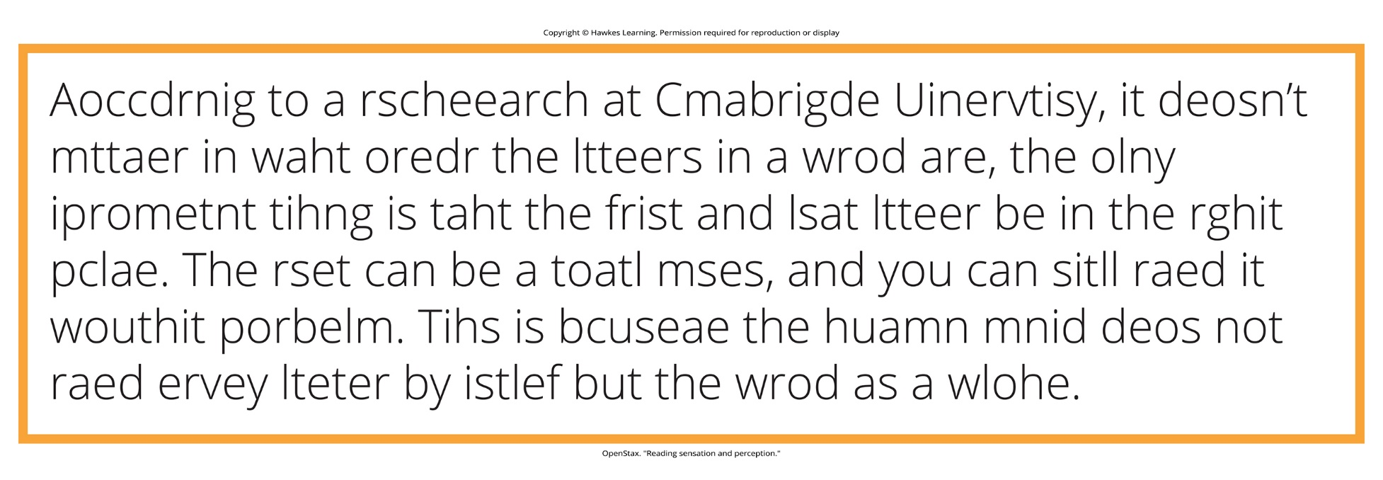
Lesson 1.2 Figure 4
Caption: According to a researcher at Cambridge University, reading sensation and perception occur so quickly, we often overlook typos. This image can be read and comprehended even though all would agree, it is only closely related to English words.

Slide 14
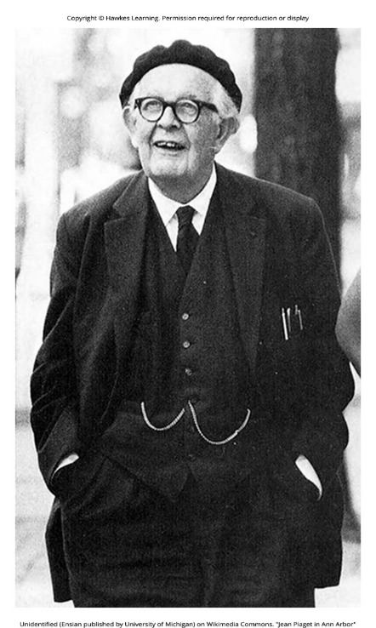
Developmental Psychology
Developmental psychology: scientific study of development across lifespan
Examines processes of physical maturation and psychological changes
Focuses on cognitive, moral, social, and other attribute changes over time
Early focus on development from childhood to adulthood
Increasing interest in studying changes in later adulthood and aging
Figure 5
Caption: Jean Piaget is famous for his theories regarding changes in cognitive ability that occur as we move from infancy to adulthood.

Slide 15
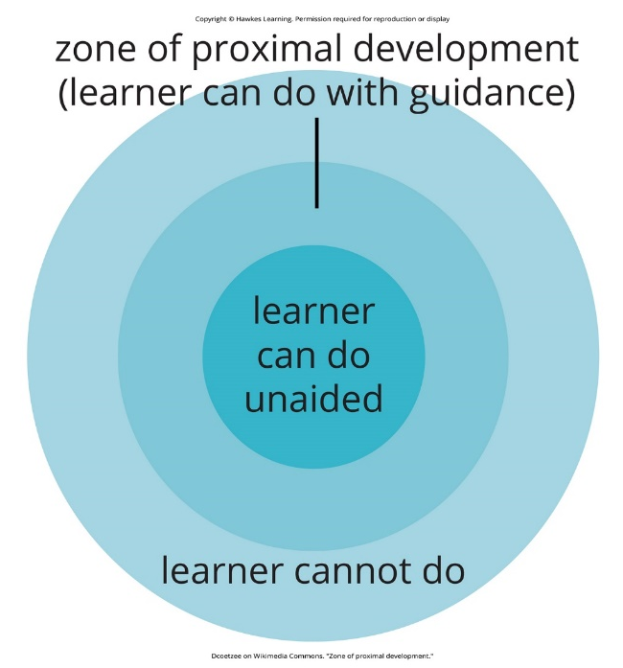
Reflection Question₁
Developmental psychologists have proposed several methods of learning. Vyotsky proposed the concept of scaffolding and the zone of proximal development (Figure 6). The theory explains how individuals move from areas of knowledge they already have to areas of new skills through the use of assistance, or scaffolding.
Can you think of activities you engaged in as a child, or skills you have tried to teach another, that utilizes the scaffolding method?
Figure 6

Slide 16
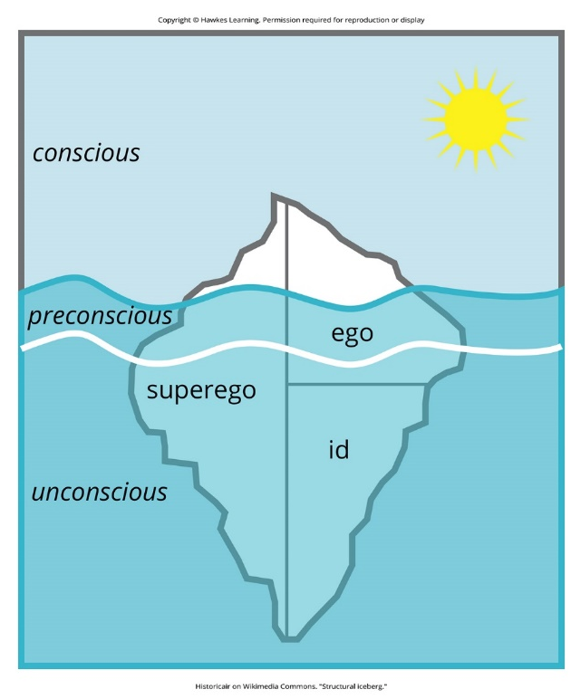
Personality Psychology
Personality psychology: study of patterns of thoughts and behaviors that make each individual unique
The early theories aimed to explain personality development (e.g. Freud, Maslow).
The contemporary approach identifies and measures personality traits.
Freud proposed that personality arose as a result of conflicts between the conscious and unconscious parts of the mind.
Figure 7
Caption: Freud's model of personality includes major division between conscious and unconscious and the id, ego, and superego.

Slide 17
Personality Traits
Personality trait: consistent pattern of thought and behavior
Five dimensions, also known as Big Five or Five Factor model
Five Factor model: conscientiousness, agreeableness, neuroticism, openness, extraversion

Slide 18
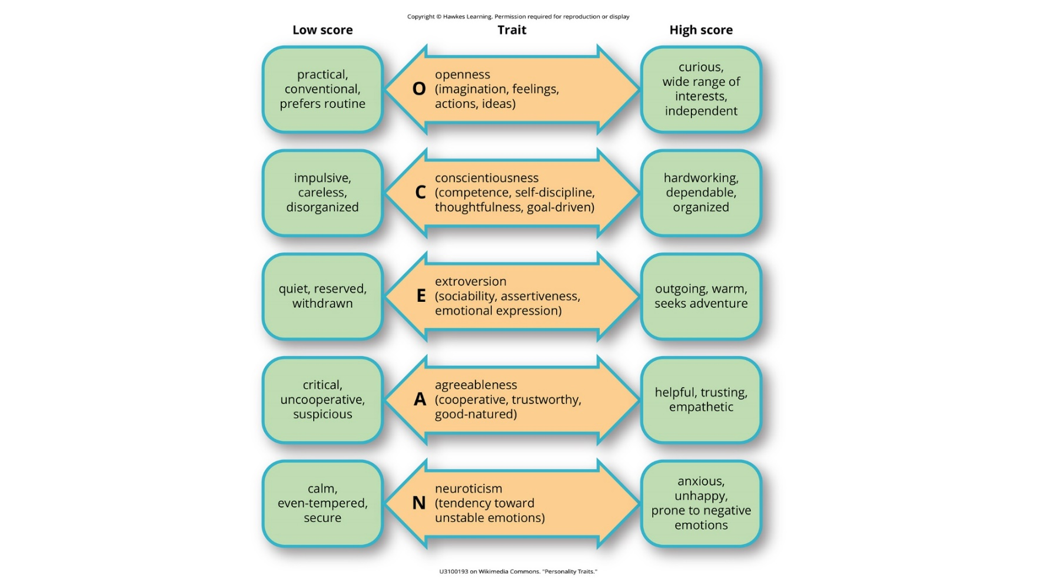
Lesson 1.2 Figure 8
Caption: Each of the dimensions of the Five Factor model is shown in this figure. The provided description would describe someone who scored highly on that given dimension. Someone with a lower score on a given dimension could be described in opposite terms.

Slide 19

Social Psychology
Studies how people interact and relate to others
Examines how behaviors and thoughts are influenced by social situations
Explores topics like conformity, obedience, attitudes, and group behavior
Known for experiments testing obedience to authority (e.g. Milgram experiment)
Led to ethical guidelines around deception and informed consent in research
Figure 9

Slide 20
Social Psychology (Broad Range Of Topics)
Explaining our own behavior vs. the behavior of others
Authority
Power
Prejudice
Attraction
Conflict
Impact of social situations on our behavior and thought patterns

Slide 21
Industrial-Organization Psychology
Applies psychological theories and research to workplace settings
Involved in personnel management, organizational structure, and work environments
Aids businesses in hiring decisions and improving employee productivity
Conducts scientific research on behavior within organizations
Combines applied and research aspects in industrial/organizational contexts

Slide 22
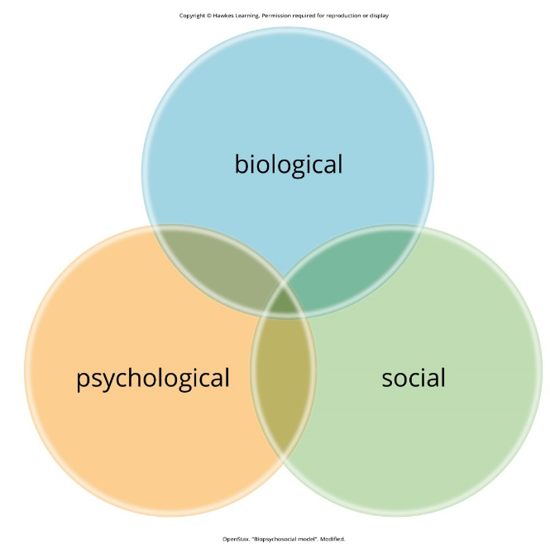
Health Psychology
Focuses on how biological, psychological, and sociocultural factors interact to affect health
Utilizes the biopsychosocial model to understand health holistically
Biopsychosocial model: perspective that asserts that biology, psychology, and social factors interact to determine an individual's health
Aims to improve health through public policy, education, intervention, and research
Studies relationships among genetics, behavior, relationships, stress, and health outcomes
Explores effective ways to motivate healthy behavior changes
Figure 10

Slide 23
Sport And Exercise Psychology
Studies psychological aspects of sport performance and exercise
Examines motivation, performance anxiety, and mental well-being in sports
Investigates effects of physical exercise on emotional health
Explores psychology of performance under demanding conditions
Covers occupations like firefighting, military, arts, and surgery

Slide 24

Clinical Psychology
Clinical psychology: area of psychology that focuses on the diagnosis and treatment of psychological disorders and other problematic patterns of behavior
Combines applied therapeutic work and scientific research
Influenced by perspectives like psychoanalysis, behaviorism, and humanism
Utilizes approaches like psychodynamic, behavioral, cognitive, and client-centered therapies
Figure 11

Slide 25
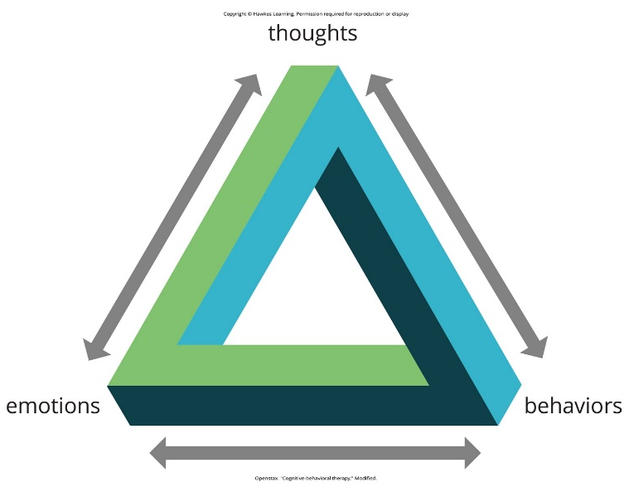
Counseling Psychology
Similar discipline focused on psychologically healthy individuals
Addresses emotional, social, vocational, and health-related outcomes
Often mistaken as synonymous with clinical psychology by the public
Figure 12

Slide 26

Forensic Psychology
Branch dealing with psychology in the context of the legal system
Assess competency, mental state, provide expert testimony in court cases
Consult on issues like child custody, sentencing, eyewitness testimony
Act as expert witnesses providing research-based opinions
Involved in jury selection, witness preparation, criminal profiling
Figure 13

Slide 27
Reflection Question₂
Think about the following questions:
Is the phenomenon of false or "implanted" memories real?
What are memories, and are they as accurate as we believe them to be?
Consider the role of the eyewitness in identifying the person who committed the crime. Are you more likely to believe the victim if there is a witness to the sexual assault? Why might we discredit a victim, if they are unable to remember certain aspects of the crime or assailant?

Slide 28

Careers In Psychology
Clinical Psychologist: requires PhD or PsyD, focuses on treatment
Academic/Research: PhD required, may involve postdoctoral training
Master's Degrees: counseling, school psychology, industrial consulting
Bachelor's Degrees: case management, sales, human resources, teaching
Health Professions: psychology education valuable for medical careers
Figure 14

Slide 29
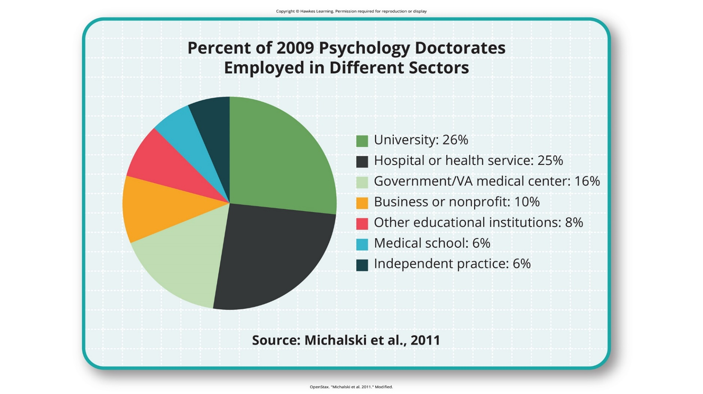
Lesson 1.2 Figure 15
Caption: Individuals earning a PhD in psychology have a range of employment options.

Slide 30
Summary
Psychology has diverse subdivisions with unique perspectives which include.
Biological bases, sensation/perception, cognition, lifespan development
Personality, industrial-organizational, health, sports, forensics, clinical
Academic careers require doctoral degrees (PhD, PsyD).
There are many career options with bachelor's/master's degrees.

Slide 31
End of Hawkes Learning PowerPoint

