Slide 1
Lesson 1.3
Why is Research Important?

Slide 2

Scientific Research
Provides an objective understanding of ourselves and our world
Allows understanding behavior when individuals cannot explain it themselves
Empirical: grounded in objective, tangible evidence that can be repeatedly observed
Contrasts with intuition and personal experience as unsupported methods.
Figure 1

Slide 3
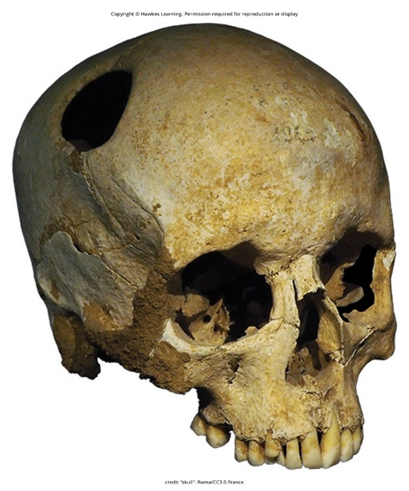
Use Of Research Information
Critical thinking involves examining claims from different perspectives.
It involves assessing the expertise and motivations behind claims.
Research requires evaluating if claims are justified by evidence.
It is important to consider other researchers' views on the claims.
Figure 2

Slide 4
Example: Evaluating Effectiveness Of Early Intervention Programs
Programs were designed to help disadvantaged children maximize development.
Research shows general effectiveness, though program effectiveness may vary.
Long-term benefits were observed for many effective programs.
Research is examined to identify the most effective program characteristics.
This research helps guide decisions on which programs to fund based on evidence.

Slide 5
Fact Vs. Opinion
In the end, research is what makes the difference between facts and opinions.
Fact: objective and verifiable observation, established using evidence collected through empirical research
Opinion: personal judgements, conclusions, or attitudes that may or may not be accurate
In the scientific community, facts can be established only using evidence collected through empirical research.

Slide 6
On Your Own
Identify whether each item is a fact or an opinion.
Anxiety always decreases performances on tests.
All Americans have a mental illness during their life.
Some mental illnesses have a genetic component.
Psychology is the most interesting subject in college/university.
Notes:
Originally an On Your Own

Slide 7
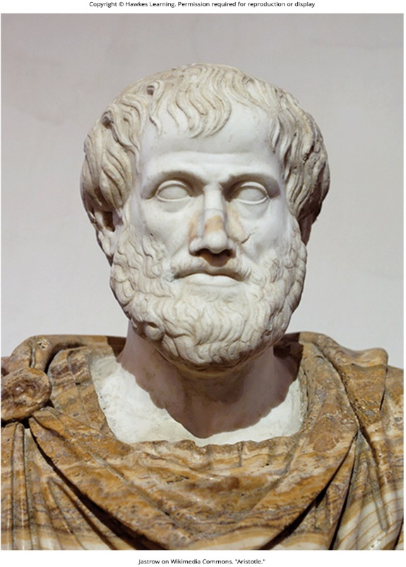
The Process Of Scientific Research
Involves testing ideas against the real world
Circular process of deductive and inductive reasoning
Deductive reasoning: results are predicted based on a general premise
Inductive reasoning: conclusions are drawn from observations
Inseparable processes with different emphases in research approaches
Figure 3

Slide 8
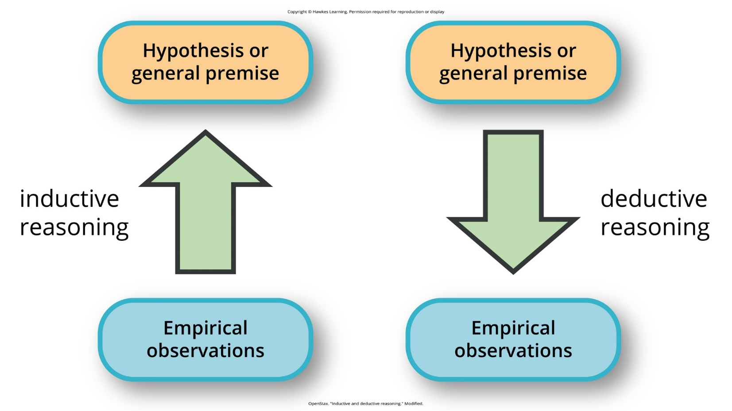
Lesson 1.3 Figure 4
Caption: Psychological research relies on both inductive and deductive reasoning.

Slide 9
Deductive Reasoning
It begins with a generalization or hypothesis to reach conclusions.
If the hypothesis is correct, deductive conclusions should be correct.
Example: All living things require energy (premise) → Ducks require energy (conclusion)
An incorrect premise can lead to logical but incorrect conclusion.
Scientists use deductive reasoning to empirically test hypotheses.

Slide 10
Inductive Reasoning
It involves the use of empirical observations to construct broad generalizations.
Conclusions may or may not be correct, regardless of observations.
Example: Noticing some fruits grow on trees → Assuming all fruits grow on trees
Scientists use inductive reasoning to formulate theories from observations.
Descriptive research approaches are closely associated with inductive processes.
Experimental research puts greater emphasis on deductive reasoning.

Slide 11
Theory
A well-developed set of ideas proposing an explanation for observed phenomena.
Theories are repeatedly checked against the real world.
Theories are too complex to be tested all at once.
Researchers create hypotheses to test specific aspects of a theory.
Hypotheses are more specific and testable predictions about the world.

Slide 12
Helpful Hint
Think of a theory as an umbrella. Everything under the umbrella stays dry, like a person's head, arms, and legs. A body is made up of individual units, and all are kept dry under the umbrella if it is positioned correctly.
A hypothesis is used to test an individual body part under the umbrella (e.g., right leg) rather than everything under the umbrella.

Slide 13
Hypothesis
A hypothesis is a testable prediction about the world.
Often is worded as an if-then statement
Example: if I study, then I'll pass.
It bridges the gap between ideas and the real world.
As hypotheses are tested, theories are modified and refined accordingly.
Hypotheses allow specific aspects of theories to be tested empirically.

Slide 14
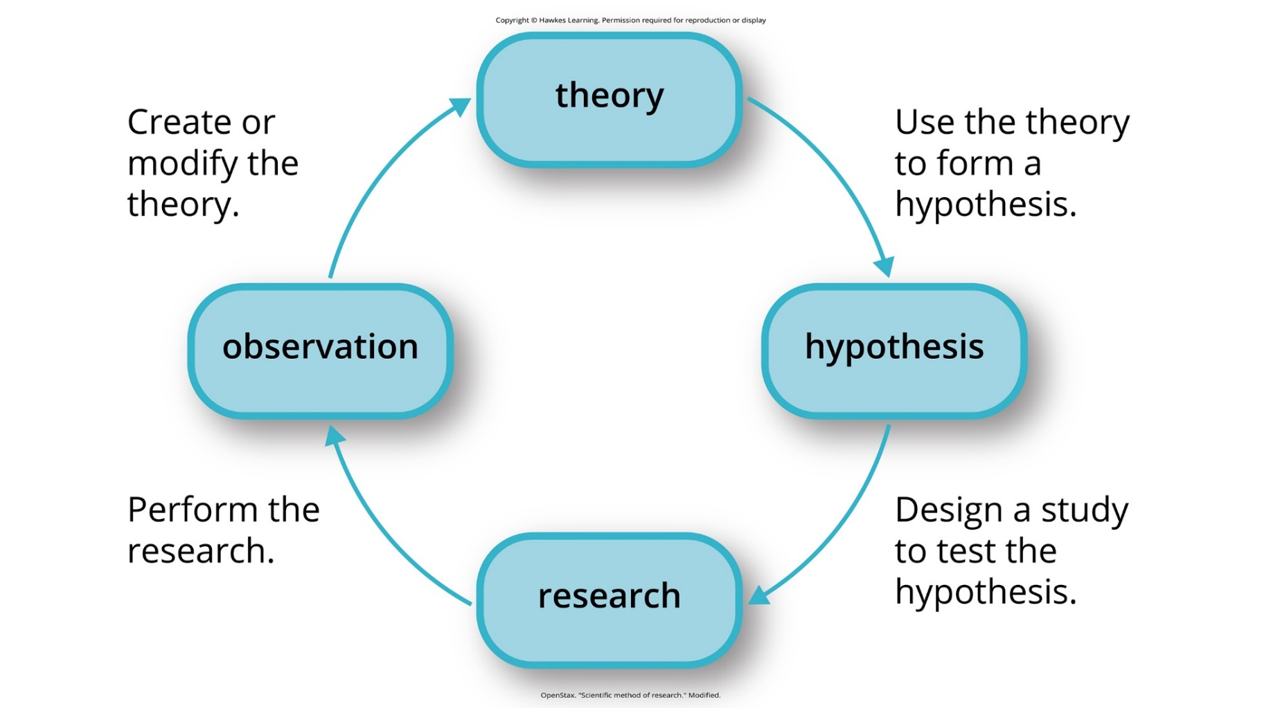
Lesson 1.3 Figure 5
Caption: The scientific method of research includes proposing hypotheses, conducting research, and creating or modifying theories based on results.

Slide 15
Group Activity
Think of a concept you are interested in (e.g., test performance). Then, form a hypothesis in the form of an if → then statement (e.g., If room temperature decreases, then average test score increases).

Slide 16
Falsifiability
Scientific hypotheses must be falsifiable or capable of being shown incorrect.
Freud's ideas were criticized as not able to be falsifiable.
Example: id, ego, superego
Taught regardless due to their historical significance for personality psychology and psychotherapy
In contrast, James-Lange theory generates falsifiable hypotheses. (Figure 6)

Slide 17
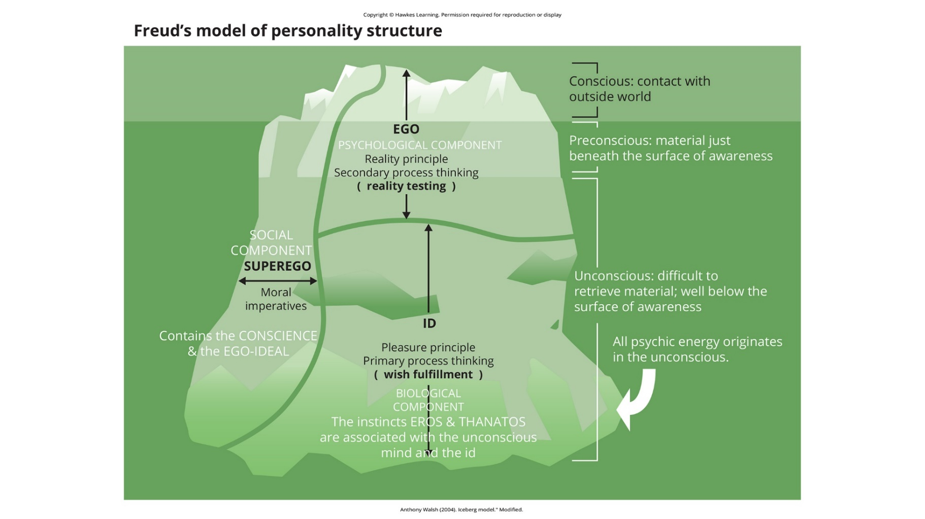
Lesson 1.3 Figure 6
Caption: Many of the specifics of Freud's theories, such as his division of the mind into id, ego, and superego, have fallen out of favor in recent decades because they are not falsifiable. In broader strokes, his views set the stage for much of psychological thinking today, such as the unconscious nature of the majority of psychological processes.

Slide 18
James-Lange Theory Example
Theory: Emotional experience relies on physiological arousal of that state.
Hypothesis: Without awareness of arousal, person won't feel fear
It was tested by comparing emotional experiences of those aware/unaware of arousal.
Research showed reduced but still present emotion without arousal awareness.

Slide 19
Summary
Scientists aim to explain and understand the world through testable theories.
Theories generate hypotheses that are testable and falsifiable.
Theories supported by tests are retained and refined, while unsupported theories discarded.
This process allows separating fact from opinion through research.
Good research information aids wise decision-making in policy and personal life.

Slide 20
End of Hawkes Learning PowerPoint

