Slide 1
Lesson 1.4
Approaches to Research

Slide 2
Types Of Research Methods
Observational techniques consist of studying behavior through observation.
Interactions between researcher and participants include:
Questioning, interviews, experiments
Types of research include:
Archival data, case studies, naturalistic observation, surveys
Correlational methods allow researchers to examine relationships between variables but cannot establish cause-and-effect relationships.
Experimental research offers control over variables but may lack real-world applicability and face ethical constraints, limiting its scope in addressing certain psychological questions.

Slide 3
Reflection Question
A researcher is interested in the long-term effects of child abuse. She believes that child abuse can lead to depression symptoms in adults.
What are the pros and cons of using archival research? Survey research? Case studies?
A research assistant suggests naturalistic observation. Is this a good idea?
How would you design this experiment? What are the ethical challenges to using this design?

Slide 4
Clinical Or Case Studies
Observational research focuses on studying a single person or a small group intensely, providing rich insights into specific cases.
This approach allows researchers to gain a deep understanding of individuals and phenomena, unmatched by other methods.
The specificity of case studies limits their generalizability to the broader population.
While case studies offer vast amounts of information, their applicability to average individuals or society at large may be limited.
Researchers face a trade-off between depth of understanding and the ability to apply findings to wider contexts when utilizing case study methods.

Slide 5
On Your Own₁
What are the pros and cons of case studies?

Slide 6

Naturalistic Observation
Observing behavior in its natural context without interference.
Provides insights into behavior as it naturally occurs.
Applies to both human and animal studies.
Requires researchers to be inconspicuous to avoid influencing behavior.
Examples include observing children on a playground and studying animals in their habitats.
Figure 1

Slide 7
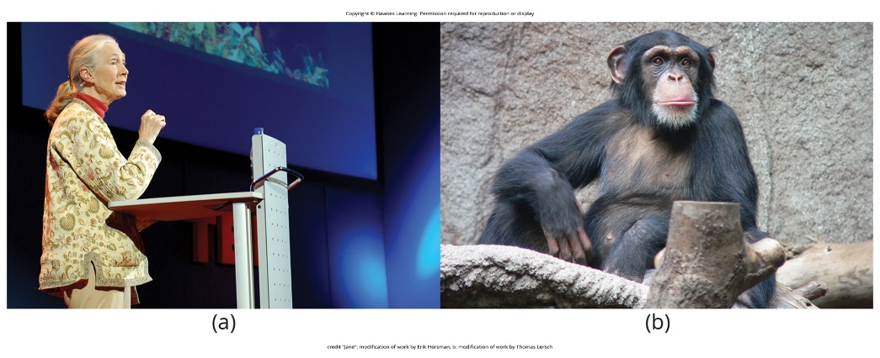
Benefits Of Naturalistic Observation
Higher ecological validity and realism compared to other research approaches.
Allows for the collection of accurate data in natural settings.
Enhances the ability to generalize findings to real-world situations.
Avoids the problem of people or animals modifying their behavior due to observation.
Ensures a deeper understanding of behavior as it naturally unfolds.
Figure 3

Slide 8

Drawbacks Of Naturalistic Observation
Difficult to set up and control experiments in natural settings.
Lack of control over when or if behavior will occur for observation.
Requires significant investments of time, money, and luck.
Examples include potential issues with restroom studies and animal migration.
Challenges in maintaining objectivity and avoiding interference with natural behavior.
Figure 2

Slide 9
On Your Own₂
What are the pros and cons naturalistic observation?

Slide 10
Observer Bias
Observers may unconsciously skew observations to fit research goals or expectations.
Arises from observers' close involvement in the research project.
Mitigation: Establish clear criteria for recording behaviors to prevent bias.
Strategy: Compare observations by multiple observers to test consistency.
Objective: Enhance validity and accuracy of observational research findings.

Slide 11
Inter-Rater Reliability
Measure of reliability assessing consistency among different observers' observations
Used in observational research to ensure consistency and accuracy of data collection.
Purpose: Test the reliability of observations made by multiple observers.
Method: Comparing observations of the same event by different observers.
Enhances the credibility and validity of research findings by reducing the impact of individual biases.

Slide 12
Surveys
Surveys are lists of questions designed to gather data from research participants.
They can be delivered as paper-and-pencil questionnaires, electronically, or verbally.
Surveys allow researchers to collect data from a large group of individuals efficiently.
Researchers use samples, subsets of a population, to generalize findings to the larger population.
Surveys can answer various research questions and provide insights into attitudes, behaviors, and opinions within a population.

Slide 13

Benefits Of Surveys
Surveys enable researchers to collect data from larger samples compared to other methods.
They allow for efficient data collection and can be completed in a short time.
Sample: subsets of a population used to generalize findings.
Surveys provide insights into attitudes, behaviors, and opinions within a population.
They can answer diverse research questions across different domains, such as social attitudes and behaviors.
Figure 5

Slide 14
Drawbacks Of Surveys
Despite their efficiency, surveys may suffer from response bias, where participants provide inaccurate or misleading responses.
Surveys require careful design to ensure questions are clear and unbiased.
Researchers must consider the limitations of survey samples when generalizing findings to the broader population.
Response bias occurs when participants provide inaccurate or misleading responses.
Surveys may not capture nuanced attitudes or behaviors and may overlook subtle forms of prejudice or bias.

Slide 15

Archival Research
Relies on looking at past records or data sets to identify interesting patterns or relationships
Involves analyzing existing records without interacting with research participants directly
Allows researchers to access large amounts of data with less time and money investment
Research questions are tailored to fit the structure of the existing data sets
Consistency between records from different sources may be problematic for comparing data sets
Figure 6

Slide 16
Benefits Of Archival Research
No direct interaction with research participants is required, which saves time and resources.
It allows access to large existing data sets that would be difficult or impossible to collect otherwise.
It allows for the study of historical events or trends over long periods of time.
It can provide important information and identify risk factors without additional data collection.
Example: Analyzing academic records to study college completion rates and risk factors

Slide 17
Drawbacks Of Archival Research
Researchers have no control over the information originally collected in the existing records
Research questions must be tailored to fit the available data, limiting flexibility
Lack of consistency between records from different sources may hinder data comparison
Inability to follow up or clarify information in the existing records
Example: Difficulty comparing academic records if data was collected differently across sources

Slide 18
On Your Own₃
What are the pros and cons of archival research?

Slide 19

Longitudinal Research
Involves repeated data-gathering from the same group over an extended period of time
Used in studies of human development, lifespan, and diseases to understand risk factors
Example: Cancer Prevention Study-3 tracks participants over 20 years to identify cancer risk factors
Allows researchers to observe changes in individuals over time
Can involve very large sample sizes to ensure generalizability of findings
Figure 7

Slide 20
Characteristics Of Longitudinal Studies
What: Data are gathered from same group of participants over a long period of time
When it is used: Long-term health studies, following individuals with childhood abuse histories, follow a cohort over time (better understand risk factors)
Why: Powerful statistical design because each participant serves as his/her/their own control
Challenges: Substantial time and financial investment, participants or researchers may leave the project

Slide 21

Benefits Of Longitudinal Research
Tracks changes in the same individuals over an extended period, providing rich data
Large sample sizes increase confidence in generalizing findings to the larger population
Enables identification of risk factors and predictors for various outcomes like diseases
Example: Earlier longitudinal studies linked smoking to increased cancer rates
Allows for observation of developmental changes and lifespan effects
Figure 8

Slide 22
Drawbacks Of Longitudinal Research
High attrition rates as participants drop out over the long time period
Researchers must continually check if remaining sample still represents the population
Requires extensive commitment from participants to continue participation for years or decades
Costly and time-consuming to conduct, often taking decades to complete
Potential for confounding variables to influence results over the extended timeframe

Slide 23
Cross-Sectional Research
Involves comparing multiple segments of the population at the same time
Example: Comparing dietary habits of 20, 30, and 40-year-old individuals concurrently
Examines differences between different generational cohorts or age groups
Example: Surveying different age groups on support for same-sex marriage

Slide 24
Characteristics Of Cross-Sectional Studies
What: Data are gathered from participants at one point in time and subgroups are compared (e.g., age groups, gender, education level, etc.)
When it is used: Used most frequently for attitudinal and polling research
Why: Provides a snapshot in time and is cheaper than longitudinal research
Challenges: Cannot examine changes in groups over time or generational differences due to different experiences

Slide 25
Benefits Of Cross-Sectional Research
Requires a shorter time investment compared to longitudinal studies
Can survey multiple age groups or cohorts simultaneously
Provides a snapshot of different segments of the population at one point in time
Allows for examining potential generational or cohort differences
Data can be collected relatively quickly compared to longitudinal designs

Slide 26
Drawbacks Of Cross-Sectional Research
Differences observed could be due to cohort effects rather than age effects
Example: Older cohorts may have different views due to social climates they grew up in
Does not track changes within individuals over time
Potential for confounding variables across different cohorts or age groups
Limited in its ability to establish causality or developmental changes

Slide 27
Summary
Clinical/case studies provide in-depth data but limited generalizability.
Naturalistic observation allows realistic observation but lacks experimental control.
Surveys enable rapid large-scale data collection with limited depth.
Archival research utilizes existing data sets to answer questions.
Longitudinal research tracks changes over time, cross-sectional compares groups concurrently.

Slide 28
End of Hawkes Learning PowerPoint

