Slide 1
Lesson 1.6
Ethics

Slide 2

Research Involving Human Participants
Any experiment with human participants must follow strict ethical guidelines to prevent harm.
Institutions receiving federal funding must have an institutional review board (IRB).
An IRB is a committee that reviews proposals for research involving human participants.
IRB members include administrators, scientists, and community representatives from the institution.
The purpose of the IRB is to ensure proposed research adheres to ethical principles.
IRB approval is generally required before experiments with human participants can be conducted.
Figure 1

Slide 3
Informed Consent
An informed consent form provides a written description of what participants can expect in an experiment.
Informed consent includes:
  The potential risks and implications of the research.
  Participation in the study is voluntary.
  Participant can discontinue the study at any time without penalty.
  Informed consent guarantees that any data collected in the experiment will remain completely confidential.
  Parents or legal guardians must sign the consent form for children under the age of 18.

Slide 4
On Your Own
Explain why you think each of the following was included in the informed consent process.
The potential risks and implications of the research are included.
Participation in the study is voluntary.
The participant can discontinue the study at any time without penalty.
Informed consent guarantees that any data collected in the experiment will remain completely confidential.
Parents or legal guardians must sign the consent form for children under the age of 18.
Notes:
Originally an On Your Own

Slide 5
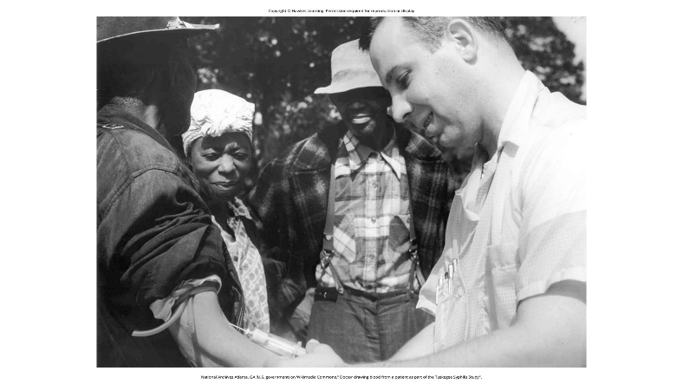
Deception
Informed consent aims for honesty in describing research, but deception is sometimes used to prevent participant bias.
Deception is strategic, ensuring the study's integrity while avoiding harm to participants.
It involves purposeful misleading, safeguarding against knowledge that could influence results.
  Example: Research on attire's impact on perceptions might hide its true purpose to prevent bias.
Figure 2

Slide 6
Debriefing
Deception may be employed to ensure participants' responses remain unbiased by prior knowledge of the experiment's purpose.
Full debriefing post-study is essential when deception is used, providing participants with complete and honest information.
Participants are informed about the experiment's purpose, data usage, reasons for deception, and avenues for further information.
Debriefing fosters transparency and ensures participants understand the study's context and ethical considerations.

Slide 7
Dig Deeper: Ethics And The Tuskegee Syphilis Study
In 1932, the U.S. Public Health Service conducted the unethical Tuskegee Syphilis Study on poor, Black men.
600 men were recruited to participate, with over half testing positive for syphilis as the experimental group.
The syphilis-positive participants were never informed they had the disease or received proper treatment.
Effective syphilis treatment (penicillin) became available in 1947 but was deliberately withheld from participants.
Over 40 years, participants unknowingly spread syphilis to wives and children as the disease went untreated.
The unethical study continued until exposed by the press in 1972, leading to outrage and new ethical guidelines.
Participants were deceived, denied treatment, and allowed to infect families, causing substantial harm and suffering.

Slide 8
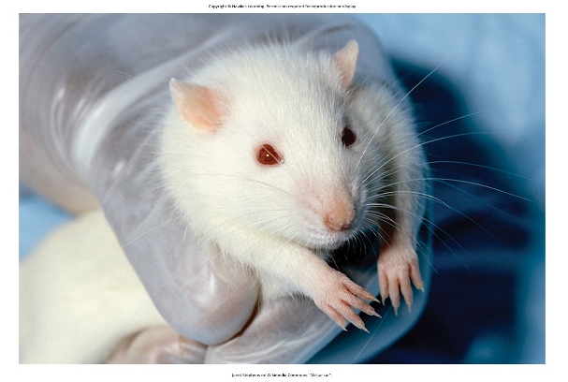
Research Involving Animal Subjects
Animal research in psychology predominantly involves rodents or birds, representing 90% of such studies. (APA n.d.-b.)
Animals are utilized in research due to similarities in basic processes to humans, allowing for ethical substitution in studies.
Ethical treatment of animal subjects is paramount, requiring researchers to minimize pain and distress.
Institutional Animal Care and Use Committees (IACUC) oversee animal research proposals, ensuring humane treatment.
IACUC comprises administrators, scientists, veterinarians, and community members, conducting semi-annual facility inspections and approving research projects.
Figure 3

Slide 9
Summary₁
Ethical guidelines for research involving human participants have evolved over time.
Any experiment with human participants must receive approval from an institutional review board (IRB).
Participation in experiments must be completely voluntary and require informed consent.
If deception is involved, participants must be fully debriefed after the study concludes.

Slide 10
Summary₂
Animal research also follows strict ethical standards to minimize pain and distress.
Animal studies require approval from an institutional animal care and use committee (IACUC).
Animal facilities undergo regular inspections to ensure humane treatment of research animals.

Slide 11
End of Hawkes Learning PowerPoint

