Slide 1
Lesson 10.1
Sex and Gender

Slide 2
Sex
Sex denotes the presence of physical or physiological differences—mostly reproductive characteristics—between males and females.
The sex chromosomes are one of 23 pairs of chromosomes found in humans.
Female sex chromosomes are denoted with XX, and male chromosomes are denoted with XY.

Slide 3
Intersex
The term intersex is used to describe individuals with reproductive or sexual anatomy that does not fit the definitions of male or female determined by external sex organs, such as the presence of a penis or vagina.
A 2021 study found that up to 2% of the population does not fit these absolutes of female or male.
This may be discovered in utero, directly after birth, or after the onset of puberty.

Slide 4
Social Constructs & Gender
Social constructs are ideas a society or group agrees upon as normal.
Gender is a social construct based on a person's identity, presentation of self, behavior, and interaction with others.
Psychologists view gender as learned behavior and a culturally produced identity.

Slide 5
Reflection Question
How do you think the way a person is raised can affect how they feel about their gender?
How do you think gender construction and socialization affect girls and boys differently?

Slide 6
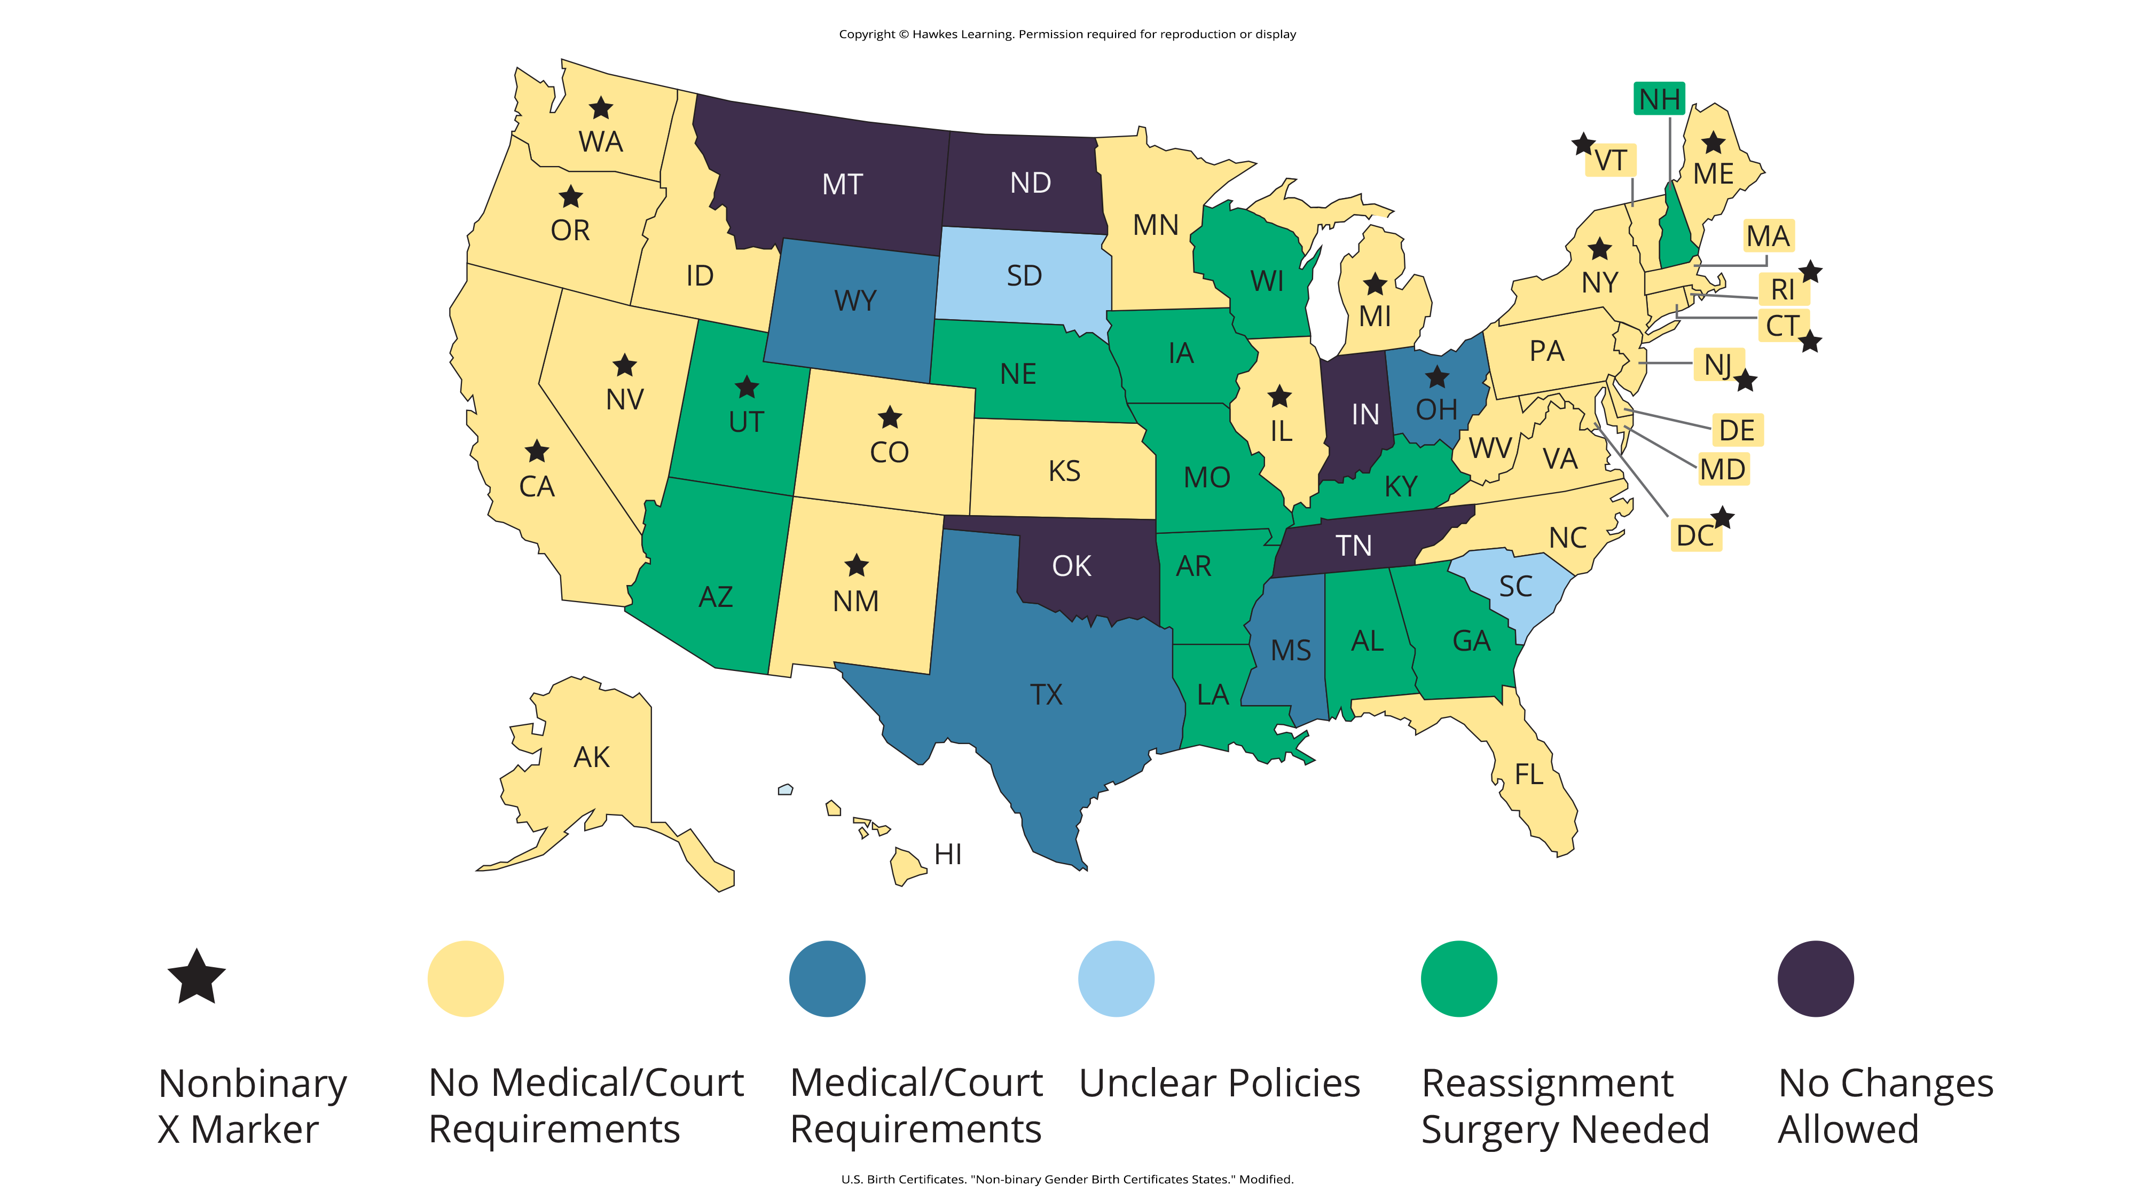
Lesson 10.1 Figure 4
Caption: Movement Advancement Project (2023) reported that many states are reviewing and updating their birth certificate laws. About one third of states allow the choice of M, F, or X gender markers on birth certificates. Some states require medical or court documentation, but others do not.

Slide 7
Gender Binary
Gender binary: The dichotomous view of gender or the classification of sex and gender into two distinct, opposite, and disconnected forms of masculine and feminine.
This is not universal.

Slide 8

Gender Spectrum
Gender spectrum denotes gender as a continuum that includes male and female but without establishing them as absolutes or polar opposites.
Figure 1

Slide 9

Gender Norms
Gender norms are a behavior or attribute that society assigns to a particular sex.
Figure 3

Slide 10

Gender Identity
Gender identity is a person's deeply held internal perception of their gender.

Slide 11
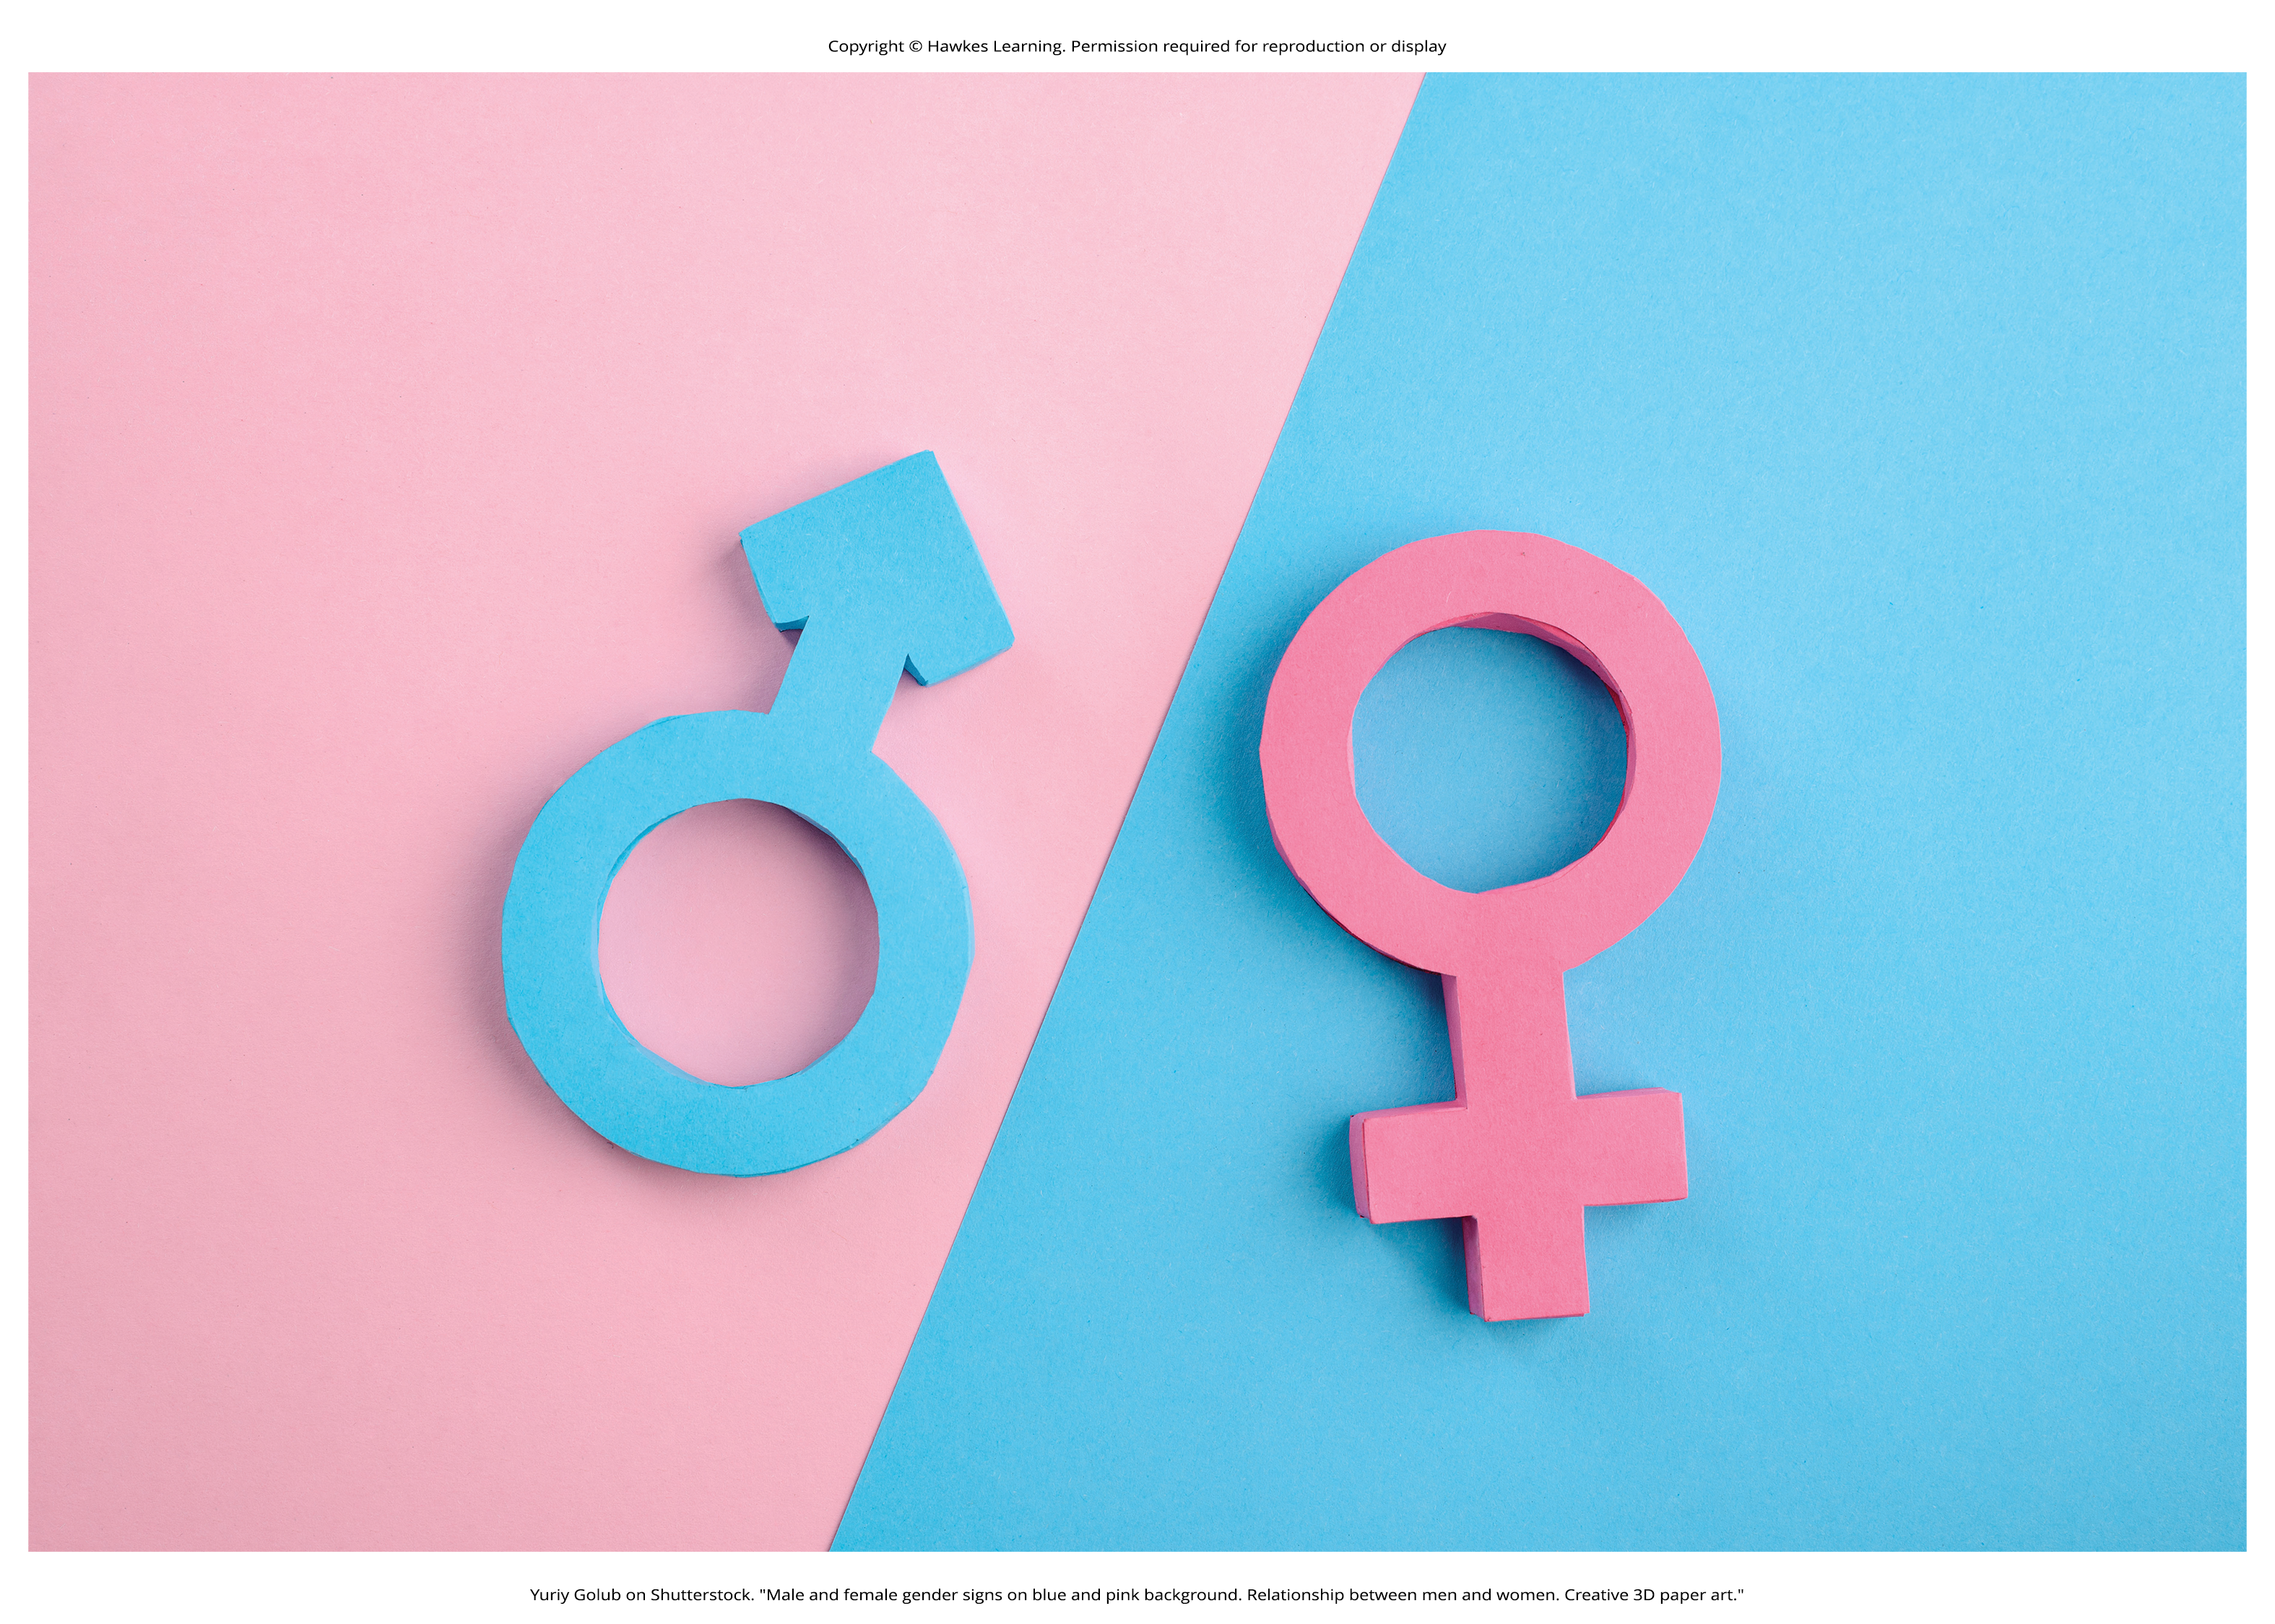
Examples Of Gender Expression₁
Cisgender people whose gender identity aligns with the sex they were assigned at birth.
Figure 2

Slide 12

Examples Of Gender Expression₂
Transgender people whose gender identity is different from the sex they were assigned at birth.
Sometimes shortened to "trans."
Figure 7

Slide 13
Transitioning
Some transgender individuals may undertake a process of transition, in which they move toward living in a way that aligns with their gender identity rather than with their sex assigned at birth.
Hormone therapy is used to change the physical appearance of sex characteristics and is done with a trained physician.
Gender-affirming surgery includes many surgical options tailored to the needs of the patient.

Slide 14
Gender Fluidity
Gender fluidity is when a person's gender identity or expression changes over time or even day to day.
gender nonbinary: one of the most common terms used for people to self-identify when their gender is not male or female
gender nonconforming: behavior, appearance, or expression that does not conform to the prevailing social expectations about masculine or feminine gender norms
genderqueer: used to describe a person whose gender identity does not follow conventional binary gender characteristics
For some people, gender fluid is a gender identity.

Slide 15
Gender Dysphoria
Gender dysphoria is psychological distress that results from an incongruence between one's sex assigned at birth and one's gender identity (APA, 2022b).
Prior to 1973 this was called gender identity disorder and considered a mental illness by the APA.

Slide 16
Prejudice and Discrimination
Prejudice and discrimination toward trans and nonbinary people is a social problem.
For example, more than half of LGBTQIA+ adults and 70% of transgender or gender nonconforming people report experiencing discrimination from a health care professional

Slide 17
On Your Own
Answer the following short-answer questions.
What is the difference between being transgender and being gender nonconforming?
What are some of the official records transgender people may change when they’re transitioning?
What is gender dysphoria?

Slide 18
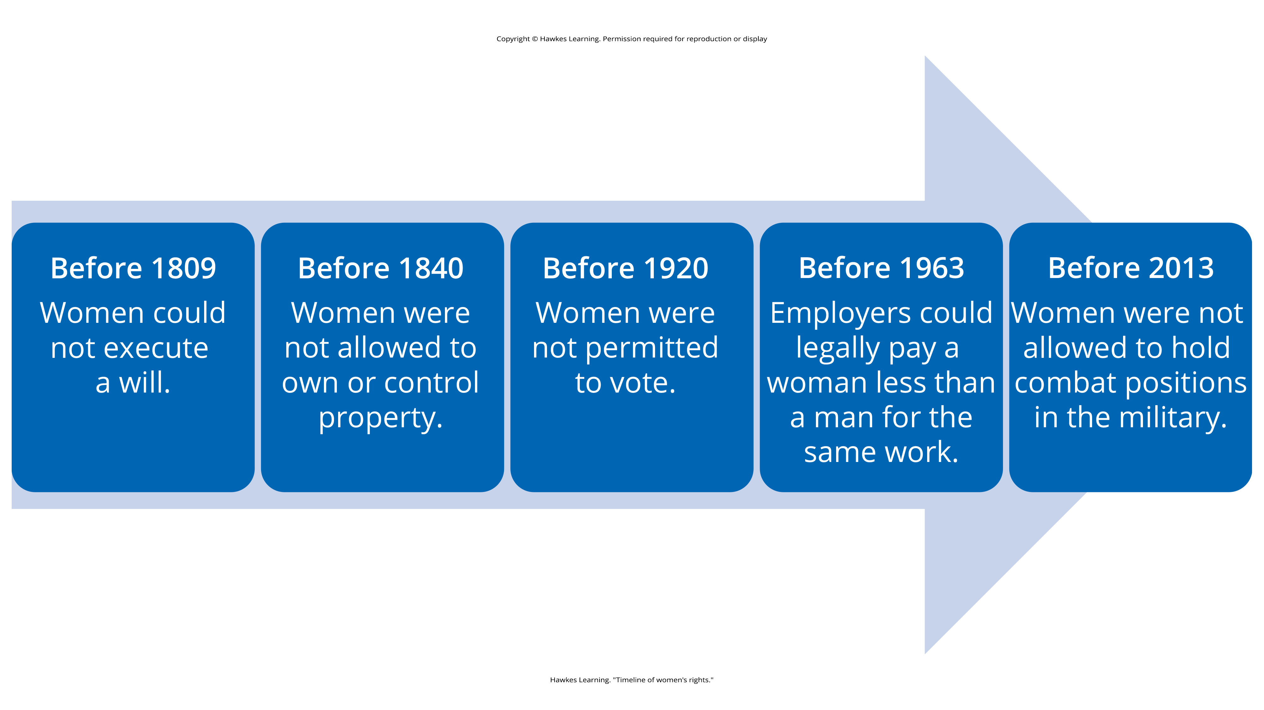
Lesson 10.1 Figure 11
Caption: A timeline of women's rights in the United States (Imbornoni, 2021)

Slide 19
Inequality
Gender stratification: a system in which groups of people experience unequal access to basic yet highly valuable social resources
The United States is characterized by stratification by gender, race and/or ethnicity, income, occupation, and more.
Evidence of gender stratification is especially prevalent within the economic realm.

Slide 20
End of Hawkes Learning PowerPoint

