Slide 1
Lesson 10.2
Understanding Sexual Behavior

Slide 2
Sexual Behavior
Sex is an important part of our lives.
From an evolutionary perspective, the reason is obvious—perpetuation of the species.
Sexual behavior in humans, however, involves much more than reproduction.

Slide 3
Physiological Mechanisms Of Sexual Behavior₁
Much of what we know about physiological mechanisms of sexual behavior comes from animal research.
The following examples are related to studies from rats.
Lesions in the medial preoptic area disrupt a male rat's ability to engage in sexual behavior.
These lesions do not affect a male rat’s efforts to seek a sexually reproductive female rat.

Slide 4
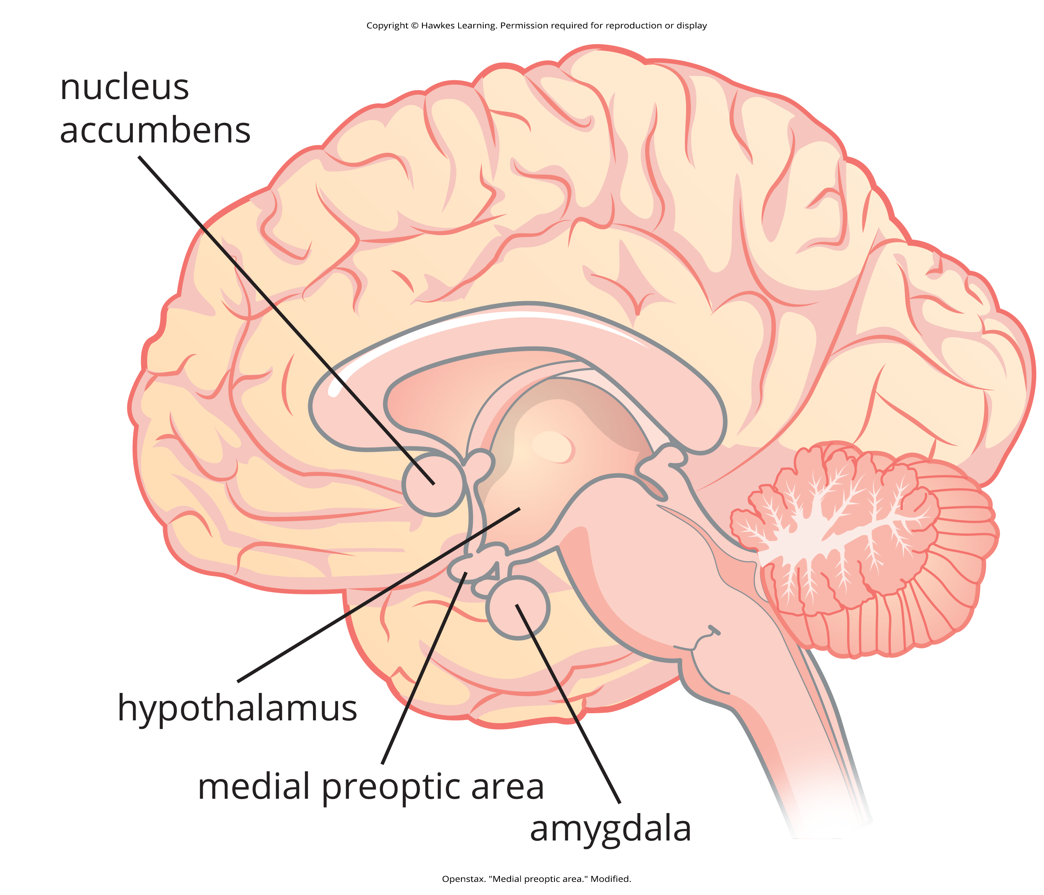
Physiological Mechanisms Of Sexual Behavior₂
Animal research suggests that the limbic structures such as the amygdala and nucleus accumbens are especially important for sexual motivation.
Damage to these areas decreased sexual motivation while leaving the ability to do so intact.
Figure 1

Slide 5
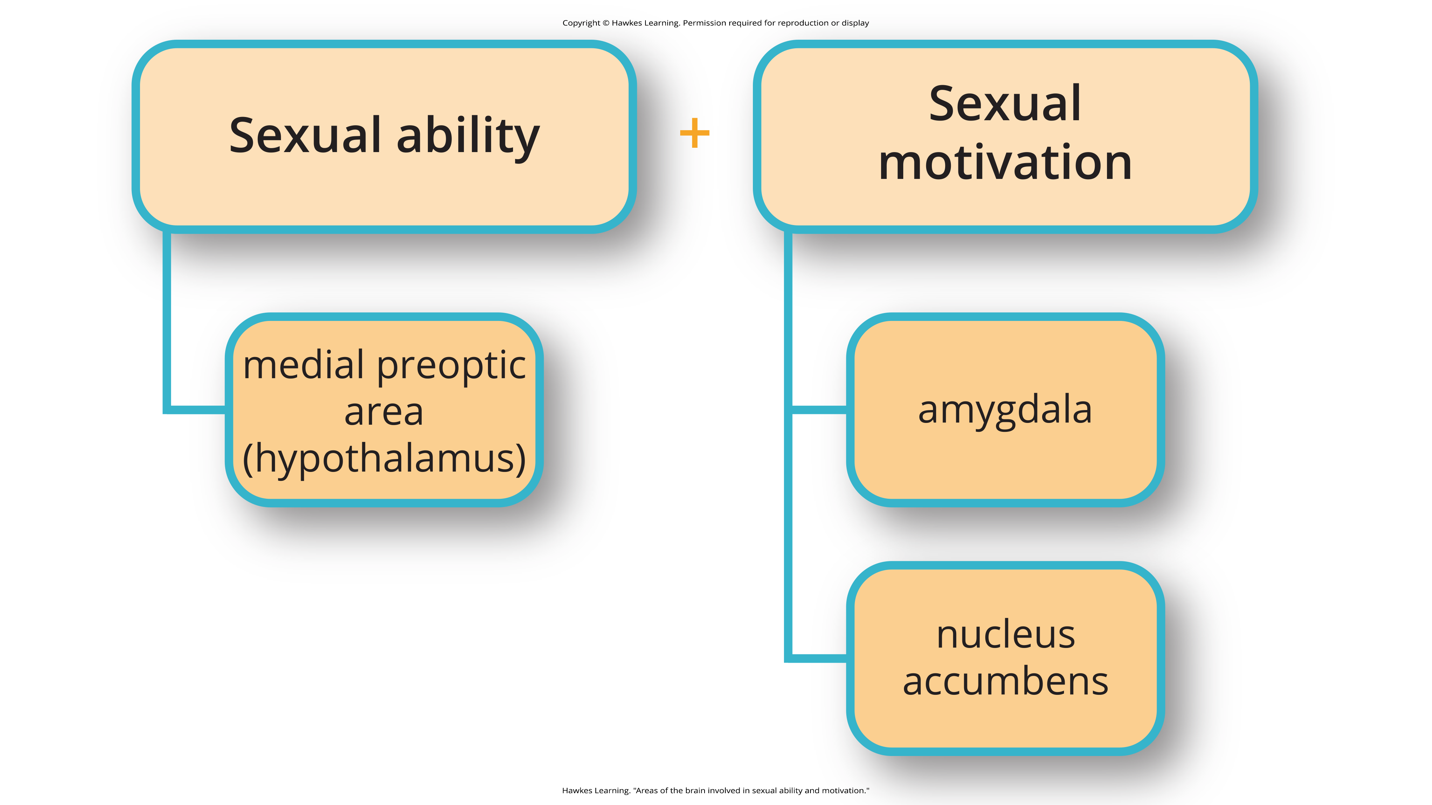
Lesson 10.2 Figure 2
Caption: Different areas of the brain are involved in different aspects of sexual behavior.

Slide 6
Human Sexual Behavior
Human sexual behavior is much more complex, but some parallels can be drawn.
The popularity of erectile dysfunction drugs indicates that sexual motivation and the ability to engage in sex can be dissociated in humans.
Given the hypothalamus's role in endocrine function, it is not surprising that hormones play an important role in sexual function and motivation.

Slide 7
On Your Own
Answer the following short-answer questions.
1. In an experiment, a male rat actively seeks out access to a new room that houses a receptive female but does not initiate mating upon arrival into the room. What deficit might the adult male rat have?
2. In an experiment, a male rat is fully capable of mating but does not appear interested in the sexually receptive female placed in his cage. What deficit might the adult male rat have?

Slide 8
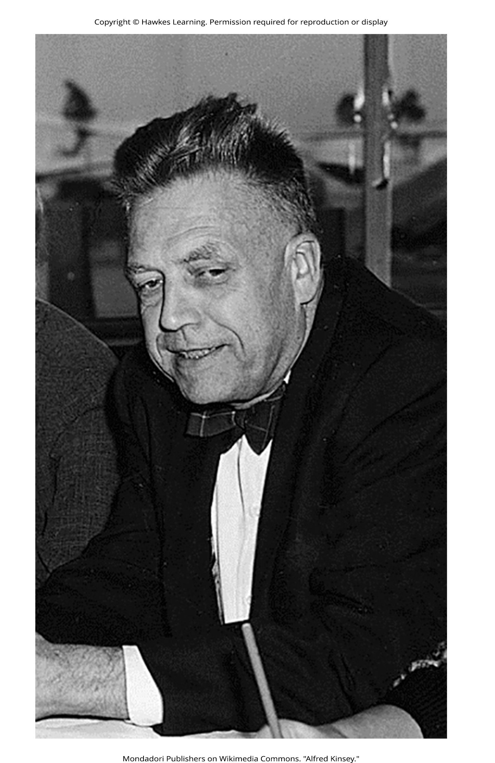
Kinsey's Research₁
Alfred Kinsey was the first psychologist to do a large-scale survey of human sexual behavior.
First done in the 1940's
Sensational at the time
Published two books on the topic that were popular with the public
Figure 3

Slide 9
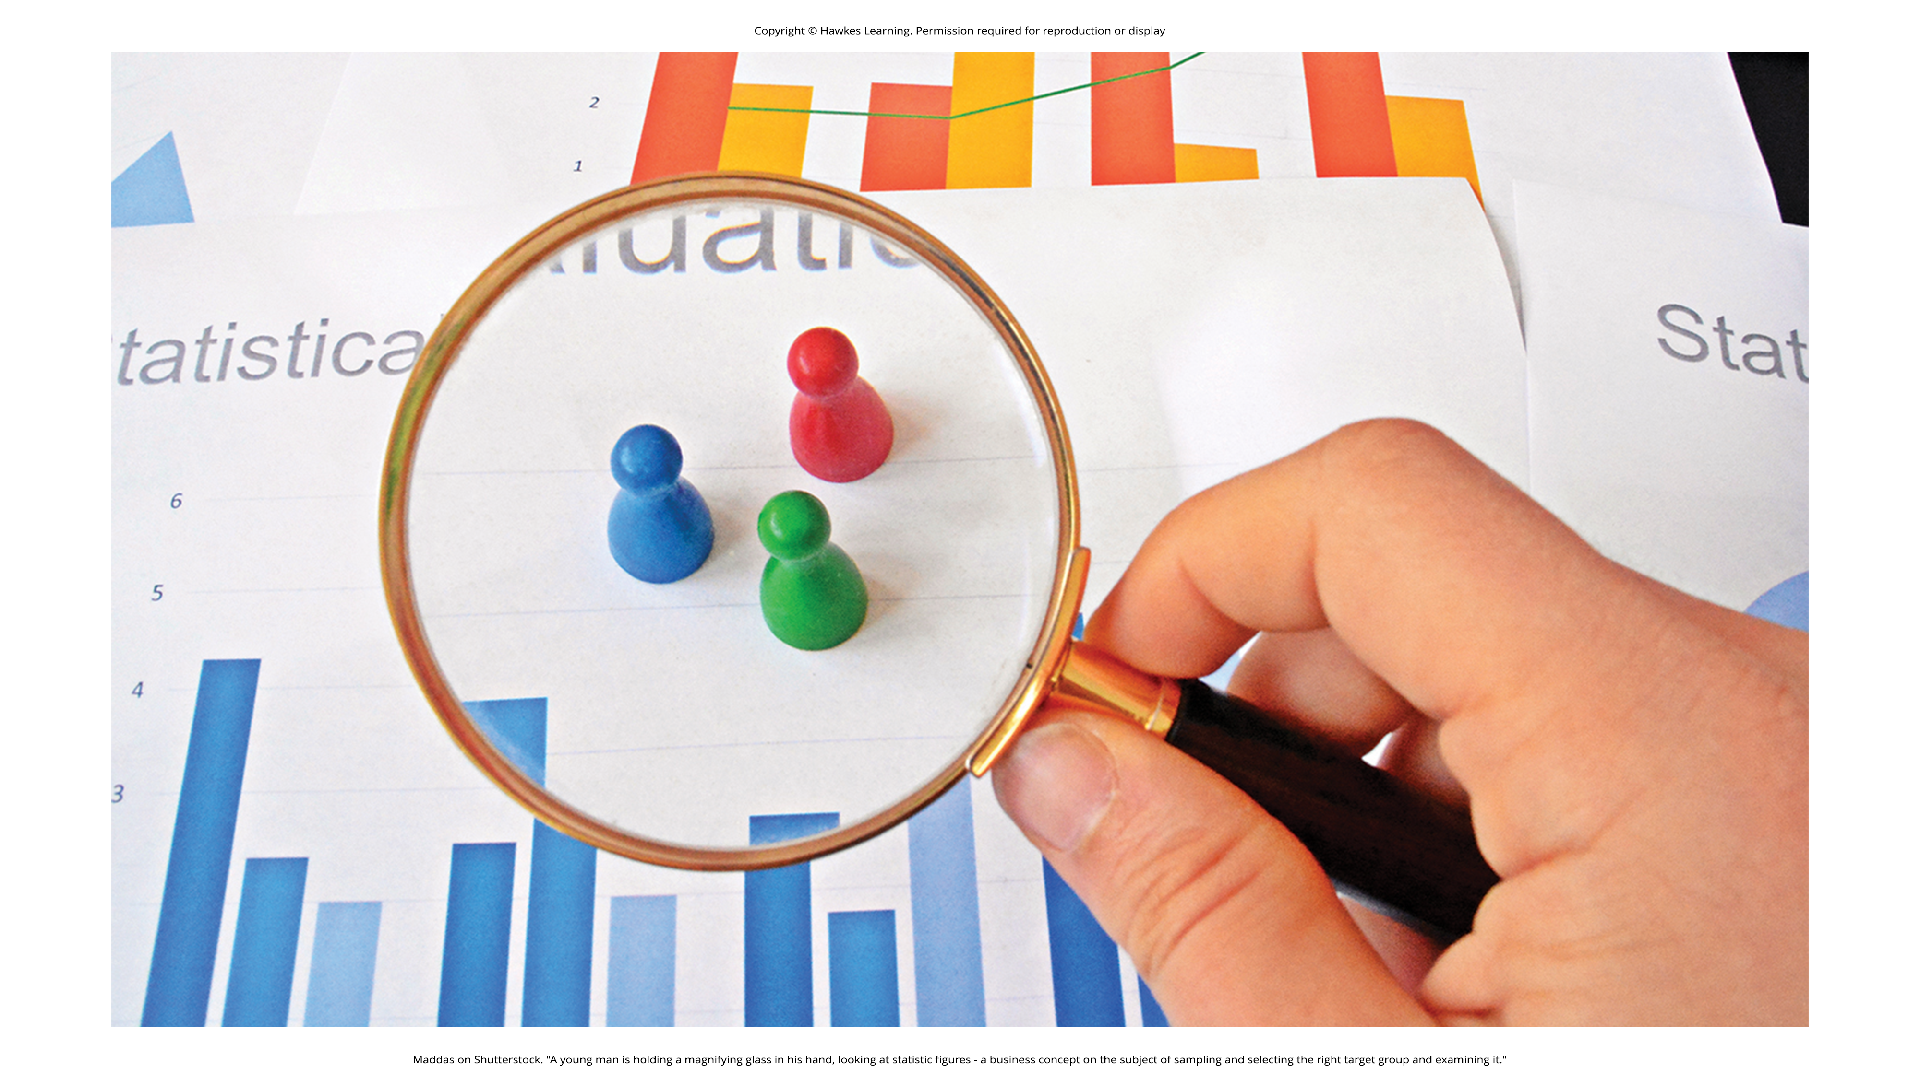
Kinsey's Research₂
The original research was criticized for possible sampling and statistical errors.
Regardless, the research described a remarkably diverse range of sexual behaviors and experiences.
Women are just as interested in sex as men.
Masturbation is common.
Homosexual acts are fairly common.
Figure 4

Slide 10
Group Activity₁
In a small group, briefly discuss the limitations of the Kinsey study. How would you have changed it to improve its validity?

Slide 11
Sexual Orientation
Sexual orientation is an individual's emotional and erotic attractions to other people.
Homosexual
Heterosexual
Bisexual

Slide 12
Masters And Johnson's Research
Masters and Johnson documented the sexual response cycle by observing over 700 people engage in sex acts. They found that the response cycle was roughly equal in men and women.
Observed sex between individuals in a variety of positions
Heterosexual sex
Homosexual sex
Masturbation
Measured physiological responses as part of this

Slide 13
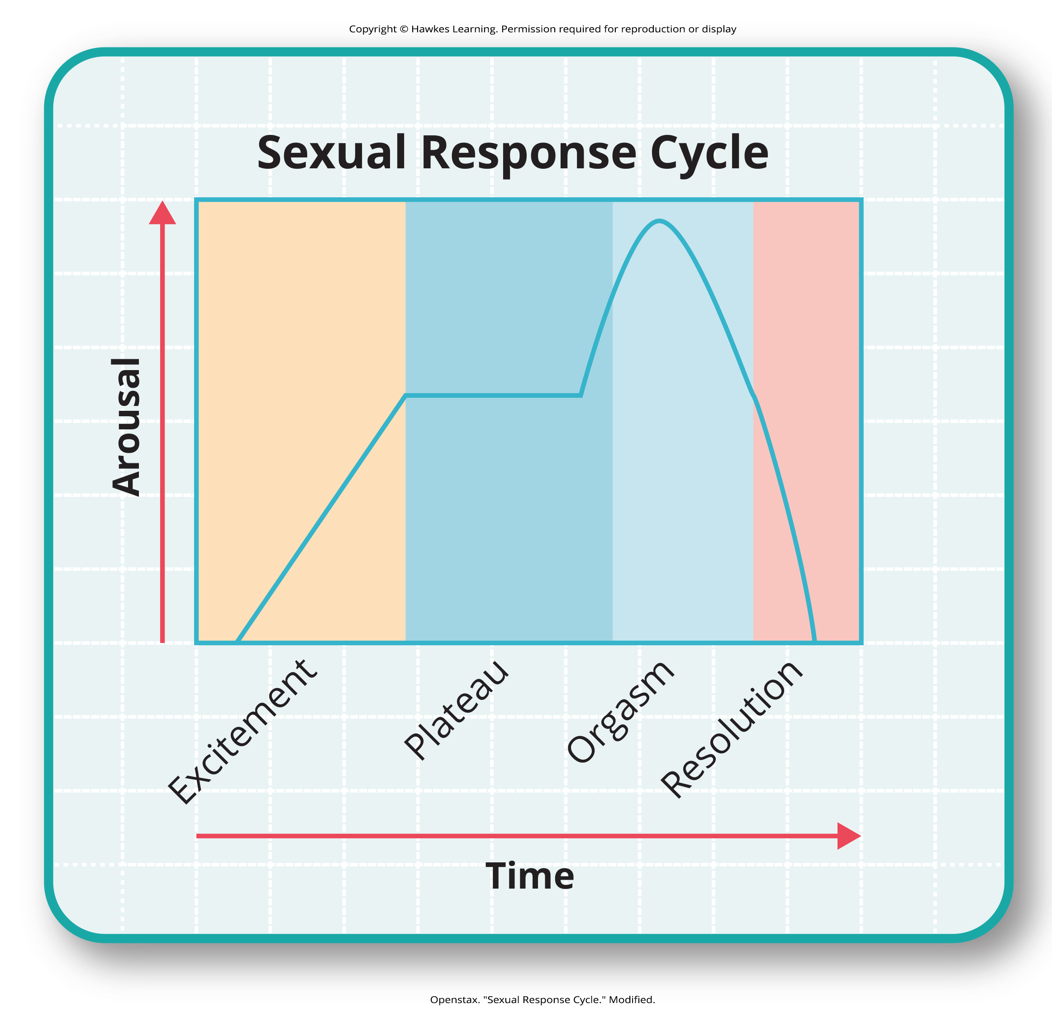
Sexual Response Cycle
There are four phases in the cycle:
Excitement
Plateau
Orgasm
Resolution
Figure 5

Slide 14
Refractory Period
Refractory period: Time immediately following an orgasm during which an individual is incapable of experiencing another orgasm.
Different from person to person
Males have longer refractory periods
Lasts longer as a person ages

Slide 15
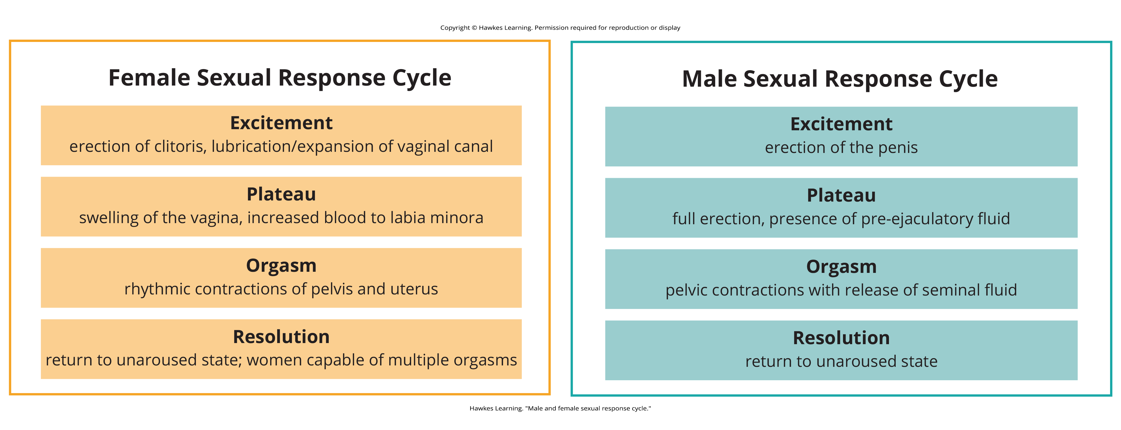
Lesson 10.2 Figure 6
Caption: The female sexual response cycle goes through the same stages as the male sexual response cycle; however, males have longer refractory periods than females.

Slide 16
Sexual Health And Education
Sexual health: a state of physical, emotional, mental and social well-being in relation to sexuality
World Health Organization (WHO) definition (2004)
Sexually transmitted infection (STI) is an infection transmitted through sexual contact.
May be bacterial, viral, or parasitic in origin
Sexual pleasure is the physical and/or psychological satisfaction and enjoyment derived from erotic experiences.

Slide 17
Sex Education
Sex education: Teaching about human sexuality, relationships, anatomy, reproduction, STIs, sexual activity, sexual orientation, gender, abstinence, contraception, and reproductive rights.
Varies from state to state and country to country
Twenty-five states, including Washington, DC, require it.
Abstinence-only education teaches delaying engaging in any sexual activity until marriage.

Slide 18

Sexual Attitudes
Sexual attitudes are defined as "values and beliefs about sexuality, based on family and cultural views about sexuality, sex education, and sexual experiences" (APA, 2023).
Often stem from cultural and religious backgrounds
Vary greatly around the world
Figure 8

Slide 19

Lesson 10.2 Figure 7
Caption: As of March 2023, the states in the U.S. that have mandated sex education in their public school systems are filled in blue.

Slide 20
Double Standard
Sexual double standard, a rule or principle that is unfairly applied in different ways to different people.
Men are permitted to have more premarital sexual partners than women.
Women should in engage in premarital sex with loving, committed partners.
Older people shouldn't engage in sex.
These are longstanding double standards. Younger generations are increasingly breaking these down.

Slide 21
Group Activity₂
As a group, brainstorm common words and terms for the following types of people:
Positive terms for a sexually active man
Negative terms for a sexually active man
Positive terms for a sexually active woman
Negative terms for a sexually active woman
Discuss ways in which your list reflects the sexual double standard, as well as gender norms and norms for sexuality.

Slide 22
Summary
The hypothalamus and the limbic system play an important role in sexual behavior and motivation.
Sexual behavior and the motivation to do so are linked but separate processes.
Alfred Kinsey conducted some of the first large-scale research on sexual behavior, which showed its incredible diversity.
William Masters and Virginia Johnson documented the sexual response cycle after observing individuals engaging in sexual activity.
Norms regarding sexuality and sexual expression vary across cultures.
The U.S. tends to be conservative in its sexual attitudes and approach to sexual education.
Sexual attitudes differ across cultures, religions, and generations.
Gen Z is more open to discussing sex.

Slide 23
End of Hawkes Learning PowerPoint

