Slide 1
Lesson 10.3
Sexuality

Slide 2
Sexuality
Throughout time and place, the vast majority of human beings have participated in sexual relationships (Broude, 2003).
  Each generation has interpreted sexuality differently.
  Historically, religion has been the greatest influence on behavior.
  Recently, this has changed to peer and social media.

Slide 3

Lesson 10.3 Figure 1
Caption: Sexual practices can differ greatly among groups. Recent studies show that married couples have sex about twice a week. Other data show that older people have sex about two to three times a month, and younger couples have sex about once a week (Montgomery, 2018).

Slide 4
Sexuality And Sexual Orientation
Sexuality: The capacity to experience sexual feelings and attraction
Sexual orientation: An individual's emotional and erotic attractions to other people
  Defined by their physical, mental, emotional, and sexual attraction or lack thereof
  Sexual attraction is not necessarily based on gender identity or expression.

Slide 5

Common Sexual Orientations
Heterosexuality: attraction to individuals of a different sex
Homosexuality: attraction to individuals of the same sex
Bisexuality: attraction to individuals of either sex
Asexuality: lack of sexual attraction and arousal
Pansexuality: attraction that does not regard gender and is not limited by sex, gender identity, or gender expression
Omnisexuality: attraction that acknowledges gender and is not limited by sex, gender identity, or gender expression
  Other orientations exist, and perhaps sexual orientation is better thought of as being on a spectrum.
Figure 3

Slide 6

Heteronormativity
Heteronormativity is the belief or assumption that heterosexuality, predicated on the gender binary, is the default, preferred or normal mode of sexual orientation.
  Socially promotes heterosexual sexual and marital relationships, relationships, and families as most fitting
  Developed in a heteronormative society
  Has led to ongoing discrimination against nonheterosexual individuals
Figure 3

Slide 7
On Your Own
For each scenario, identify the correct term.
Gamilia is not sexually attracted to anyone. What is her sexual orientation?
David's company only offers health insurance to married heterosexual couples. This social institution is an example of what?
Marie and Juan assume their daughter will grow up to be feminine and marry a man. This is an example of what belief?

Slide 8
Awareness Of Sexual Orientation
According to scientific understanding, people are usually—but not always—aware of their sexual orientation.
  Typically begins in middle childhood
  The timing of announcing one’s sexual orientation varies from person to person.
  There is no scientific consensus regarding the exact reasons why an individual has a certain sexual orientation.

Slide 9
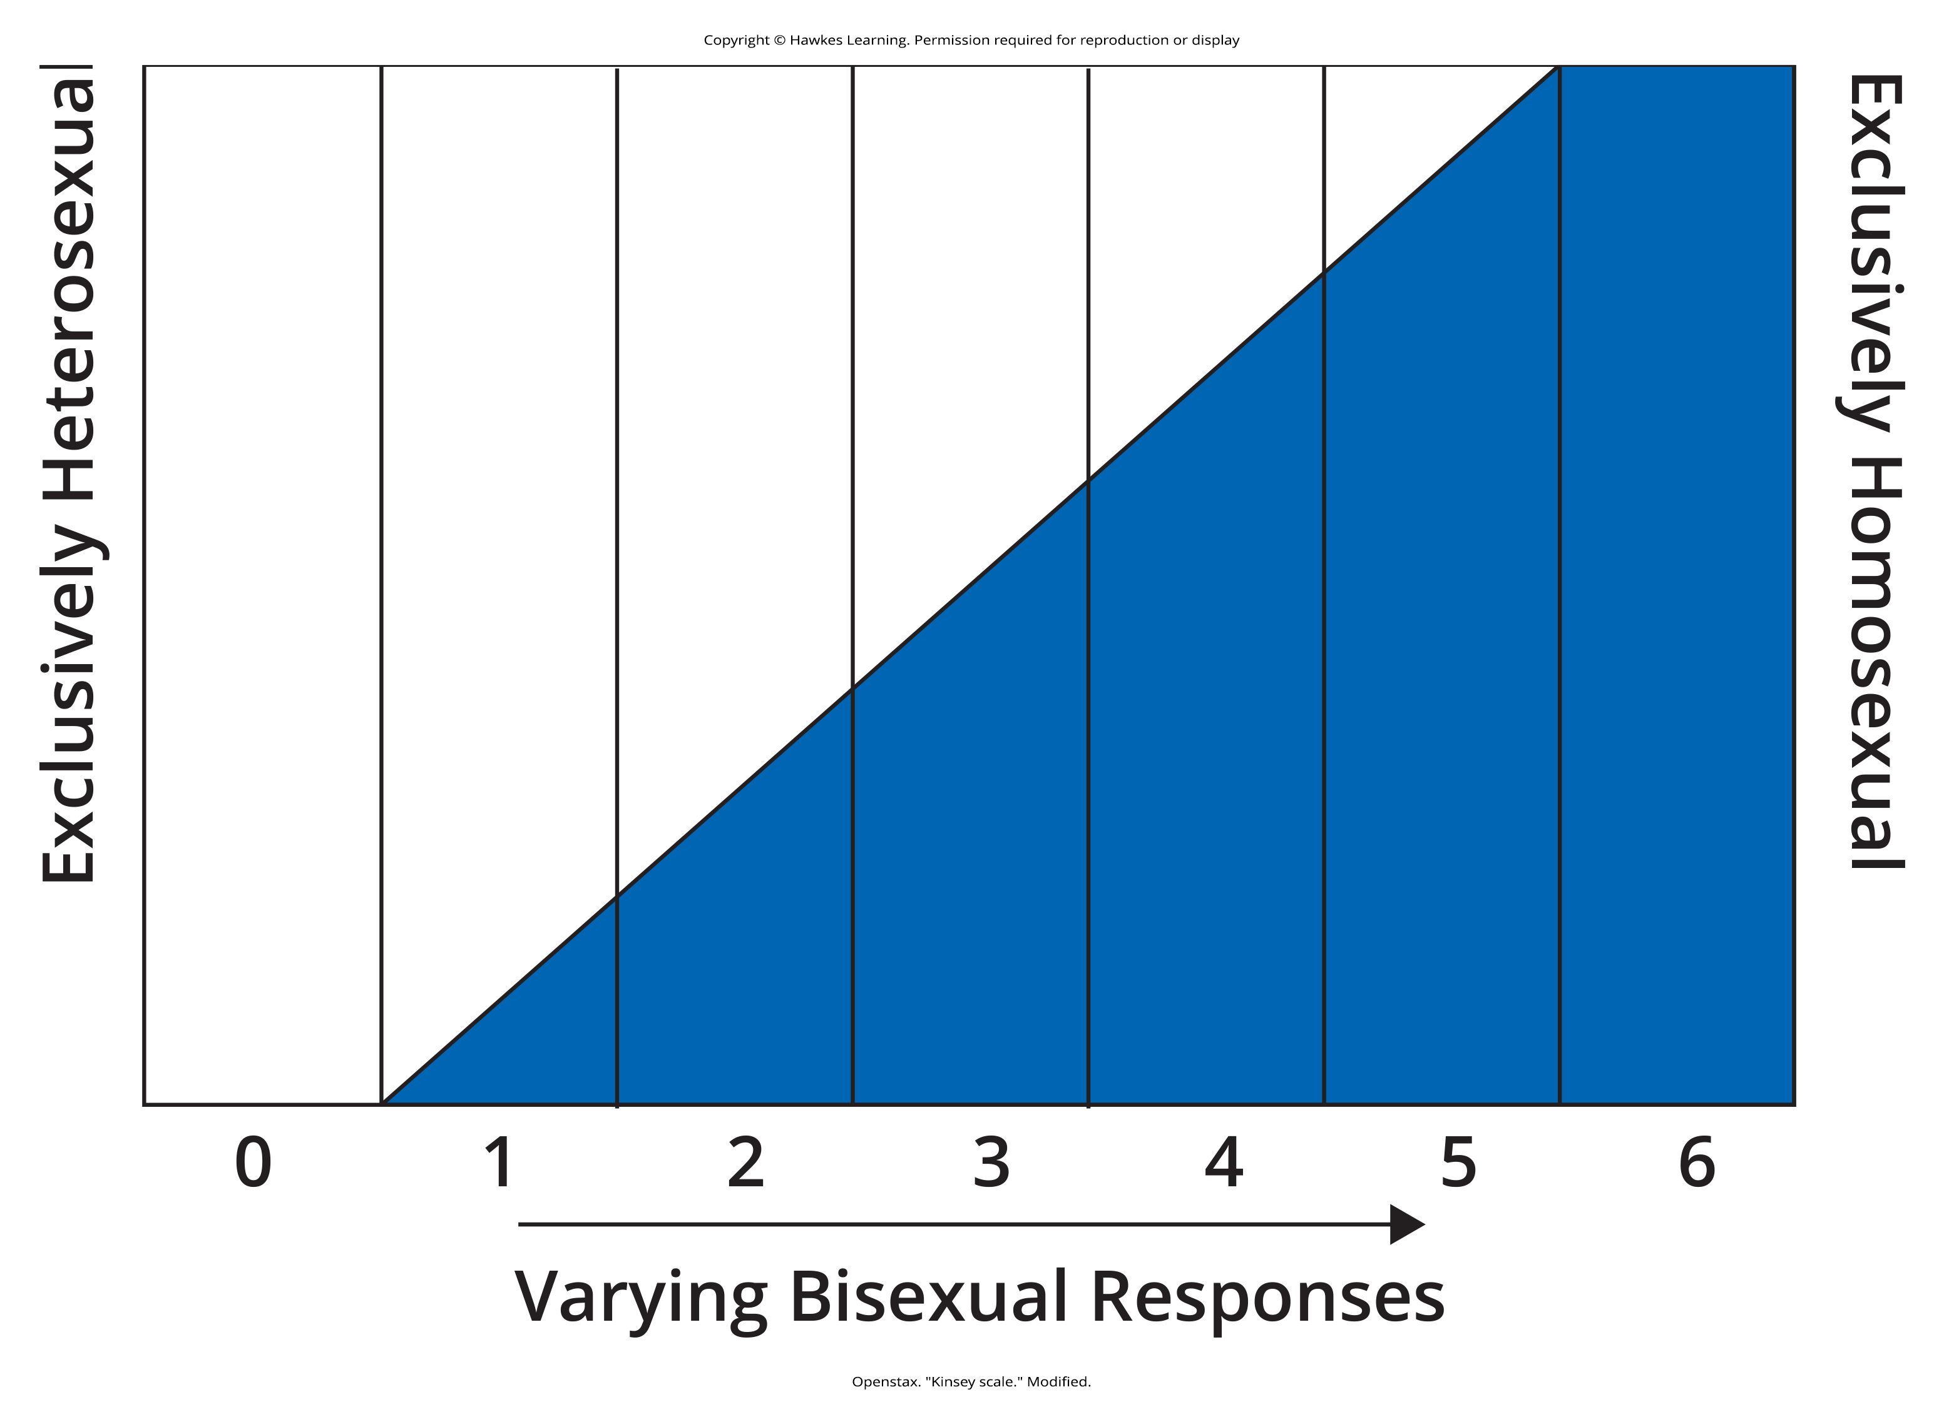
Kinsey’s Scale of Sexual Orientation
Alfred Kinsey, author of the Kinsey Report, was among the first to conceptualize sexuality as a continuum rather than a strict dichotomy.
Figure 4

Slide 10
Homosocial
Homosocial, a term coined by Eve Kosofsky Sedgwick, opposed the term homosexual to describe nonsexual relationships.
  This recognized that in U.S. culture, there was a divide between sexual and social norms.
  Women are allowed to more freely express homosocial feelings (like hugging, hand-holding, and physical closeness).

Slide 11
Sexuality and Discrimination
In recent years, inclusivity has evolved to be inclusive of all sexualities and sexual orientations.
  Research has provided clear evidence showing that those in the LGBTQI+ community are treated differently from straight, cisgender people throughout society.
  Much of this discrimination is based on stereotypes and misinformation.

Slide 12

Examples of Discriminatory Action
The following data shows the level of discrimination that people in the LGBTQIA+ community have faced and still face.
  60% reported discrimination in being fired from or denied a job.
  48% reported discrimination in not being promoted or receiving a negative evaluation at work.
  15% reported discrimination in housing decisions.
  41% reported being bullied before the age of 18.
Figure 5

Slide 13
Heterosexism
Heterosexism: An ideology and set of institutional practices that privilege heterosexual and heterosexuality over other sexual orientations
  Similar to racism and sexism
  A systematic disadvantage embedded in our social institution.
  Several state and federal laws have been enacted to reduce this, but most are not universal.

Slide 14
Equality Act
A proposed bill by LGBTQIA+ advocates to be a more comprehensive set of protections.
  Calls for fairness in public accommodations, public education, federal funding, credit, and jury service not currently covered by the Employee Non-Discrimination Act (ENDA).
  As of 2024, this legislation has not been adopted.

Slide 15
Public Policies On Non-discrimination
Public policy changes have been slow and limited to date.
  Employee Non-Discrimination Act (ENDA) focuses only on fairness in the workplace.
  Respect for Marriage Act is a federal law that provides authority for same-sex and interracial marriages.

Slide 16
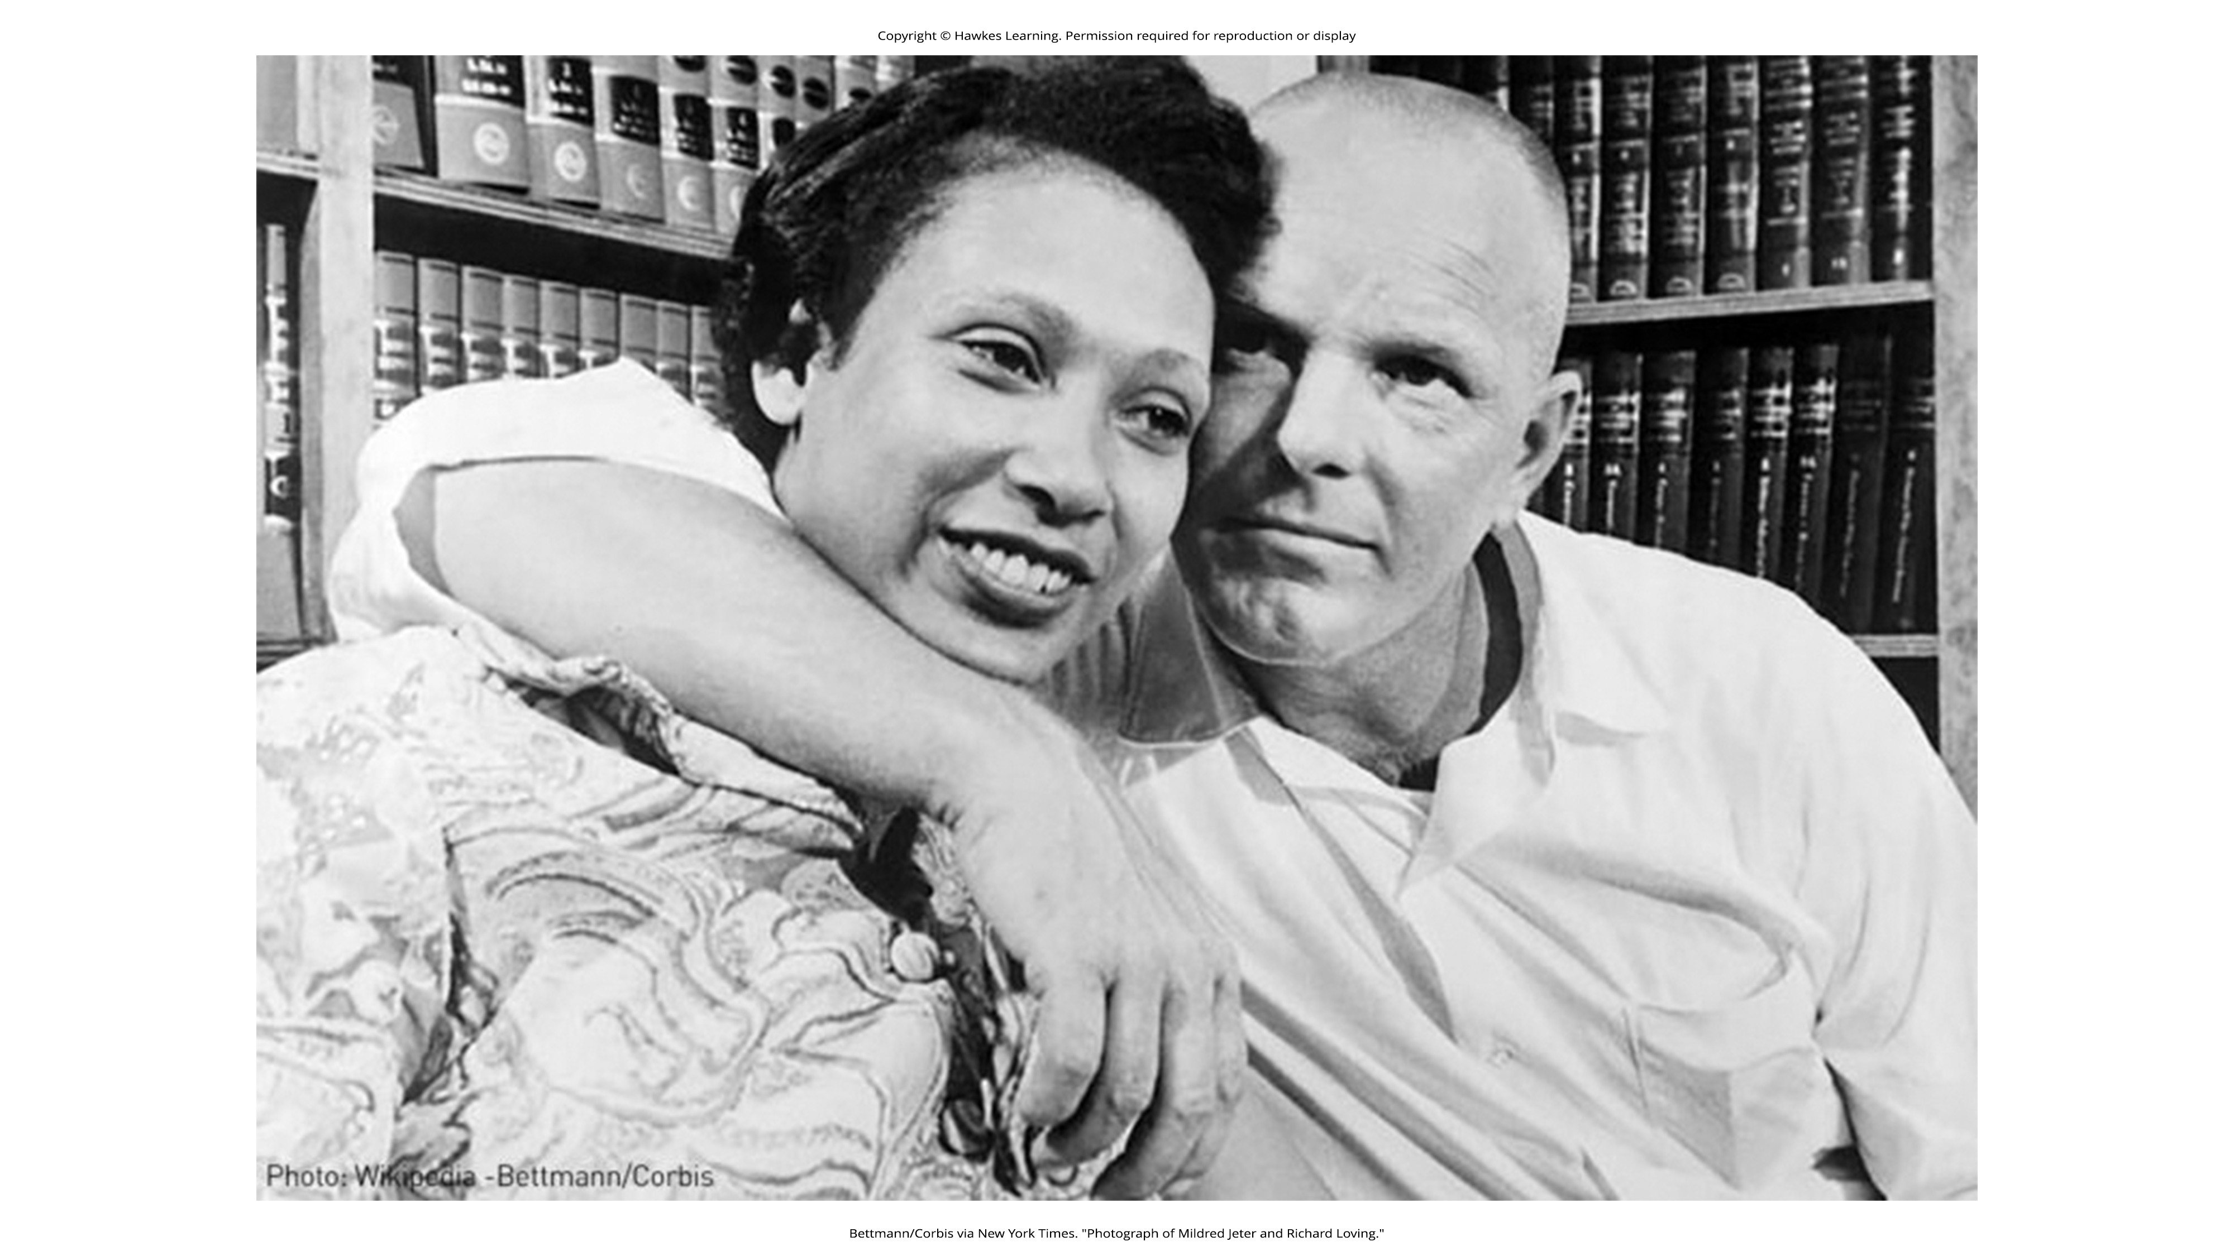
Lesson 10.3 Figure 6
Caption: Mildred and Richard Loving appealed their criminal case to the U.S. Supreme Court where it was decided unanimously to overturn their convictions and allow them to remain legally wed in the state of Virginia. This decision ended all race-based legal restrictions on marriage across the nation. The Loving v. Virginia case also established marriage as a fundamental right, supporting future

Slide 17
Child Custody Laws
Before the 1980s, it was nearly impossible for LGBTQIA+ parents to adopt or raise children without great difficulty.
  In June 2015, the Supreme Court ruled that same-sex couples had the legal right to adopt children in the case of Oberfell v. Hodges.
  Some states allow adoption by all couples, including unmarried couples.

Slide 18

Lesson 10.3 Figure 7
Caption: Obergefell v. Hodges was a landmark civil rights case in 2015 in which the U.S. Supreme Court ruled that the fundamental right to marry is guaranteed to same-sex couples by both the Due Process Clause and the Equal Protection Clause of the Fourteenth Amendment to the United States Constitution. James Obergefell, pictured left, married John Arthur James, pictured right, in 2013. After James' passing, Obergefell was not recognized on the death certificate as the surviving spouse.

Slide 19
Sexual Fluidity
Sexual fluidity: A change in sexual attraction, identity, or behavior
  Common in young people and people within the LGBTQIA+ community
  It is also common to have a relatively stable understanding of one’s sexuality.

Slide 20
Conversion Therapy
Conversion therapy is a largely discredited practice of trying to realign a person’s sexual orientation from nonheterosexual to heterosexual.
  Also called reparative therapy, reorientation therapy, or sexual orientation change
  Early claims of success have been largely discredited, even by the authors of these reports.

Slide 21
Reflection Questions
How is your sexuality tied to your gender?
How conscious are you of how you perform your gender roles and sexual orientation on a daily basis?
How much do cultural expectations about gender and sexuality affect the way you feel about your own ability to perform gender roles?
Are the performance of gender and sexual identities changing? How so?
Do people of differing races, ethnicities, nationalities, religions, and social classes experience their gender roles differently or similarly? Why or why not?

Slide 22
Summary
Sexuality is the capacity to experience sexual feelings and attractions.
  Almost everyone in the world has participated in sexual activity.
  Norms vary from generation to generation. Historically, religion has been the main guiding factor.
Sexual orientation is an individual's emotional and erotic attraction to others that covers all domains but is not necessarily based on gender identity or expression.
Heteronormativity is often considered the default sexual orientation. This developed from a heteronormative society and often leads to discrimination.
Sexual orientation varies from person to person and covers a wide spectrum of orientations.
Discrimination against members of the LGBTQIA+ community is an ongoing issue despite legal efforts to change this.
Conversion therapy is now a largely discredited method to change an individual's orientation from nonheterosexual to heterosexual.

Slide 23
End of Hawkes Learning PowerPoint

