Slide 1
Lesson 11.1
What Is Personality?

Slide 2

Personality
Personality refers to the long-standing traits and patterns that propel individuals to constantly think, feel, and behave in specific ways.
Our personality is what makes us unique.
Personality is thought to be long term, stable, and not easily changed.
Figure 2

Slide 3

Reflection Question
Think about how your personality compares to those of your family, friends, classmates, or coworkers. What personality strengths do you see in yourself? In others?
Figure 1

Slide 4
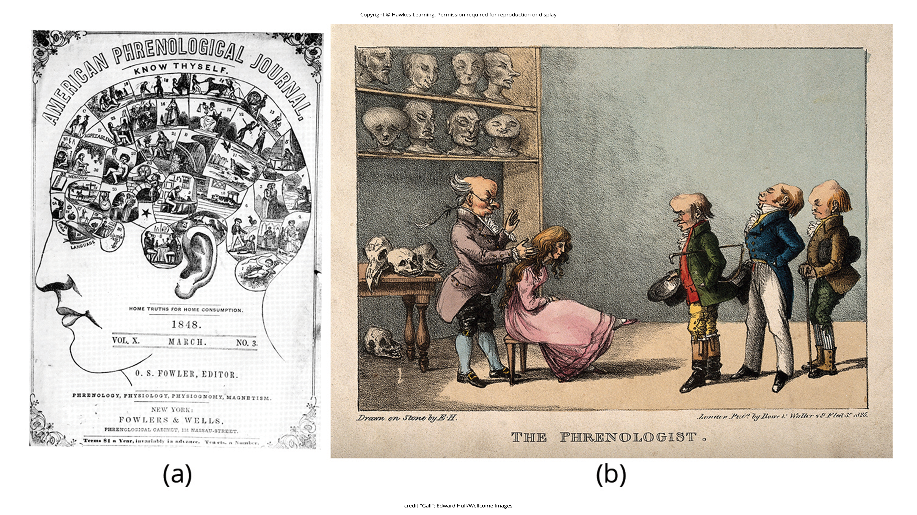
Historical Perspectives
Personality has been studied for at least 2,000 years.
Originating in philosophy and medicine, psychology is somewhat of a latecomer to this field of study.
Figure 3

Slide 5
Hippocrates
Hippocrates theorized that personality traits and human behaviors are based on four separate temperaments associated with four fluids ("humors") of the body.
Choleric temperament (yellow bile from the liver)
Melancholic temperament (black bile from the kidneys)
Sanguine temperament (red blood from the heart)
Phlegmatic temperament (white phlegm from the lungs)

Slide 6
Galen
Galen (Greek physician and philosopher) built on Hippocrates theory.
He believed that both diseases and personality differences could be explained by imbalances in the humors.
He also believed that each person exhibits one of the four humors.
Galen’s theory was prevalent for over 1,000 years.

Slide 7
Temperaments Associated With The Four Humors
Choleric
Passionate, ambitious, bold
Melancholic
Reserved, anxious, unhappy
Sanguine
Joyful, eager, optimistic
Phlegmatic
Calm, reliable, thoughtful

Slide 8
Franz Gall
Franz Gall proposed that the distances between bumps on the skull reveal a person’s personality traits, character, and mental abilities.
Phrenology: the pseudoscience described by Gall
Discredited as a valid theory due to lack of empirical support

Slide 9
Immanuel Kant
Immanuel Kant agreed with Galen that everyone could be sorted into one of the four temperaments and that there was no overlap between the four categories.
He developed a list of traits that could be used to describe the personality of a person from each of the four temperaments.

Slide 10
Wilhelm Wundt
Wilhelm Wundt also built off of Galen's theory but suggested that a better description of personality could be achieved using two major axes.
The two axes were:
Emotional/nonemotional
Changeable/unchangeable
The first axis separated strong from weak emotions.
The second axis divided the changeable temperaments.

Slide 11
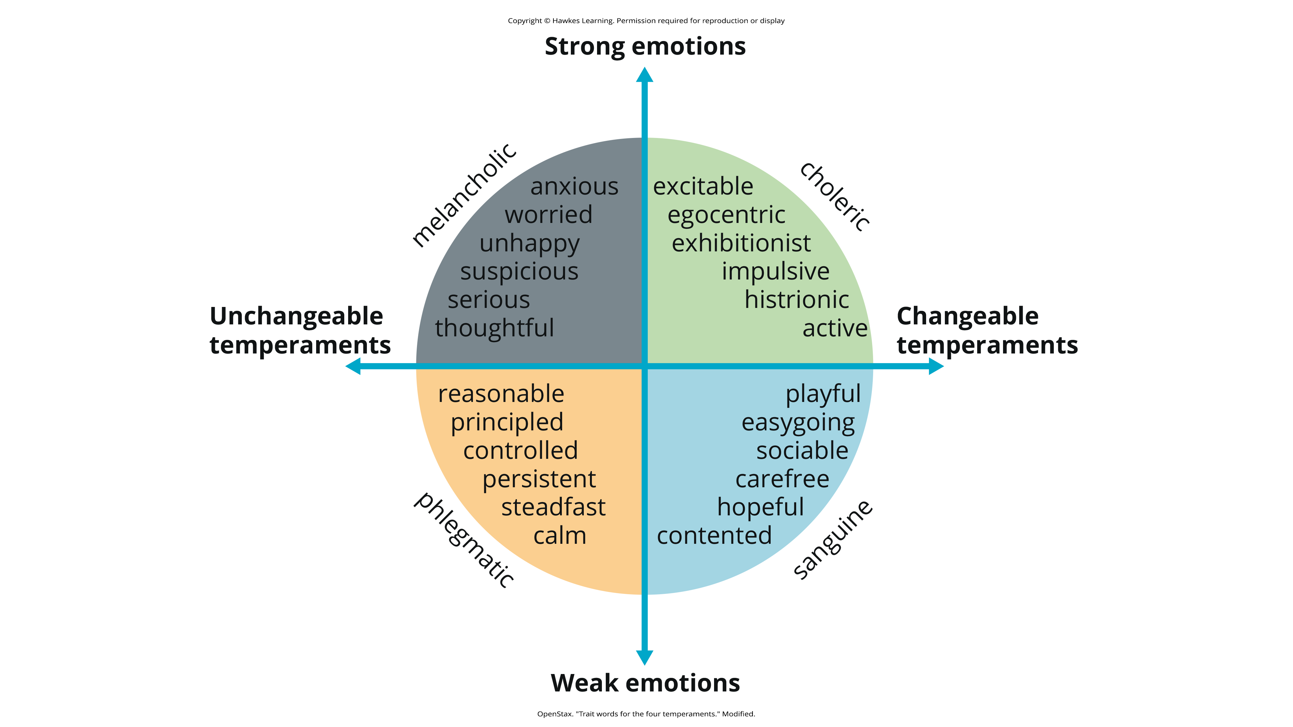
Lesson 11.1 Figure 4
Caption: Developed from Galen's theory of the four temperaments, Kant proposed trait words to describe each temperament. Wundt later suggested the arrangement of the traits on two major axes.

Slide 12
On Your Own
Consult the chart on the previous slide. Indicate which manner of emotions fits each temperament (i.e., strong emotions + unchangeable).
Melancholic
Choleric
Phlegmatic
Sanguine

Slide 13
Sigmond Freud
Sigmond Freud's psychodynamic perspective of personality was the first comprehensive theory of personality.
The theory explained a wide variety of both normal and abnormal behaviors.
Freud stated that sex and aggression, along with childhood sexuality, are forces that influence our personality.

Slide 14
Neo-Freudians
A group of Freud's followers called neo-Freudians reduced the emphasis on sex.
Their theories focused more on the social environment and the effects of culture on shaping personality.
Freud and the neo-Freudian's theories dominated through the first half of the 20th century.

Slide 15
Summary
Personality, the long-standing traits and patterns that propel individuals to think, feel, and behave in specific ways constantly, have been studied for over 2,000 years.
Early emphasis was on bodily fluids and their effects on personality. These beliefs dominated for over 1,000 years.
Freud and the neo-Freudians were the first to compose a comprehensive personality theory. These theories lasted into the middle of the 20th century.
Other theories have emerged since Freud's work. These include learning, humanistic, biological, evolutionary, trait, and cultural perspectives.

Slide 16
End of Hawkes Learning PowerPoint

