Slide 1
Lesson 11.2
Freud and the Psychodynamic Perspective

Slide 2
Sigmund Freud
Sigmund Freud is probably the most controversial and misunderstood psychological theorist.
He was a medical doctor, not a psychologist.
Freud was the first to systematically study and theorize the workings of the unconscious mind in the manner we associate with modern psychology.
Freud referred to the unconscious mind as a mental activity that we are unaware of and unable to access.

Slide 3
Levels Of Consciousness₁
To explain the concept of the conscious mind to the unconscious experience, he compared the mind to an iceberg.
Freud said our conscious is about one tenth of our mind, and the rest is unconscious.
Conscious: mental activity (thoughts, feelings, and memories) that we can access at any time
Unconscious: mental activity of which we are unaware and unable to access

Slide 4
Levels Of Consciousness₂
According to Freud, unacceptable urges and desires are kept in our unconscious through a process called repression.
Example: We sometimes say things that we don’t intend to say by unintentionally substituting another word for the one we meant: this is called a Freudian slip.
Freud suggested that these slips of the tongue are actually sexual or aggressive urges accidentally slipping out of the unconscious.

Slide 5
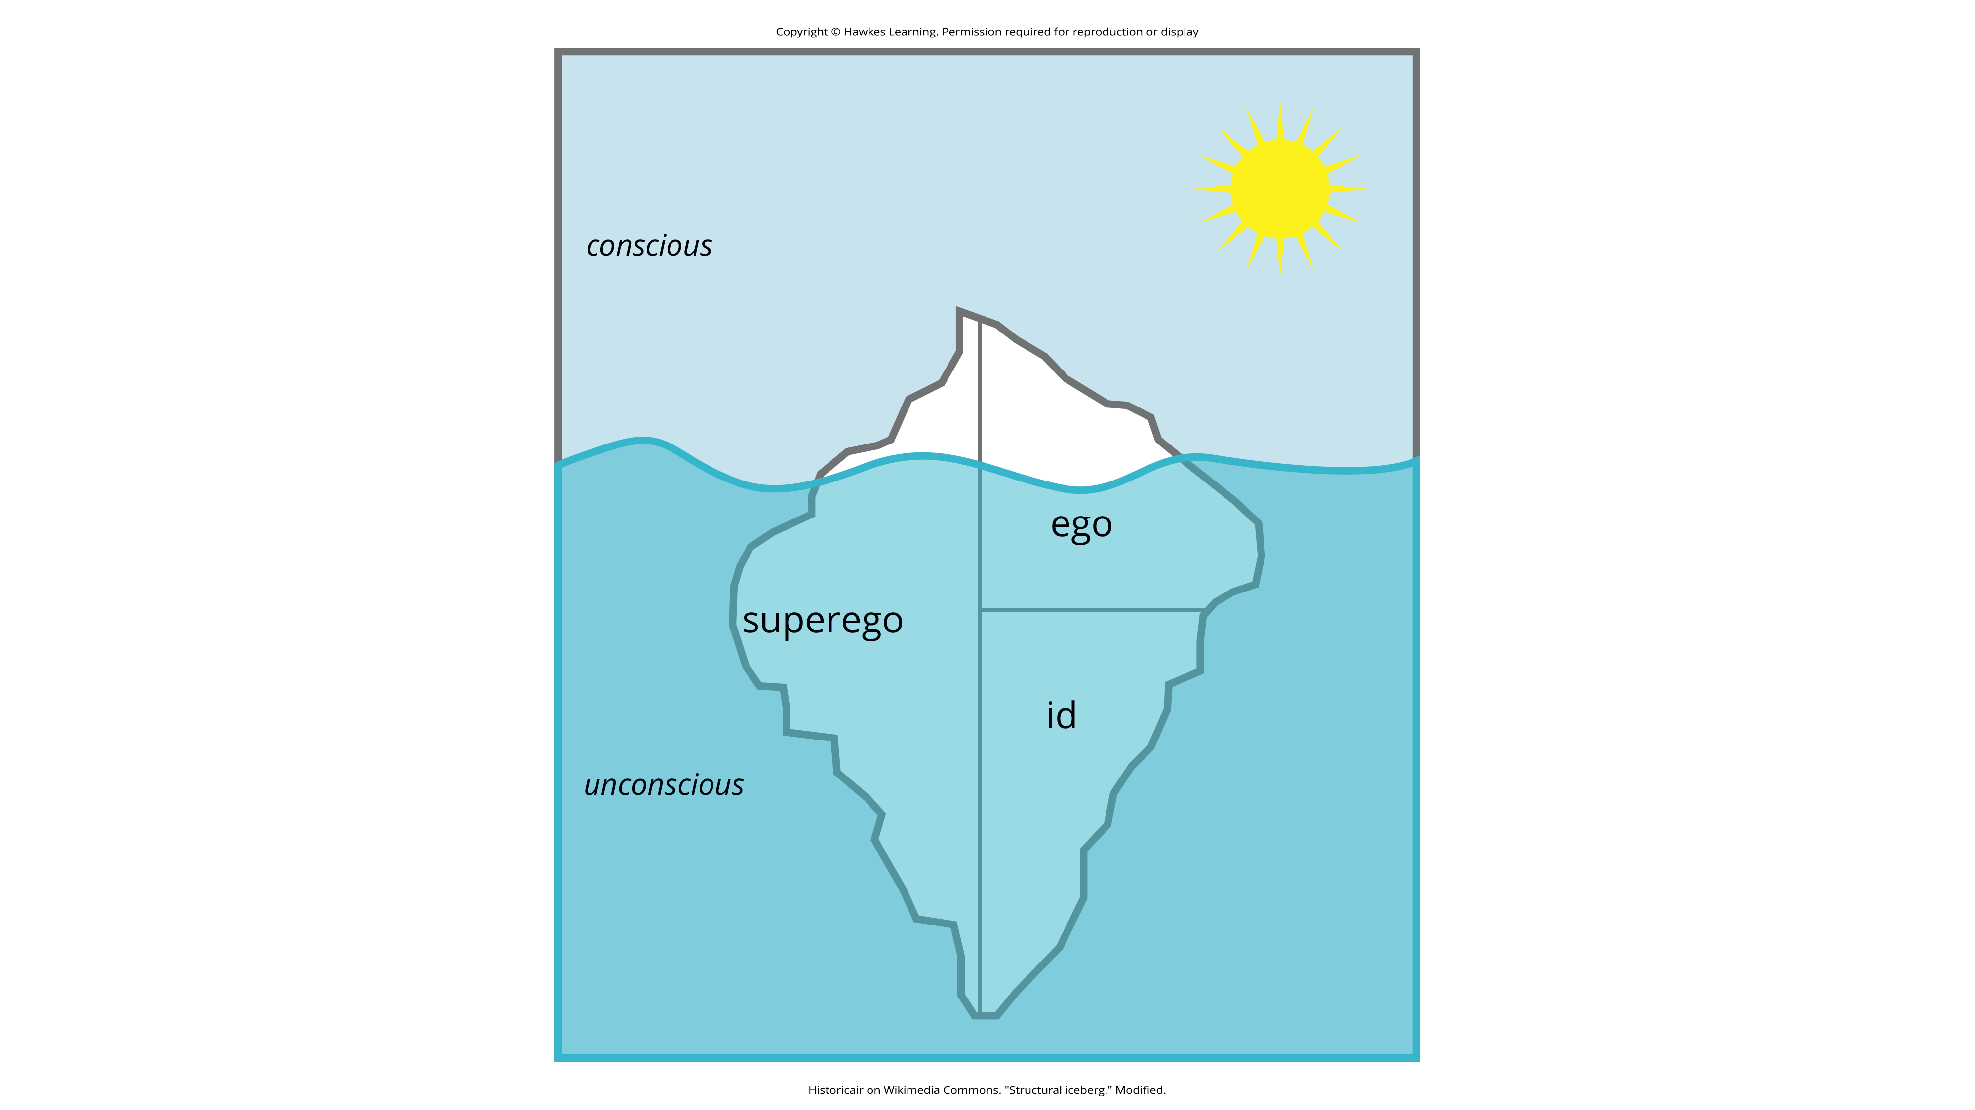
Lesson 11.2 Figure 1
Caption: Freud believed that we are only aware of a small amount of our mind's activities and that most of it remains hidden from us in our unconscious. The information in our unconscious affects our behavior although we are unaware of it.

Slide 6
Psychodynamic Theory Of Personality
According to Freud, our personality develops from the conflict between two forces: our biological aggressive and pleasure-seeking drives versus our internal (socialized) control over these drives.
Personality is the result of our efforts to balance these two competing forces.
Freud suggested we can understand this by imagining three interacting systems within our minds. He called them the id, ego, and superego.

Slide 7
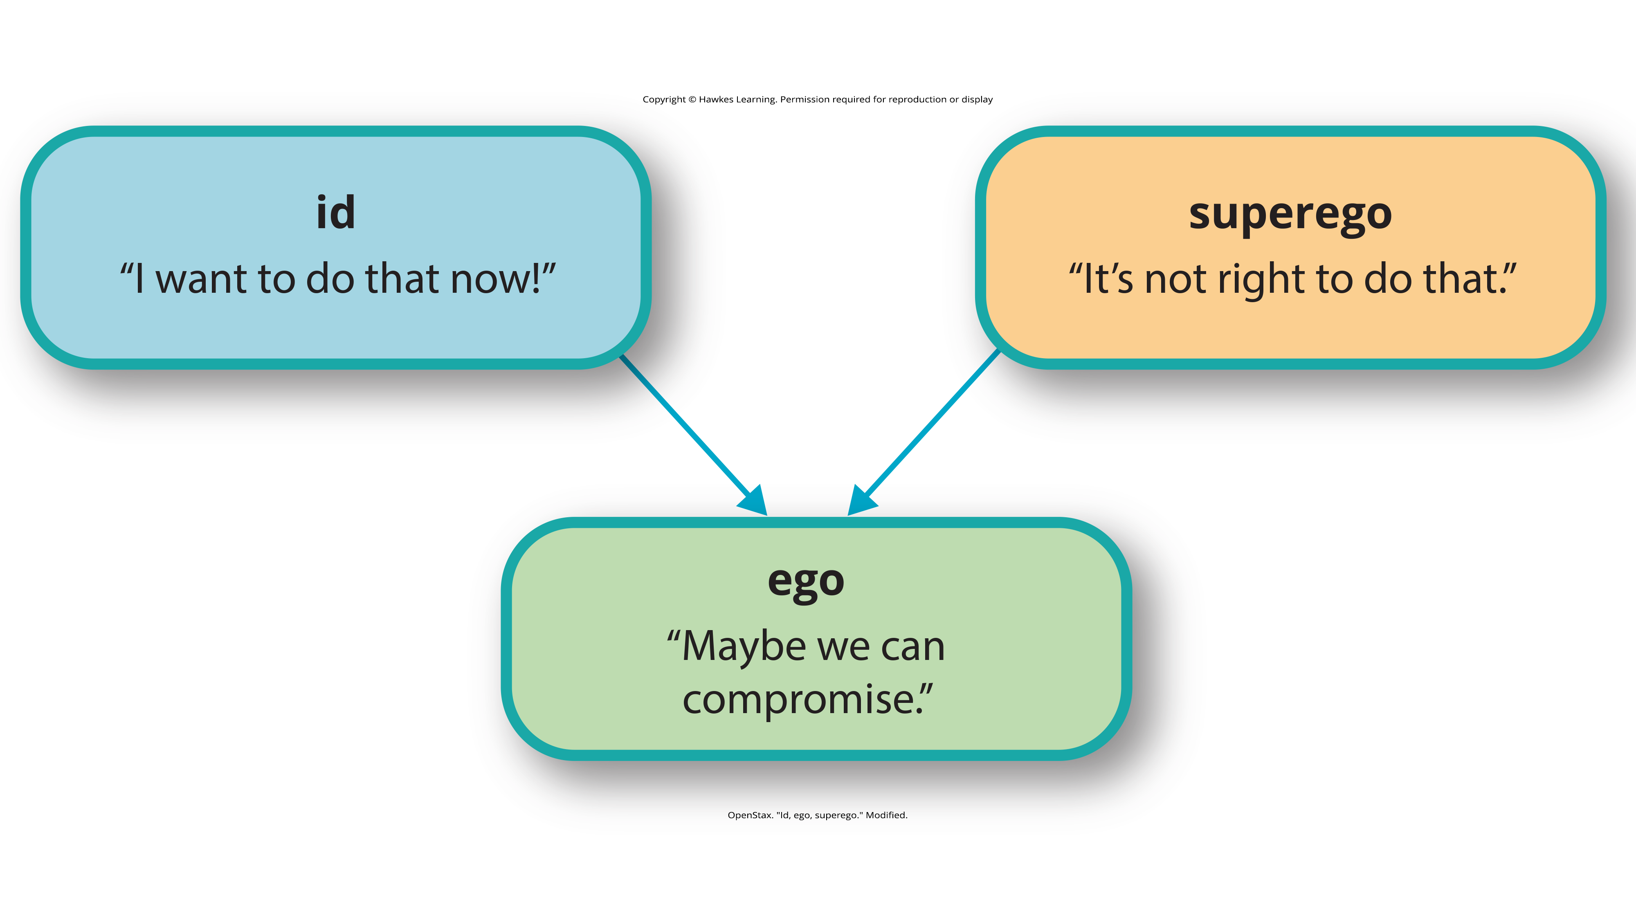
Lesson 11.2 Figure 2
Caption: The job of the ego, or self, is to balance the aggressive/pleasure-seeking drives of the id with the moral control of the superego.

Slide 8

The Id, Ego, And Superego₁
Id: The aspect of personality that consists of our most primitive drives or urges, including impulses for hunger, thirst, and sex
Present at birth
Seeks immediate gratification
Ego: The aspect of personality that represents the self or the part of one's personality that is visible to others
Develops through interactions with others
Rational part of personality
Superego: The aspect of personality that serves as one's moral compass or conscience
Develops through interactions with others
Learning the rules of right and wrong
Strives for perfection
Figure 3
Caption: While you may want to eat a burger right this second, your ego and superego step in to justify why that may not be appropriate for this situation.

Slide 9
The Id, Ego, And Superego₂
The id and superego are in constant conflict because the id wants instant gratification regardless of the consequences.
The superego tells us that we must behave in socially acceptable ways.
The ego's job is to find the middle ground.
Imbalances in the system can lead to neurosis (a tendency to experience negative emotions.

Slide 10
Control By The Id, Ego, Or Superego
Depending on which of the three systems exerts the most control, Freud said certain personalities would be exhibited.
According to Freud, someone with a strong ego has a healthy personality.
According to Freud, someone with a strong id might be narcissistic or impulsive.
According to Freud, someone with a strong superego might be controlled feelings of guilt and might deny themselves even socially acceptable pleasures.

Slide 11
On Your Own₁
Identify a conflict between the id and superego like the one described previously. Explain the perspective of the id and superego and how an individual's ego might resolve the problem.
Conflict
Id perspective
Superego perspective
Ego perspective

Slide 12
Defense Mechanisms₁
Freud believed that feelings of anxiety result in the ego's inability to mediate the conflict between the id and the superego.
Freud believed that the ego seeks to restore balance through various protective measures known as defense mechanisms.
Defense mechanisms: Unconscious, protective behaviors designed to reduce ego anxiety
The ego, usually conscious, resorts to unconscious strivings to prevent the ego from being overwhelmed by anxiety.
We are typically unaware that we are using them.
They operate in ways that distort reality.

Slide 13
Defense Mechanisms₂
While everyone uses defense mechanisms, Freud believed that the overuse of them may be problematic.
There are several types of defense mechanisms.
Repression
Reaction formation
Regression
Projection
Rationalization
Displacement
Sublimation

Slide 14
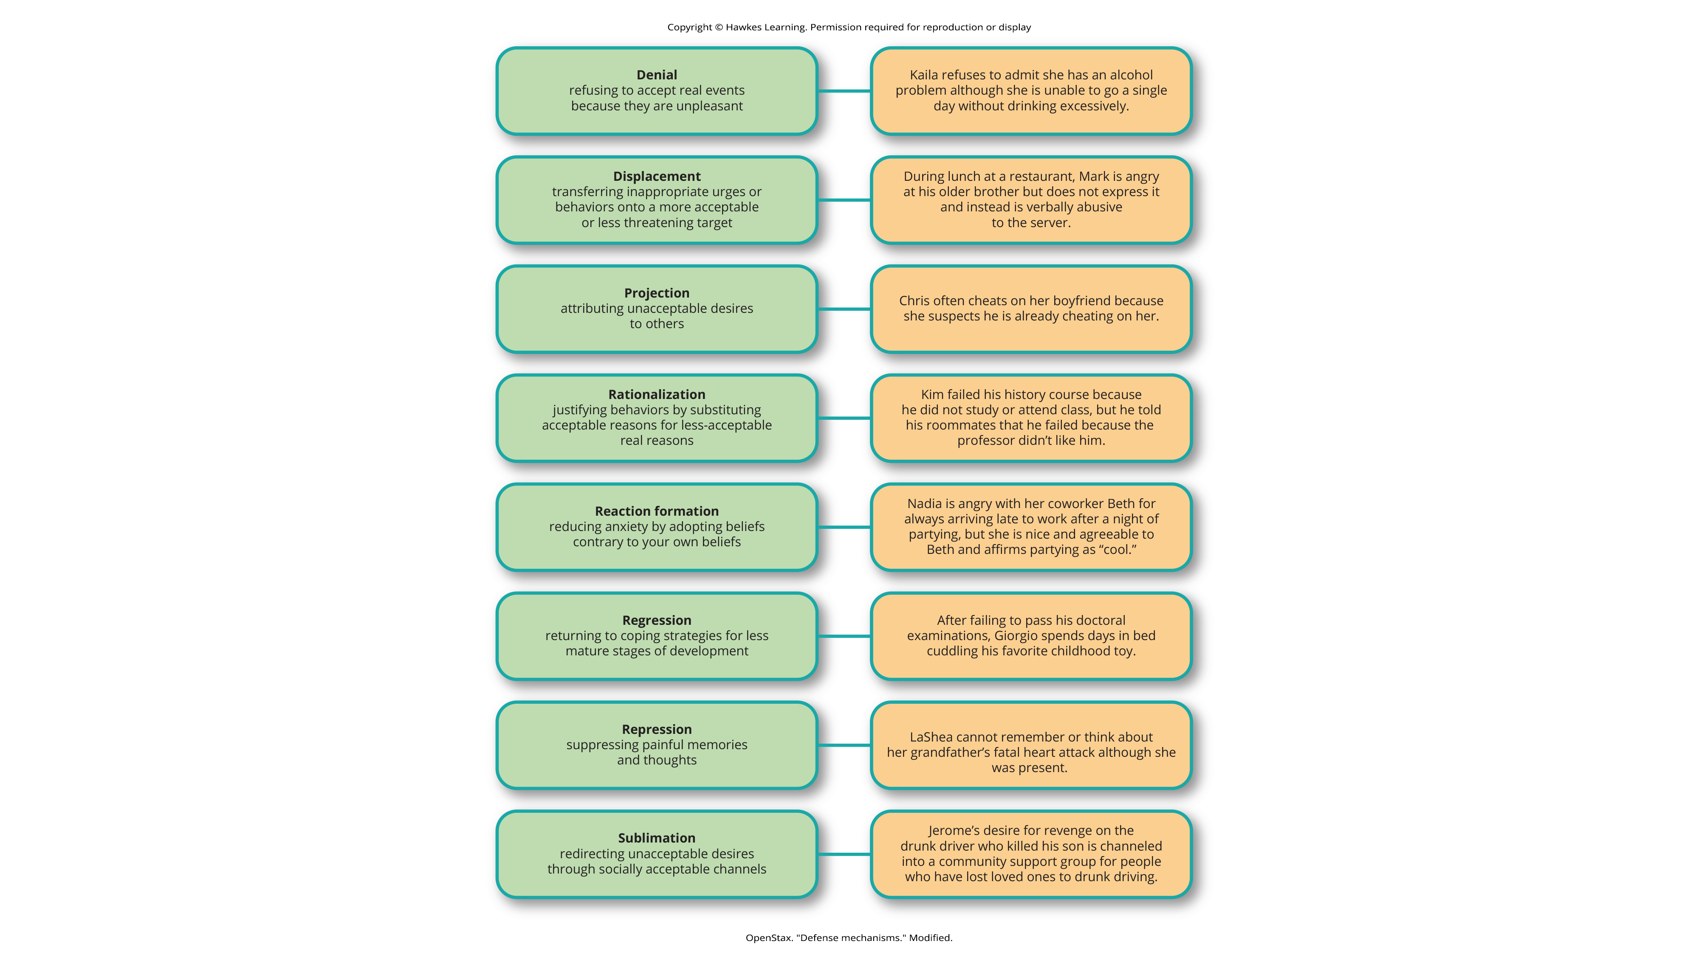
Lesson 11.2 Figure 4
Caption: Defense mechanisms are unconscious protective behaviors that work to reduce anxiety.

Slide 15
On Your Own₂
Provide an example of the following defense mechanisms.
Regression
Sublimation
Projection
Rationalization
Denial

Slide 16
Stages Of Psychosexual Development
Freud believed that personality develops during early childhood, and childhood experiences shape our personalities as well as our behavior
In each psychosexual stage of development, the child’s pleasure-seeking urges, coming from the id, are focused on a different area of the body, called an erogenous zone.
The stages are oral, anal, phallic, latency, and genital.

Slide 17
Controversy Over Freud's Psychosexual Development Theory
Freud's psychosexual development theory is quite controversial.
To understand the origins of the theory, it is helpful to be familiar with the political, social, and cultural influences of Freud's day in Vienna at the turn of the twentieth century.
During this era, a climate of sexual repression, combined with limited understanding and education surrounding human sexuality, heavily influenced Freud's Perspective.
Given that sex was a taboo topic, Freud assumed that negative emotional states (neuroses) stemmed from the suppression of unconscious sexual and aggressive urges.

Slide 18
Oral Stage
In the oral stage (birth to 1 year), pleasure is focused on the mouth.
Eating and pleasure derived from sucking (nipples, pacifiers, and thumbs) play a large part in the baby’s first year of life.
Around 1 to 2 years of age, babies are weaned from the bottle or breast, and this process can create conflict if not handled properly by caregivers.
According to Freud, an adult who smokes, drinks, overeats, or bites their nails is fixated in the oral stage of psychosexual development.
They may have been weaned too early or too late, resulting in these fixation tendencies, all of which seek to ease anxiety.

Slide 19

Lesson 11.2 Figure 5
Caption: According to Freud, fixation in the oral stage results in an adult who smokes, drinks, overeats, or bites their nails.

Slide 20
Anal Stage
After passing through the oral stage, children enter what Freud termed the anal stage (1 to 3 years).
During this stage, children are typically going through toilet training.
Freud asserted that parents who offer praise and rewards encourage positive results and can help children feel competent during the training process.
Parents who are harsh in toilet training can cause a child to become fixated at the anal stage, leading to the development of an anal-retentive personality.
The anal-retentive personality is stingy and stubborn, has a compulsive need for order and neatness, and might be considered a perfectionist.
If parents are too lenient in toilet training, the child might also become fixated and display an anal-expulsive personality.
The anal-expulsive personality is messy, careless, disorganized, and prone to emotional outbursts.

Slide 21
Phallic Stage
Freud's third stage of psychosexual development is the phallic stage (3 to 6 years), corresponding to the age when children become aware of their bodies and recognize the differences between male and female anatomy.
Conflict arises when the child feels a desire for the opposite-sex parent and jealousy and hatred toward the same-sex parent.
The Oedipus complex is a phenomenon where a male child sees their father as a rival for their mother's attention.
In contrast, the Electra complex is when a female child sees their mother as a rival for their father's attention.
A more controversial and criticized aspect of Freud's theory was penis envy, where a female child is angry at their mother for not providing them with a penis (Freud, 1931; Scott, 2005).

Slide 22
Latency Period
Following the phallic stage of psychosexual development is a period known as the latency period (6 years to puberty).
This period is not considered an active stage because sexual feelings are dormant as children focus on other pursuits, such as school, friendships, hobbies, and sports.
Example: A child in this phase of development may invite their entire class to their birthday party and be very disappointed when two of those children are unable to attend.

Slide 23
Genital Stage
The final stage is the genital stage, starting in puberty when the young person directs urges to same-age partners.
According to Freud, individuals who successfully completed the previous stages and reach the genital stage with no fixations are said to be well-balanced, healthy adults.
These well-balanced adults tend to remain in this stage as they navigate relationships and sexual orientation and determine the qualities of the person they want in a life partner.

Slide 24
On Your Own₃
Identify the stage described in the following scenarios.
Stages: Oral, anal, phallic, latency, and genital
-Heidi is more interested in school and her friends than getting into romantic relationships with boys. She no longer sees her mother as competition for her father’s attention. Heidi is most likely in which of the stage of development?
-Deontay gets jealous when his father kisses his mother. According to Freud, which stage would Deontay be in?
-Yolanda has just hit puberty. Which stage would she be in, according to Freud?

Slide 25
Summary
Sigmund Freud presented the first comprehensive theory of personality.
He was also the first to recognize that much of our mental life takes place beyond our conscious awareness.
Freud also proposed three components to our personality: the id, ego, and superego.
The job of the ego is to balance the sexual and aggressive drives of the id with the moral ideal of the superego.
Freud also said that personality develops through a series of psychosexual stages. In each stage, pleasure focuses on a specific erogenous zone.
Failure to resolve a stage can lead one to become fixated in that stage, leading to unhealthy personality traits. Successful resolution of the stages leads to a healthy adult.

Slide 26
End of Hawkes Learning PowerPoint

