Slide 1
Lesson 11.3
Neo-Freudians: Adler, Erikson, Jung and Horney

Slide 2
Who Were The Neo-Freudians?
Freud attracted many followers who modified his ideas to create new theories about personality.
These theorists, referred to as neo-Freudians, generally agreed with Freud that childhood experiences matter but deemphasized sex, focusing more on the social environment and effects of culture on personality.
Four notable neo-Freudians include:
  Alfred Adler
  Erik Erikson
  Carl Jung (pronounced "Yoong")
  Karen Horney (pronounced "HORN-eye")

Slide 3
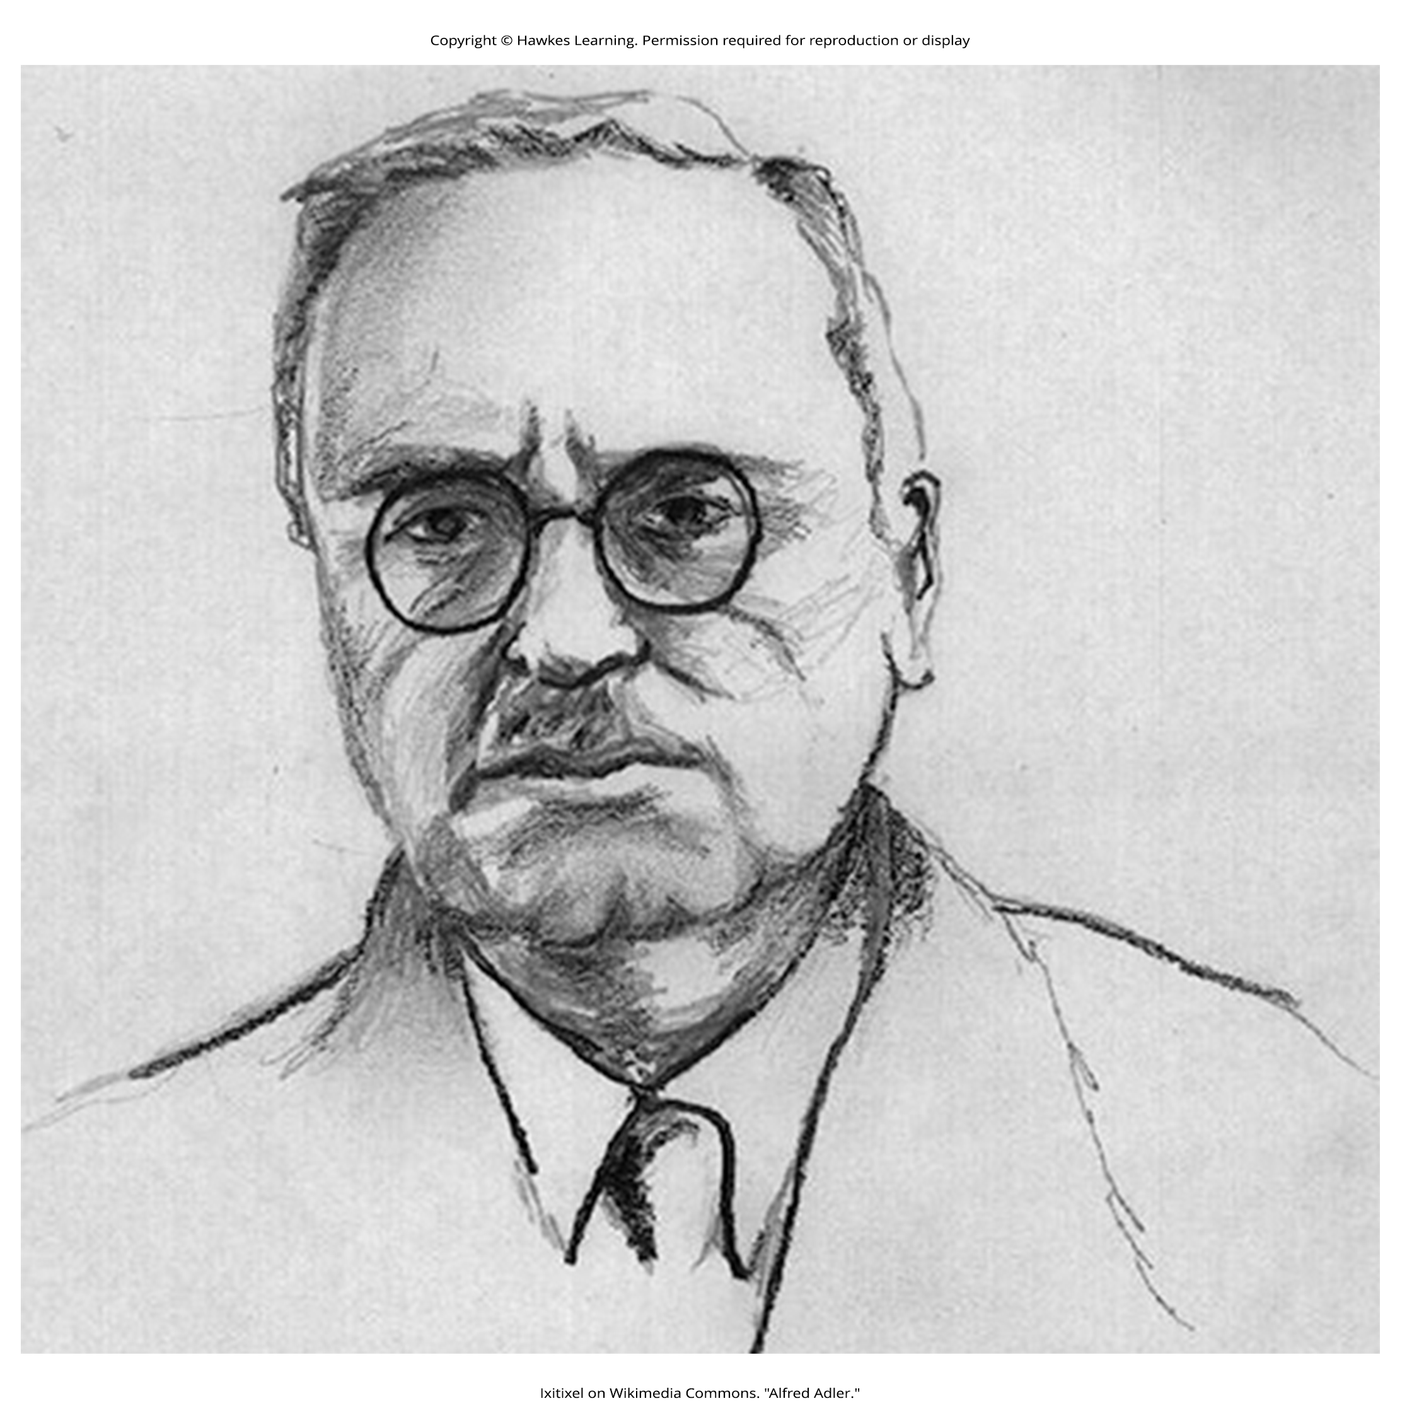
Alfred Adler
Alfred Adler founded a school of psychology called individual psychology, which focuses on our drive to compensate for feelings of inferiority.
  Adler (1937, 1956) proposed the concept of the inferiority complex.
  An inferiority complex refers to a person's feelings that they lack worth and don't measure up to the standards of others or of society.
  Adler proposed that we may feel inferior when we are not measuring up in the following fundamental social tasks:
    Occupational tasks (careers)
    Societal tasks (friendship)
    Love tasks (finding an intimate partner for a long-term relationship)
Figure 1

Slide 4
Adler’s Birth Order Theory
One of Adler's major contributions to personality psychology was the idea that our birth order shapes our personality.
  He proposed that older siblings, who start out as the focus of their parents' attention but later must share that attention once a new child joins the family, compensate by becoming overachievers.
  The youngest children, according to Adler, may be spoiled, leaving the middle child with the opportunity to minimize the negative dynamics of the youngest and oldest children.

Slide 5
Reflection Question₁
How are the dynamics with your siblings?
Do you agree with Adler? Is the oldest sibling an overachiever?
Is the youngest child spoiled?
What about the middle child?
Do they minimize negative dynamics between the youngest and oldest sibling?

Slide 6
Erik Erikson
Erik Erikson's theory of psychosocial development emphasized the social relationships that are important at each stage of personality development.
  Erikson identified eight stages, each of which represents a conflict or developmental task.
  The development of a healthy personality and a sense of competence depends on the successful completion of each task.

Slide 7
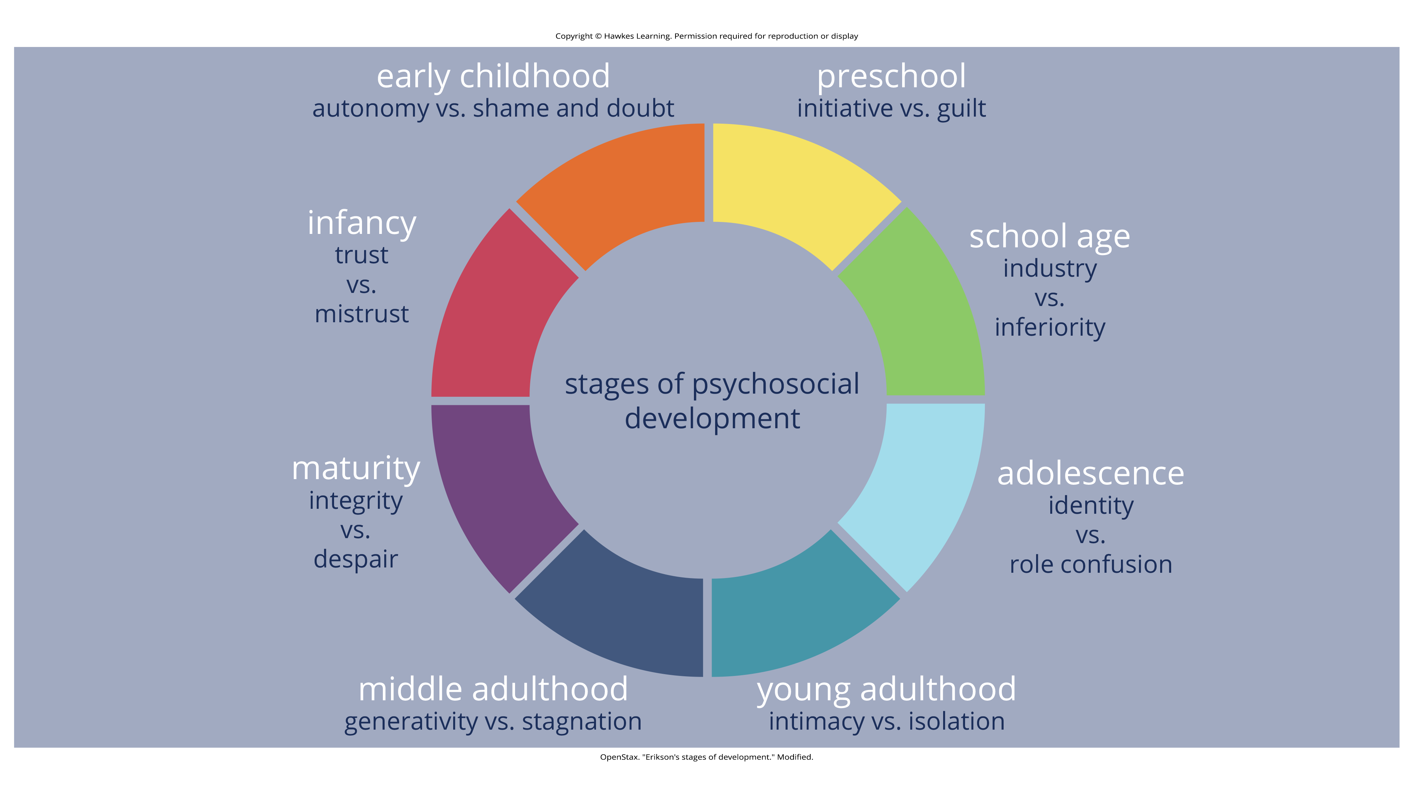
Lesson 11.3 Figure 2
Caption: Erik Erikson proposed an eight-stage model of psychosocial development.

Slide 8
Reflection Question₂
What stage of Erikson's theory would you say you are in now?
What about the previous stages?
How have you resolved them?

Slide 9
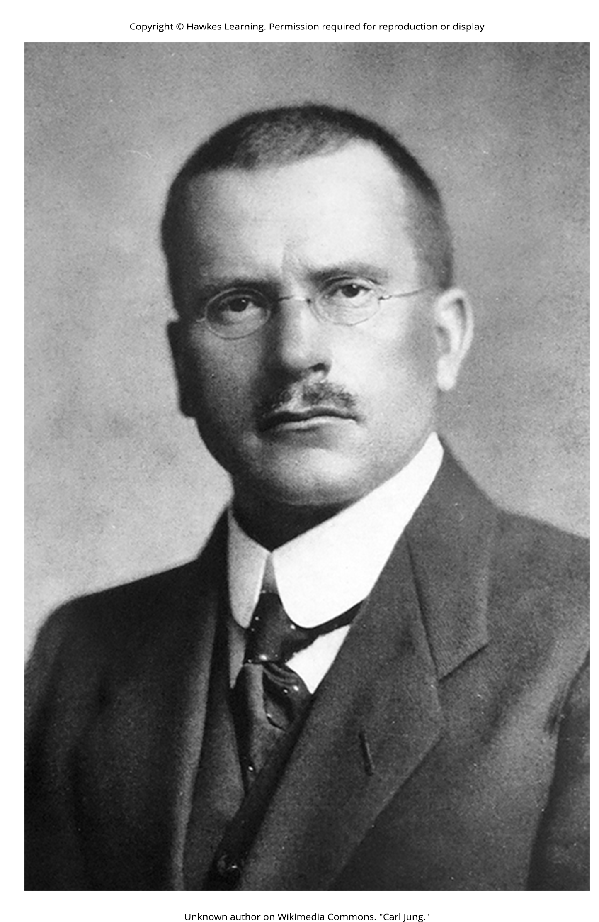
Carl Jung
Carl Jung focused on analytical psychology, which emphasizes balancing opposing forces of conscious and unconscious thought and experience within one's personality.
  According to Jung, this work is a continuous learning process—mainly occurring in the second half of life—of becoming aware of unconscious elements and integrating them into consciousness.
The collective unconscious is a universal version of the personal unconscious, holding mental patterns, or memory traces, which are common to all of us (Jung, 1928).
Jung believed in archetypes, which are universal themes in cultures expressed through literature, art, and drama.
Figure 3

Slide 10
Jung’s Extroversion And Introversion
Jung also proposed two attitudes or approaches toward life: extroversion and introversion (Jung, 1923).
  If you are an extrovert, then you are a person who is energized by being around others.
  If you are an introvert, your energy is derived from your inner psychic activity.
Jung believed a balance between extroversion and introversion best served the goal of self-realization.

Slide 11
Are Archetypes Genetically Based?
Jung proposed that human responses to archetypes are similar to instinctual responses in animals.
  One criticism of Jung is that there is no evidence that archetypes are biologically based or similar to animal instincts (Roesler, 2012).
  Jung formulated his ideas about 100 years ago, and great advances have been made in the field of genetics since that time.
  We've found that human babies are born with certain capacities, including the ability to acquire language.
  We've also found that symbolic information (such as archetypes) is not encoded on the genome and that babies cannot decode symbolism, refuting the idea of a biological basis to archetypes.

Slide 12
Karen Horney₁
Karen Horney was one of the first women trained as a Freudian psychoanalyst.
  Horney believed that each individual has the potential for self-realization and that the goal of psychoanalysis should be moving toward a healthy self rather than exploring early childhood patterns of dysfunction.
  Horney also disagreed with the Freudian idea that female children have penis envy and are jealous of male biological features.
  According to Horney, any jealousy is most likely culturally based, due to the greater privileges that men often have, meaning that the differences between men's and women's personalities are culturally based, not biologically based.
  She further suggested that males have womb envy because they cannot give birth.

Slide 13
Karen Horney₂
Horney's theories focused on the role of unconscious anxiety.
  She suggested that normal growth can be blocked by basic anxiety stemming from needs not being met, such as childhood experiences of loneliness and/or isolation.
  How do children learn to handle this anxiety? Horney suggested three styles of coping:
    Moving toward people: affiliation and dependence
    Moving against people: aggression and manipulation
    Moving away from people: detachment and isolation

Slide 14

Lesson 11.3 Figure 4
Caption: Karen Horney argued that the way we cope with anxiety and insecurity as children can impact our relationships and coping strategies in adulthood.

Slide 15
Reflection Question₃
What are your tendencies in dealing with anxiety?
Do you move away from people, toward people, or against people?
What do you think explains these tendencies?

Slide 16
On Your Own
Answer each question about the neo-Freudian theories of personality.
Which neo-Freudian psychologist came up with the concepts of introversion and extroversion?
Adler, Erikson, Jung, or Horney
Which psychologist's theory best explains why Pam is bullying other children?
Adler, Erikson, Jung, or Horney
Who came up with a theory that outlines a series of conflicts that explain development throughout the lifespan?
Adler, Erikson, Jung, or Horney

Slide 17
Summary
The neo-Freudians were psychologists whose work followed from Freud's. They generally agreed with Freud that childhood experiences matter, but they decreased the emphasis on sex and focused more on the social environment and effects of culture on personality.
  Some of the notable neo-Freudians are Alfred Adler, Carl Jung, Erik Erikson, and Karen Horney.
The neo-Freudian approaches have been criticized because they tend to be philosophical rather than based on sound scientific research.
In addition, as with Freud's psychoanalytic theory, the neo-Freudians based much of their theories of personality on information from their patients.

Slide 18
End of Hawkes Learning PowerPoint

