Slide 1
Lesson 11.4
Learning Approaches

Slide 2
What's Different About The Learning Approach?
In contrast to the psychodynamic approaches of Freud and the neo-Freudians, which relate personality to inner (and hidden) processes, the learning approaches focus only on observable behavior.
This illustrates one significant advantage of the learning approaches over psychodynamics:
Because learning approaches involve observable, measurable phenomena, they can be scientifically tested.

Slide 3
The Behavioral Perspective
Behaviorists do not believe in biological determinism.
They do not see personality traits as inborn.
They view personality as significantly shaped by the reinforcements and consequences outside of the organism.
In other words, people behave in a consistent manner based on prior learning.

Slide 4
B. F. Skinner's Viewpoint
B. F. Skinner, a strict behaviorist, believed that environment was solely responsible for all behavior, including the enduring, consistent behavior patterns studied by personality theorists.
Skinner (1953) proposed that we increase the behaviors that lead to positive consequences, and we decrease the behaviors that lead to negative consequences.
Skinner disagreed with Freud's idea that personality is fixed in childhood. He argued that personality develops over our entire life, not only in the first few years.

Slide 5

Lesson 11.4 Figure 1
Caption: Hang gliding is a risky sport, and we're more likely to take risks when those choices are reinforced.

Slide 6
The Social-Cognitive Perspective
Albert Bandura agreed with Skinner that personality develops through learning.
He disagreed, however, with Skinner's strict behaviorist approach to personality development because he felt that thinking and reasoning are important components of learning.
Social-cognitive theory: Bandura's theory of personality that emphasizes both cognition and learning as sources of individual differences in personality
In social-cognitive theory, the concepts of reciprocal determinism, observational learning, and self-efficacy all play a part in personality development.

Slide 7
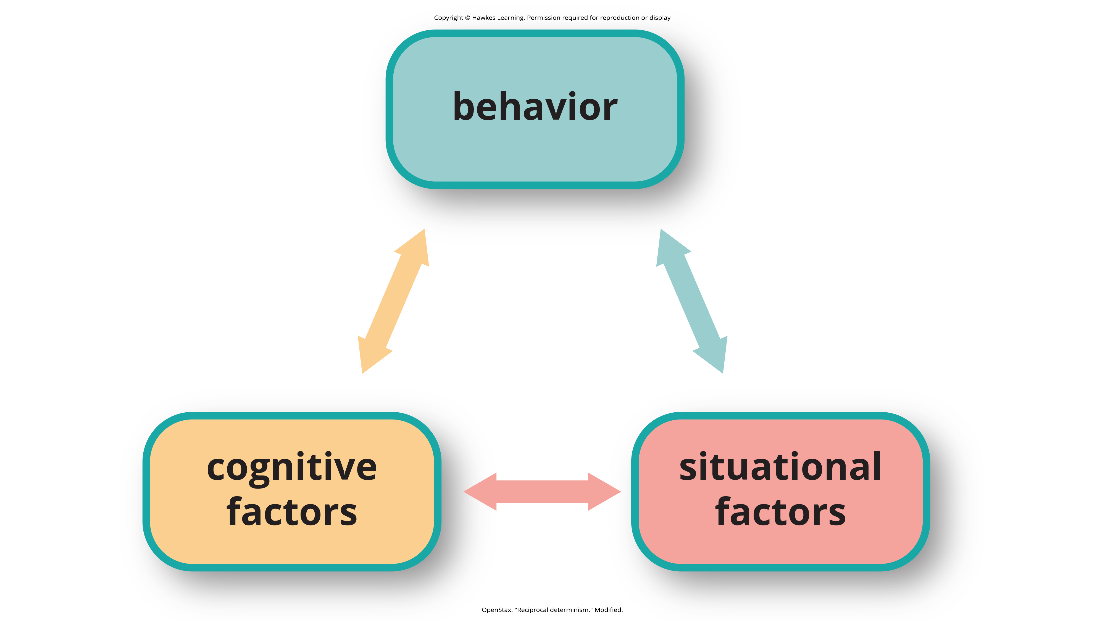
Lesson 11.4 Figure 2
Caption: Bandura proposed the idea of reciprocal determinism: Our behavior, cognitive processes, and situational context all influence each other.

Slide 8
Reciprocal Determinism
In contrast to Skinner's idea that the environment alone determines behavior, Bandura (1986) proposed the concept of reciprocal determinism, in which cognitive processes, behavior, and context all interact, each factor influencing and being influenced by the others simultaneously.
Cognitive processes refer to all characteristics previously learned, including beliefs, expectations, and personality characteristics.
Behavior refers to anything that we do that may be rewarded or punished.
Context in which the behavior occurs refers to the environment or situation, which includes rewarding/punishing stimuli.

Slide 9
On Your Own₁
Answer the following questions based on the bungee jumping example in the following list.
Factor: behavior
Would you go bungee jumping?
Factor: situational factors
What situation would make you more likely to go bungee jumping? What situation would make you less likely to go bungee jumping?
Factor: cognitive factors
What beliefs, values, and past experiences contribute to your decision to go or not go bungee jumping?
Notes:
Originally an On Your Own

Slide 10
Observational Learning₁
Bandura's key contribution to learning theory was the idea that much learning is vicarious.
We learn by observing someone else's behavior and its consequences, which Bandura called observational learning.
He felt that this type of learning also plays a part in the development of our personality.
Just as we learn individual behaviors, we learn new behavior patterns when we see them performed by other people or models.
Drawing on the behaviorists' ideas about reinforcement, Bandura suggested that whether we choose to imitate a model's behavior depends on whether we see the model reinforced or punished.

Slide 11
Observational Learning₂
Through observational learning, we come to learn what behaviors are acceptable and rewarded in our culture, and we also learn to inhibit deviant or socially unacceptable behaviors by seeing what behaviors are punished.
We can see the principles of reciprocal determinism at work in observational learning.
Example: personal factors determine which behaviors in the environment a person chooses to imitate
Those environmental events in turn are processed cognitively according to other personal factor

Slide 12
Reflection Questions
Can you think of an example where you learned from someone else's mistake?
How do you think this changed how you think about the behavior in question?
Can you think of a time you learned something beneficial by observing someone else?
Do you still remember how to do that task?

Slide 13
Self-Efficacy
Bandura (1977, 1995) has studied a number of cognitive and personal factors that affect learning and personality development and most recently has focused on the concept of self-efficacy.
Self-efficacy is an individual's belief in their own capabilities or capacities to complete a task.
Self-efficacy affects how we approach challenges and reach goals. In observational learning, self-efficacy is a cognitive factor that affects which behaviors we choose to imitate as well as our success in performing those behaviors.

Slide 14
Locus Of Control
Julian Rotter (1966) proposed the concept of locus of control, which refers to our beliefs about the power we have over our lives.
In Rotter's view, people possess either an internal or an external locus of control.
Those of us with an internal locus of control ("internals") tend to believe that most of our outcomes are the direct result of our efforts.
Those of us with an external locus of control ("externals") tend to believe that our outcomes are outside of our control.
Externals see their lives as being controlled by other people, luck, or chance.

Slide 15
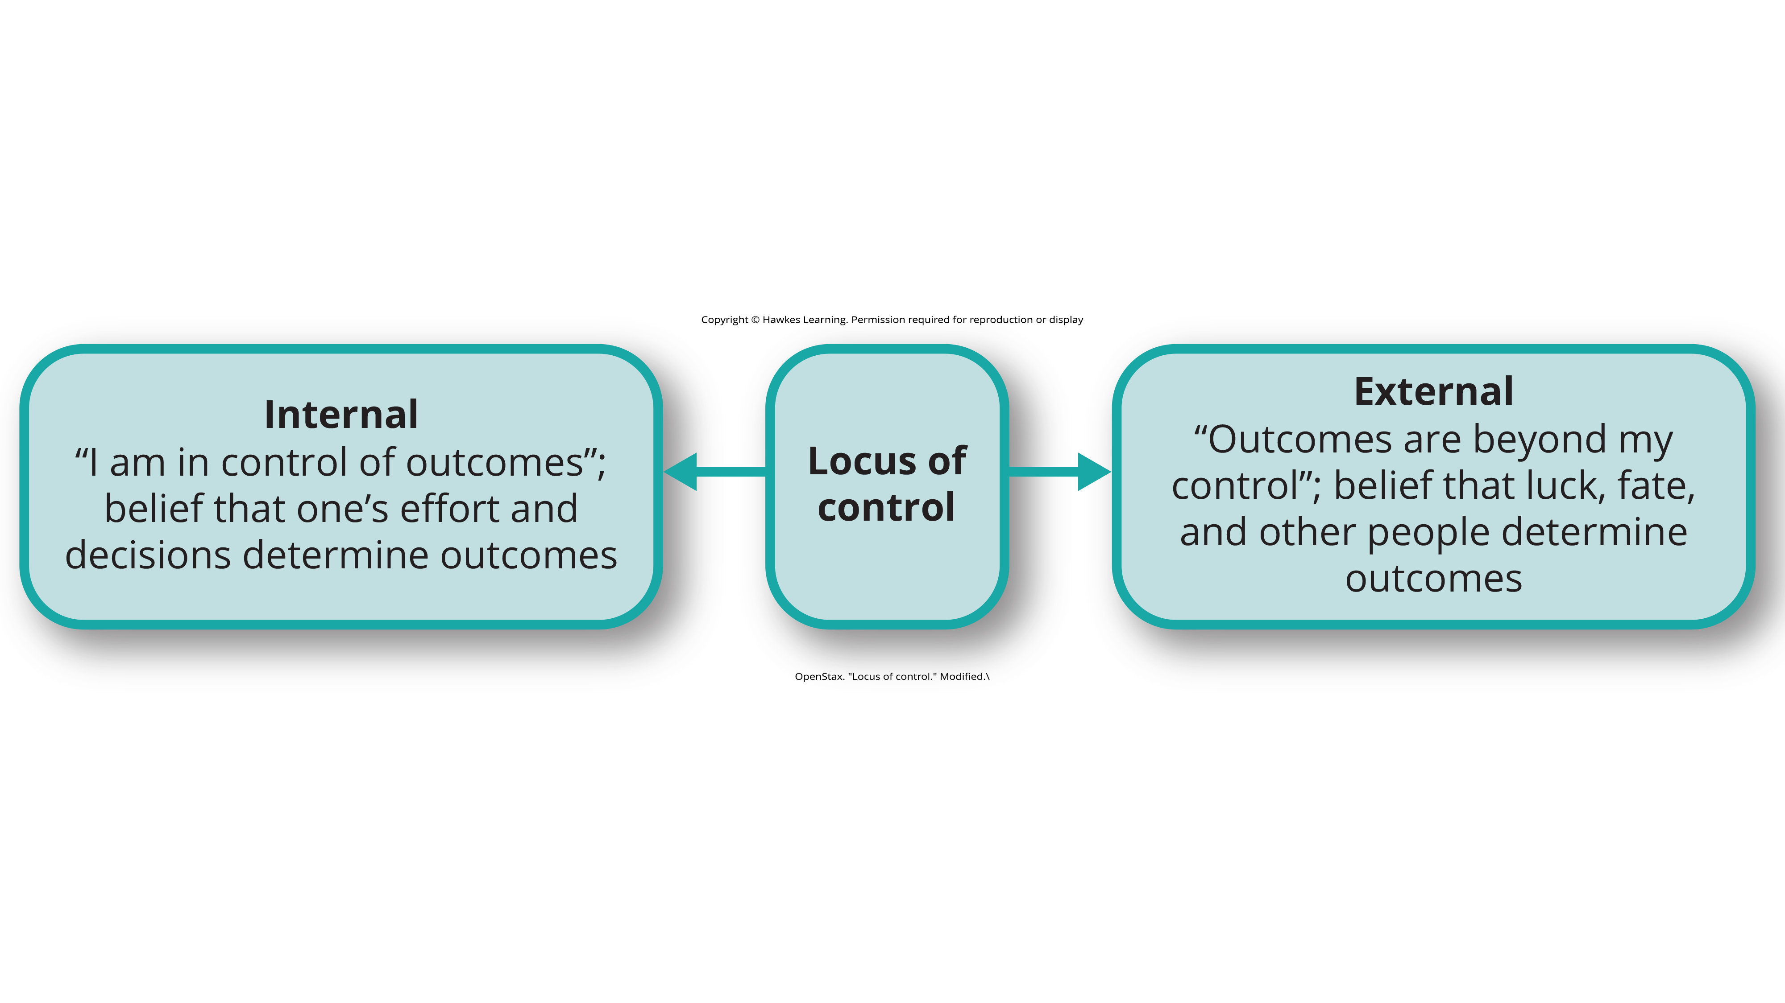
Lesson 11.4 Figure 3
Caption: Locus of control occurs on a continuum from internal to external.

Slide 16
Internal Locus Of Control
Researchers have found that people with an internal locus of control (Benassi et al., 1988; Buddelmeyer & Powdthavee, 2016; Cobb-Clark et al., 2014; Lefcourt, 1982; Maltby et al., 2007; Whyte, 1977, 1978, 1980):
Perform better academically
Achieve more in their careers
Are more independent
Are healthier
Are more able to cope with setbacks
Are less likely to be depressed

Slide 17
On Your Own₂
Identify the most likely responses for the following scenarios.
Gerald didn't make the basketball team. Which of the following responses would best represent an external locus of control?
"I don't care about making the basketball team anyway."
"The coach was never going to pick me anyway."
"I didn't get picked because I did not practice enough."
Let's assume you failed your math test. Which of the following explanations would be an internal locus of control?
"I am stupid."
"I didn't study hard enough."
"The class is just too hard."
Notes:
Originally an On Your Own

Slide 18
Walter Mischel And The Person-Situation Debate
Mischel found that the data did not support the central principle of the field—that a person's personality traits are consistent across situations.
His report triggered a decades-long period of self-examination, known as the person-situation debate, among personality psychologists.
Mischel suggested that perhaps we were looking for consistency in the wrong places.
He found that although behavior was inconsistent across different situations, it was much more consistent within situations—so that a person's behavior in one situation would likely be repeated in a similar one.
He also found that behavior is consistent in equivalent situations across time.
One of Mischel's most notable contributions to personality psychology was his ideas on self-regulation.

Slide 19
Self-Regulation
According to Lecci and Magnavita (2013), "Self-regulation is the process of identifying a goal or set of goals and, in pursuing these goals, using both internal (e.g., thoughts and affect) and external (e.g., responses of anything or anyone in the environment) feedback to maximize goal attainment" (p. 6.3).
Self-regulation is also known as will power.
We tend to think of will power as the ability to delay gratification.

Slide 20

The Marshmallow Study₁
Mischel designed a study to assess self-regulation in young children.
In the marshmallow study, Mischel and his colleagues placed a preschool child in a room with one marshmallow on the table.
The child was told that he could either eat the marshmallow now, or wait until the researcher returned to the room, and then he could have two marshmallows (Mischel et al., 1972).
Figure 4

Slide 21
The Marshmallow Study₂
What Mischel and his team found was that young children differ in their degree of self-control.
The children who had more self-control in preschool (the ones who waited for the bigger reward) were more successful in high school.
Higher SAT scores
Positive peer relationships
Less likely to have substance abuse issues; as adults, they also had more stable marriages
(Mischel et al., 1989; Mischel et al., 2010).
Children who had poor self-control in preschool (the ones who grabbed the one marshmallow) were not as successful in high school, and they were found to have academic and behavioral problems.

Slide 22
Current Views On Mischel's Study
Today, the debate is mostly resolved, and most psychologists consider both the situation and personal factors in understanding behavior.
For Mischel (1993), people are situation processors. The children in the marshmallow test each processed, or interpreted, the rewards structure of that situation in their own way.
Mischel's approach to personality stresses the importance of both the situation and the way the person perceives the situation. Instead of behavior being determined by the situation, people use cognitive processes to interpret the situation and then behave in accordance with that interpretation.

Slide 23
Summary₁
Behavioral theorists view personality as significantly shaped and impacted by the reinforcements and consequences outside of the organism.
People behave in a consistent manner based on prior learning.
B. F. Skinner, a prominent behaviorist, said that we demonstrate consistent behavior patterns because we have developed certain response tendencies.
Mischel focused on how personal goals play a role in the self-regulation process.

Slide 24
Summary₂
Albert Bandura said that one's environment can determine behavior, but at the same time, people can influence the environment with both their thoughts and behaviors, which is known as reciprocal determinism.
Bandura also emphasized how we learn from watching others.
He felt that this type of learning also plays a part in the development of our personality.
Bandura discussed the concept of self-efficacy, which is our level of confidence in our own abilities.
Rotter proposed the concept of locus of control, which refers to our beliefs about the power we have over our lives.
Mischel focused on how self-regulation patterns in early childhood can predict academic success and social behavior in adolescence.

Slide 25
End of Hawkes Learning PowerPoint

