Slide 1
Lesson 11.5
Humanistic Approaches

Slide 2
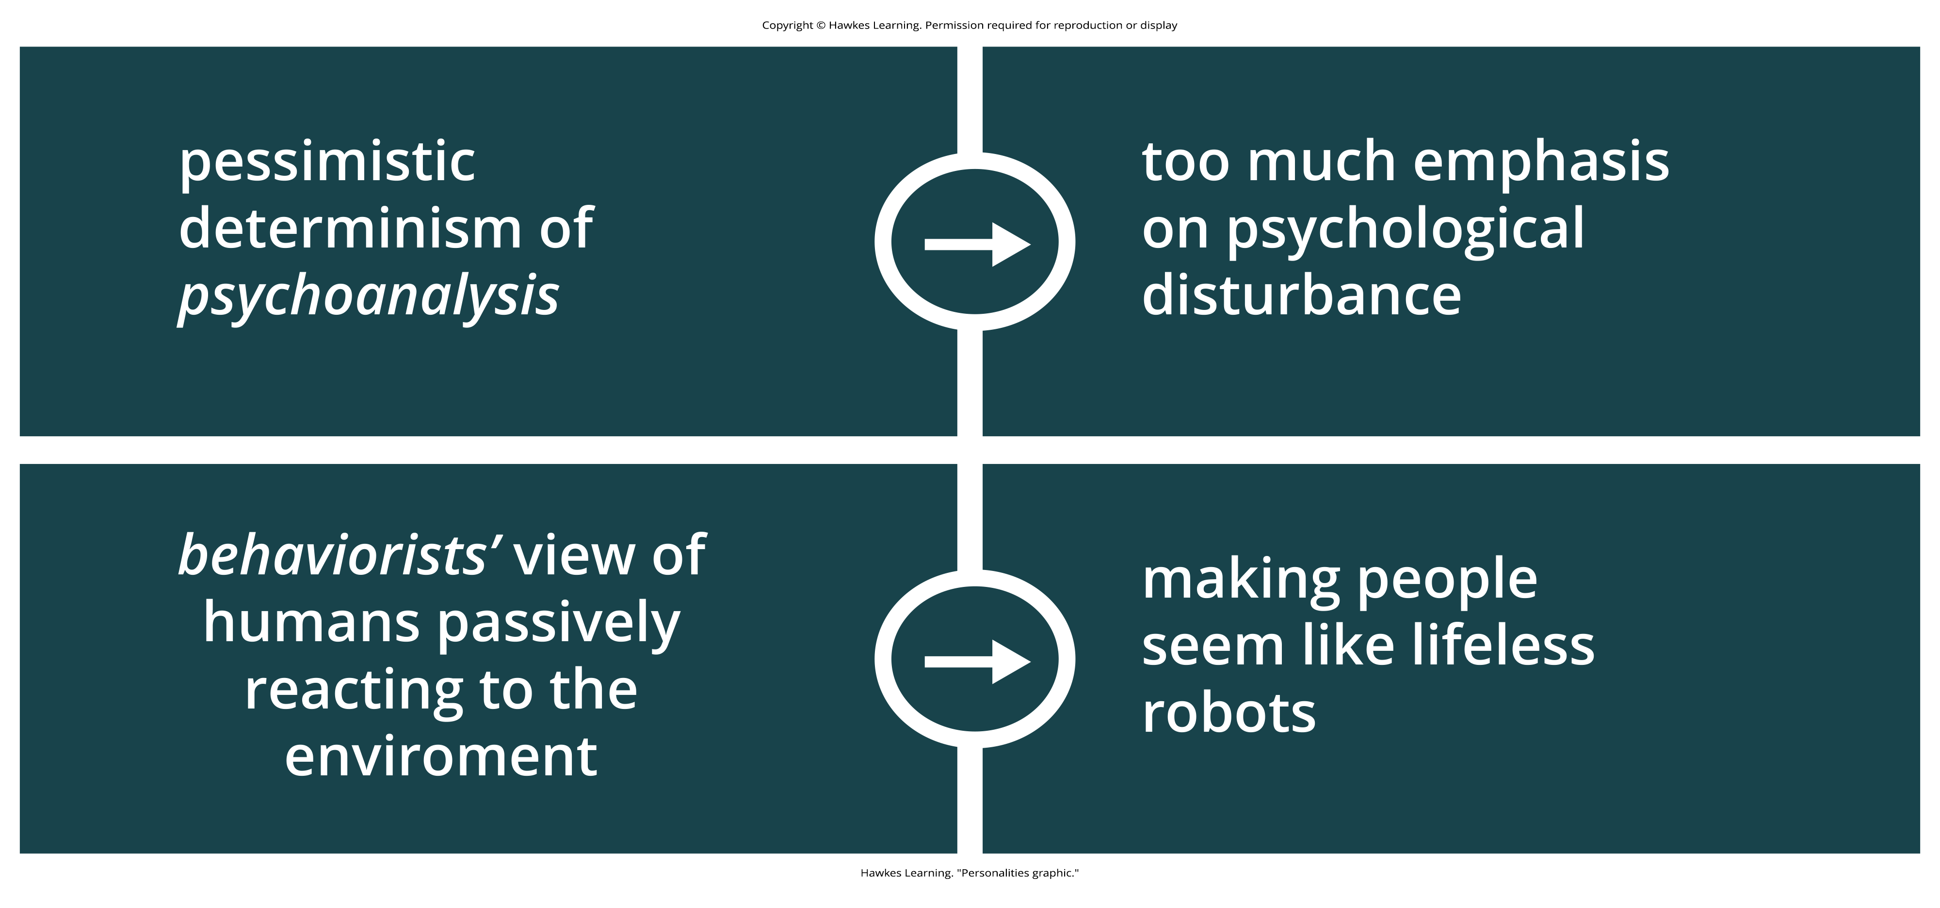
What Is Humanism?
Humanism is touted as a reaction to two psychological movements and their believed effects on society.
Figure 1
Caption: What makes individuals have different personalities?

Slide 3
Humanism's Comparison To Other Theories
Humanism does not suggest that psychoanalytic, behaviorist, and other points of view are incorrect.
It argues that these perspectives do not recognize the depth and meaning of human experience.
It also argues that they fail to recognize the innate capacity for self-directed change and transforming personal experiences.

Slide 4
On Your Own₁
In your own words, recap the reasons why proponents of humanism feel the other perspectives are inadequate.
Notes:
Originally an On Your Own

Slide 5
Abraham Maslow
The humanistic perspective focuses on how healthy people develop.
One pioneering humanist, Abraham Maslow, studied people who he considered to be healthy, creative, and productive, including Albert Einstein, Eleanor Roosevelt, Thomas Jefferson, Abraham Lincoln, and others.
Maslow (1950, 1970) found that such people share similar characteristics including:
Openness
Creativity
A loving spirit
Spontaneity
Compassion
Concern for others
Acceptance of themselves

Slide 6
Maslow's Hierarchy Of Needs
In Maslow's hierarchy of needs, Maslow proposes that human beings have certain needs in common and that these needs must be met in a certain order.
The highest need is the need for self-actualization, which is the achievement of our fullest potential.
This is one of the best-known humanistic theories.

Slide 7
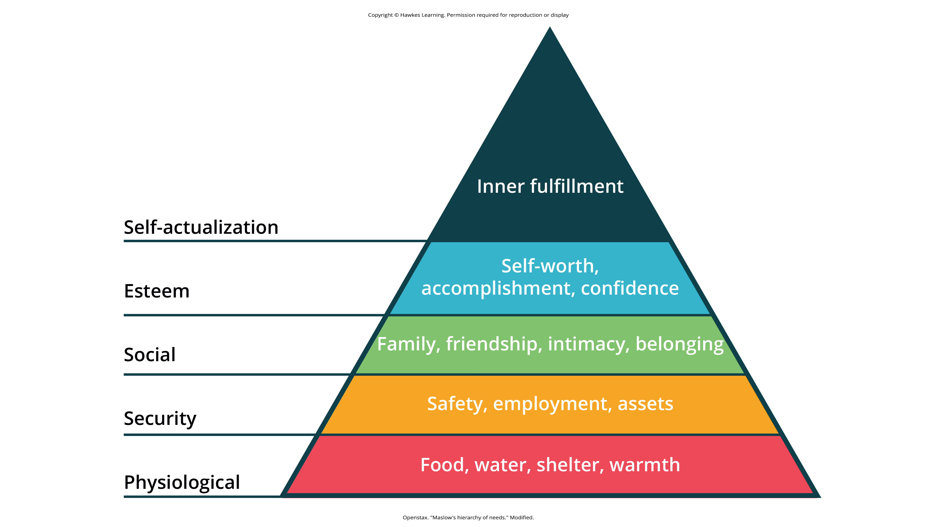
Lesson 11.5 Figure 2
Caption: Maslow's hierarchy of needs

Slide 8
Carl Rogers
Another humanistic theorist was Carl Rogers.
One of Rogers's main ideas about personality regards self-concept, our thoughts and feelings about ourselves.
How would you respond to the following question?
"Who am I?"

Slide 9
What Your Response Indicates
If your response to the question is primarily positive, then you tend to feel good about who you are, and you see the world as a safe and positive place.
If your response is mainly negative, then you may feel unhappy with who you are.

Slide 10
Real Vs. Ideal Self
Rogers further divided the self into two categories:
the ideal self
the real self
The ideal self is the person that you would like to be; the real self is the person you actually are.
Rogers focused on the idea that we need to achieve consistency between these two selves.
We experience congruence when our thoughts about our real self and ideal self are very similar—in other words, when our self-concept is accurate.
High congruence leads to a greater sense of self-worth and a healthy, productive life.

Slide 11
Reflection Question
Take some time to think about your ideal self and your real self.
How do these versions of self compare in your own life?
Does your ideal self include plausible qualities that you can work toward?

Slide 12
On Your Own₂
Identify the answers that best complete the following statements.
People with low congruence would have a:
Higher likelihood of being maladjusted.
Greater sense of self-worth.
People with high congruence would have a:
Higher likelihood of being maladjusted.
Greater sense of self-worth.
Notes:
Originally an On Your Own

Slide 13
Summary
Humanistic psychologists Abraham Maslow and Carl Rogers focused on the growth potential of healthy individuals.
They believed that people strive to become self-actualized.
Both Rogers's and Maslow's theories greatly contributed to our understanding of the self.
They emphasized free will and self-determination, with each individual desiring to become the best person they can become.

Slide 14
End of Hawkes Learning PowerPoint

