Slide 1
Lesson 11.6
Biological Approaches

Slide 2
What Is The Biological Approach?
Psychologists who favor the biological approach believe that inherited predispositions as well as physiological processes can be used to explain differences in our personalities (Burger, 2008; Khatibi & Khormaei, 2016).

Slide 3
Behavioral Genetics
In the field of behavioral genetics, the Minnesota Study of Twins Reared Apart—a well-known study of the genetic basis for personality—conducted research with twins from 1979 to 1999.
  In studying 350 pairs of twins, including pairs of identical and fraternal twins reared together and apart, researchers found that identical twins, whether raised together or apart, have very similar personalities (Bouchard, 1994; Bouchard et al., 1990; Segal, 2012; Koenig, 2020).
  These findings suggest the heritability of some personality traits.
  Heritability refers to the proportion of difference among people that is attributed to genetics.

Slide 4
Heritability Ratios Greater Than 0.50
Some of the traits that the study reported as having more than a 0.50 heritability ratio include:
  Leadership
  Obedience to authority
  A sense of well-being
  Feelings of alienation
  Resistance to stress
  Fearfulness
The implication is that some aspects of our personalities are largely controlled by genetics.
It is important to point out that traits are not determined by a single gene but by a combination of many genes, as well as by epigenetic factors that control whether the genes are expressed.

Slide 5
Reflection Question₁
How much of our personality is in-born and biological?
How much is influenced by the environment and culture we are raised in?

Slide 6
Temperament
Most contemporary psychologists believe temperament has a biological basis due to its appearance very early in our lives (Rothbart, 2011; Strelau, 2020).
  Thomas and Chess (1977) found that babies could be categorized into one of three temperaments: easy, difficult, or slow to warm up.
  However, environmental factors (family interactions, for example) and maturation can affect the ways in which children's personalities are expressed (Carter et al., 2008).

Slide 7
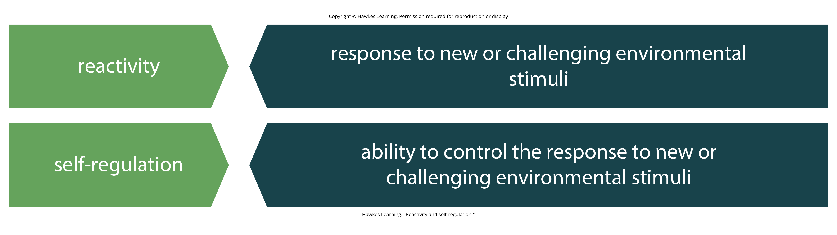
Temperament in Adulthood
Research suggests that there are two dimensions of our temperament that are important parts of our adult personality—reactivity and self-regulation (Rothbart et al., 2000).
Figure 1
Caption: The two dimensions of our adult personality are reactivity and self-regulation.

Slide 8
Body Type And Temperament
The first comprehensive system of constitutional psychology was proposed by American psychologist William H. Sheldon (1940, 1942).
  Sheldon believed that your body type can be linked to your personality.
  Sheldon's life's work was spent observing human bodies and temperaments.
  Based on his observations and interviews of hundreds of people, he proposed three body/personality types, which he called somatotypes.

Slide 9
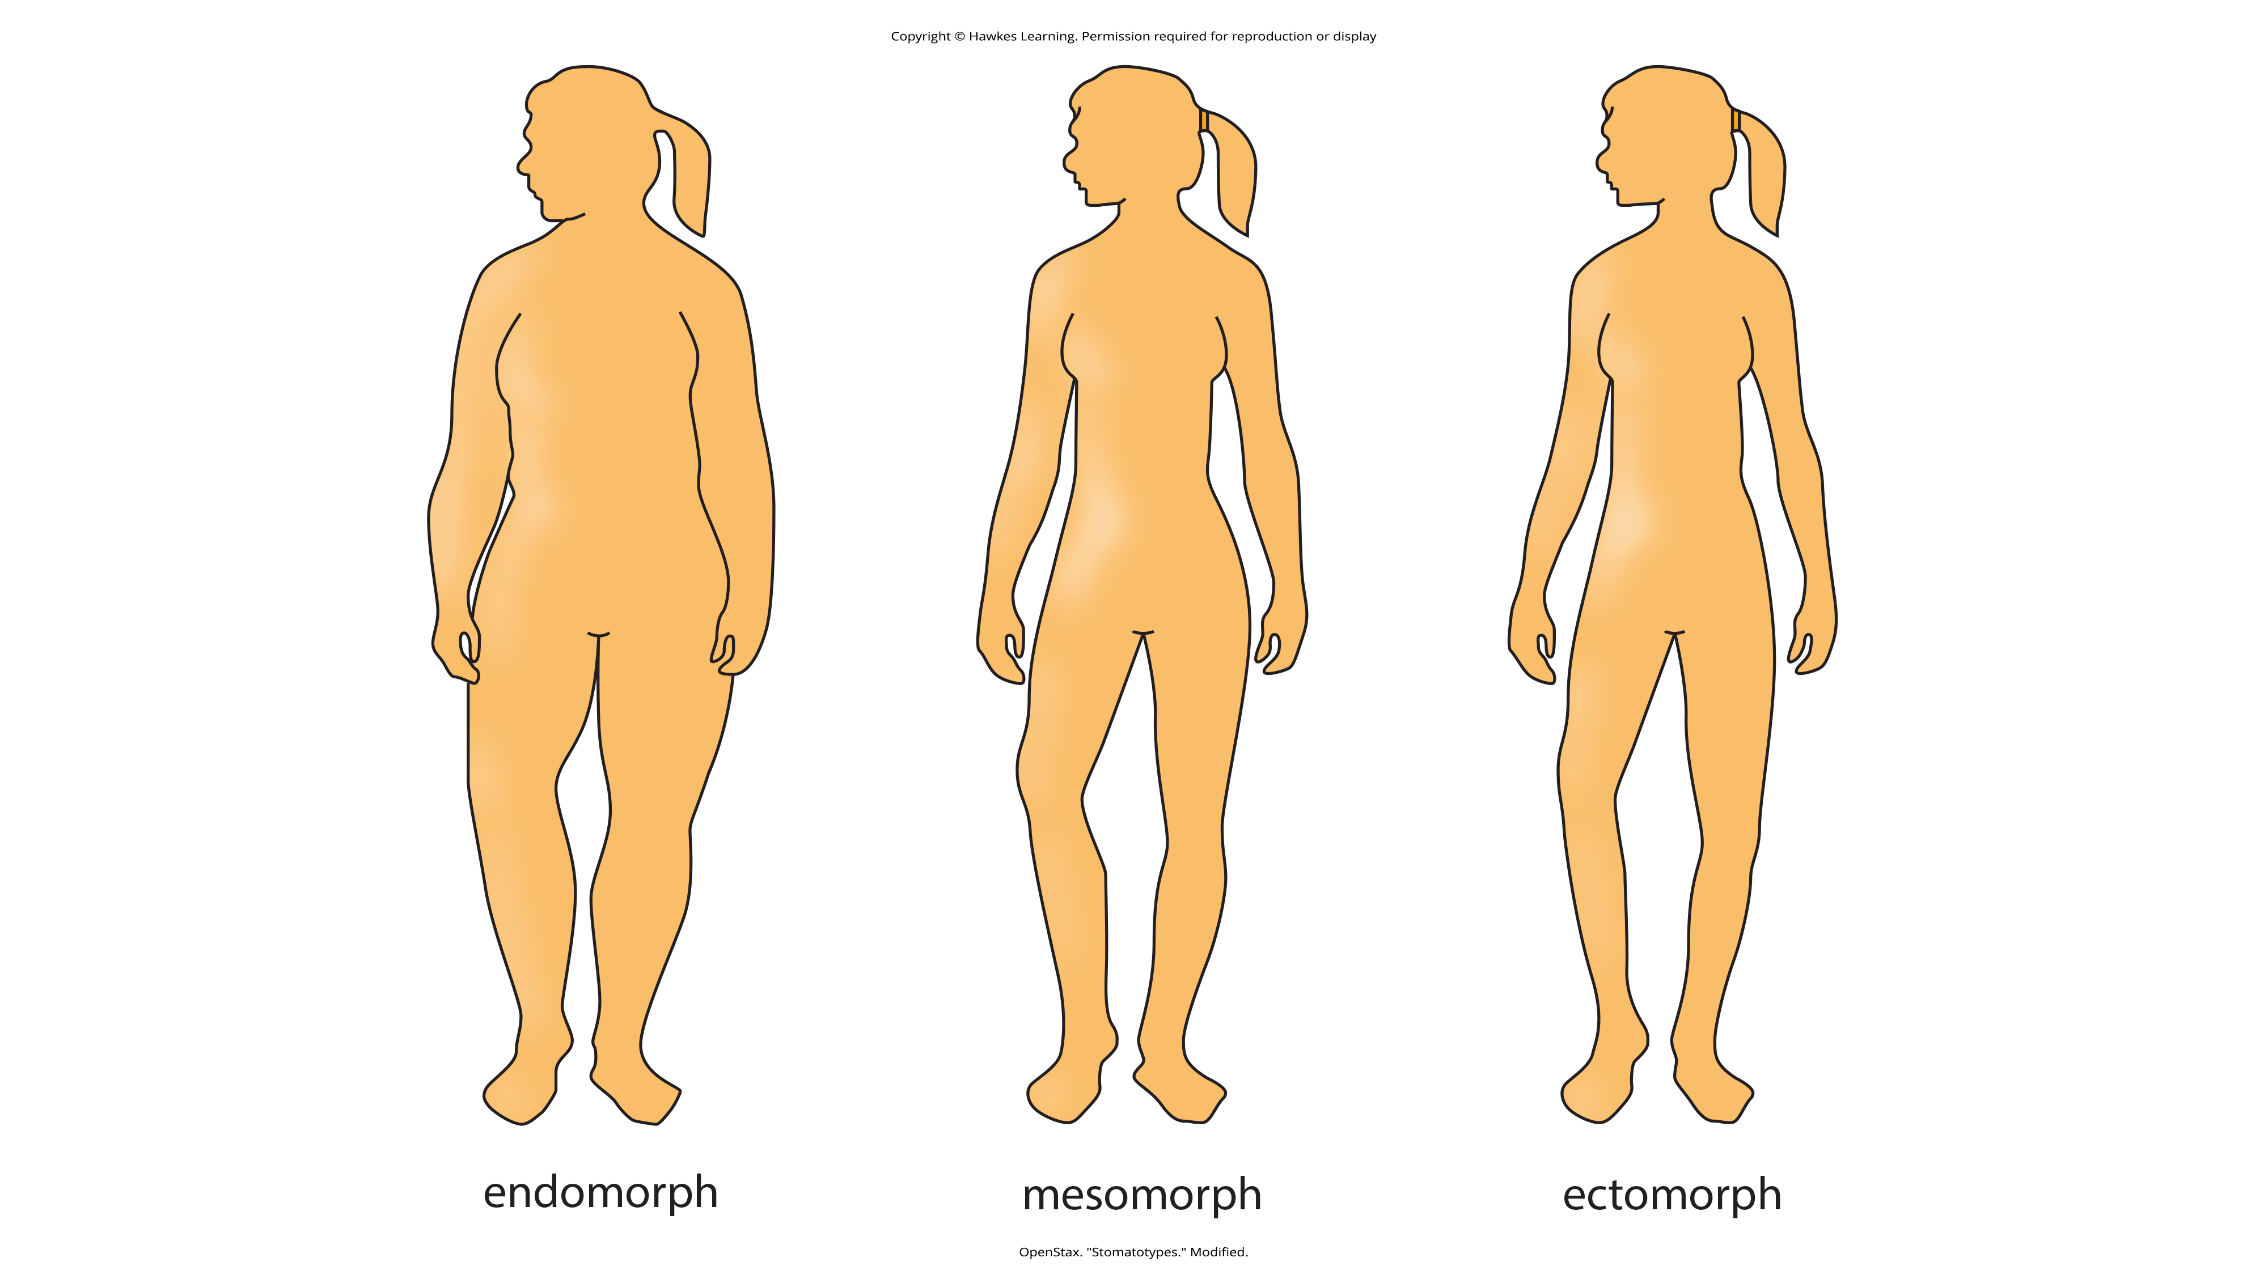
Somatotypes
William H. Sheldon identified three somatotypes:
  Ectomorphs
  Endomorphs
  Mesomorphs
Figure 2
Caption: Sheldon proposed three somatotypes: endomorphs, mesomorphs, and ectomorphs. Do you think Sheldon's ideas about somatotypes are generally accurate about most people?

Slide 10
  Ectomorphs
Ectomorphs are thin with a small bone structure and very little fat on their bodies.
  According to Sheldon, the ectomorph personality is anxious, self-conscious, artistic, thoughtful, quiet, and private.
  They enjoy intellectual stimulation and feel uncomfortable in social situations.

Slide 11
  Endomorphs
Endomorphs are the opposite of ectomorphs. Endomorphs have narrow shoulders and wide hips and carry extra fat on their round bodies.
  Sheldon described endomorphs as being relaxed, comfortable, good-humored, even-tempered, sociable, and tolerant.
  Endomorphs enjoy affection and detest disapproval.

Slide 12
  Mesomorphs
The third somatotype is the mesomorph. This body type falls between the ectomorph and the endomorph.
  Mesomorphs have a large bone structure, well-defined muscles, broad shoulders, narrow waists, and attractive, strong bodies.
  According to Sheldon, mesomorphs are adventurous, assertive, competitive, and fearless.
  They are curious and enjoy trying new things but can also be obnoxious and aggressive.

Slide 13
  Somatotypes And Criminality
Sheldon (1949) also conducted further research into somatotypes and criminality.
He measured the physical proportions of hundreds of juvenile delinquent boys in comparison to male college students and found that problem youth were primarily mesomorphs.
  Why might this be?
    Perhaps it's because they are quick to anger and don't have the restraint demonstrated by ectomorphs.
    Maybe it's because a person with a mesomorphic body type reflects high levels of testosterone, which may lead to more aggressive behavior.

Slide 14
  Critiques Of Sheldon's Work
Sheldon's method of somatotyping is not without criticism, as it has been considered largely subjective (Carter & Heath, 1990; Cortés & Gatti, 1972; Parnell, 1958).
  More systematic and controlled research methods did not support his findings (Eysenck, 1970; Nickerson, 2023).
  Consequently, it's not uncommon to see his theory labeled as pseudoscience, much like Gall's theory of phrenology (Rafter, 2008; Rosenbaum, 1995).
  However, studies involving correlations between somatotype, temperament, and children's school performance (Sanford et al., 1943); somatotype and performance of pilots during wartime (Damon, 1955); and somatotype and temperament (Peterson et al., 2006) did support his theory.

Slide 15
Reflection Question₂
Which somatotype are you?
Do you agree with the personality description that fits your body type?

Slide 16
  Summary
Some aspects of our personalities are largely controlled by genetics.
Environmental factors (such as family interactions) and maturation can affect the ways in which children's personalities are expressed.

Slide 17
End of Hawkes Learning PowerPoint

