Slide 1
Lesson 11.7
Trait Theorists

Slide 2
Gordon Allport
Gordon Allport, a trait theorist (Allport & Odbert, 1936), found 4,500 words in the English language that could describe people.
He organized these personality traits into three categories: cardinal traits, central traits, and secondary traits.
A cardinal trait is one that dominates your entire personality.
Central traits are those that make up our personalities (such as loyal, kind, agreeable, friendly, sneaky, wild, and grouchy).
Secondary traits are present under specific circumstances and include preferences and attitudes. For example, one person can only sleep on the left side of the bed, and yet another always orders their salad dressing on the side.

Slide 3
On Your Own₁
Describe a cardinal trait, central trait, and a secondary trait that you possess.
cardinal trait:
central trait:
secondary trait:

Slide 4
Raymond Cattell
Raymond Cattell (1946, 1957) narrowed down the list to about 171 traits.
Cattell (1957) identified 16 factors or dimensions of personality: warmth, reasoning, emotional stability, dominance, liveliness, rule-consciousness, social boldness, sensitivity, vigilance, abstractedness, privateness, apprehension, openness to change, self-reliance, perfectionism, and tension.
Cattell developed a personality assessment based on these 16 factors, called the PF16.
Instead of a trait being present or absent, each dimension is scored over a continuum, from high to low.
For example, your level of warmth describes how warm, caring, and nice to others you are. If you score low on this index, you tend to be distant and cold. A high score on this index signifies you are supportive and comforting.

Slide 5
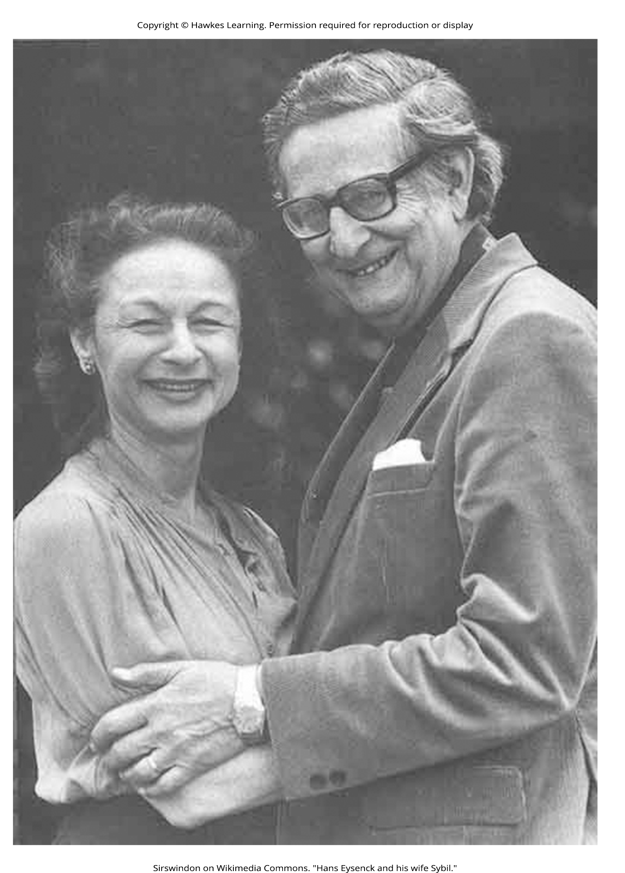
Hans And Sybil Eysenck₁
Psychologists Hans and Sybil Eysenck were personality theorists who focused on temperament, the inborn, genetically based personality differences.
The Eysencks (Eysenck, 1990, 1992; Eysenck & Eysenck, 1963) viewed people as having two specific personality dimensions: extroversion/introversion and neuroticism/stability.
Figure 1

Slide 6
Hans And Sybil Eysenck₂
According to their theory, people high on the trait of extroversion are sociable, outgoing, and readily connect with others.
People high on the trait of introversion have a higher need to be alone, engage in solitary behaviors, and limit their interactions with others.
In the neuroticism/stability dimension, people high on neuroticism tend to be anxious and even with low stress, their bodies and emotional state tend to go into a flight-or-fight reaction.
In contrast, people high on stability tend to need more stimulation to activate their flight-or-fight reaction and are considered more emotionally stable.
Based on these two dimensions, the Eysencks' theory divides people into four quadrants.
These quadrants are sometimes compared with the four temperaments described by the Greeks: melancholic, choleric, phlegmatic, and sanguine.

Slide 7
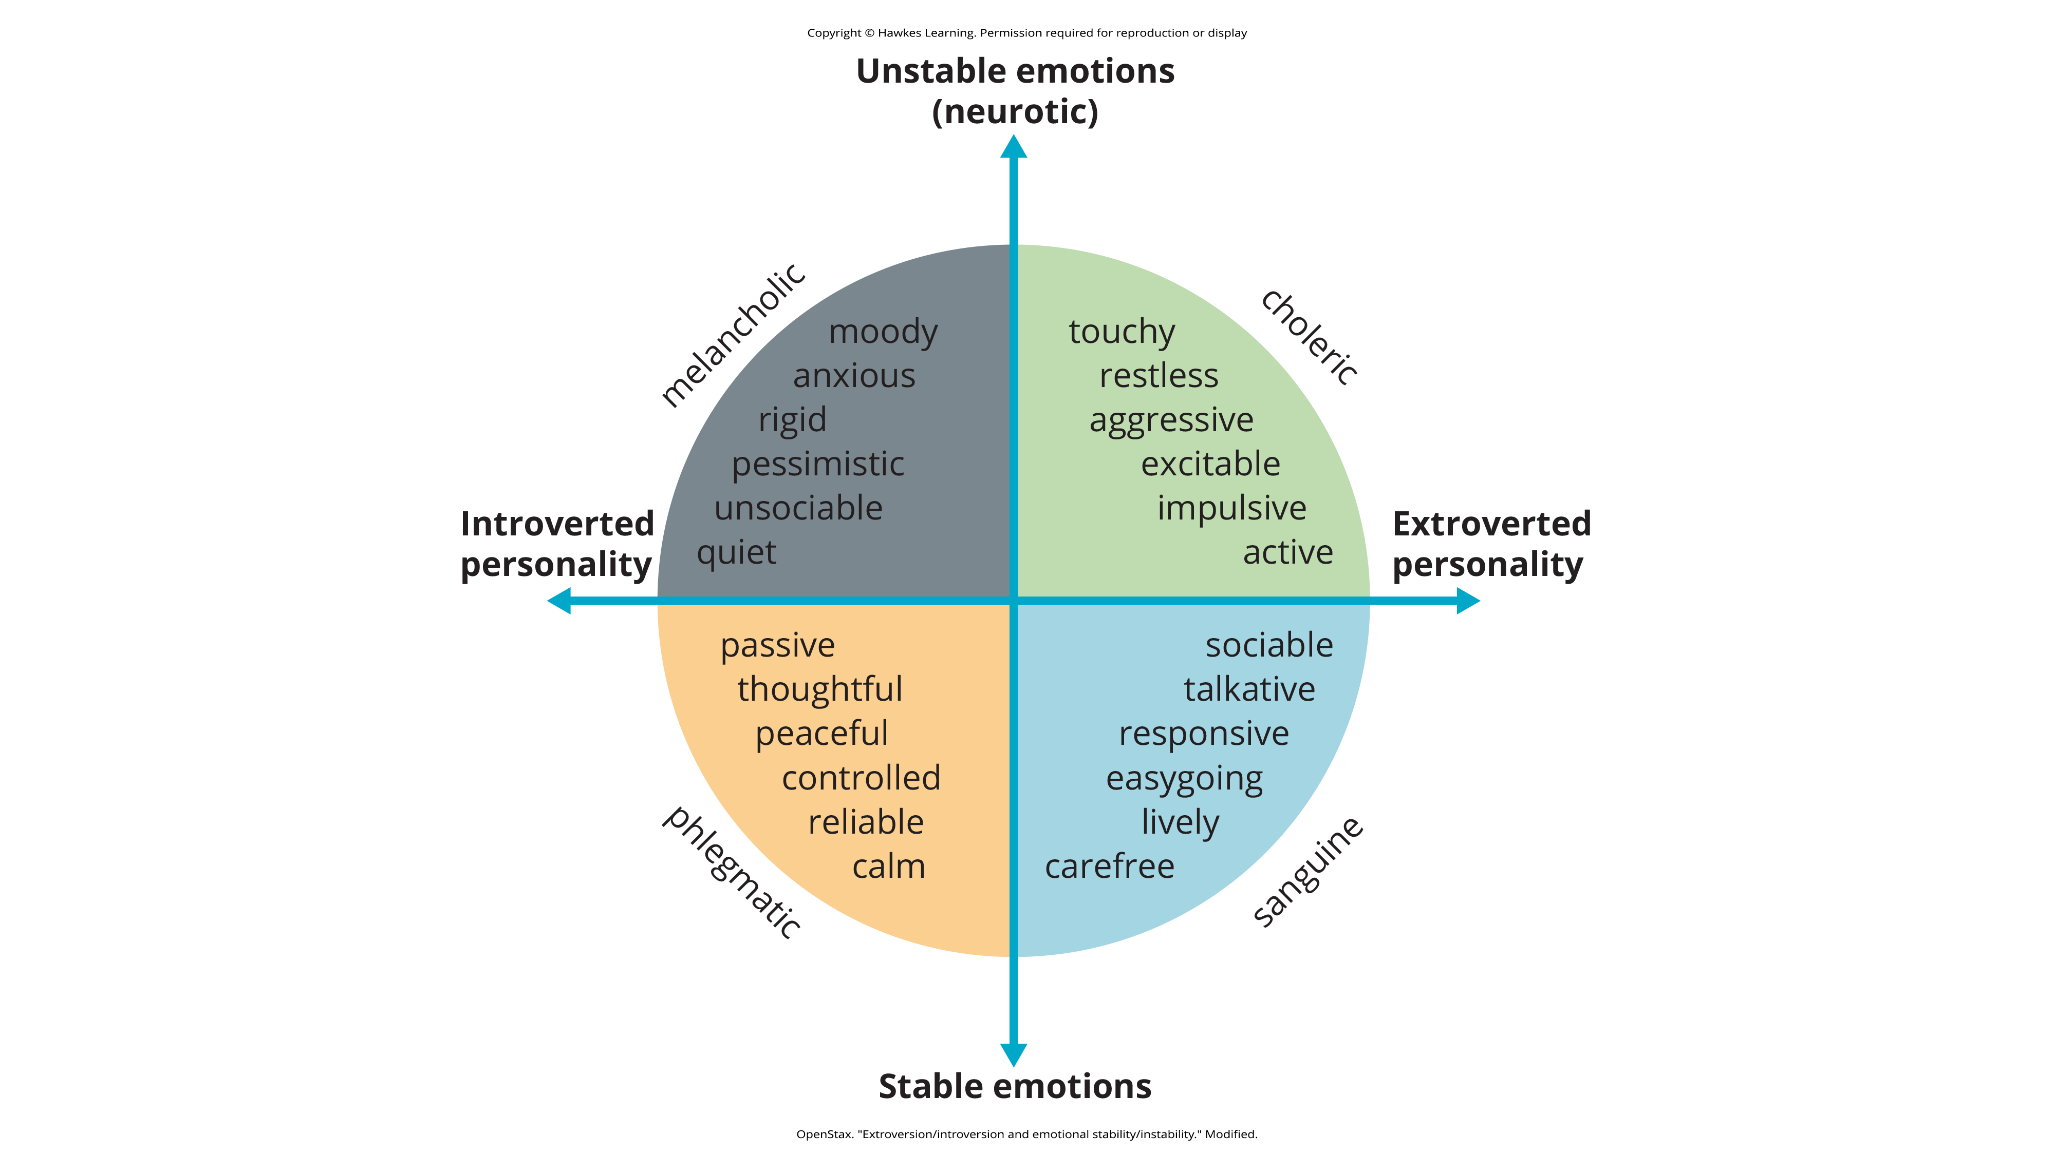
Lesson 11.7 Figure 2
Caption: The Eysencks described two factors to account for variations in our personalities: extroversion/introversion and emotional stability/instability.

Slide 8
Hans And Sybil Eysenck₃
Later, the Eysencks added a third dimension: psychoticism versus superego control (Eysenck et al., 1985).
In this dimension, people who are high on psychoticism tend to be independent thinkers, cold, nonconformists, impulsive, antisocial, and hostile, whereas people who are high on superego control tend to have high impulse control; they are more altruistic, empathetic, cooperative, and conventional (Eysenck et al., 1985).

Slide 9
Five Factor Model₁
Another personality theory, called the Five Factor Model, effectively hits a middle ground, with its five factors referred to as the Big Five personality traits.
The five traits include the following:
Openness to experience is characterized by imagination, feelings, actions, and ideas.
People who score high on this trait tend to be curious and have a wide range of interests.
Conscientiousness is characterized by competence, self-discipline, thoughtfulness, and achievement-striving (goal-directed behavior).
People who score high on this trait are hardworking and dependable.
Numerous studies have found a positive correlation between conscientiousness and academic success (Akomolafe, 2013; Chamorro-Premuzic & Furnham, 2008; Conrad & Patry, 2012; Noftle & Robins, 2007; Wagerman & Funder, 2007).

Slide 10
Five Factor Model₂
Extroversion is characterized by sociability, assertiveness, excitement-seeking, and emotional expression.
People who score high on this trait are usually described as outgoing and warm.
Not surprisingly, people who score high on both extroversion and openness are more likely to participate in adventure and risky sports due to their curious and excitement-seeking nature (Tok, 2011).
Agreeableness is the tendency to be pleasant, cooperative, trustworthy, and good-natured.
People who score low on agreeableness tend to be described as rude and uncooperative, yet one recent study reported that men who scored low on this trait earned more money than men who were considered more agreeable (Judge et al., 2012).

Slide 11
Five Factor Model₃
Neuroticism is the tendency to experience negative emotions.
People high on neuroticism tend to experience emotional instability and are characterized as angry, impulsive, and hostile.
Watson and Clark (1984) found that people reporting high levels of neuroticism also tend to report feeling anxious and unhappy.
In contrast, people who score low in neuroticism tend to be calm and even-tempered.

Slide 12
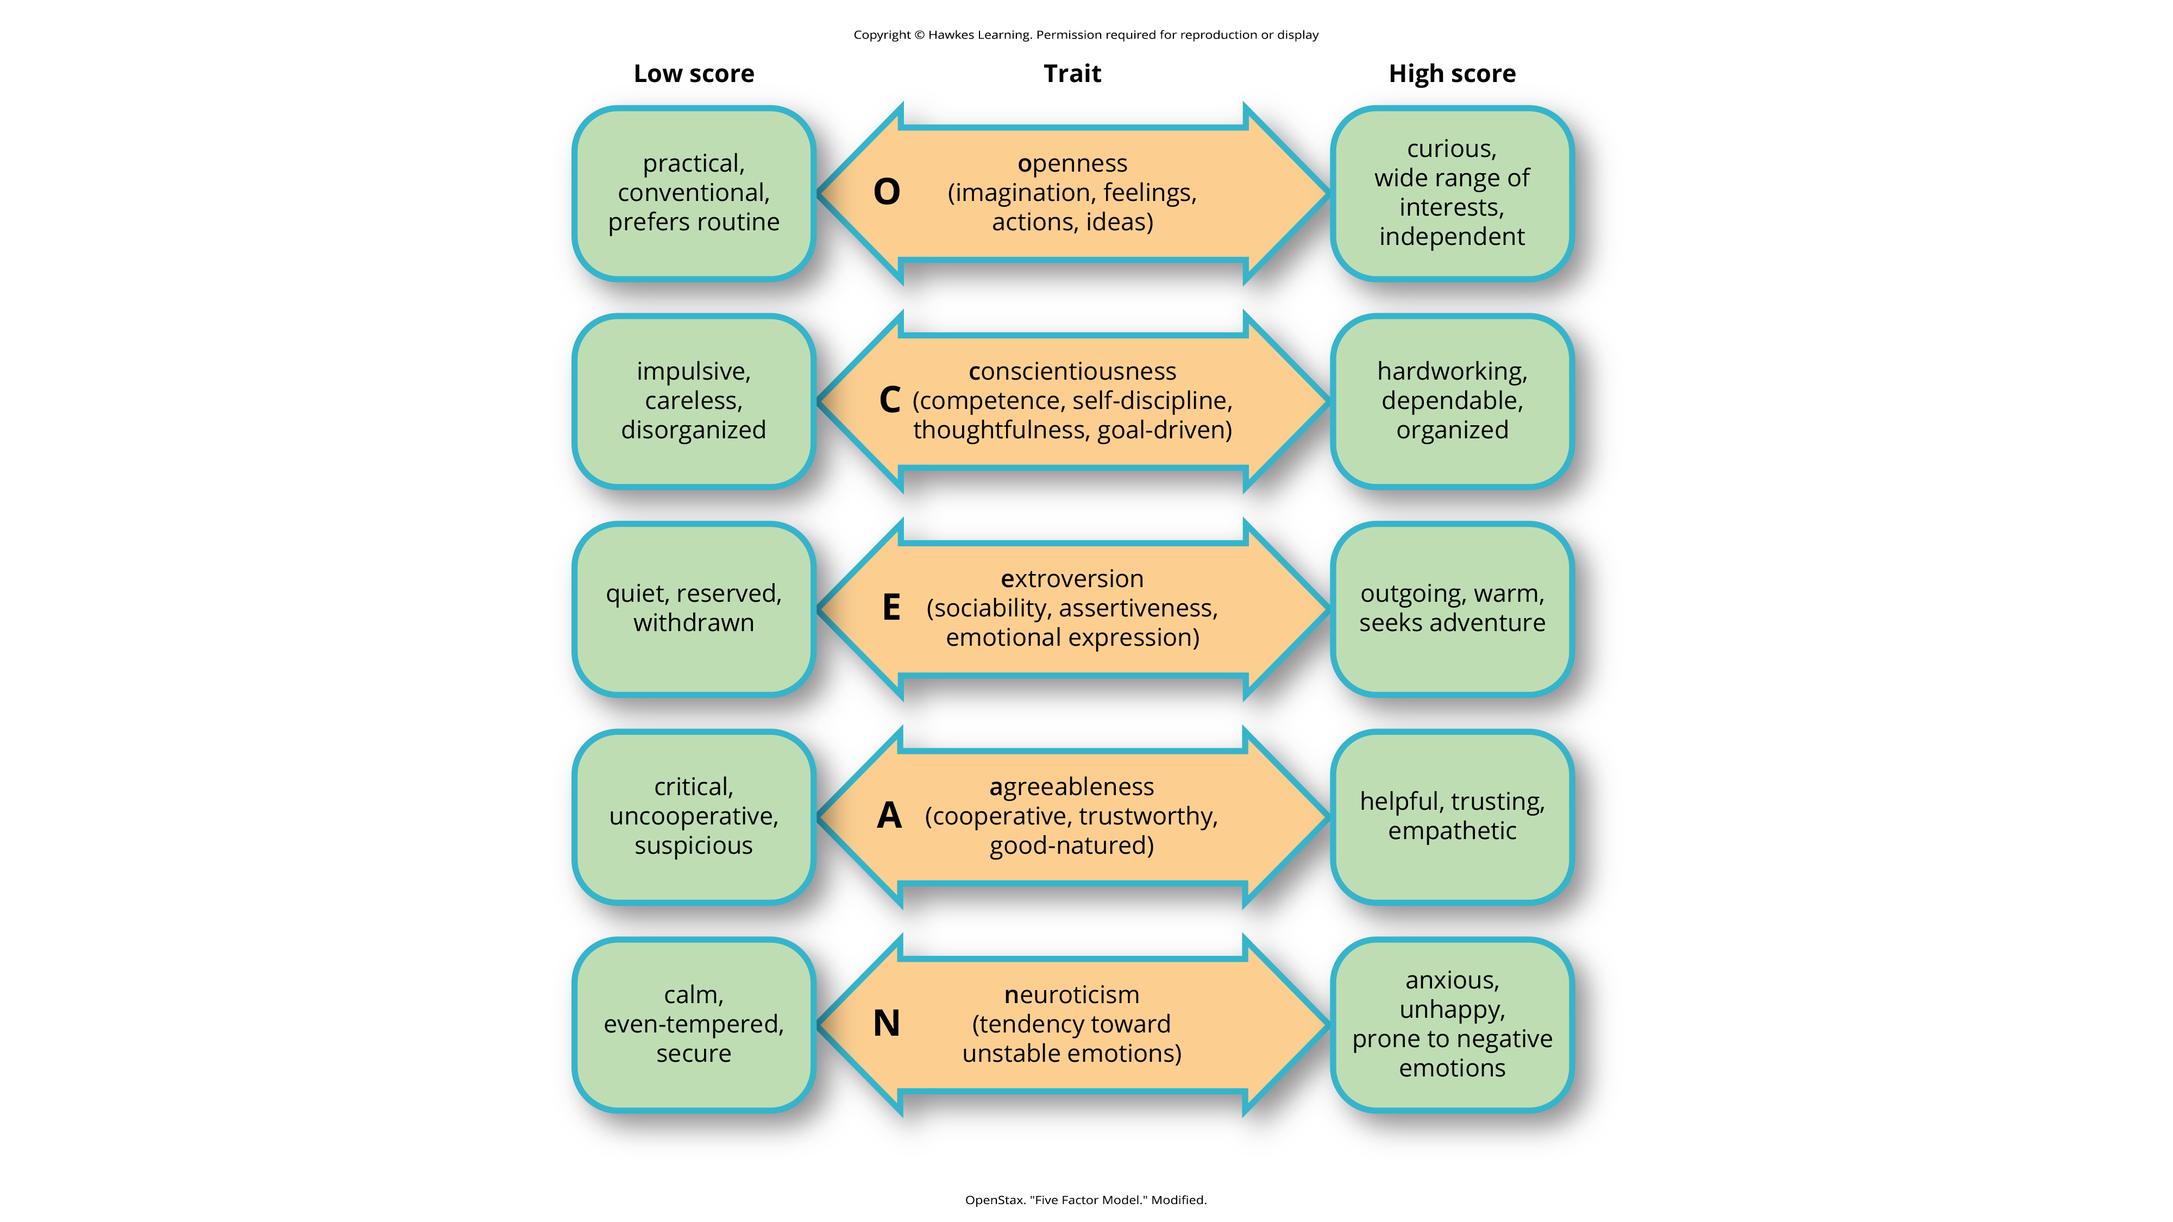
Lesson 11.7 Figure 3
Caption: In the Five Factor Model, each person has five traits that are scored on a continuum from high to low. In the center column, notice that the first letter of each trait spells the mnemonic OCEAN.

Slide 13
Reflection Question
Do you think you would score high or low on certain Five Factor Model personality traits?
If so, which ones and why?

Slide 14
How To Interpret The Big Five Theory
The Big Five personality factors each represent a range between two extremes.
Most of us tend to lie somewhere midway along the continuum of each factor, rather than at polar ends.
It's important to note that the Big Five traits are relatively stable over our lifespan, with some tendency for the traits to increase or decrease slightly.
Researchers have found that:
Conscientiousness increases through young adulthood into middle age, as we become better able to manage our personal relationships and careers (Donnellan & Lucas, 2008; Van Dijk et al., 2020).
Agreeableness also increases with age, peaking between 50 to 70 years old (Terracciano et al., 2005).
Neuroticism and extroversion tend to decline slightly with age (Donnellan & Lucas, 2008; Terracciano et al., 2005).

Slide 15
The Universal Application Of The Big Five Theory
The Big Five traits have been shown to exist across ethnicities, cultures, and ages and may have substantial biological and genetic components (Jang et al., 1996; Jang et al., 2006; McCrae & Costa, 1997; Schmitt et al., 2007).
Many of these five traits are loosely related, differing in importance, adaptability, and utility within each culture.
Example: Two independent studies on impulse buying in Pakistan and the U.S. found that impulse purchasing is more likely to occur for individuals who score high on levels of neuroticism (Jamali & Baloch, 2019; Tarka et al., 2022).

Slide 16
Summary
Trait theorists attempt to explain our personality by identifying our stable characteristics and ways of behaving.
They have identified important dimensions of personality.
The Five Factor Model is the most widely accepted trait theory today. The five factors are openness, conscientiousness, extroversion, agreeableness, and neuroticism.
These traits occur along a continuum.

Slide 17
End of Hawkes Learning PowerPoint

