Slide 1
Lesson 11.8
Cultural Understandings of Personality

Slide 2

Culture's Role In Shaping Personality
Personality is shaped by both genetic and environmental factors.
The culture in which you live is one of the most important environmental factors that shapes your personality (Triandis & Suh, 2002; Linton, 2007; Cheung et al., 2011).
The term culture refers to all of the beliefs, customs, art, and traditions of a particular society.
Culture is transmitted to people through language as well as through the modeling of culturally acceptable and nonacceptable behaviors that are either rewarded or punished (Triandis & Suh, 2002).
Figure 1

Slide 3
Anthropology
The discipline of anthropology focuses on studying cultural differences in human functioning, including how personality traits differ or remain stable cross-culturally.
It appears that there are both universal and culture-specific aspects that account for variation in people's personalities.

Slide 4

Western Culture Vs. Others
Western ideas about personality may not be applicable to other cultures (Benet-Martinez & Oishi, 2008; Cheung et al., 2011; Fan et al., 2021).
There is evidence that the strength of personality traits varies across cultures.
Let's examine at some of the Big Five factors (conscientiousness, neuroticism, openness, and extroversion) across cultures.
Asian cultures are more collectivist, and people in these cultures tend to be less extroverted.
People in Central and South American cultures tend to score higher on openness to experience.
Europeans score higher on neuroticism.
(Benet-Martinez & Karakitapoglu-Aygun, 2003)
Figure 2

Slide 5
Group Activity
Socialization is the process where a child slowly acquires a set of habits, attitudes, traits, and ways of behaving that allow them to operate in the groups they are a member of.
In small groups, list different types of learned behaviors or beliefs that depend on where we are born or where we grow up.
How might that impact how others perceive a child's personality?

Slide 6
Regional Differences In Personality
There also seem to be regional personality differences within the United States.
Researchers analyzed responses from over 1.5 million individuals in the United States and found that there are three distinct regional personality clusters:
Cluster 1, which is in the Upper Midwest and Deep South, is dominated by people who fall into the "friendly and conventional" personality.
Cluster 2, which includes the West, is dominated by people who are more relaxed, emotionally stable, calm, and creative.
Cluster 3, which includes the Northeast, has more people who are stressed, irritable, and depressed. People who live in Clusters 2 and 3 are also generally more open (Rentfrow et al., 2013).

Slide 7
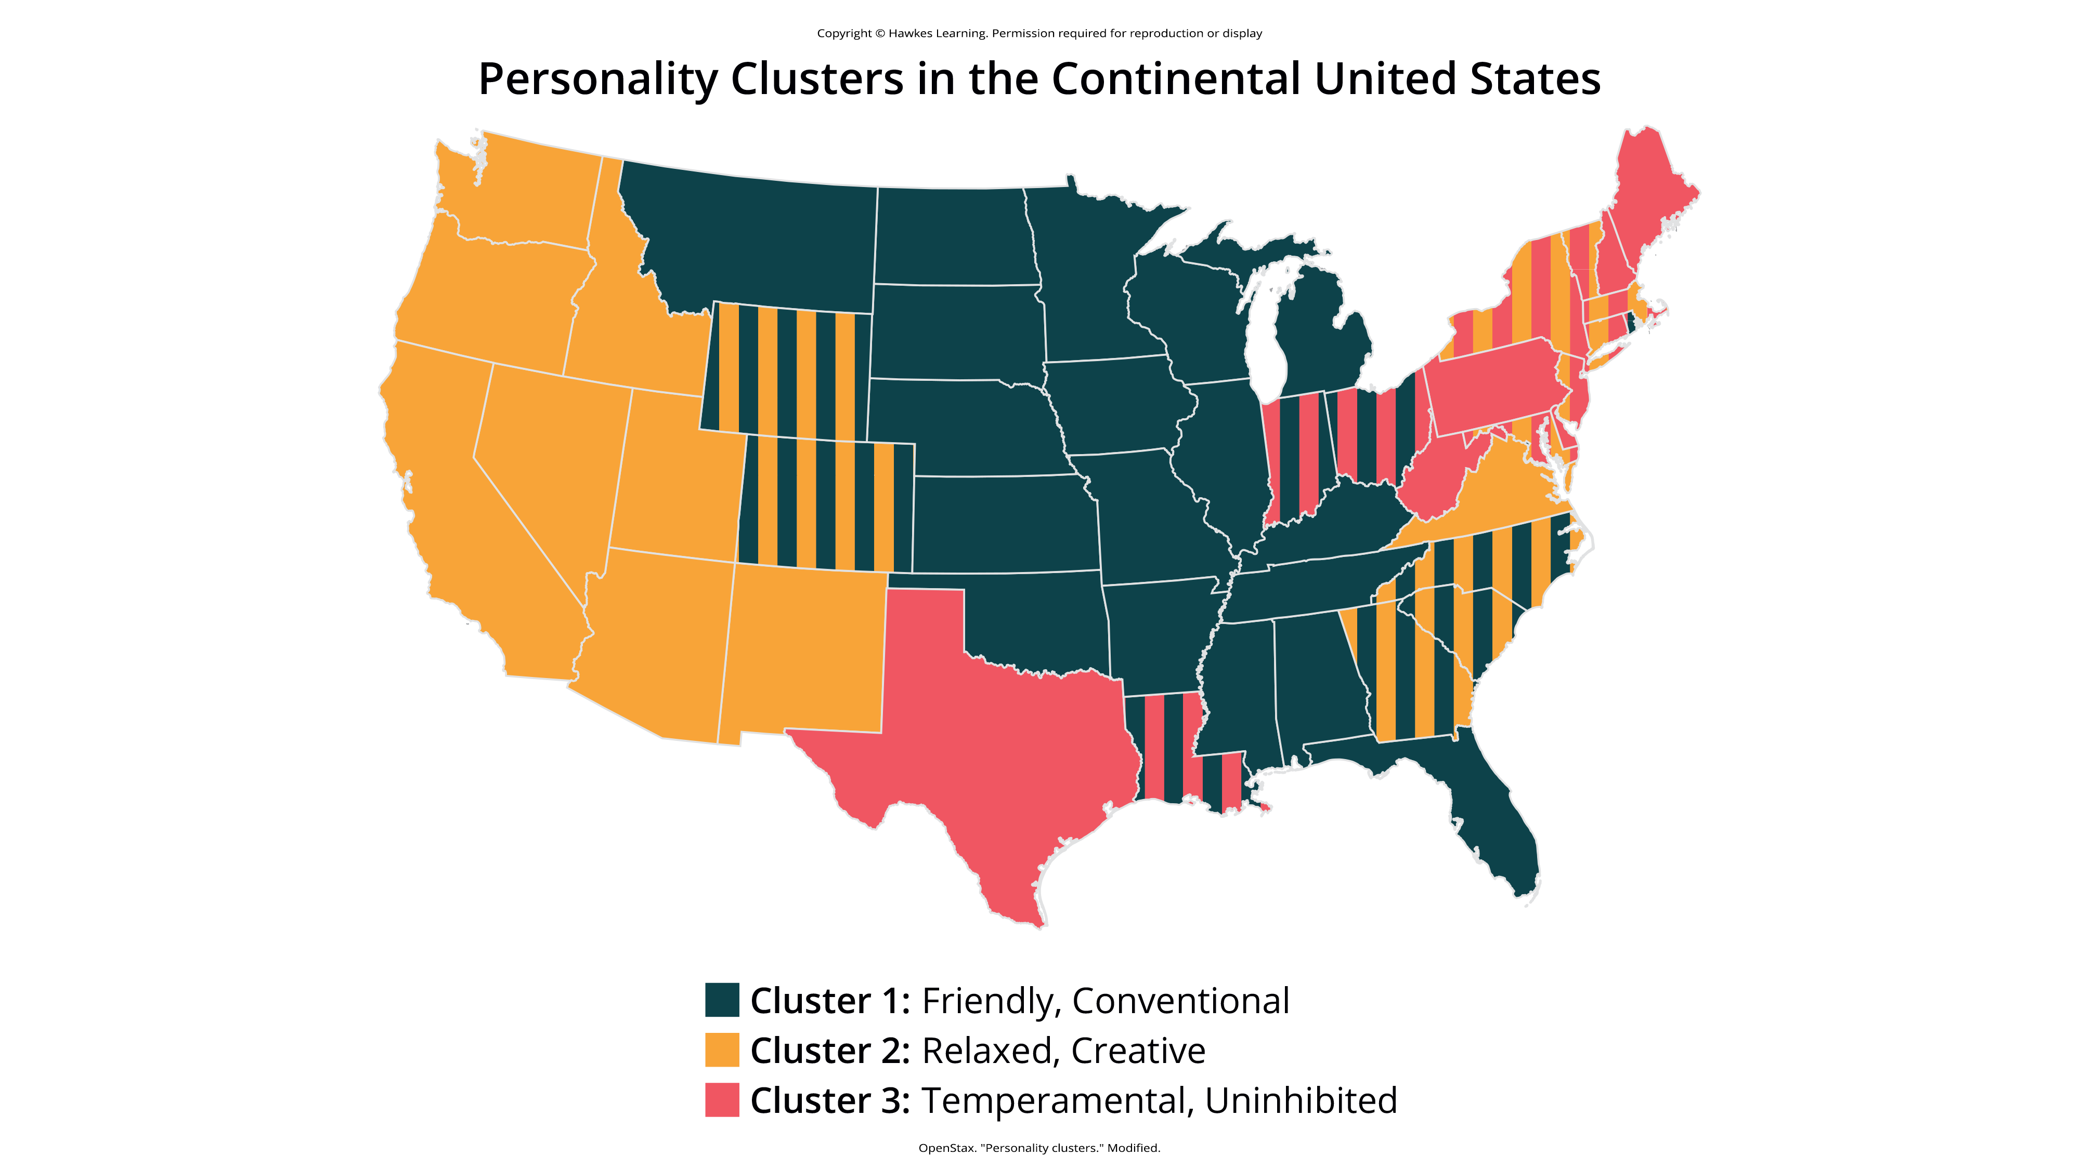
Lesson 11.8 Figure 3
Caption: Researchers found three distinct regional personality clusters in the United States. People tend to be friendly and conventional in the Upper Midwest and Deep South; relaxed, emotionally stable, and creative in the West; and stressed, irritable, and depressed in the Northeast (Rentfrow et al., 2013).

Slide 8
Origins Of Regional Differences
One explanation for the regional differences is selective migration (Rentfrow et al., 2013; McCann, 2022).
Selective migration is the concept that people choose to move to places that are compatible with their personalities and needs.
Example: A person high on the agreeable scale would likely want to live near family and friends and would choose to settle or remain in such an area.
In contrast, someone high on openness would prefer to settle in a place that is recognized as diverse and innovative.

Slide 9
Individualistic Cultures
Individualist cultures and collectivist cultures place emphasis on different basic values.
People who live in individualist cultures tend to believe that independence, competition, and personal achievement are important.
Individuals in Western nations such as the United States, England, and Australia score high on individualism (Oyserman et al., 2002; Fan et al., 2021).

Slide 10
Collectivist Cultures
People who live in collectivist cultures value social harmony, respectfulness, and group needs over individual needs.
Individuals who live in countries in Asia, Africa, and South America score high on collectivism (Hofstede, 2001; Triandis, 1995; Cheung et al., 2011).
These values influence personality.
Example: Yang (2006) found that people in individualist cultures displayed more personally oriented personality traits, whereas people in collectivist cultures displayed more socially oriented personality traits.

Slide 11
Reflection Questions
Consider your personal experience with collectivistic and individualistic cultures, in real life, through media, etc., and answer the following questions:
In which culture would you expect a greater degree of happiness? Why?
2. In which culture would you expect a higher crime rate? Why?
3. How might students in such cultures react differently to personal success and failure?
4. How and why might individuals in these two cultures have different orientations to dealing with time? What would be an easy way to examine cross-cultural comparisons to time orientation?

Slide 12
Studying Personality In A Cross-Cultural Context₁
There are three approaches that can be used to study personality in a cultural context:
The cultural-comparative approach, the indigenous approach, and the combined approach, which incorporates elements of both views.
Since ideas about personality have a Western basis, the cultural-comparative approach seeks to test Western ideas about personality in other cultures to determine whether they can be generalized and if they have cultural validity (Cheung et al., 2011).
For example, recall from the lesson on the trait perspective that researchers used the cultural-comparative approach to test the universality of McCrae and Costa's Five Factor Model.
They found applicability in numerous cultures around the world, with the Big Five traits being stable in many cultures (McCrae & Costa, 1997; McCrae et al., 2005).

Slide 13
Studying Personality In A Cross-Cultural Context₂
The indigenous approach came about in reaction to the dominance of Western approaches to the study of personality in non-Western settings (Cheung et al., 2011).
Because Western-based personality assessments cannot fully capture the personality constructs of other cultures, the indigenous model has led to the development of personality assessment instruments that are based on constructs relevant to the culture being studied (Cheung et al., 2011).

Slide 14
Studying Personality In A Cross-Cultural Context₃
The third approach to cross-cultural studies of personality is the combined approach.
It serves as a bridge between Western and indigenous psychology as a way of understanding both universal and cultural variations in personality (Cheung et al., 2011).

Slide 15
Summary
The culture in which you live is one of the most important environmental factors that shapes your personality.
Western ideas about personality may not be applicable to other cultures. In fact, there is evidence that the strength of personality traits varies across cultures. Individualist cultures and collectivist cultures place emphasis on different basic values.
People who live in individualist cultures tend to believe that independence, competition, and personal achievement are important.
People who live in collectivist cultures value social harmony, respectfulness, and group needs over individual needs.
There are three approaches that can be used to study personality in a cultural context: the cultural-comparative approach, the indigenous approach, and the combined approach, which incorporates both elements of both views.

Slide 16
End of Hawkes Learning PowerPoint

