Slide 1
Lesson 11.9
Personality Assessment

Slide 2
Personality Testing
Personality testing is often used to screen applicants for employment and job training.
  Personality tests are also used in criminal cases and custody battles and to assess psychological disorders.

Slide 3
Self-Report Inventories
Self-report inventories are a kind of objective test used to assess personality.
They typically use multiple-choice items or numbered scales, which represent a range from 1 (strongly disagree) to 5 (strongly agree).
  They often are called Likert scales after their developer, Rensis Likert (1932).

Slide 4
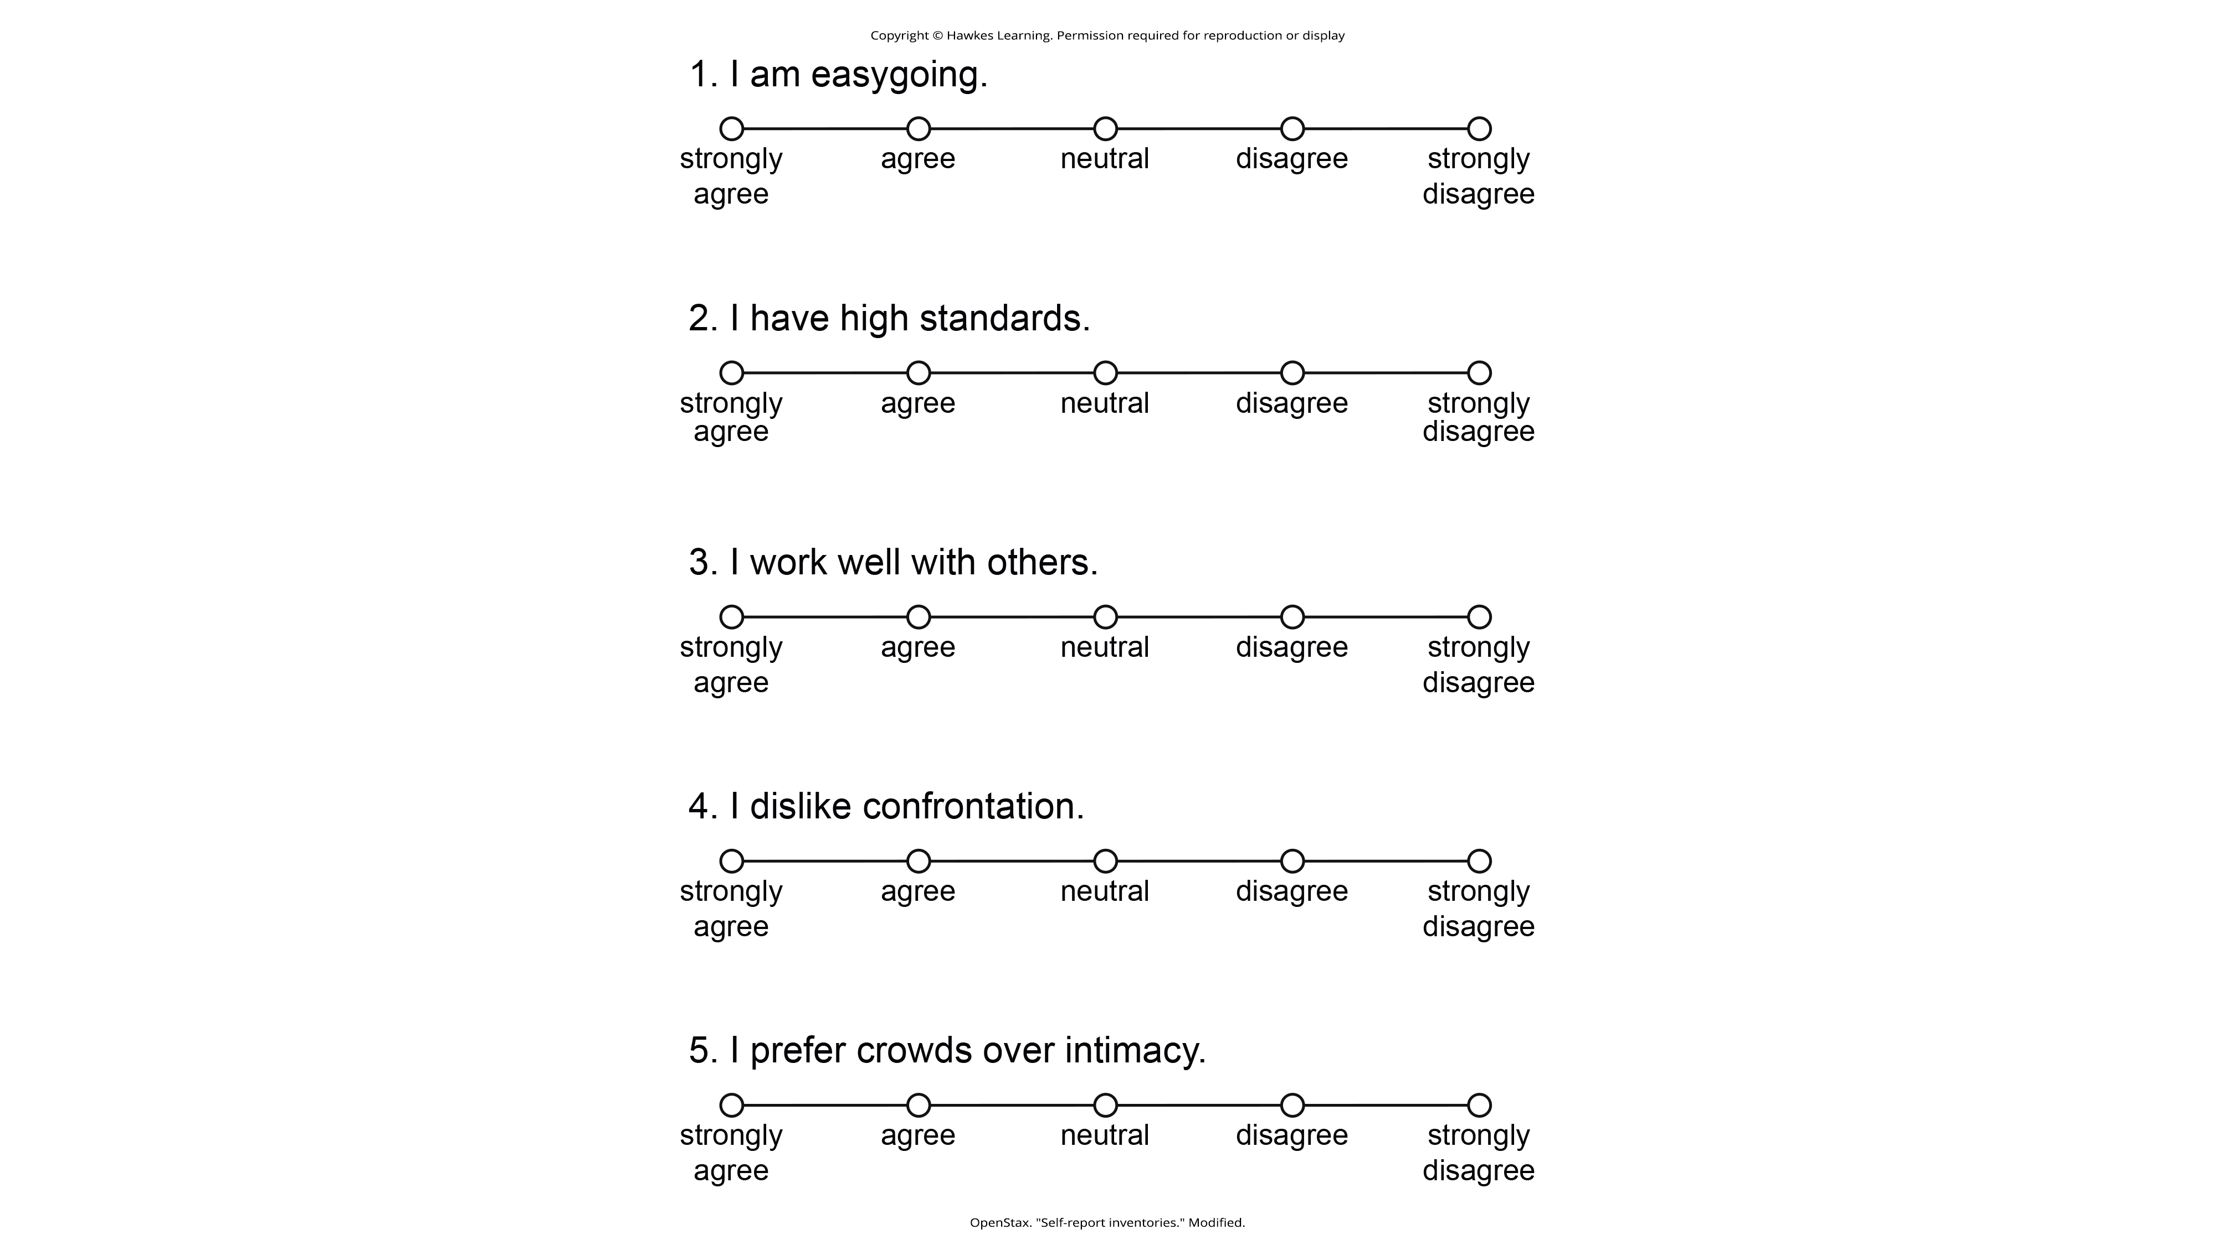
Lesson 11.9 Figure 1
Caption: If you've ever taken a survey, you are probably familiar with Likert-type scale questions. Most personality inventories employ these types of response scales.

Slide 5
Minnesota Multiphasic Personality Inventory (MMPI)
One of the most widely used personality inventories is the Minnesota Multiphasic Personality Inventory (MMPI). The MMPI takes 1 to 2 hours to complete and includes 10 scales:
  hypochondriasis
  depression
  hysteria
  psychopathic deviance (social deviance)
  masculinity versus femininity
  paranoia
  psychasthenia (obsessive/compulsive qualities)
  schizophrenia
  hypomania
  social introversion

Slide 6
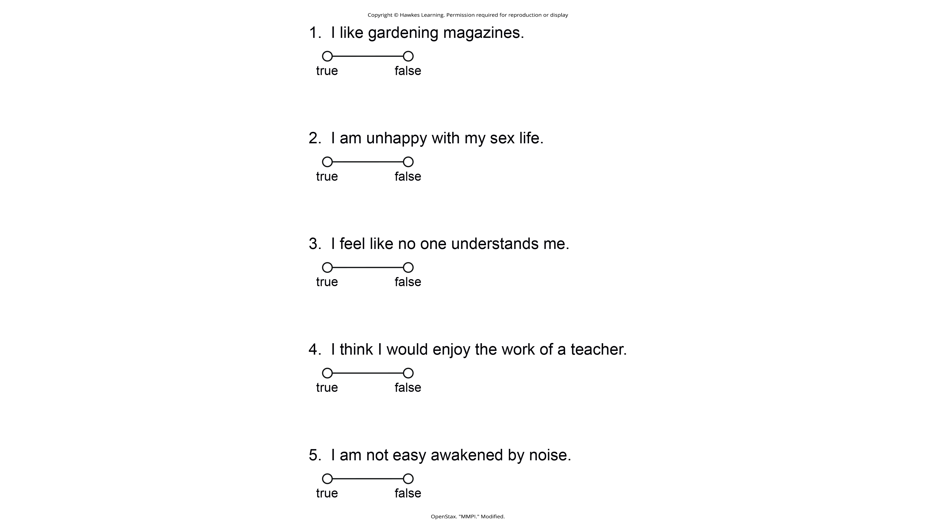
Lesson 11.9 Figure 2
Caption: These true/false questions resemble the kinds of questions you would find on the MMPI.

Slide 7
MMPI-2-RF
In 2008, the test was again revised, using more advanced methods, to the MMPI-2-RF.
  This version takes about one half the time to complete and has only 338 questions.
  Despite the new test's advantages, the MMPI-2 is more established and is still more widely used.
  Although the MMPI was originally developed to assist in the clinical diagnosis of psychological disorders, it is now also used for occupational screening, such as in law enforcement and in college, career, and marital counseling (Ben-Porath & Tellegen, 2008; Floyd & Gupta, 2022).

Slide 8
Reliability And Validity Of The MMPI
In addition to clinical scales, the tests also have validity and reliability scales.
  These scales help distinguish between responses that represent one's true self or if they are trying to put on a positive or negative impression.
  For example, someone who applies to a job may present themselves more positively, whereas an individual who is feigning a mental disorder may over report their symptoms.
Impression management is an important aspect of psychological testing, which should be considered in any self-report psychological assessment.

Slide 9
Projective Testing
Projective test: A personality assessment in which a person responds to ambiguous stimuli, revealing hidden feelings, impulses, and desires
  This kind of test relies on one of the defense mechanisms proposed by Freud—projection—as a way to assess unconscious processes.
  During this type of testing, a series of ambiguous cards is shown to the person being tested, who then is encouraged to project his feelings, impulses, and desires onto the cards—by telling a story, interpreting an image, or completing a sentence.
  A challenge with projective tests is that scores and interpretations can vary from clinician to clinician, which makes it less valid and reliable (Aronow et al., 2001; Lilienfeld et al., 2000).

Slide 10
Improving The Reliability Of Projective Tests
Many projective tests have undergone standardization procedures (for example, Exner, 2002) and can be used to assess whether someone has unusual thoughts, has a high level of anxiety, or is likely to become volatile.
  Some examples of projective tests include:
    Rorschach Inkblot Test
    Thematic Apperception Test (TAT)
    Contemporized-Themes Concerning Blacks Test
    TMAS Multicultural Thematic Apperception Test (Tell Me A Story)
    Rotter Incomplete Sentence Blank (RISB)

Slide 11
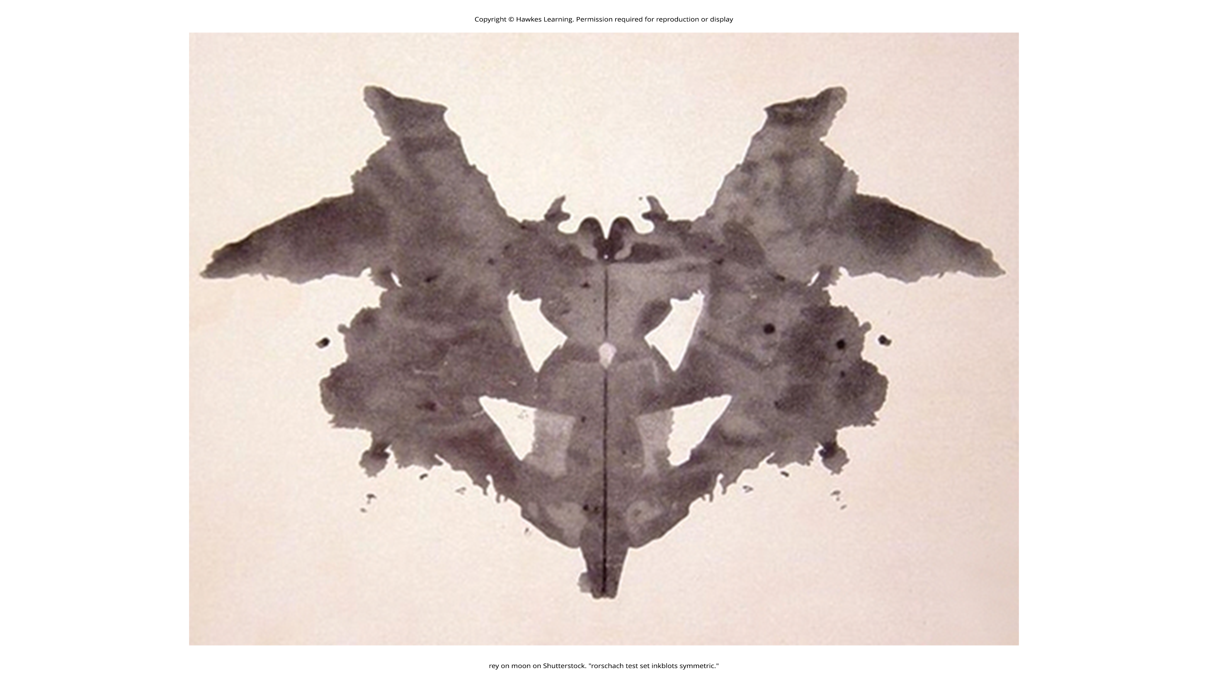
Lesson 11.9 Figure 3
Caption: The Rorschach inkblot is one of the most commonly known forms of projective tests.

Slide 12
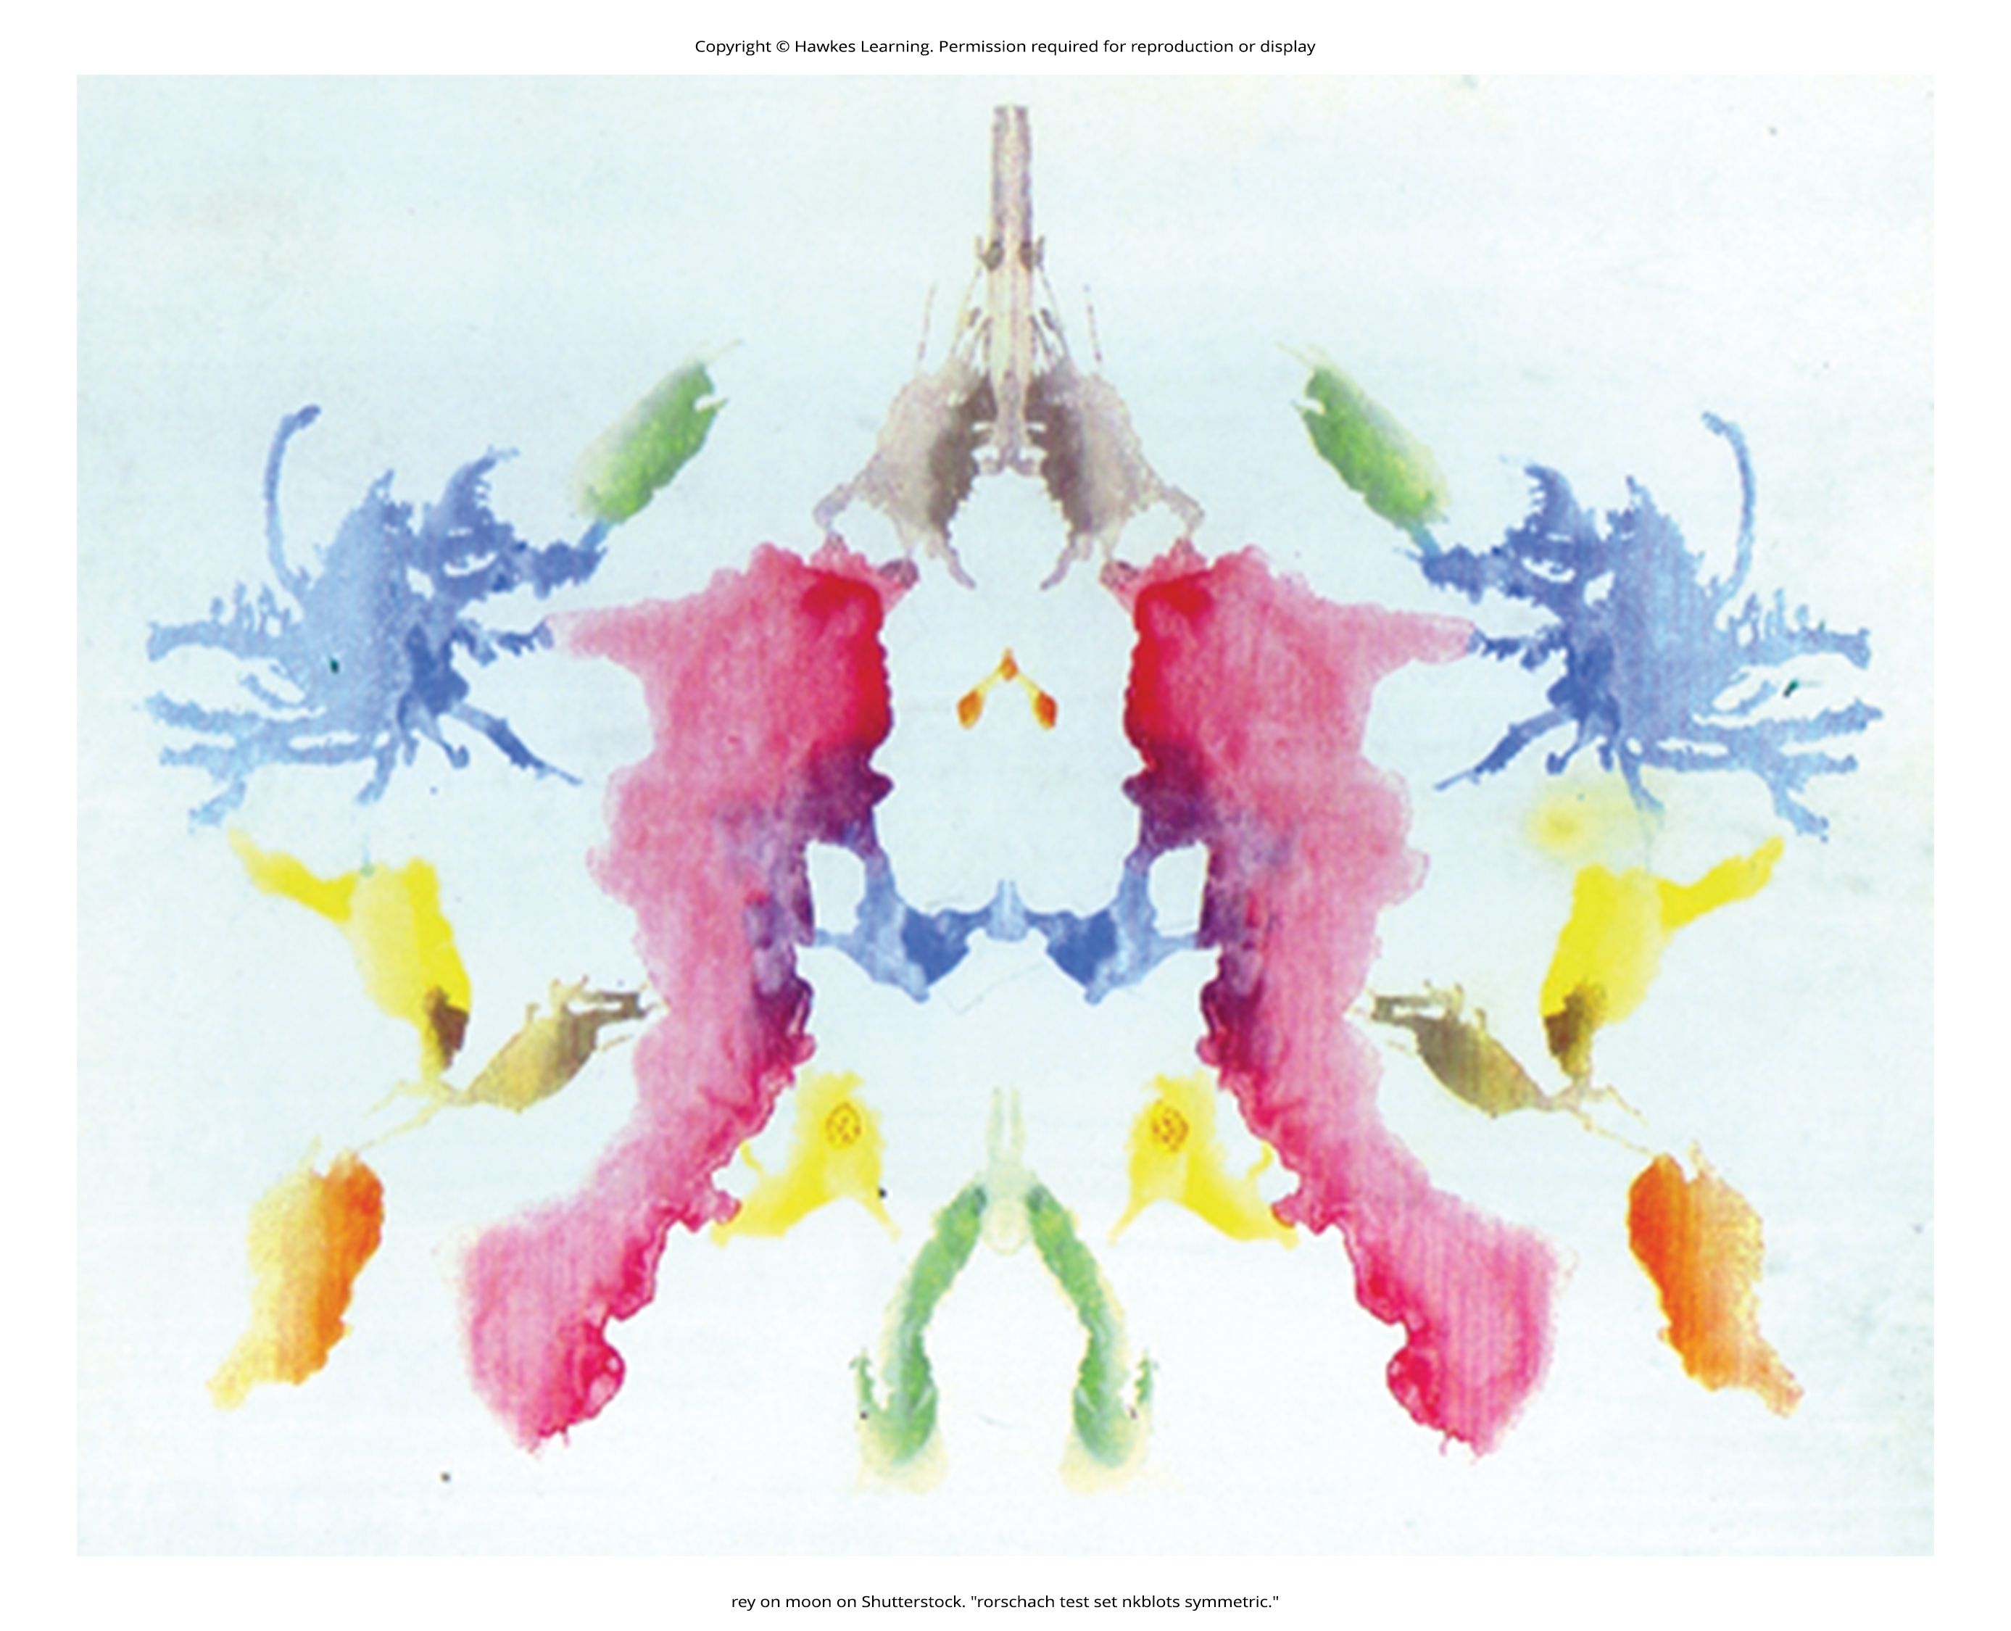
Rorschach Inkblot Test
Developed in 1921 by a Swiss psychologist named Hermann Rorschach (pronounced "ROAR-shock")
  It is a series of symmetrical inkblot cards that are presented to a client by a psychologist.
  Upon presentation of each card, the psychologist asks the client, "What might this be?"
  What the test-taker sees reveals unconscious feelings and struggles (Piotrowski, 1987; Weiner, 2003).
  The Rorschach has been standardized using the Exner system and is effective in measuring depression, psychosis, and anxiety (Mondal & Kumar, 2021).
Figure 4

Slide 13
Thematic Apperception Test (TAT)
Created in the 1930s by Henry Murray, an American psychologist, and a psychoanalyst named Christiana Morgan.
  A person taking the TAT is shown eight to 12 ambiguous pictures and is asked to tell a story about each picture. The stories give insight into their social world, revealing hopes, fears, interests, and goals.
  The storytelling format helps to lower a person's resistance divulging unconscious personal details (Cramer, 2004).
  The TAT has been used in clinical settings to evaluate psychological disorders, and more recently, it has been used in counseling settings to help clients gain a better understanding of themselves and achieve personal growth.
  Standardization of test administration is virtually nonexistent among clinicians, and the test tends to be modest to low on validity and reliability (Aronow et al., 2001; Lilienfeld et al., 2000). Despite these shortcomings, the TAT has been one of the most widely used projective tests (Teglasi, 2021).

Slide 14
Rotter Incomplete Sentence Blank (RISB)
Developed by Julian Rotter in 1950
There are three forms of this test for use with different age groups: the school form, the college form, and the adult form.
  The tests include 40 incomplete sentences that people are asked to complete as quickly as possible.
  The average time for completing the test is approximately 20 minutes, as responses are only one to two words in length.
  This test is similar to a word association test, and like other types of projective tests, it is presumed that responses will reveal desires, fears, and struggles.
  The RISB is used in screening college students for adjustment problems and in career counseling (Holaday et al., 2000; Rotter & Rafferty 1950).

Slide 15
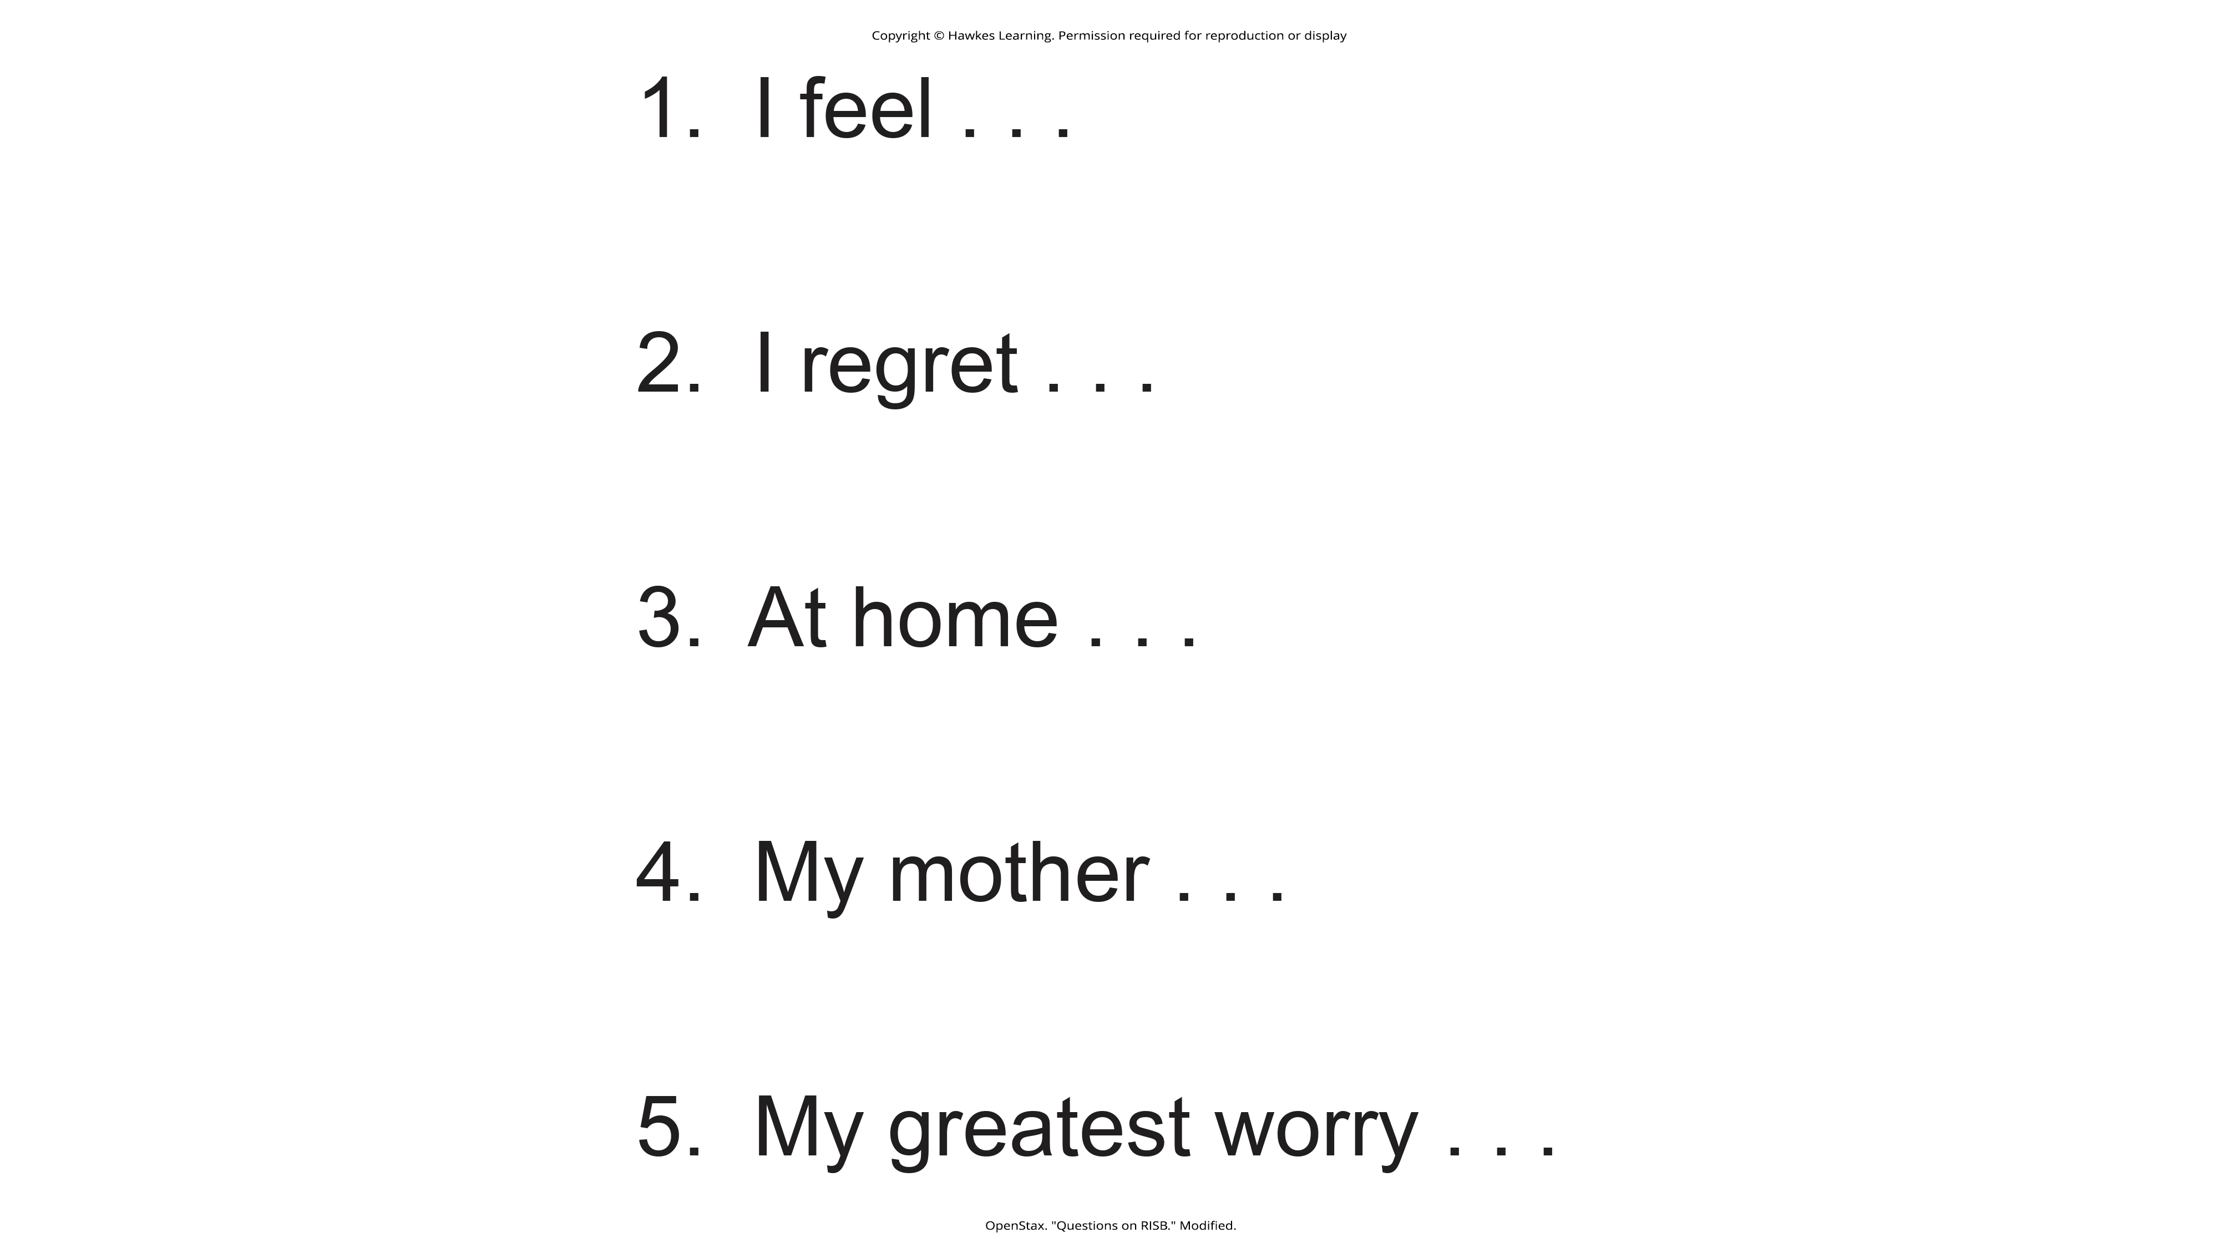
Lesson 11.9 Figure 5
Caption: These incomplete sentences resemble the types of questions on the RISB. How would you complete these sentences?

Slide 16
Problems With Projective Tests
For many decades, these traditional projective tests have been used in cross-cultural personality assessments.
However, it was found that test bias limited their usefulness (Hoy-Watkins & Jenkins-Moore, 2008). It is difficult to assess the personalities and lifestyles of members of widely divergent ethnic/cultural groups using personality instruments based on data from a single culture or race (Hoy-Watkins & Jenkins-Moore, 2008).

Slide 17
Contemporized-Themes Concerning Blacks Test (C-TCB)
Robert Williams developed the first culturally specific projective test designed to reflect the everyday life experiences of Black Americans (Hoy-Watkins & Jenkins-Moore, 2008).
  The C-TCB contains 20 color images that show scenes of Black American lifestyles.
  When the C-TCB was compared with the TAT or Black Americans, it was found that use of the C-TCB led to increased story length, higher degrees of positive feelings, and stronger identification with the C-TCB (Hoy, 1997; Hoy-Watkins & Jenkins-Moore, 2008).

Slide 18
TEMAS Multicultural Thematic Apperception Test
Designed to be culturally relevant to minority groups, especially Hispanic youths (Costantino et al., 2014).
  TEMAS —standing for "Tell Me a Story" but also a play on the Spanish word temas (themes)—uses images and storytelling cues that relate to minority culture (Costantino, 1982).

Slide 19
On Your Own
Based on what you know about psychological assessments, which test do you think has the highest reliability?
Rorschach Inkblot Test
Thematic Apperception Test
MMPI-2

Slide 20
Summary
Personality tests are techniques designed to measure one's personality.
  They are used to diagnose psychological problems as well as to screen candidates for college and employment.
There are two types of personality tests: self-report inventories and projective tests.
  The MMPI is one of the most common self-report inventories. It asks a series of true/false questions that are designed to provide a clinical profile of an individual.
  Projective tests use ambiguous images or other ambiguous stimuli to assess an individual's unconscious fears, desires, and challenges.
    The Rorschach Inkblot Test, the TAT, the RISB, and the C-TCB are all forms of projective tests.

Slide 21
End of Hawkes Learning PowerPoint

