Slide 1
Lesson 12.1
What is Social Psychology?

Slide 2

Social Psychology₁
Social psychologists assert that an individual's thoughts, feelings, and behaviors are influenced by social situations.
Social psychology: field of psychology that examines how people impact or affect each other, with particular focus on the power of the situation
Intrapersonal topics (those that pertain to the individual)
Include emotions and attitudes, the self, and social cognition (the ways in which we think about ourselves and others)
Interpersonal topics (those that pertain to couples and groups)
Include helping behavior (Figure 2), aggression, prejudice and discrimination, attraction and close relationships, and group processes and intergroup relationships.
Figure 2

Slide 3
Social Psychology₂
Social psychologists focus on how people construe or interpret situations and how these interpretations influence their thoughts, feelings, and behaviors (Ross & Nisbett, 1991).
Social psychology studies individuals in a social context and how situational variables interact to influence behavior.
Behavior is a product of both the situation (e.g., cultural influences, social roles, and the presence of bystanders) and the person (e.g., personality characteristics).

Slide 4
Situationism
Social psychologists have tended to take the situationist perspective
Situationism: describes a perspective that behavior and actions are determined by the immediate environment and surroundings

Slide 5
Dispositionism
Personality psychologists have promoted the dispositionist perspective.
Dispositionism: asserts that our behavior is determined by internal factors, such as personality traits and temperament

Slide 6
Internal Factor
Internal factor: internal attribute of a person, such as personality traits or temperament

Slide 7
Fundamental Attribution Error₁
In individualist cultures, the predominant view tends to favor a dispositional approach in explaining human behavior.
We tend to think that people are in control of their own behavior.
Therefore, any behavior change must be due to something internal, such as their personality, habits, or temperament.
People tend to assume that the behavior of another person is a trait of that person and underestimate the power of the situation on the behavior of others.
Fundamental attribution error: tendency to overemphasize internal factors as attributions for behavior and underestimate the power of the situation

Slide 8
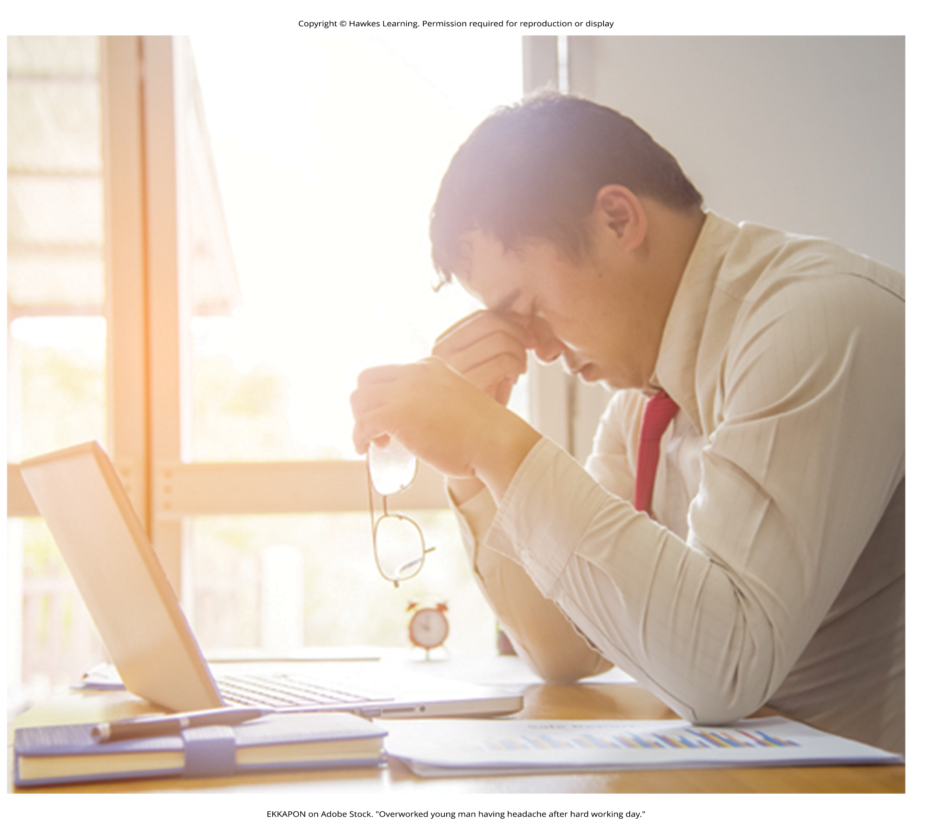
Fundamental Attribution Error Scenario
Alec returns home from work, and upon opening the front door, his spouse happily greets him and inquires about his day. Instead of greeting his spouse, Alec yells at them, "Leave me alone!"
The most common response is that Alec is a mean, angry, or unfriendly person (his traits).
This is an internal or dispositional explanation.
However, imagine that Alec was just laid off from his job due to company downsizing.
Would your explanation for Alec's behavior change?
Your revised explanation might be that Alec was frustrated and disappointed about losing his job; therefore, he was in a bad mood (his state).
This is an external or situational explanation for Alec's behavior.
Figure 3

Slide 9
Reflection Question
Why do you think that most Americans tend to take a dispositional approach? What values or historical developments might contribute to this cultural norm?

Slide 10
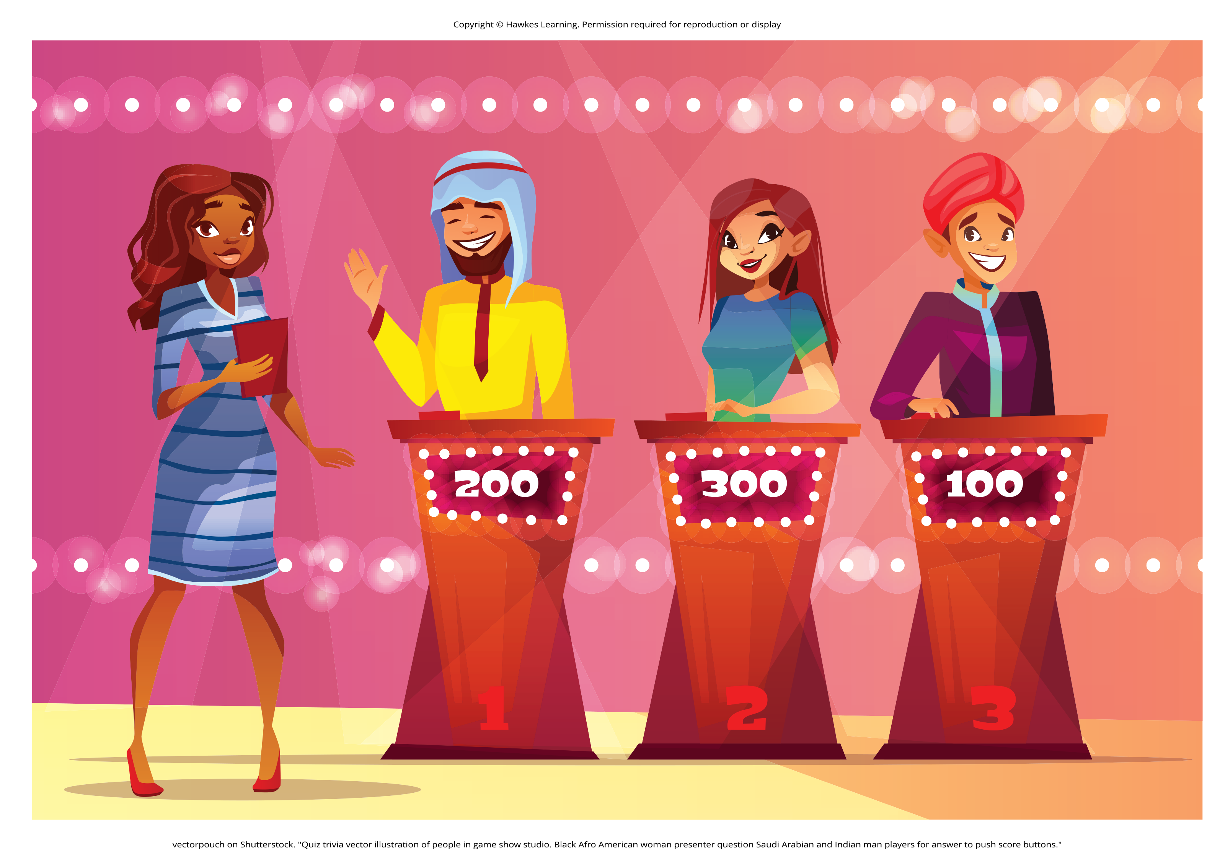
Fundamental Attribution Error₂
Fundamental attribution error leads people to overlook situational influences on behavior.
In quizmaster study, questioners had advantage by writing difficult questions they knew answers to.
Contestants only answered 4 out of 10 questions correctly.
Contestants rated questioners as more intelligent than themselves.
Observers also rated questioners as having more general knowledge than contestants.
Figure 4

Slide 11
Individualistic Culture
People from an individualistic culture have the greatest tendency to commit the fundamental attribution error (Dean & Koenig, 2019).
Individualistic culture: culture that focuses on individual achievement and autonomy
Individualistic cultures are found in western countries, such as the United States, Canada, and the United Kingdom.

Slide 12
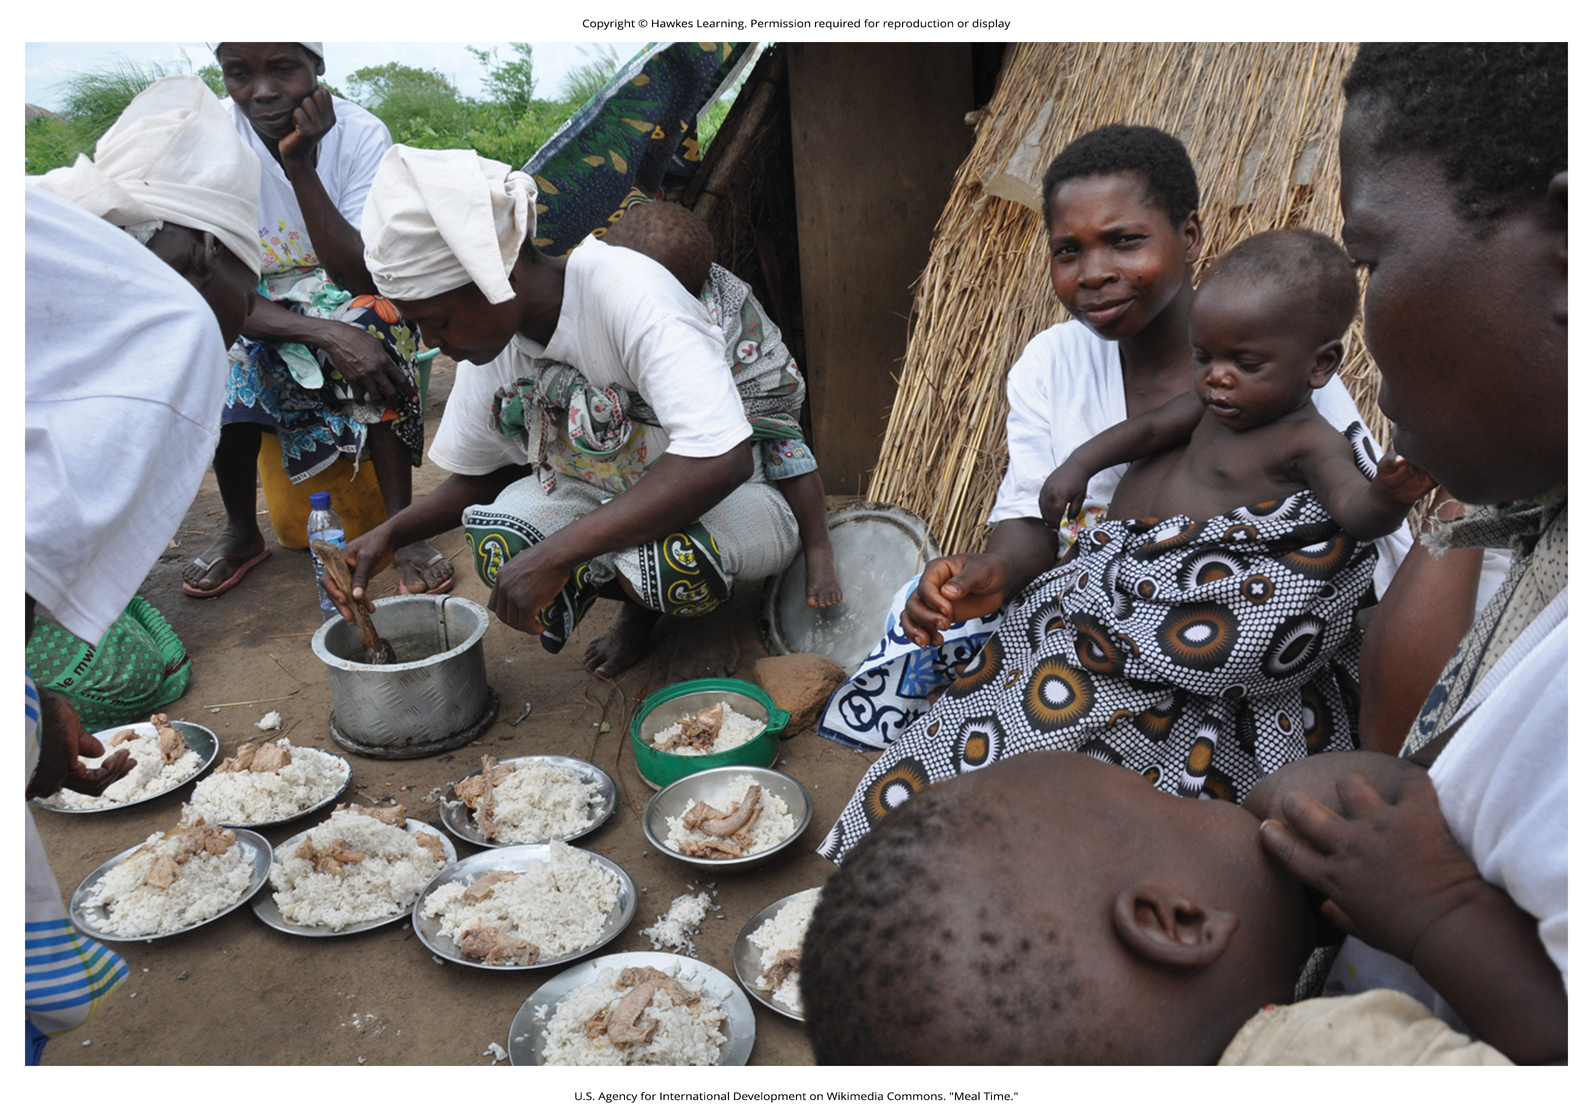
Collectivistic Culture
Collectivistic cultures tend to be found in east Asian countries and in Latin American and African countries.
Collectivist culture: culture that focuses on communal relationships with others such as family, friends, and community
Figure 5

Slide 13

Actor-Observer Bias
When it comes to explaining our own behaviors, however, we have much more information available to us.
The actor-observer bias is the phenomenon of attributing other people's behavior to internal factors (fundamental attribution error) while attributing our own behavior to situational forces (Jones & Nisbett 1971; Nisbett et al., 1973; Choi & Nisbett, 1998).
As actors of behavior, we have more information available to explain our own behavior.
However, as observers, we have less information available; therefore, we tend to default to a dispositionist perspective.
Figure 6

Slide 14
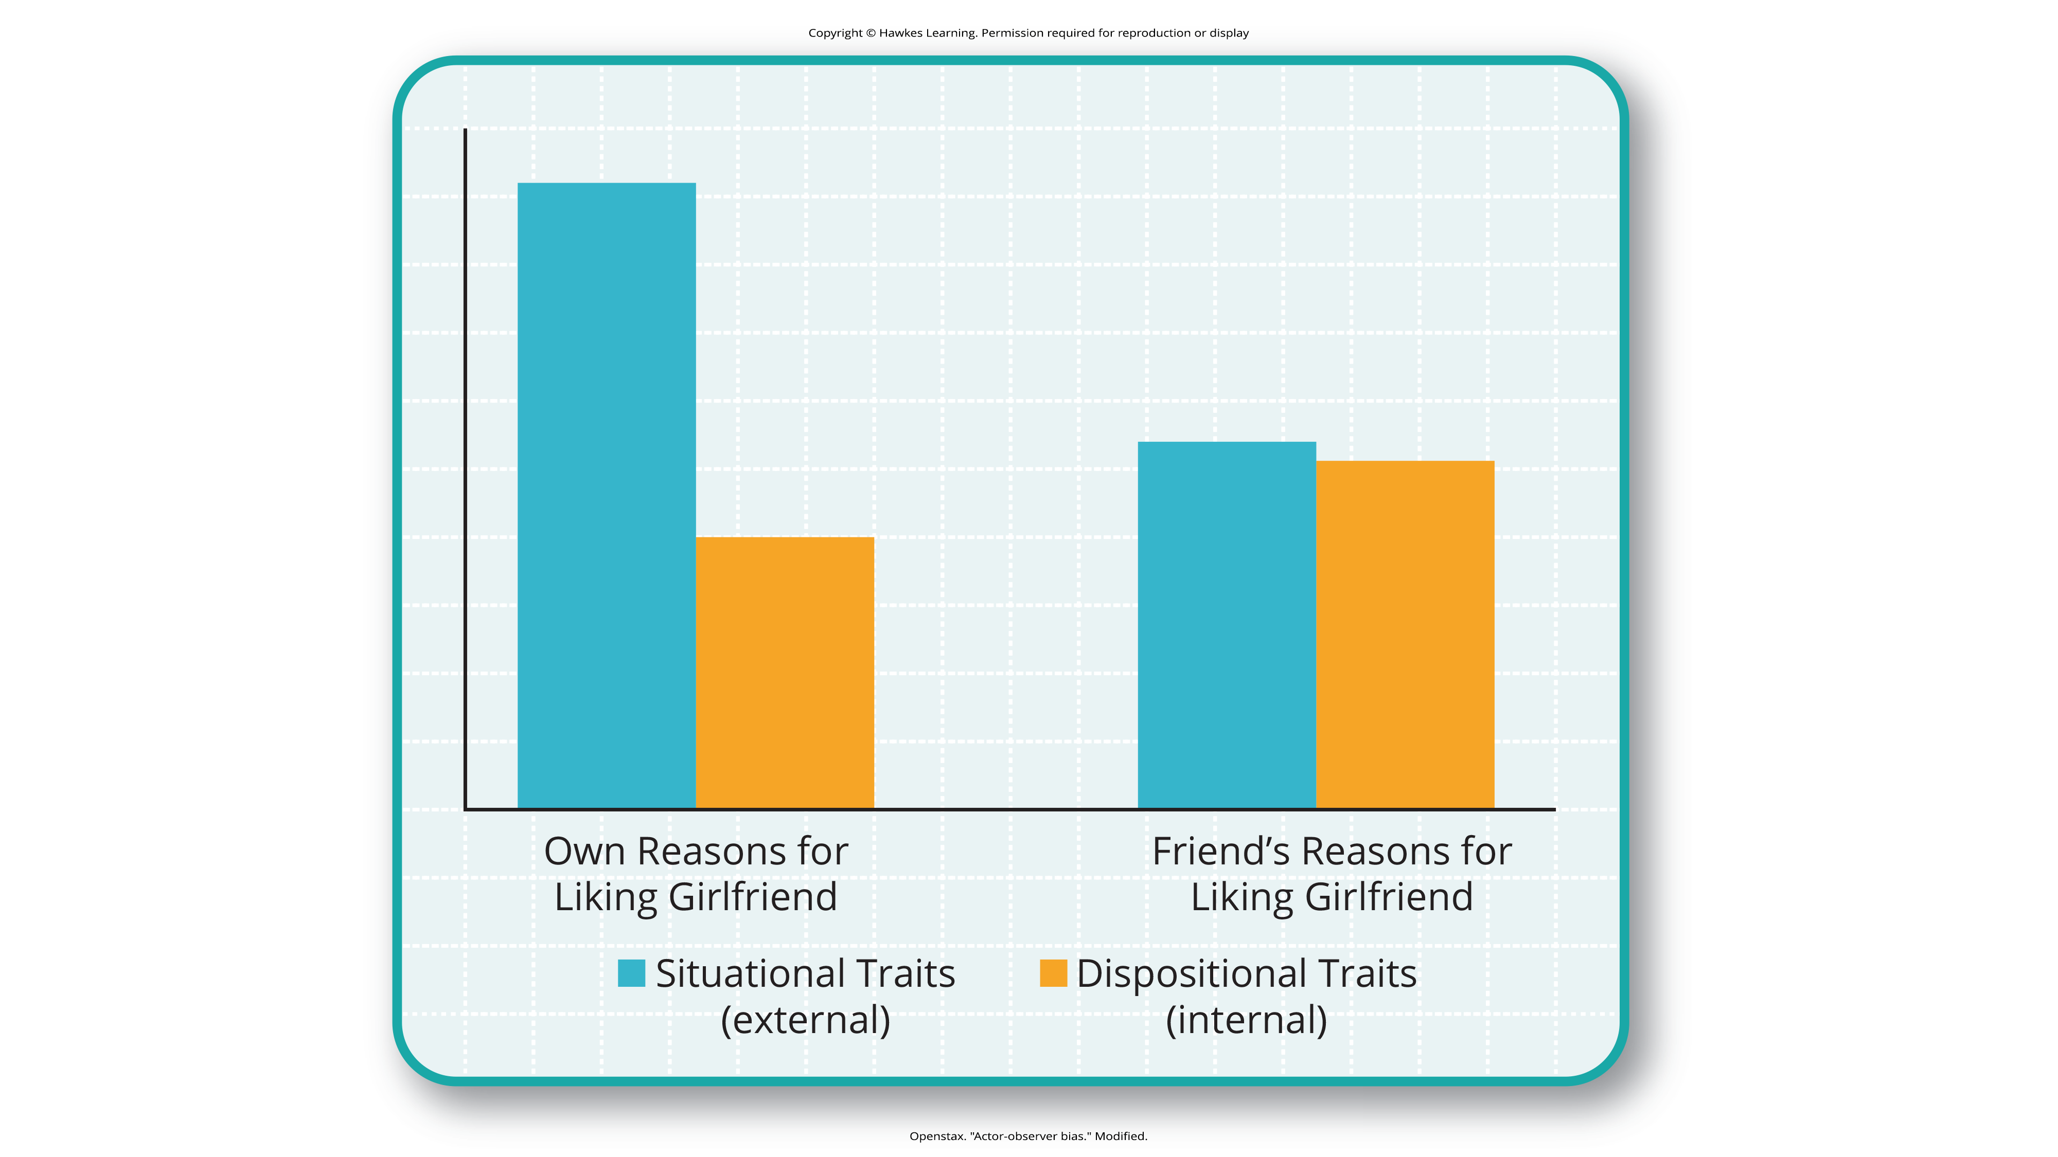
Lesson 12.1 Figure 7
Caption: Actor-observer bias is evident when subjects explain their own reasons for liking a girlfriend versus their impressions of others' reasons for liking a girlfriend.

Slide 15
On Your Own
What are the similarities and differences between actor-observer bias and the fundamental attribution error?

Slide 16

Self-Serving Bias
A self-serving bias is an attribution that enables us to see ourselves in favorable light
Example: making internal attributions for success and external attributions for failures
The tendency of an individual to take credit by making dispositional or internal attributions for positive outcomes but situational or external attributions for negative outcomes is known as the self-serving bias (Miller & Ross, 1975).
This bias serves to protect self-esteem.
Figure 8

Slide 17
Group Activity
Jot down a list of your personal strengths and your perceived weaknesses.
Now, tally up the number of strengths and weaknesses in your respective lists.
Then, as a group or class, list examples of strengths and weaknesses and write them down in a central location.
Examine the list of "weaknesses." How many are truly negative or are less serious or "self problems" ("Well, I sometimes work too hard and expect too much of myself.")? How might this reflect a self-serving bias?

Slide 18
Attribution
Attribution refers to a belief about the cause of a result.
One model of attribution proposes three main dimensions:
Locus of control (internal versus external)
Stability (stable versus unstable)
Controllability (controllable versus uncontrollable)
Stability refers to the extent to which the circumstances that result in a given outcome are changeable.
The circumstances are considered stable if they are unlikely to change.
Controllability refers to the extent to which the circumstances that are associated with a given outcome can be controlled.

Slide 19
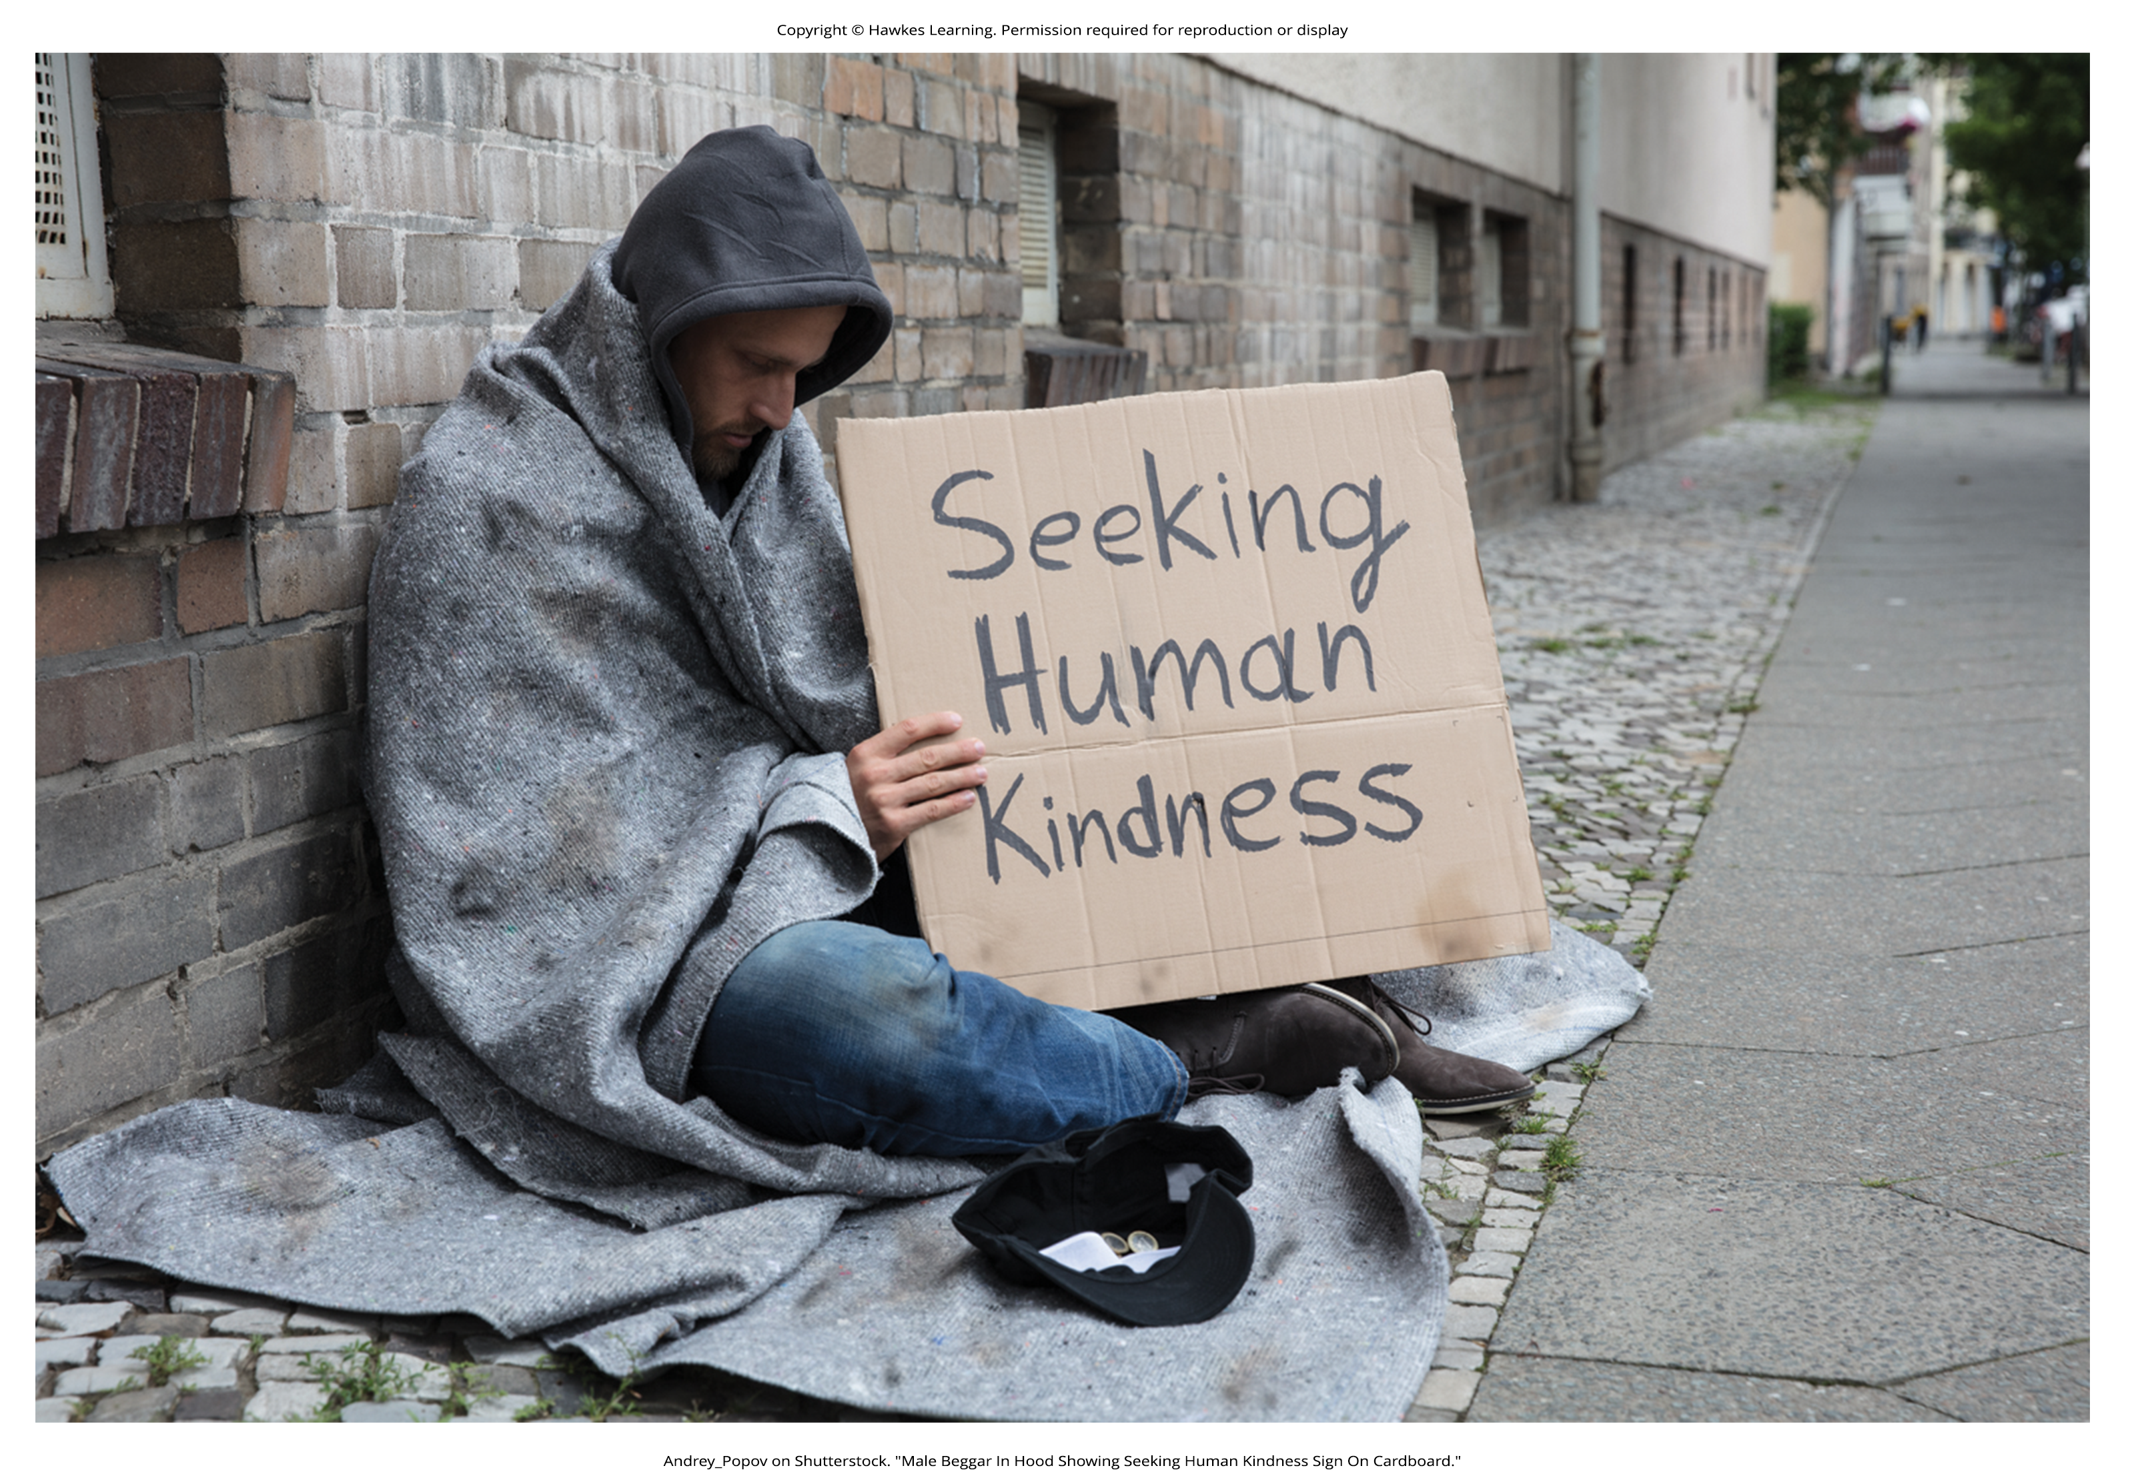
Just-World Hypothesis₁
The just-world hypothesis is the belief that people get the outcomes they deserve (Lerner & Miller, 1978).
People tend to think that good people experience positive outcomes, and bad people experience negative outcomes (Jost et al., 2004; Jost & Major, 2001).
Example: If you want to experience positive outcomes, you just need to work hard to get ahead in life.
Figure 9

Slide 20
Summary
Social psychology is the subfield of psychology that studies the power of the situation to influence individuals' thoughts, feelings, and behaviors.
Psychologists categorize the causes of human behavior as those due to internal factors, such as personality, or those due to external factors, such as cultural and other social influences.
Behavior is better explained, however, by using both approaches. People tend to over-rely on dispositional explanations for behavior and ignore the power of situational influences, a perspective called the fundamental attribution error.
People from individualistic cultures are more likely to display this bias versus people from collectivistic cultures.
Our explanations for our own and others' behaviors can be biased due to not having enough information about others' motivations for behaviors and by providing explanations that bolster our self-esteem.

Slide 21
End of Hawkes Learning PowerPoint

