Slide 1
Lesson 12.2
Self-Presentation

Slide 2
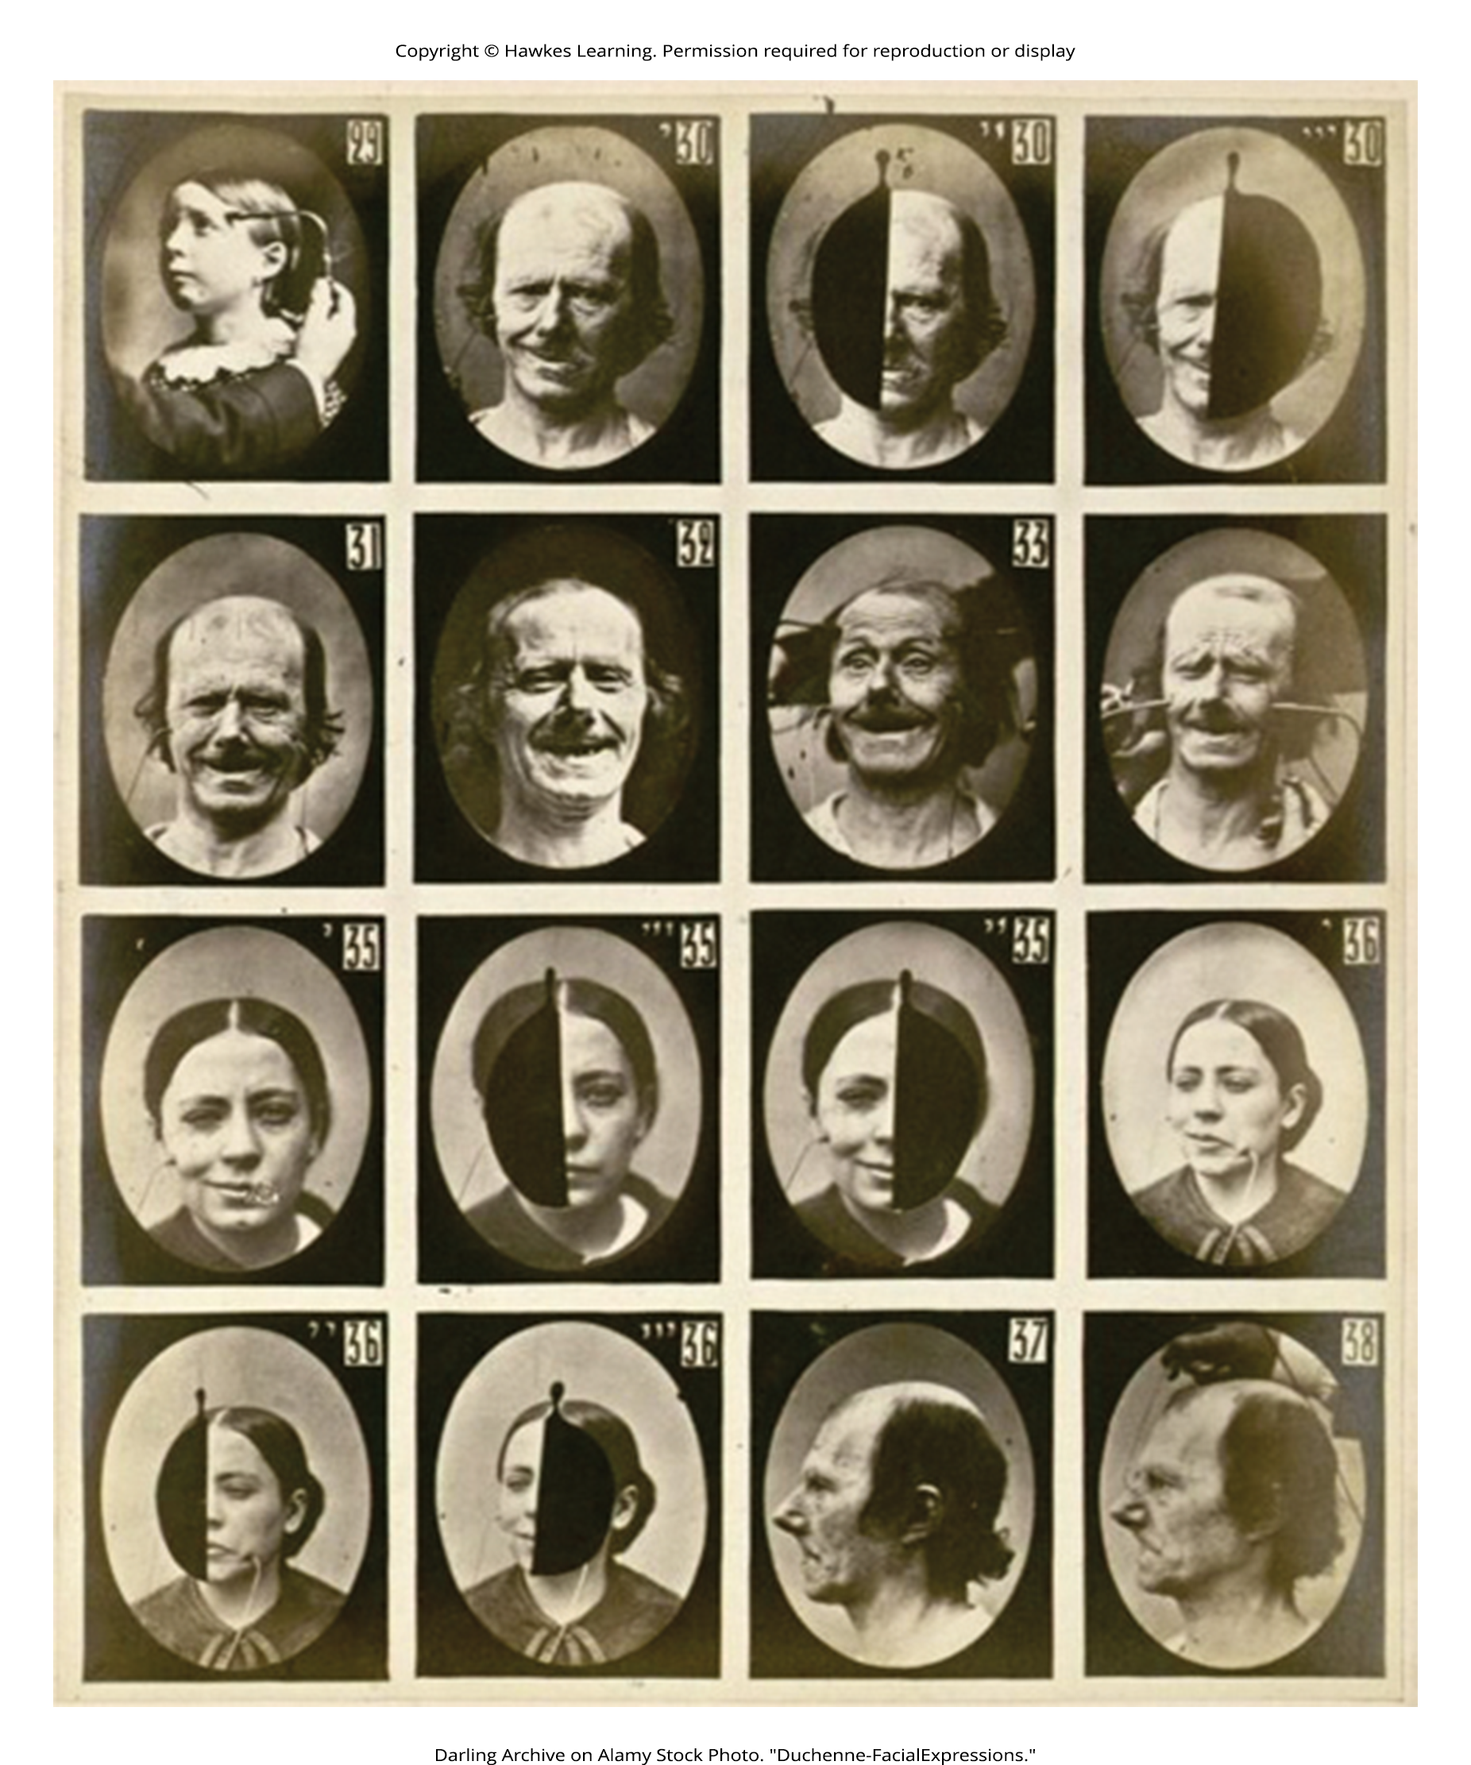
Self-Presentation
Social psychology is the study of how people affect one another's thoughts, feelings, and behaviors.
Situational forces have a strong influence on human behavior including social roles, social norms, and scripts.
Humans use the social environment as a source of information, or as cues, on how to behave.
Figure 1

Slide 3
On Your Own₁
Describe how you might react in each of the following situations.
You arrive to a new class and don't know anyone. All of your peers are quiet, and most are on their phones or flipping through books.
The woman next to you at a coffee shop is sitting alone, and she suddenly begins choking.
You want to walk across the street even though there is a red light. There is a large crowd next to you waiting for the light to change.

Slide 4

Social Roles₁
A social role is a pattern of behavior that is expected of a person in a given setting or group (Hare, 2003).
Each one of us has several social roles.
A student/ a parent/ an aspiring teacher/ a son or daughter/ a spouse and a lifeguard.
Social roles are defined by culturally shared knowledge.
Nearly everyone in a given culture knows what behavior is expected of a person in a given role.
Figure 2

Slide 5
Social Roles₂
Social roles, and our related behaviors, can vary across different settings.
How do you behave when you are engaging in the role of son or daughter and attending a family function?
How do you behave when you are engaged in the role of employee at your workplace? It is very likely that your behavior will be different.

Slide 6

On Your Own₂
Examine the following photo and consider what social roles seem to be present here. Underneath the photo, record any common social behaviors you observe based on these roles.
Figure 3

Slide 7
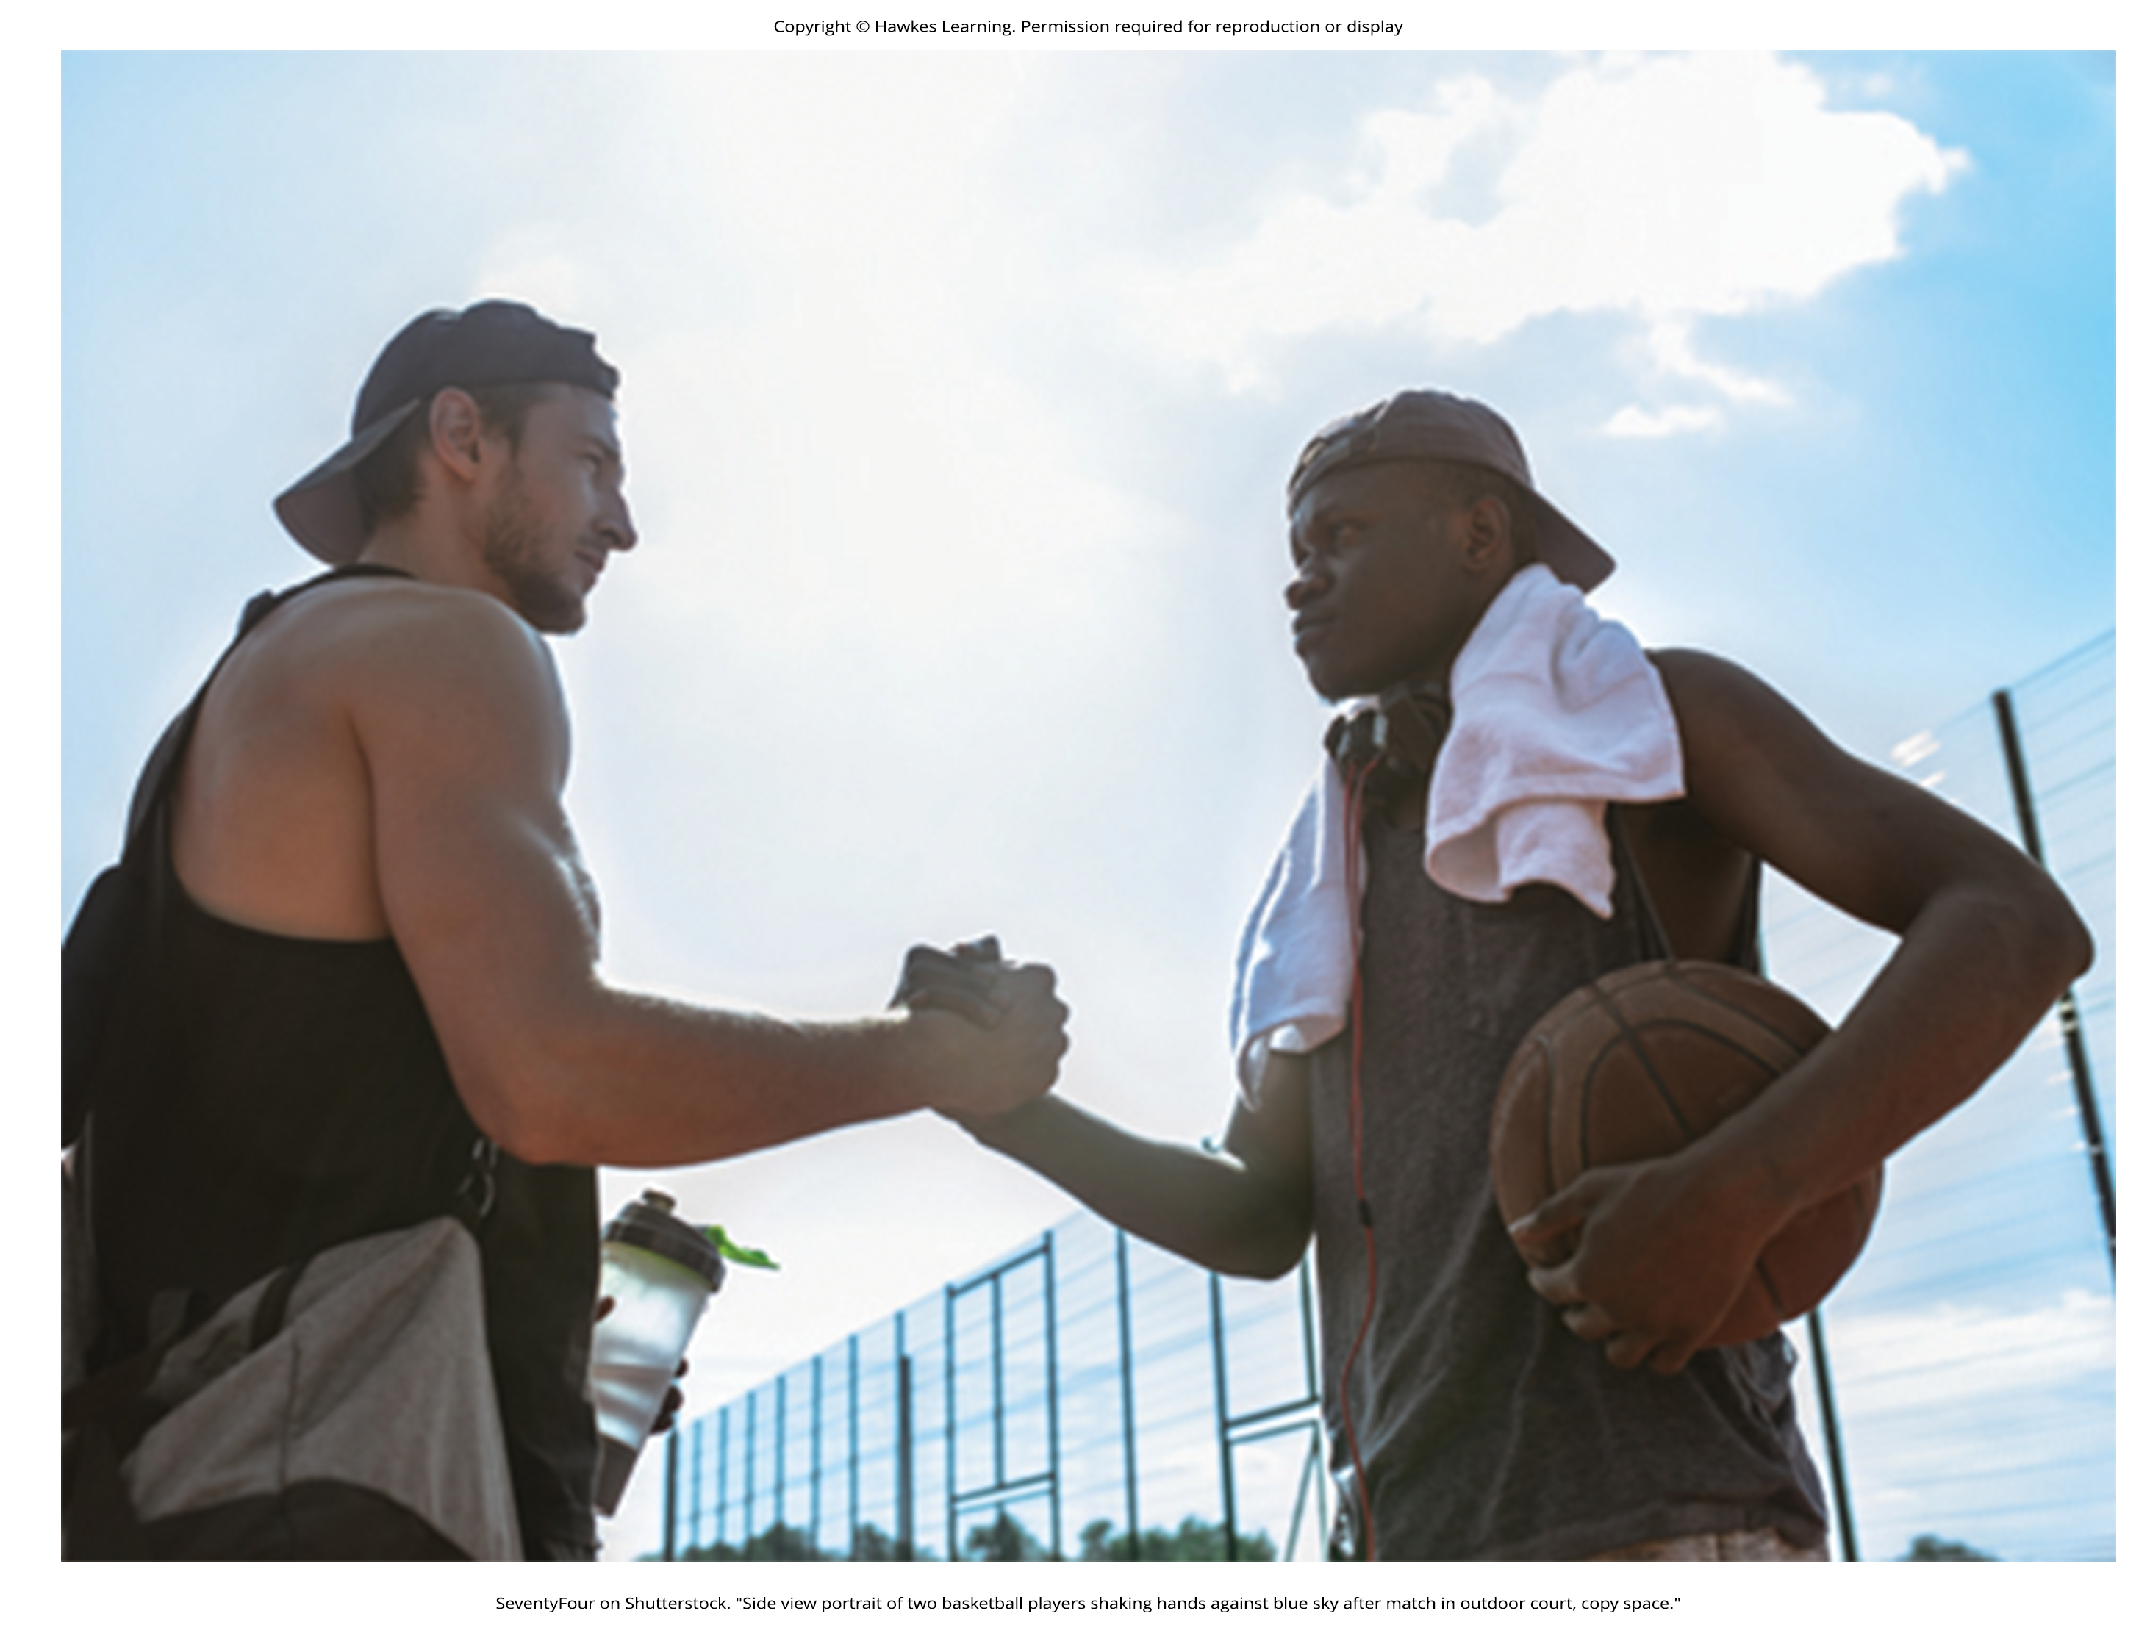
Social Norms
A social norm is a group's expectation of what is appropriate and acceptable behavior for its members—how they are supposed to behave and think (Deutsch & Gerard, 1955; Berkowitz, 2004).
How are we expected to act?
What are we expected to talk about?
What are we expected to wear?
Social norms are everywhere including in families, gangs, and on social media outlets.
Figure 4

Slide 8
Reflection Question₁
What are some social norms when using Snapchat? How do people react when these norms are not followed?

Slide 9
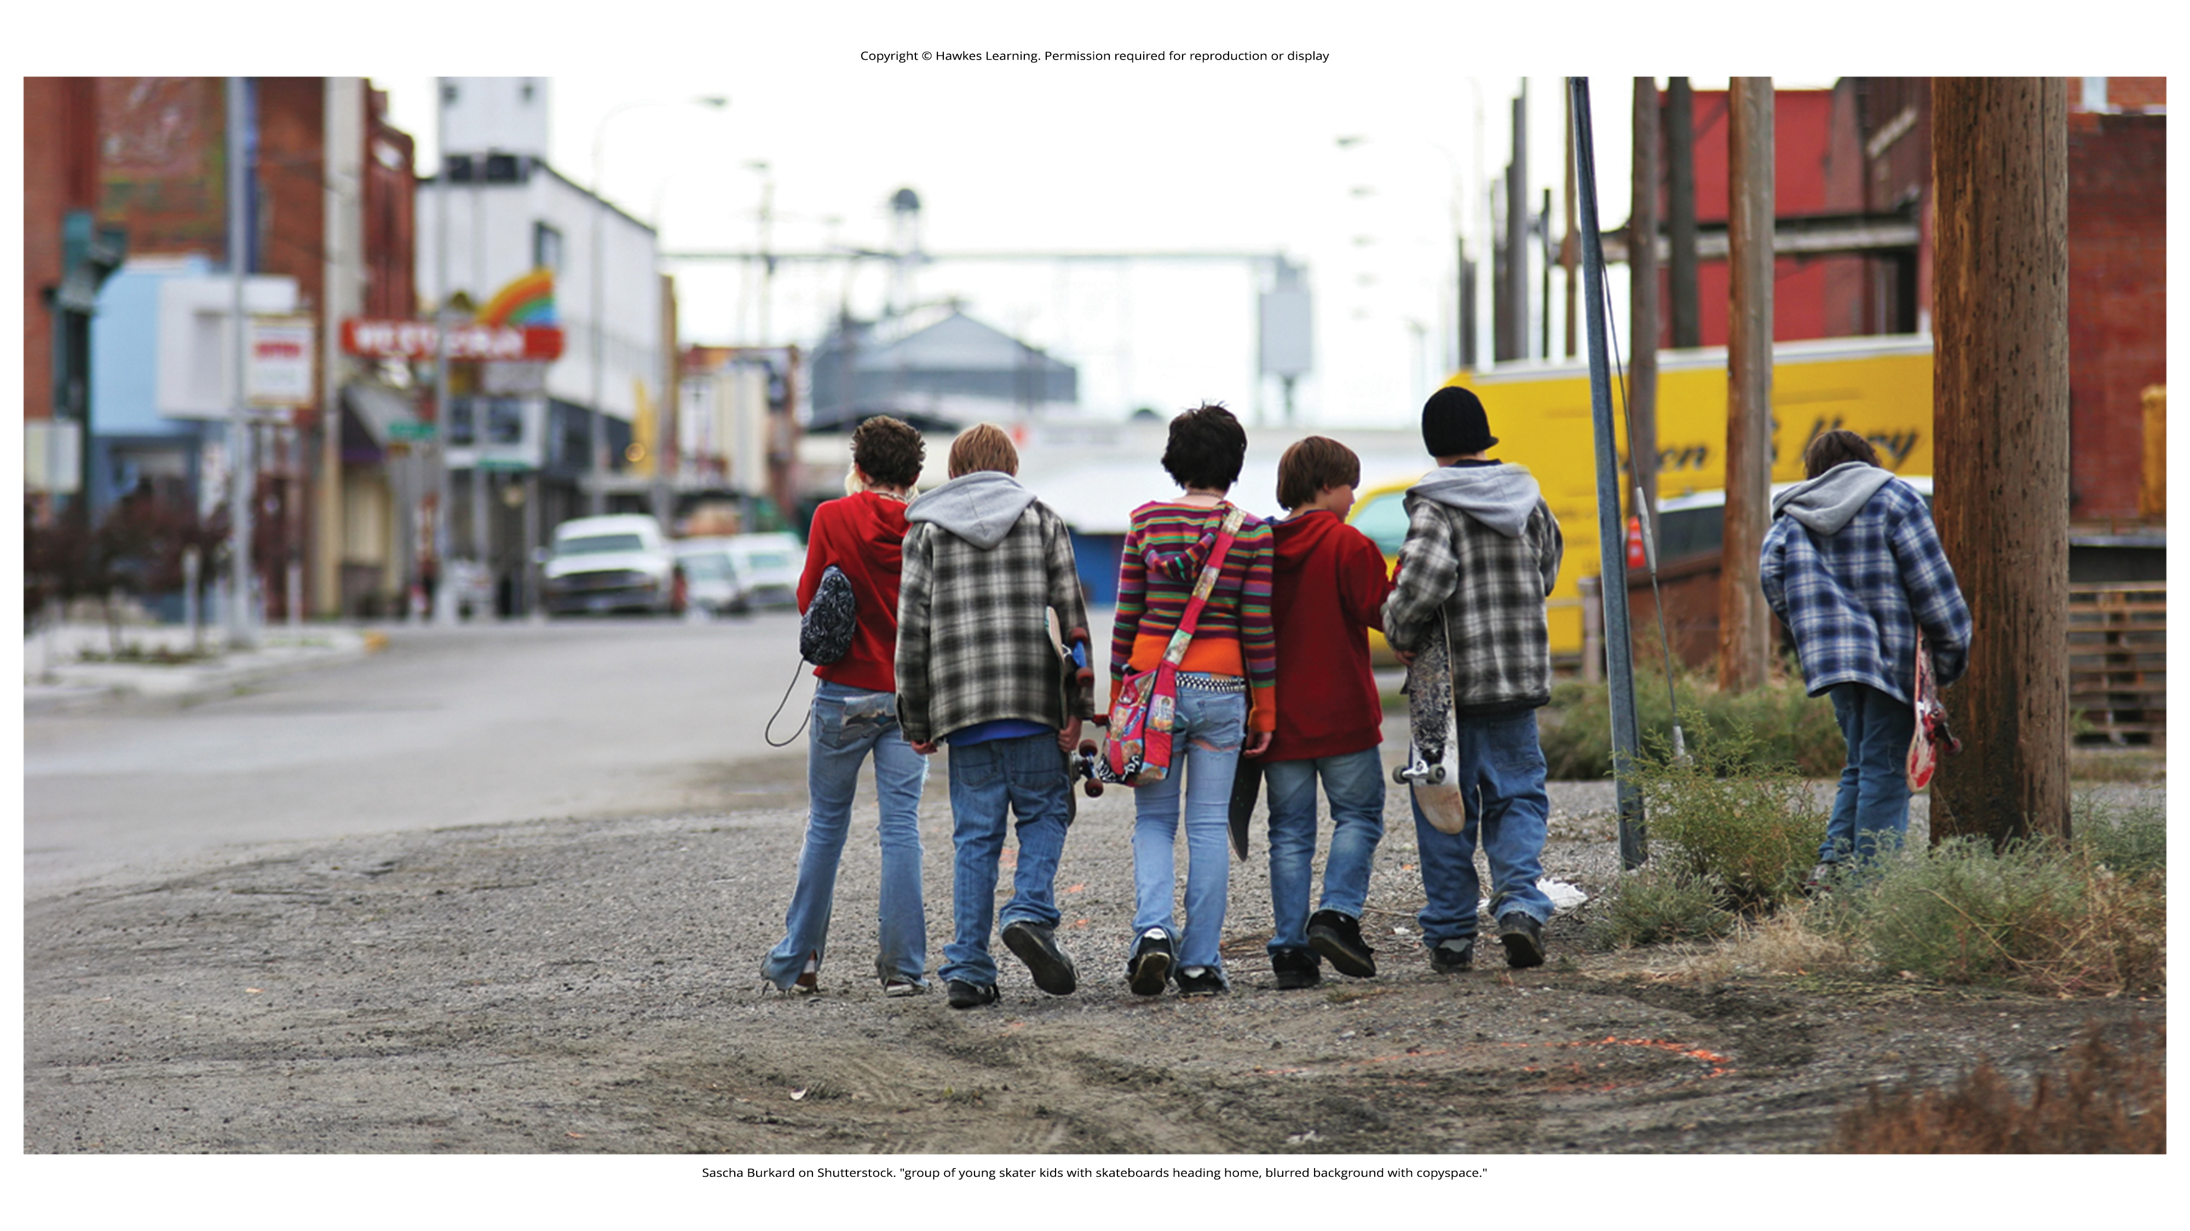
Connect the Concepts: Tweens, Teens, And Social Norms
How can a label or name brand make someone feel happier?
Think back to what you've learned about lifespan development.
What is it about preteens and young teens that make them want to fit in (Figure 5)?
Does this change over time?
Think back to your high school experience, or look around your college campus.
How do you notice people branding themselves?
What messages do we get from the media about how to fit in?
Figure 5

Slide 10
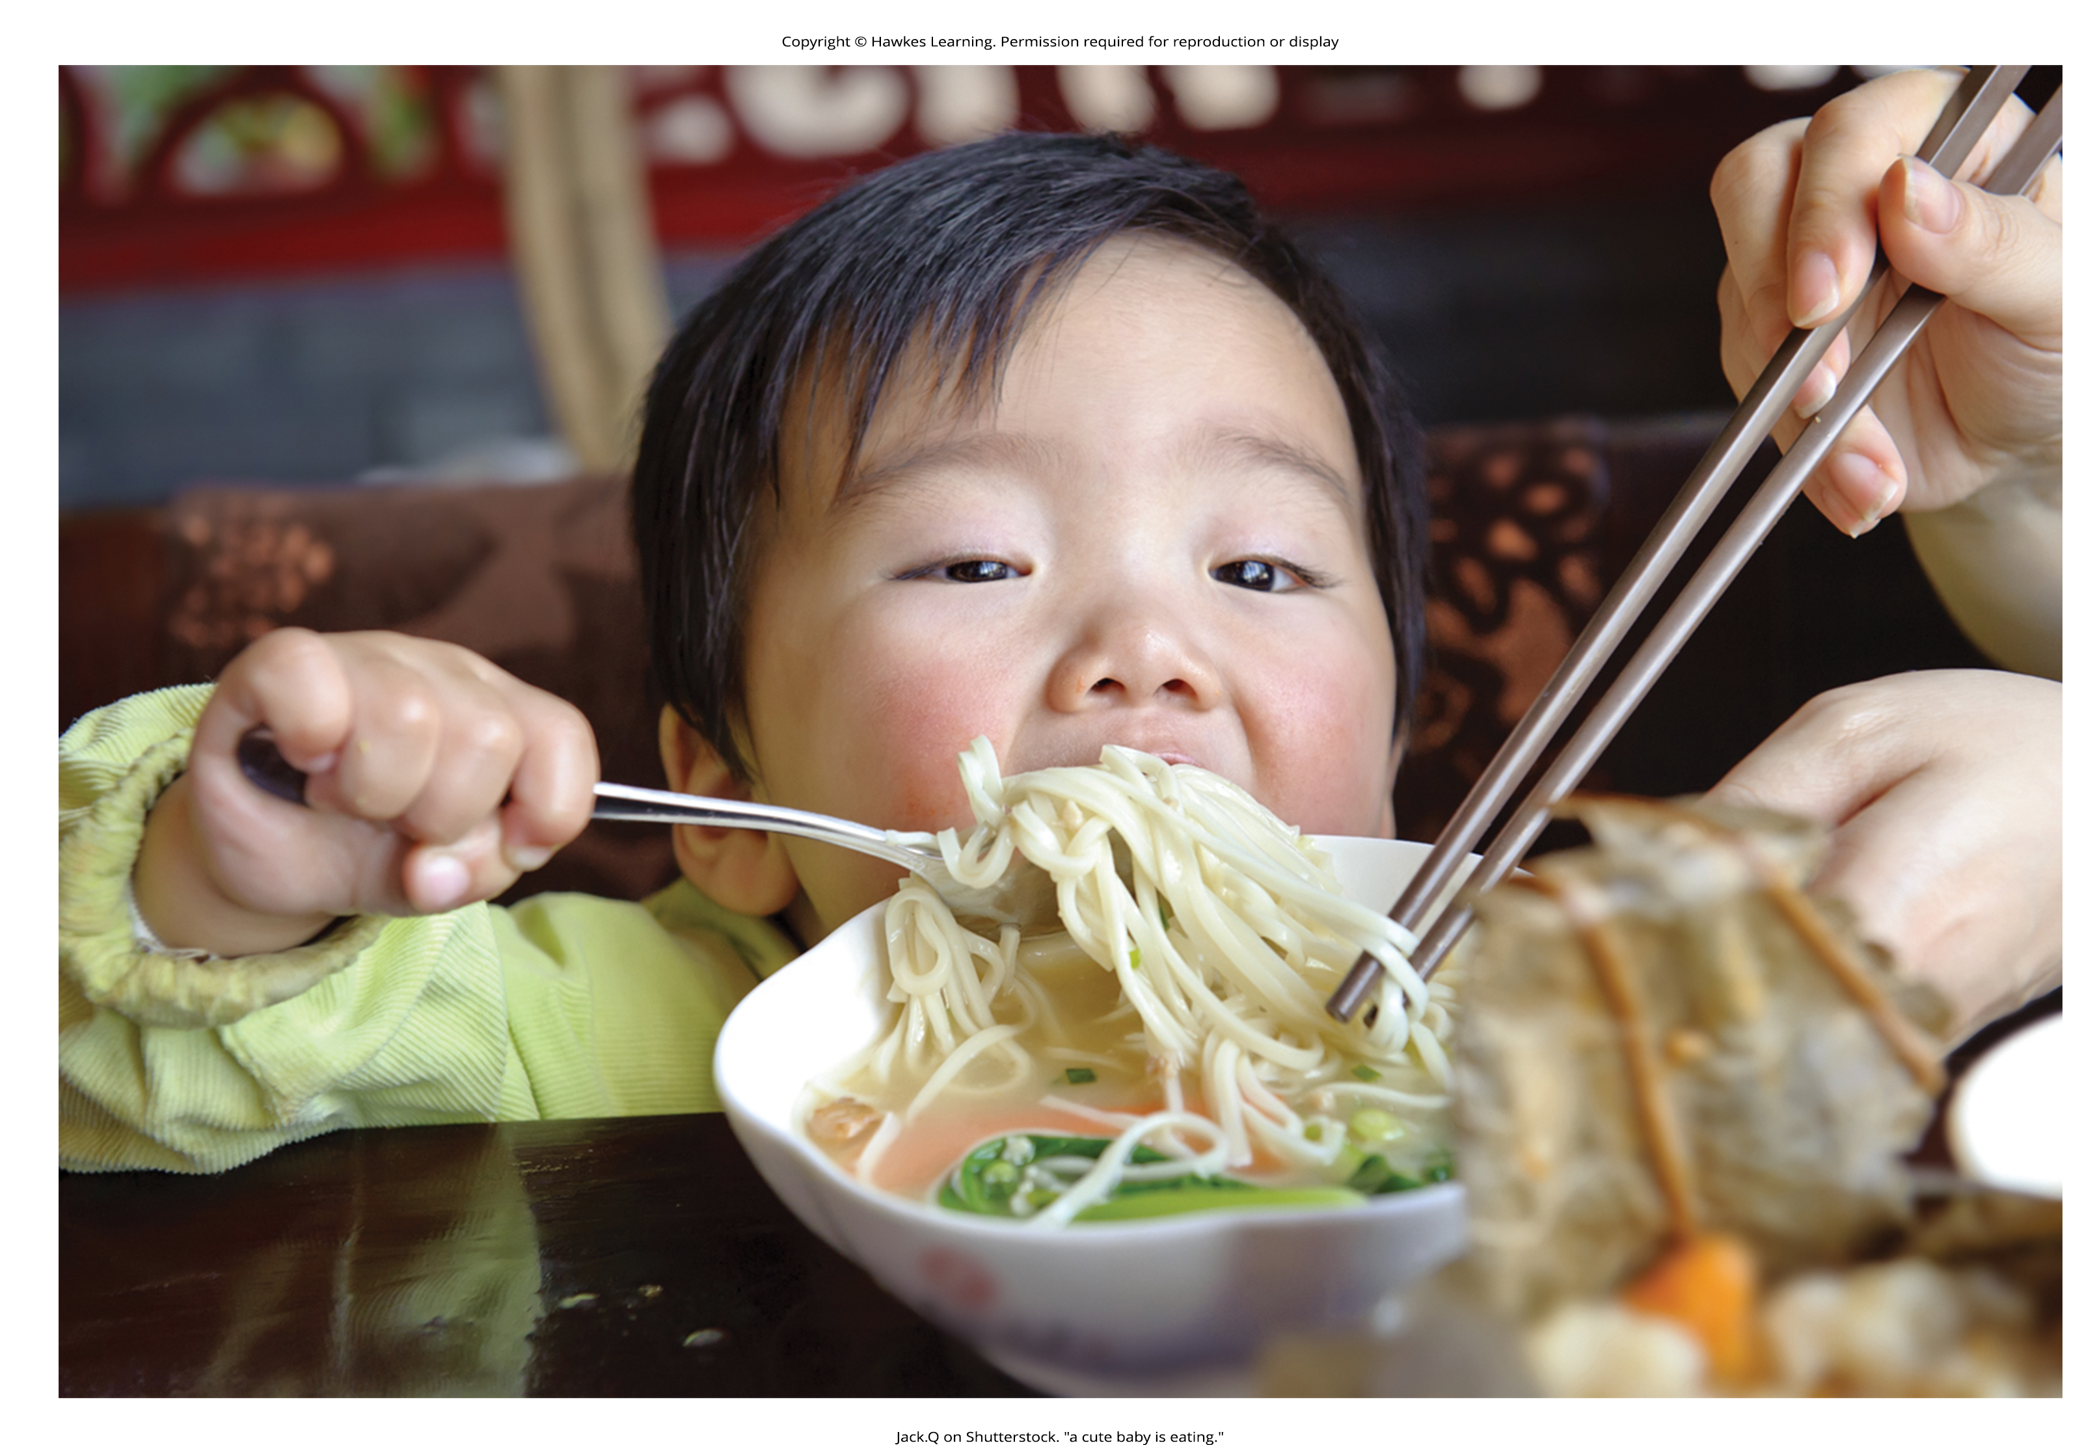
Scripts
A script is a person's knowledge about the sequence of events expected in a specific setting (Schank & Abelson, 1977).
There are cultural differences in scripts.
Scripts are important sources of information to guide behavior in given situations.
Figure 6

Slide 11
Zimbardo's Stanford Prison Experiment₁
The famous Stanford prison experiment was conducted by social psychologist Philip Zimbardo and his colleagues at Stanford University.
It demonstrated the power of social roles, social norms, and scripts.
In the summer of 1971, an advertisement was placed in a California newspaper asking for male volunteers to participate in a study about the psychological effects of prison life.
The volunteers underwent psychological testing.
24 healthy male college students were selected.
A mock prison was constructed in the basement of the psychology building at Stanford.

Slide 12
Group Activity
As a group, discuss what you've learned about research methods. Based on this, why do you think it is important that these participants were randomly assigned?

Slide 13
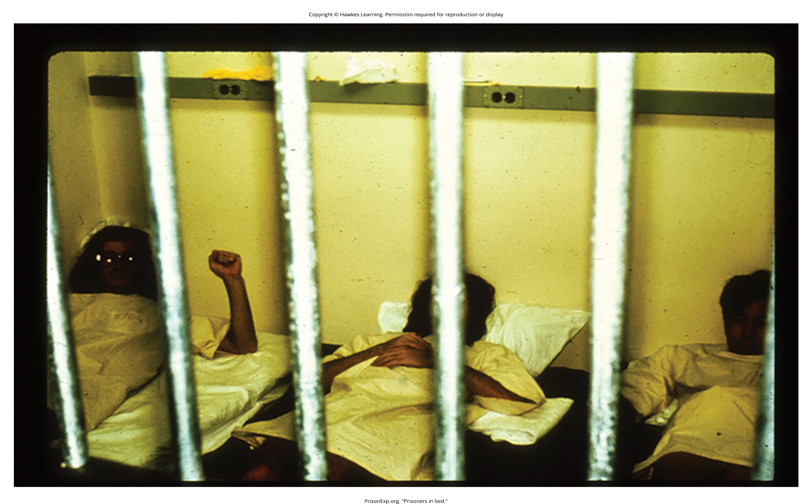
Zimbardo's Stanford Prison Experiment₂
Participants assigned to play the role of prisoners were "arrested" at their homes and taken to the mock prison.
The experiment was scheduled to run for several weeks.
To the surprise of the researchers, both the "prisoners" and "guards" assumed their roles with zeal.
On day two, some of the prisoners revolted, and the guards quelled the rebellion by threatening the prisoners with night sticks.
The guards came to harass the prisoners in an increasingly sadistic manner through a complete lack of privacy, lack of basic comforts (such as mattresses to sleep on), and degrading chores and late-night counts.
The prisoners began to show signs of severe anxiety and hopelessness.
After only 6 days, the experiment had to be ended due to the participants' deteriorating behavior.
Figure 7

Slide 14
Reflection Question₂
What is your reaction to this experiment? Why do you think both the prisoners and the guards were so quick to adapt to their roles? What does this suggest about the ways in which human beings rise to, and fall from, power?

Slide 15
Zimbardo's Stanford Prison Experiment₃
The behaviors displayed by both the guards and the prisoners sparked interest for many years.
The Stanford prison experiment demonstrated the power of social roles, norms, and scripts in affecting human behavior.
The guards and prisoners enacted their social roles by engaging in behaviors appropriate to the role.
According to Zimbardo, none of the participants suffered long-term harm (Alexander, 2001).

Slide 16
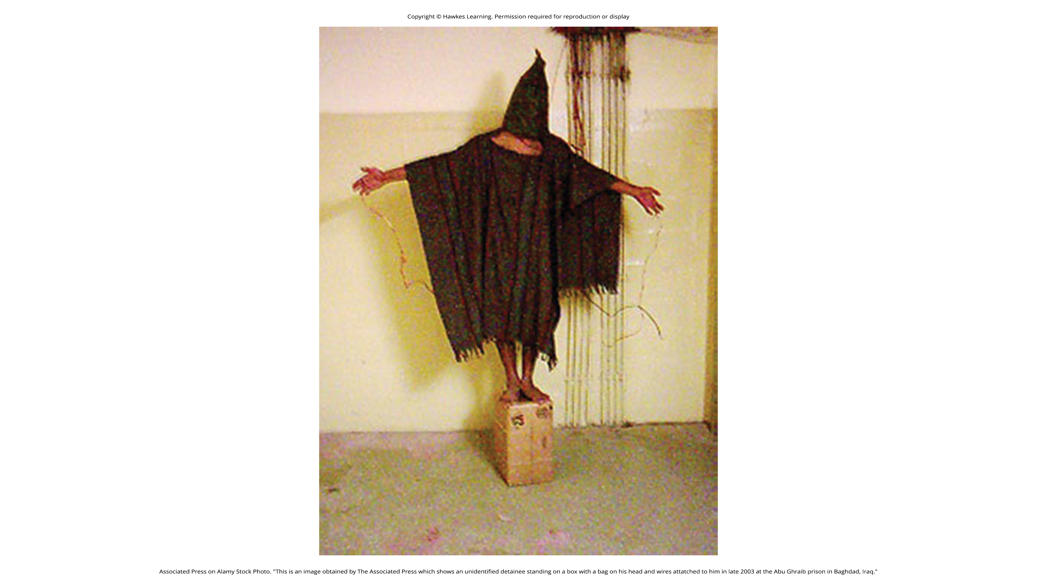
Zimbardo's Stanford Prison Experiment₄
The Stanford Prison Experiment has some parallels with the abuse of prisoners of war by U.S. Army troops and CIA personnel at the Abu Ghraib prison in 2003 and 2004.
The offenses at Abu Ghraib were documented by photographs of the abuse, some taken by the abusers themselves (Figure 8).
Figure 8

Slide 17
Summary
Human behavior is largely influenced by our social roles, norms, and scripts.
Social norms dictate the behavior that is appropriate or inappropriate for each role.
Each social role has scripts that help humans learn the sequence of appropriate behaviors in a given setting.
The famous Stanford prison experiment is an example of how the power of the situation can dictate the social roles, norms, and scripts we follow in a given situation.

Slide 18
End of Hawkes Learning PowerPoint

