Slide 1
Lesson 12.3
Attitudes and Persuasion

Slide 2

Attitude₁
Attitude is our evaluation of a person, an idea, or an object. We have attitudes for many things ranging from products that we might pick up in the supermarket to important social issues.
Typically, attitudes are favorable or unfavorable: positive or negative (Eagly & Chaiken, 1993).
Attitudes have three components:
An affective component (feelings)
A behavioral component (the effect of the attitude on behavior)
A cognitive component (belief and knowledge)
(Rosenberg & Hovland, 1960).
Figure 1

Slide 3
Attitude₂
Our attitudes and beliefs are influenced by external forces and internal influences that we control.
Our attitudes and thoughts are not always changed by situational pressures, but they can be consciously changed by our own free will.

Slide 4

Cognitive Dissonance₁
Our behavior, attitudes, and beliefs are affected when we experience a threat to our self-esteem or positive self-image.
Psychologist Leon Festinger (1957) defined cognitive dissonance as psychological discomfort arising from holding two or more inconsistent attitudes, behaviors, or cognitions (thoughts, beliefs, or opinions).
His theory of cognitive dissonance states that when we experience a conflict in our behaviors, attitudes, or beliefs that runs counter to our positive self-perceptions, we experience psychological discomfort (dissonance).
Figure 2

Slide 5
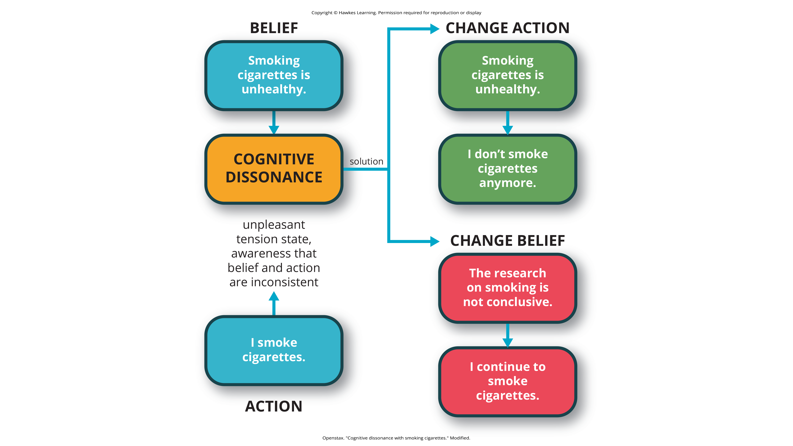
Lesson 12.3 Figure 3
Caption: Cognitive dissonance is aroused by inconsistent beliefs and behaviors. Believing cigarettes are bad for your health but smoking cigarettes anyway can cause cognitive dissonance. To reduce cognitive dissonance, individuals can change their behavior, as in quitting smoking, or change their belief, such as discounting the evidence that smoking is harmful.

Slide 6

Cognitive Dissonance₂
We can reduce cognitive dissonance by bringing our cognitions, attitudes, and behaviors in line—that is, making them harmonious.
This can be done in different ways, such as:
Changing our discrepant behavior (e.g., stop smoking)
Changing our cognitions through rationalization or denial (e.g., telling ourselves that health risks can be reduced by smoking filtered cigarettes)
Adding a new cognition (e.g., "Smoking suppresses my appetite, so I don't become overweight, which is good for my health.")
Figure 4

Slide 7
The Effect Of Initiation
A classic experiment by Aronson and Mills (1959) demonstrated this justification of effort effect.
College students volunteered to join a campus group that would meet regularly to discuss the psychology of sex.
Participants were randomly assigned to one of three conditions: no initiation, an easy initiation, and a difficult initiation into the group.
After participating in the first discussion, which was deliberately made very boring, participants rated how much they liked the group.
Participants who underwent a difficult initiation process to join the group rated the group more favorably than did participants with an easy initiation or no initiation (Figure 5).

Slide 8
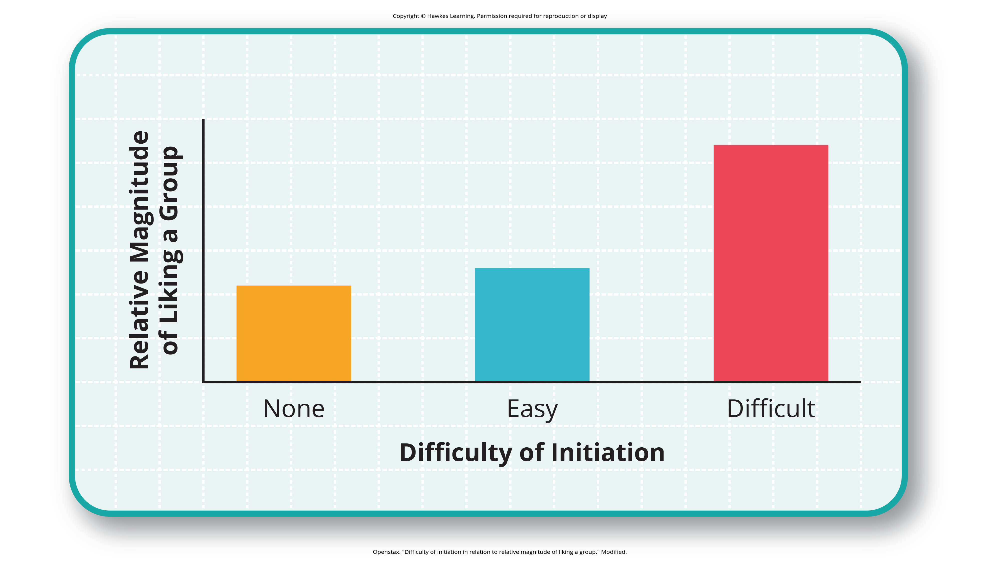
Lesson 12.3 Figure 5
Caption: Justification of effort has a distinct effect on a person liking a group. Students in the difficult initiation condition liked the group more than students in other conditions due to the justification of effort effect.

Slide 9
Reflection Question
There has been at least one hazing-related death in the U.S. every year since the early 1960s.
Research hazing deaths in the United States. Evaluate any one story and consider the following:
Why would an individual allow themselves to be hazed, even to the point of death?
How is hazing a form of cognitive dissonance?
What social groups utilize hazing (or other forms of cognitive dissonance) to increase group cohesion?

Slide 10
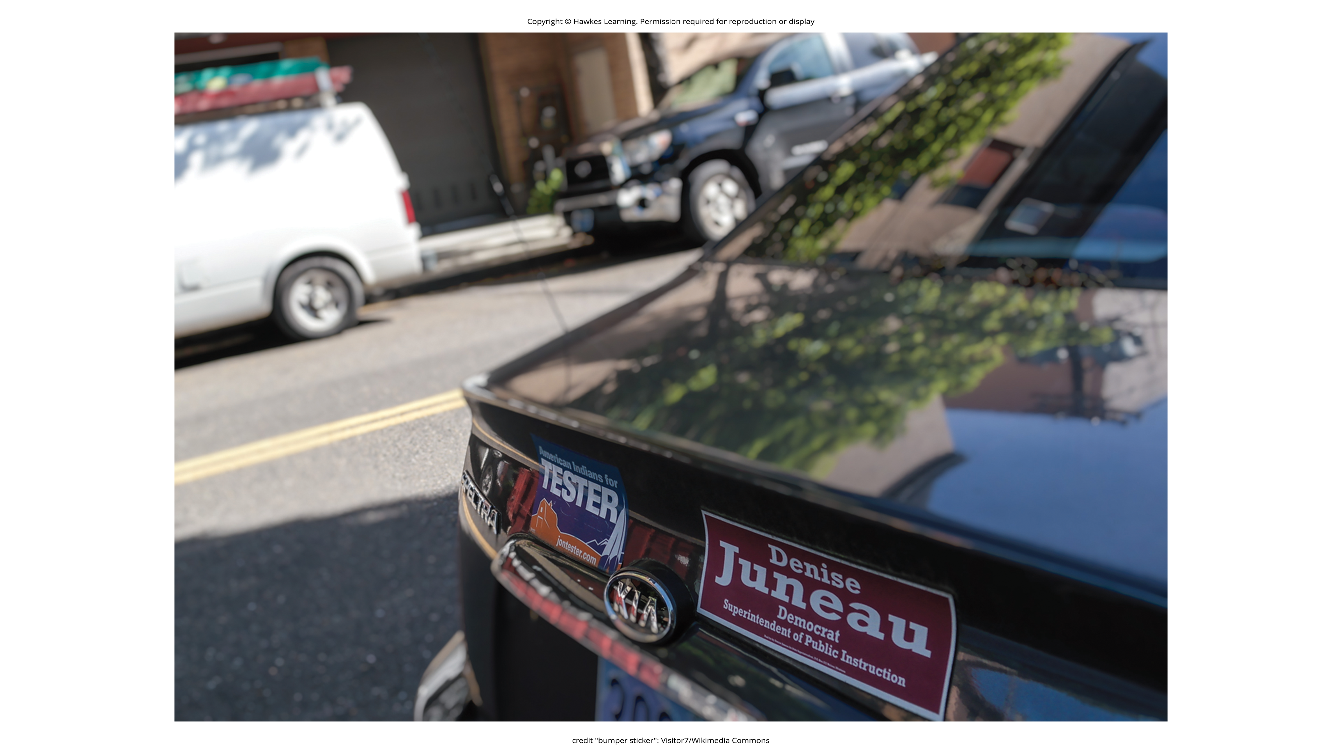
Persuasion
Persuasion is the process of changing our attitude toward something based on some kind of communication.
A lot of the persuasion we experience comes from outside forces.
Figure 6

Slide 11
Yale Attitude Change Approach-Case Study₁
During the Second World War, Carl Hovland extensively researched persuasion for the U.S. Army.
Out of this work came a model called the Yale attitude change approach.
It describes the conditions under which people tend to change their attitudes.
Hovland demonstrated that certain features of the source of a persuasive message, the content of the message, and the characteristics of the audience will influence the persuasiveness of a message (Hovland et al., 1953).
Features of the source of the persuasive message include the credibility of the speaker (Hovland & Weiss, 1951) and the physical attractiveness of the speaker (Eagly & Chaiken, 1975; Petty et al., 1997).

Slide 12
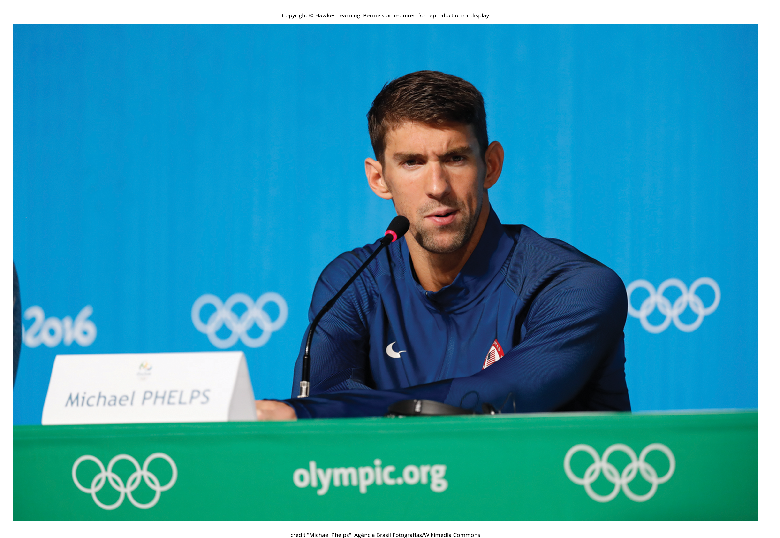
Yale Attitude Change Approach-Case Study₂
Messages that are more subtle are more persuasive than direct messages.
Arguments that occur first, such as in a debate, are more influential if messages are given back-to-back.
Features of the audience that affect persuasion are attention, intelligence, self-esteem, and age.
People with lower intelligence are more easily persuaded than people with higher intelligence.
Figure 7

Slide 13
Elaboration Likelihood Model
The elaboration likelihood model considers the variables of the attitude change approach:
Features of the source of the persuasive message
Contents of the message
Characteristics of the audience
According to the elaboration likelihood model of persuasion, there are two main routes that play a role in delivering a persuasive message: central and peripheral (Figure 8).

Slide 14
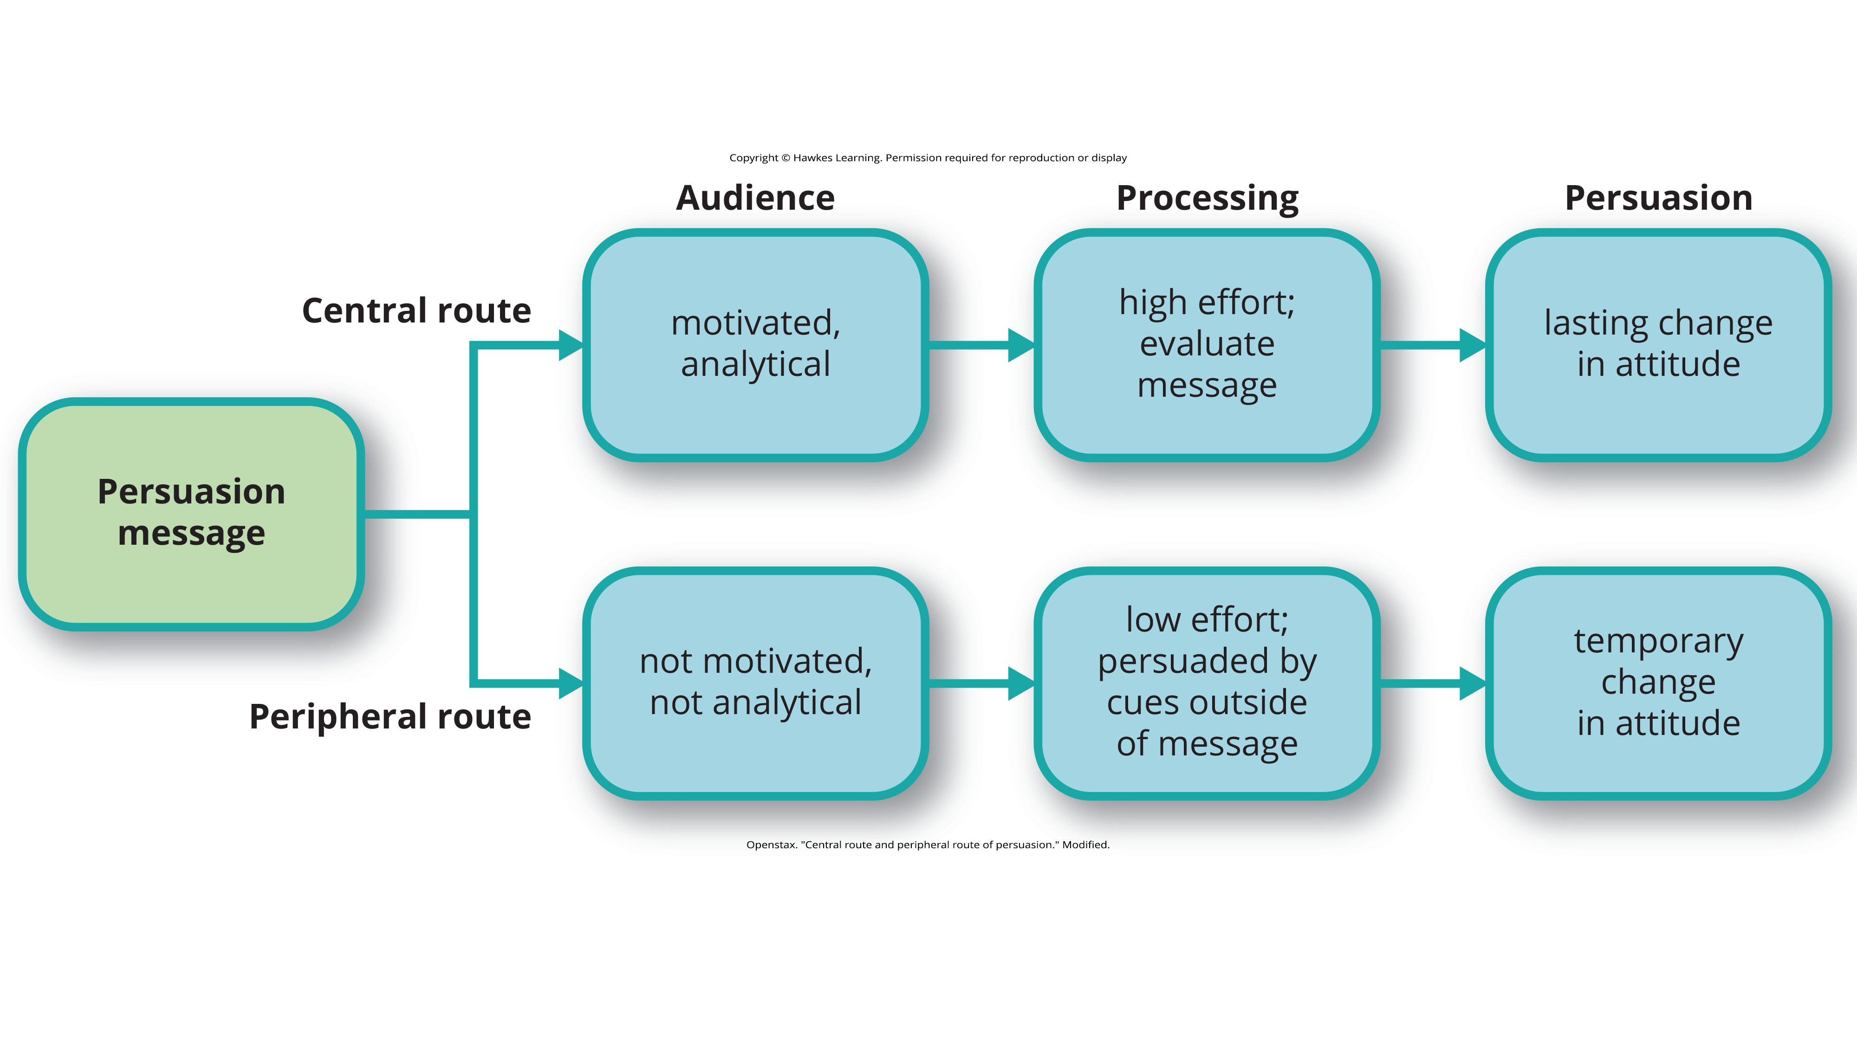
Lesson 12.3 Figure 8
Caption: Persuasion can take one of two paths, and the durability of the end result depends on the path.

Slide 15
Central Route
The central route is logic driven and uses data and facts to convince people of an argument's worthiness.
Example: A car company seeking to persuade you to purchase their model will emphasize the car's safety features and fuel economy.
For the central route of persuasion to be effective in changing attitudes, thoughts, and behaviors, the argument must be strong and, if successful, will result in lasting attitude change.
The central route to persuasion works best when the target of persuasion, or the audience, is analytical and willing to engage in processing the information.

Slide 16
Group Activity
Commercial Appeal: Which Is More Effective, the Central or Peripheral Route?
Break into small groups and have each member search YouTube for a commercial advertising something that you have or would like to buy.
After examining the commercial, consider what type of persuasion is being utilized. Is the commercial appealing to logic and evidence, or does it appeal on a more emotional level?
Which route do you think is more effective? Why?

Slide 17
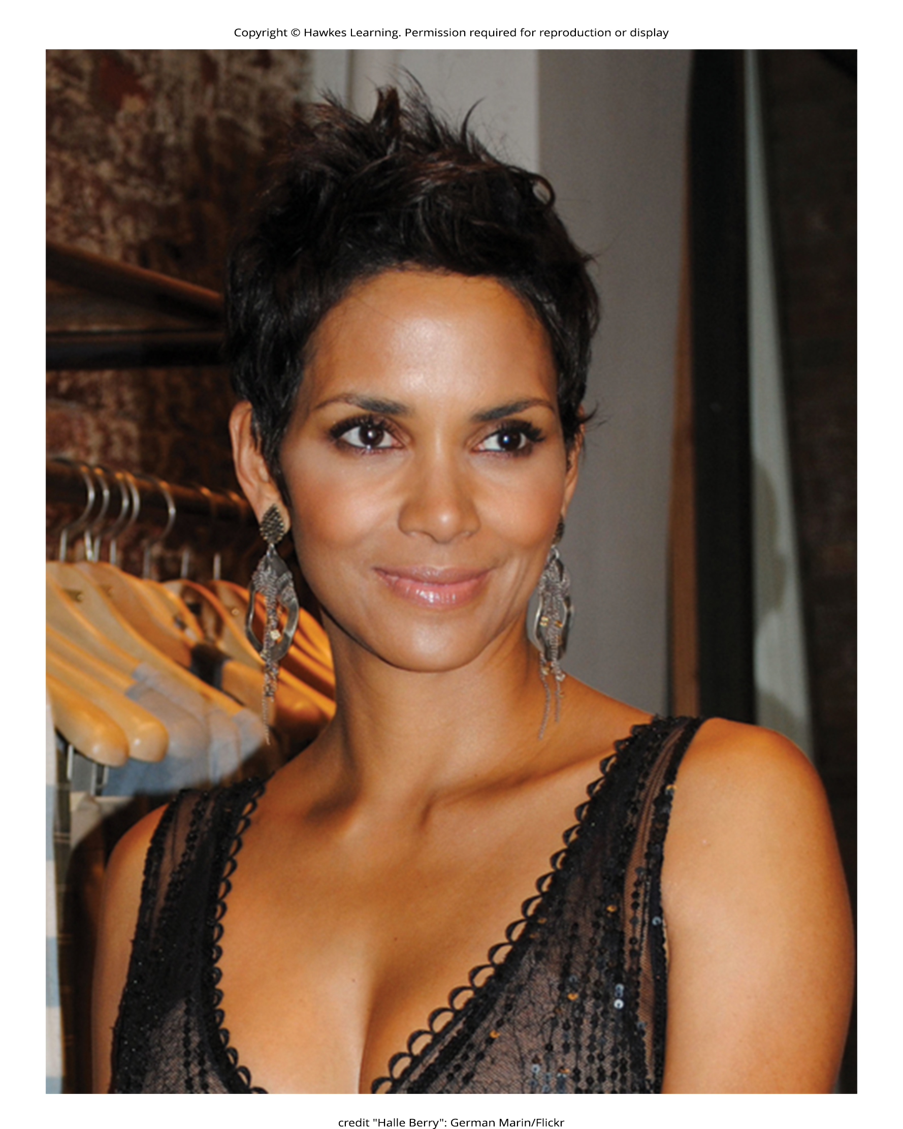
Peripheral Route
The peripheral route is an indirect route that uses peripheral cues to associate positivity with the message (Petty & Cacioppo, 1986).
The peripheral route relies on association with positive characteristics, such as positive emotions and celebrity endorsement.
Example: having a popular athlete advertise athletic shoes is a common method used to encourage individuals to purchase the shoes
This route to attitude change does not require much effort or information processing.
This method of persuasion may promote positivity toward the message or product, but it typically results in a less permanent attitude or behavior change.
The audience does not need to be analytical or motivated to process the message.
Figure 9

Slide 18

Foot-In-The-Door Technique
Using the foot-in-the-door technique, the persuader gets a person to agree to a small favor or to buy a small item, only to later request a larger favor or purchase of a bigger item.
The foot-in-the-door technique was demonstrated in a study by Freedman and Fraser (1966) in which participants who agreed to post a small sign in their yard or sign a petition were more likely to agree to put a large sign in their yard than people who declined the first request (Figure 10).
Research on this technique also illustrates the principle of consistency (Cialdini, 2001).
Our past behavior often directs our future behavior, and we have a desire to maintain consistency once we have a committed to a behavior.
Figure 10

Slide 19
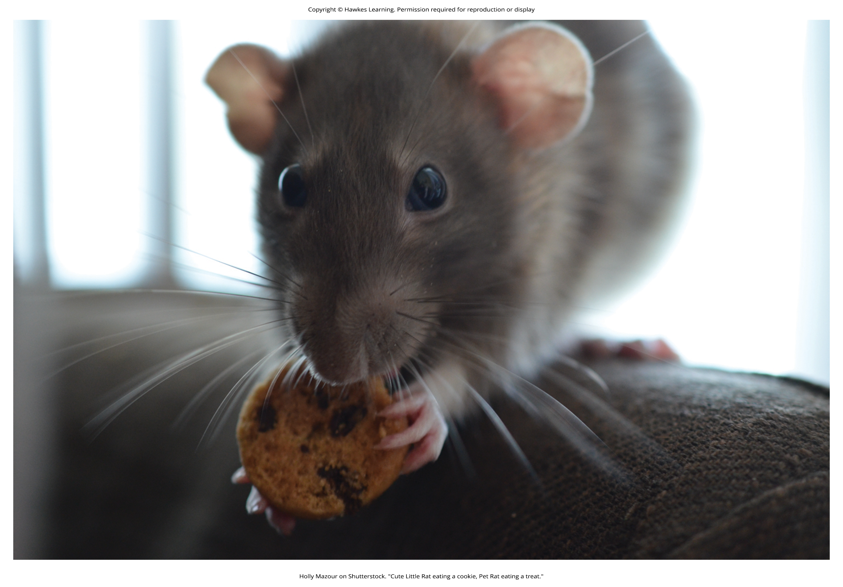
Foot-In-The-Door Technique Example
How would a store owner use the foot-in-the-door technique to sell you an expensive product?
Example: Say that you are buying the latest model smartphone, and the salesperson suggests you purchase the best data plan.
You agree to this.
The salesperson then suggests a bigger purchase—the 3-year extended warranty.
After agreeing to the smaller request, you are more likely to also agree to the larger request.
Figure 11

Slide 20
Summary
Attitudes are our evaluations or feelings toward a person, idea, or object and typically are positive or negative.
Attitudes and beliefs are influenced by external forces and internal influences that we control.
An internal form of attitude change is cognitive dissonance or the tension we experience when our thoughts, feelings, and behaviors are in conflict.
External forces of persuasion include advertising; the features of advertising that influence our behaviors include the source, message, and audience.
There are two primary routes to persuasion.
The central route to persuasion uses facts and information to persuade potential consumers.
The peripheral route uses positive association with cues such as beauty, fame, and positive emotions.

Slide 21
End of Hawkes Learning PowerPoint

