Slide 1
Lesson 12.4
Conformity, Compliance, and Obedience

Slide 2
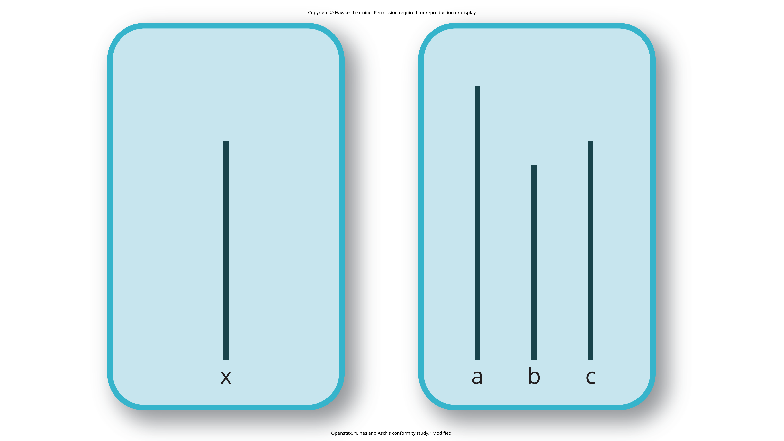
Confederates
A confederate is a person who works or a researcher and is aware of the experiment, but who acts as a participant.
Used to manipulate social situations as part of the research design
Solomon Asch conducted several experiments in the 1950s to determine how people are affected by the thoughts and behaviors of other people.
In the classroom, the participants were asked to judge which of three line segments was closest in length to line segment x (Figure 1).
In Asch's study, the confederates identified a line segment that was obviously shorter than the target line—a wrong answer.
The naïve participant then had to identify aloud the line segment that best matched the target line segment.
Figure 1

Slide 3
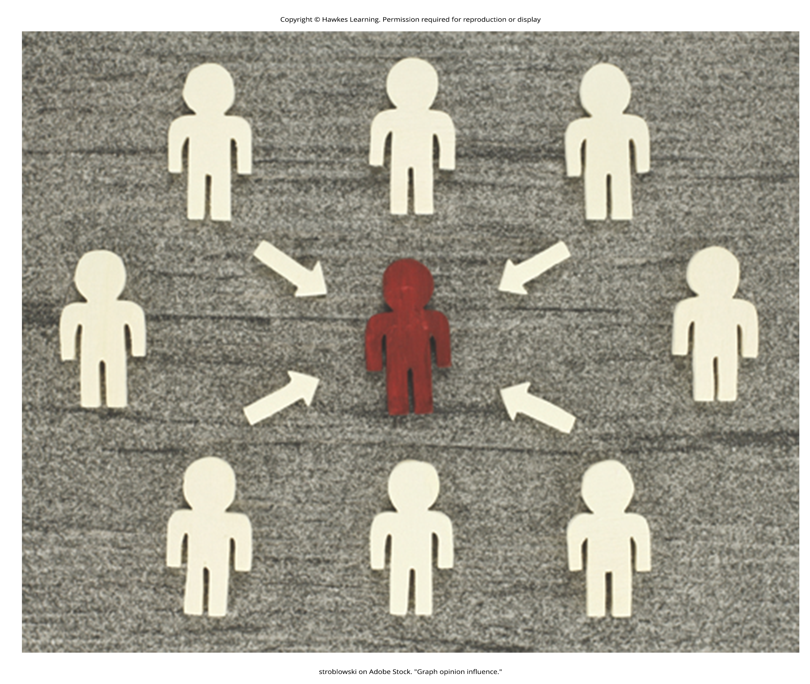
Conformity
Conformity is the change in a person's behavior to go along with the group, even if they do not agree with the group.
Asch (1955) found that 76% of participants conformed to group pressure at least once by indicating the incorrect line.
The Asch effect is the influence of the group majority on an individual's judgment.
Figure 2

Slide 4
Reflection Question₁
What factors do you think make a person more likely to yield to group pressure?

Slide 5
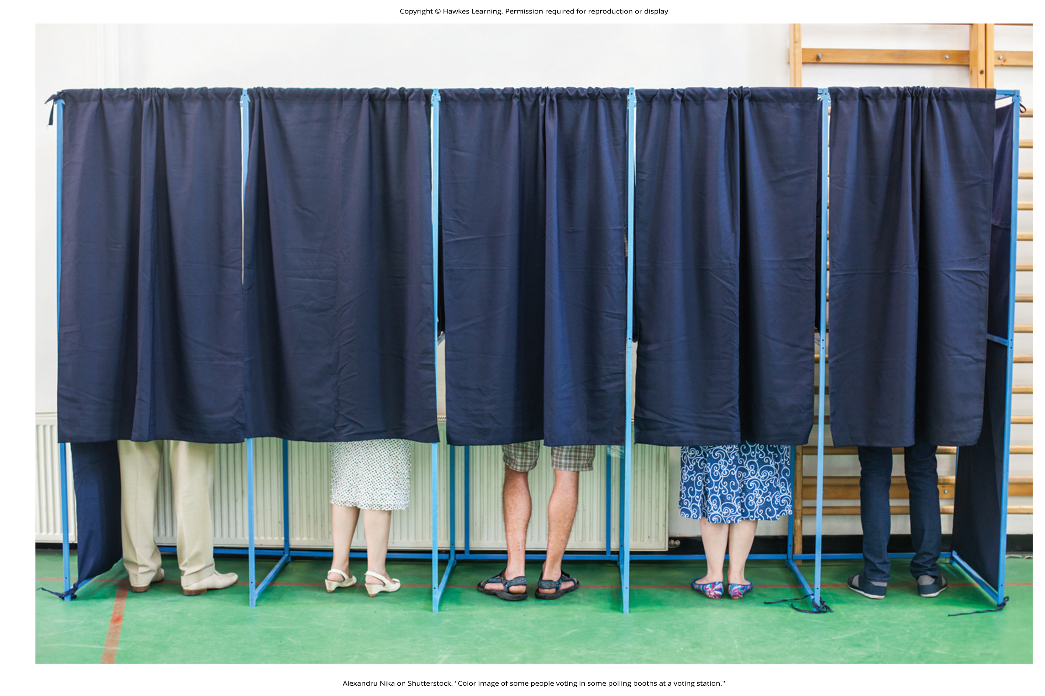
Asch Effect
Research shows that the size of the majority, the presence of another dissenter, and the public or relatively private nature of responses are key influences on conformity.
Compliance can be a form of conformity.
Compliance refers to going along with a request or demand, even if you do not agree with the request.
In Asch's studies, the participants complied by giving the wrong answers but privately did not accept that the obvious wrong answers were correct.
Figure 3

Slide 6
Reflection Question₂
How do you think you would have responded if you were in Asch's study?

Slide 7
Normative Social Influence
Normative social influence: conformity to a group norm to fit in, feel good, and be accepted by the group

Slide 8
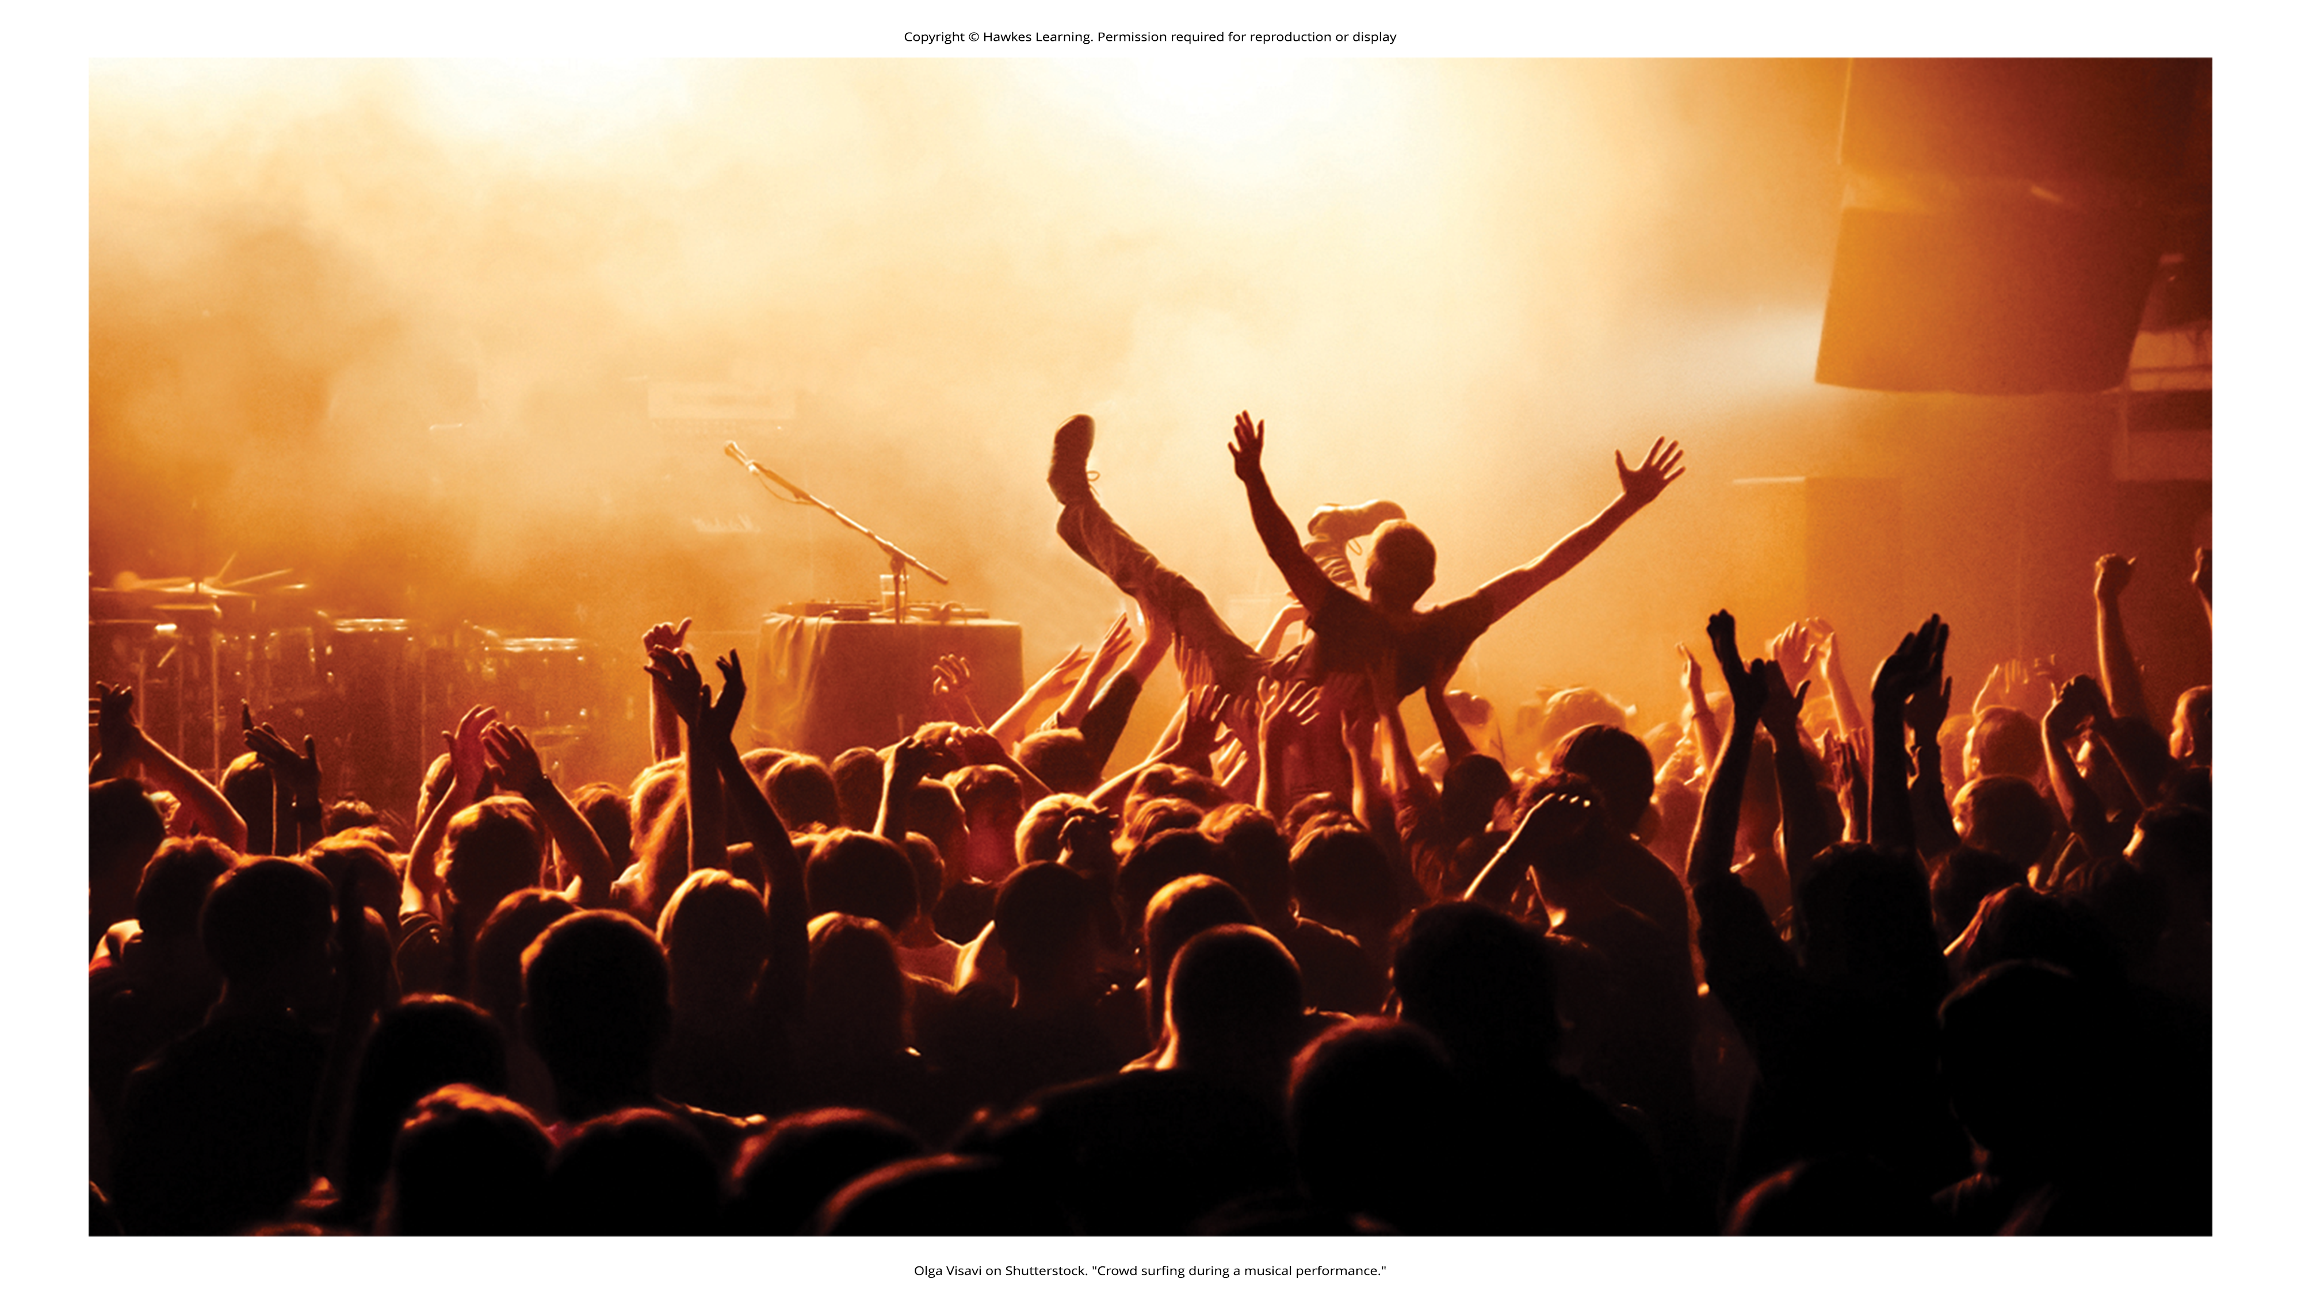
Informational Social Influence
Informational social influence: conformity to a group norm prompted by the belief that the group is competent and has the correct information
Example: Imagine that you are in a movie theater watching a film and what seems to be smoke comes in the theater from under the emergency exit door.
You are not certain that it is smoke; it might be a special effect for the movie, such as a fog machine.
When you are uncertain, you will tend to look at the behavior of others in the theater.
If other people show concern and get up to leave, you are likely to do the same.
If others seem unconcerned, you are likely to stay put and continue watching the movie (Figure 4).
Figure 4

Slide 9

Lesson 12.4 Figure 5
Caption: The term influencer now refers to individuals with a large social media platform and/or follower base. How does this newly coined term relate to conformity and compliance?

Slide 10

Lesson 12.4 Figure 6
Caption: Many people around the world wore masks, kept their distance from other people, and stayed inside during the pandemic. What influences were there on those behaviors?

Slide 11
Stanley Milgram's Experiment₁
Obedience is the change of an individual's behavior to comply with a demand by an authority figure.
People often comply with the request because they are concerned about a consequence if they do not comply.
Stanley Milgram was a social psychology professor at Yale.
Was influenced by the trial of Adolf Eichmann, a Nazi war criminal
Eichmann's defense for the atrocities he committed was that he was "just following orders."
Milgram designed an experiment and initially recruited 40 men for his experiment.
The participants were led to believe that they were participating in a study to improve learning and memory, and were instructed to deliver electric shocks of increasing intensity to "learners" (who were actually confederates) when they answered questions incorrectly.
The participants did not know that the learners were confederates and that the confederates did not actually receive shocks.

Slide 12
Stanley Milgram's Experiment₂
Participants obediently and repeatedly shocked learners for incorrect answers.
The confederate learners cried out for help, begged the participant teachers to stop, and even complained of heart trouble.
When the researcher told the participant-teachers to continue the shock, 65% of the participants continued the shock to the maximum voltage and to the point that the learner became unresponsive (Figure 7).

Slide 13
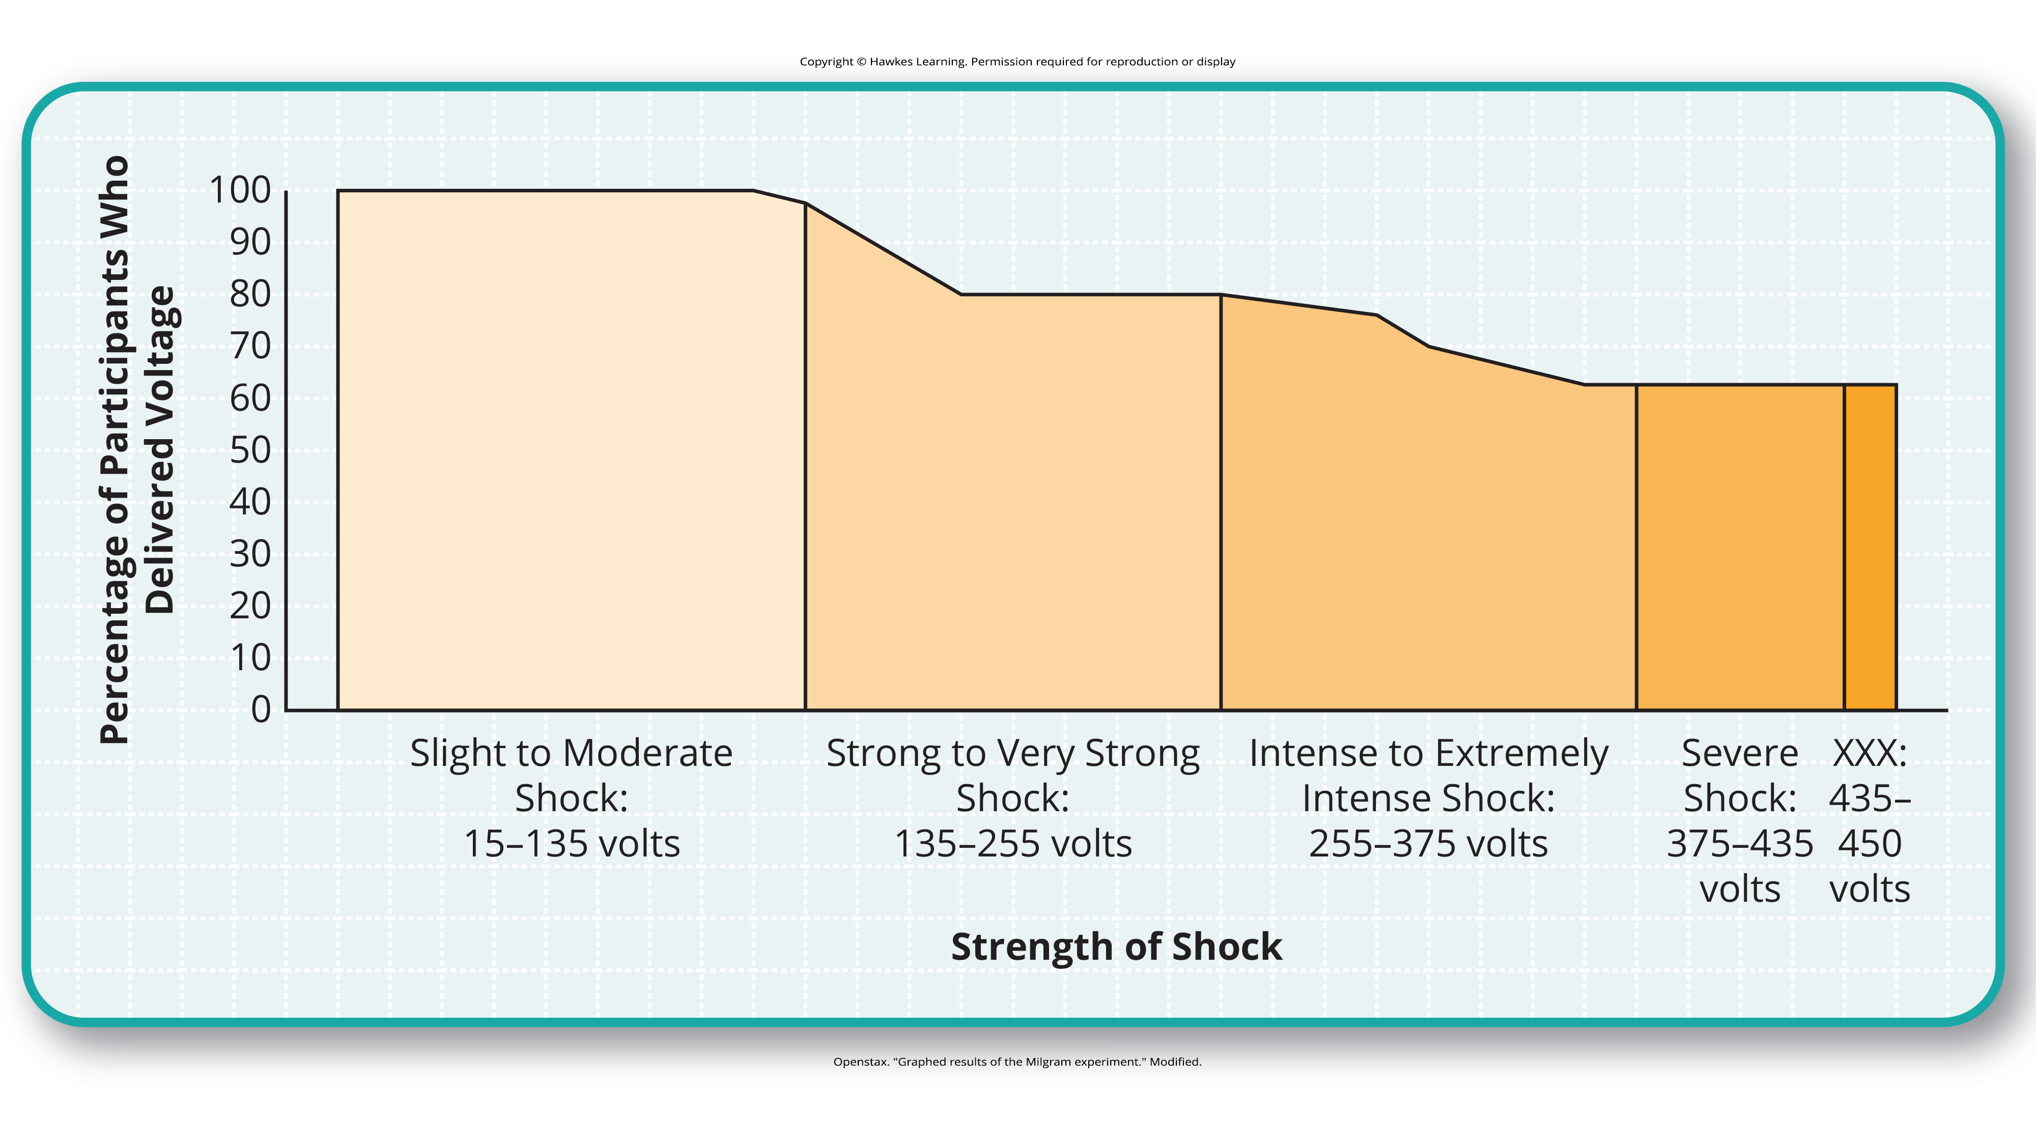
Lesson 12.4 Figure 7
Caption: The Milgram experiment showed the surprising degree to which people obey authority. Two out of three (65%) participants continued to administer shocks to an unresponsive learner.

Slide 14
Reflection Question₃
What do you think makes someone obey authority to the point of causing serious harm to another person?

Slide 15
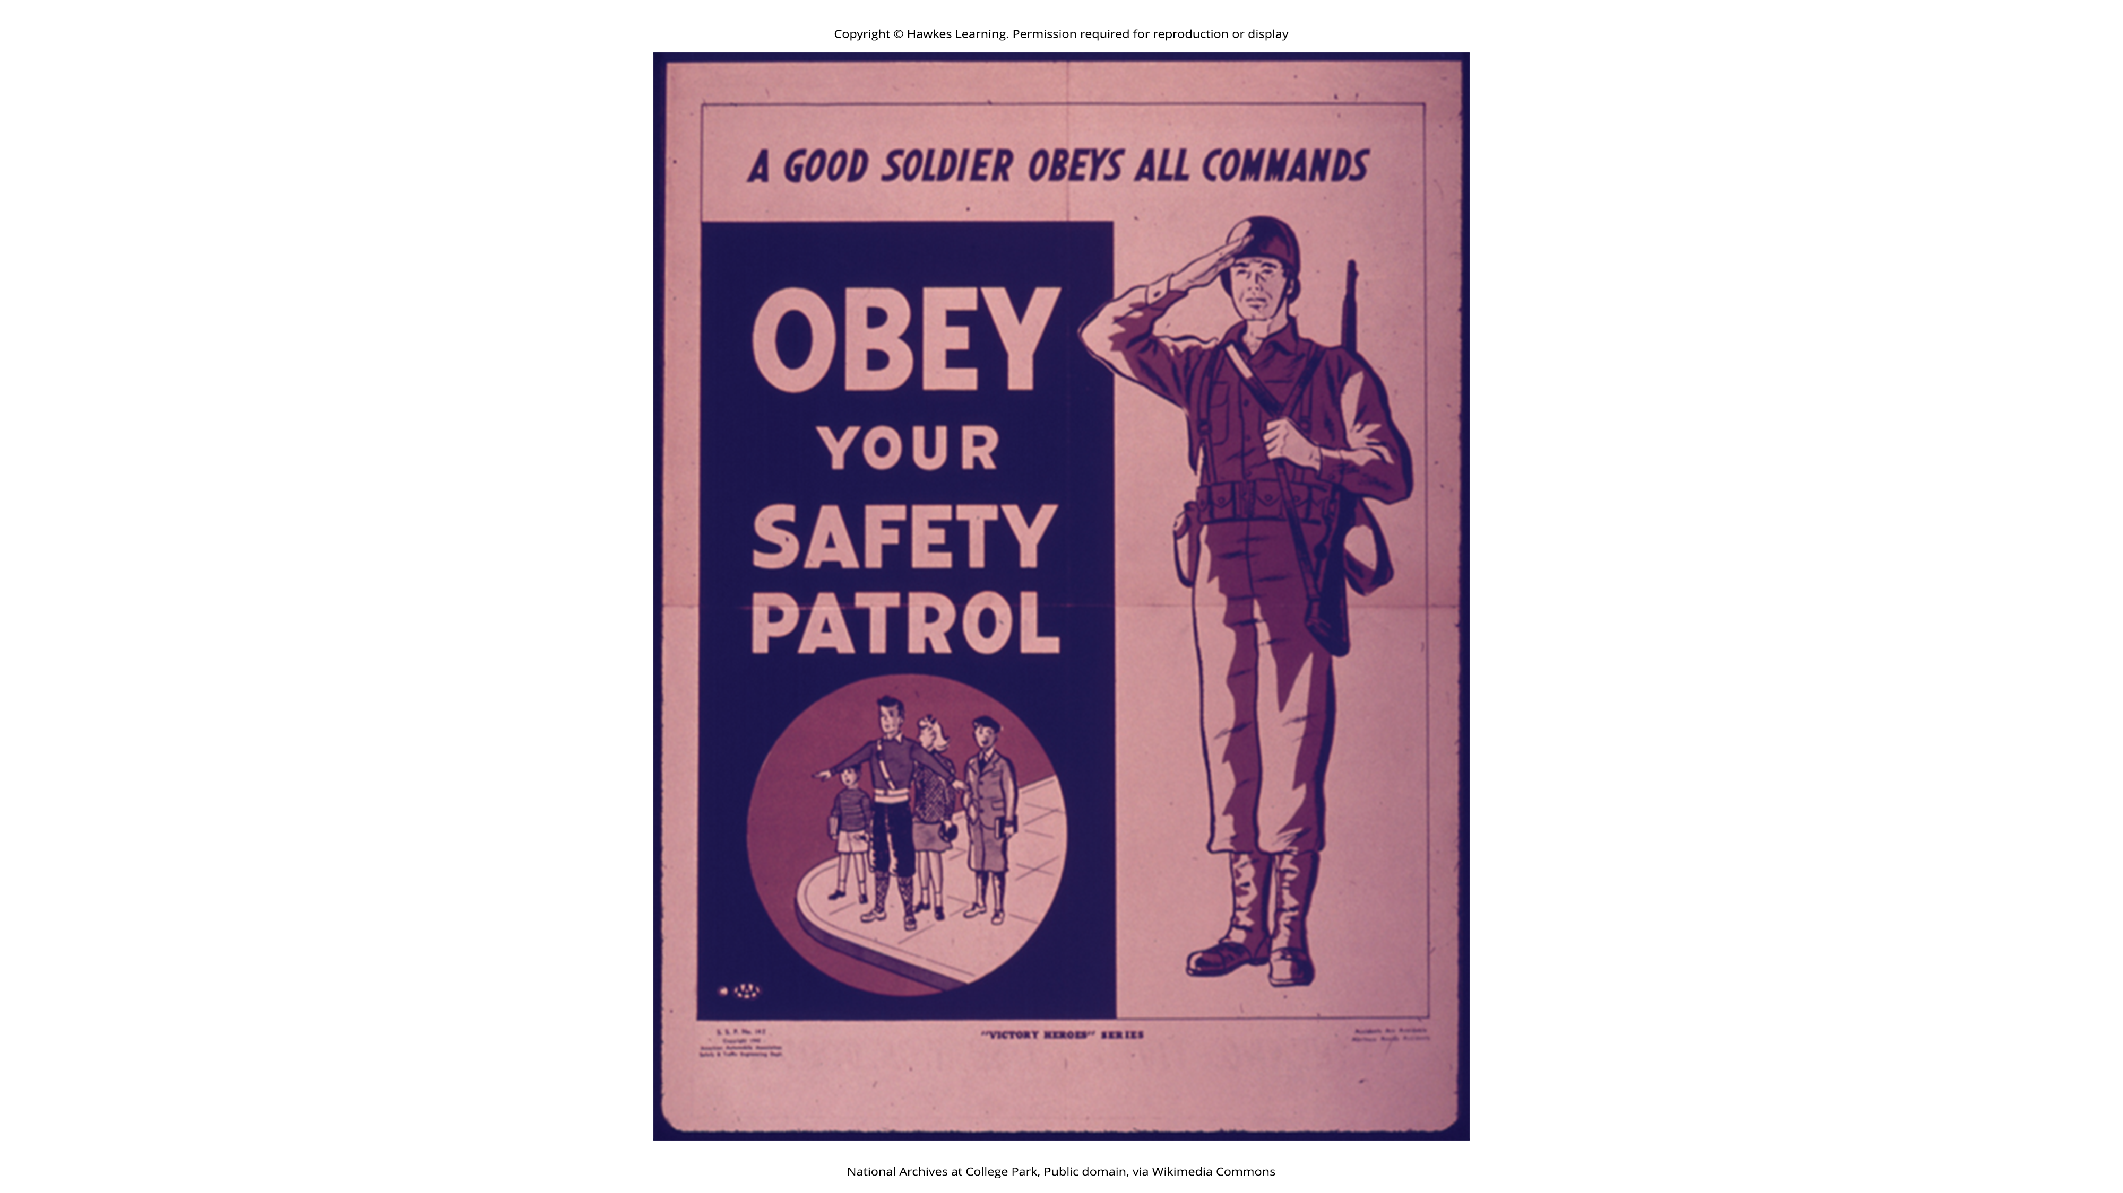
Lesson 12.4 Figure 8
Caption: What do you think about the tagline of this World War II poster? What if the command goes against the soldier's morals or beliefs? Should they still obey?

Slide 16
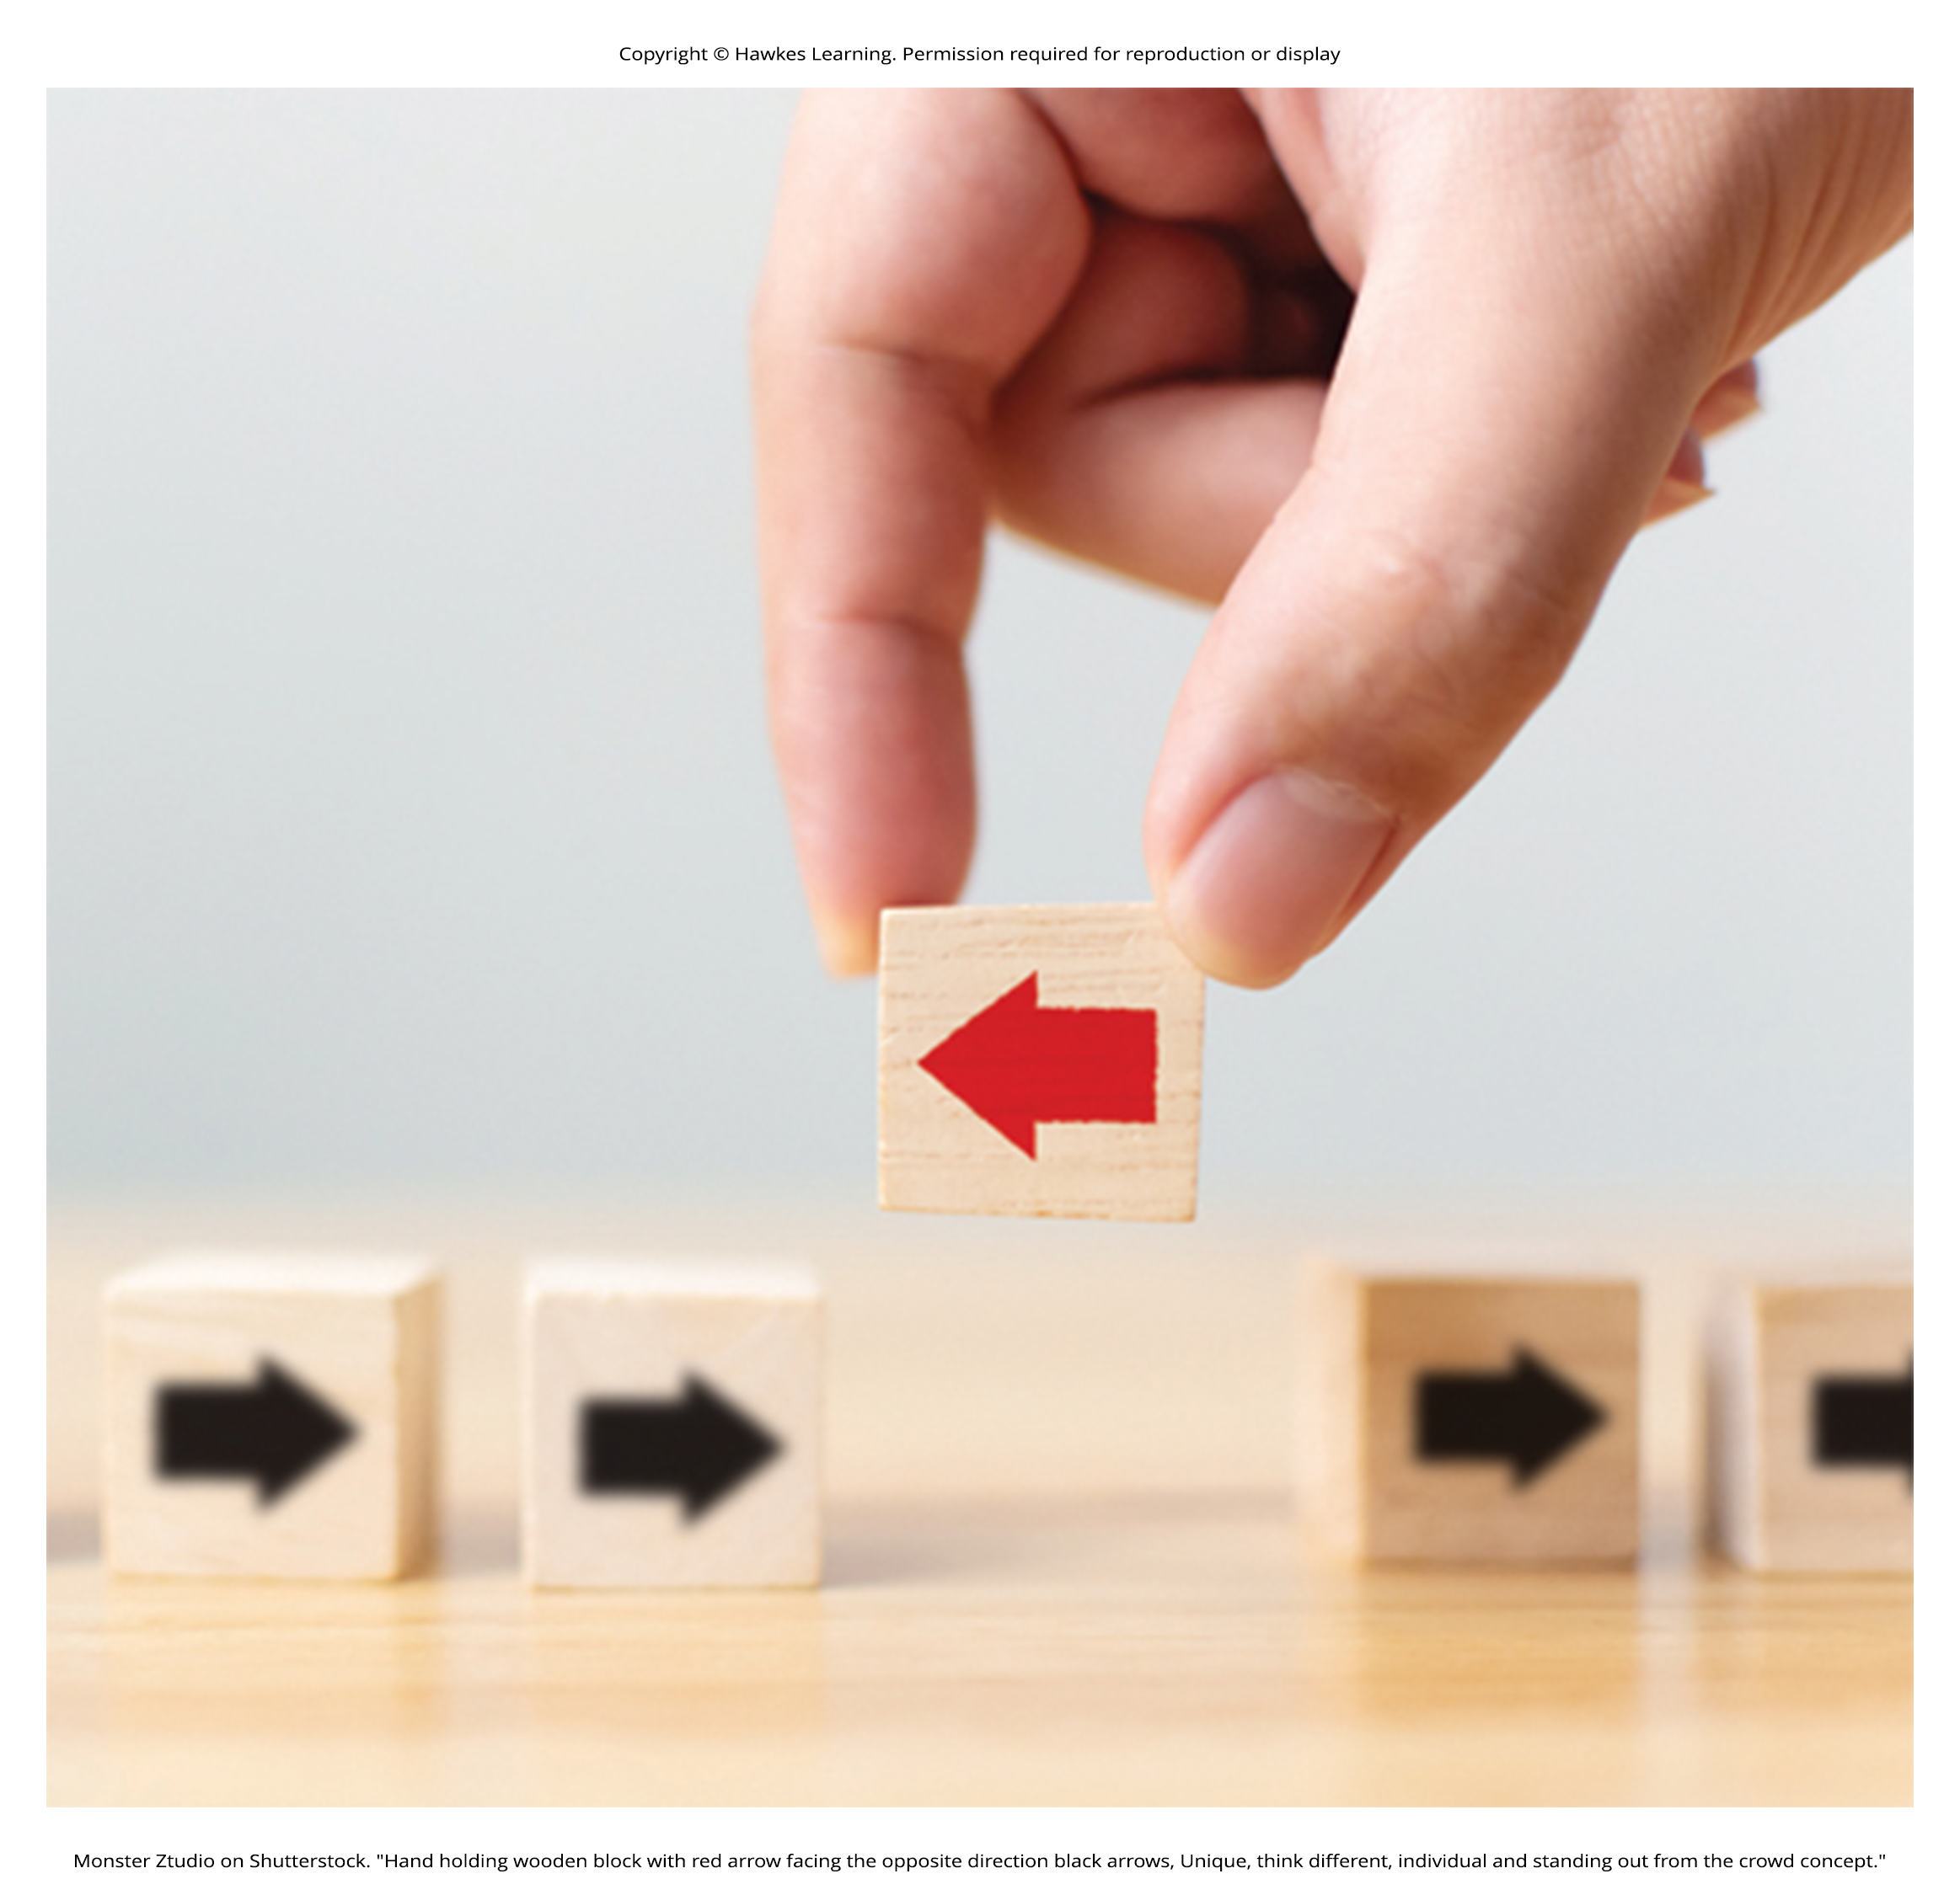
Groupthink₁
When in group settings, we are often influenced by the thoughts, feelings, and behaviors around us.
Groupthink is the modification of the opinions of members of a group to align with what they believe is the group consensus (Janis, 1972).
In group situations, the group often takes action that individuals would not perform outside the group setting.
Groupthink can hinder opposing trains of thought. This elimination of diverse opinions contributes to faulty decision making.
Figure 9

Slide 17
Dig Deeper: Groupthink And The COVID-19 Pandemic
While many people around the world wore masks, practiced social distancing, limited their social engagements, and received the COVID-19 vaccine, there are a number of people who did not conform to these recommendations.
While studying individuals' decision-making, researchers found that isolation, high levels of stress, and strong pressure greatly influenced one's decision to conform (Forsyth, 2020).
With so many unknowns, social isolation, and stress being at an all-time high around the world, leaders both for and against mask mandates had the ideal combination of factors to promote their views.
Those factors, paired with announcements and affirmations, such as, "We're all in this together," increased the effectiveness of the groups' messages.
Do you see evidence of groupthink?

Slide 18
Symptoms Of Groupthink
Perceiving the group as invulnerable or invincible or that it can do no wrong
Believing the group is morally correct
Group members withholding information to avoid disrupting the group consensus
The squashing of dissenting group members' opinions
The shielding of the group leader from dissenting views
Perceiving an illusion of unanimity among group members
Holding stereotypes or negative attitudes toward the out-group or others' with differing viewpoints (Janis, 1972)

Slide 19
Groupthink₂
There are several strategies that can improve group decision making including
Seeking outside opinions
Voting in private
Having a leader withhold position statements until all group members have voiced their views
Conducting research on all viewpoints
Weighing the costs and benefits of all options
Developing a contingency plan
(Janis, 1972; Mitchell & Eckstein, 2009)

Slide 20
Group Polarization
Group polarization (Teger & Pruitt, 1967) is the strengthening of an original group attitude after the discussion of views within a group.
It explains many actions taken by groups that would not be undertaken by individuals.
It can be observed at political conventions, when platforms of the party are supported by individuals who, when not in a group, would decline to support them.
Example: a group's discussion of how attractive someone is
Does your opinion change if you find someone attractive, but your friends do not agree?
If your friends agree, might you then find this person even more attractive?

Slide 21
Reflection Question₄
Describe a time when your opinion of something changed because of a group discussion. What was the opinion, and why do you think you changed it?

Slide 22

Social Facilitation
Social facilitation occurs when an individual performs better when an audience is watching than when the individual performs the behavior alone.
Example: skilled basketball players will be more likely to make a free throw basket when surrounded by a cheering audience than when playing alone in the gym (Figure 10)
Figure 10

Slide 23
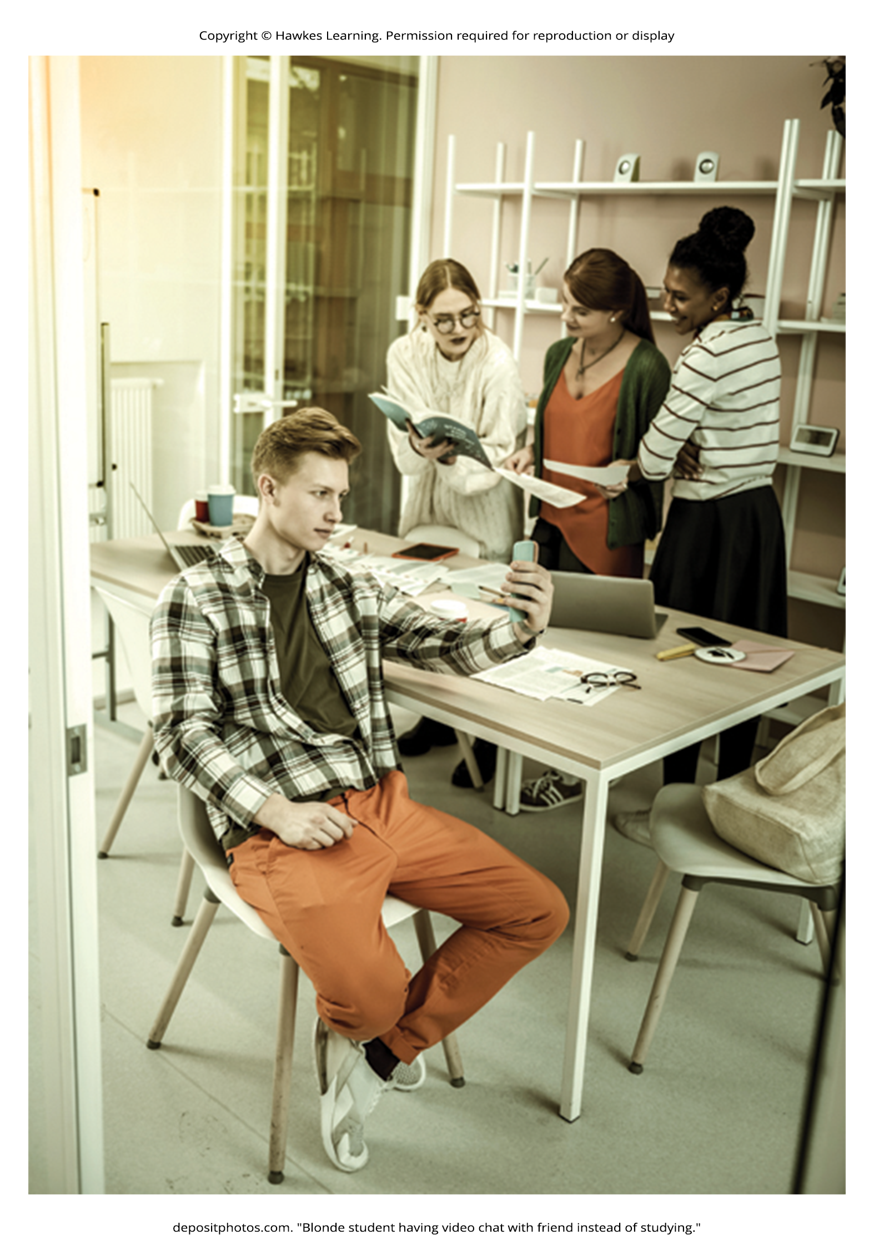
Social Loafing
Social loafing is the exertion of less effort by a person working together with a group.
It occurs when our individual performance cannot be evaluated separately from the group.
Group performance declines on easy tasks (Karau & Williams, 1993).
Because each individual's efforts cannot be evaluated, individuals become less motivated to perform well.
Example: Within a group of people cooperating to clean litter from the roadside, some will exert a great amount of effort, but others will exert little effort.
The entire job gets done, and it may not be obvious who worked hard and who didn't.
Figure 11

Slide 24
Reflection Question₅
When you've worked on a group project, have you had to contribute more than your fair share because your group members weren't putting in the work?
Have you exerted less effort on a project because you knew that you were graded as a group?
Describe what your experience was like.

Slide 25
Summary
Conformity to group norms is driven by two motivations: the desire to fit in and be liked and the desire to be accurate and gain information from the group.
Authority figures also have influence over our behaviors, and many people become obedient and follow orders even if the orders are contrary to their personal values.
Conformity to group pressures can also result in groupthink.
Group situations can improve human behavior through facilitating performance on easy tasks but inhibiting performance on difficult tasks.
The presence of others can also lead to social loafing when individual efforts cannot be evaluated.

Slide 26
End of Hawkes Learning PowerPoint

