Slide 1
Lesson 12.5
Prejudice and Discrimination

Slide 2
Prejudice And Discrimination
Human conflict can result in crime, war, and mass murder, such as genocide.
Prejudice and discrimination can often be causes of human conflict.
Prejudice and discrimination affect everyone.

Slide 3
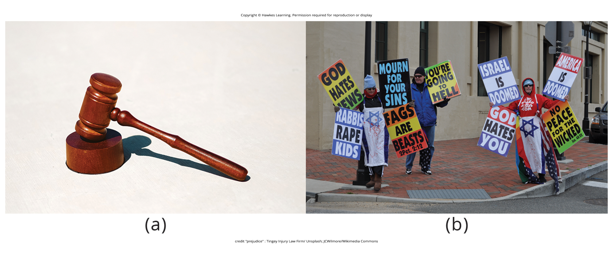
Lesson 12.5 Figure 1
Caption: Prejudice and discrimination still occur across the globe. (a) In February 2022, a Texas Company was found guilty of racial discrimination in employment practices, such as unequal pay, hostile work environments, and promotion denials, for their Black employees. (b) Members of the Westboro Baptist Church engage in discrimination based on religion and sexual orientation.

Slide 4
On Your Own
Define prejudice, stereotype, and discrimination in your own words.
Notes:
Originally an On Your Own

Slide 5
Prejudice
Prejudice is a negative attitude and feeling toward an individual based solely on one's membership in a particular social group (Allport, 1954; Brown, 2010).
It is common against people who are members of an unfamiliar cultural group.
Social groups can include gender, race, ethnicity, nationality, social class, religion, sexual orientation, profession, and more.
You can simultaneously be a member of more than one social group.

Slide 6
Stereotype
Prejudice often begins in the form of a stereotype.
Stereotype: specific beliefs or assumptions about individuals based solely on their membership in a group, regardless of their individual characteristics
Stereotypes become overgeneralized and applied to all members of a group.

Slide 7
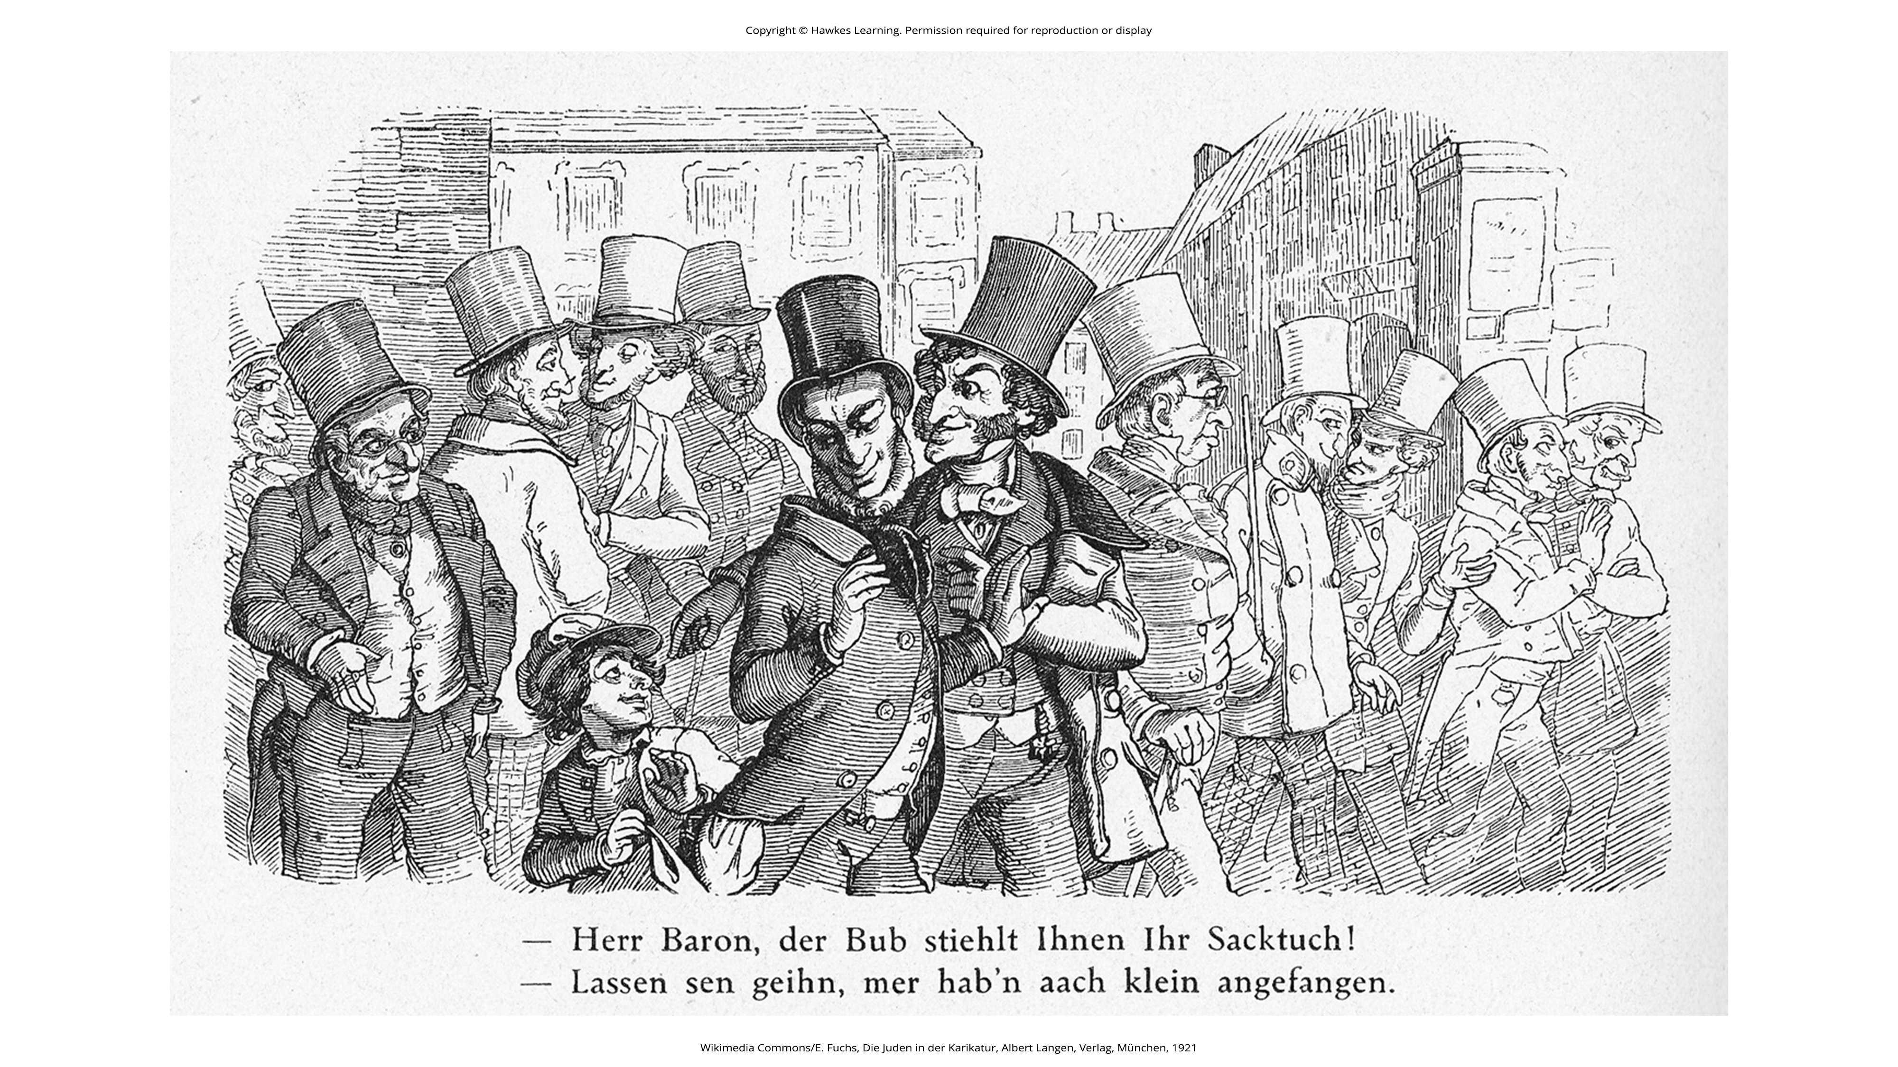
Lesson 12.5 Figure 2
Caption: This is a caricature based on a stereotype of Jewish stock-exchange speculators that appeared in the German satirical magazine Fliegende Blätter in 1851. The caption reads: "Herr Baron, that lad's stealing your handkerchief!" "Let him go, we once started small too." Widespread use and acceptance of stereotypes can directly contribute to dangerous social conditions and even be used to wrongly justify violence.

Slide 8
Reflection Question₁
What are some stereotypes and prejudices that you hold about people who are from a race, gender, and age group different from your own? Have you been on the receiving end of stereotyping or prejudice?

Slide 9
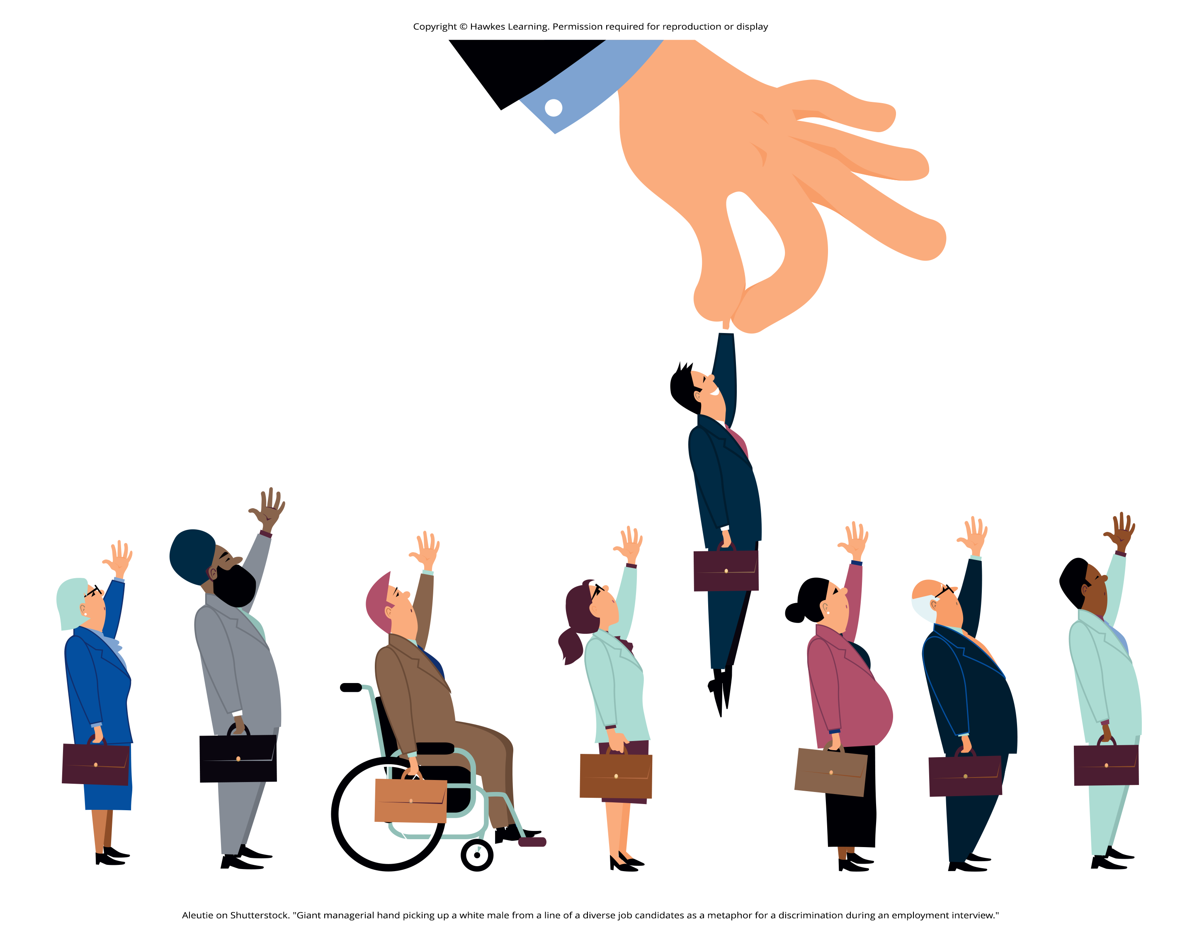
Discrimination
Sometimes people will act on their prejudiced attitudes toward a group of people, and this behavior is known as discrimination.
Discrimination: negative actions toward an individual or group of people as a result of their membership in a particular group
As a result of holding negative beliefs (stereotypes) and negative attitudes (prejudice) about a particular group, people often treat the target of prejudice poorly.
Figure 3

Slide 10
Reflection Question₂
Have you ever been the target of discrimination? If so, how did this negative treatment make you feel?

Slide 11
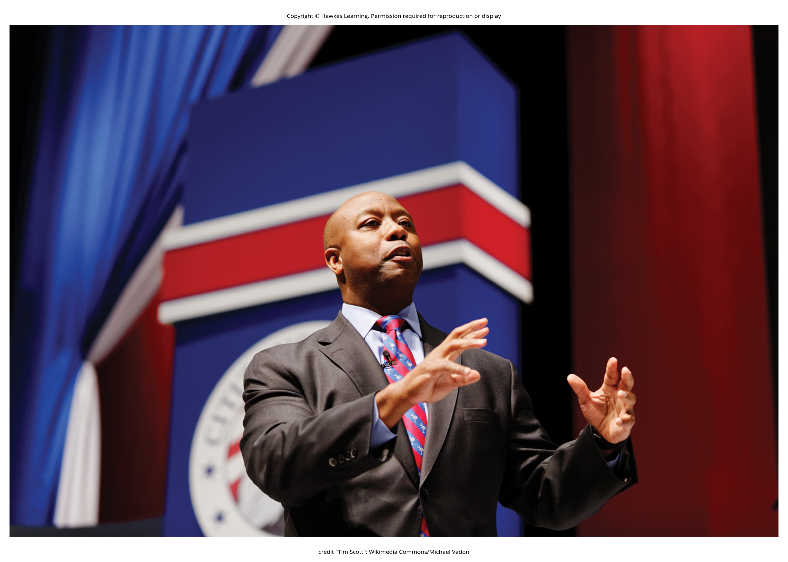
Racism
Racism is prejudice and discrimination against an individual based solely on one's membership in a specific racial group.
It exists for many racial and ethnic groups.
One reason modern forms of racism, and prejudice in general, are hard to detect is related to the dual attitudes model (Wilson et al., 2000).
Humans have two forms of attitudes: explicit attitudes, which are conscious and controllable, and implicit attitudes, which are unconscious and uncontrollable (Devine, 1989; Olson & Fazio, 2003).
Figure 4

Slide 12
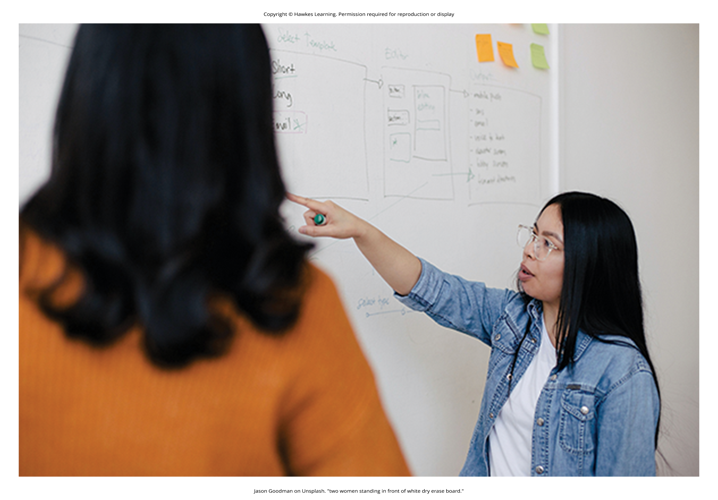
Sexism
Sexism is prejudice and discrimination toward individuals based on their gender or sex.
It may be overt or subtle and difficult to detect.
Common forms of sexism in modern society include gender role expectations, such as expecting women to be the caretakers of the household.
It also includes people's expectations for how members of a gender group should behave.
Figure 5

Slide 13
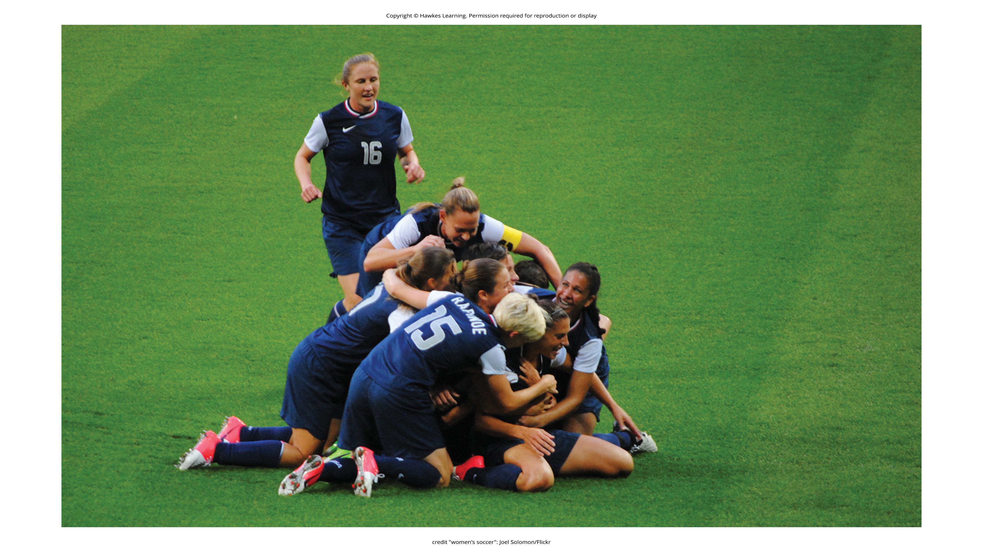
Lesson 12.5 Figure 6
Caption: In 2016, five women of the U.S. women's national soccer team filed a law suit against the U.S. Soccer Federation on the basis of wage discrimination. The women's team, despite more wins and higher viewer ratings, receives lower compensation than the men's team for friendly and non-friendly matches, base salary, World Cup wins, and Olympic wins.

Slide 14
Reflection Question₃
Have you ever experienced or witnessed sexism? Why do you think there are perceptions about certain jobs as being more male- or female-oriented?

Slide 15
Ageism
People often form judgments and hold expectations about people based on their age.
Ageism: prejudice and discrimination toward individuals based solely on their age
Typically, ageism occurs against older adults, but ageism also can occur toward younger adults.
Ageism is widespread in U.S. culture (Nosek, 2005).

Slide 16
Reflection Question₄
Have you ever experienced ageism? How did it impact you?

Slide 17
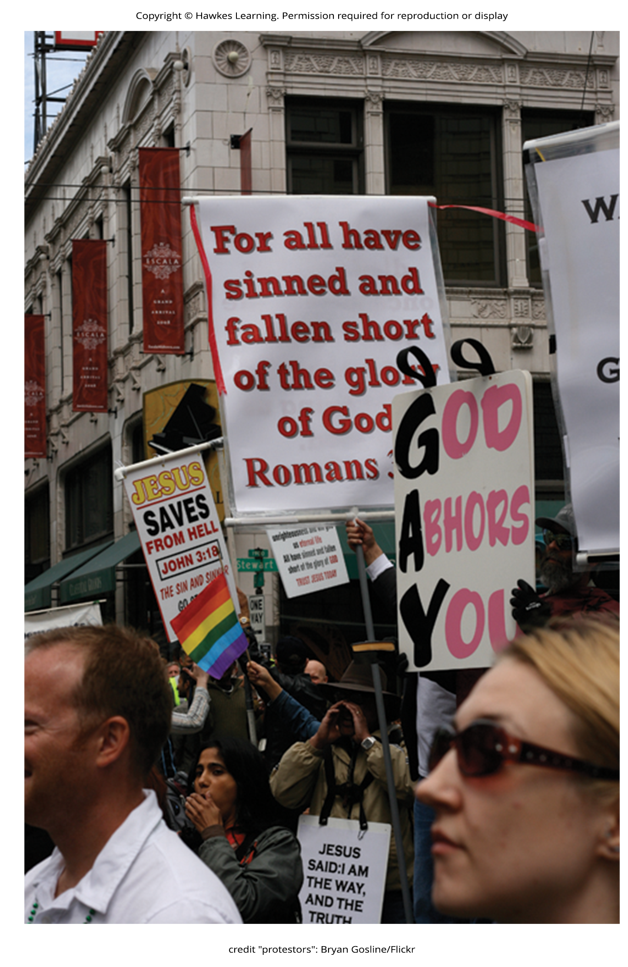
Homophobia
Homophobia is an umbrella term referring to prejudice and discrimination of individuals based solely on their sexual orientation, which is often applied to bisexual, lesbian, gay, and other nonheterosexual people.
Figure 7

Slide 18

Transphobia
Transphobia is the hatred of those who are perceived to break or blur stereotypical gender roles, often expressed as stereotyping, discrimination, harassment, and/or violence.
Figure 8

Slide 19
Reflection Question₅
Have you experienced or witnessed homophobia in real life? If not, have you witnessed it portrayed in media? What stereotypes, prejudiced attitudes, and discrimination were evident?

Slide 20
Why Do Prejudice And Discrimination Exist?
Prejudice and discrimination persist in society due to social learning and conformity to social norms.
Children learn prejudiced attitudes and beliefs from society.
From their parents, teachers, friends, the media, and other sources of socialization, such as social media (O'Keeffe et al., 2011)

Slide 21
Reflection Question₆
If a child from a low-income family received a merit scholarship to attend a private school, what concerns might their parents have about their treatment by classmates?

Slide 22
Self-Fulfilling Prophecy
When we hold a stereotype about a person, we have expectations that they will fulfill that stereotype.
Self-fulfilling prophecy: treating stereotyped group members according to our biased expectations only to have this treatment influence the individual to act according to our stereotypic expectations, thus confirming our stereotypic beliefs

Slide 23
Reflection Question₇
Have you ever fallen prey to the self-fulfilling prophecy or confirmation bias? Were you the source or target?

Slide 24

Confirmation Bias
When interacting with the target of our prejudice, we tend to pay attention to information that is consistent with our stereotypic expectations and ignore information that is inconsistent with our expectations.
Confirmation bias: tendency to focus on information that supports our beliefs while ignoring or failing to seek contradictory evidence
Figure 9

Slide 25
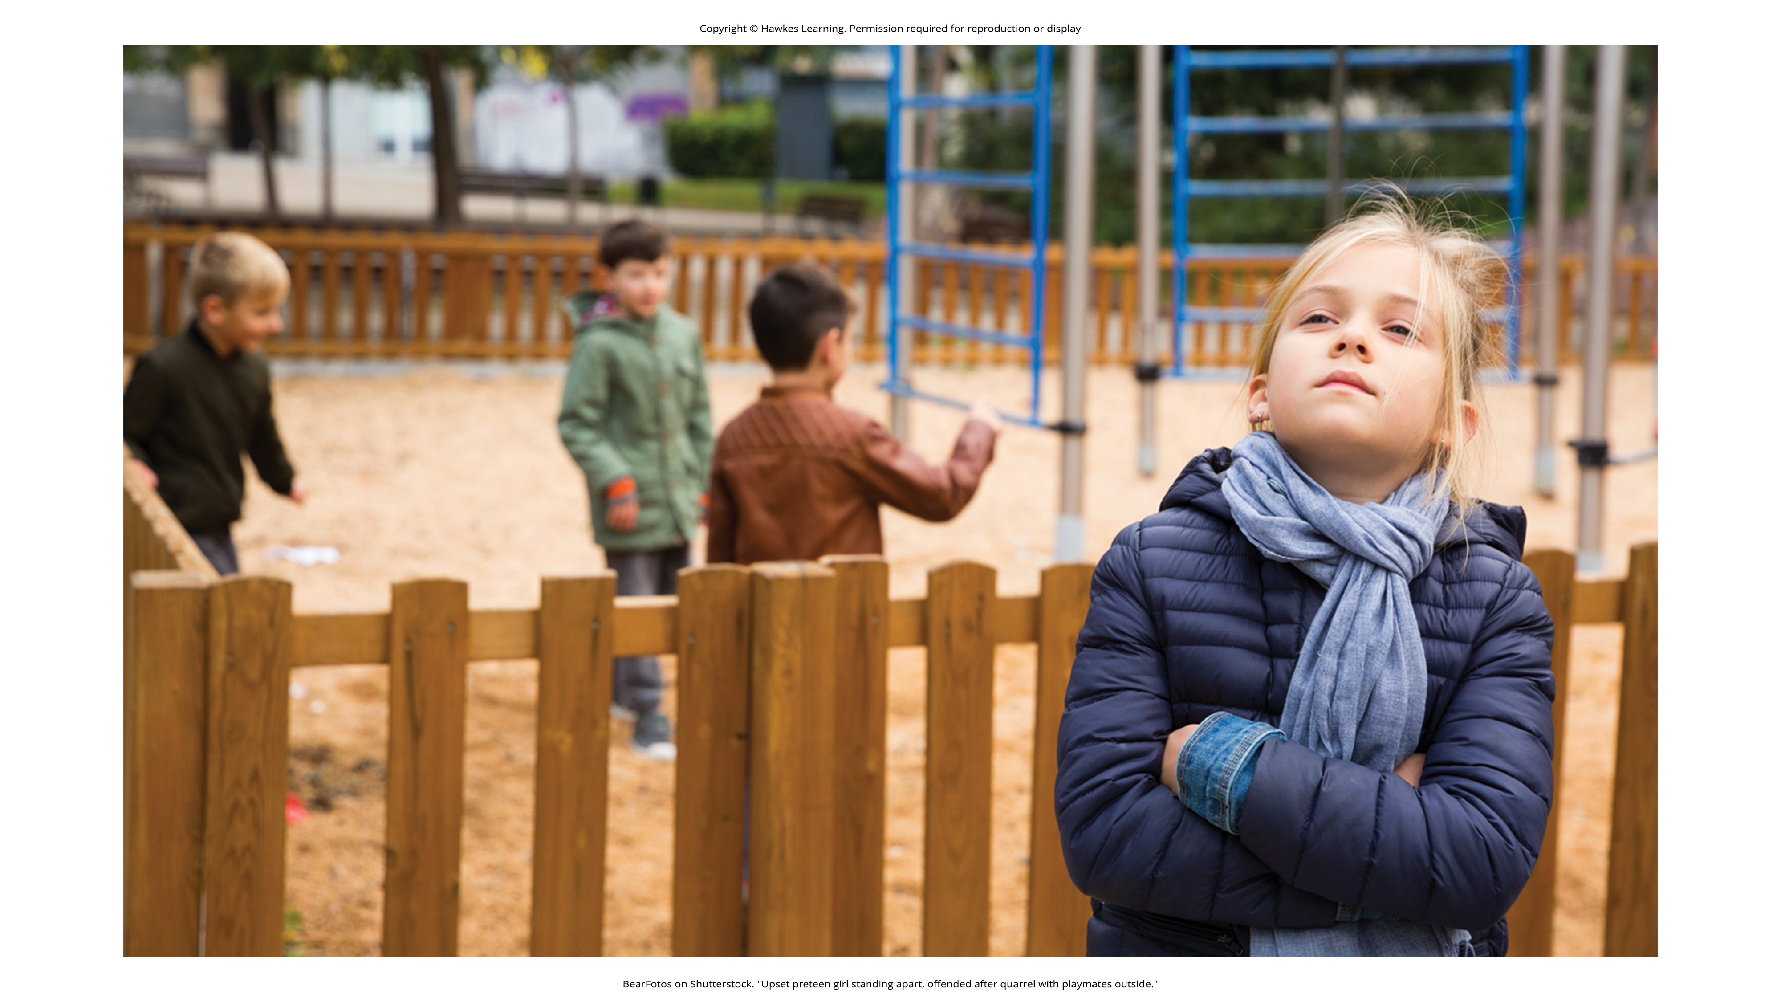
In-Group Vs. Out-Group
An in-group is a group that we identify with or see ourselves as belonging to.
A group that we don't belong to, or an out-group, is a group that we view as fundamentally different from us.
Example: if you are female, your gender in-group includes all females, and your gender out-group includes all males (Figure 10)
People often view gender groups as being fundamentally different from each other in personality traits, characteristics, social roles, and interests.
Figure 10

Slide 26
In-Group Bias
We develop in-group bias: a preference for our own group over other groups.
This in-group bias can result in prejudice and discrimination because the out-group is perceived as different and is less preferred than our in-group.

Slide 27
Scapegoating
Scapegoating is the act of blaming an out-group when the in-group experiences frustration or is blocked from obtaining a goal (Allport, 1954).

Slide 28
Summary
Prejudice, or negative feelings and evaluations, is common when people are from a different social group (i.e., out-group).
Negative attitudes toward out-groups can lead to discrimination.
Prejudice and discrimination against others can be based on gender, race, ethnicity, social class, sexual orientation, or a variety of other social identities.
In-groups who feel threatened may blame the out-groups for their plight, thus using the out-group as a scapegoat for their frustration.

Slide 29
End of Hawkes Learning PowerPoint

