Slide 1
Lesson 12.6
Aggression

Slide 2
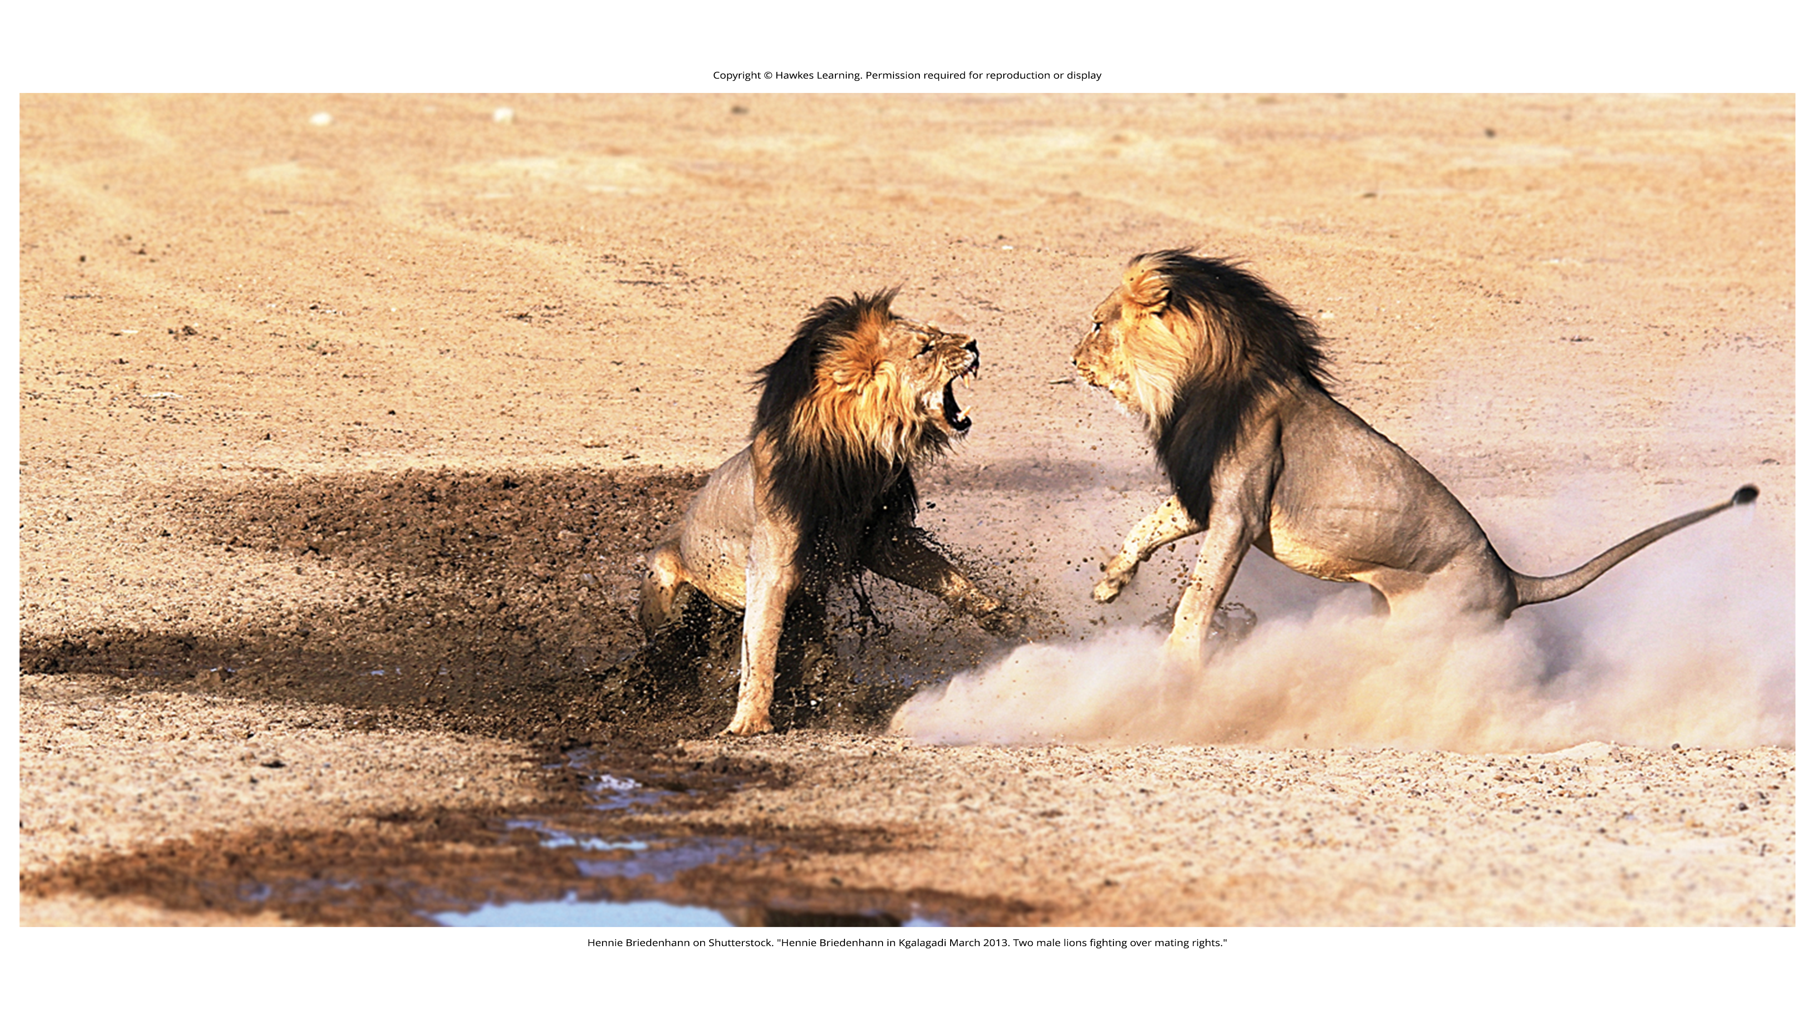
Aggression₁
Humans engage in aggression when they seek to cause harm or pain to another person.
Aggression takes two forms depending on one's motives: hostile or instrumental.
Figure 1

Slide 3
Hostile Aggression
Hostile aggression is motivated by feelings of anger with intent to cause pain
Example: a fight in a bar with a stranger

Slide 4
Instrumental Aggression
Instrumental aggression is motivated by achieving a goal and does not necessarily involve intent to cause pain (Berkowitz, 1993).
Example: a contract killer who murders for hire

Slide 5
On Your Own
Give three examples of hostile aggression and three examples of instrumental aggression.

Slide 6
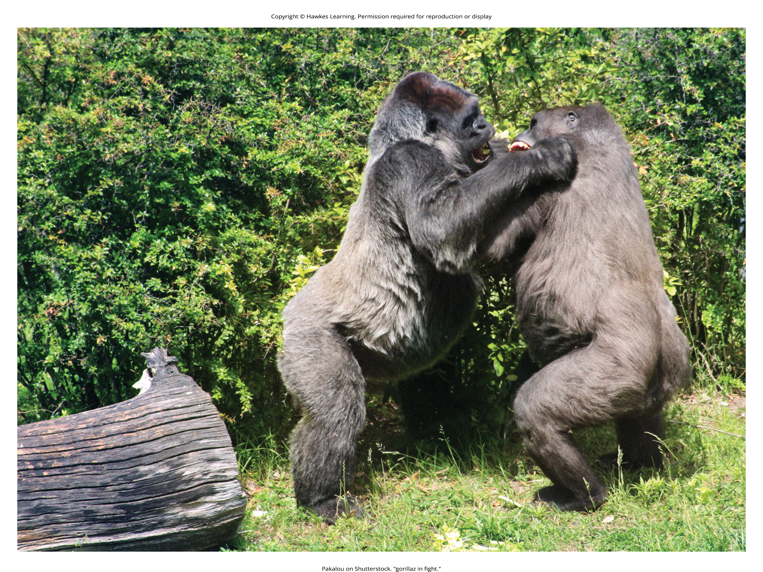
Aggression₂
Some researchers argue that aggression serves an evolutionary function (Buss, 2004).
From the perspective of evolutionary psychology, human male aggression, likely serves to display dominance over other males (Figure 2).
Women typically display instrumental forms of aggression, with their aggression serving as a means to an end (Dodge & Schwartz, 1997).
The frustration aggression theory (Dollard et al., 1939) states that when humans are prevented from achieving an important goal, they become frustrated and aggressive.
Figure 2

Slide 7
Bullying₁
Bullying is repeated negative treatment of another person, often an adolescent, over time (Olweus, 1993).
The negative treatment typical in bullying is the attempt to inflict harm, injury, or humiliation, and bullying can include physical or verbal attacks.
Bullying can also be psychological.
Boys tend to engage in direct, physical aggression, such as physically harming others.
Girls tend to engage in indirect, social forms of aggression, such as spreading rumors, ignoring, or socially isolating others.

Slide 8
Reflection Question₁
Based on what you have learned about child development and social roles, why do you think boys and girls display different types of bullying behavior?

Slide 9

Bullying₂
Bullying involves three parties: the bully, the victim, and witnesses or bystanders.
The act of bullying involves an imbalance of power with the bully holding more power—physically, emotionally, and/or socially—over the victim.
There are several negative consequences of bullying for the victim and bystanders.
Victims experience decreased mental health, including experiencing anxiety and depression (Cuesta et al., 2021).
Victims of bullying may underperform in schoolwork (Bowen, 2011).
Bullying also increases the occurrence of suicidal thoughts and actions for both the bully and the victim (APA, 2010; Kwan et al., 2022).
Figure 3

Slide 10
Bullying₃
Researchers have identified some patterns in children who are at a greater risk of being bullied (Olweus, 1993):
Children who are emotionally reactive are at a greater risk for being bullied.
Children who are different from others are likely to be targeted for bullying.
Gay, lesbian, bisexual, and transgender teens are at very high risk of being bullied.

Slide 11

Cyberbullying₁
Cyberbullying is carried out over technology, such as social media platforms, instant messaging apps, chat rooms, or online forums (Smith & O'Higgins Norman, 2021).
Cyberbullying: repeated behavior that is intended to cause psychological or emotional harm to another person and takes place online
The bullying is typically covert, concealed, done in private, and the bully can remain anonymous.
Cyberbullying can include harassing a victim by spreading rumors, defaming the victim online, and ignoring, insulting, laughing at, or teasing the victim (Spears et al., 2009).
Figure 4

Slide 12
Reflection Question₂
More than half of bullying situations (57%) stop when a peer intervenes on behalf of the student being bullied (Hawkins et al., 2001; Gaffney et al., 2021).
What do you think are the barriers for a peer to stand up to a bully on behalf of another?
Why do you think that bullying ends more easily when another defends the target of the bullying?

Slide 13

Cyberbullying₂
The effects of cyberbullying are just as harmful as traditional bullying and include the victim feeling frustration, anger, sadness, helplessness, powerlessness, and fear.
Victims will experience lower self-esteem (Hoff & Mitchell, 2009; Spears et al., 2009).
Research suggests that both cyberbullying victims and perpetrators are more likely to experience suicidal ideation, and they are more likely to attempt suicide than individuals who have no experience with cyberbullying (Hinduja & Patchin, 2010).
Figure 5

Slide 14
Reflection Question₃
What features of technology make cyberbullying easier and perhaps more accessible to young adults? What can parents, teachers, and social networking platforms, like Instagram, do to prevent cyberbullying?

Slide 15
The Bystander Effect
The bystander effect is a phenomenon in which a witness or bystander does not volunteer to help a victim or person in distress.
The bystander just watches what is happening.
Social psychologists hold that we make these decisions based on the social situation, not our own personality variables.

Slide 16
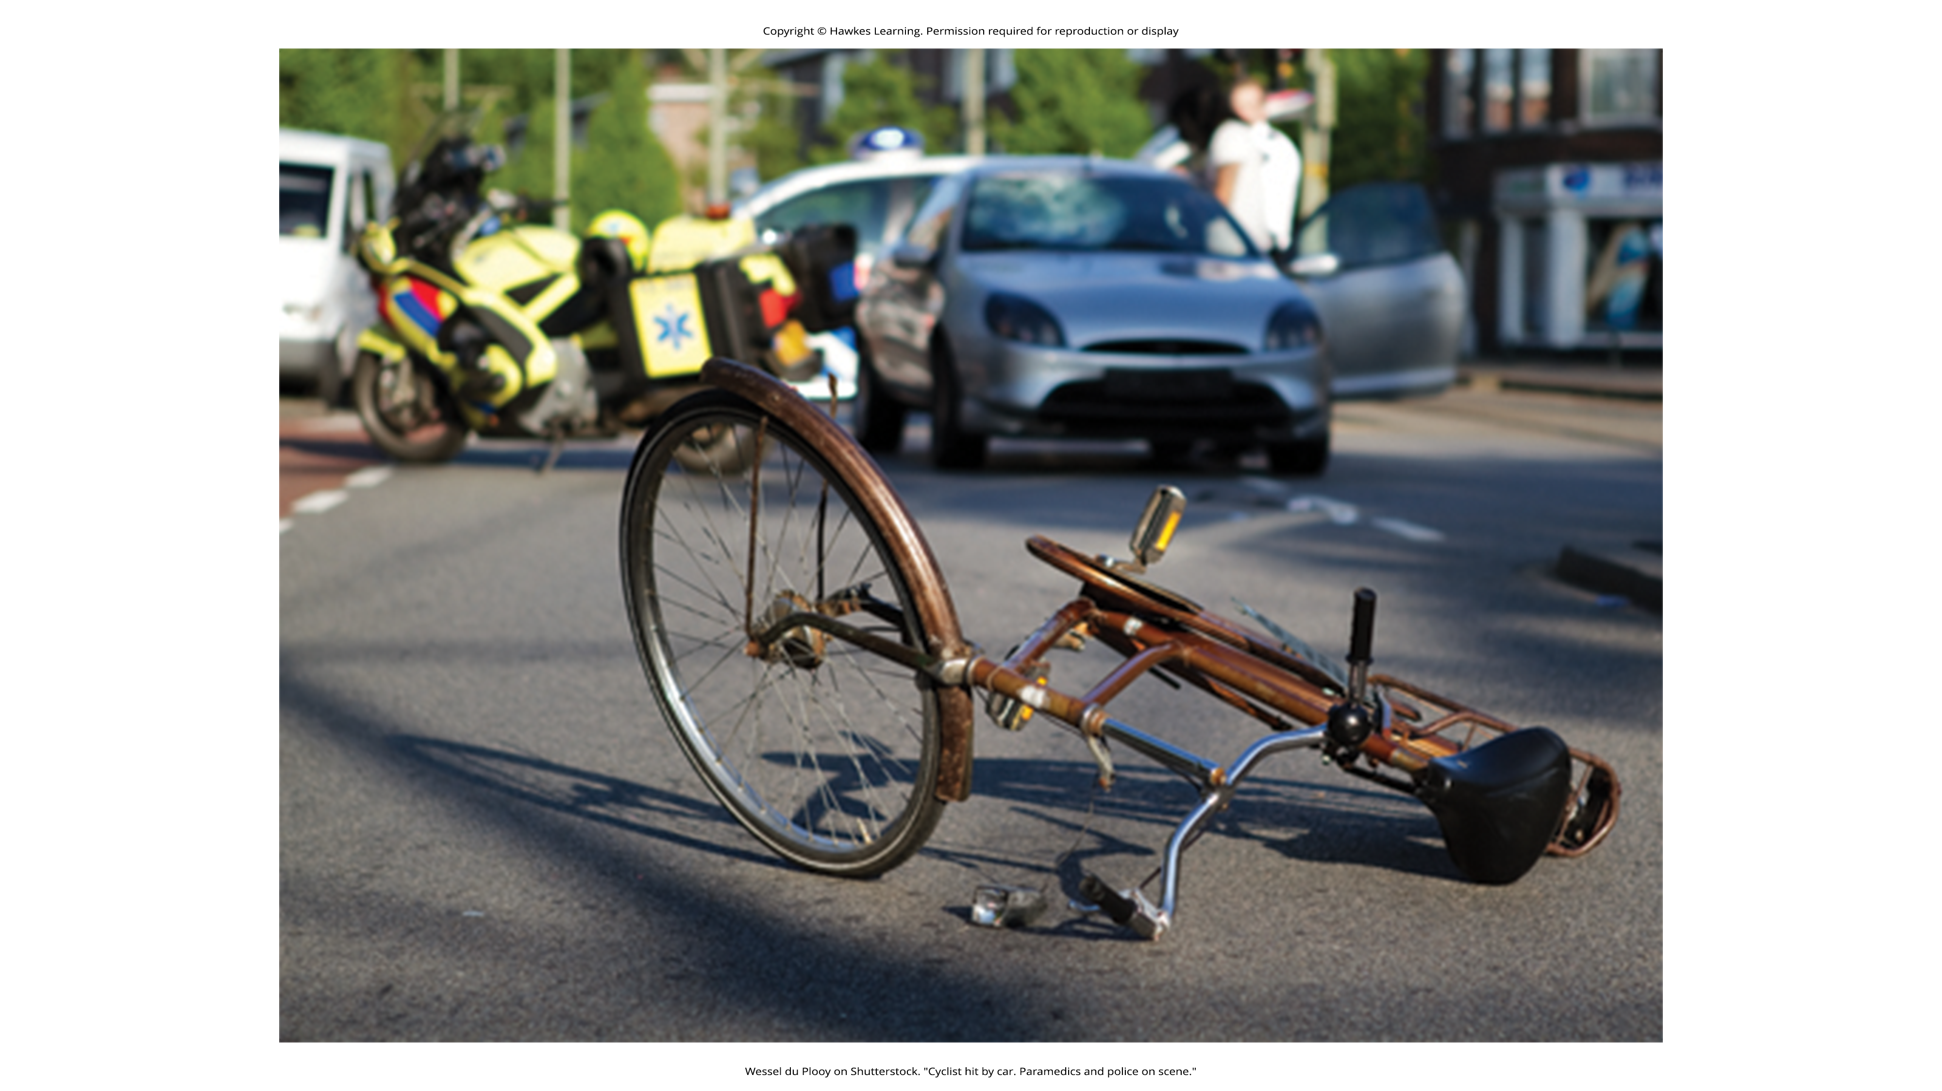
Diffusion Of Responsibility
Diffusion of responsibility is the tendency for no one in a group to help because the responsibility to help is spread throughout the group (Bandura, 1999).
Figure 6

Slide 17
Group Activity
As you learned, the bystander effect can be very powerful, holding people back from helping, especially when someone is desperately in need.
Test out the theory in real life. In pairs or small groups, go out into the community and create a situation in which one of the group members needs assistance, such as carrying a heavy load while trying to open the door. Have the person struggle alone while the other members watch to see if anyone comes to aid. Then, in a different location or time, re-create the situation. Except this time, have the other group members offer to help. See how many strangers offer to help as well.

Slide 18
Summary
Aggression is seeking to cause another person harm or pain.
Hostile aggression is motivated by feelings of anger with intent to cause pain.
Instrumental aggression is motivated by achieving a goal and does not necessarily involve intent to cause pain.
Bullying is an international public health concern that largely affects the adolescent population.
Cyberbullying is a newer form of bullying that takes place in an online environment where bullies can remain anonymous, and victims are helpless to address the harassment.
Despite the social norm of helping others in need, when there are many bystanders witnessing an emergency, diffusion of responsibility will lead to a lower likelihood of any one person helping.

Slide 19
End of Hawkes Learning PowerPoint

