Slide 1
Lesson 12.7
Prosocial Behavior

Slide 2
Prosocial Behavior
Voluntary behavior with the intent to help other people is called prosocial behavior.
Why do people help other people?
Is personal benefit, such as feeling good about oneself, the only reason people help one another?

Slide 3
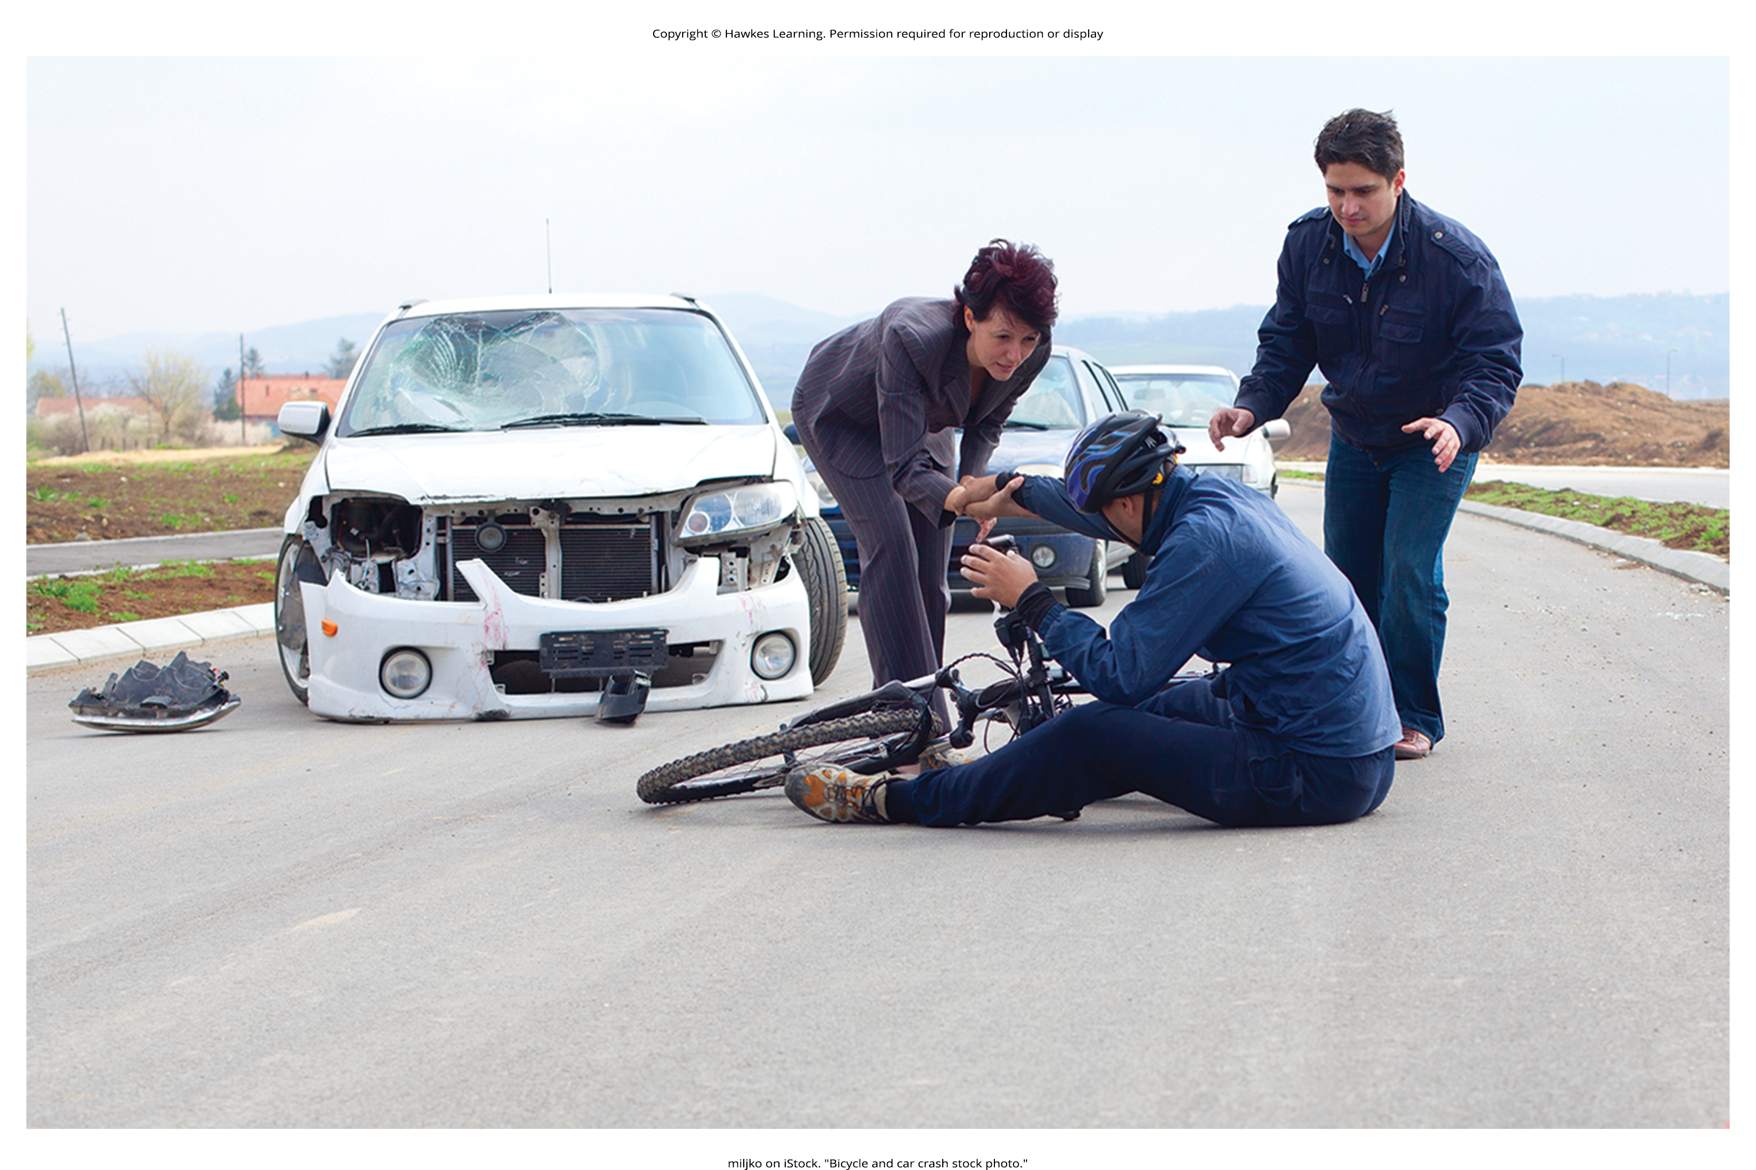
Altruism
Altruism refers to people's desire to help others even if the costs outweigh the benefits of helping.
People acting in altruistic ways may disregard the personal costs associated with helping (Figure 1).
Some researchers suggest that altruism operates on empathy.
Figure 1

Slide 4
Empathy
Empathy is the capacity to understand another person's perspective, to feel what they feel.
An empathetic person makes an emotional connection with others and feels compelled to help (Batson, 1991).
Some researchers argue that helping is always self-serving because our egos are involved, and we receive benefits from helping (Cialdini et al., 1997).
It is challenging to determine experimentally the true motivation for helping.
Whether is it largely self-serving (egoism) or selfless (altruism)
A debate on whether pure altruism exists continues.

Slide 5
Group Activity₁
In small groups, discuss the difference between apathy, empathy, and sympathy.
Now, have the members of the group think of a situation from your own lives in which empathy may be needed.
What would an apathetic, sympathetic, and empathetic response be?
What would the potential impact of each response be?

Slide 6

Forming Relationships
You are more likely to be friends with people you have regular contact with.
It is easier to form relationships with people you see often because you have the opportunity to get to know them.
We are more likely to become friends or lovers with someone who is similar to us in background, attitudes, and lifestyle.
Figure 2

Slide 7
Reflection Question
The mere-exposure effect is a psychological phenomenon by which people tend to develop a preference for things merely because they are familiar with them. This is an extension of proximity effects in regards to attraction. In other words, the more we see it, the more familiar we are with it, the more we like it.
Can you think of a person, a song, TV show, or product that you started to like after being exposed to it several times?

Slide 8
Homophily
Homophily is the tendency for people to form social networks, including friendships, marriages, business relationships, and many other types of relationships, with others who are similar (McPherson et al., 2001).

Slide 9
Group Activity₂
Homophily limits our exposure to diversity (McPherson et al., 2001).
Individually, find an example in the news about a hate crime (like a mass shooting at a synagogue) or racially based crime movements, such as #BlackLivesMatter.
In groups, introduce the news article you found and how you think it is an example of the dark side of homophily.

Slide 10

Reciprocity
Once we form relationships with people, we desire reciprocity.
Reciprocity: give and take in relationships
We want our relationships to be a two-way street.
We are more likely to like and engage with people who like us back.
Figure 3

Slide 11
Self-Disclosure
Self-disclosure is the sharing of personal information (Laurenceau et al., 1998).
We form more intimate connections with people with whom we disclose important information about ourselves.
Self-disclosure is a characteristic of healthy intimate relationships, as long as the information disclosed is consistent with our own views (Cozby, 1973).

Slide 12
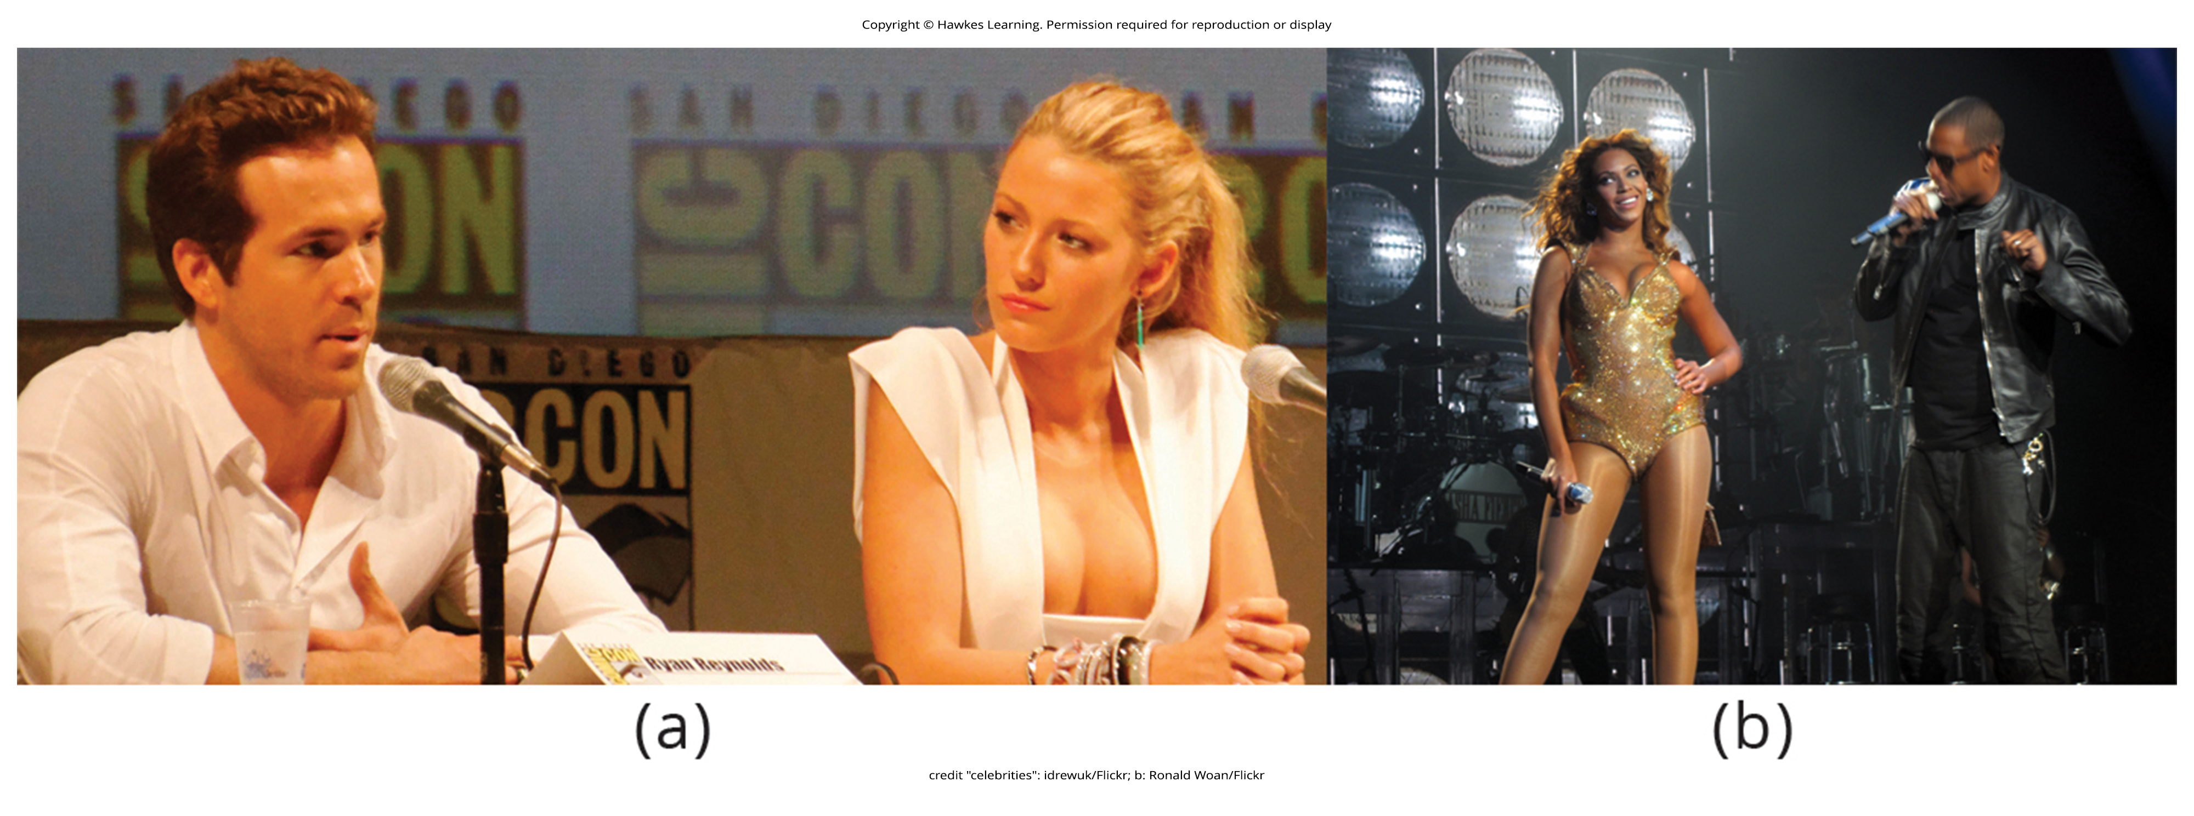
Attraction
Researchers have documented several characteristics in men and women that humans find attractive.
People differ in what they consider attractive, and attractiveness is culturally influenced.
Although humans want mates who are physically attractive, this does not mean that we look for the most attractive person possible.
The matching hypothesis asserts that people tend to pick someone they view as their equal in physical attractiveness and social desirability (Taylor et al., 2011).
Figure 4

Slide 13
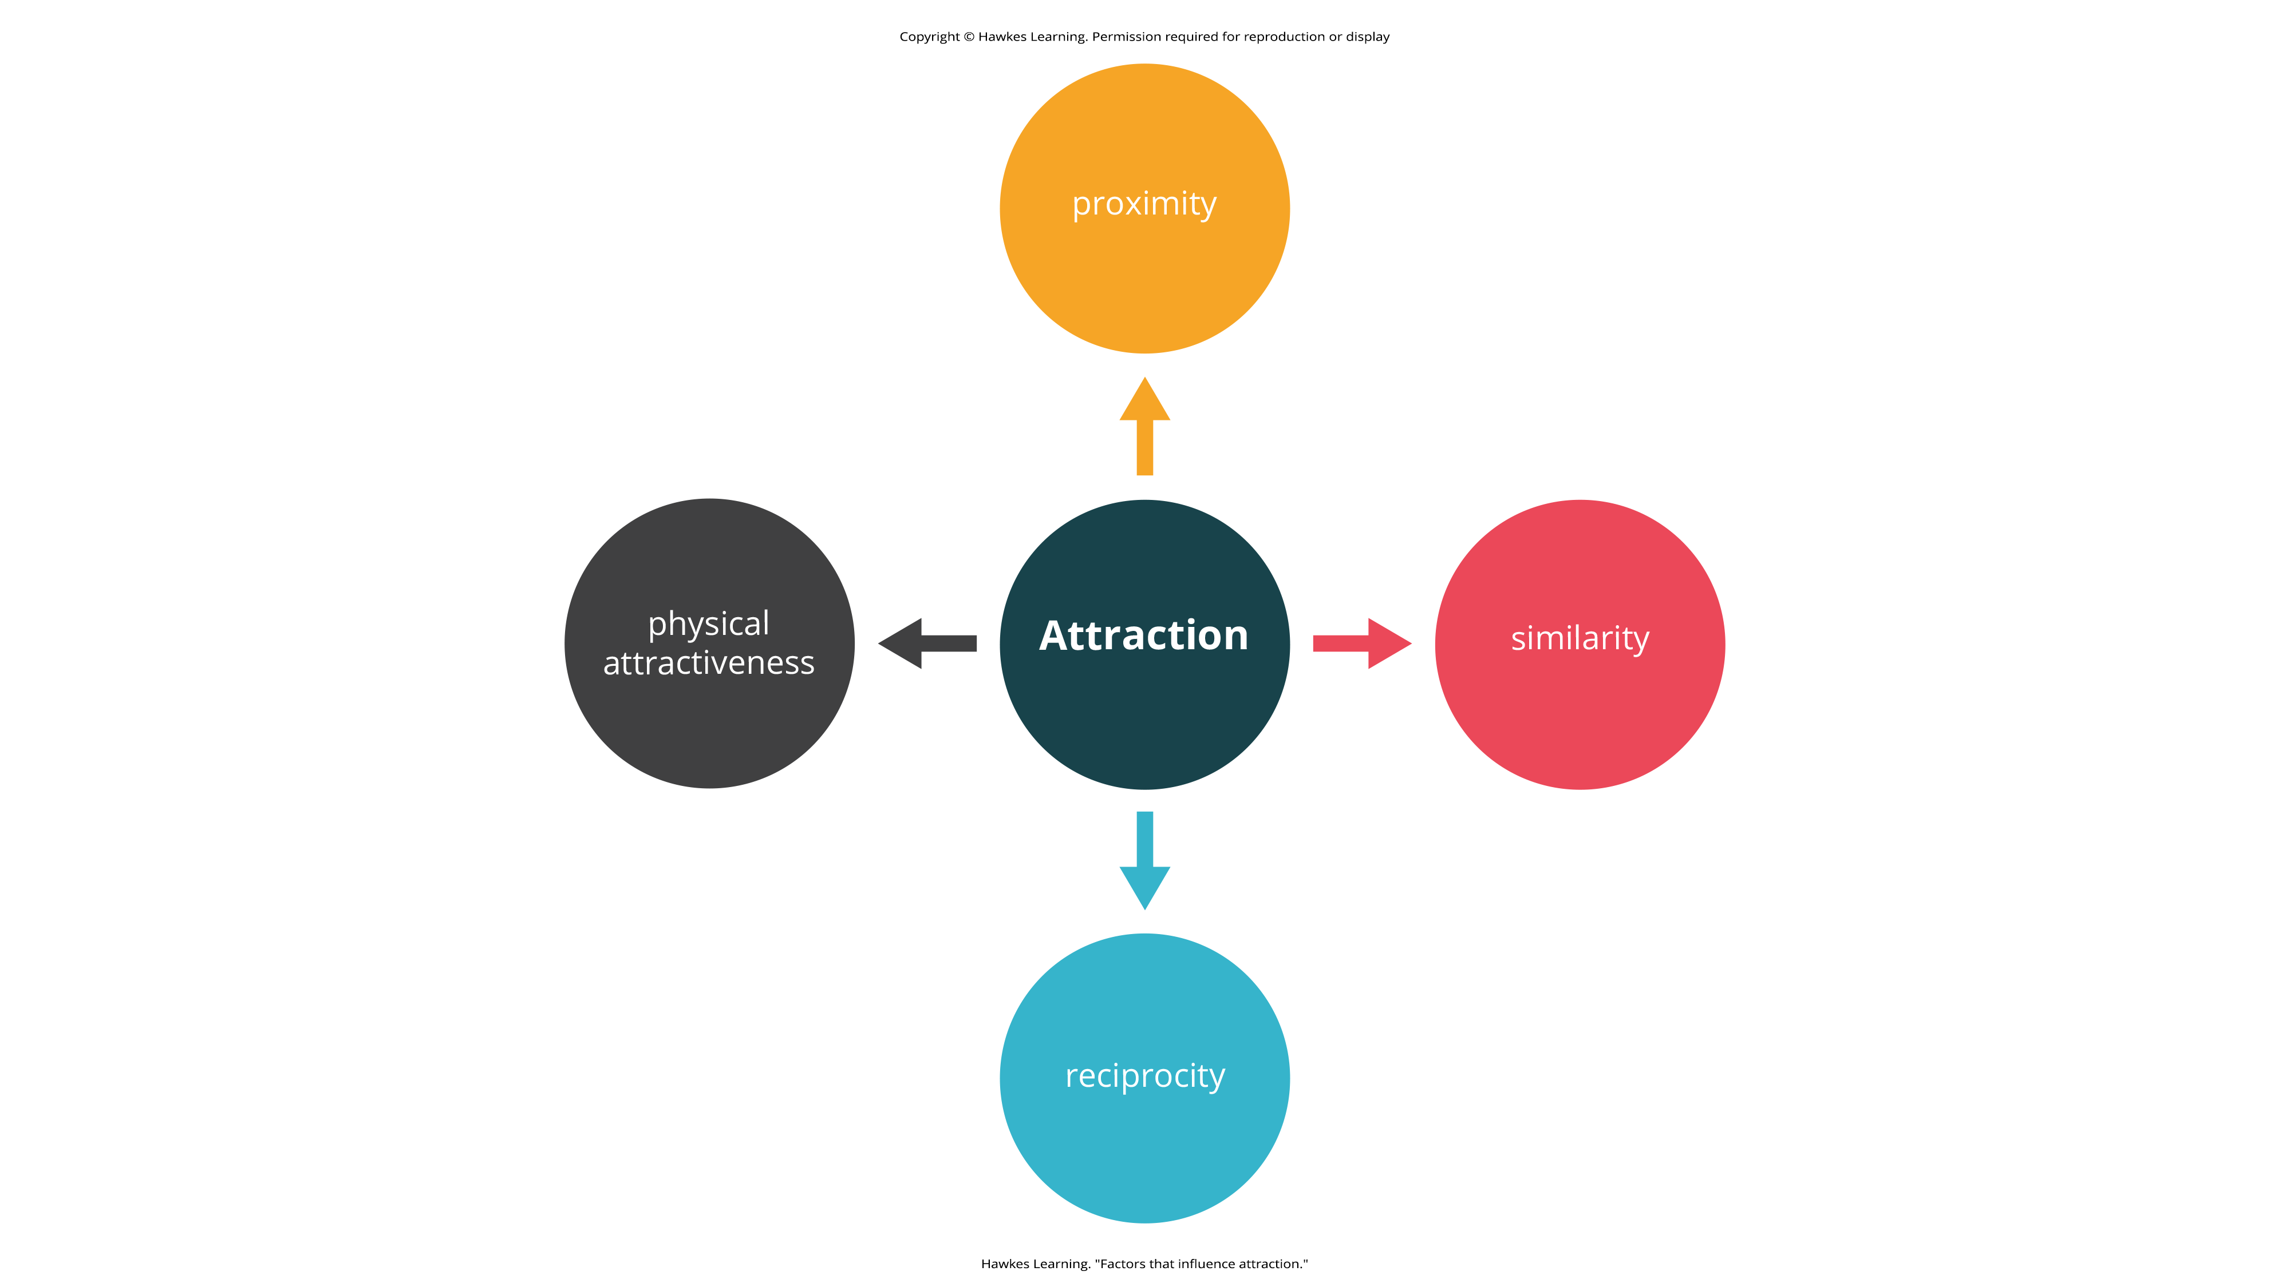
Lesson 12.7 Figure 5
Caption: There are several factors that influence attraction.

Slide 14
Sternberg's Triangular Theory Of Love₁
Robert Sternberg (1986) proposed that there are three components of love: intimacy, passion, and commitment.
These three components form a triangle that defines multiple types of love.
Triangular theory of love: model of love based on three components: intimacy passion, and commitment
Several types of love exist depending on the presence or absence of each of these components.

Slide 15
Sternberg's Triangular Theory Of Love₂
Intimacy is the sharing of details and intimate thoughts and emotions.
Passion is the physical attraction—the flame in the fire.
Commitment is standing by the person—the "in sickness and health" part of the relationship.

Slide 16
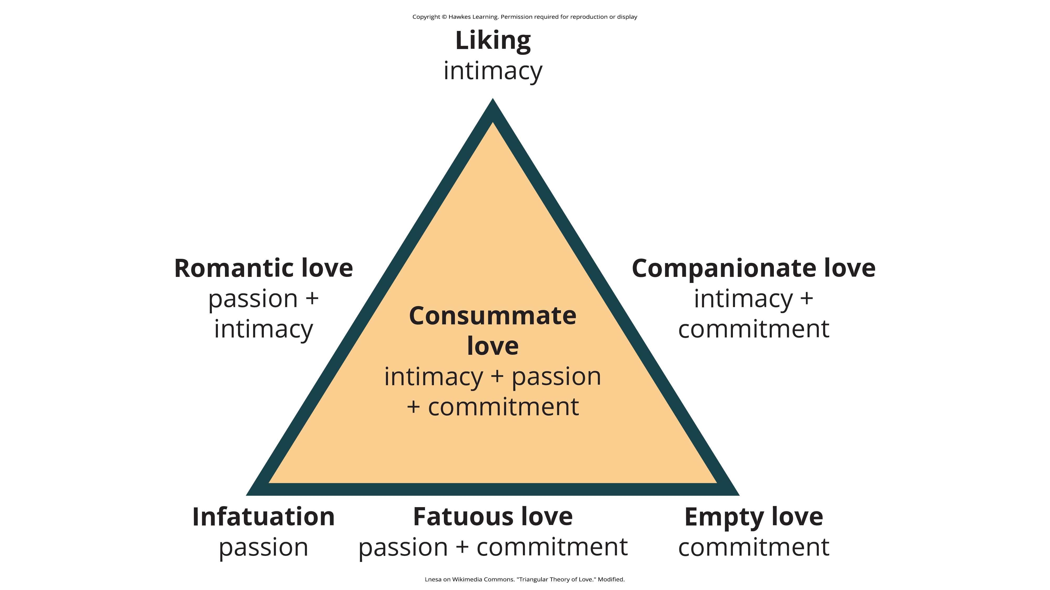
Lesson 12.7 Figure 6
Caption: According to Sternberg's triangular theory of love, seven types of love can be described from combinations of three components: intimacy, passion, and commitment.

Slide 17
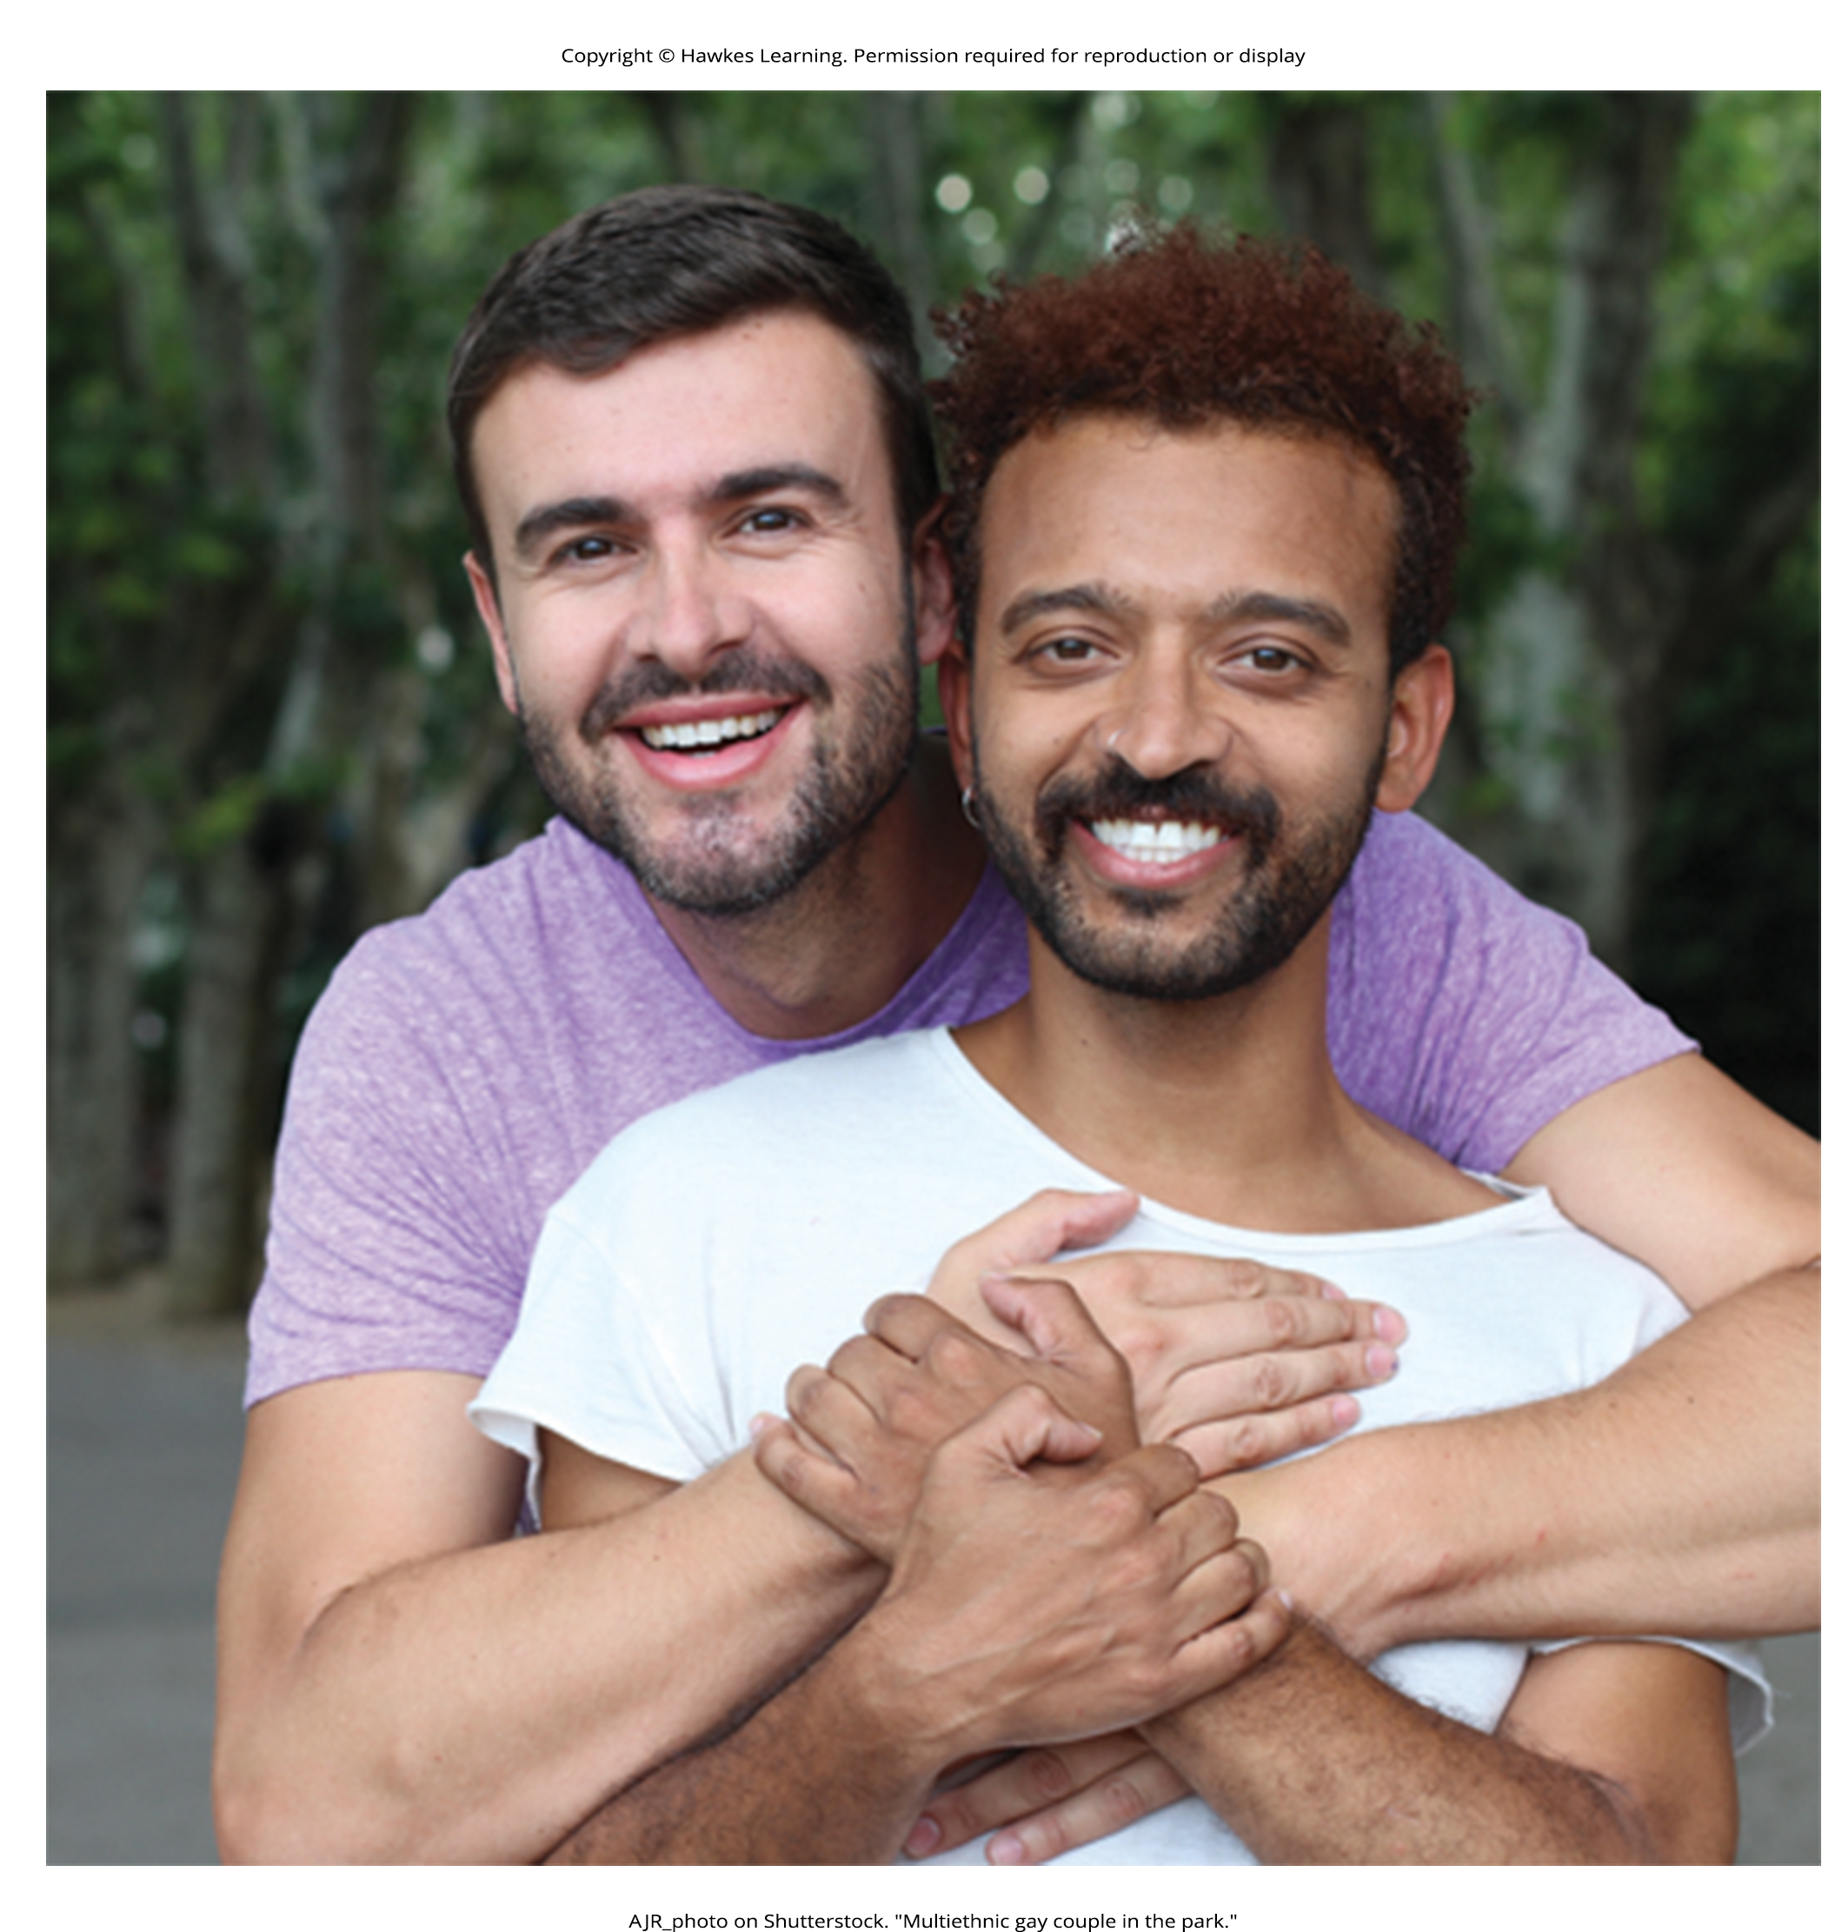
Consummate Love
Sternberg (1986) stated that a healthy relationship will have all three components of love.
Intimacy, passion, and commitment]
This is described as consummate love.
Figure 7

Slide 18
Other Forms Of Love
Liking is defined as having intimacy but no passion or commitment.
Infatuation is the presence of passion without intimacy or commitment.
Empty love is having commitment without intimacy or passion.

Slide 19
Companionate Love
Companionate love is characteristic of close friendships and family relationships.
It consists of intimacy and commitment but no passion.

Slide 20
Romantic Love
Romantic love is defined by having passion and intimacy but no commitment.

Slide 21
Fatuous Love
Fatuous love is defined by having passion and commitment but no intimacy, such as a long-term sexual love affair.

Slide 22

Social Exchange Theory
According to social exchange theory, we act as naïve economists in keeping a tally of the ratio of costs and benefits of forming and maintaining a relationship with others (Figure 8) (Rusbult & Van Lange, 2003).
People are motivated to maximize the benefits of social exchanges, or relationships, and minimize the costs.
Example: If you have ever decided to commit to a romantic relationship, you probably considered the advantages and disadvantages of your decision.
You may have considered having companionship, intimacy, and passion but also being comfortable with a person you know well.
You may think that over time boredom from being with only one person may set in; moreover, it may be expensive to share activities, such as attending movies and going to dinner.
The benefits of dating your romantic partner presumably outweigh the costs, or you wouldn't continue the relationship.
Figure 8

Slide 23
Summary
Altruism is a pure form of helping others out of empathy, which can be contrasted with egoistic motivations for helping.
We typically form relationships with people who are close to us in proximity and people with whom we share similarities.
We expect reciprocity and self-disclosure in our relationships.
We want to form relationships with people who are physically attractive.
There are many types of love that are determined by various combinations of intimacy, passion, and commitment; consummate love, which is the ideal form of love, contains all three components.
Individuals often use a social exchange approach and weigh the costs and benefits of forming and maintaining a relationship.

Slide 24
End of Hawkes Learning PowerPoint

