Slide 1
Lesson 13.1
What is Industrial and Organizational Psychology?

Slide 2

Industrial And Organizational Psychology
Also known as I-O psychology
Branch of psychology that studies how human behavior and psychology affect work and how they are affected by work
Psychologists work in four main contexts: academia, government, consulting firms, and business
Divided into three broad areas: industrial, organizational and human factors
Figure 1

Slide 3

Industrial Psychology
Industrial psychology is concerned with describing job requirements and assessing individuals for their ability to meet those requirements.
Once employees are hired, industrial psychology studies and develops ways to train, evaluate, and respond to those evaluations.
It must also consider issues of legality regarding discrimination in hiring.
Figure 2

Slide 4
Organizational Psychology
Organizational psychology is a discipline interested in how the relationships among employees affect those employees and the performance of a business.
Includes studying worker satisfaction, motivation, and commitment.
It also studies management, leadership, and organizational culture, as well as how an organization's structures, management and leadership styles, social norms, and role expectations affect individual behavior.
It considers the subjects of harassment, including sexual harassment, and workplace violence.

Slide 5
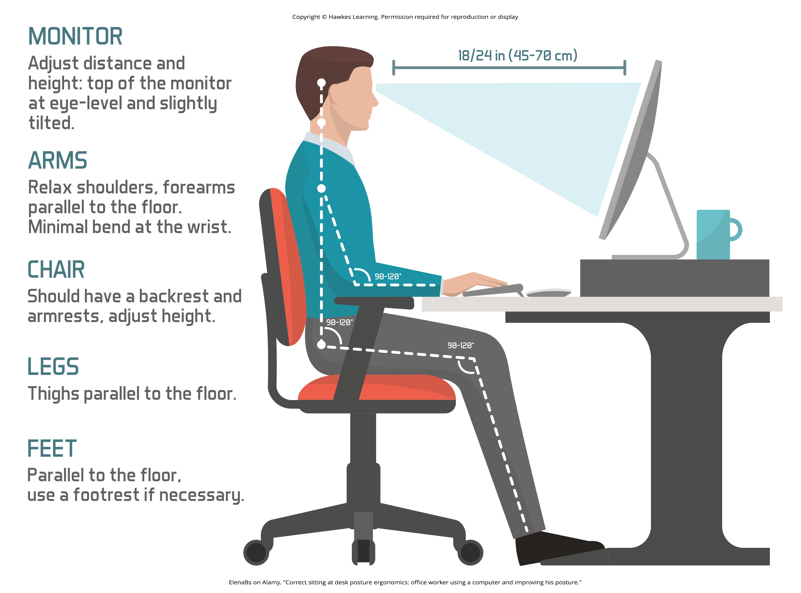
Human Factors Psychology
Human factors psychology is the study of how workers interact with the tools of work and how to design those tools to optimize workers' productivity, safety, and health.
They can also include the examination of how humans interact with complex displays and their ability to interpret them accurately and quickly.
Figure 3

Slide 6
Group Activity
Take a moment to consider the following questions:
What do you hope to get out of this psychology class?
How do you know if the class has met your expectations?
In three separate groups, define a set of expectations for your class, your instructor, and you as a student. Each groups should then create a measure or evaluation to assess your assigned target (class, instructor, student).
How easy is it to evaluate a class or the performance of a person? We know when something or someone does not meet our expectations, but how often do we consider our expectations at the beginning of a class?

Slide 7
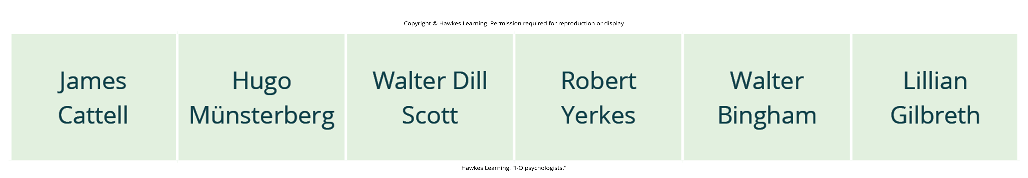
Historical Development Of I-O Psychology₁
Industrial and organizational psychology had its origins in the early 20th century.
Cattell's contribution to industrial psychology is largely reflected in his founding of the Psychological Corporation.
Evolved in the 1930s
Published the Wechsler-Bellevue Intelligence Scales for adults
The Wechsler intelligence tests have been expanded and updated and now include intelligence scales for children.
Figure 4

Slide 8
Reflection Question
Consider a job interview you attended. What kind of questions were you asked? Were they all about the role and the company, or were you also asked personal questions about yourself?

Slide 9
Historical Development Of I-O Psychology₂
In 1913, Münsterberg published Psychology and Industrial Efficiency.
Covered topics such as employee selection, employee training, and effective advertising
Employee selection is critical to the efficiency of any workplace.
Managers must hire employees that are a good fit for the role and fit in well with the rest of the employees.

Slide 10

Historical Development Of I-O Psychology₃
In 1903, Scott published two books: The Theory of Advertising and Psychology of Advertising.
They are the first books to describe the use of psychology in the business world.
The focus of all this research was in what we now know as industrial psychology.
Figure 5

Slide 11
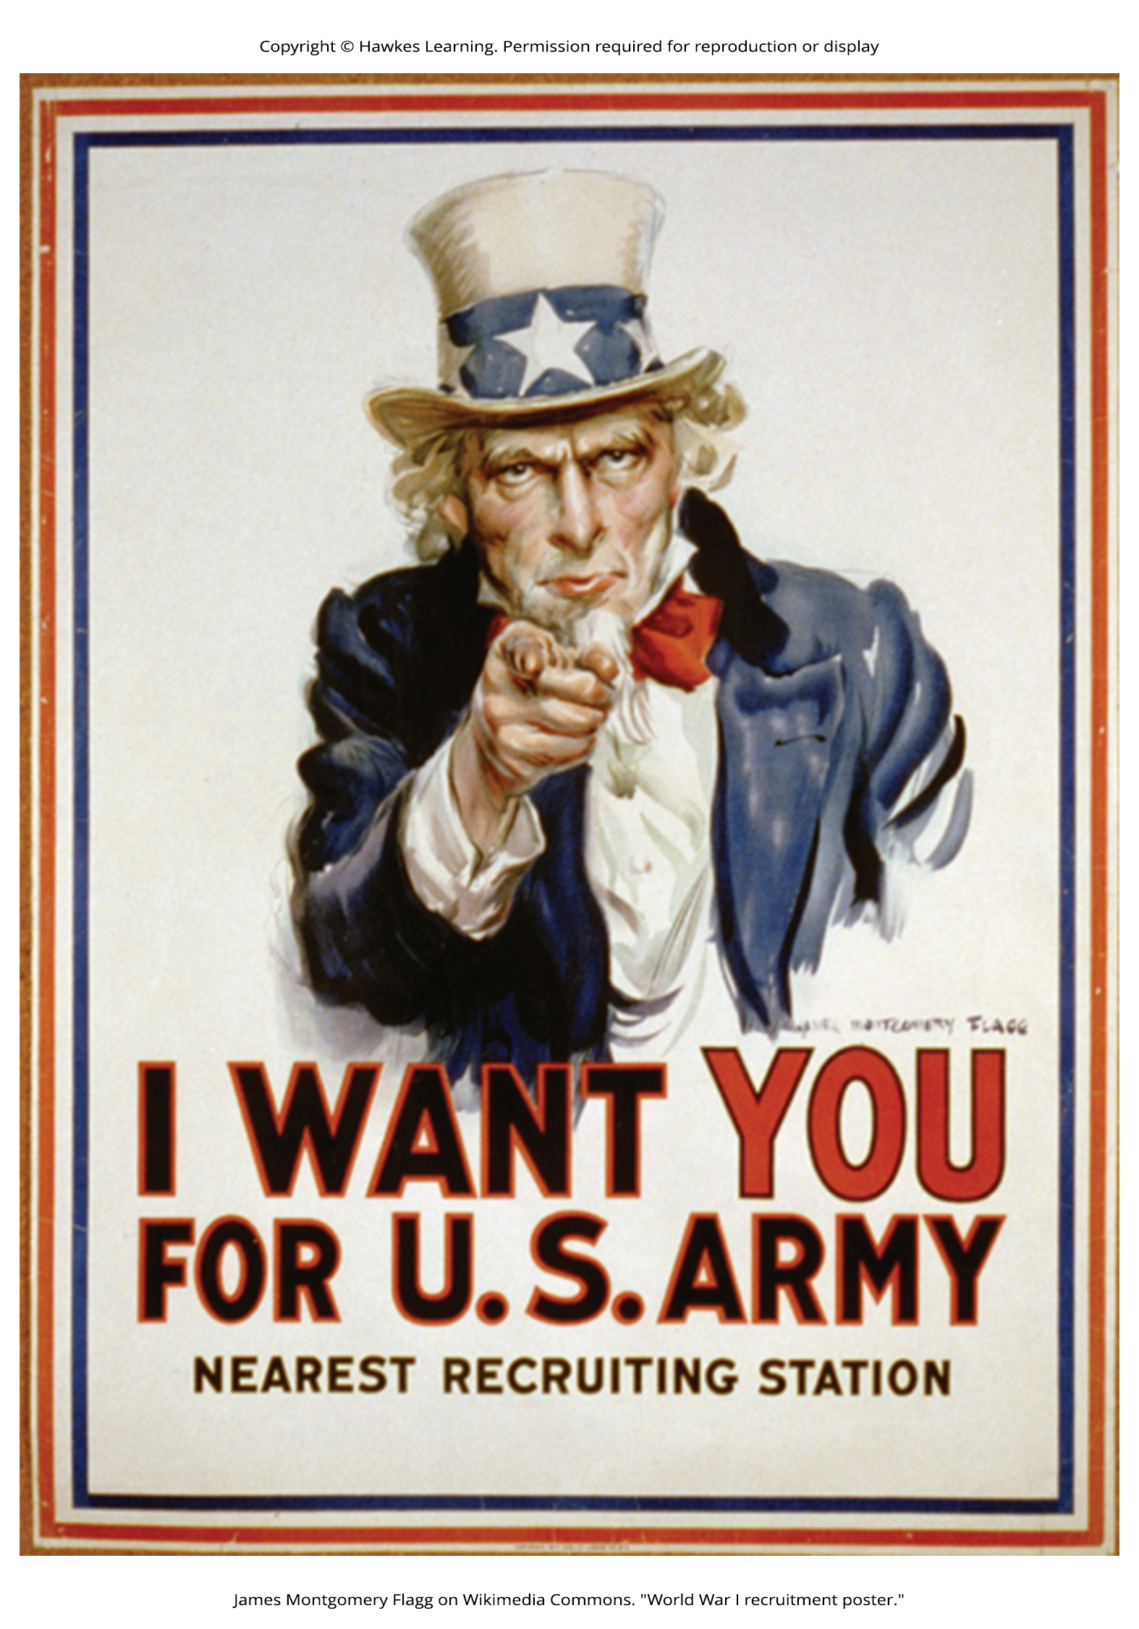
Historical Development Of I-O Psychology₄
The involvement of the United States in World War I in April 1917 catalyzed the participation in the military effort of psychologists working in this area.
Yerkes organized a group under the Surgeon General's Office (SGO) that developed methods for screening and selecting enlisted men.
Developed the Army Alpha test to measure mental abilities
Today, if you want to enter the military as an aviation officer, you would take the Aviation Standard Test Battery (ASTB-E).
Both of these modern-day military tests were developed from the early tests of Yerkes, Scott, and Bingham.
Figure 6

Slide 12
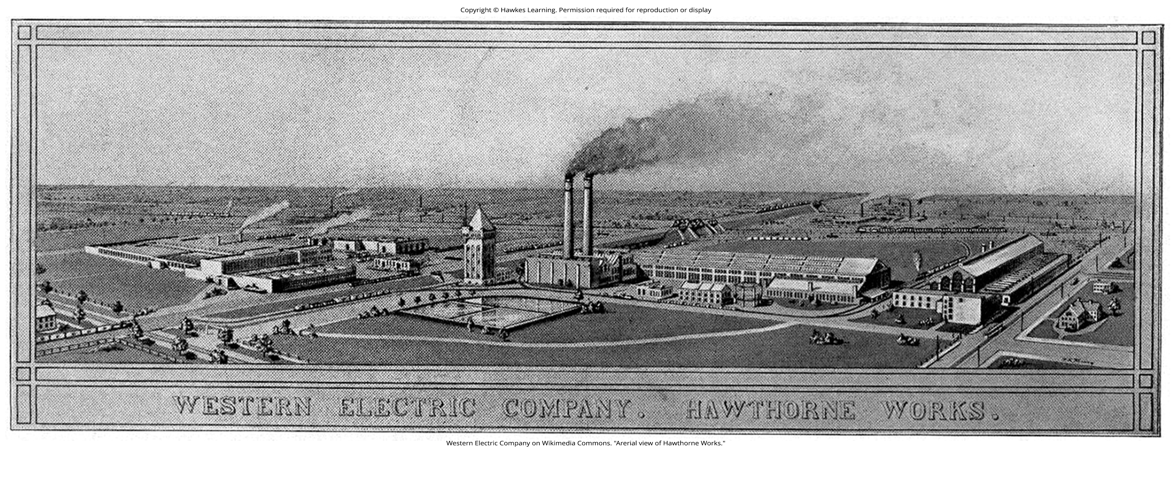
Historical Development Of I-O Psychology₅
After the war, work on personnel selection continued, with researchers like Millicent Pond studying pre-employment testing for factory workers.
Versions of these pre-employment tests are still used by many companies today to assess job fit.
From 1929 to 1932, Elton Mayo and colleagues conducted studies at Western Electric's Hawthorne Works.
These Hawthorne Studies marked the beginning of organizational psychology and went beyond just employee selection and placement.
The studies initially focused on the effects of lighting in the physical work environment but expanded to cover interpersonal relations, motivation, and organizational dynamics.
Figure 7

Slide 13
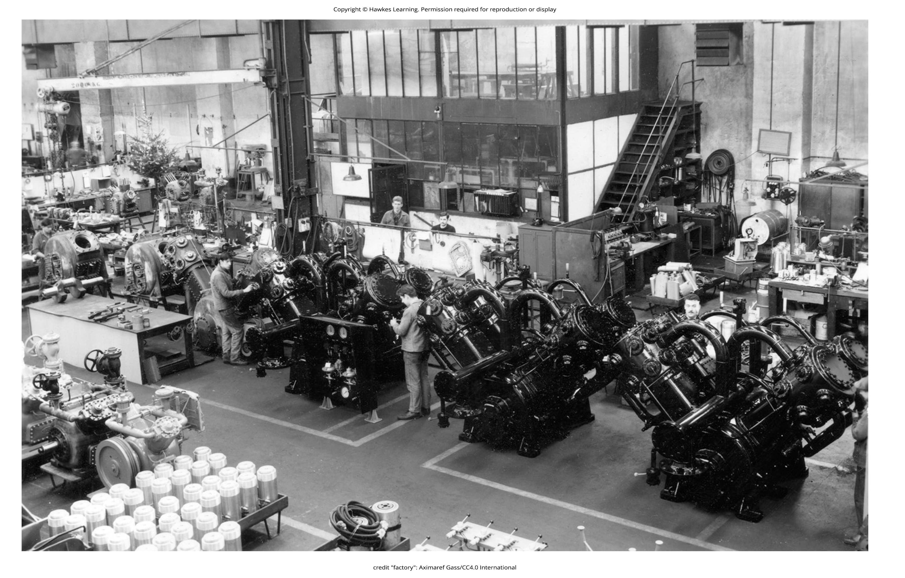
Historical Development Of I-O Psychology₆
Employees at the Hawthorne factory were aware of a lighting experiment being conducted.
As lighting was increased in stages, worker output increased each time.
However, when lighting was decreased but workers were told it increased, output still increased.
This led researchers to conclude that workers' awareness of being studied and desire to help the study, rather than lighting itself, impacted their productivity.
This phenomenon became known as the Hawthorne effect, describing increased performance due to being noticed and observed by researchers or supervisors.
Figure 8

Slide 14
Group Dynamics
In the 1930s, researchers began studying employees' feelings about their jobs, with Kurt Lewin researching leadership styles, team structures, and dynamics.
Lewin is considered the founder of social psychology, and his work influenced organizational psychology.
Lewin and his students studied how leadership styles affect aggression, group dynamics, and satisfaction, and Lewin coined the term "group dynamics."
Parallel to industrial and organizational psychology, the field of human factors psychology was developing with Frederick Taylor proposing redesigning workplaces to increase output and wages.
Taylor's theory faced criticism for potentially exploiting workers despite increasing productivity, as seen in his example of workers handling iron ingots with rest periods.

Slide 15
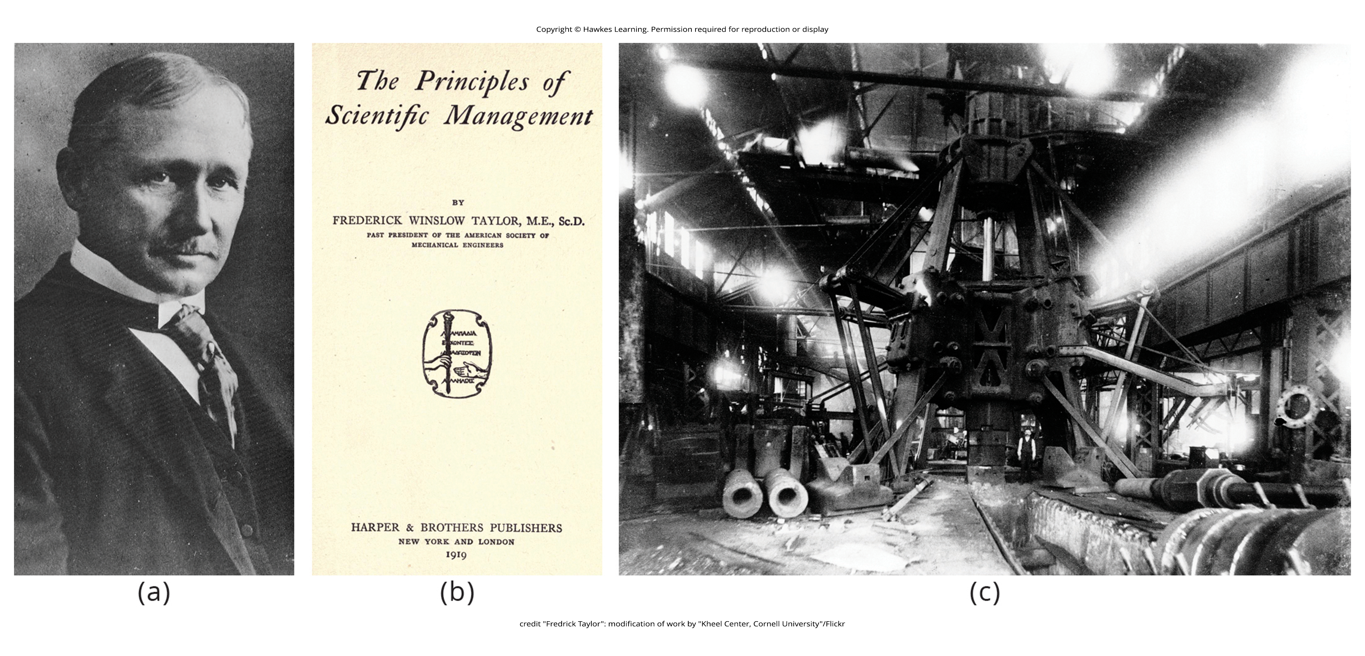
Lesson 13.1 Figure 9
Caption: (a) Frederick Taylor (1911) strived to engineer workplaces to increase productivity, based on the ideas he set forth in (b) his book The Principles of Scientific Management. (c) Taylor designed this steam hammer at the Midvale Steel Company.

Slide 16
From WWII To Today
World War II also drove the expansion of industrial psychology.
Bingham developed new systems for job selection, classification, training, and performance review, plus methods for team development, morale change, and attitude change (Katzell & Austin, 1992).
Concerns about the fairness of employment tests arose, and the ethnic and gender biases in various tests were evaluated with mixed results.
Today, I-O psychology is a diverse and deep field of research and practice, as you will learn about in the rest of this chapter.
The Society for Industrial and Organizational Psychology (SIOP) has projected a 3.8% growth rate between 2021 and 2031 for corporate positions, government, research and development, colleges and universities, and employment services.

Slide 17
On Your Own
Identify the contribution of each of the founding members of I-O psychology below:
Hugo Münsterberg
James Cattell
Walter Dill Scott
Robert Yerkes
Elton Mayo
Frederick Taylor
Lillian Gilbreth

Slide 18
Summary
The field of I-O psychology had its birth in industrial psychology and the use of psychological concepts to aid in personnel selection.
With research such as the Hawthorne study, it was found that productivity was affected more by human interaction and not physical factors.
Both WWI and WWII had a strong influence on the development of an expansion of industrial psychology in the United States and elsewhere.
The tasks the psychologists were assigned led to development of tests and research in how the psychological concepts could assist industry and other areas.
This movement aided in expanding industrial psychology to include organizational psychology.

Slide 19
End of Hawkes Learning PowerPoint

