Slide 1
Lesson 13.2
Industrial Psychology: Selecting and Evaluating Employees

Slide 2
Industrial Psychology
This branch focuses on identifying and matching persons to tasks within an organization.
It includes job analysis.
Job analysis: determining and listing tasks associated with a particular job

Slide 3
Selecting Employees
A job analysis is approached in two ways.
First approach: task-oriented approach, requires listing tasks based on how frequently they need to be performed, level of difficulty, and importance to the job.
Second approach: called job specification, describes the knowledge, skills, and abilities (KSAs) required of the worker to successfully perform the job.
Research suggests that the reliability and accuracy of a job analysis can depend on the nature of the descriptions and the source for the job analysis.
The United States Department of Labor maintains a database, O*Net, which includes previously compiled job analyses for a wide variety of jobs in different occupations.

Slide 4
On Your Own
Identify a job that you think would fit well with the following personality traits, and explain why you think that might be the case.
Agreeableness (places high value on the approval of others)
Conscientiousness (organized and careful to perform the task well)
Extroversion (enjoys the company of others)

Slide 5

Candidate Analysis And Testing
The process to narrow down potential candidates can involve testing, an interview, work samples, or other exercises.
The goal of these exercises are to match personality characteristics that would ensure good performance on the job.
Example: a high rating of agreeableness might be desirable in a customer support position
As a result, multiple forms of assessment should be conducted to determine a candidate's best fit for the position (Arthur et al., 2001; Stewart & Thornton, 2021).
Examples: IQ tests, integrity tests, and physical tests, such as drug tests or physical fitness tests
Figure 1

Slide 6

Interviews
The interview process is common for most jobs in the United States.
In an unstructured interview, the interviewer does not determine the questions beforehand.
The responses are not scored with a standardized system.
In a structured interview, the questions are prepared in advance and scored the same for each candidate.
Easier to compare across multiple candidates
Figure 2

Slide 7
Reflection Question₁
What tips have you learned to improve your performance at job interviews?

Slide 8

Training
Training usually begins for new employees with an orientation period during which they are provided information about the company and administrative policies.
An important goal of orientation training is to educate the new employee about the organizational culture, values, visions, hierarchies, and norms (Figure 3).
Arthur et al. (2003) found organizational training was effective when measured by employee response, learning outcomes, job behavior evaluations, and results-based criteria like productivity.
The examined studies represented diverse forms of training including self-instruction, lecture and discussion, and computer-assisted training.
Figure 3

Slide 9
Mentoring
Mentoring is a form of informal training in which an experienced employee guides the work of a new employee.
Mentoring is recognized as particularly important to the career success of women (McKeen & Bujaki, 2007; Ragins et al., 2021).

Slide 10
Reflection Question₂
Do you think it important to have a mentor when starting a career? Why or why not?

Slide 11
Evaluating Employees
Industrial and organizational psychologists are typically involved in designing performance-appraisal systems for organizations.
These systems are designed to evaluate whether each employee is performing their job satisfactorily.
Industrial and organizational psychologists study, research, and implement ways to make work evaluations as fair and positive as possible.
They also work to decrease the subjectivity involved with performance ratings.

Slide 12
Performance Appraisals
Performance appraisals are typically documented several times a year, often with a formal process and an annual one-on-one brief meeting between an employee and their supervisor.
The original job analysis and employee goals should inform performance appraisals.
The supervisor communicates concerns, reinforces good performance, discusses rewards or consequences, and documents poor performance
Performance appraisals allow organizations to document poor performance as justification for terminating an employee.

Slide 13
360-Degree Feedback Appraisal
One approach to performance appraisal is called the 360-degree feedback appraisal (Figure 4).
In this system, the employee's appraisal derives from a combination of ratings by supervisors, peers, employees supervised by the employee, and from the employee themselves.
The purpose of the 360-degree system is to give the employee (who may be a manager) and supervisor different perspectives of the employee's job performance.
It should help employees make improvements through their own efforts or through training.

Slide 14
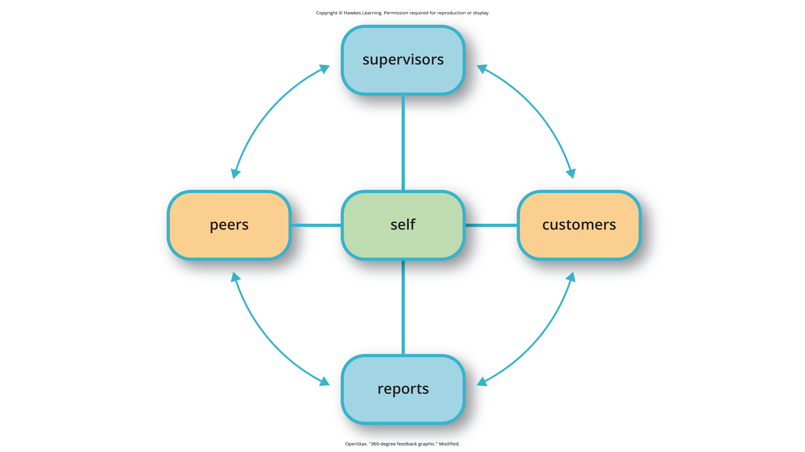
Lesson 13.2 Figure 4
Caption: In a 360-degree feedback appraisal, supervisors, customers, direct reports, peers, and the employee themselves rate an employee's performance.

Slide 15
Reflection Question₃
If you were CEO of a large company, would you include 360-degree feedback appraisals to evaluate employees' performances? Why or why not?

Slide 16
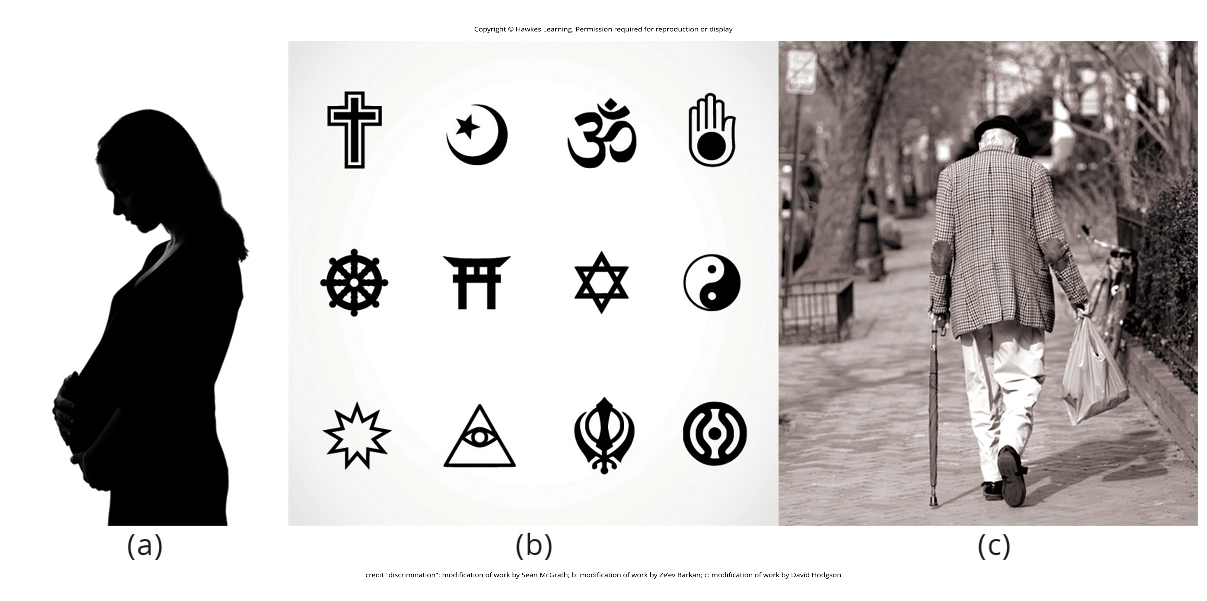
Bias And Protections In Hiring
Interview rankings can be influenced by factors other than knowledge, skills, and abilities necessary for the position.
Hiring managers may discriminate by choosing not to hire an employee because they belong to a specific group rather than because of their knowledge, skills, and abilities (Figure 5).
There are numerous local, state, and federal laws in the United States that prevent discriminatory hiring practices.
Figure 5

Slide 17
Reflection Question₄
What do you think organizations can do to prevent discriminatory hiring practices on the job?

Slide 18
The U.S. Equal Employment Opportunity Commission (EEOC)
The U.S. Equal Employment Opportunity Commission (EEOC) is responsible for enforcing federal laws that make it illegal to discriminate against a job applicant or an employee because of the following:
Race
Color
Religion
Sex (including pregnancy)
National origin
Age (40 or older)
Disability
Genetic information
Figure 6 provides some of the legal language from laws that have been passed to prevent discrimination.
The United States has several specific laws regarding fairness and avoidance of discrimination.
Example: Equal Pay Act

Slide 19
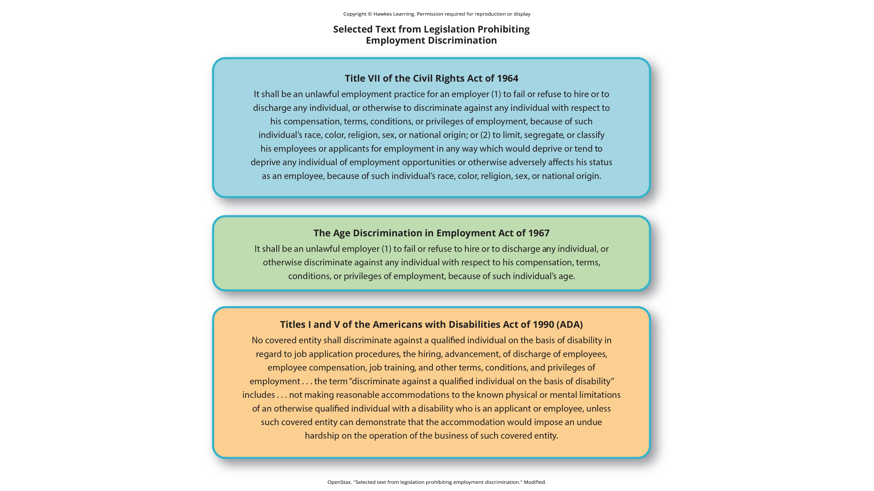
Lesson 13.2 Figure 6
Caption: The laws shown here protect employees in the U.S. from discriminatory practices.

Slide 20
Reflection Question₅
What do you think can be done to reduce the gender pay gap?

Slide 21
Immutable Characteristics
Title VII of the Civil Rights Act of 1964 makes it illegal to treat individuals unfavorably because of their race or color of their skin.
An employer cannot discriminate based on skin color, hair texture, or other immutable characteristics.
Immutable characteristics: traits that employers cannot use to discriminate in hiring, benefits, promotions, or termination
These traits are fundamental to one's personal identity
Example: skin color and hair texture

Slide 22
Americans With Disabilities Act (ADA)
The Americans with Disabilities Act (ADA) of 1990 states people may not be discriminated against due to the nature of their disability.
A disability is defined as a physical or mental impairment that limits one or more major life activities such as hearing, walking, and breathing.
If a disability is disclosed, an employer must make reasonable accommodations for the performance of a disabled employee's job.
Example: making the work facility handicapped accessible with ramps, providing readers for blind personnel, or allowing for more frequent breaks
The ADA has now been expanded to include individuals with alcoholism, former drug use, obesity, or psychiatric disabilities.

Slide 23
Bona Fide Occupational Qualifications (BFOQs)₁
The Civil Rights Act and the Age Discrimination in Employment Act make provisions BFOQs.
BFOQ: requirement of certain occupations for which denying an individual employment would otherwise violate the law, such as requirements concerning religion or sex
There are no BFOQ exceptions that apply to race.
Examples of BFOQ: hiring someone of a specific religion for a leadership position in a worship facility

Slide 24
Bona Fide Occupational Qualifications (BFOQs)₂
Courts have established a three-part test for sex-related BFOQs that are often used in other types of legal cases for determining whether a BFOQ exists.
The first test is whether all or substantially all women would be unable to perform a job.
The second test is the "essence of the business" test, in which having to choose the other gender would undermine the essence of the business operation.
This means that hiring cannot be made purely on customers' or others' preferences.
The third and final test is whether the employer cannot make reasonable alternative accommodations, such as reassigning staff so that a woman does not have to work in a male-only part of a jail or other gender-specific facility.
Most cases of BFOQs are decided on a case-by-case basis, and these court decisions inform policy and future case decisions

Slide 25
Summary
Industrial psychology studies the attributes of jobs, applicants of those jobs, and methods for assessing fit to a job.
These procedures include job analysis, applicant testing, and interviews.
It also studies and puts into place procedures for the orientation of new employees and ongoing training of employees.
The process of hiring employees can be vulnerable to bias, which is illegal, and industrial psychologists must develop methods for adhering to the law in hiring.
Performance appraisal systems are an active area of research and practice in industrial psychology.

Slide 26
End of Hawkes Learning PowerPoint

