Slide 1
Lesson 13.3
Organizational Psychology: The Social Dimension of Work

Slide 2
Organizational Psychology
Organizational psychology is the second major branch of study and practice within the discipline of industrial and organizational psychology.
The focus is on social interactions and their effect on the individual and on the functioning of the organization.

Slide 3
Job Satisfaction₁
Some people love their jobs, some people tolerate their jobs, and some people cannot stand their jobs.
Job satisfaction describes the degree to which individuals enjoy their job.
Job satisfaction is typically measured after a change in an organization, such as a shift in the management model, to assess how the change affects employees.
It may also be routinely measured by an organization to assess one of many factors expected to affect the organization's performance.

Slide 4
Reflection Question₁
Have you ever felt highly satisfied or dissatisfied with your job? How did it affect your thoughts, feelings, and motivation to perform?

Slide 5
Job Satisfaction₂
Job satisfaction is measured using questionnaires that employees complete.
A Likert scale (typically) provides five possible answers to a statement or question that allows respondents to indicate their positive-to-negative strength of agreement or strength of feeling regarding the question or statement.
  The possible responses to a question such as "How satisfied are you with your job today?" might be "Very satisfied," "Somewhat satisfied," "Neither satisfied, nor dissatisfied," "Somewhat dissatisfied," and "Very dissatisfied."
Sometimes these surveys are created for specific jobs; at other times, they are designed to apply to any job.
Job satisfaction can be measured at a global level.
Job satisfaction is related to general life satisfaction although there has been limited research on how the two influence each other or whether personality and cultural factors affect both job and general life satisfaction.
Job satisfaction is related to organizational performance, which suggests that implementing organizational changes to improve employee job satisfaction will improve organizational performance (Bowling et al., 2018; Judge & Kammeyer-Mueller, 2012).

Slide 6
Dig Deeper: Job Satisfaction In Federal Government Agencies
2013 study: plummeting federal job satisfaction vs private sector, due to pay and training
2021 survey: government job satisfaction still lags private industries
Partnership for Public Service researches federal job satisfaction since 2003
NASA highest, Homeland Security lowest among large agencies
Job satisfaction score based on 3 survey questions about recommending organization, job satisfaction, organization satisfaction

Slide 7

Job Stress
Job stress affects job satisfaction.
Job stress, or job strain, is caused by specific stressors in an occupation.
Stress can be an ambiguous term as it is used in common language.
Stress is the perception and response of an individual to events judged as overwhelming or threatening to the individual's well-being (Gyllensten & Palmer, 2005).
Stress is a result of an employee's perception that the demands placed on them exceed their ability to meet them (Gyllensten & Palmer, 2005)
  Example: having to fill multiple roles in a job or life in general
Figure 1

Slide 8
Downsizing
Downsizing is an increasingly common response to a business's pronounced failure to achieve profit goals, and it involves laying off a significant percentage of the company's employees.
I-O psychologists may be involved in all aspects of downsizing.
  How the news is delivered to employees
  How laid-off employees are supported
  How retained employees are supported

Slide 9
Business Growth
Corporation often grow larger by combining with other businesses.
  Can be accomplished through a merger (i.e., the joining of two organizations of equal power and status) or an acquisition (i.e., one organization purchases the other)
In an acquisition, the purchasing organization is usually the more powerful or dominant partner.
Both departments must be merged, which commonly involves a reduction of staff (Figure 2).
This leads to organizational processes and stresses similar to those that occur in downsizing events.
Mergers require determining how the organizational culture will change, to which employees also must adjust (van Knippenberg et al., 2002).
Research in this area focuses on understanding employee reactions and making practical recommendations for managing these organizational changes.

Slide 10
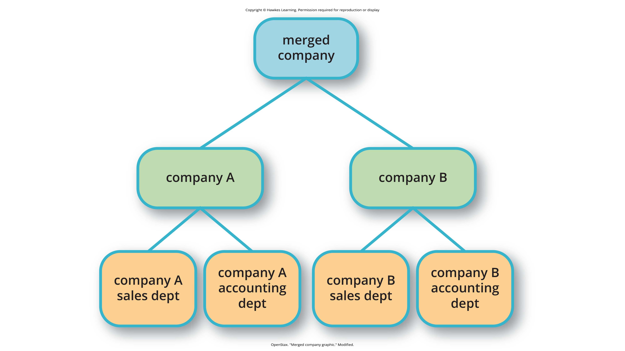
Lesson 13.3 Figure 2
Caption: When companies are combined through a merger (or acquisition), there are often cuts due to duplication of core functions, like sales and accounting, at each company.

Slide 11

Work-Family Balance₁
Many people juggle the demands of work life with the demands of their home life.
  Example: caring for children or elderly parents
Greenhaus and Beutell (1985) first identified three sources of work-family conflicts:
  Time devoted to work makes it difficult to fulfill requirements of family, or vice versa.
  Strain from participation in work makes it difficult to fulfill requirements of family, or vice versa.
  Specific behaviors required by work make it difficult to fulfill the requirements of family, or vice versa.
Women often have greater responsibility for family demands.
Research has documented that women report greater levels of stress from work-family conflict (Gyllensten & Palmer, 2005).
  The COVID-19 pandemic has only increased these disparities for women in the workforce (APA Committee on Women in Psychology, 2020).
Figure 3

Slide 12
Work-Family Balance₂
Ways to decrease work-family conflict include support in the home, workplace support, and flextime.
Telecommuting involves employees working at home and setting their own hours, which allows them to work during different parts of the day and to spend part of the day with their family.
There are organizations that have onsite daycare centers, and some companies even have onsite fitness centers and health clinics.
There are many exemplar corporations with policies designed to reduce work-family conflict.
  Example: Google's "Take Care" program offering concierge services for errands
  Example: IBM's policy of 3 years of job-guaranteed leave after the birth of a child
  Example: The Department of Defense updated the Military Parental Leave Program in January of 2023, granting 12 weeks of paid leave following the birth or adoption of a child (U.S. Department of Defense, 2023).

Slide 13
Scientific Management
A significant portion of I-O research focuses on management and human relations.
Douglas McGregor (1960) combined scientific management and human relations into the notion of leadership behavior.
  Scientific management: theory of management that analyzes and synthesizes workflows with the main objective of improving economic efficiency
His theory lays out two different styles called Theory X and Theory Y.

Slide 14
Theory X
In the Theory X approach to management, managers assume that most people dislike work and are not innately self-directed.
Theory X managers perceive employees as people who prefer to be led and told which tasks to perform and when.
Theory X workplaces will often have employees punch a clock when arriving and leaving the workplace, and tardiness is punished.
Supervisors determine whether an employee needs to stay late, and even this decision would require someone higher up in the command chain to approve the extra hours.
Supervisors will ignore employees' suggestions for improved efficiency and reprimand employees for speaking out of order.
Supervisors blame efficiency failures on individual employees rather than the systems or policies in place.
Managerial goals are achieved through a system of punishments and threats rather than enticements and rewards.
Managers are suspicious of employees' motivations and always suspect selfish motivations for their behavior at work (e.g., being paid is their sole motivation for working).

Slide 15
Theory Y
In the Theory Y approach, managers assume that most people seek inner satisfaction and fulfillment from their work.
Employees function better under leadership that allows them to participate in and provide input about setting their personal and work goals.
Employees participate in decisions about prioritizing tasks; they may belong to teams that, once given a goal, decide themselves how it will be accomplished.
In such a workplace, employees are able to provide input on matters of efficiency and safety.
A Theory Y workplace will also meaningfully consult employees on any changes to the work process or management system.

Slide 16
Reflection Question₂
Do you agree with McGregor (1960), or do you see a case where Theory X may be more desirable than Theory Y?

Slide 17
Transactional Leadership
Leadership is an important element of management.
Leadership styles have been of major interest within I-O research, and researchers have proposed numerous theories of leadership.
In transactional leadership, the focus is on supervision and organizational goals, which are achieved through a system of rewards and punishments (i.e., transactions).
Transactional leaders maintain the status quo: They are managers.

Slide 18

Transformational Leadership
People who employ transformational leadership possess four attributes to varying degrees:
  Charismatic (highly liked role models)
  Inspirational (optimistic about goal attainment)
  Intellectually stimulating (encourage critical thinking and problem solving)
  Considerate
  (Bass et al., 1996)
Figure 4

Slide 19
Followership
A new and emerging area of research within psychology focuses on leadership and the relationship with leaders from the perspective of a follower.
This "followership" research suggests that studies need to examine the leader-follower relationship in both directions—instead of focusing only on leadership—to better understand the dynamics of the relationship (Matshoba-Ramuedzisi et al., 2022).
People are individuals, and because they are different, there probably is no single best leadership-follower dynamic between leaders and followers.

Slide 20
Work Teams
Work teams bring together diverse skills, experience, and expertise.
In the team-based approach, teams are brought together and given a specific task or goal to accomplish.
Some teams work well and other teams do not.
  Teams can mask team members that are not working (i.e., social loafing).
Teams can be inefficient due to poor communication; they can have poor decision-making skills due to conformity effects; and they can have conflict within the group.
The popularity of teams may result from the team halo effect: Teams are given credit for their successes, but individuals within a team are blamed for team failures (Naquin & Tynan, 2003).
One aspect of team diversity is their gender mix.

Slide 21
Reflection Question₃
Why do you think certain teams work well together and certain teams do not?

Slide 22
Types of Teams
There are three basic types of teams:
  Problem resolution teams are created for the purpose of solving a particular problem or issue (for example, the diagnostic teams at the Centers for Disease Control).
  Creative teams are used to develop innovative possibilities or solutions; for example, design teams for car manufacturers create new vehicle models.
  Tactical teams are used to execute a well-defined plan or objective, such as a police or FBI SWAT team handling a hostage situation (Larson & LaFasto, 1989).

Slide 23
Reflection Question₄
Which team would you like to be a part of—problem resolution, creative, or tactical? Why?

Slide 24
Organizational Culture
Organizational culture encompasses the values, visions, hierarchies, norms, and interactions among its employees.
It is how an organization is run, how it operates, and how it makes decisions—the industry in which the organization participates may have an influence.
Ostroff and colleagues (2003) identified three layers in organizational culture: observable artifacts, espoused values, and basic assumptions.
  Observable artifacts are the symbols, language (jargon, slang, and humor), narratives (stories and legends), and practices (rituals) that represent the underlying cultural assumptions.
  Espoused values are concepts or beliefs that the management or the entire organization endorse. They are the rules that allow employees to know which actions they should take in different situations and which information they should adhere to.
  These basic assumptions generally are unobservable and unquestioned.
Researchers have developed survey instruments to measure organizational culture.

Slide 25
Diversity Training
Diversity training educates participants about cultural differences with the goal of improving teamwork.

Slide 26
Dig Deeper: Managing Generational Differences
Age is an important consideration in managing employees, as workers' expectations and attitudes develop from their generational experiences.
Members of Generation X are nearing retirement, while Millennials are in the middle of their careers, and Generation Z is beginning to enter the workforce.
These three generations have distinctive expectations, habits, attitudes, and motivations, with a major difference being their knowledge and use of technology in the workplace.
Recruiting and retaining Millennials and Gen Z employees poses challenges, as they do not necessarily expect to build a career with one company.
Retention of Millennial and Gen Z employees requires flexibility and robust benefits packages, including mental health and overall wellness support.
Research into recruiting and retaining younger adults remains at the forefront of industrial-organizational research.

Slide 27

Sexual Harassment
Most organizations have developed sexual harassment policies that define sexual harassment (or harassment in general) and the procedures set in place to prevent and address it when it does occur.
The U.S. Equal Employment Opportunity Commission (1997) provides the following description of sexual harassment:
  “Unwelcome sexual advances, requests for sexual favors, and other verbal or physical conduct of a sexual nature constitute sexual harassment when this conduct explicitly or implicitly affects an individual's employment, unreasonably interferes with an individual's work performance, or creates an intimidating, hostile, or offensive work environment. (par. 2)”
Figure 5

Slide 28
Forms Of Sexual Harassment
There are several forms of sexual harassment, which include the following:
  Quid pro quo means you give something to get something, and in this case, it refers to a situation in which organizational rewards are offered in exchange for sexual favors.
    Example: a supervisor might request an action, such as a kiss or a touch, in exchange for a promotion, a positive performance review, or a pay raise
  The threat of withholding a reward if a sexual request is refused
  Hostile environment sexual harassment is when an employee experiences conditions in the workplace that are considered hostile or intimidating.
    Example: a work environment that allows offensive language or jokes or displays sexually explicit images
Isolated occurrences of these events do not constitute harassment, but a pattern of repeated occurrences does.

Slide 29
Workplace Violence₁
Workplace violence is any act or threat of physical violence, harassment, intimidation, or other threatening, disruptive behavior that occurs at the workplace.
It ranges from threats and verbal abuse to physical assaults and even homicide (Occupational Safety & Health Administration, n.d.).
There are different targets of workplace violence:
  A person could commit violence against coworkers, supervisors, or property.
  Warning signs often precede such actions: intimidating behavior, threats, sabotaging equipment, or radical changes in a coworker's behavior.
  Often there is intimidation and then escalation that leads to even further escalation.

Slide 30
Reflection Question₅
What do you think are some challenges employees face when reporting workplace aggression?

Slide 31
Workplace Violence₂
Murder is a leading cause of death in the workplace.
There are many triggers for workplace violence.
  Example: the feeling of being treated unfairly, unjustly, or disrespectfully.
Procedural justice refers to the fairness of the processes by which outcomes are determined in conflicts with or among employees.
To understand and predict workplace violence, Greenberg and Barling (1999) emphasized the importance of considering the employee target of aggression or violence and characteristics of both the workplace and the aggressive or violent person.

Slide 32
Reflection Question₆
What is an example of implementing a procedural justice policy in the workplace that may prevent aggression to a supervisor?

Slide 33
Summary
Organizational psychology is concerned with the effects of interactions among people in the workplace, on the employees themselves, and on organizational productivity.
Job satisfaction and its determinants and outcomes are a major focus of organizational psychology research and practice.
Organizational psychologists have also studied the effects of management styles and leadership styles on productivity.
Organizational psychology also looks at the organizational culture and how that might affect productivity.
Sexual harassment includes language, behavior, or displays that create a hostile environment; it also includes sexual favors requested in exchange for workplace rewards (i.e., quid pro quo).
I-O psychology has conducted extensive research on the triggers and causes of workplace violence and safety.

Slide 34
End of Hawkes Learning PowerPoint

