Slide 1
Lesson 13.4
Human Factors Psychology and Workplace Design

Slide 2
Human Factors Psychology
Human factors psychology is also known as ergonomics.
This field is concerned with the integration of the human-machine interface in the workplace through design.
Human factor professionals help with software design, testing, evaluation, and determining regulations and principles for best design (Howell, 2003).
The American National Standards Institute (ANSI, 2000) develops many standards related to ergonomic design.
Example: Standards for the design of control-center workstations that are used for transportation control or industrial process control

Slide 3
Reflection Question
Why do you think psychologists are employed to help address issues related to workplace safety?

Slide 4
Safety Checklists
Many of the concerns of human factors psychology are related to workplace safety.
They often assist industry leaders in creating safety checklists.
The surgical safety checklist shown in Figure 1 was developed by the World Health Organization (WHO).

Slide 5
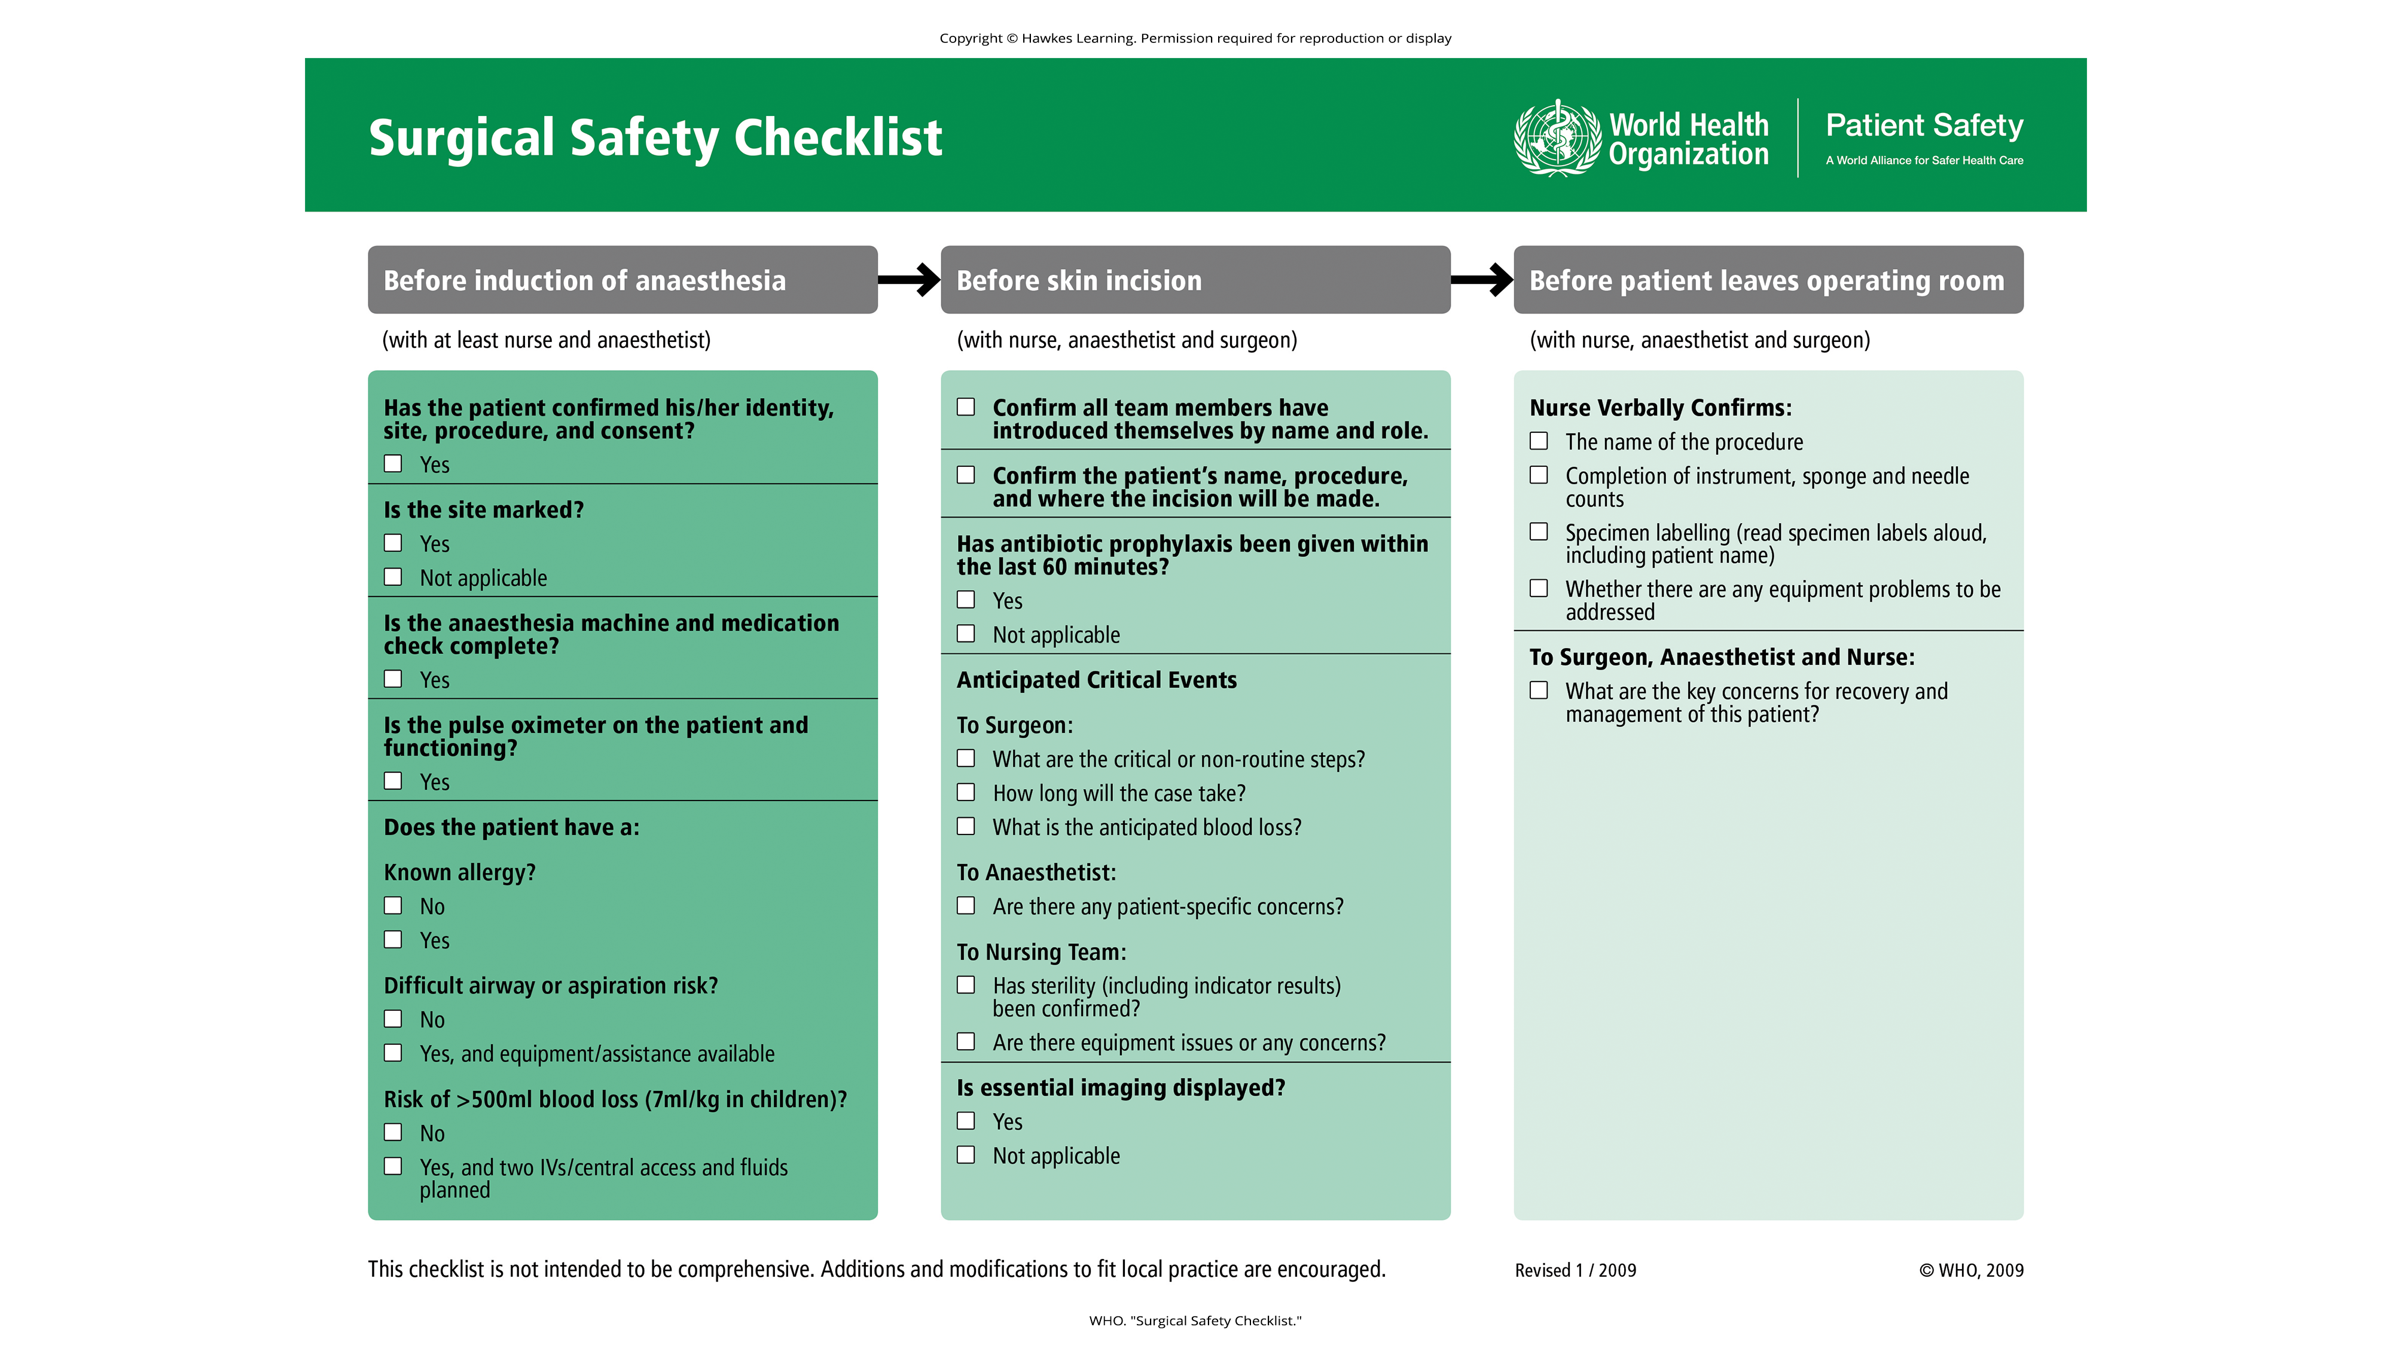
Lesson 13.4 Figure 1
Caption: Checklists, such as the WHO surgical checklist, help reduce workplace accidents.

Slide 6
On Your Own
Write a safety checklist for cooking food on the stove in your kitchen.

Slide 7
Safety Concerns
Safety concerns also lead to limits on how long an operator, such as a pilot or truck driver, is allowed to operate the equipment.
Example: The Federal Aviation Administration (FAA) introduced limits for how long a pilot is allowed to fly without an overnight break.

Slide 8
Areas Of Study In Human Factors Psychology₁
Attention
Description: includes vigilance and monitoring, recognizing signals in noise, mental resources, and divided attention
I-O Questions:
How is attention maintained?
What about tasks maintains attention?
How to design systems to support attention?
Cognitive engineering
Description: includes human software interactions in complex automated systems, especially the decision-making processes of workers as they are supported by the software system
I-O Questions:
How do workers use and obtain information provided by software?

Slide 9
Areas Of Study In Human Factors Psychology₂
Task analysis
Description: breaking down the elements of a task
I-O Questions:
How can a task be performed more efficiently?
How can a task be performed more safely?
Cognitive task analysis
Description: breaking down the elements of a cognitive task
I-O Questions:
How are decisions made?

Slide 10
Summary
Human factors psychology, or ergonomics, studies the interface between workers and their machines and physical environments.
Human factors psychologists specifically seek to design machines to better support the workers using them.
Psychologists may be involved in design of work tools such as software, displays, or machines from the beginning of the design process or during the testing of an already developed product.
Human factor psychologists are also involved in the development of best design recommendations and regulations, including safety.

Slide 11
End of Hawkes Learning PowerPoint

