Slide 1
Lesson 14.1
What Is Stress?

Slide 2

What Is Stress?₁
College students face a lot of pressure and stress.
Example: exams, term papers, debt, employment
Stress also surrounds financial security, friendships, work, and family.
Scientific interest in stress and how we adapt and cope has been longstanding in psychology.
Figure 1

Slide 3

What Is Stress?₂
Stress: first emerged in 1930s scientific literature; became common in public discourse in the 1970s (Lyon, 2012)
Often used loosely to describe feelings of frustration, anger, conflict, overwhelm, or fatigue
Difficult to define due to its vague and subjective nature
Stimulus-based definitions: stress as a demanding or threatening event
Response-based definitions: stress as the body's physiological reaction to the environment
Figure 2

Slide 4
What Is Stress?₃
Hans Selye's definition: "response of the body to any demand" (Selye, 1976, p. 74)
Response-based because it imagines stress in terms of a physiological reaction to any demand
Modern view: stress as a process of perceiving and appraising events appraised as overwhelming or threatening to well-being (Lazarus & Folkman, 1984)
Emphasizes how we judge stressors (demanding or threatening events)
Appraisals influenced by our reactions to these events

Slide 5
Group Activity
With a group, discuss what you feel to be more common: stress as a stimulus or stress as a response. Why do you feel this way?

Slide 6

Primary Appraisal
Primary appraisal is a judgment about the degree of potential harm or threat to well-being from a stressor.
Threat: anticipating negative consequences (e.g., excessive work demands)
Challenge: believing in potential gain or growth (e.g., learning new skills) (Jamieson & Hangen, 2018)
Example: A promotion can be seen as a threat due to increased work demands vs. a challenge for professional growth.
Example: A student on the cusp of graduation may see it as a threat or a challenge (Figure 3).
Figure 3

Slide 7
Secondary Appraisal
Secondary appraisal is judgment of the options available to cope with a stressor and perceptions of their effectiveness (Lyon, 2012) (Figure 4).
Belief in one's ability to complete a task (self-efficacy) is important (Bandura, 1994; Jamieson & Hangen, 2018).
A threat is viewed as less catastrophic if one believes something can be done (Lazarus & Folkman, 1984).
Example: Two women find a lump; their stress levels differ based on their perceived ability to handle the situation.

Slide 8
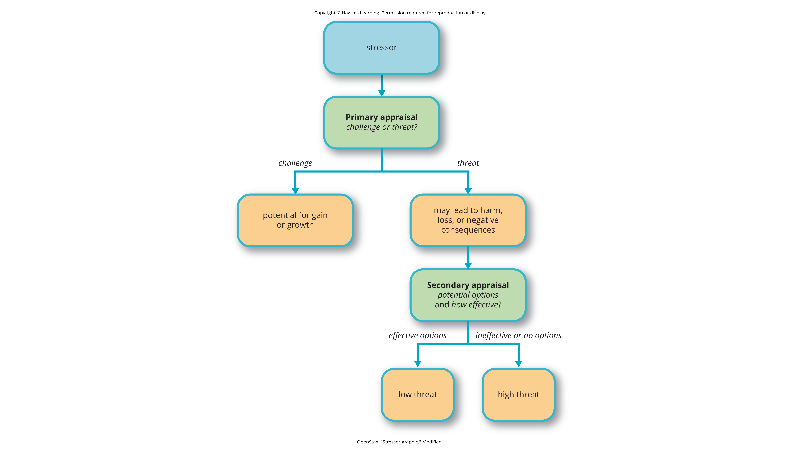
Lesson 14.1 Figure 4
Caption: When encountering a stressor, a person judges its potential threat (primary appraisal) and then determines if effective options are available to manage the situation. Stress is likely to result if a stressor is perceived as extremely threatening or threatening with few or no effective coping options available.

Slide 9
Appraisal and Stress
Some stressors are more stressful because they are more threatening and leave less potential for appraisal variation.
Appraisal plays a role in augmenting/diminishing our reactions to stressful events (Everly & Lating, 2002).
Appraisal of an event as harmful and overwhelming leads to a subjective stress experience.
Stress is not so much what happens to you as it is how you respond (Selye, 1976).

Slide 10
Reflection Question₁
Can you think of a scenario in which you might not feel stressed, but most other people would? How about a scenario you find particularly stressful that others might not? What do you think causes these reactions for you?

Slide 11

Good Stress₁
Eustress is stress that motivates us to do things in our best interest.
Proposed by Selye, who pointed out not all stress is harmful (1974)
Examples: studying for exams, visiting the doctor regularly, exercising, performing well at work
Moderate stress can enhance memory and recall.
Study: Male participants who memorized a scientific text passage showed improved memory of it immediately after a mild stressor (Hupbach & Fieman, 2012)
Figure 5

Slide 12
On Your Own
Discuss an example in your own life of when stress has positively impacted you. Describe what this impact looked like and what, if anything, you learned from the experience.

Slide 13
Good Stress₂
Performance increases with stress up to an optimal level (Figure 6).
Fully energized, focused, and efficient
Stress beyond this level = distress
Distress is excessive, debilitating stress that leads to burnout and health decline.
Proposed by Selye
Feelings of burnout, fatigue, exhaustion, and decreased performance
If excessive for too long, health can erode (Everly & Lating, 2002)

Slide 14
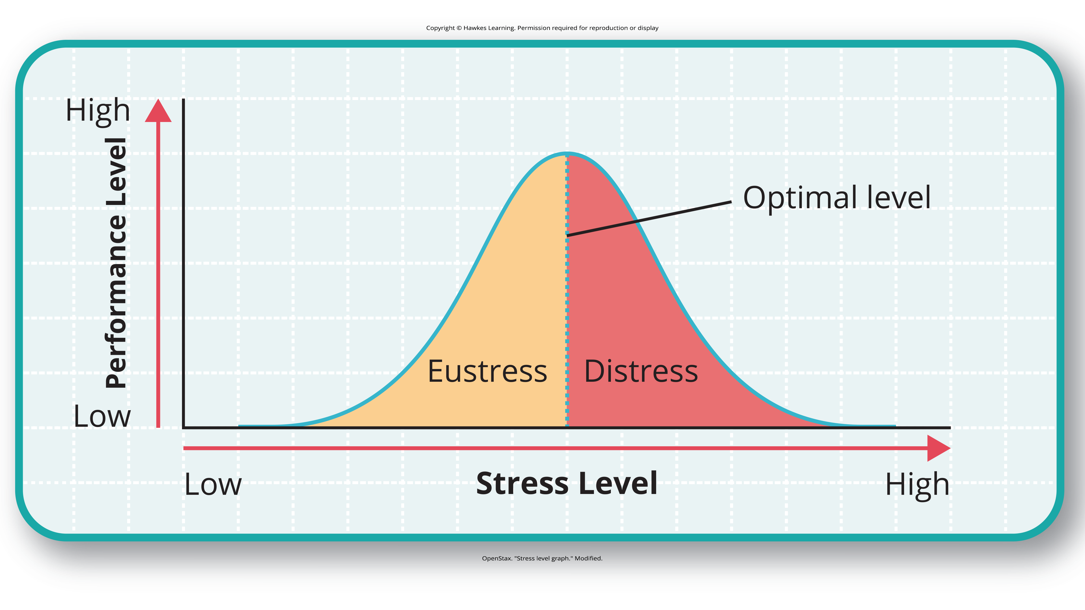
Lesson 14.1 Figure 6
Caption: As the stress level increases from low to moderate so does performance (eustress). At the optimal level (the peak of the curve), performance has reached its peak. If stress exceeds the optimal level, it will reach the distress region, where it will become excessive and debilitating, and performance will decline (Everly & Lating, 2002).

Slide 15

The Prevalence Of Stress
Stress has been rising over recent years, often feeling overwhelming and unmanageable.
Stress responses can be:
Physiological (accelerated heart rate, headaches, gastrointestinal problems)
Cognitive (difficulty concentrating, inability to make decisions)
Behavioral (drinking alcohol, smoking, taking actions to eliminate stress)
Figure 7
Caption: (a) Young adults are experiencing more stress than ever before due to the COVID-19 pandemic and the uncertainties it brought. (b) On top of COVID-19 stress, adults of all ages are facing additional stressors related to the war in Ukraine and worries about inflation and global stability (Abrams, 2022).

Slide 16
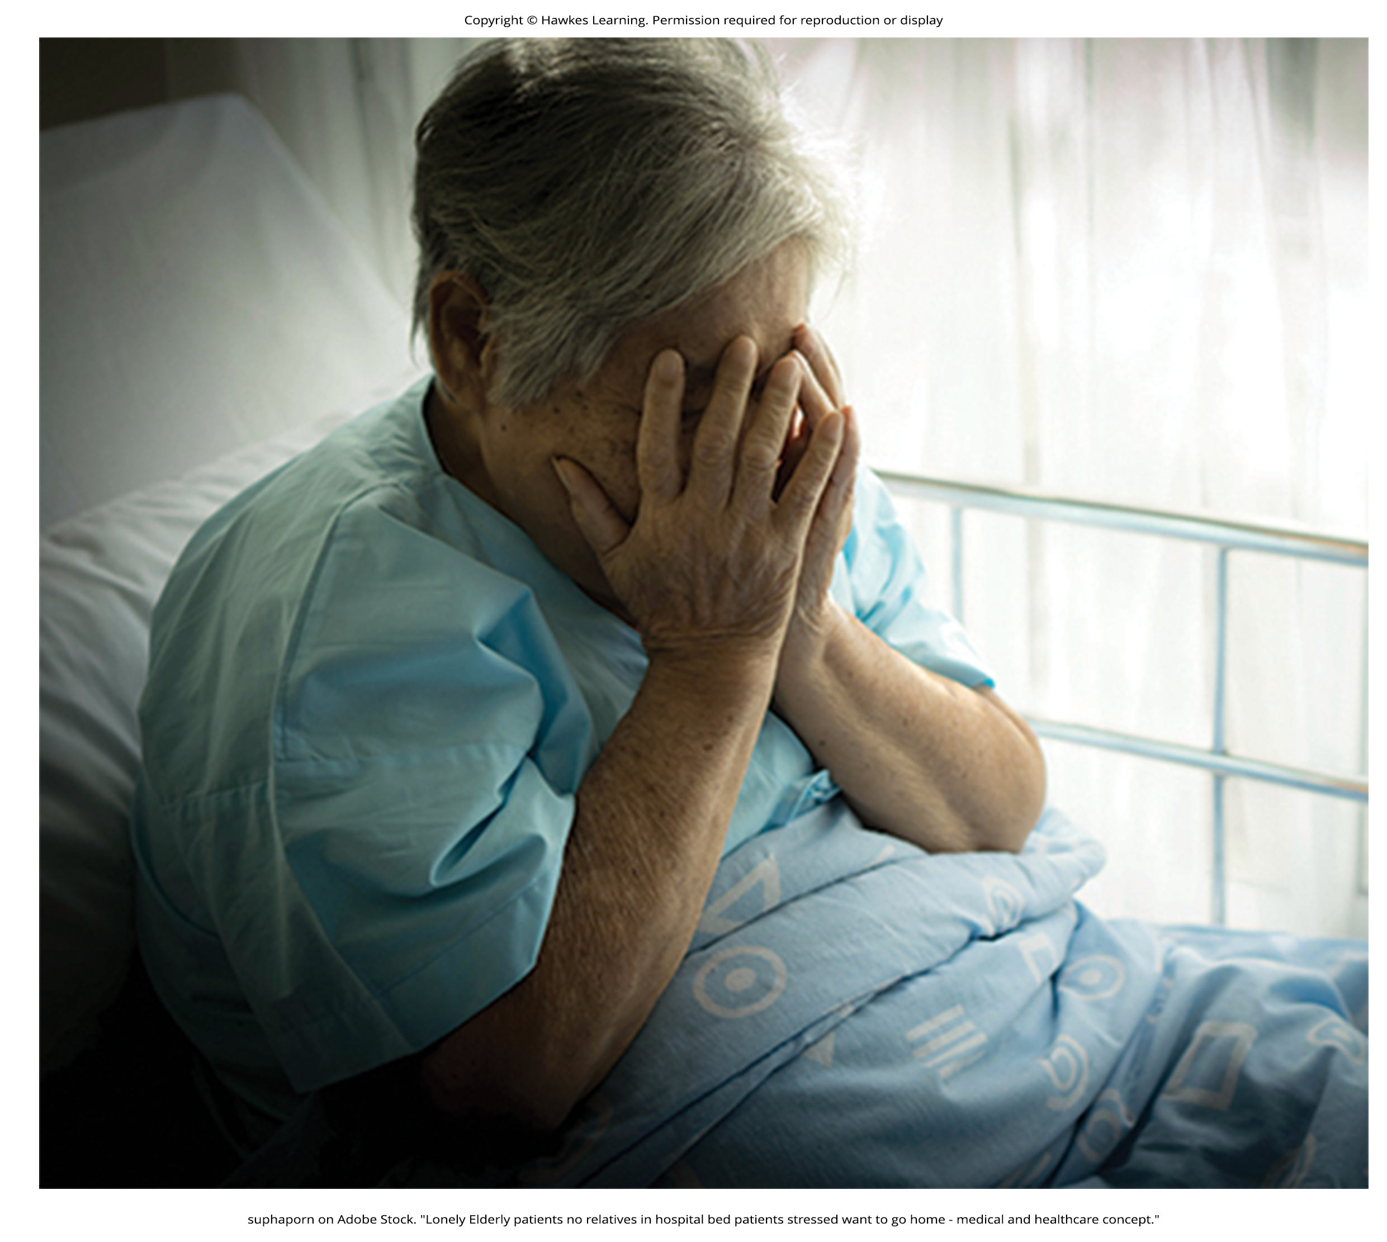
Health Psychology₁
Stress can be positive, but it can have harmful health implications (Cohen & Herbert, 1996; Forman & Zhang, 2021).
Health psychology is about the importance of psychological influences on health, illness, and how people respond to the latter (Taylor, 1999; Sawyer et al., 2019).
Emerged in 1970s
Investigates lifestyle choices
Designs interventions
Identifies at-risk populations for negative health outcomes
Figure 8

Slide 17

Health Psychology₂
Young adults face high stress levels due to:
Discrimination, employment, finances, family planning, and social media pressures
Example: Average age of first-time parents has increased ~3 years since 2002 (The Commonwealth Fund, 2020; Pew Research Center, 2018).
Due to childcare costs, maternal health, uncertain parental leave, and worldwide instability
Figure 9

Slide 18

Early Contributions To The Study of Stress
Scientific interest in stress dates back nearly a century with early pioneers like Walter Cannon.
Identified the body's physiological reactions to stress in the early 20th century
Hans Selye, another pioneer, researched stress responses and developed the concept of general adaptation syndrome.
Figure 10

Slide 19
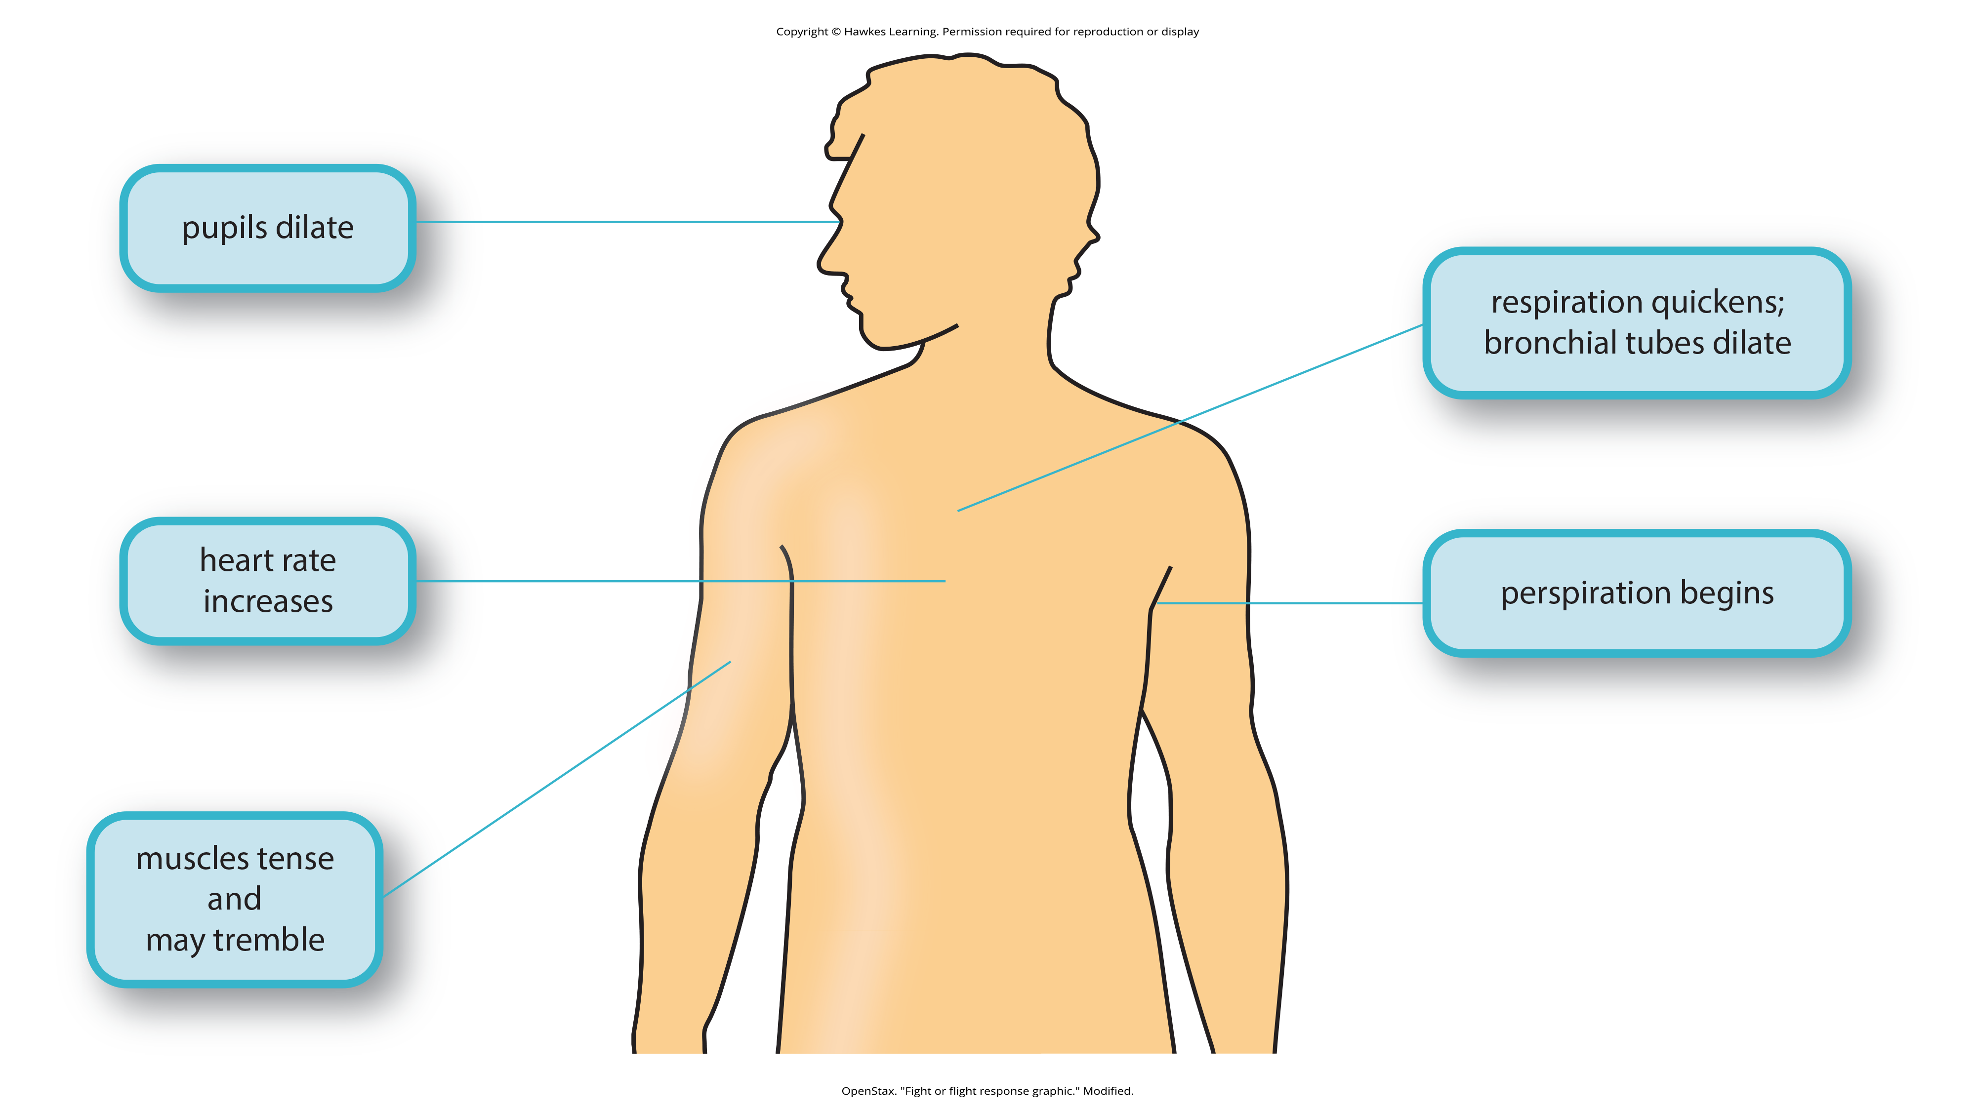
Cannon And The Fight-Or-Flight Response
Fight-or-flight response occurs during strong emotions, especially perceived threats (Cannon, 1932).
Helps the person to either fight or flee from a threat
Built-in mechanism to maintain homeostasis
Adaptive since it enables us to adjust internally and externally to changes
Arouses the body by activating the sympathetic nervous system and endocrine system
Figure 11

Slide 20
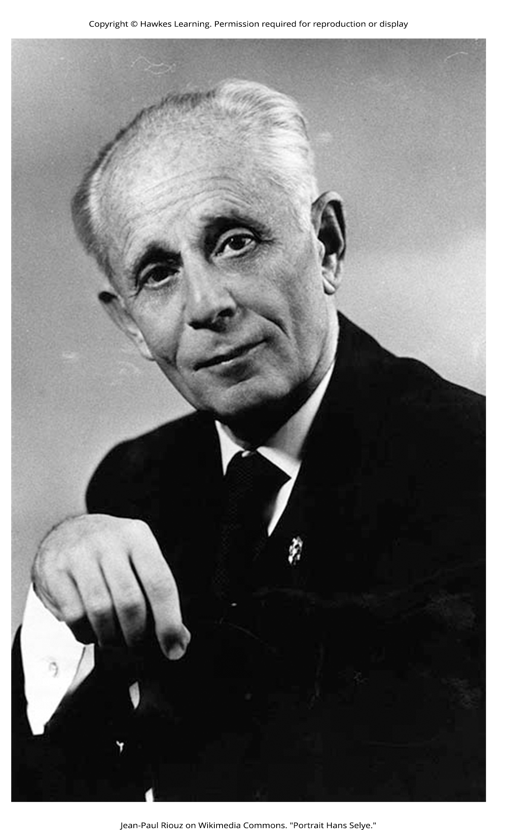
Selye And The General Adaptation Syndrome₁
In the 1930s, Selye (Figure 12) was involved in studies involving sex hormones in rats.
When exposed to prolonged negative stressors, rats showed three signs:
Adrenal enlargement
Thymus and lymph node shrinkage
Stomach ulceration
These responses were triggered by a series of physiological reactions unfolding over time.
Same pattern of reactions, regardless of stressor type
He discovered the general adaptation syndrome: the body's nonspecific physiological response to stress.
Figure 12

Slide 21
Selye And The General Adaptation Syndrome₂
The syndrome (Figure 13) consists of three stages: alarm reaction, stage of resistance, and stage of exhaustion.
Alarm reaction: immediate physiological reaction to a threat, similar to fight-or-flight
Stage of resistance: adaptation to the stressor while remaining on alert
Stage of exhaustion: depletion of physical resources, leading to illness or death

Slide 22
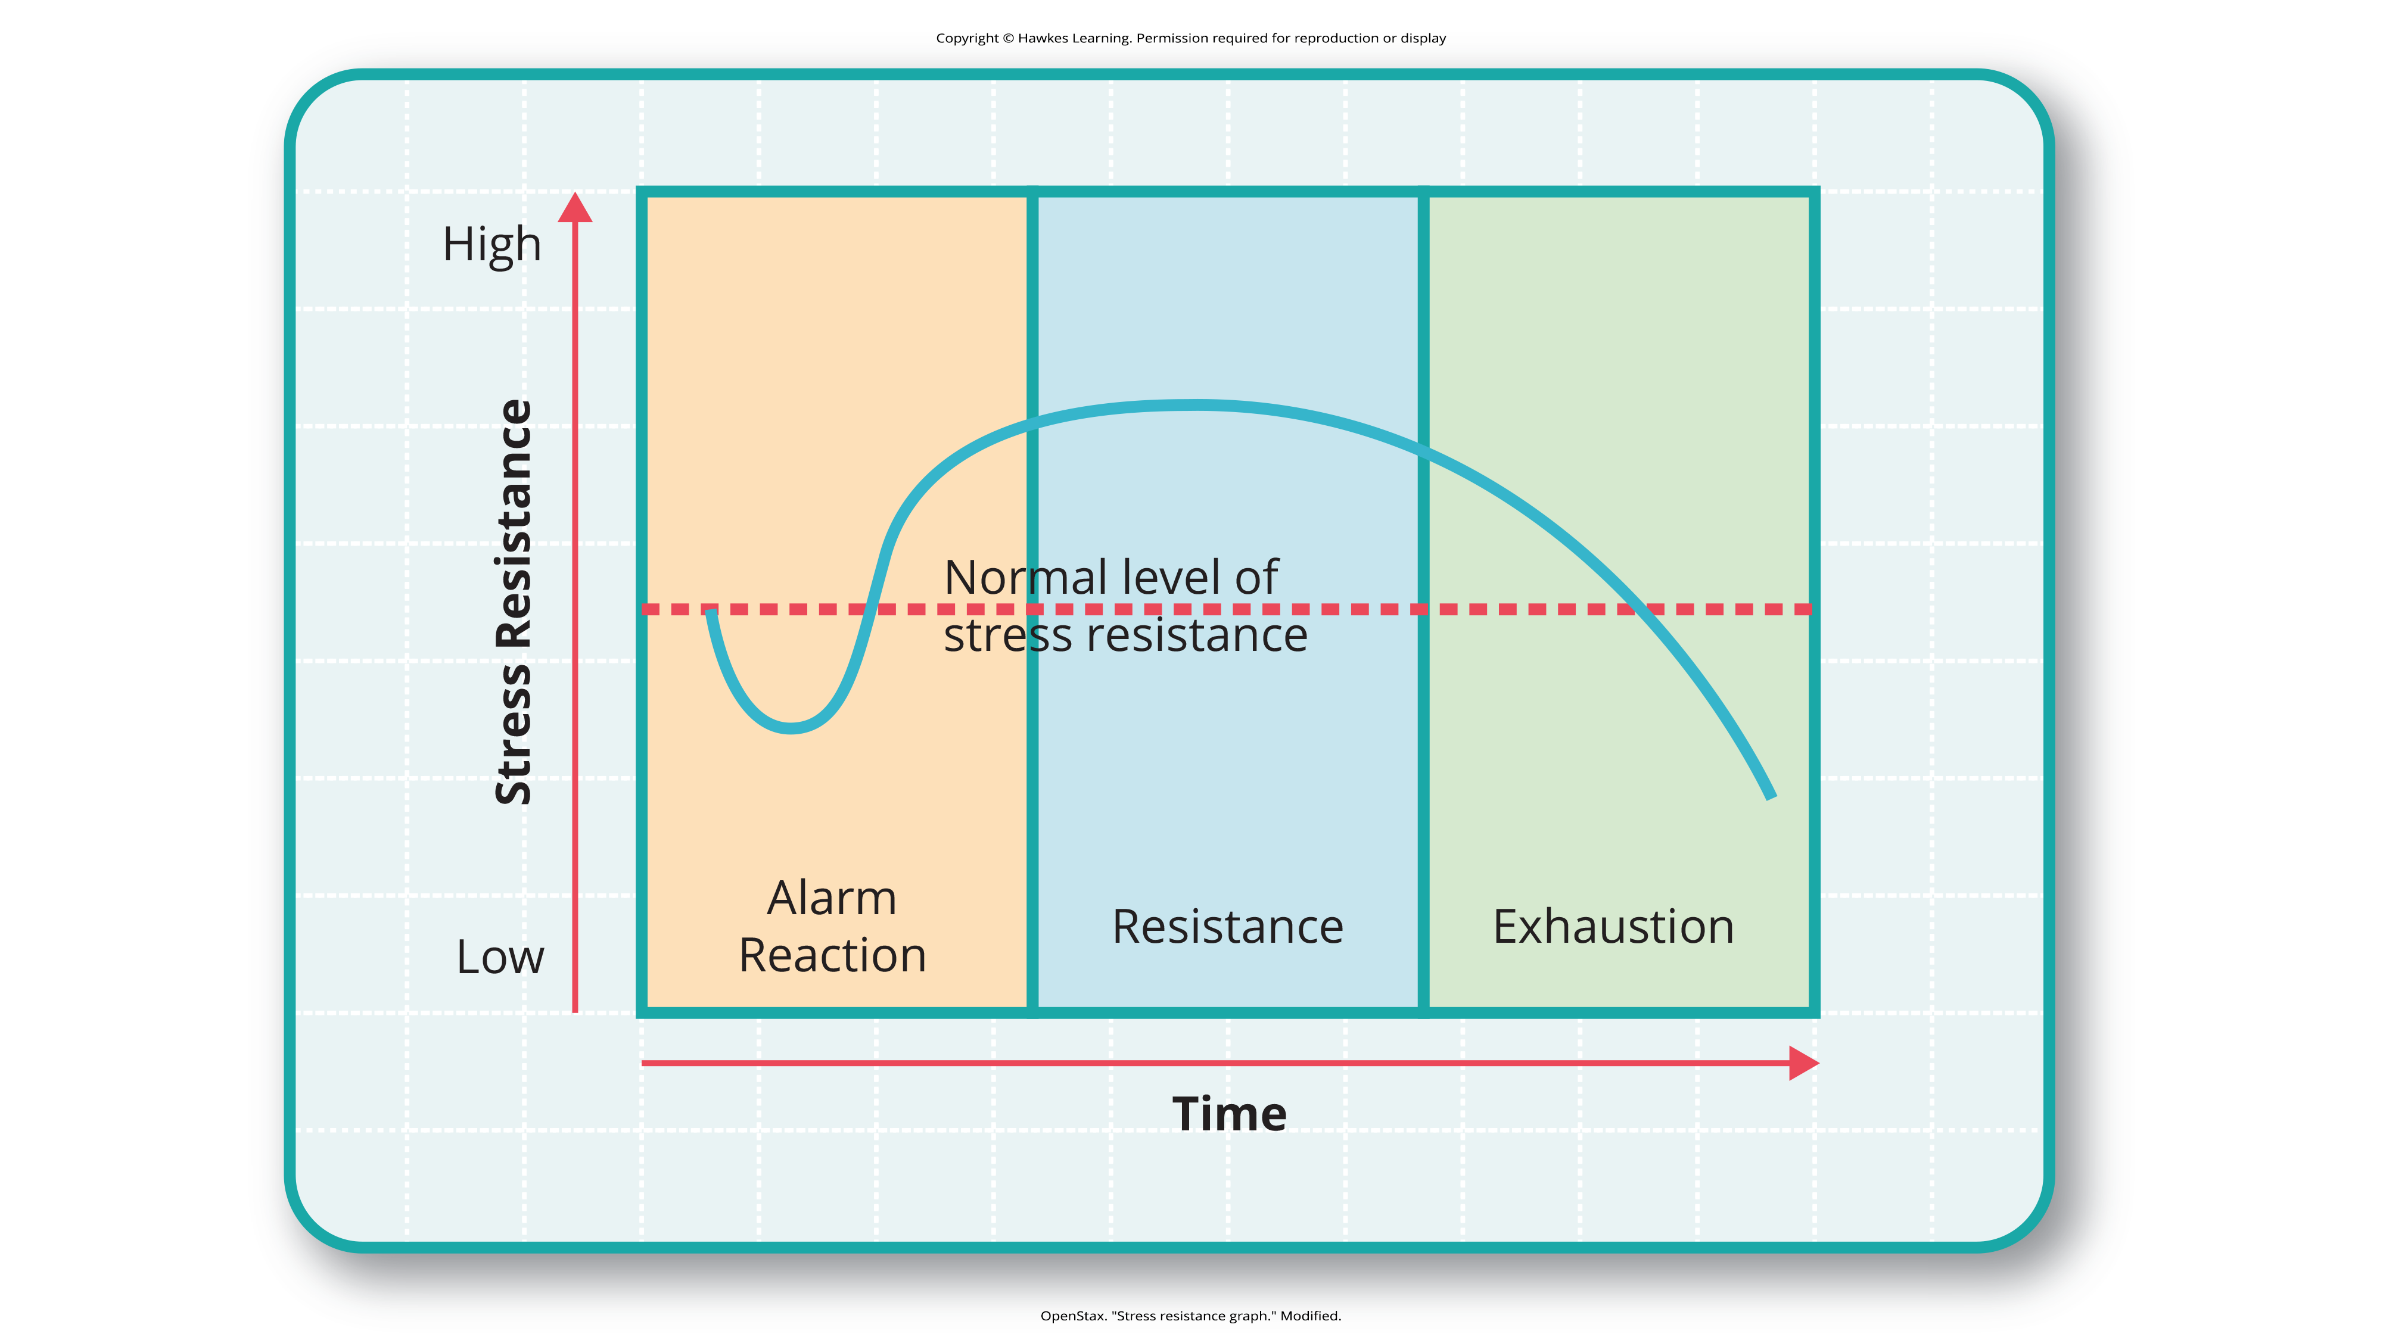
Lesson 14.1 Figure 13
Caption: The three stages of Selye's general adaptation syndrome are shown in this graph. Prolonged stress ultimately results in exhaustion (Selye, 1936; 1976).

Slide 23

Selye And The General Adaptation Syndrome₃
General adaptation syndrome suggests that stressors tax the body via 3 phases:
An initial jolt
A subsequent readjustment
A later depletion of all physical resources, ultimately leading to health problems or even death
This model is a response-based imagining of stress that has had a large impact on the field of stress.
Offers an explanation for how stress can lead to physical damage (Rochette et al., 2023)
Figure 14

Slide 24
Reflection Question₂
Does it surprise you to learn of the potential serious impacts of stress? Why or why not?

Slide 25
The Physiological Basis Of Stress₁
The physiological mechanisms of stress involve:
Sympathetic nervous system: arousal via adrenaline release; activates fight-or-flight responses
HPA axis: slower in response, prepares the body for action
Hypothalamus releases corticotropin-releasing factor, which causes the pituitary gland to release ACTH (Figure 15).
ACTH activates adrenal glands, which secrete hormones(including cortisol) into the bloodstream.
Cortisol: a stress hormone; helps provide a boost of energy to either run or fight

Slide 26
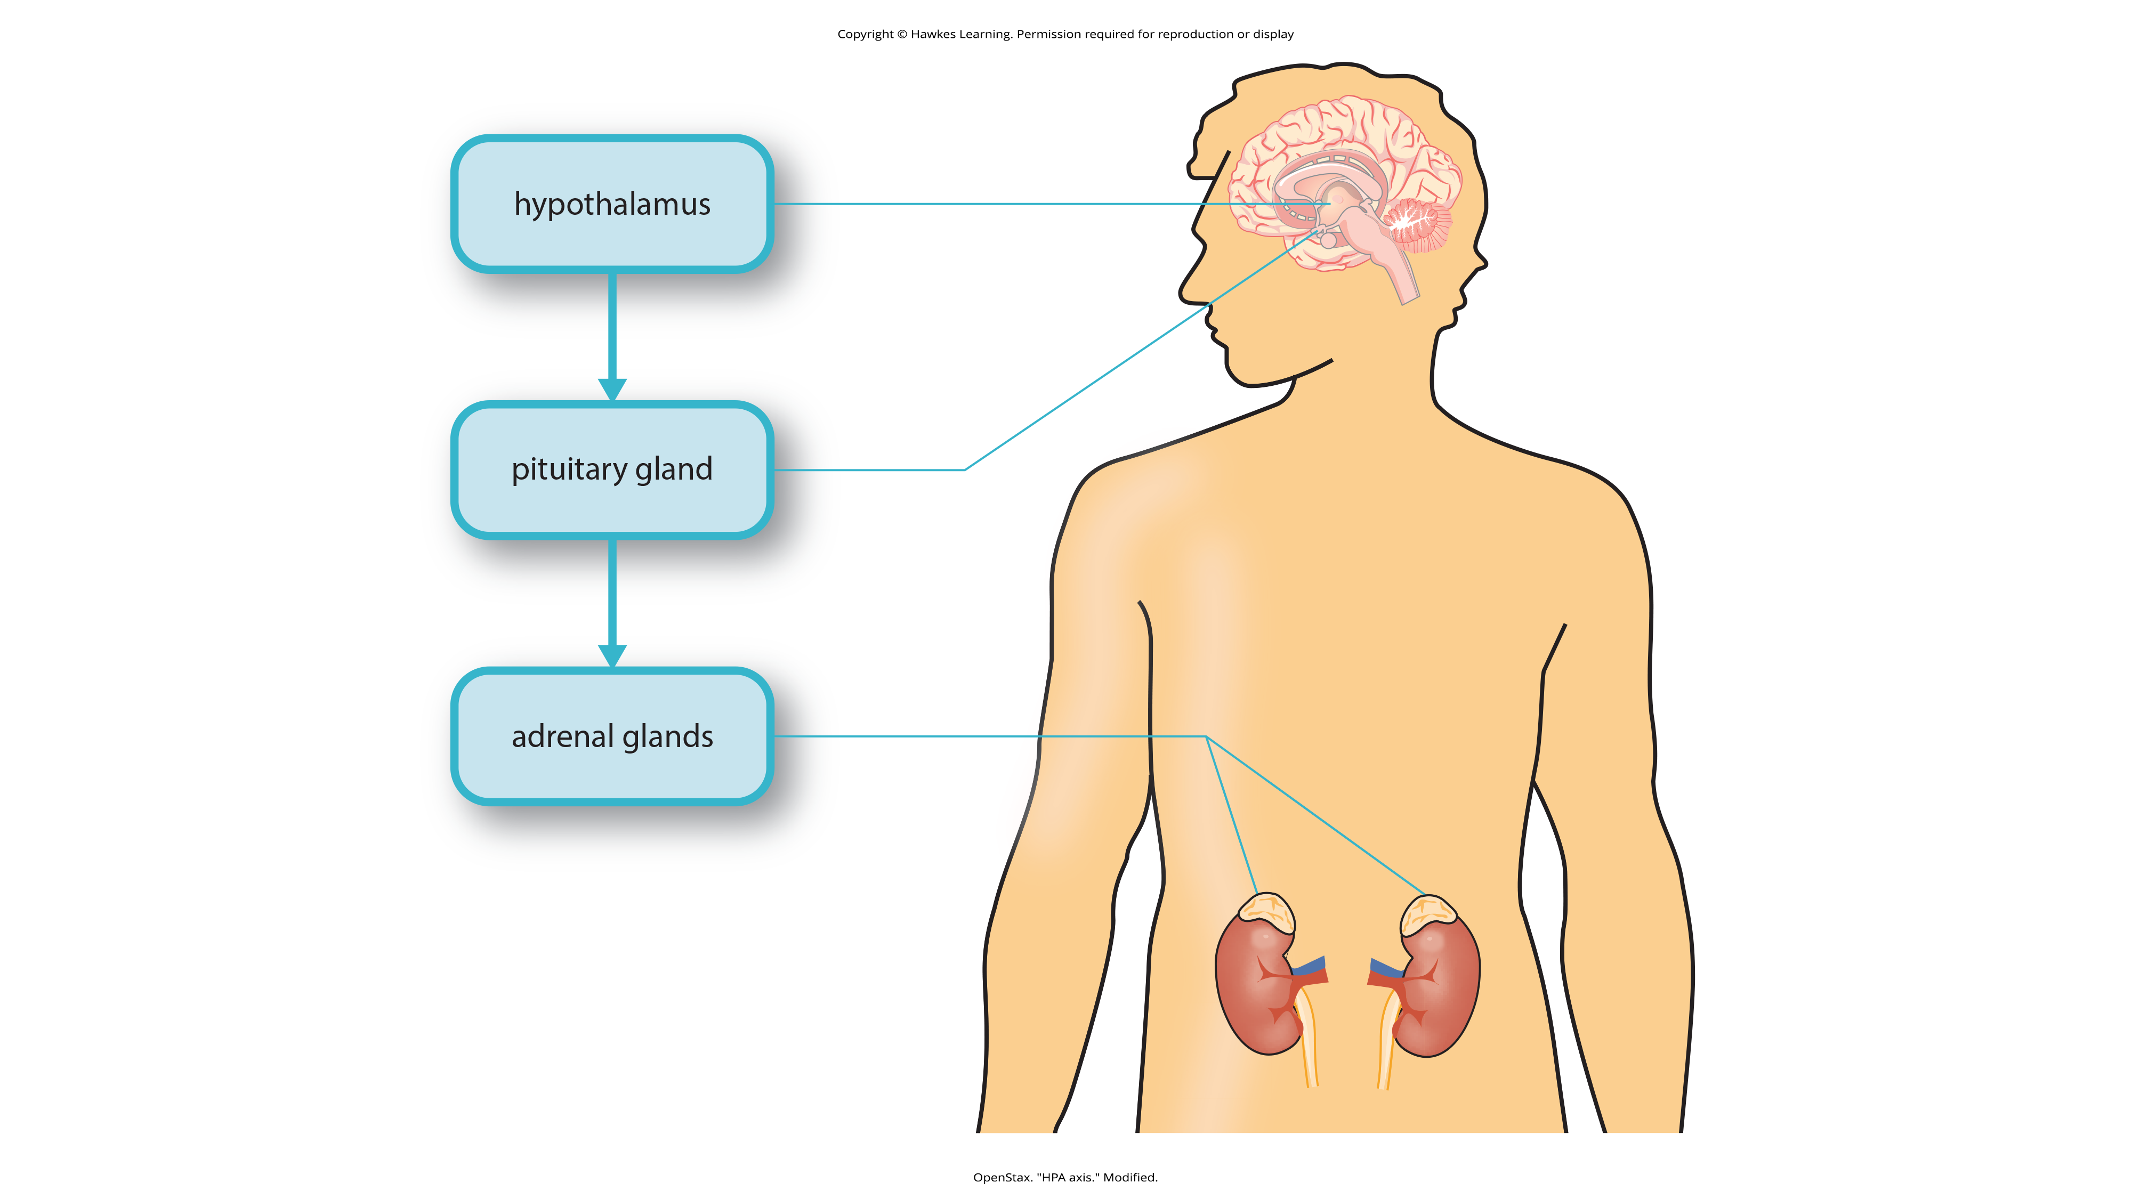
Lesson 14.1 Figure 15
Caption: This diagram shows the functioning of the hypothalamic-pituitary-adrenal (HPA) axis. The hypothalamus activates the pituitary gland, which in turn activates the adrenal glands, increasing their secretion of cortisol.

Slide 27
The Physiological Basis Of Stress₂
This process can provide favorable effects:
Extra energy
Temporarily improved immune system functioning
Decreases pain sensitivity
Prolonged cortisol release weakens the immune system (Glaser & Kiecolt-Glaser, 2005; Morey et al., 2015).
High levels among depressed individuals (Geoffroy et al., 2013; Fiksdal et al., 2019)
A stressful event causes a variety of reactions that then affect bodily processes in ways that prepare for action.
When stress is extreme/chronic, it can have negative consequences.

Slide 28
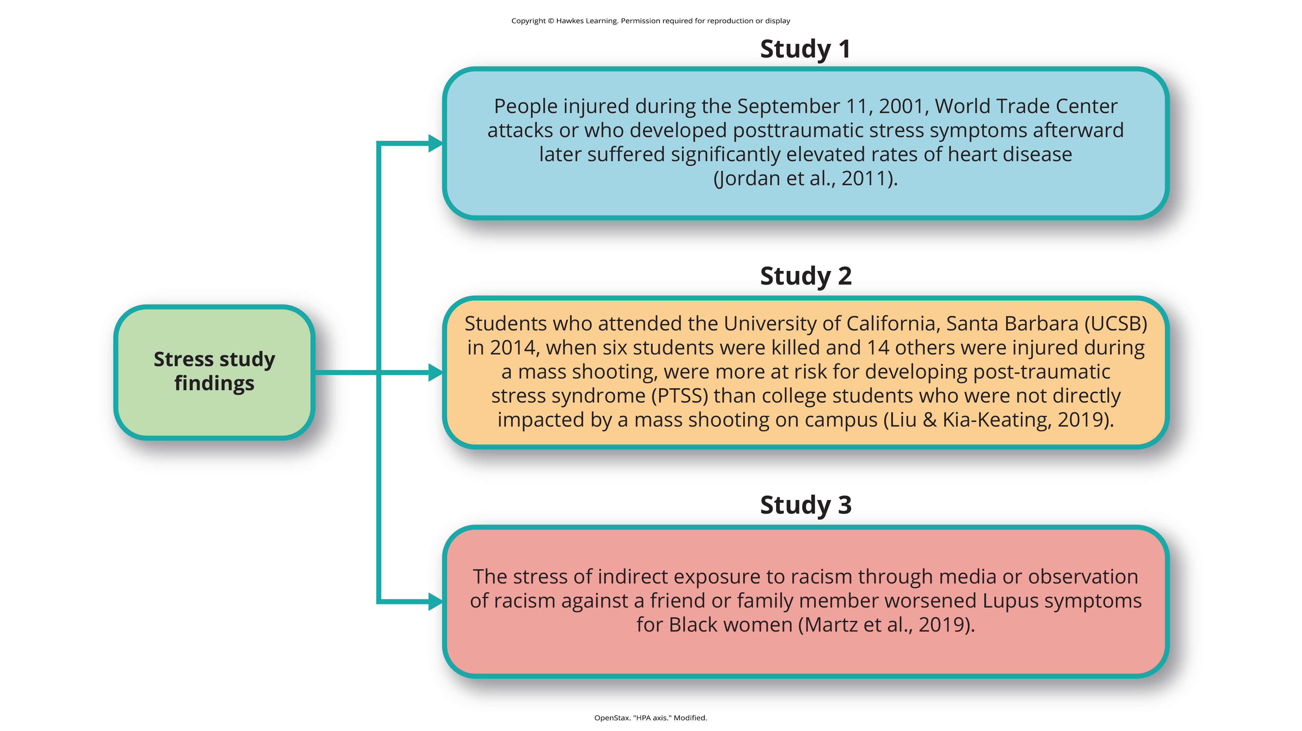
Stress Study Findings

Slide 29
Summary
Stress is a process where someone perceives/responds to events appraised as overwhelming/threatening.
Health psychology studies the impact of psychological factors on health and well-being.
The fight-or-flight response involves the coordinated activity of the sympathetic nervous system and HPA axis.
Selye's general adaptation syndrome describes a three-phase process of stress response: alarm reaction, resistance, and exhaustion.
Chronic stress can lead to psychological disorders and physical illnesses.

Slide 30
End of Hawkes Learning PowerPoint

