Slide 1
Lesson 14.2
Stressors

Slide 2
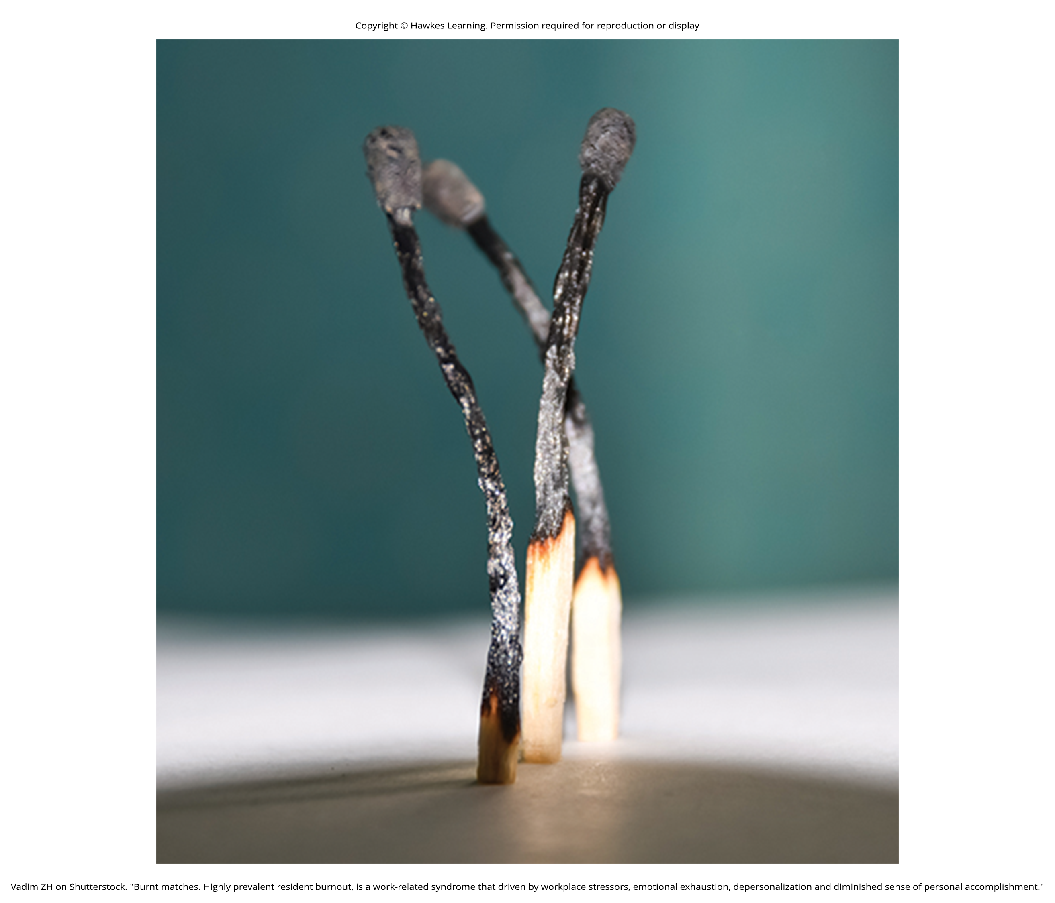
Stressors
Two types of stressors (Cohen et al., 2007, APA, 2022)
Chronic stressors: persist over extended periods
Example: caring for a parent with dementia
Acute stressors: brief focal events
Example: falling on an icy sidewalk and breaking a leg
Vary in shape and size, including traumatic events and life changes
Figure 1

Slide 3
Reflection Question₁
What are some stressors that you face in your life currently? How does your mind and body generally react to these stressors?

Slide 4
Traumatic Events
Some stressors involve traumatic events in which actual death or injury is threatened.
Examples: military combat, physical assaults, terrorist attacks, natural disasters, car accidents
Men, non-Whites, and lower SES groups report more traumatic events (Hatch & Dohrenwend, 2007; Landberg et al., 2019).
Exposure to extreme stressors may lead to posttraumatic stress disorder (PTSD): chronic stress reaction (American Psychiatric Association, 2022).
Can include intrusive/painful memories of stressor event, jumpiness, negative emotional states, detachment, outbursts, and avoidance

Slide 5
On Your Own₁
In your own words, describe the differences between chronic stressors and acute stressors.

Slide 6
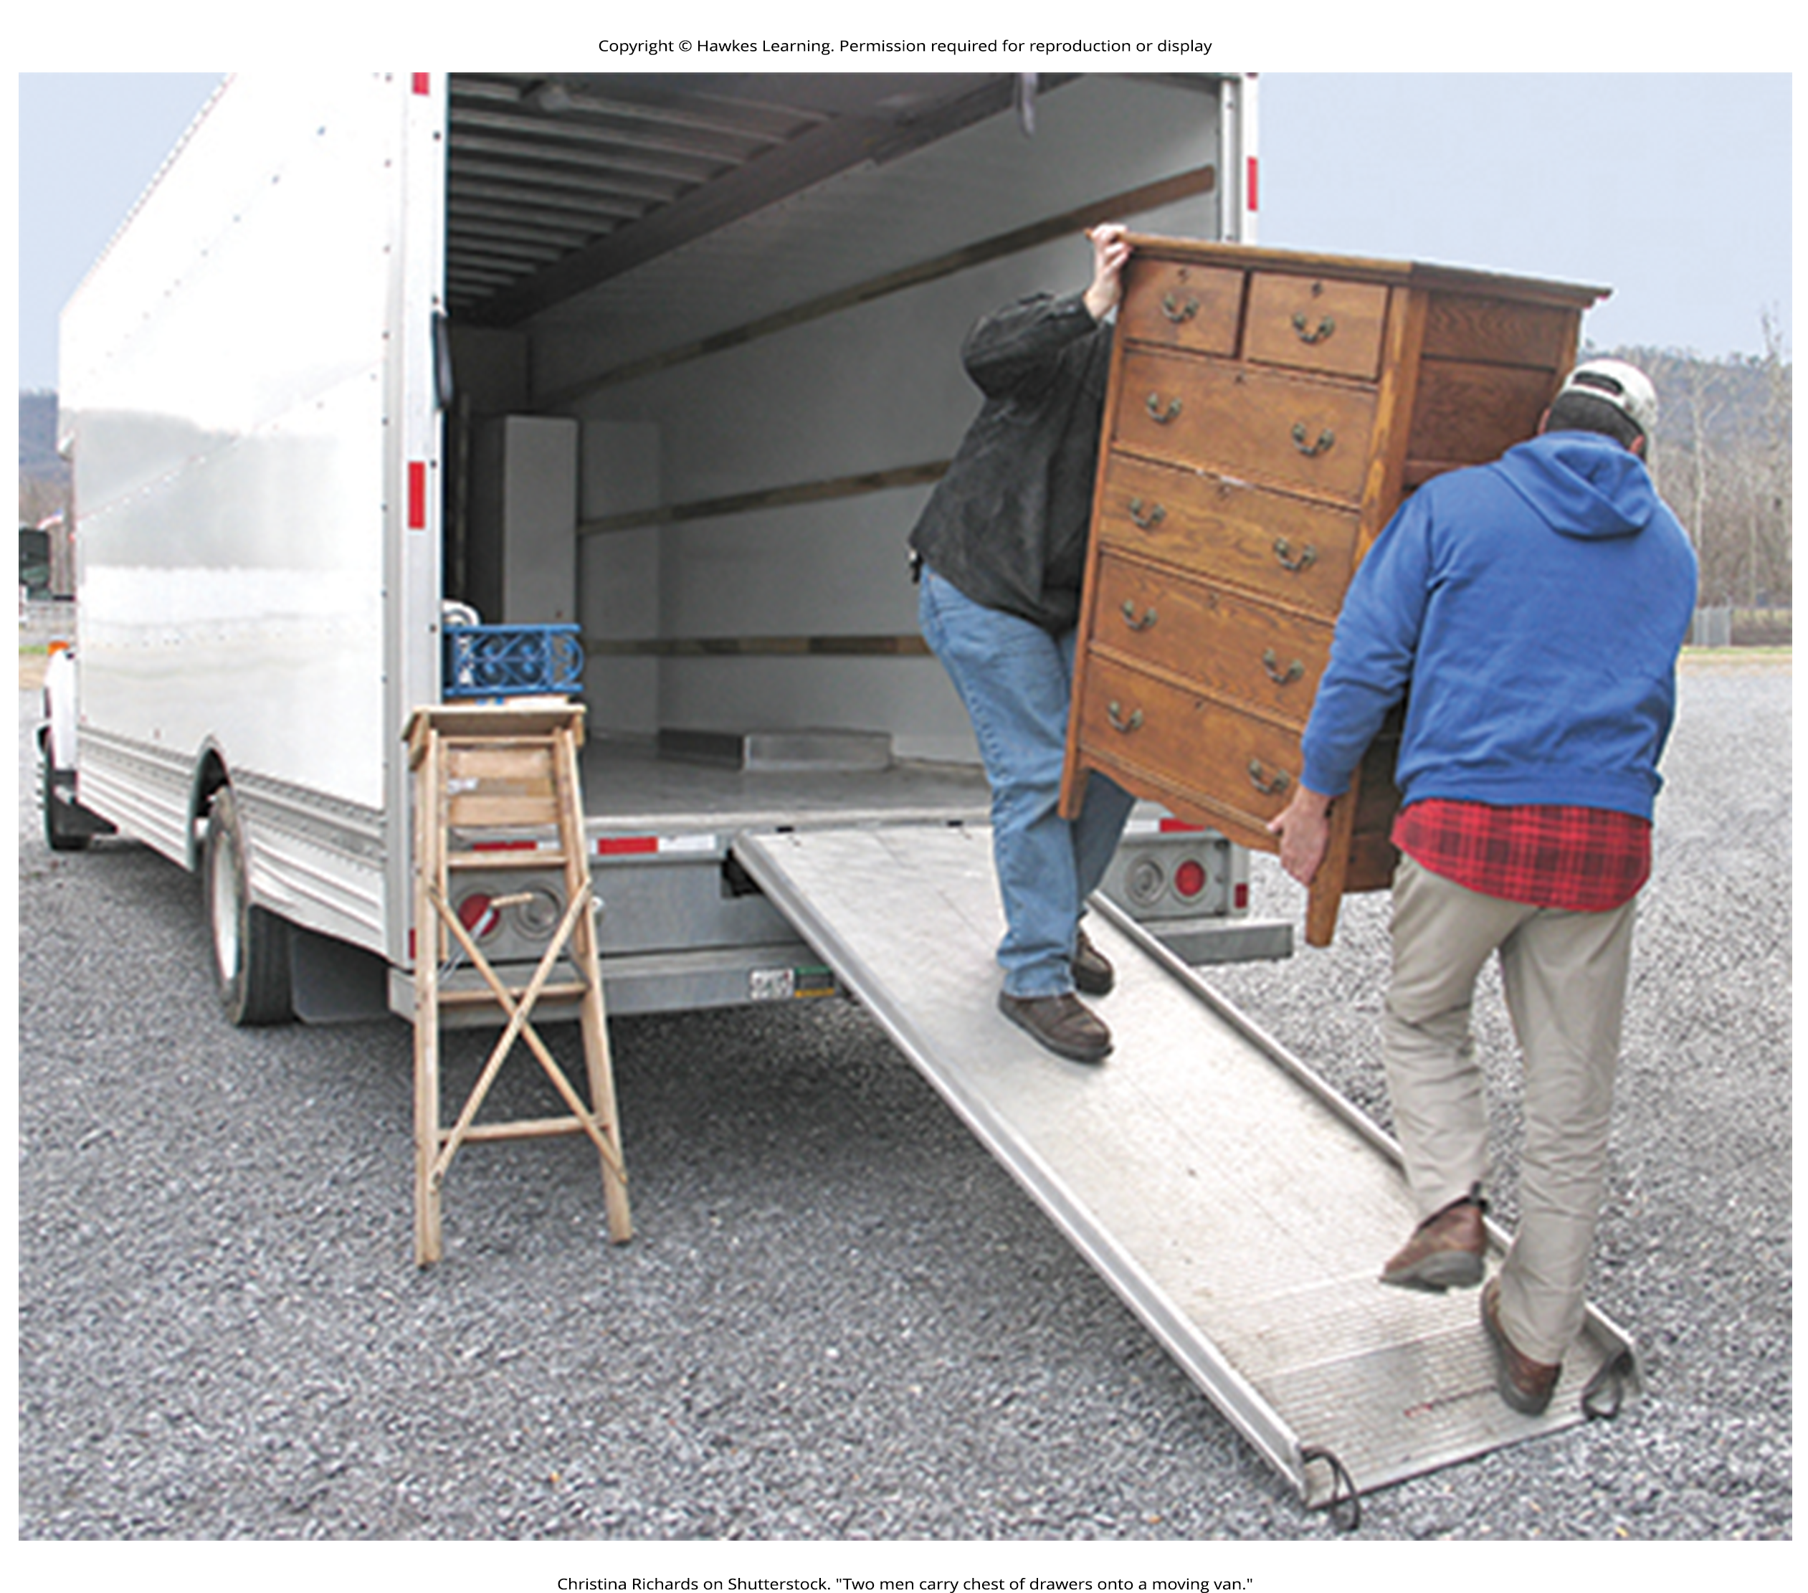
Life Changes
Most stressors are not traumatic or intense; instead, they require us to make changes and adjust.
Examples: death of a family member, marriage, divorce, moving
Accumulation of changes may increase risk of physical illness.
Figure 2

Slide 7

Social Readjustment Rating Scale (SRRS)
SRRS: 43 life events requiring varying degrees of readjustment (Holmes & Rahe, 1967)
Developed by Thomas Holmes and Richard Rahe to link life stressors and physical illness
Include pleasant life events like marriage, holidays, retirement
Figure 3

Slide 8
Life Change Units (LCUs)₁
Study: Holmes and Rahe asked 394 participants to provide numerical estimates for the 43 life events.
Estimates = readjustment needed for each event
Resulted in mean value scores, or LCUs, ranging from 11 to 100 (Rahe et al., 1967)
Example: death of a family member (63 LCUs) vs. change in eating habits (15 LCUs)

Slide 9

Life Change Units (LCUs)₂
High LCU scores were linked to physical illnesses and mental health problems (Cohen et al., 2019; Monat & Lazarus, 1991; Scully et al., 2000).
Study: Researchers obtained LCU scores for U.S. and Norwegian Navy personnel going on a 6-month voyage.
Correlations between LCU scores prior to voyage and subsequent illness during the voyage (Rahe, 1974)
Figure 4

Slide 10
Criticisms Of The SRRS
Vague items (e.g., death of a close friend) (Dohrenwend, 2006)
Assumes undesirable events are no more stressful than desirable ones (Derogatis & Coons, 1993)
Does not consider respondents' appraisals of life events
Still useful for identifying potential stress-related health outcomes (Scully et al., 2000; Blasco-Fontecilla et al., 2012)
Example: found to predict stress-related depression in middle-aged mothers during COVID-19 (Taylor et al., 2021)

Slide 11
Connect The Concepts: Correlational Research
SRRS uses the correlational research method to link stress and health.
LCU scores correlated with number of self-reported symptoms
Correlations typically positive: as LCUs increase, symptoms increase
Cannot show causal relationship between stress and illness

Slide 12
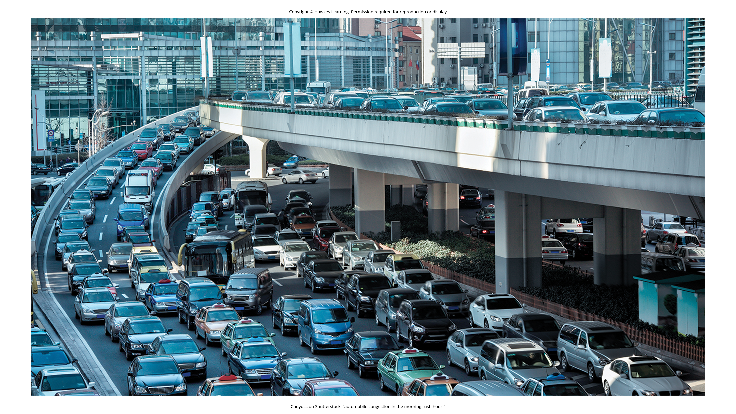
Hassles
Daily hassles: minor irritations that build up over time
Example: rush hour traffic
Can leave us as stressed as life change events (Figure 5) (Kanner et al., 1981; Udayar et al., 2021)
More strongly associated with health problems than life changes (DeLongis et al., 1982)
Lead to negative and distressed mood states (Bolger et al., 1989)
New source of stress: cyber hassles on social media
Figure 5

Slide 13
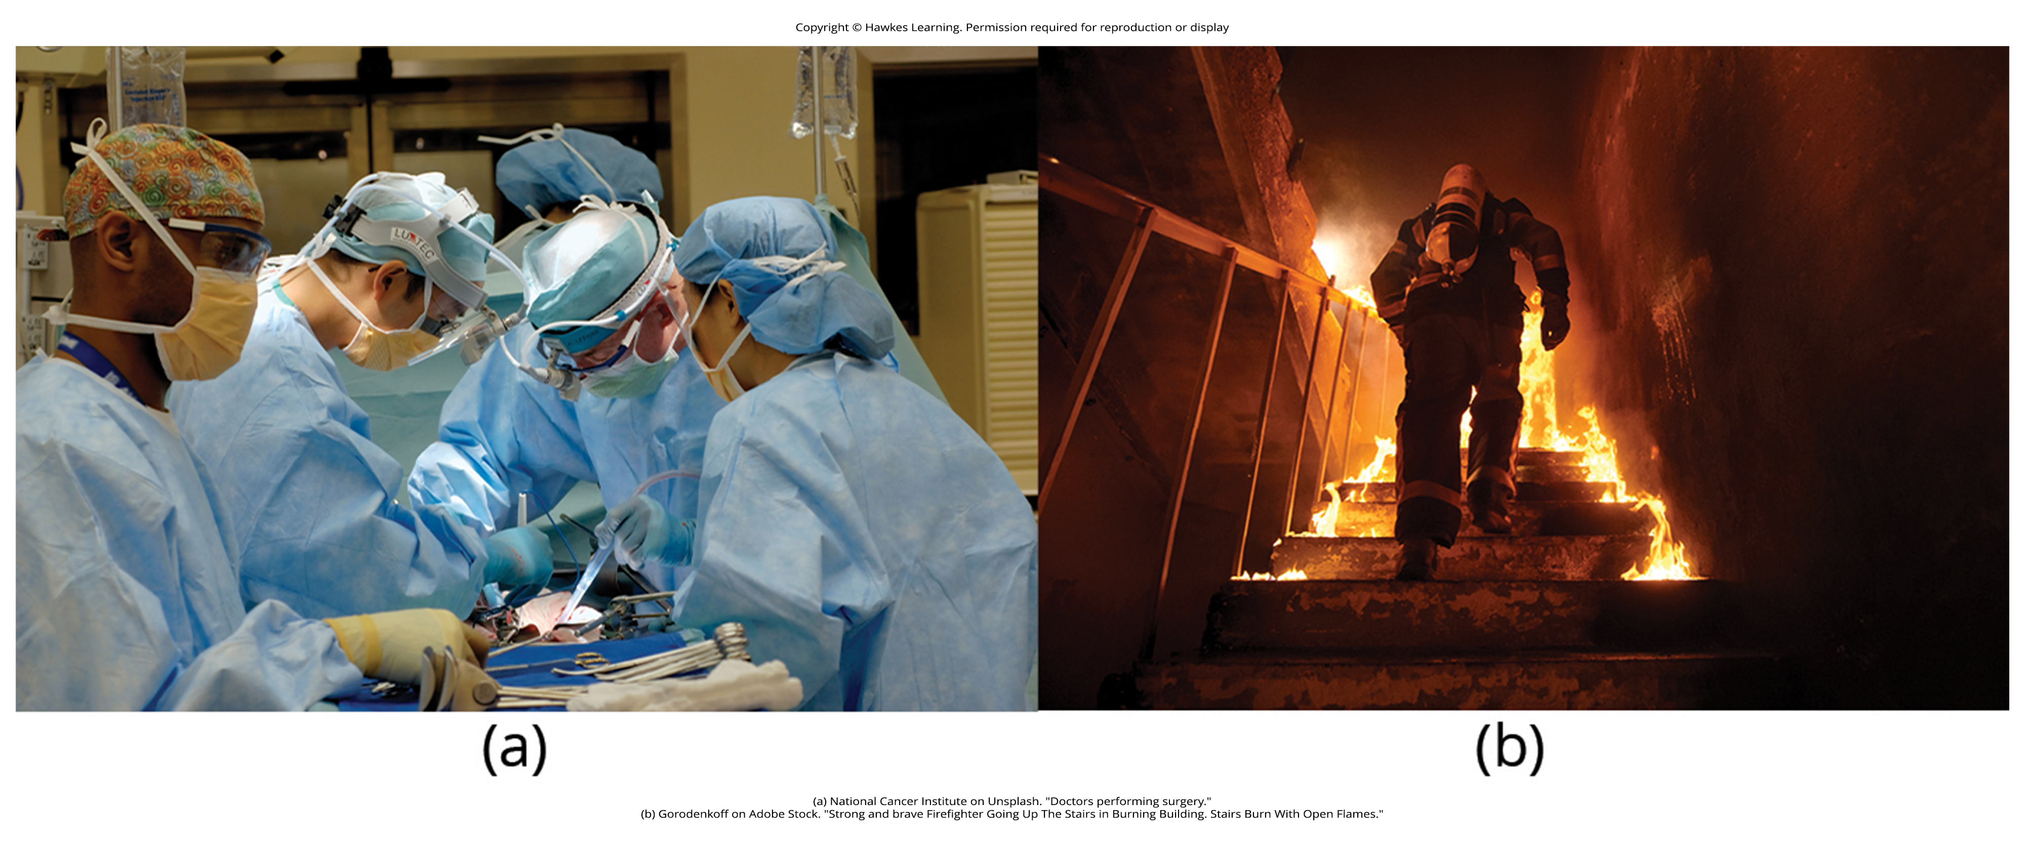
Other Stressors
Can include situations with challenging and unpleasant events, like challenging work conditions
Includes jobs with heavy workloads and little control
Examples: firefighters, police officers, social workers, emergency medical workers
Figure 6
Caption: (a) Emergency room physicians, especially during the COVID-19 pandemic, and (b) firefighters hold high-stress occupations (Galbraith et al., 2020; Rajabi et al., 2020).

Slide 14

Job Strain
Job strain: excessive demands with little decision-making discretion (Karasek & Theorell, 1990)
Examples: factory workers, postal clerks, supermarket cashiers, and taxi drivers
Associated with hypertension (Schnall & Landsbergis, 1994; Landsbergis et al., 2013), heart disease (Aboa-Éboulé et al., 2007; Sara et al., 2018; Wang et al., 2021), weight changes (Kivimäki et al., 2015; Nyberg et al., 2011), depression (Stansfeld et al., 2012)
Figure 7

Slide 15
On Your Own₂
Does it surprise you to learn that these types of jobs can create such a negative impact on one's life? What suggestions might you have for someone facing a high level of stress in their occupation?

Slide 16
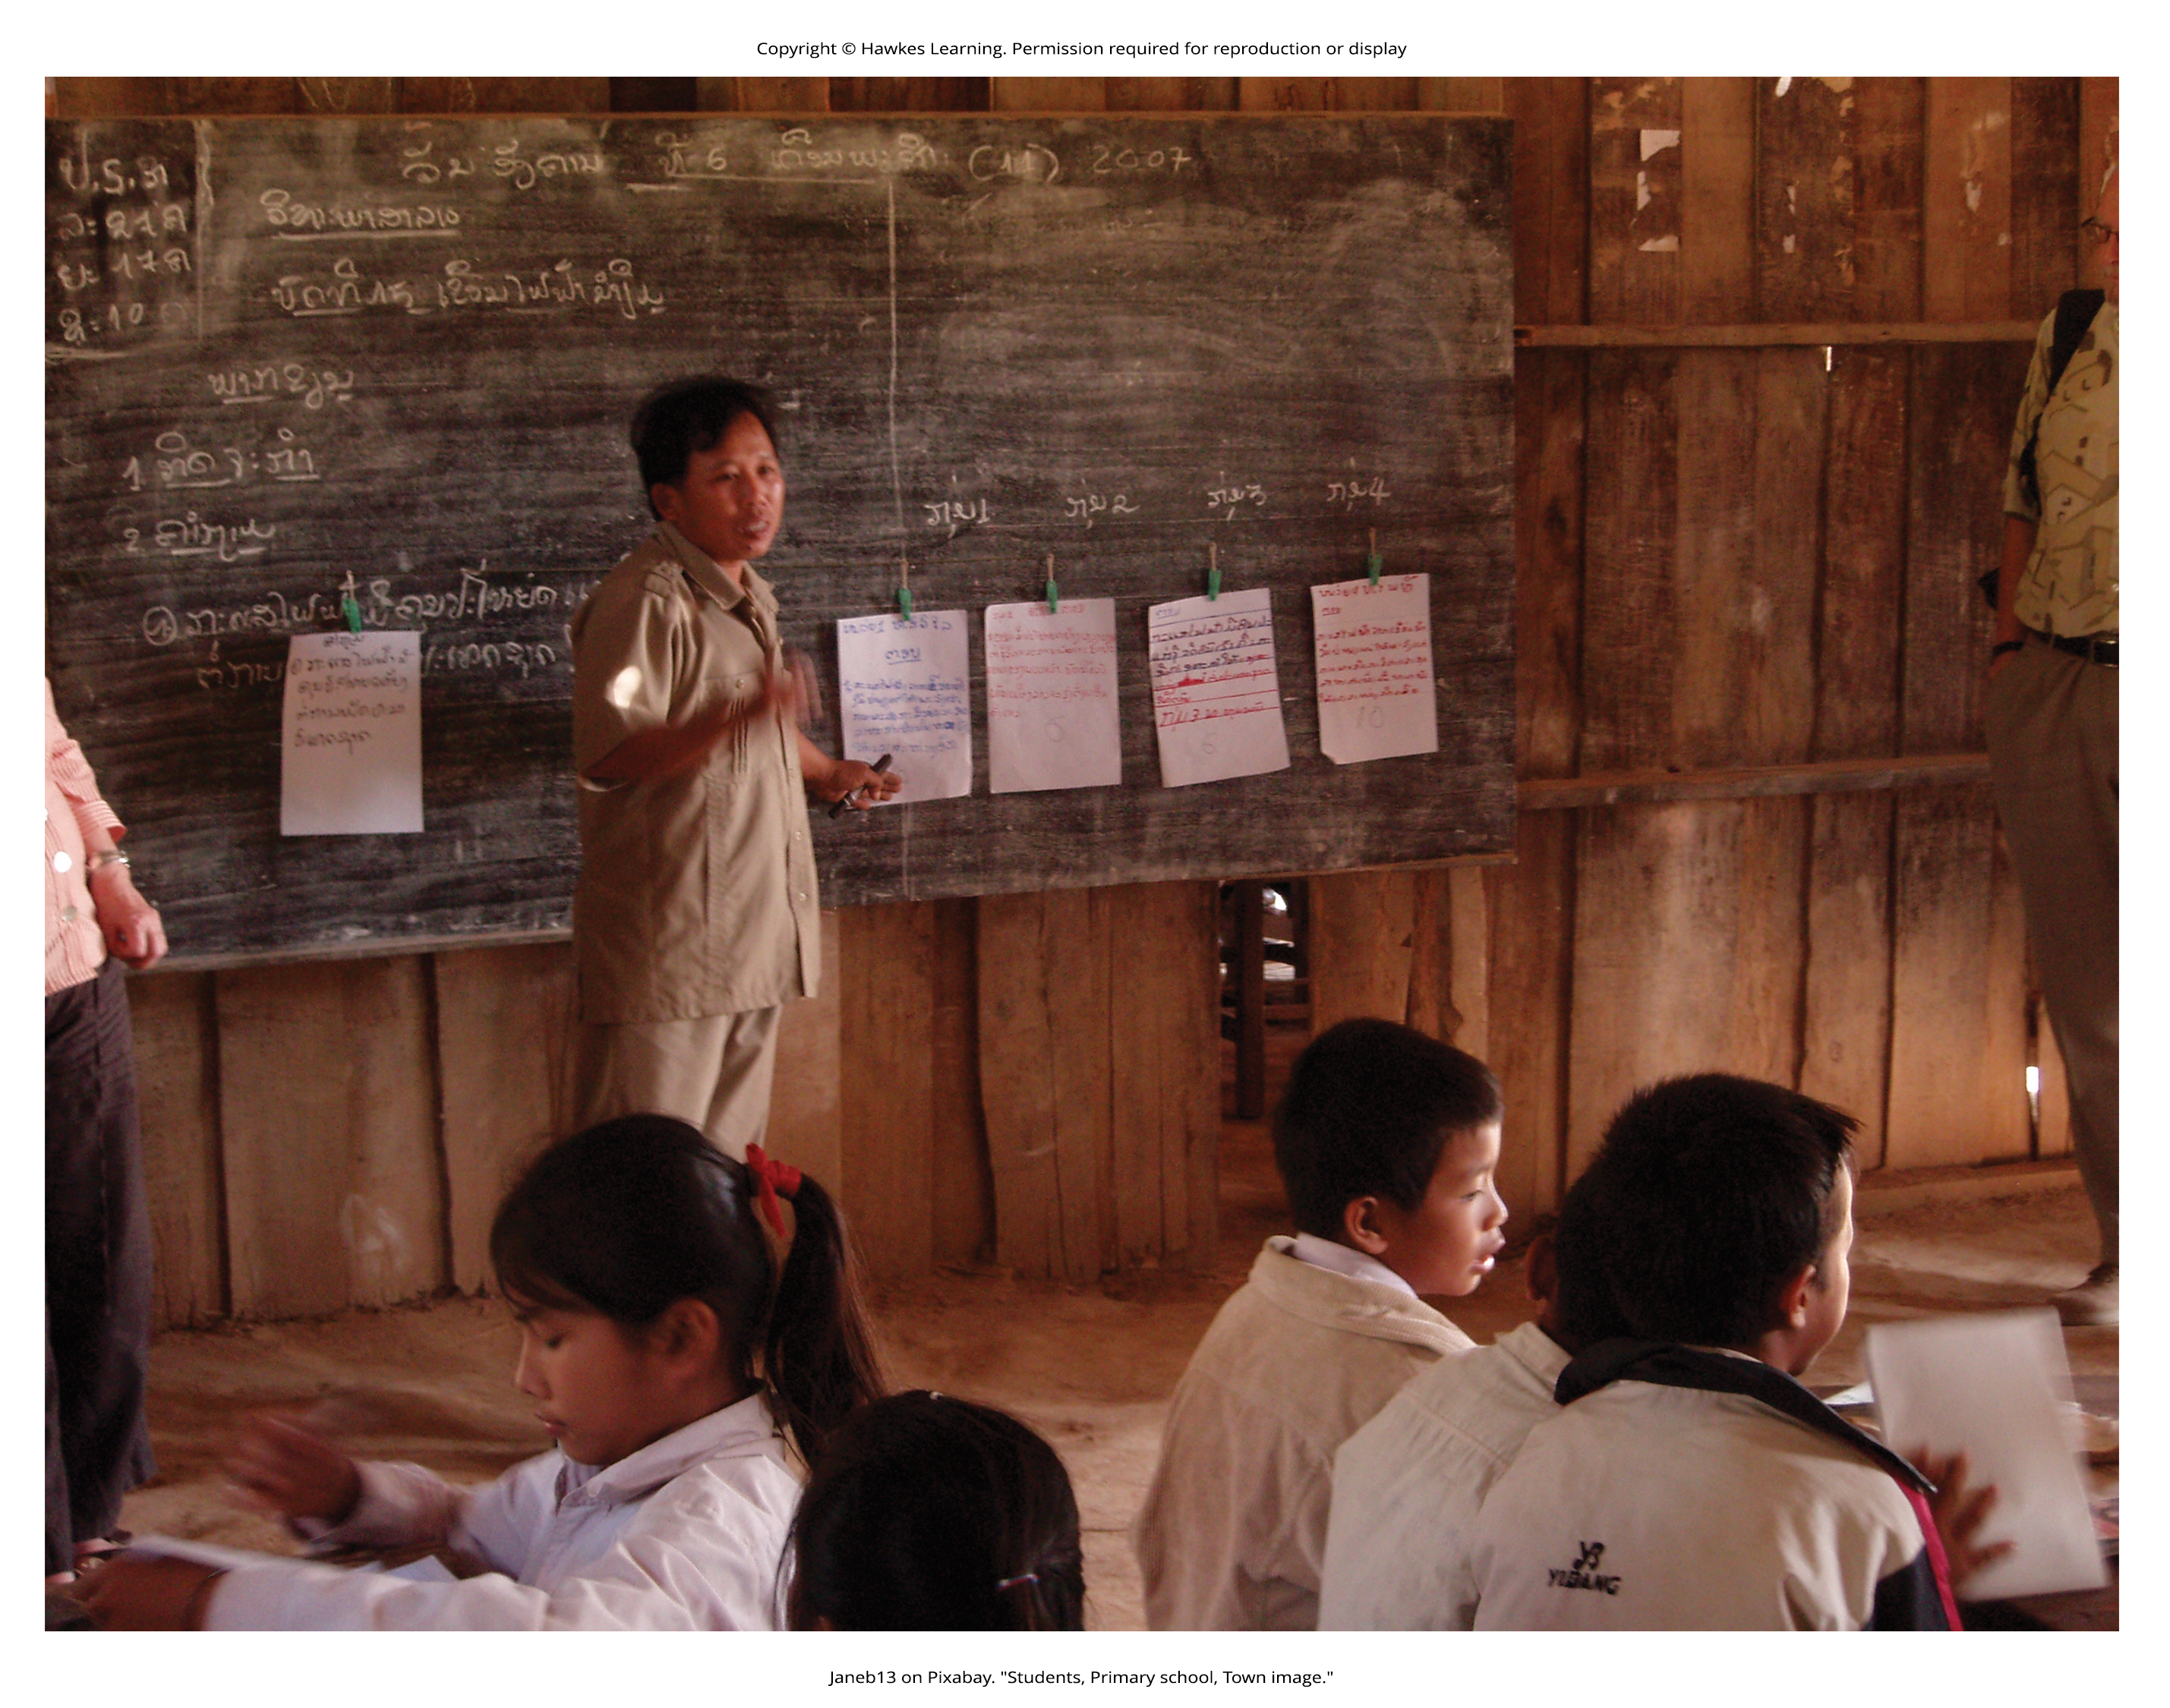
Job Burnout
Job burnout: general sense of emotional exhaustion in relation to one's job (Maslach & Jackson, 1981; Mayo Clinic, 2021)
Common in human service jobs like social work and teaching
Three dimensions: exhaustion, depersonalization, diminished personal accomplishment
Risk factors: job strain, older age, being unmarried, manual labor
Figure 8

Slide 17
Reflection Question₂
What career aspirations do you have? Do you think that stress will play a large role in these positions? Why or why not?

Slide 18
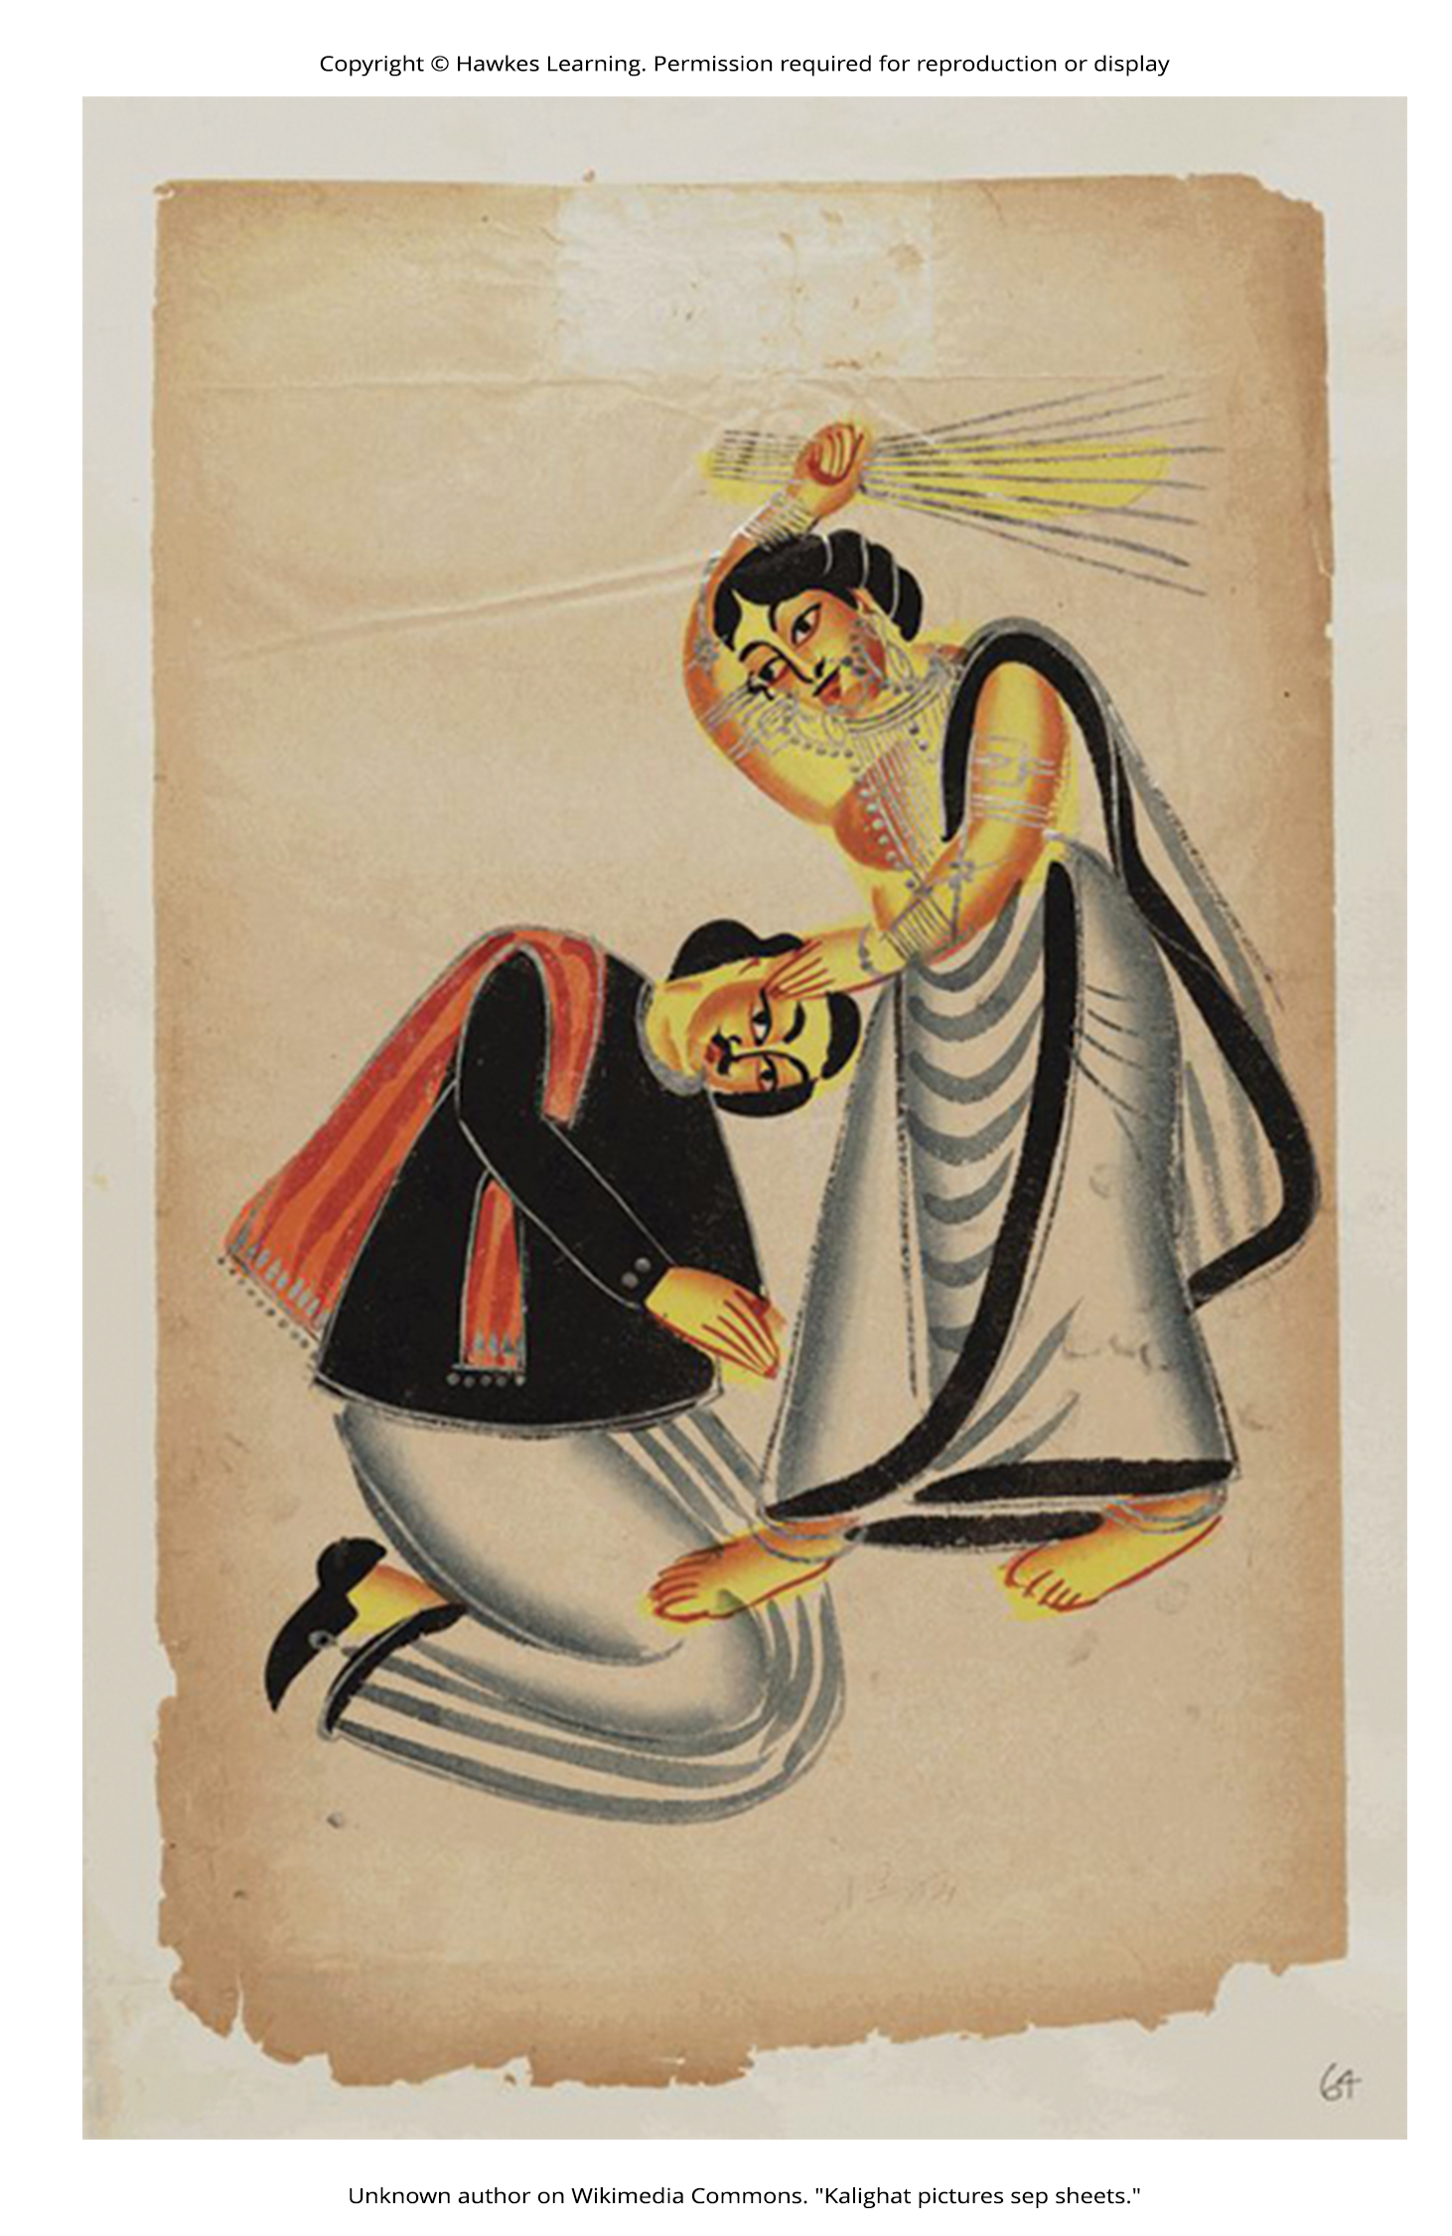
Relationships
Negative aspects of close relationships can be potent stressors.
Examples: conflicts, lack of emotional support, lack of reciprocity
Problems in relationships can take a toll emotionally and physically.
Example: increased heart problems (De Vogli et al., 2007)
Figure 9

Slide 19
Summary
Stressors vary from traumatic events to daily hassles.
SRRS measures stress through life change units (LCUs).
Job strain and burnout are significant occupational stressors.
Negative aspects of relationships can also be potent stressors.

Slide 20
End of Hawkes Learning PowerPoint

