Slide 1
Lesson 14.3
Stress and Illness

Slide 2

Stress And Illness
The stress response consists of coordinated physiological reactions that can be beneficial.
Health is affected when stress is ongoing, resulting in sustained physiological reactions.
As Robert Sapolsky (1998) described,
“Stress-related disease emerges, predominantly, out of the fact that we so often activate a physiological system that has evolved for responding to acute physical emergencies, but we turn it on for months on end, worrying about mortgages, relationships, and promotions. (p. 6)"
Figure 1

Slide 3
Psychophysiological Disorders₁
Chronic stress reactions lead to cumulative wear and tear on the body.
High stress levels can impact heart health and weaken the immune system.
Example: Someone exposed to high levels of cortisol might become vulnerable to infection or disease (McEwen, 1998; Morey et al., 2015).
Psychophysiological disorders are physical diseases brought about or worsened by stress.

Slide 4
Psychophysiological Disorders₂
Psychophysiological disorders: physical disorders whose symptoms are brought about or worsened by stress/emotional factors
Can produce physical symptoms brought on my psychological factors
Examples: cardiovascular, gastrointestinal, respiratory, musculoskeletal, and skin (Everly & Lating, 2002; Sansone, 2010)

Slide 5

Psychophysiological Disorders₃
Stressful personality traits can also be contributors to poor health.
Examples: hypertension caused by repressed anger; asthma caused by separation anxiety (Alexander, 1950)
Friedman & Booth-Kewley (1987) proposed disease-prone personality characteristics.
Depression was identified as a risk factor for all major disease-related causes of death (May et al., 2017; Mykletun et al., 2007; Pratt et al., 2016).
Neuroticism was identified as a risk factor for chronic health problems and mortality (Ploubidis & Grundy, 2009; O'Suilleabhain & Hughes, 2018).
Figure 2

Slide 6
Reflection Question₁
Have you ever experienced a physical effect of stress? If so, what happened? Did you make any attempts to cope with this stress?

Slide 7
Stress And The Immune System
Immune system: protects the body from invading toxins and microorganisms
Consists of structures, cells, and mechanisms that keep us healthy
Eliminates bacteria, viruses, and other foreign substances (Everly & Lating, 2002)

Slide 8
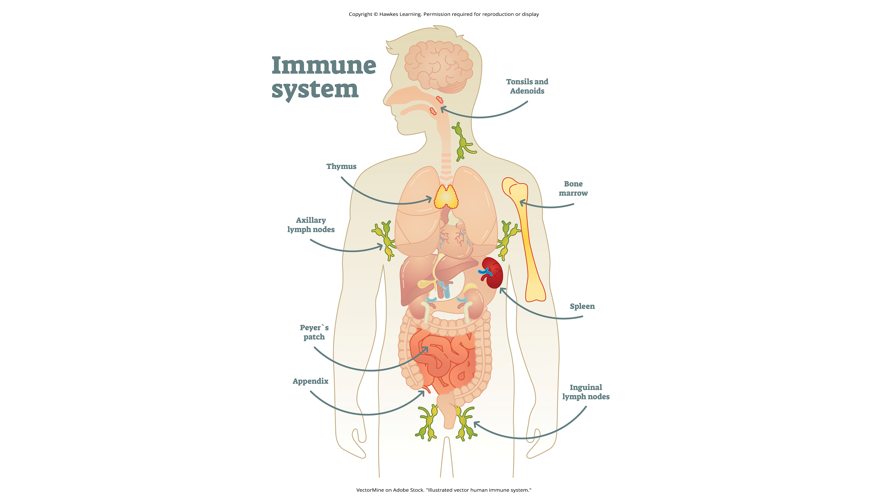
Lesson 14.3 Figure 3
Caption: The immune system is a complex set of mechanisms that helps defend our bodies.

Slide 9

Immune System Errors
Autoimmune diseases occur when the immune system attacks healthy cells.
Examples: rheumatoid arthritis, lupus, and Graves' disease (Mayo Clinic, 2023)
Immunosuppression is the decreased effectiveness of the immune system.
Example: AIDS is caused by HIV, which greatly weakens the immune system, leaving a person vulnerable to infections (Powell, 1996).
Figure 4

Slide 10
Stressors And Immune Function₁
Psychoneuroimmunology studies how psychological factors influence the immune system.
First coined in 1981 as the title of a book (Zacharie, 2009)
Studies show immune responses can be classically conditioned (Everly & Lating, 2002).
Example: rats developing an aversion to immunosuppressive flavored water, but later developing immunosuppression when tasting water (Ader & Cohen, 1975)
Other studies demonstrated this can happen in both animals and humans (Ader & Cohen, 2001; Hadamitzky et al., 2019).

Slide 11
On Your Own₁
What does Ader and Cohen's research suggest about us as human beings and the impact of stress?

Slide 12

Stressors And Immune Function₂
Various stressors are associated with weakened immune functioning (Glaser & Kiecolt-Glaser, 2005; Kiecolt-Glaser et al., 2002a; Segerstrom & Miller, 2004; Dhabhar, 2014; Seiler et al., 2019).
Examples: public speaking, unemployment, burnout/job strain
Figure 5

Slide 13
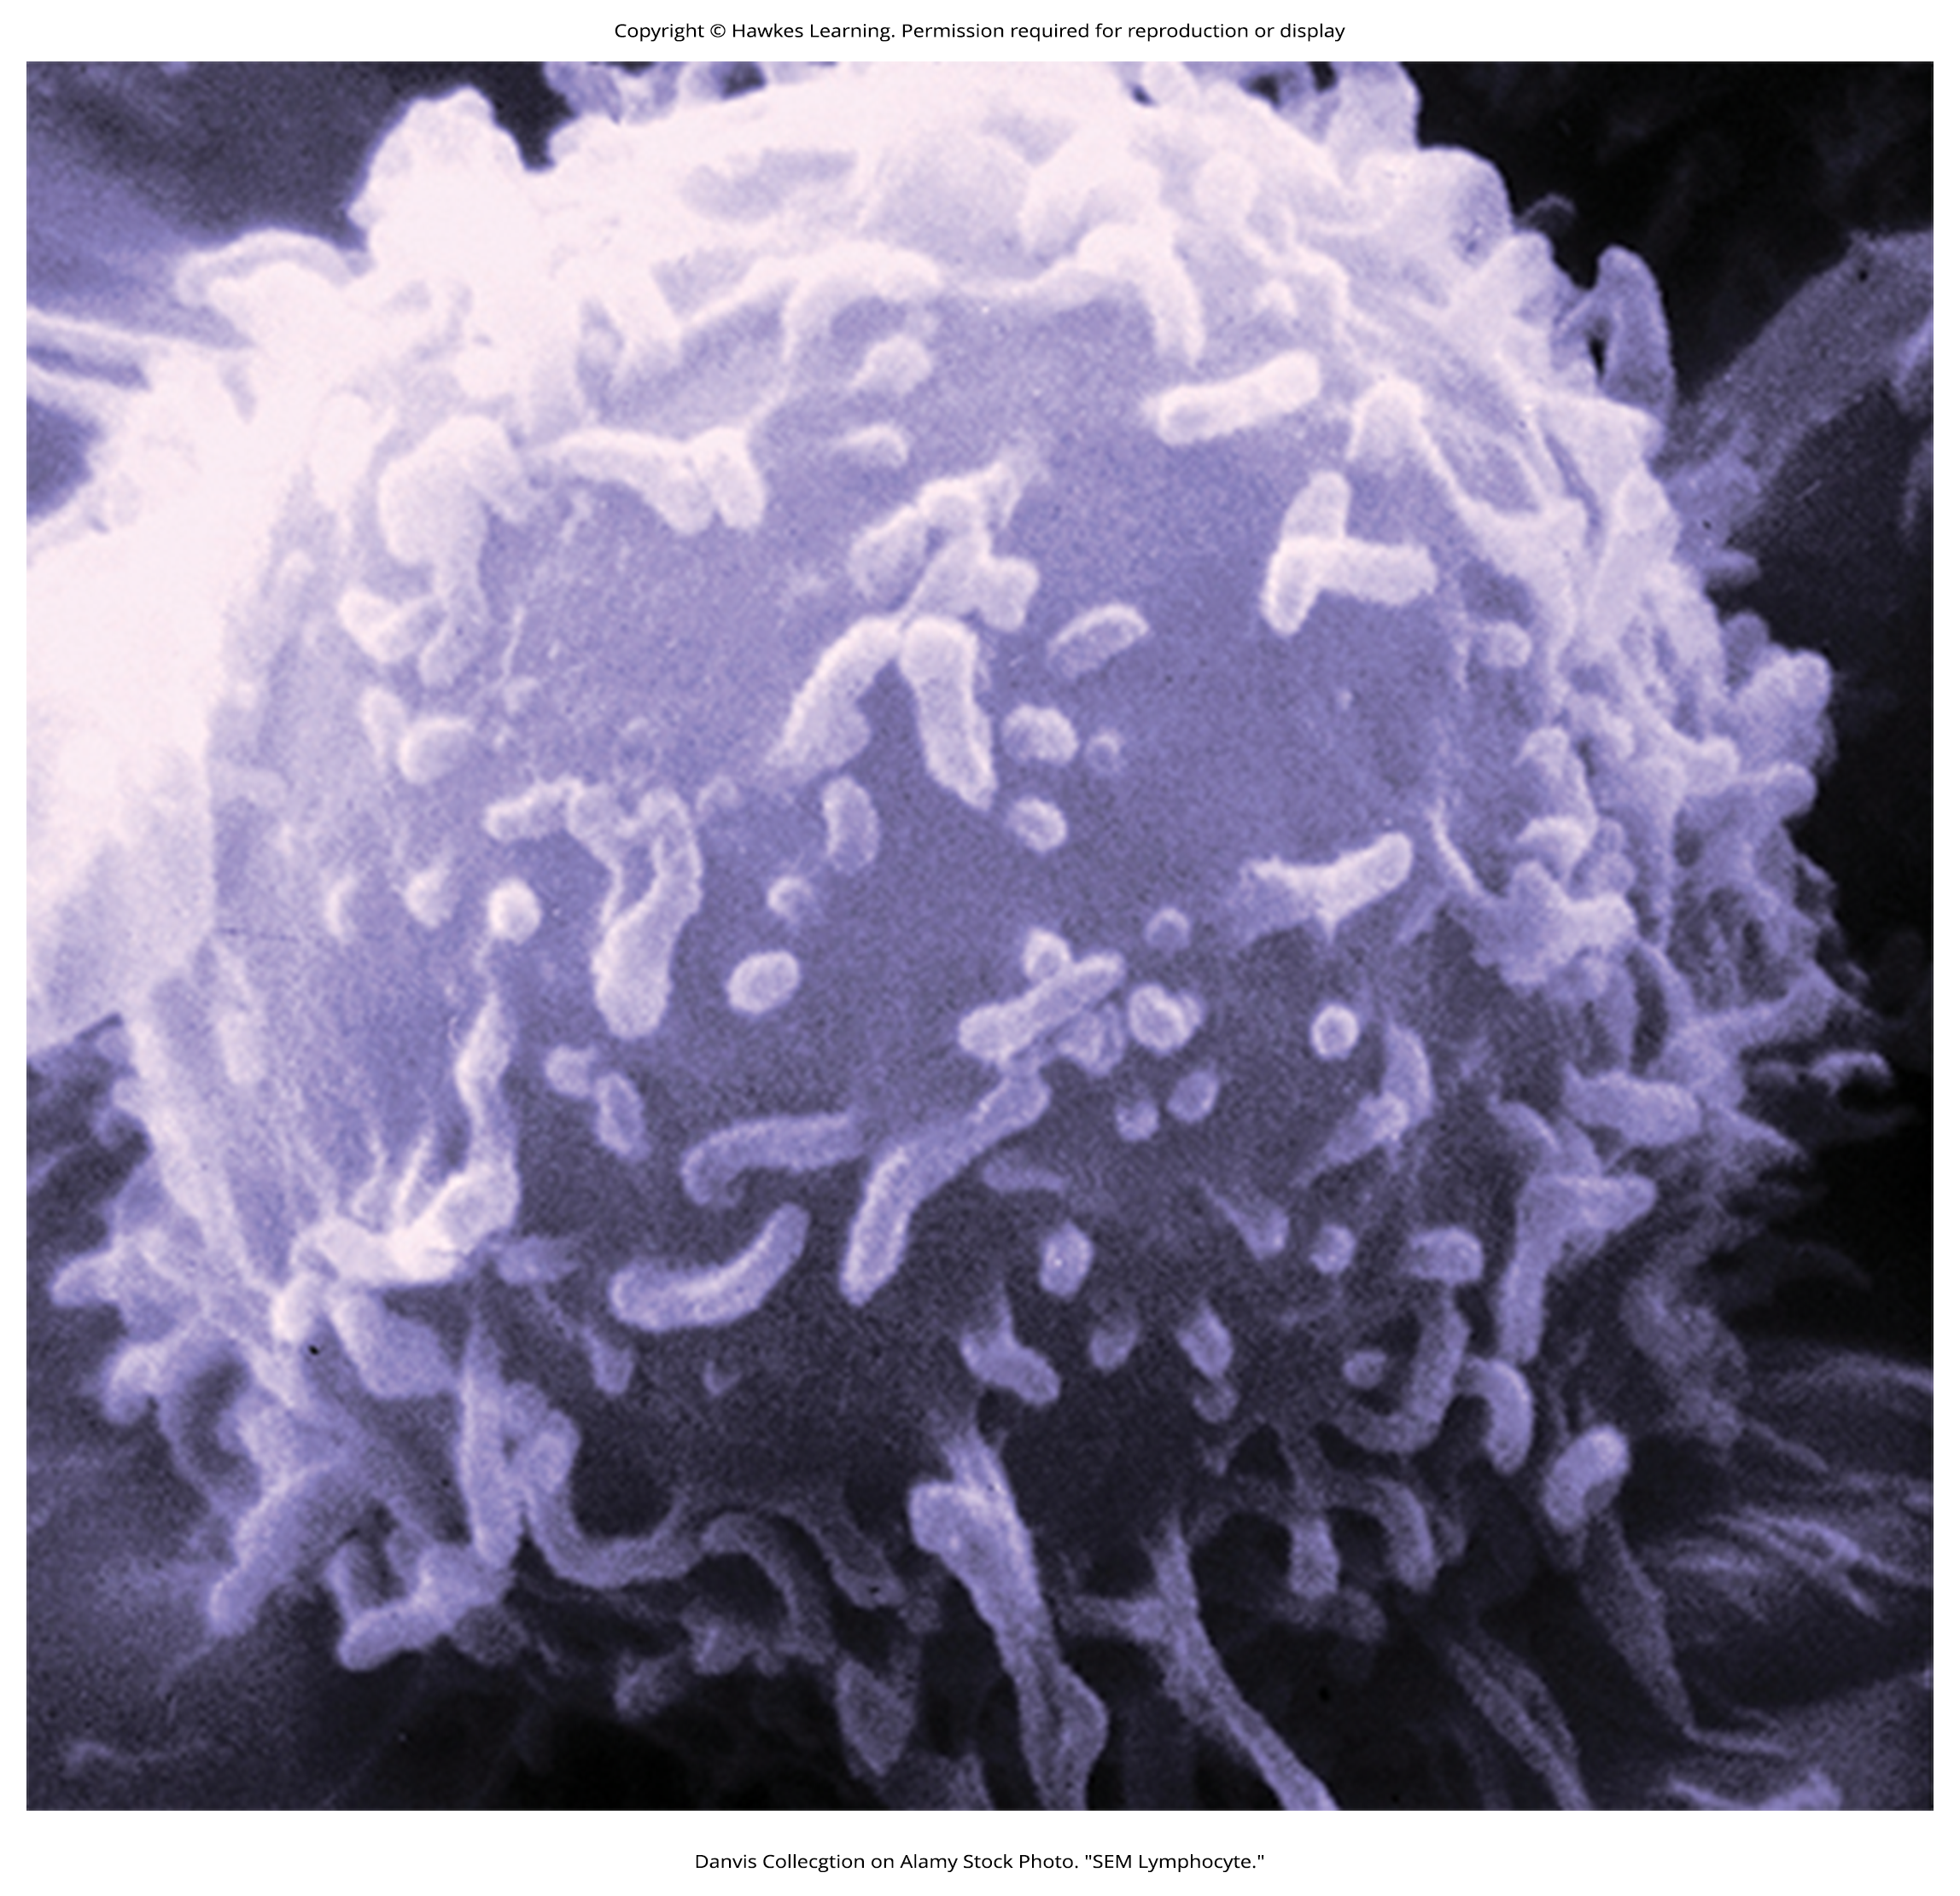
Stressors And Immune Function₃
There is a physiological connection between the brain and immune system.
Example: Sympathetic nervous system innervates immune organs like the thymus and spleen (Maier et al., 1994).
HPA axis activation adversely impacts immune function.
Inhibits production of lymphocytes (white blood cells) (Everly & Lating, 2002)
Figure 6

Slide 14
Stressors And Immune Function₄
People with high stress levels should be more likely to develop an illness than those with little stress.
Study: 276 healthy volunteers interviewed about recent stressful experiences (Cohen et al., 1998).
Given nasal drops containing the cold virus
Those with chronic stressors for more than 1 month more likely to develop colds (Figure 7)

Slide 15
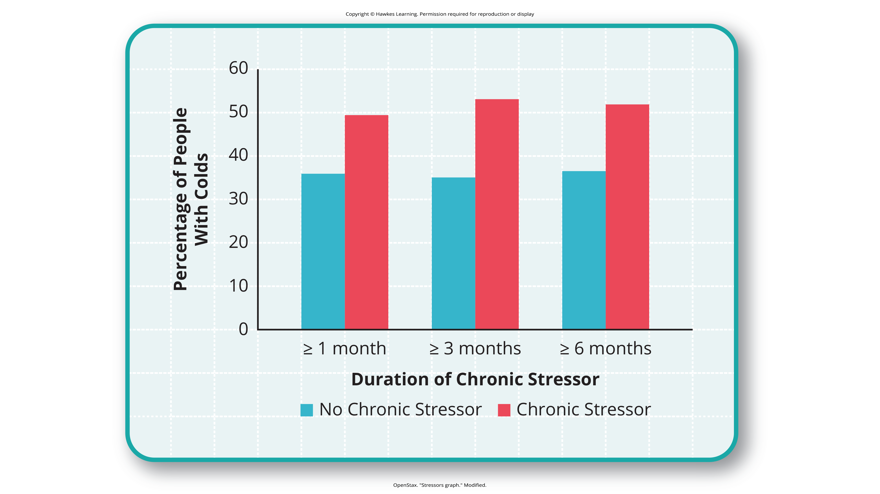
Lesson 14.3 Figure 7
Caption: This graph shows the percentages of participants who developed colds (after receiving the cold virus) after reporting having experienced chronic stressors lasting at least 1 month, 3 months, and 6 months (adapted from Cohen et al., 1998).

Slide 16
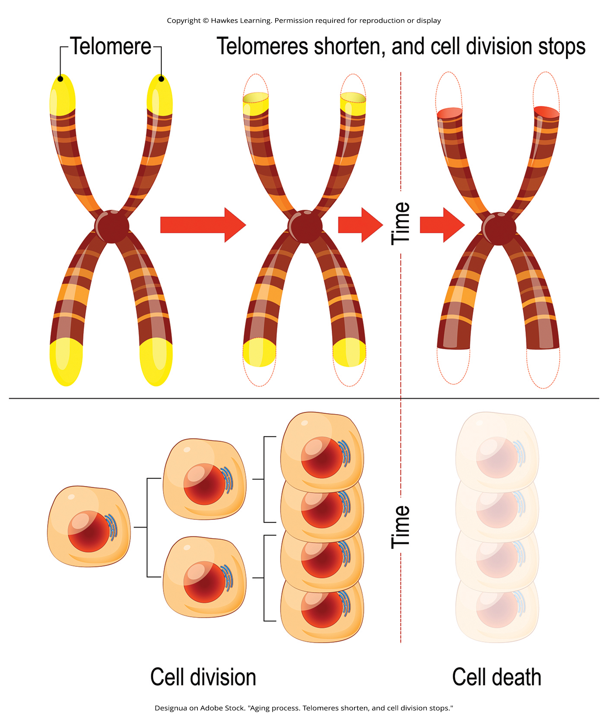
Dig Deeper: Stress And Aging: A Tale Of Telomeres₁
Stress can shorten telomeres (segments of DNA that protect chromosome ends).
Inhibits cell division, including growth and new cells (Sapolsky, 2004)
Study: The longer a mother spent caring for her ill child, the shorter her telomeres (Epel et al., 2004).
Figure 8

Slide 17
Dig Deeper: Stress And Aging: A Tale Of Telomeres₂
Other studies found associations between stress and eroded telomeres (Blackburn & Epel, 2012; Lin & Epel, 2022).
Example: Childhood exposure to violence found to accelerate telomere erosion from ages 5 to 10 (Shalev et al., 2013).
Example: U.K. women ages 41 to 80 with adverse experiences during childhood had shortened telomeres (Surtees et al., 2010), and telomere size decreased as the amount of adversity increased (Figure 9).

Slide 18
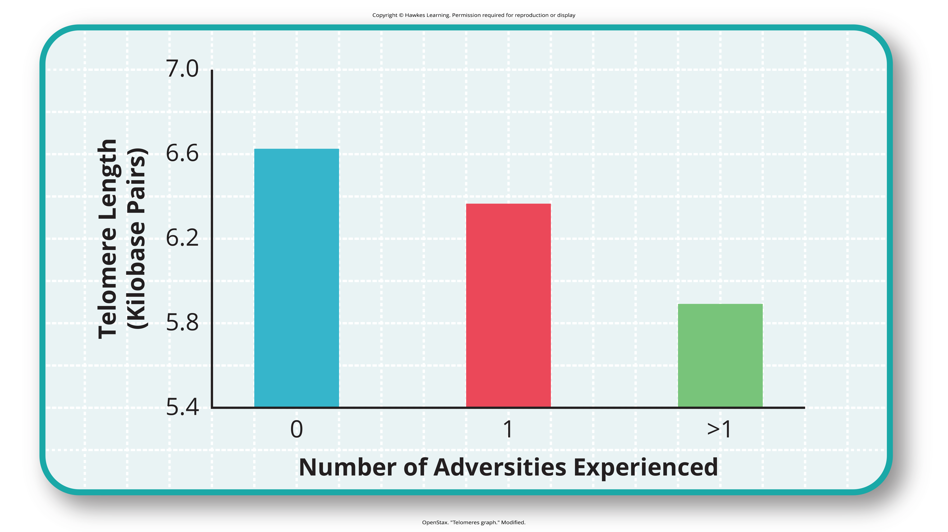
Lesson 14.3 Figure 9
Caption: Telomeres are shorter in adults who experienced more trauma as children (adapted from Blackburn & Epel, 2012).

Slide 19
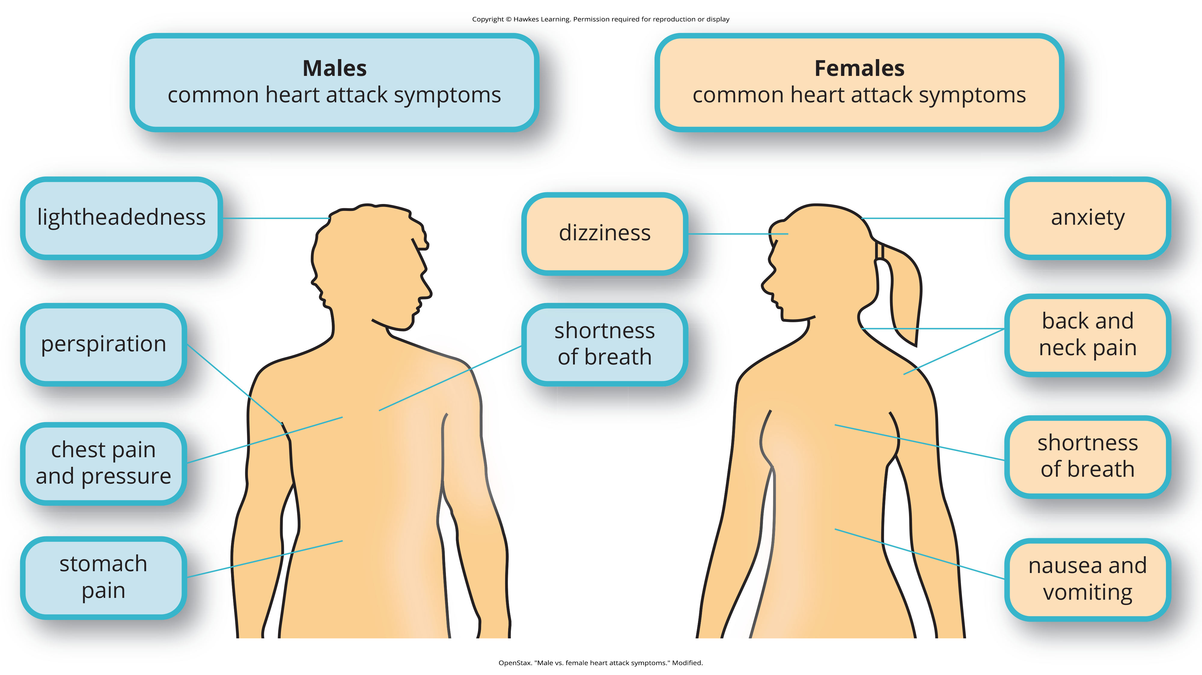
Cardiovascular Disorders
Cardiovascular disorders: disorders involving the cardiovascular system
Major focal point in psychophysiological disorder studies (Everly & Lating, 2002)
Heart disease: a major cardiovascular condition
Leading cause of death in the developed world (CDC, 2022a)
Symptoms vary, but usually involve angina (Office on Women's Health, 2009; CDC, 2023a)
Figure 10

Slide 20
Hypertension₁
Hypertension: high blood pressure
Major risk factor for heart disease
Forces the heart to pump harder, more physical strain
Can lead to heart attack, stroke, heart failure
Has no symptoms (AHA, 2022)
Risk factors for cardiovascular disorders: aging, income, education, employment status, unhealthy diet, tobacco use, physical inactivity, excessive alcohol consumption, obesity, diabetes (CDC, 2022a)

Slide 21
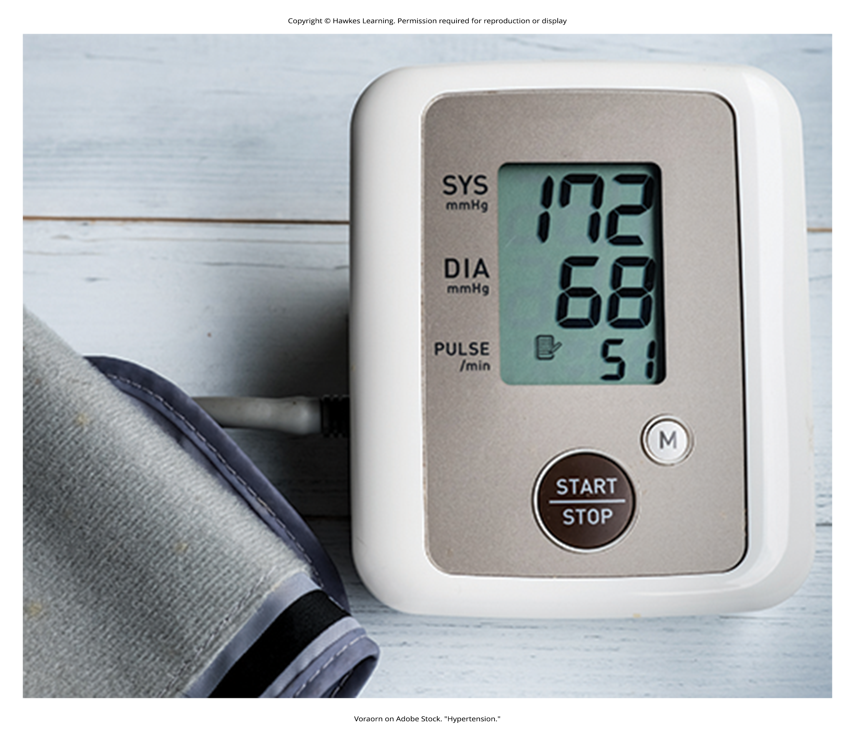
Hypertension₂
Stress and psychological factors play a crucial role in cardiovascular health (Nusair et al., 2012).
Exposure to stressors of many kinds has been linked to cardiovascular problems.
Examples for hypertension: job strain (Trudel et al., 2010), natural disasters (Babaie et al., 2021), marital conflict (Smith et al., 2021), perceived discrimination (Panza et al., 2019; Sims et al., 2012)
Figure 11

Slide 22

Are You Type A Or Type B?
Those prone to heart disease tend to think, feel, and act differently than those who are not (Friedman & Rosenman, 1974).
Type A individuals are driven workaholics, preoccupied with deadlines.
Type B individuals are more relaxed, laid-back (Figure 12).
Heart disease was over 7 times more frequent among Type As than Type Bs (Friedman & Rosenman, 1959).
Figure 12

Slide 23
Type A₁
Major components:
Aggressive/chronic struggle to achieve more in less time (Friedman & Rosenman, 1974)
Excessive competitive drive
Chronic sense of time urgency
Impatience
Hostility toward others
Link between Type A behavior and later development of heart disease (Rosenman et al., 1975; Haynes et al., 1980)
Not replicated in later research (Glassman, 2007; Myrtek, 2001)
More attention toward whether any specific elements of Type A behavior predict heart disease (Sahoo et al., 2018)

Slide 24
Reflection Question₂
Do you feel that you are more of a Type A person or a Type B person? What behaviors do you exude that reflect your thoughts on this?

Slide 25
Type A₂
The anger/hostility dimension may be crucial in heart disease development (Montenegro & Montenegro, 2018).
Study: 1,000 male medical students completed a questionnaire about how they react to pressure.
Some reported high levels of anger; others reported less.
Those with higher anger were 6 times more likely to have had a heart attack by age 55 (Chang et al., 2002).
Anger and hostility constitute serious long-term risk factors for adverse cardiovascular outcomes (Chida & Steptoe, 2009).
Hostility and social strain form a cycle (Figure 13).

Slide 26
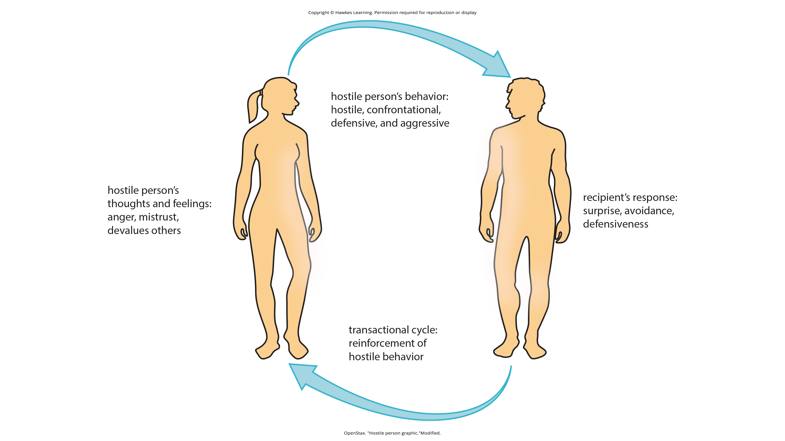
Lesson 14.3 Figure 13
Caption: According to the transactional model of hostility for predicting social interactions (Vella et al., 2012), the thoughts and feelings of a hostile person promote antagonistic behavior toward others, which in turn reinforces complimentary reactions from others, thereby intensifying one's hostile disposition and intensifying the cyclical nature of this relationship.

Slide 27
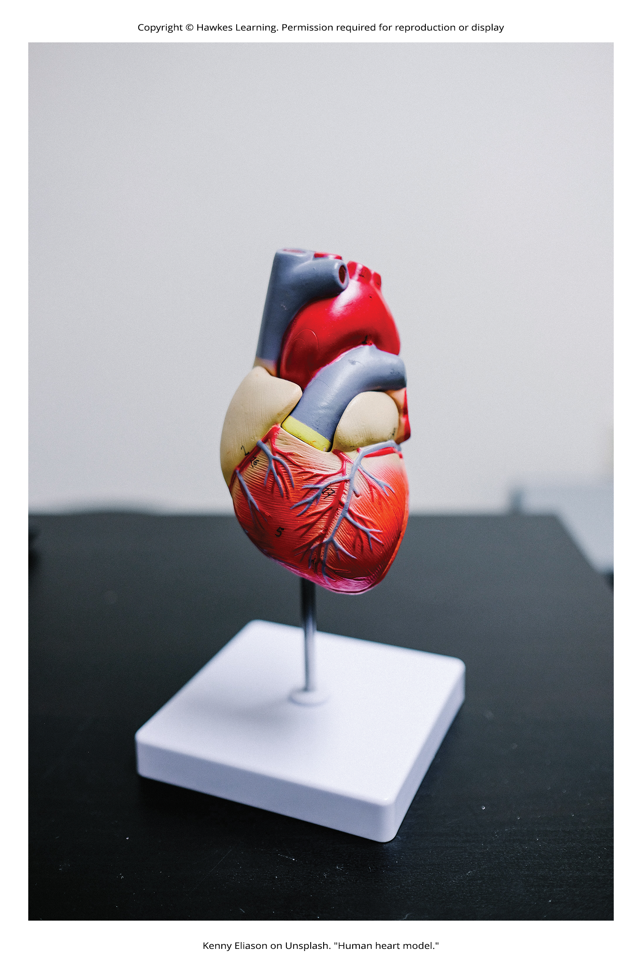
Negative Affectivity
Negative affectivity: tendency to experience distressed emotional states (Watson et al., 1988)
Linked to hypertension and heart disease (Balog, 2018)
Study: in 3,000 participants, those with higher negative affectivity at time of study more likely to develop hypertension (Jonas & Lando, 2000)
Figure 14

Slide 28
Depression And The Heart₁
A clear relationship exists between depression and heart disease.
First recognized by Benjamin Malzberg (1937), who found the death rate among patients with depression was 6 times higher
Depressed individuals have a higher risk of developing heart disease (Glassman, 2007).

Slide 29
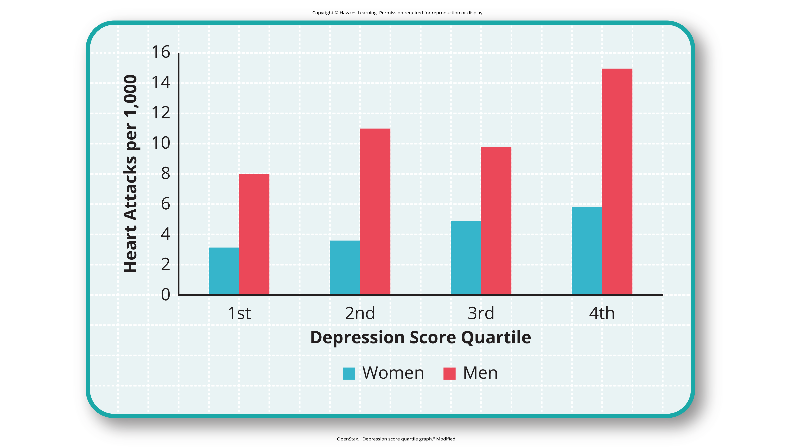
Lesson 14.3 Figure 15
Caption: This graph shows the incidence of heart attacks among men and women by depression score quartile (adapted from Barefoot & Schroll, 1996).

Slide 30
On Your Own₂
Have you or someone close to you ever suffered from depression? If so, how has that impacted your physical well-being?

Slide 31
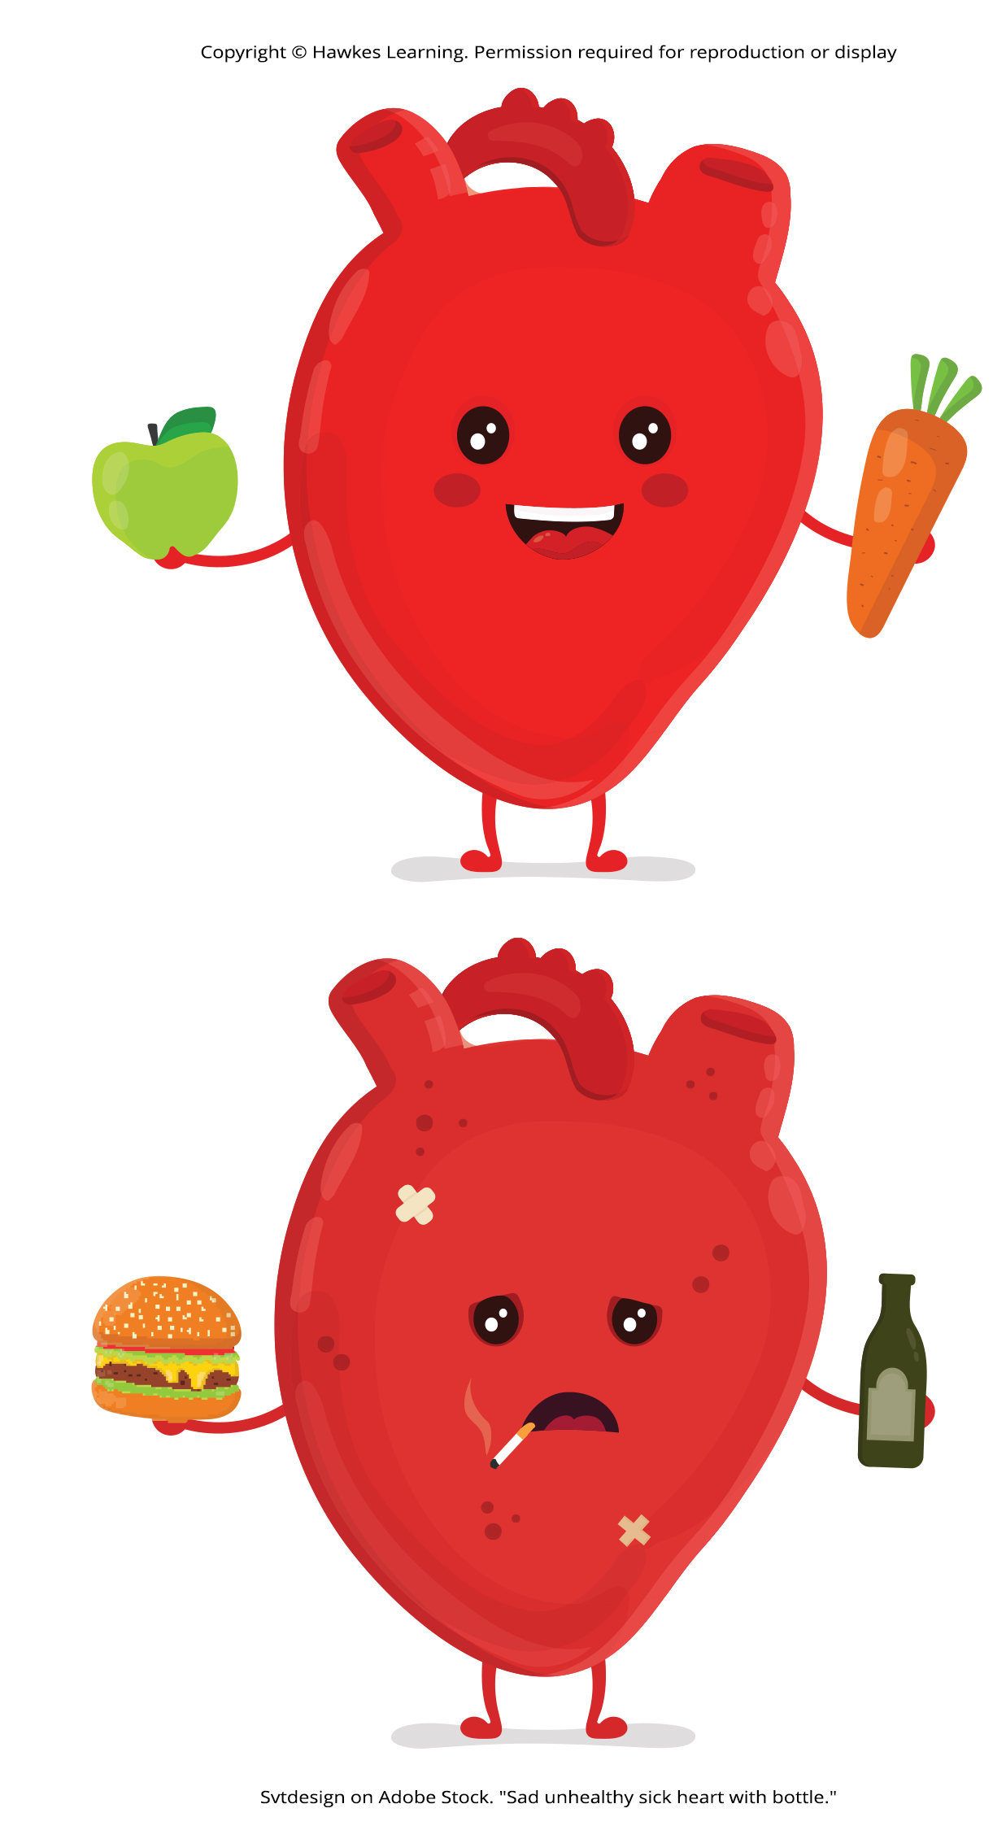
Depression And The Heart₂
Those with heart disease have more depression, and those with depression are more likely to develop heart disease and experience higher mortality (Hare et al., 2013; Ziegelstein, 2023).
The more severe the depression, the higher the risk (Glassman, 2007).
The American Heart Association recommends routine depression screening (Lichtman et al., 2008).
Recommended including depression as risk factor for heart disease patients (AHA, 2023)
Figure 16

Slide 32
Asthma₁
Asthma is a chronic disease where airways become obstructed.
Caused by inflammation, tightening, and narrowing of the airways (Figure 17) (American Lung Association, 2023)
Can experience wheezing, chest tightness, shortness of breath, and coughing (CDC, 2023b)
It affects over 21 million U.S. adults and is on the rise (CDC, 2022b).
Psychological factors, like stress and emotions, can trigger asthma (Wright et al., 1998), but only in some patients (Ritz et al., 2006).

Slide 33
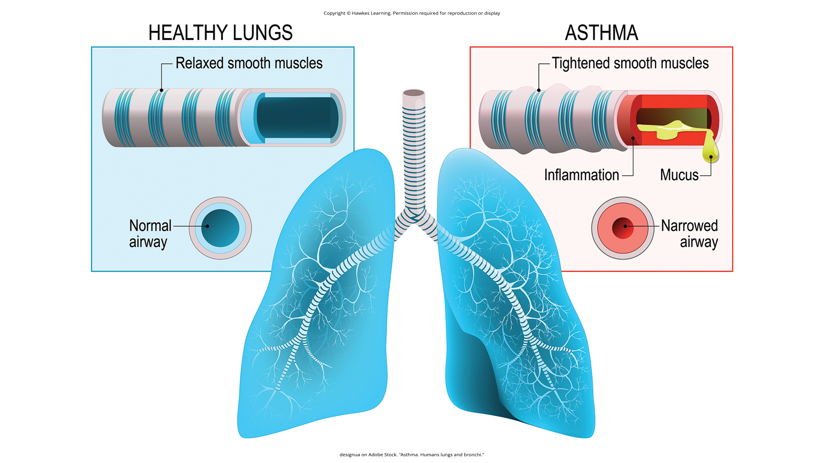
Lesson 14.3 Figure 17
Caption: In patients with asthma, the airways become inflamed and narrowed.

Slide 34

Asthma₂
People with asthma report negative emotions, and asthma attacks are linked to high emotionality (Lehrer et al., 1993).
Study: 18-year-old man with asthma suffered a breakup, leaving him depressed (D'Amato et al., 2010).
Suffered asthma symptoms whenever he saw her profile on Facebook
Social media as trigger for depressed asthmatic individuals
Figure 18

Slide 35
Reflection Question₃
Does it surprise you to learn of the ways in which social media has created an unhealthy situation for this man? Why or why not?

Slide 36
Headaches
Headache: continuous pain anywhere in the head/neck region
Migraines: type thought to be caused by blood vessel swelling and increased blood flow (McIntosh, 2022)
Characterized by severe pain in the head, an upset stomach, and disturbed vision
Experienced more by women than men (American Academy of Neurology, 2022)

Slide 37
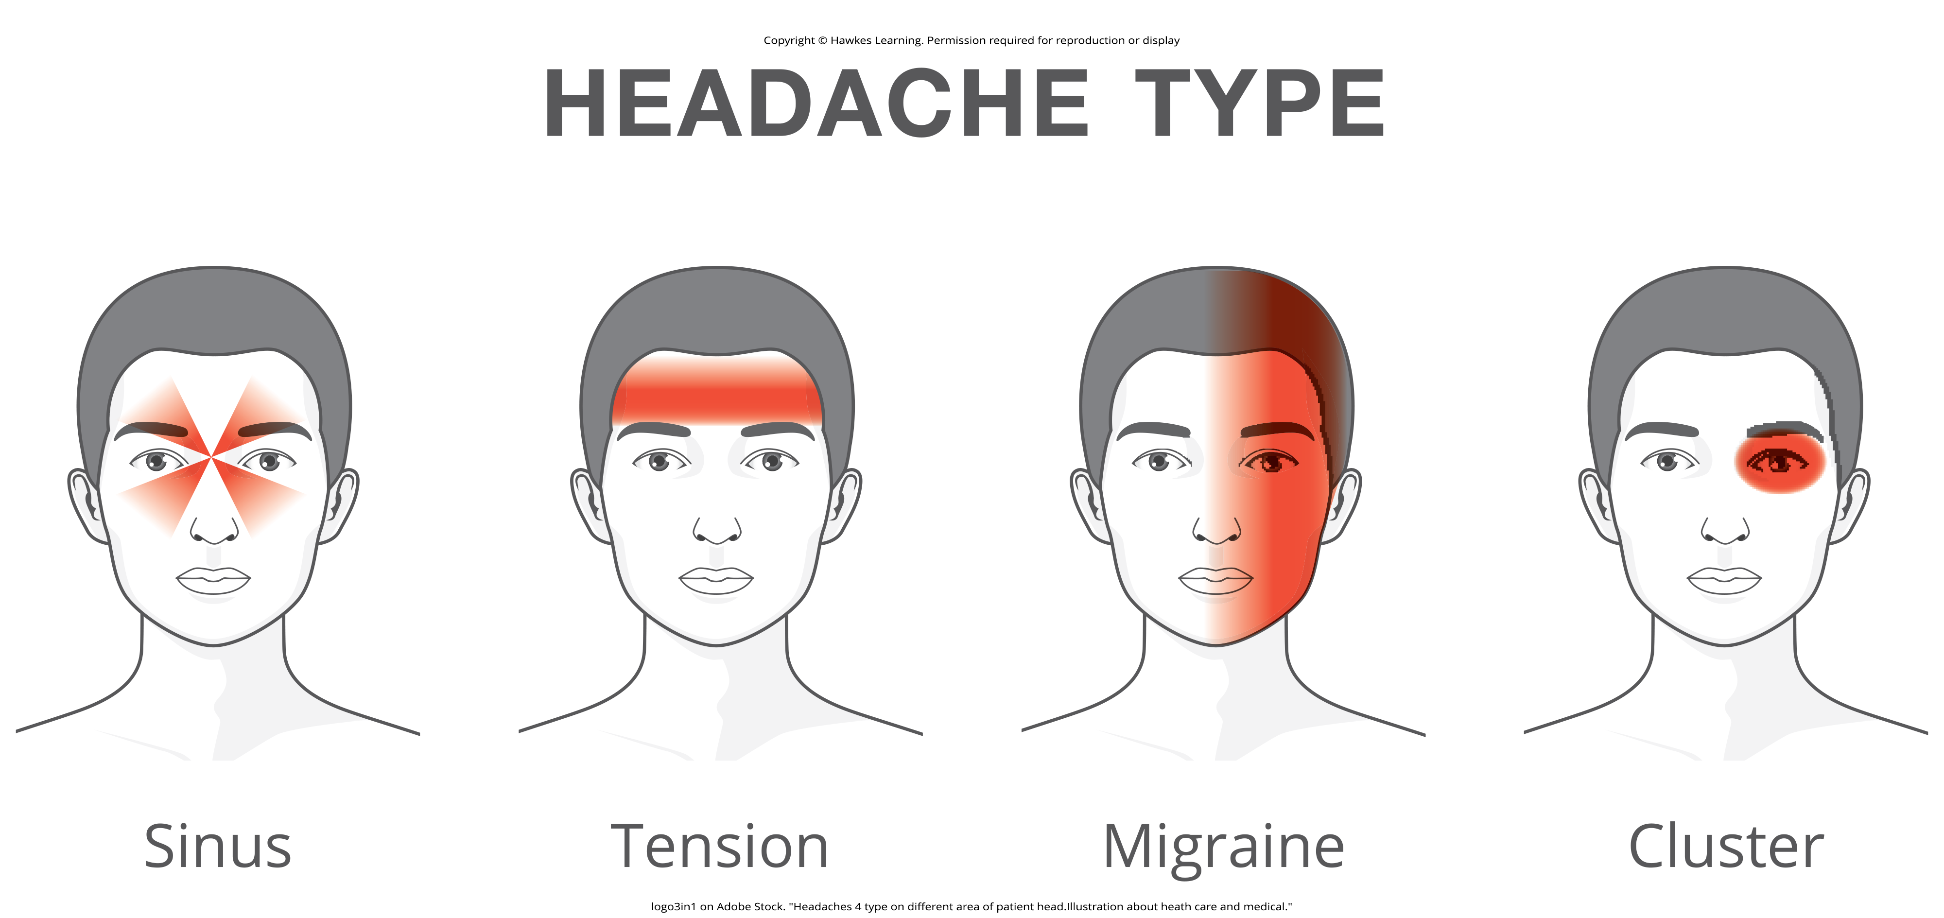
Tension Headaches₁
Tension headaches: caused by tightening/tensing of facial and neck muscles
Most common type, accounting for about 42% of headaches worldwide (Stovner et al., 2007)
Experienced by one third of the U.S. population
Factors: sleep deprivation, skipping meals, eye strain, overexertion, muscular tension from poor posture, stress
Figure 19

Slide 38
Tension Headaches₂
Stress increases sensitivity to pain (Caceres & Burns, 1997; Logan et al., 2001).
Tension headache sufferers have a lower threshold for and greater sensitivity to pain (Ukestad & Wittrock, 1996).
Report greater levels of stress when faced with a stressor (Myers et al., 1998)
Stress may contribute to tension headaches by increasing sensitivity in already-sensitive pain pathways (Cathcart et al., 2008).

Slide 39
Summary
Psychophysiological disorders are physical diseases influenced by stress.
Stress weakens immune system functioning, leading to health issues.
Cardiovascular disorders, asthma, and tension headaches are notably affected by stress.

Slide 40
End of Hawkes Learning PowerPoint

