Slide 1
Lesson 14.4
Regulation of Stress

Slide 2
Regulation of Stress
Stress impacts our bodies negatively, potentially causing significant health problems.
Effective coping strategies are essential for managing stress and its emotional effects.
Coping: mental and behavioral efforts to manage stress and its causes

Slide 3

Coping Styles₁
Lazarus and Folkman (1984) identified two main coping styles: problem-focused and emotion-focused.
Problem-focused coping attempts to manage or alter the problem/stressor.
Strategy: identify the problem, consider solutions, weigh costs/benefits, select an alternative (Lazarus & Folkman, 1984)
Emotion-focused coping attempts to change or reduce the negative emotions associated with stress.
Strategy: avoid/minimize/distance from the problem, seek something positive in the negative, reappraisal (Lazarus & Folkman, 1984)
Figure 1

Slide 4
Coping Styles₂
Problem-focused coping is the more likely approach with controllable stressors (Folkman & Lazarus, 1980).
Emotional-focused coping is more likely with uncontrollable stressors (Folkman & Lazarus, 1980).
Most stressors can be modified and are, therefore, controllable.
Example: A student who fails an exam can study harder for the next time.

Slide 5
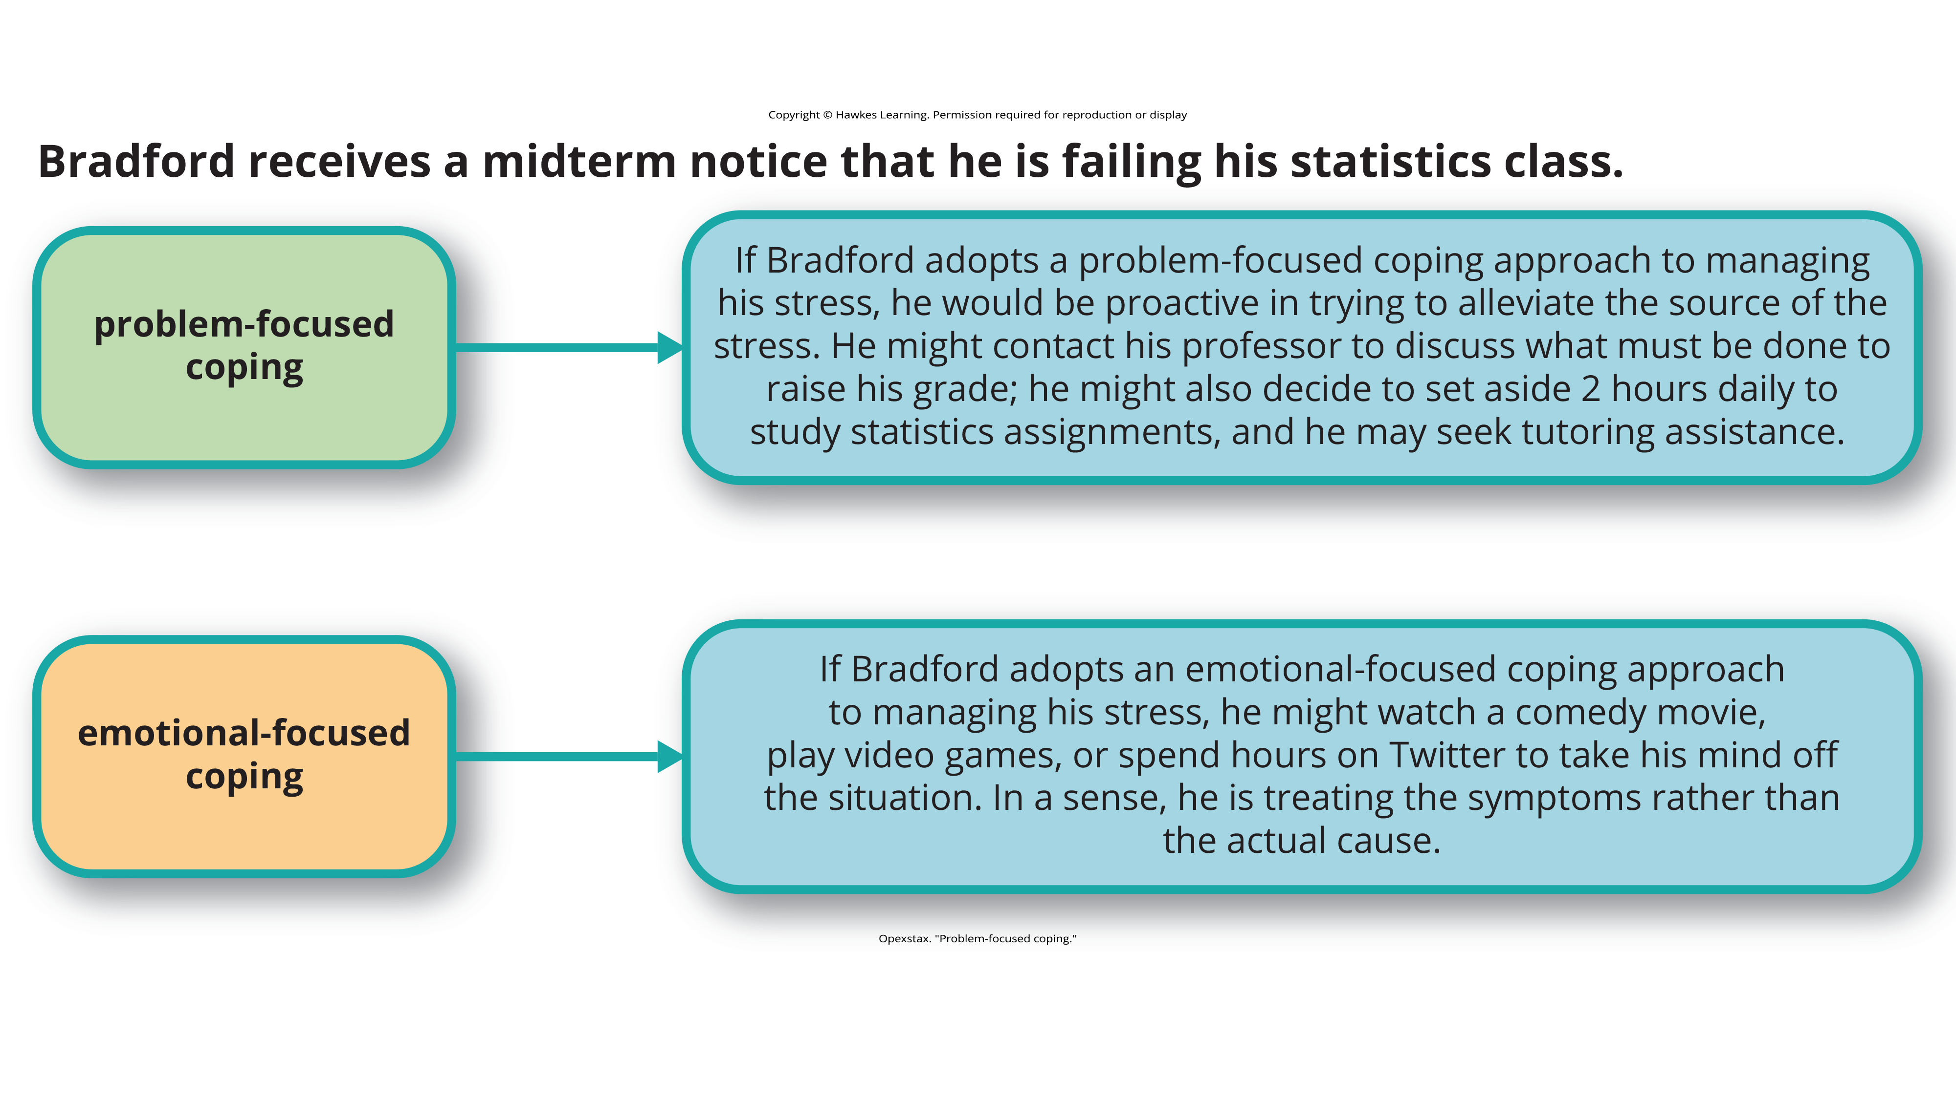
Problem-Focused Coping

Slide 6
Group Activity
As a group, brainstorm other scenarios in which an emotional-focused coping strategy is more effective than a problem-focused attempt. Do you notice any similarities in the kind of situations you came up with?

Slide 7

Perceived Control
Perceived control is our belief in our ability to influence and shape outcomes.
Major implications for our health and happiness (Infurna & Gerstorf, 2014)
Linked to better physical health, mental health, and psychological well-being (Rippe et al., 2021)
Bandura (1997) emphasized the importance of perceived control in managing stress intensity and duration.
Research shows that perceived control can reduce emotional and physical reactivity to stressors (Neupert et al., 2007).
During the COVID-19 pandemic, perceived control was a significant factor in maintaining health and well-being (Rippe et al., 2021).
Figure 2

Slide 8
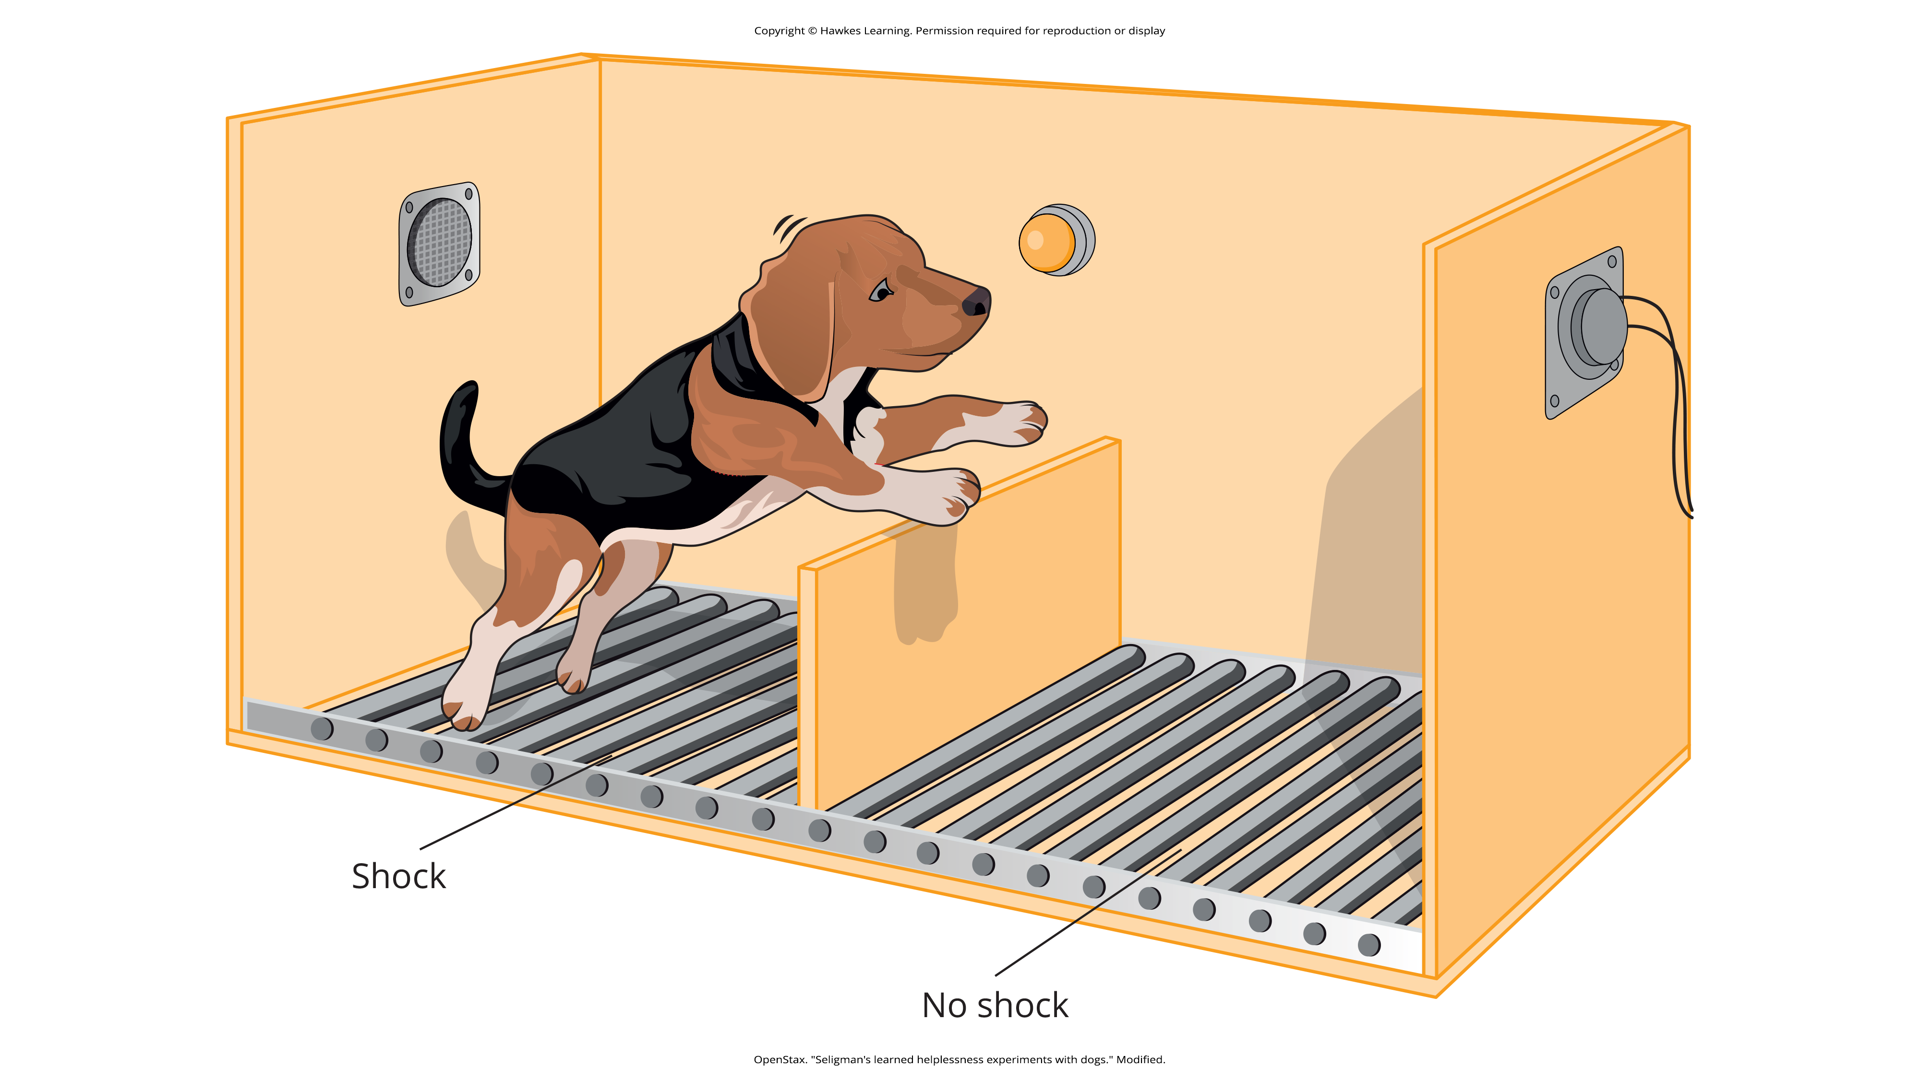
Dig Deeper: Learned Helplessness
Learned helplessness occurs when individuals feel they have no control over repeated negative events.
Study: In Seligman's experiments with dogs, those unable to escape shocks later failed to try escaping when they could (Figure 3).
Helps explain certain types of depression, where individuals feel powerless to change negative circumstances
Figure 3

Slide 9
Reformulated Learned Helplessness Model
The reformulated learned helplessness model includes attributions as factors contributing to helplessness and depression (Abramson et al., 1978).
Attributions: internal vs. external, stable vs. unstable, and global vs. specific
People who make internal, stable, and global attributions for negative outcomes are more prone to depression when faced with stress (Peterson & Seligman, 1984).

Slide 10

Control And Stress
Perceived control over health behaviors links to better health outcomes (Bandura, 2004) and lower risk of physical health issues.
Social class differences in health outcomes can be partly explained by variations in perceived control (Kraus et al., 2012).
Higher perceived control in affluent individuals may lead to overestimations of their influence.
Example: higher rates of voting in more affluent communities (Krosnick, 1990)
Enhancing perceived control can help individuals of lower social standing manage stress and improve health (Lachman & Weaver, 1998).
Figure 4

Slide 11
Reflection Question₁
Why do you think that people in a higher economic status are more likely to believe that their vote actually matters when we live in a system where each vote is counted equally? What larger issues might be at play here?

Slide 12

Social Support₁
Forming and maintaining strong, stable relationships is a fundamental human motive (Baumeister & Leary, 1995; Szkody & McKinney, 2020).
Social support is the assistance and comfort received from others, providing significant stress relief (Szkody et al., 2020).
Includes advice, guidance, encouragement, emotional comfort
Other people can be a comfort and help in times of stress.
Example: elephants sensing stress and comforting each other (Krumboltz, 2014)
Figure 5

Slide 13
On Your Own
What does your emotional support system look like? Have you been able to lean on it over the years? Why or why not?
Notes:
Originally an On Your Own

Slide 14
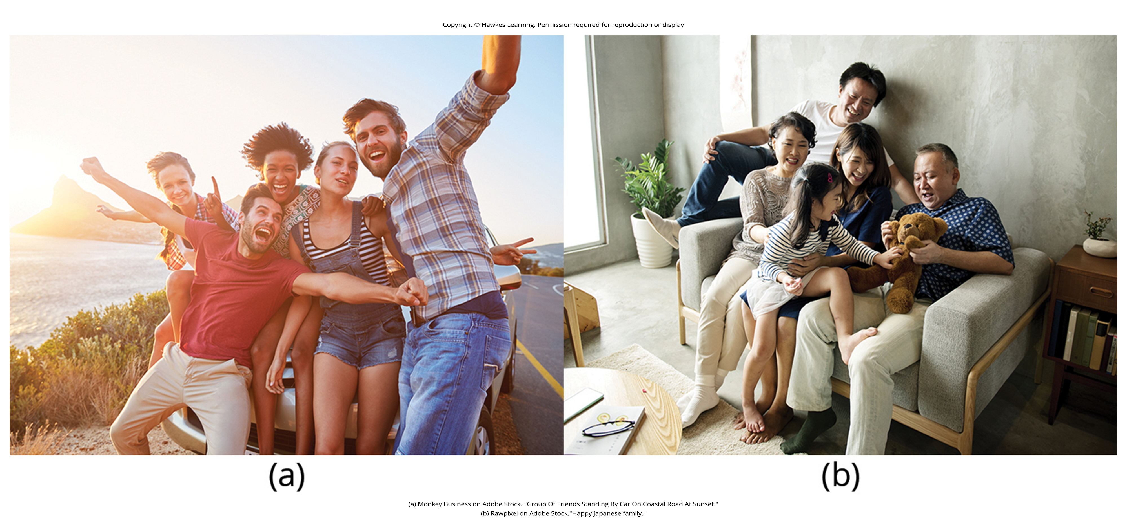
Social Support₂
Social support research started in the 1970s with a study on the health consequences of being socially integrated (Stroebe & Stroebe, 1996).
Social support is one of the well-documented psychosocial factors affecting health outcomes (Szkody & McKinney, 2020; Uchino, 2009).
Longitudinal research confirms that strong social relationships improve survival rates, akin to quitting smoking (Figure 6).
Figure 6

Slide 15
Reflection Question₂
Does it surprise you to learn of the enormous impact of a social support system? How might this research have implications for the way human beings should treat one another?

Slide 16
Social Support₃
People with low levels of social support are at greater risk of mortality, especially cardiovascular disorders (Brummett et al., 2001).
High levels of social support are linked to better survival rates following cancer (Falagas et al., 2007; Kadambi et al., 2020) and HIV (Lee & Rotheram-Borus, 2001; Lelutiu-Weinberger et al., 2020).
Lack of real-life social support can be compensated by technology.
Study: College freshman who communicated with friends online were less distressed (Ranney & Troop-Gordon, 2012).

Slide 17
Reflection Question₃
Do you use any forms of social media? If so, do you think that it helps you to feel connected to others? Why or why not?

Slide 18
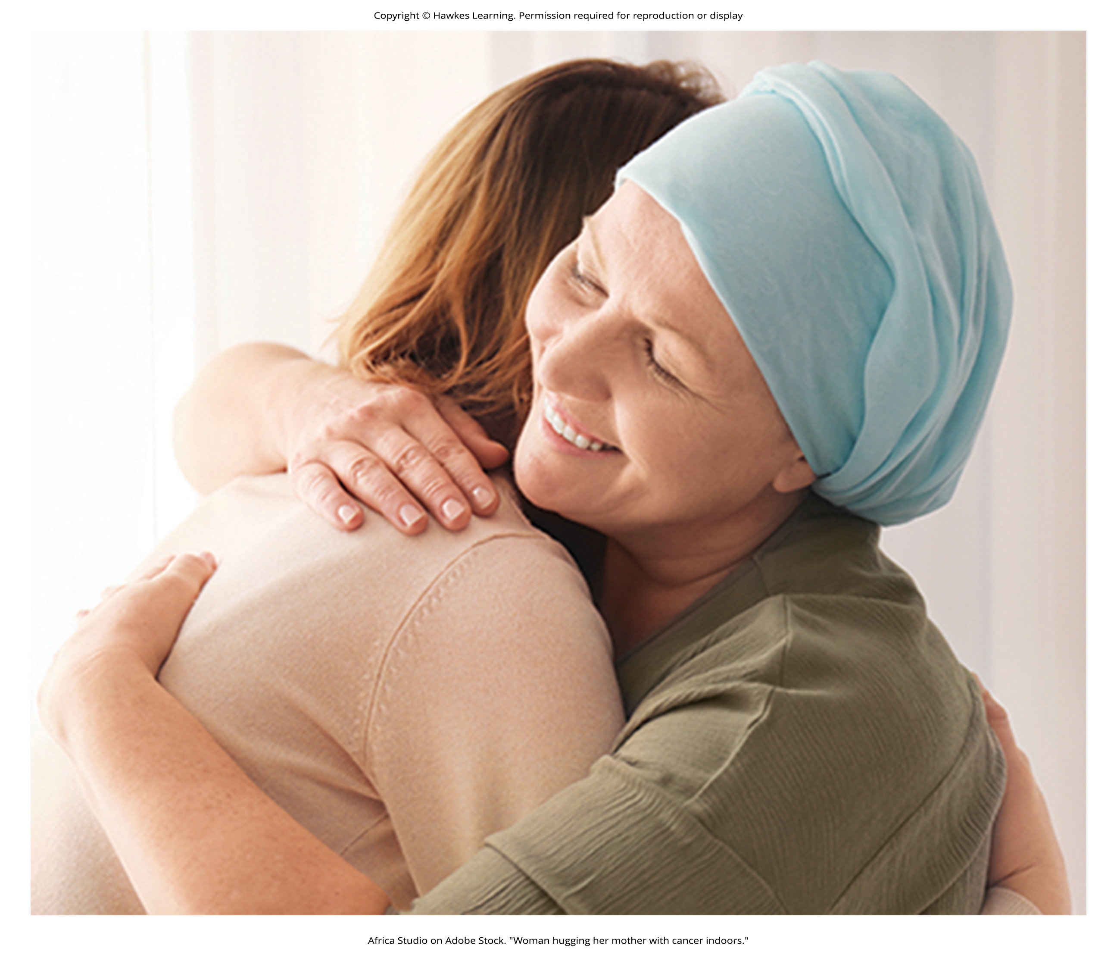
Physiology Of Social Support₁
Boosts immune system, especially among people experiencing stress (Uchino et al., 2012)
Example: shown to increase optimism, decrease side effects, increase quality of life, and enhance treatment outcomes in cancer patients (Benson et al., 2020; Ciria-Suarez et al., 2021; Sayilan & Dogan, 2020; Wondimagegnehu et al., 2019)
Figure 7

Slide 19
Physiology of Social Support₂
Reduces blood pressure, especially in male participants (Lei et al., 2019)
Connected to favorable health outcomes because of several beneficial physiological effects in stressful situations
May lead to healthy behaviors like diet, exercise, smoking cessation, and cooperation with medical regimens (Uchino, 2009)

Slide 20
Dig Deeper: Coping With Prejudice And Discrimination
Prejudice and discrimination are unique stressors for those targeted by such attitudes and behaviors (Brondolo et al., 2009).
Linked to depression, cardiovascular disease, hypertension
Coping strategies for racism-related stress include focusing on racial identity and managing anger expression (Brondolo et al., 2009).
Strong racial identity may help individuals separate personal from group-directed prejudice, potentially reducing distress (Brondolo et al., 2009).
Sense of belonging might alleviate distress, but research on this had had mixed results (Seaton & Lida, 2019).
Effectiveness of anger management strategies is mixed; research shows varied results for expression and suppression (Brondolo et al., 2009).
Understanding and researching effective coping mechanisms for racism-related stress remains crucial for addressing its impacts (Brondolo et al., 2009).

Slide 21
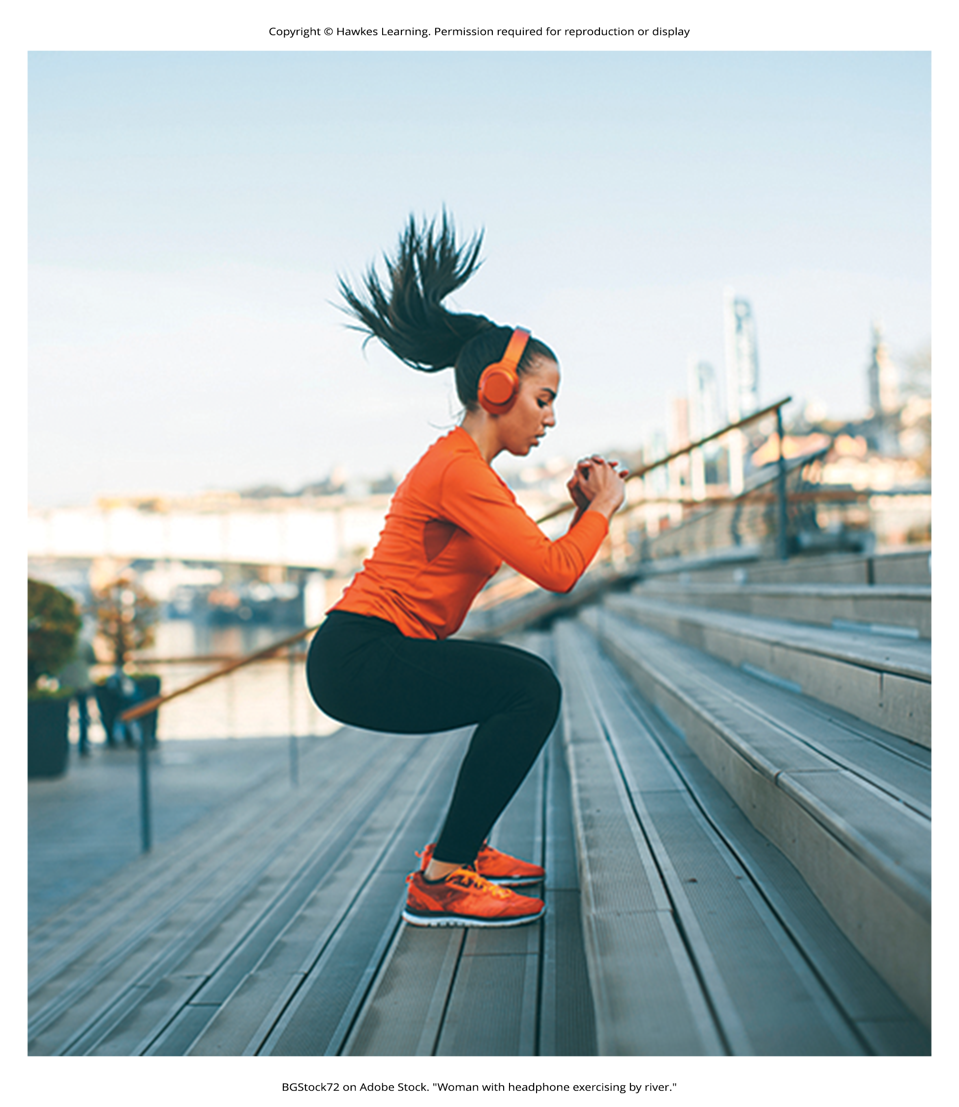
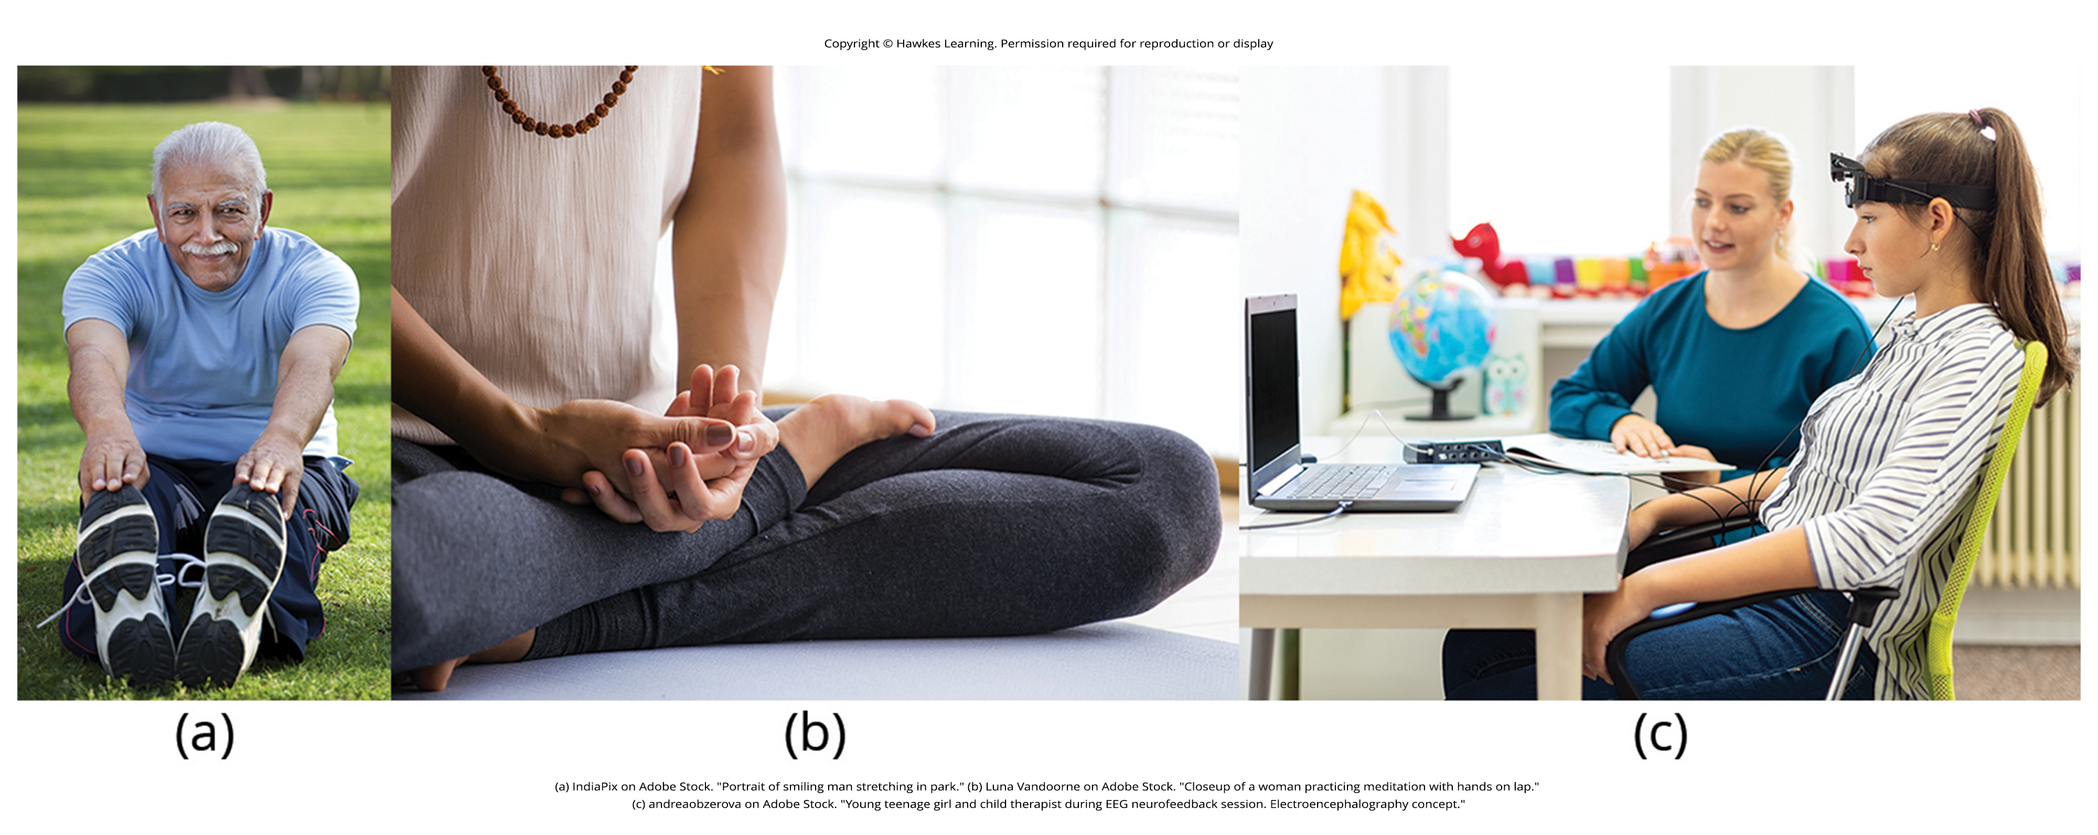
Stress Reduction Techniques
There are many ways to manage stress beyond having control and social support (Figure 9).
Exercise is an effective technique to combat stress (Saeed et al., 2019).
Benefits both physical and mental health (Everly & Lating, 2002)
Mitigates negative impacts of isolation/anxiety (Ranasinghe et al., 2020)
Figure 8
Caption: Stress reduction techniques may include (a) exercise, (b) meditation and relaxation, or (c) biofeedback.
Figure 9

Slide 22
Reflection Question₄
How has exercise, or a lack thereof, impacted your mental health?

Slide 23
Physiological Benefits Of Exercise
Decreases hypothalamic-pituitary-adrenal responsiveness to stressors
Study: Rats that exercised or 6 weeks showed a decrease in response to mild stressors (Campeau et al., 2010).
Prevents telomere shortening and premature aging (Puterman et al., 2010)
Minimizes detrimental effects of stress on hippocampus/memory (Head et al., 2012)
Reduces anxiety (Speck et al., 2010) and depression in cancer survivors (Craft et al., 2012)

Slide 24
Relaxation Response Technique
The relaxation response technique combines relaxation with transcendental meditation.
Developed by Herbert Benson (Greenberg, 2006)
Reduces sympathetic arousal, effectively treating high blood pressure (Benson & Proctor, 1994)
Used for women during labor to decrease pain intensity (Nasution et al., 2018)
The technique consists of four components (Stein, 2001):
Sitting upright on a comfortable chair with feet on the ground, body relaxed
A quiet environment with eyes closed
Repeating a word or phrase, such as "alert mind, calm body"
Allowing the mind to focus on pleasant thoughts, such as nature

Slide 25
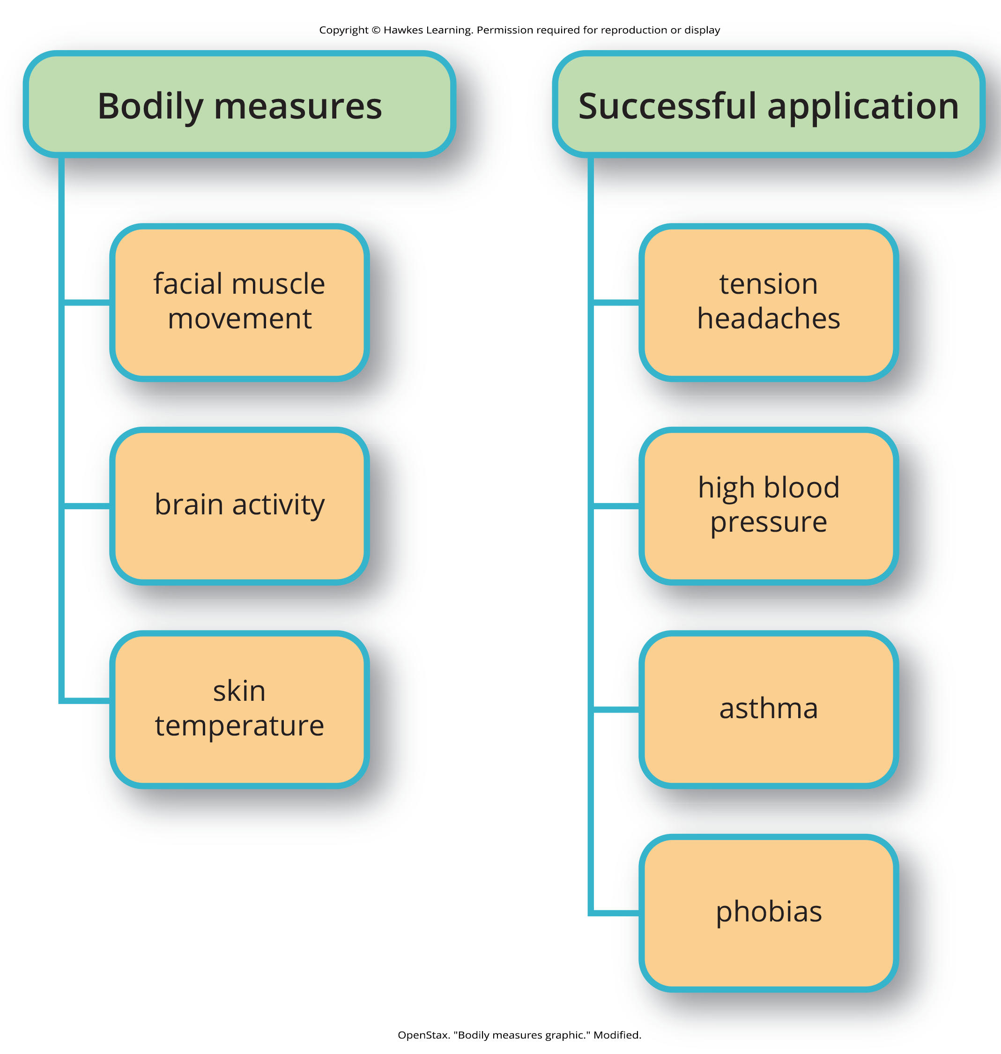
Biofeedback
Biofeedback uses equipment to measure a person's neuromuscular and autonomic activity.
Developed by Gary Schwartz at Harvard University in the 1970s
Provides feedback via visual or auditory signals
Enables individual to develop strategies that help gain voluntary control over normally involuntary bodily processes (Schwartz & Schwartz, 1995)
Figure 10

Slide 26
Summary
Effective stress management involves problem-focused and emotion-focused coping strategies.
Perceived control over stressors is crucial for physical and mental well-being.
Social support provides significant protection by boosting immune function and encouraging healthy behaviors.
Comprehensive stress management incorporates exercise, relaxation techniques, and supportive social networks to improve overall health outcomes.

Slide 27
End of Hawkes Learning PowerPoint

