Slide 1
Lesson 14.5
The Pursuit of Happiness

Slide 2
Group Activity₁
Independently, jot down what you think the word happiness means. Then, find a small group and have everyone share their answers. What similarities do you notice? How about differences?

Slide 3

Happiness
Happiness is an ambiguous term; everyone has different definitions.
Definitions emphasize different aspects, such as spiritual enlightenment, inner peace, and meaningful activities.
Despite differences, common agreement exists that happiness involves multiple dimensions.
Figure 1

Slide 4
Elements Of Happiness₁
Three distinct elements:
The pleasant life: attainment of day-to-day pleasures
The good life: identifying our unique skills and abilities
The meaningful life: using our talents in service of the greater good
The happiest individuals pursue all three elements, achieving a "full life" (Seligman et al., 2005).
Happiness is a long-term state of subjective well-being, not just a temporary mood.
An enduring state of mind with joy, contentment, and a sense of life's meaning and value (Lyubomirsky, 2001; Steptoe, 2019)

Slide 5
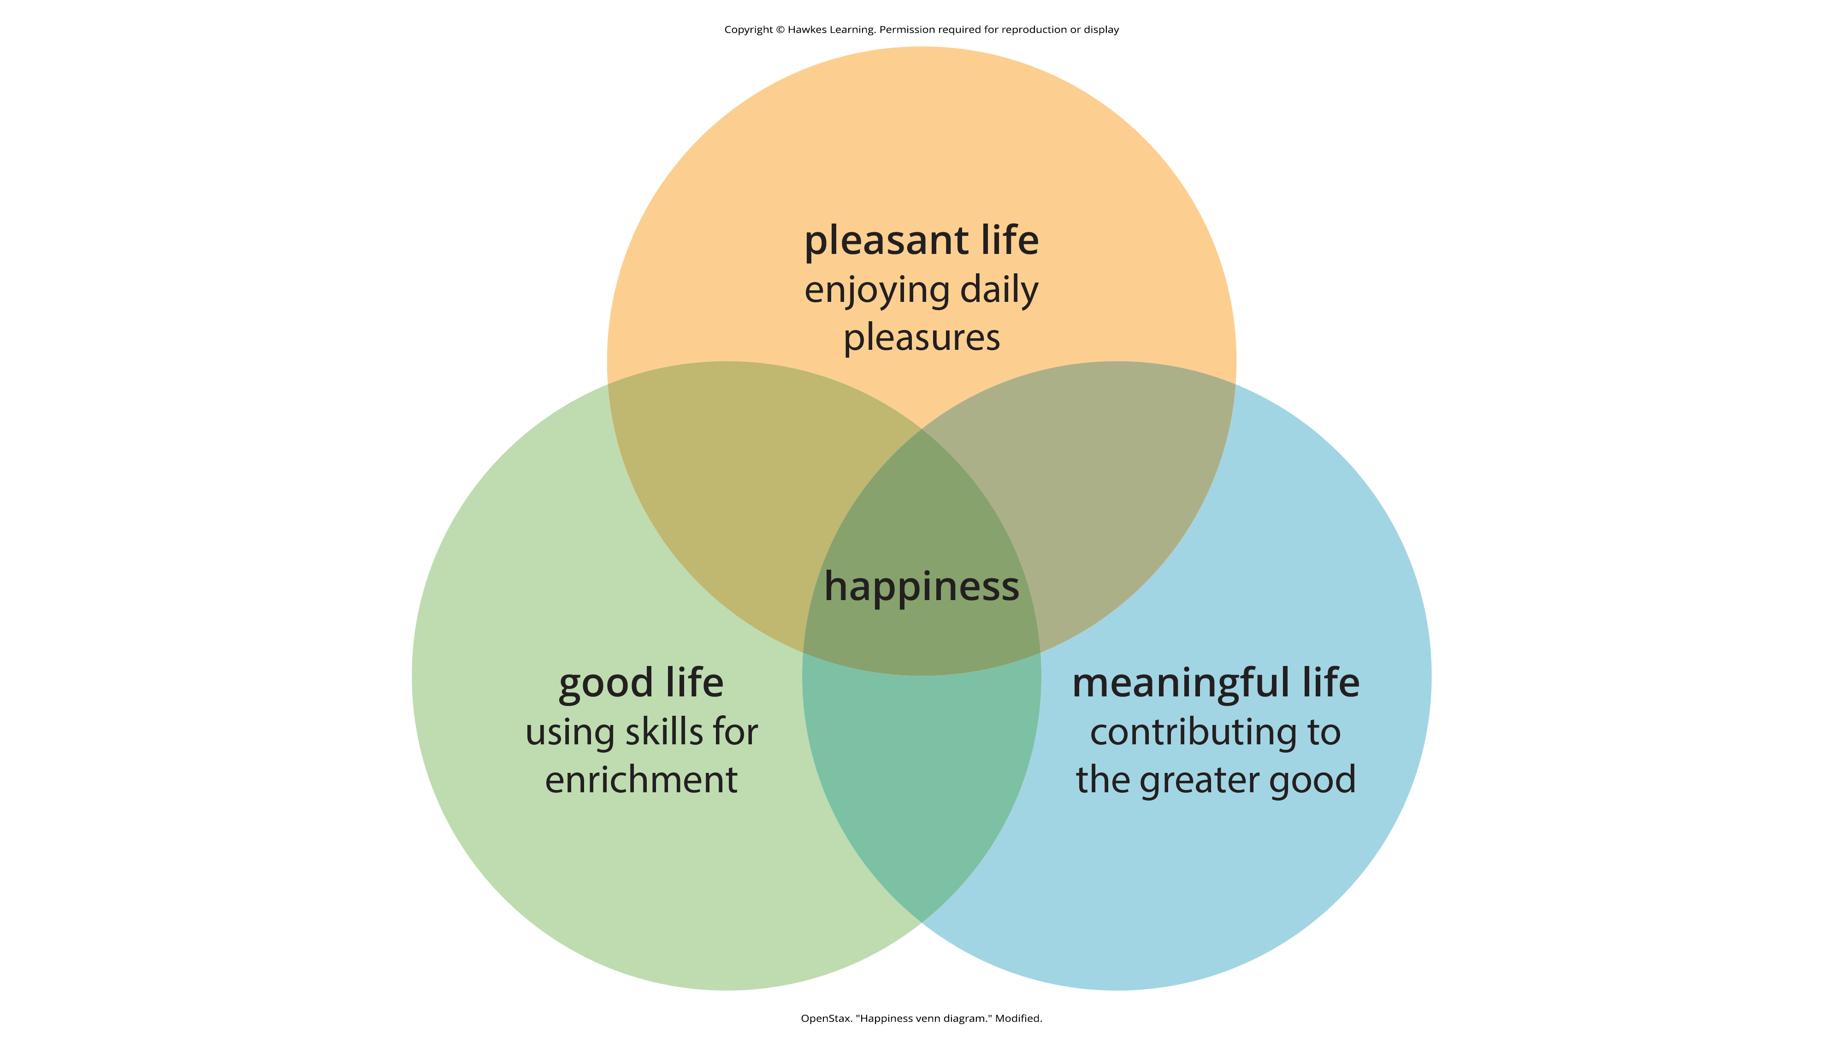
Lesson 14.5 Figure 2
Caption: Happiness is an enduring state of well-being involving satisfaction in the pleasant, good, and meaningful aspects of life.

Slide 6
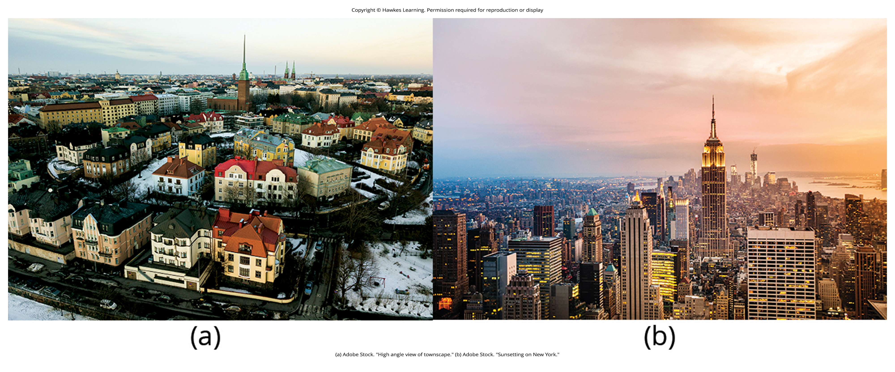
Elements Of Happiness₂
The average person is relatively happy, experiencing more positive than negative feelings (Diener et al., 2010).
The five happiest countries are: Finland, Denmark, Iceland, Switzerland, Netherlands.
The United States ranks at 16 (Figure 3) (Helliwell et al., 2022).
Figure 3
Caption: (a) Surveys of residents in over 150 countries indicated that Finland has the happiest citizens in the world. (b) Americans ranked the United States as the 16th happiest country in which to live.

Slide 7
Elements Of Happiness₃
Happiness levels of minorities, recent college graduates, and the disabled have trended downward (Gregoire, 2013).
In the first year of the COVID-19 pandemic, there was a 10% increase in people who said they were sad or worried (Helliwell et al., 2021).
Economic conditions may contribute to the decline in happiness in the United States.
Insinuates happiness is closely tied to finances

Slide 8
Factors Connected To Happiness₁
There are actors commonly linked to happiness:
Money, attractiveness, material possessions, rewarding occupation, and satisfying relationships
Family and social relationships are key predictors.
Example: Married people report higher happiness levels (Diener et al., 1999).
Example: Happy people tend to have more friends and stronger social support (Lyubomirsky et al., 2005; Beller & Wagner, 2018; Kaufman et al., 2022).

Slide 9
Reflection Question₁
Does it surprise you to learn that so many people gain happiness from their marriage and family relationships? Why or why not?

Slide 10

Money And Happiness
A nation's GDP is associated with happiness levels (Helliwell et al., 2013).
Changes in GDP have little effect on happiness (Diener et al., 2013).
Residents of affluent countries happier than those in poor countries (Diener & Biswas-Diener, 2002).
While money is associated with happiness, the relationship plateaus once basic needs are met (D'Ambrosio et al., 2020; Fanning & O'Neill, 2019; Gallup Organization, 2010).
Figure 4

Slide 11
Education And Happiness
Happy people are more likely to graduate from college and secure meaningful jobs.
More likely to succeed in said job (Lyubomirsky et al., 2005; Stryzhak, 2020)
Education shows a minimal positive correlation with happiness, but intelligence is not related to happiness (Diener et al., 1999).

Slide 12
On Your Own₁
Do you feel that you gain happiness from small pleasures in life? Write about the most recent time you can remember when you allowed yourself to gain happiness from a small moment, unrelated to financial gain or possession.

Slide 13
Religiosity, Culture, And Happiness
Religiosity does correlate with happiness (Hackney & Sanders, 2003), but it depends.
Nations/states with more difficult living conditions tend to be more religious.
In difficult living conditions, religiosity correlates with greater well-being; in favorable living conditions, well-being does not rely on religiosity (Diener et al., 2011).
People who possess highly valuable characteristics for their culture are happier (Diener, 2012).
Self-esteem is strongly related to life satisfaction in individualistic cultures (Diener et al., 1995a).
Extroverted people are happier in extroverted cultures (Fulmer et al., 2010).

Slide 14
Reflection Question₂
Why do you think less wealthy countries are more religious? What relationship might exist between those two things?

Slide 15

Factors With No Correlation To Happiness
Parenthood and physical attractiveness have no link to happiness.
People who do not have children are generally happier than those who do (Hansen, 2012; Institute for Family Studies, 2018).
Objective physical attractiveness is only weakly correlated with happiness (Diener et al., 1995b).
Figure 5

Slide 16
Life Events And Happiness₁
People often misjudge their future emotional reactions (affective forecasting) (Wilson & Gilbert, 2003).
Significant life events initially impact happiness intensely but tend to normalize over time (Figure 6).
Example: winning the lottery, suffering an accident
We eventually adapt to changing emotional circumstances (Brickman & Campbell, 1971; Helson, 1964).
Some events may have less long-lasting effects on happiness levels than expected (Brickman et al., 1978).

Slide 17
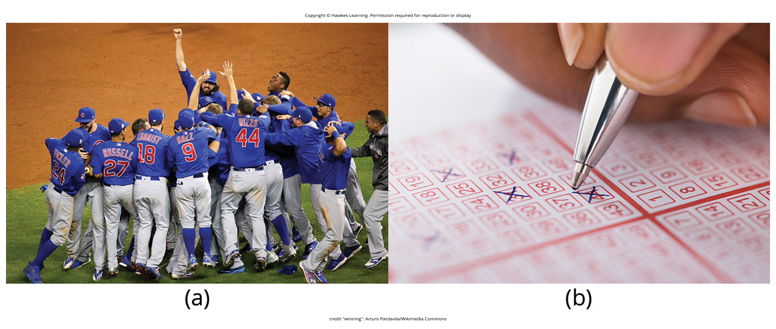
Lesson 14.5 Figure 6
Caption: (a) Chicago Cubs fans no doubt predicted feeling elated when their team won a World Series championship, a feat that had not been accomplished by that franchise in over a century. (b) In ways that are similar, those who play the lottery rightfully think that choosing the correct numbers and winning millions would lead to a surge in happiness. However, the initial burst of elation following such elusive events would most likely erode with time.

Slide 18
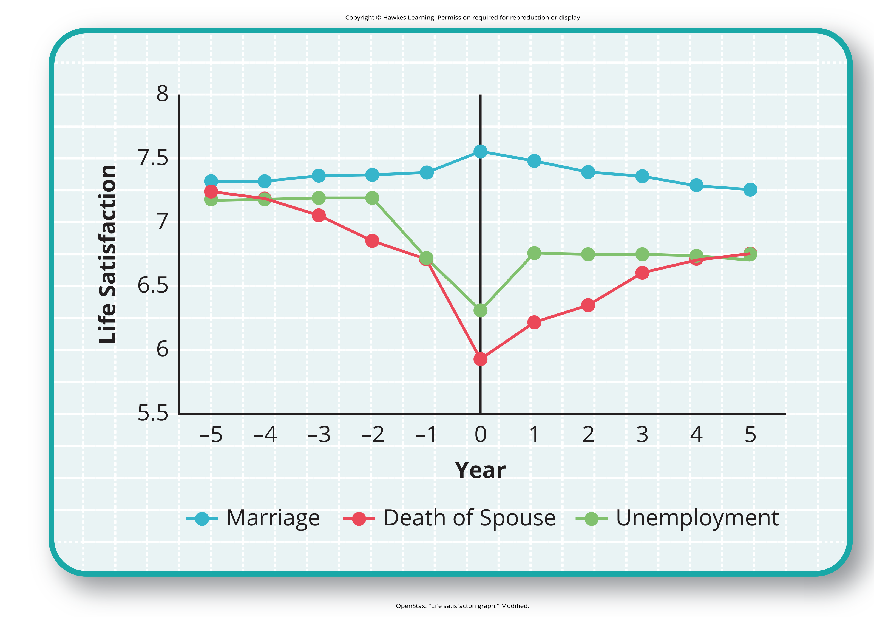
Life Events And Happiness₂
Questions about the extent to which important life events can permanently alter people's happiness (Diener et al., 2006).
Example: People tend to adapt to marriage but do not adapt to unemployment or severe disabilities (Diener, 2012).
Figure 7 shows life satisfaction scores before, during, and after life events.
Figure 7

Slide 19

Increasing Happiness
Well-being interventions can lead to lasting increases in happiness by targeting individual, organizational, and societal levels (Diener et al., 2006).
Six key variables influence national happiness scores:
GDP, social support, freedom of choice, healthy life expectancy, freedom from corruption, and generosity
Policies aimed at improving these factors can enhance societal happiness (Diener et al., 2006).
Figure 8

Slide 20

Positive Psychology₁
Positive psychology studies qualities that lead to greater fulfillment, focusing on strengths rather than problems.
Established by Seligman (Compton, 2005)
Examines subjective experiences, positive traits, and institutions that promote well-being
Figure 9

Slide 21
Positive Psychology₂
According to Seligman and Csikszentmihalyi (2000), positive psychology,
at the subjective level is about valued subjective experiences: well-being, contentment, and satisfaction (in the past); hope and optimism (for the future); and … happiness (in the present). At the individual level, it is about positive individual traits: the capacity for love and vocation, courage, interpersonal skill, aesthetic sensibility, perseverance, forgiveness, originality, future mindedness, spirituality, high talent, and wisdom. (p. 5)

Slide 22
On Your Own₂
In your own words, rephrase how Seligman and Csikszentmihalyi classify positive psychology.
Notes:
Originally an On our Own

Slide 23
Positive Psychology₃
Topics include:
Altruism, creativity, positive emotions, forgiveness/compassion, immune system functioning, and enhancing virtues for authentic happiness (Compton, 2005)
Recent efforts have focused on peace and well-being at the global level.
"Positive peace psychology" could have important implications for how to overcome oppression and work toward global peace (Cohrs et al., 2013).

Slide 24
Dig Deeper: The Center For Investigating Healthy Minds
Conducts research on positive mind qualities like kindness, forgiveness, and mindfulness (University of Wisconsin-Madison, 2019)
Includes research on interventions like kindness curricula and the effectiveness of yoga for PTSD
Founded in response to the Dalai Lama's challenge to study positive mental attributes scientifically (Center for Investigating Health Minds, 2023)

Slide 25

Positive Affect
Qualities that help promote psychological well-being are linked to favorable health outcomes.
Includes diet, physical activity, sleep quality (Boehm & Kubzansky, 2012)
Positive affect involves pleasurable engagement with the environment.
Includes happiness, joy, enthusiasm, alertness, and excitement (Watson et al., 1988)
Can be brief, long-lasting, or trait-like (Pressman & Cohen, 2005)
Linked to better health outcomes and lower depression (Pressman et al., 2019; Steptoe et al., 2008)
Figure 10

Slide 26
Optimism
Optimism is the generalized tendency to expect positive outcomes (Chang, 2001).
Also involves viewing stressors as temporary and external (Peterson & Steen, 2002)
Similar to positive affect, but not the same (Pressman & Cohen, 2005)
Linked to longevity, healthy behaviors, better immune functioning (Rasmussen & Wallio, 2008)

Slide 27
Reflection Question₃
Do you feel that you are a genuinely happy person? If so, why? If not, what strategies might you employ to boost your happiness (and health)?

Slide 28

Flow
Flow is a state of deep engagement in an activity, making it rewarding for its own sake (Csikszentmihalyi, 1997).
Related to creative endeavors and leisure activities as well as jobs or studying (Csikszentmihalyi, 1999)
Occurs in challenging activities requiring skill, contributing significantly to a fulfilling life
Characteristics: concentration, control, and altered perception of time (Csikszentmihalyi, 1997)
Figure 11

Slide 29
Reflection Question₄
Have you ever experienced this state of flow? If so, what were you doing? How did you feel during that time?

Slide 30
Summary
Happiness is an enduring state involving pleasure and engagement in life.
While happiness levels vary across nations, consistent factors are linked to it.
Positive psychology aims to understand and promote happiness through qualities like positive affect, optimism, and flow.

Slide 31
End of Hawkes Learning PowerPoint

