Slide 1
Lesson 15.1
What Are Psychological Disorders?

Slide 2
What Are Psychological Disorders?
A psychological disorder, or mental disorder, is "any conditioned characterized by cognitive and emotional disturbances, abnormal behaviors, impaired function, or any combinations of these " (American Psychiatric Association, 2022).
Psychopathology is the study of psychological disorders, including their symptoms, etiology (i.e., causes), and treatment.
Psychopathology can also refer to the manifestation of a psychological disorder.

Slide 3
Psychopathology
It is important for mental health professionals to agree on the thoughts, feelings, and behaviors that truly represent the presence of psychopathology.
Example: A person who claims to hear the voices of demons is likely showing psychopathology.
Example: A person who feels nervous about their first exam is likely not showing psychopathology.

Slide 4
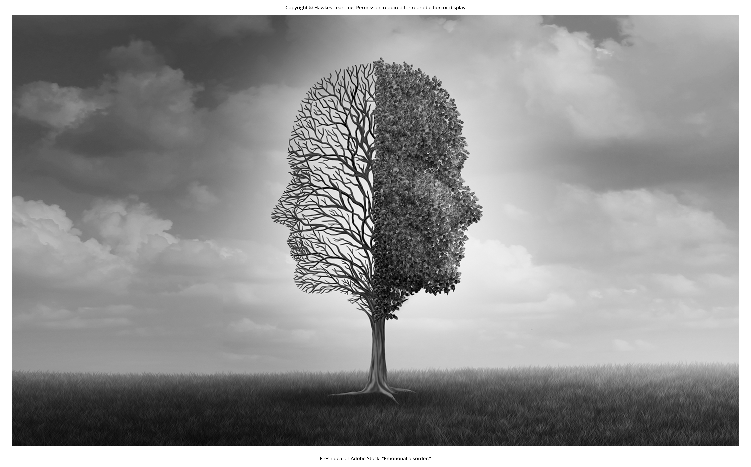
Distinguishing Psychological Disorders
Psychologists work to distinguish psychological disorders from inner experiences and behaviors that are merely situational, idiosyncratic, or unconventional.
Figure 2

Slide 5
Group Activity
Individually, write a list of behaviors that you would describe as "abnormal." As a class, write the list on the board.
Looking at the list, is there any situation in which that behavior would be considered normal? What is the difference?

Slide 6
Definition Of A Psychological Disorder
Behaviors, thoughts, and inner experiences that are atypical, distressful, dysfunctional, and sometimes dangerous are often labeled as signs of a disorder.
Example: If you were rejected after asking someone out on a date, it would be normal to feel a little dejected.
Example: If you contemplated suicide after the rejection, this response would be outside of the norm (i.e., atypical).

Slide 7

Atypicality
Atypicality does not automatically mean disordered.
Example: Red hair is considered atypical because it is relatively rare (only 4% of people in the United States have it compared to 13% in Scotland).
Red hair is uncommon but not abnormal.
Figure 3

Slide 8
Atypicality And Culture
If a behavior or inner experience differs widely from expected cultural values and expectations, it may be considered disordered.
Example: A person who walks around in a heavy winter coat on a hot summer day while screaming obscenities at strangers may be considered as showing symptoms of a psychological disorder.

Slide 9
Cultural Expectations
What may be expected and appropriate in one culture may differ from another culture.
Example: Not returning a stranger's smile in the United States might be considered socially awkward or disordered.
Example: The same behavior in Japan would not be unusual as the culture values reserve, restraint, and a concern for maintaining privacy around strangers.

Slide 10
Cultural Expectations: Eye Contact
Cultures differ in a variety of ways.
Example: In the United States and Europe, eye contact with others signifies honesty and attention.
Example: In most Latin-American, Asian, and African cultures, direct eye contact is interpreted as rude, confrontational, and aggressive.

Slide 11

Lesson 15.1 Figure 4
Caption: Eye contact is one of many social gestures that varies from culture to culture.

Slide 12
Cultural Expectations: Hallucinations
In Western societies, hallucinations (hearing or seeing things that are not physically present) are a violation of cultural expectations.
In other cultures, visions about the future may be regarded as normal and valuable experiences.
Cultural norms change over time.
What might be considered typical in a society at one time may no longer be viewed this way later.

Slide 13
Harmful Dysfunction₁
Although no universal definition of psychological disorder exists that can apply to all situations, disorders can be defined as harmful dysfunctions (Wakefield, 1992).
Natural internal mechanisms enable people to experience the world the way others do and to engage in rational thought, problem solving, and communication.
Dysfunction occurs when an internal mechanism breaks down and can no longer function.

Slide 14
Harmful Dysfunction₂
The presence of a dysfunction by itself does not determine a disorder.
The dysfunction must be harmful in that it leads to negative consequences for the individual or others.
Harm may include internal anguish or problems in day-to-day living.
Example: A person whose high levels of anxiety interferes with their social life

Slide 15
Harmful Dysfunction Example₁
Janet has an extreme fear of spiders that negatively affects her life.
She avoids all situations in which she suspects spiders to be present.
She quit her job last month because she saw a spider in the work restroom.

Slide 16
Harmful Dysfunction Example₂
Janet's condition would signify a disorder.
There is a dysfunction of an internal mechanism.
The dysfunction has resulted in harmful consequences.
Just as the symptoms of physical illness reflect dysfunctions in biological processes, the symptoms of psychological disorders presumably reflect dysfunctions in mental processes.
The internal mechanism component implies that disorders may occur through a breakdown of biological functions that govern various psychological processes.

Slide 17
The American Psychiatric Association (APA) Definition₁
A psychological disorder involves significant disturbances in thoughts, feelings, and behaviors.
Inner states or behaviors are unusual, negative, and self-defeating.
Disturbances might be troubling to those around the individual.
Example: A person who spends hours each day bathing due to thoughts of germs is experiencing atypical and negative disturbances that likely trouble their family members.

Slide 18
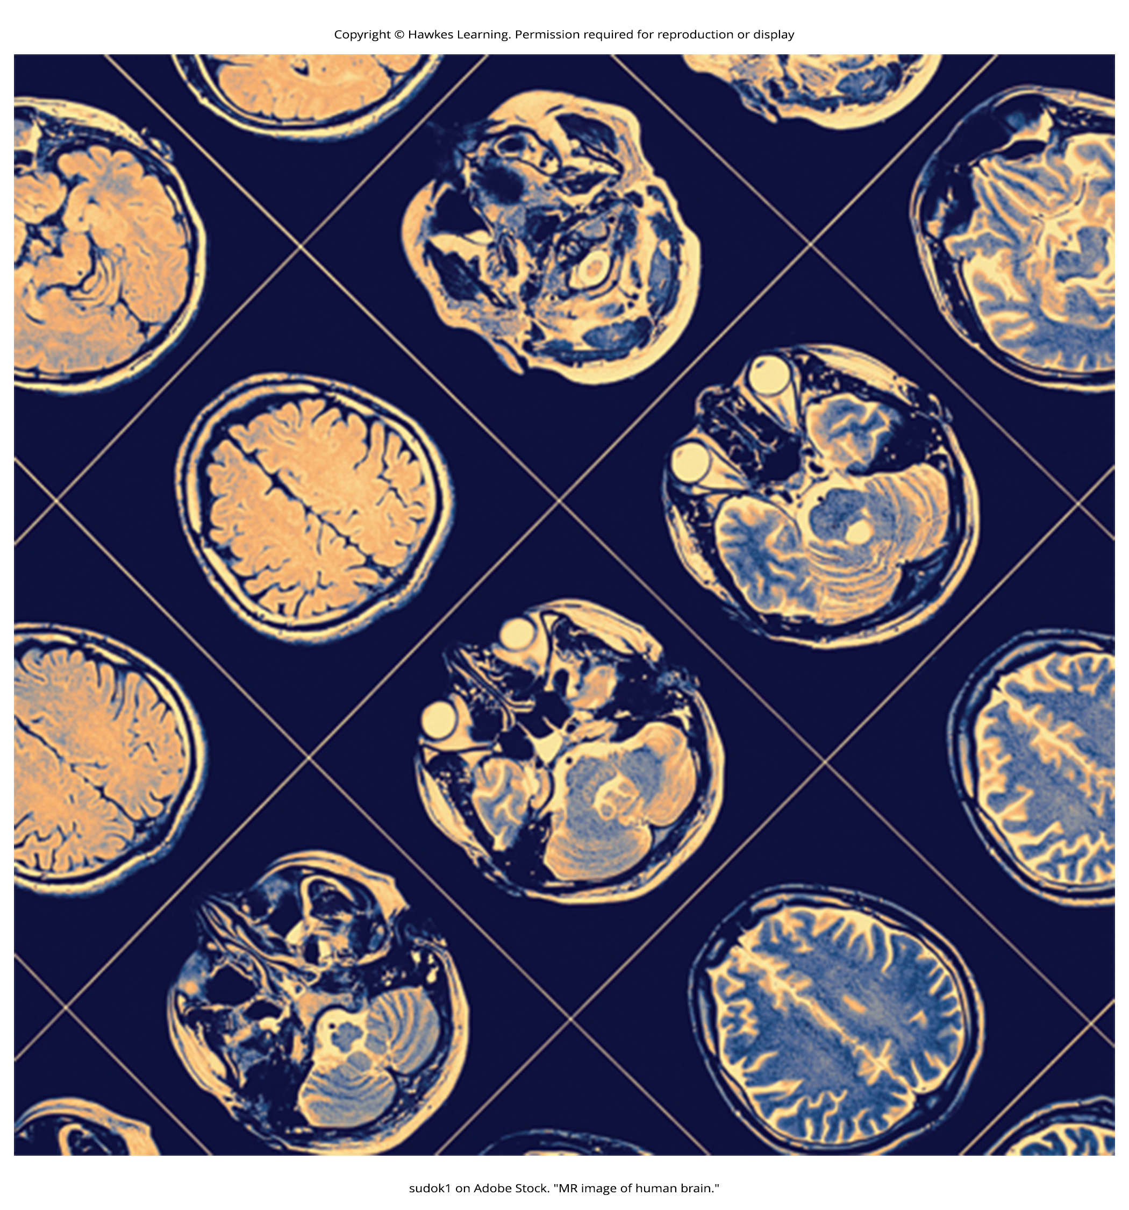
The American Psychiatric Association (APA) Definition₂
A psychological disorder involves disturbances that reflect biological, psychological, or developmental dysfunction.
Example: Hallucinations could be a sign of brain abnormalities.
Figure 7

Slide 19
The American Psychiatric Association (APA) Definition₃
A psychological disorder involves disturbances that lead to significant distress or disability in one's life.
Example: A person's fear of social situations is so distressing that it causes the person to avoid all social situations, including attending classes or applying for a job.

Slide 20
The American Psychiatric Association (APA) Definition₄
A psychological disorder involves disturbances that do not reflect expected or culturally approved responses to certain events.
Example: It is natural for a person to experience extreme sadness after the death of a close family member.
Because such reactions are culturally expected, the individual's behavior would not be assumed to demonstrate a mental disorder.

Slide 21
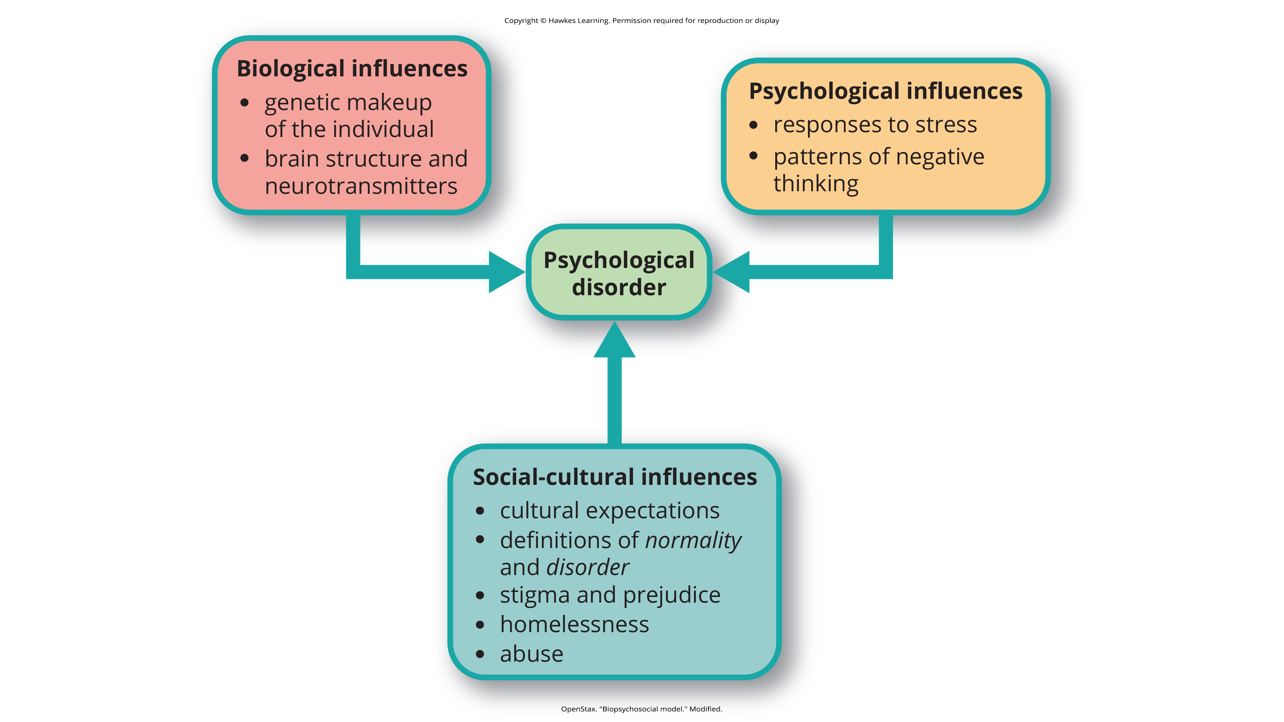
Lesson 15.1 Figure 8
Caption: The biopsychosocial model of disorder proposes that disorders are caused by biological, psychological, and social-cultural factors.

Slide 22
Defining Disorders
No single approach to defining a psychological disorder is adequate by itself.
There is no universal agreement on where the boundary is between disordered and not disordered.
Inner experiences and behaviors can vary but are only considered disordered when they are highly disturbing to us and/or others, suggest a dysfunction in normal mental functioning, and are associated with significant distress or disability in social or occupational activities.

Slide 23
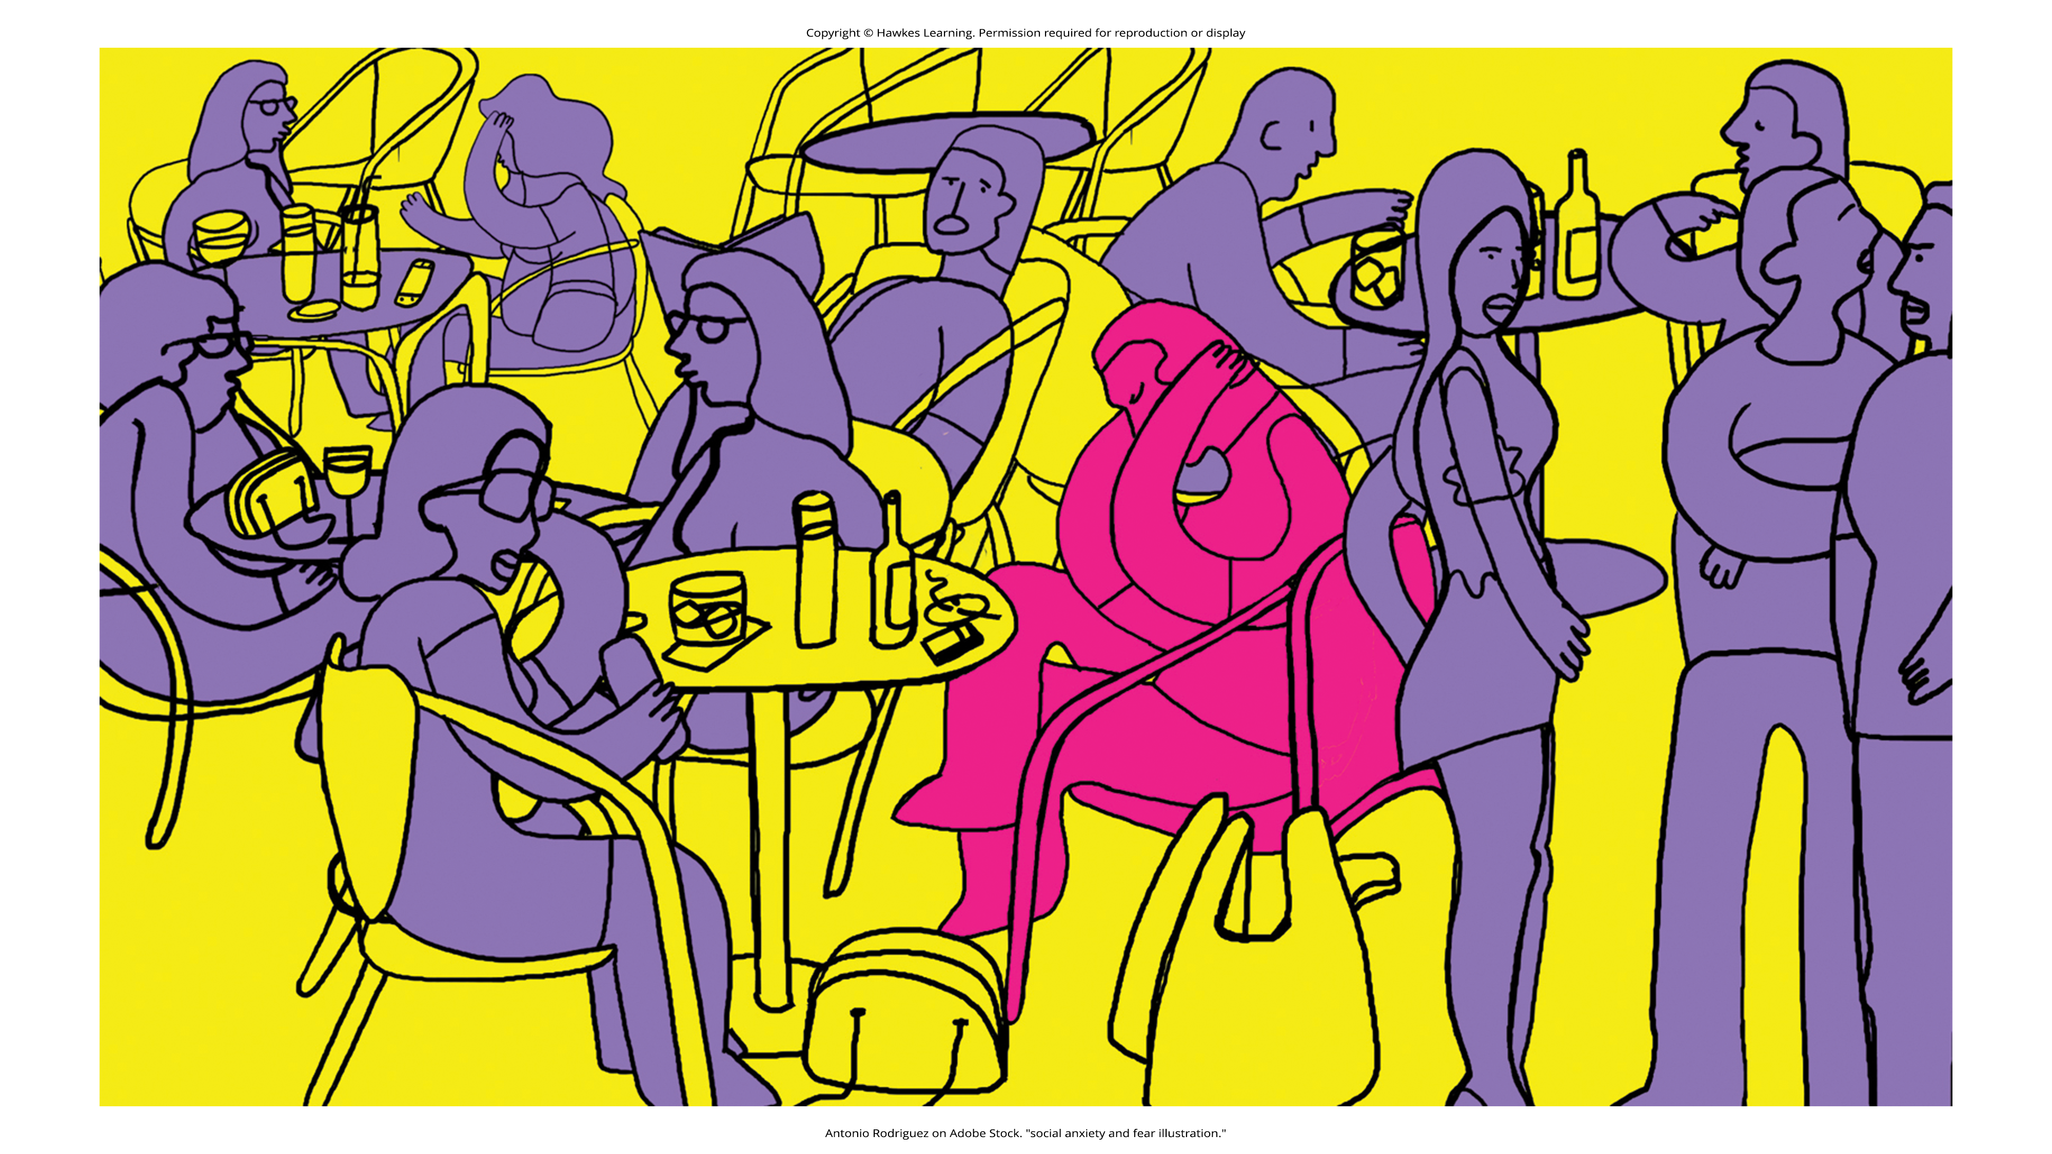
Lesson 15.1 Figure 9
Caption: Feelings of anxiety in social situations can range from normal to significantly disabling.

Slide 24
Summary₁
Psychological disorders are conditions characterized by abnormal thoughts, feelings, and behaviors.
It is essential for mental health professionals to agree on the inner experiences and behaviors that constitute a psychological disorder.
Atypicality alone does not indicate the presence of a disorder.

Slide 25
Summary₂
The American Psychiatric Association has a formal definition of psychological disorders.
The presence of a psychological disorder is signaled by significant disturbances in thoughts, feelings, and behaviors.
These disturbances must reflect some kind of dysfunction (biological, psychological, or developmental), must cause significant impairment in one's life, and must not reflect culturally expected reactions to certain life events.

Slide 26
End of Hawkes Learning PowerPoint

