Slide 1
Lesson 15.2
Diagnosing and Classifying Psychological Disorders

Slide 2
Diagnosing Psychological Disorders
A first step in studying psychological disorders is to discern significant signs and symptoms.
Arriving at a diagnosis involves appropriately identifying and labeling a set of defined symptoms.
Proper diagnosis allows professionals to use a common language in communicating about the disorder with the patient, colleagues, and the public.
A proper diagnosis is an essential element to guide proper and successful treatment.

Slide 3
The Diagnostic and Statistical Manual of Mental Disorders (DSM)
The Diagnostic and Statistical Manual of Mental Disorders, fifth edition, text revision (DSM-5-TR) was published by the American Psychiatric Association (2022).
The first edition was published in 1952.
The DSM has undergone numerous revisions and editions since its first publication.

Slide 4
Reflection Question₁
Given the prediction that over half of Americans will suffer from mental illness at some point in their lives, do you think we are over-pathologizing?
Why is it surprising that most of us might suffer mental illness at some point but not surprising that we will suffer physical illness?

Slide 5
The DSM-5-TR
The DSM-5-TR contains many categories of disorders, such as anxiety or dissociative disorders.
Each disorder's description includes:
An overview of the disorder (diagnostic features),
Specific symptoms required for diagnosis (diagnostic criteria)
Prevalence information (what percent of the population is thought to have the disorder
Associated risk factors

Slide 6
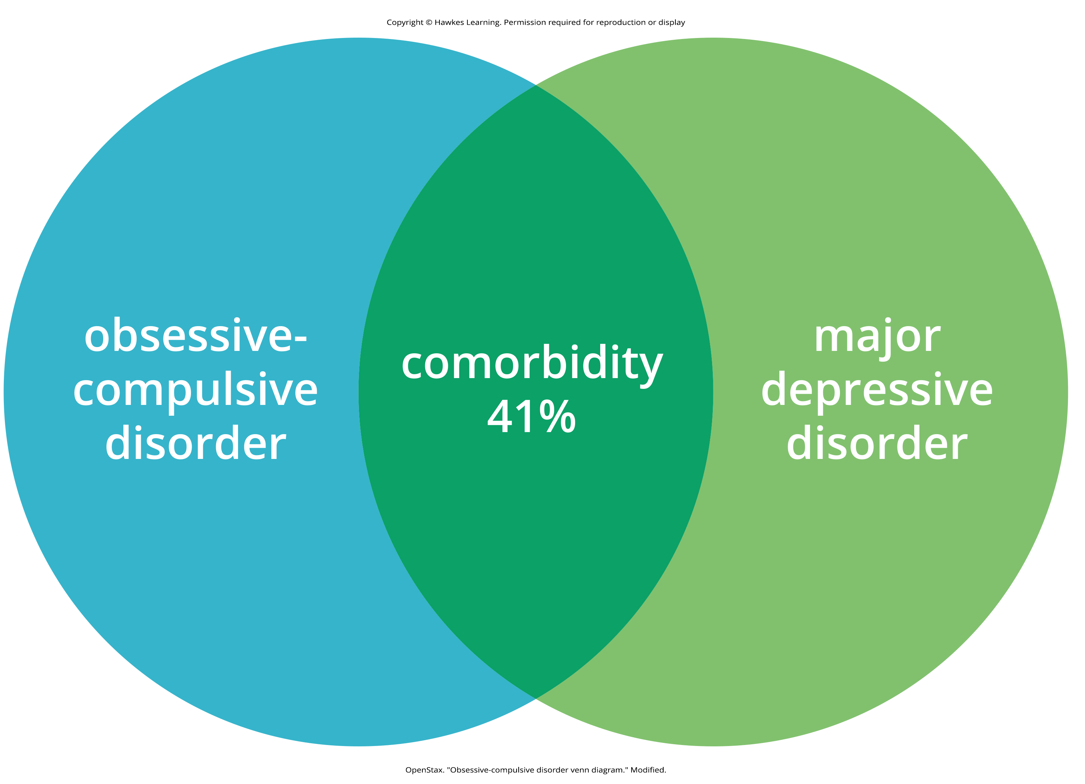
Comorbidity
Comorbidity is the co-occurrence of two disorders.
Example: Forty-one percent (41%) of those with obsessive-compulsive disorder also have major depressive disorder.
Figure 1

Slide 7
Changes In The DSM Over Time
The first two editions of the DSM listed homosexuality as a disorder; however, it was removed in 1973.
The number of diagnoses has ranged over the editions (106 in DSM-I, 265 in DSM-III, and 237 in DSM-5).
The latest edition, DSM-5-TR, includes revisions in the organization and naming of categories and in the diagnostic criteria for various disorders.
The current edition also considers the importance of gender and cultural difference in the expression of various symptoms

Slide 8
Criticisms Of The DSM
Some worry that adding diagnoses turns common human problems into mental illnesses.
The DSM-5 was criticized because its diagnostic criteria were loosened which could contribute to overdiagnosis.
Example: The DSM-IV specified that major depressive disorder must not be due to normal bereavement; however, the DSM-5 removed this exclusion.

Slide 9
Updates To The DSM-5-TR
The current edition (DSM-5-TR):
Made significant changes to terminology in diagnostic criteria and specifiers
Added clarity in defining symptoms and resolved inconsistencies
Added disorders such as prolonged grief disorder and unspecified mood disorder
Updated terminology and diagnostic criteria for 25 diagnoses, including autism spectrum disorder, bipolar I and bipolar II disorders, gender dysphoria, and major depressive disorder

Slide 10
The International Classification of Diseases (ICD)
The International Classification of Diseases (ICD) was published by the World Health Organization (WHO).
The categories of psychological disorders and the criteria for specific disorders in both the DSM and the ICD are similar.
In addition to clinical purposes, the ICD is used to examine the general health of populations and to monitor the prevalence of diseases and other health problems internationally.
Although the ICD is in its 11th edition, the United States still operates off of the 10th edition (ICD-10).

Slide 11
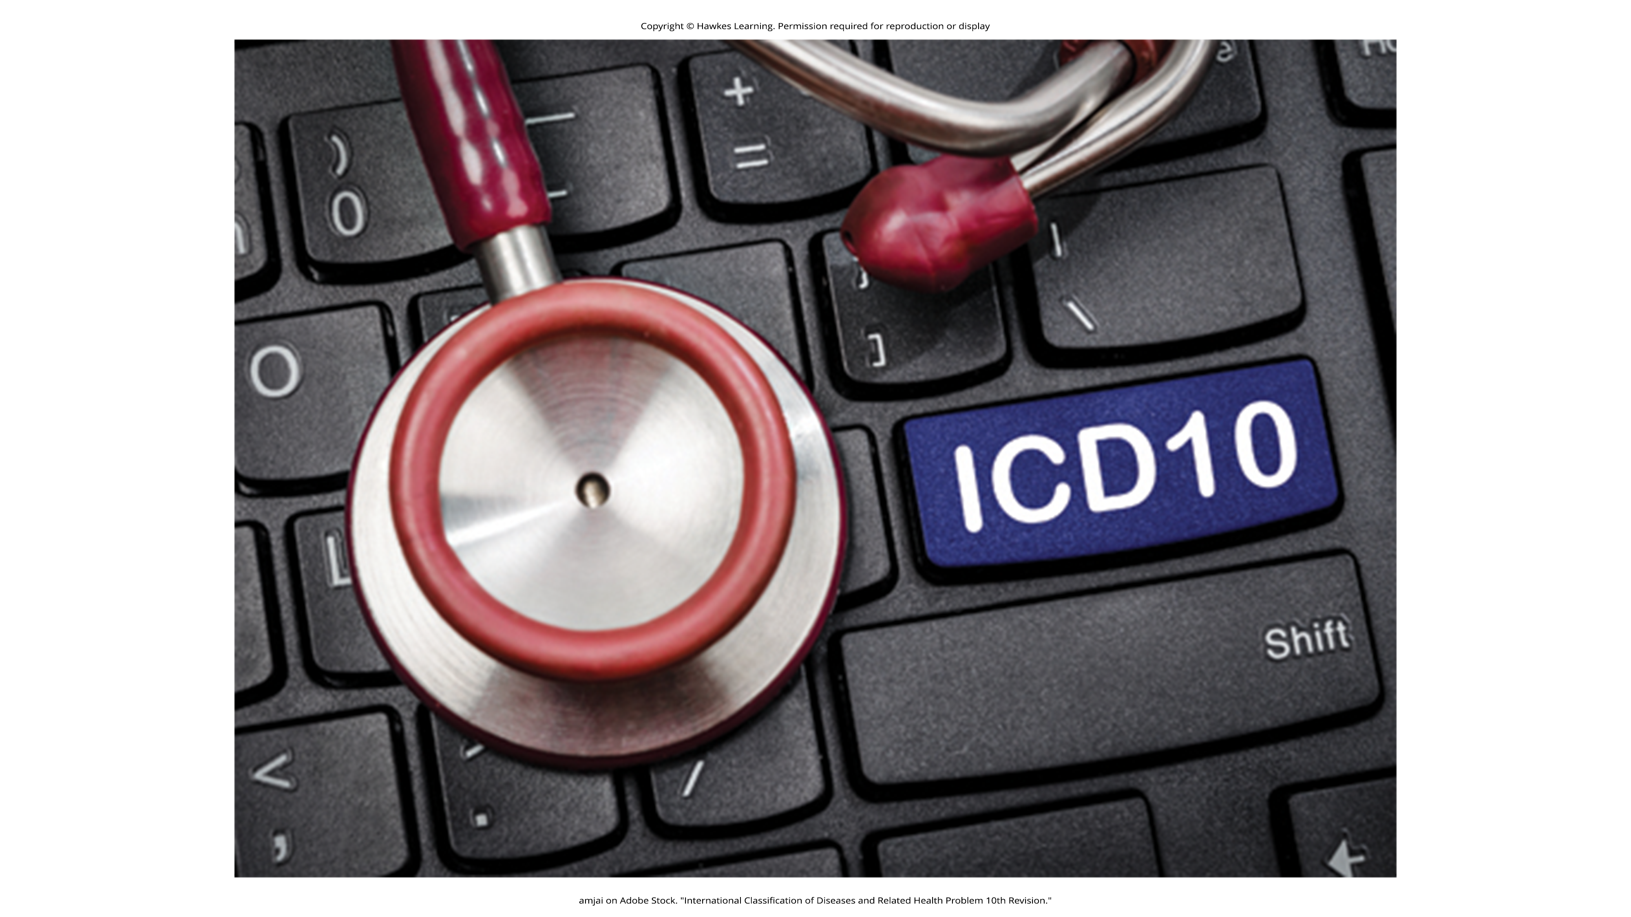
Lesson 15.2 Figure 2
Caption: A streamlined classification system aims to unify the research and diagnosis process.

Slide 12
Comparing The DSM And The ICD
A study that compared the two classification systems found that the ICD is use more frequently for clinical diagnoses worldwide.
In contrast, the DSM is preferred for research.
The DSM includes more explicit disorder criteria, along with extensive and helpful explanatory text.
The DSM is the classification system of choice among U.S. mental health professionals.

Slide 13
The Compassionate View Of Psychological Disorders₁
Psychological disorders represent extremes of inner experience and behavior.
Each of us experiences episodes of sadness, anxiety, and preoccupation with certain thoughts.
These situations are not problematic unless the accompanying thoughts and behaviors become extreme and have a disruptive effect on one's life.

Slide 14
Reflection Question₂
How do you think labels of psychological disorders can be harmful to individuals who suffer from mental illness?

Slide 15
The Compassionate View Of Psychological Disorders₂
People with psychological disorders are more than embodiments of their disorders.
Terms like schizophrenics objectify people who suffer from these conditions and promote biased and disparaging assumptions.
A psychological disorder is not what a person is; it is something that a person has.
These individuals deserve to be viewed and treated with compassion, understanding, and dignity.

Slide 16

Lesson 15.2 Figure 3
Caption: A person is not defined by their psychological disorder.

Slide 17
Summary
Diagnosis and classification of psychological disorders is essential in studying and treating psychopathology.
The DSM-5-TR (2022), which has undergone many revisions since 1952, is the system used by most U.S. professionals.
The DSM-5-TR includes specific diagnosable disorders, each described in detail, including symptoms, prevalence, risk factors, and comorbidity.
The DSM diagnostic criteria are more explicit than other systems which is valuable for clinical diagnosis and research.

Slide 18
End of Hawkes Learning PowerPoint

