Slide 1
Lesson 15.3
Perspectives on Psychological Disorders

Slide 2
Perspectives On Psychological Disorders
Scientists and mental health professionals may adopt different perspectives in attempting to understand or explain the mechanisms that underlie the development of psychological disorders.
Perspectives used to explain psychological disorders consist of:
  Assumptions about how best to study the disorder
  Its etiology
  The therapies or treatments that would be beneficial
Different perspectives provide alternate ways for how to think about the nature of psychopathology.

Slide 3
The Supernatural Perspective₁
The supernatural perspective attributed psychological disorders to a force beyond scientific understanding.
  Example: A person exhibiting a psychological disorder could be thought to be a practitioner of black magic or possessed by spirits.
  Example: Convents in the 16th and 17th centuries reported hundreds of nuns were possessed when they displayed extremely unusual behaviors.

Slide 4
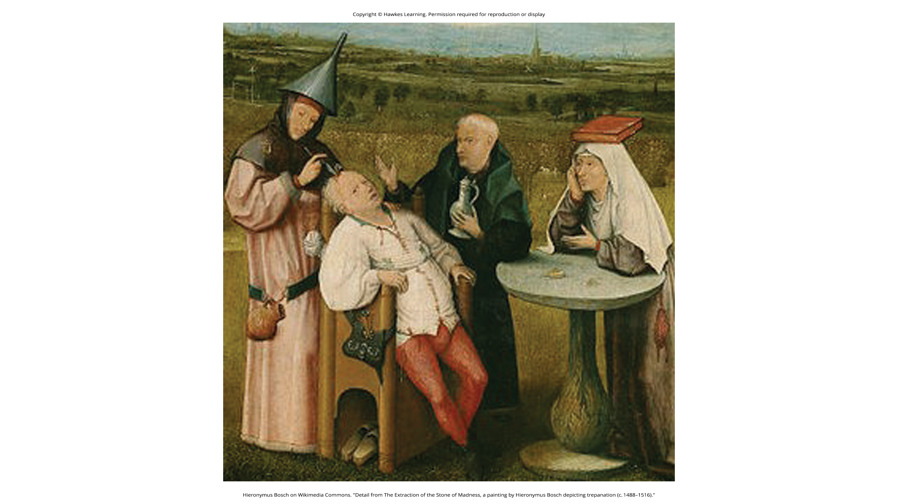
Lesson 15.3 Figure 1
Caption: In The Extraction of the Stone of Madness, a 15th-century painting by Hieronymus Bosch, a practitioner is using a tool to extract an object (the supposed “stone of madness”) from the head of an afflicted person.

Slide 5
The Supernatural Perspective₂
Such beliefs in supernatural causes of mental illness are still held in some societies.
  Example: Beliefs that supernatural forces cause mental illness are common in some cultures in modern-day Nigeria.

Slide 6
Reflection Question₁
How do you think the understanding of psychological disorders affected their treatment in the 15th through 17th centuries?

Slide 7
Biological Perspectives
The biological perspective views psychological disorders as linked to biological phenomena, such as genetics, chemical imbalances, and brain abnormalities.
  Example: Evidence suggests that most psychological disorders, including ADHD, bipolar disorder, major depressive disorder, and schizophrenia, have a genetic component.

Slide 8
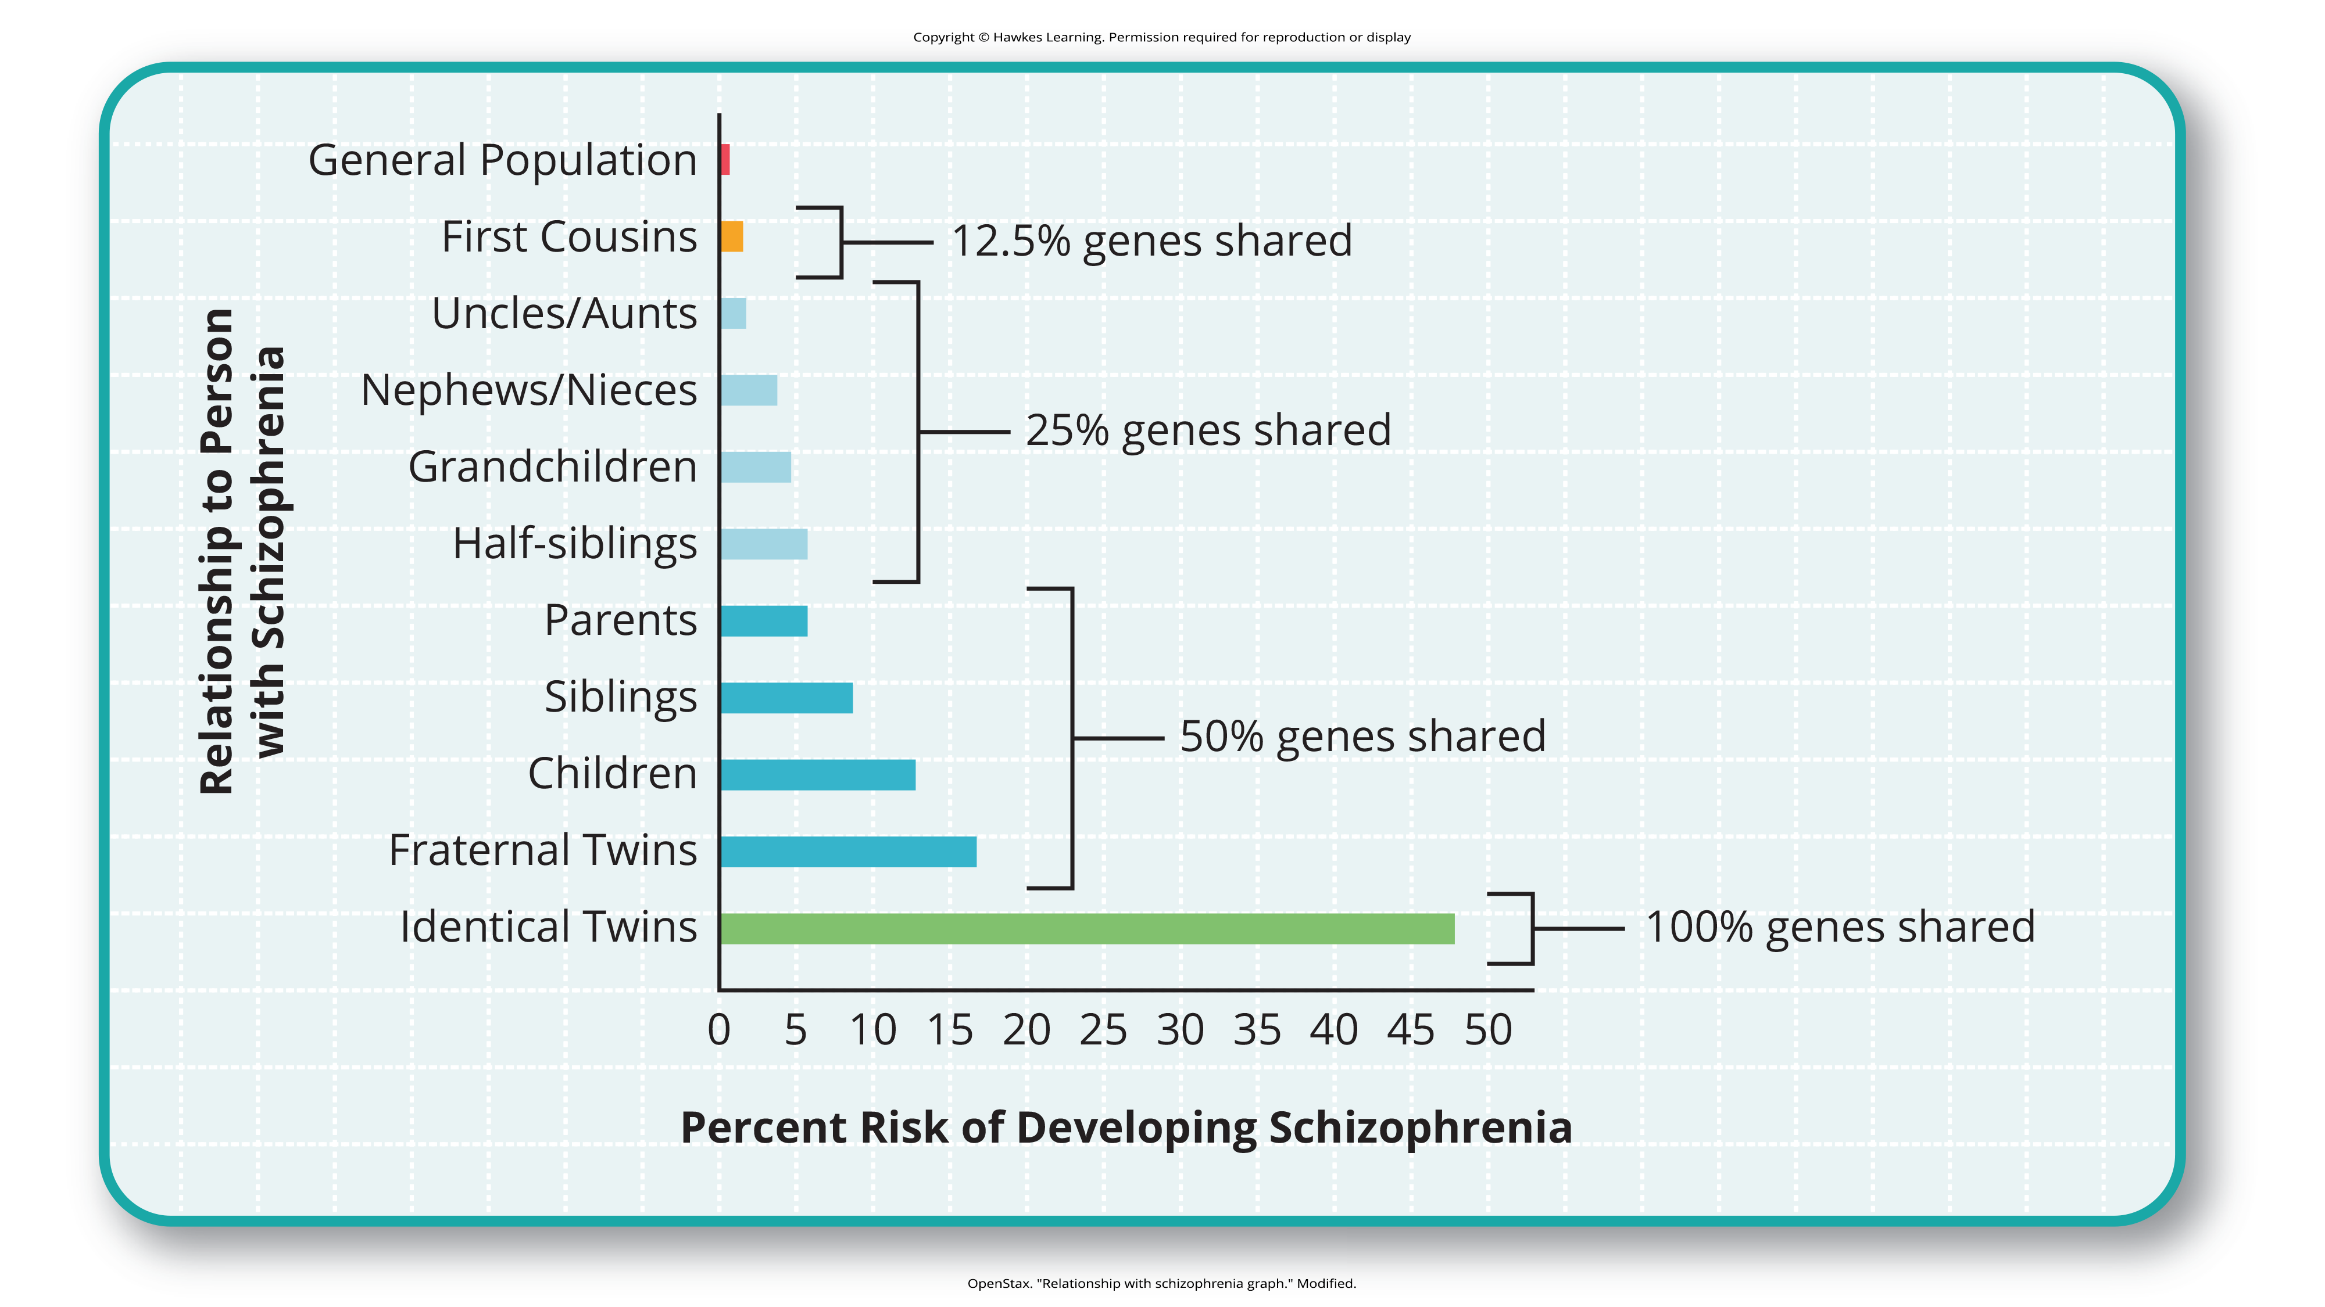
Lesson 15.3 Figure 3
Caption: A person’s risk of developing schizophrenia increases if a relative has schizophrenia. The closer the genetic relationship, the higher the risk.

Slide 9
Reflection Question₂
Have you ever been asked at a doctor's appointment about your family's history of mental health disorders? Why do you think this is a common question on patient forms and during wellness appointments?

Slide 10
Biological Perspectives: Contributing Factors
Researchers search for specific genes and genetic mutations that contribute to mental disorders.
Neural imaging can also be used to reveal how brain abnormalities might be directly involved in disorders.
Advances in our understanding of neurotransmitters and hormones have yielded insights into psychological disorders.

Slide 11
Biological Perspectives: Autism Spectrum Disorder
Researchers are investigating whether there are genetic factors in autism spectrum disorder.
  There are biological clues that indicate autism spectrum disorder is genetically influenced.
  For instance, the disorder occurs more among boys, and there is an increased likelihood of a sibling being diagnosed with the disorder if an older child has it.

Slide 12
Influences Of The Psychosocial Perspective
The psychosocial perspective emphasizes the importance of learning, stress, faulty and self-defeating thinking patterns, and environmental factors.
Psychological disorders may result from a combination of biological and psychological processes.
The diathesis-stress model (Zuckerman, 1999) integrates biological and psychosocial factors to predict the likelihood of a disorder.

Slide 13
Diathesis-Stress Model
The diathesis-stress model suggests that people with an underlying predisposition for a disorder (i.e., a diathesis) are more likely than others to develop a disorder when faced with adversity (i.e., stress).
These adverse environments or events could include childhood maltreatment, negative life events, trauma, and more.
A diathesis may be psychological, such as thinking about life events in a pessimistic, self-defeating way.

Slide 14
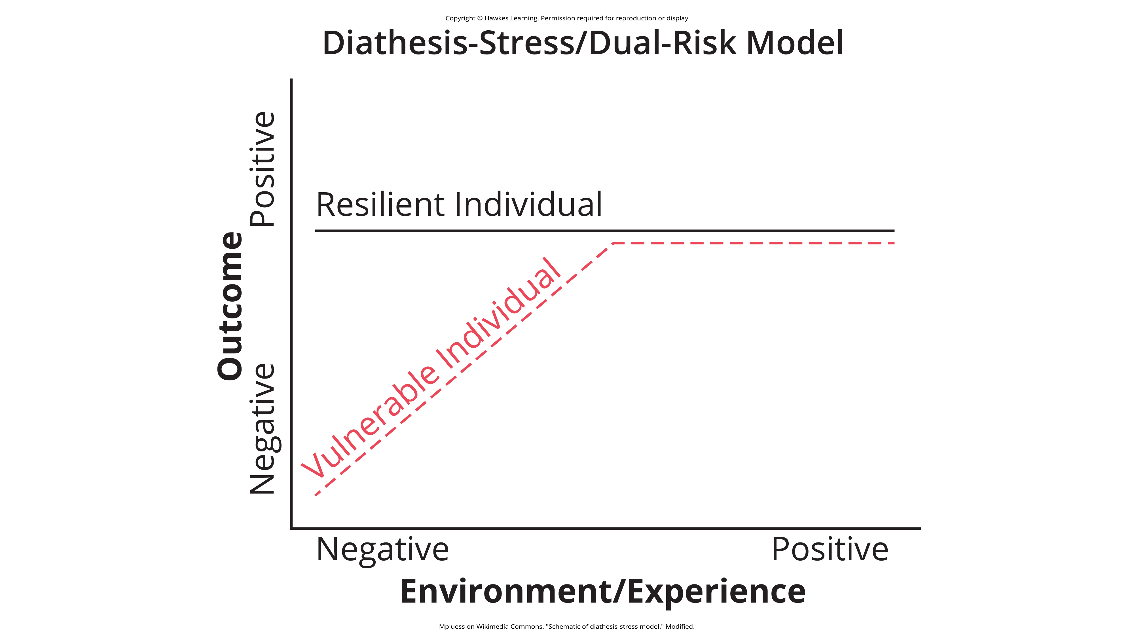
Lesson 15.3 Figure 4
Caption: The diathesis-stress model states that certain vulnerable individuals are more likely to develop a disorder when faced with adverse circumstances.

Slide 15
Key Assumption Of The Diathesis-Stress Model
The key assumption of the diathesis-stress model is that both factors, diathesis and stress, are necessary in the development of a disorder.
Different models explore the relationship between the two factors.
  The level of stress needed to produce the disorder is inversely proportional to the level of diathesis.

Slide 16
On Your Own
Explain why an individual would have schizophrenia from a supernatural, biological, and diathesis-stress perspective. Which perspective you think makes the most sense, and why?

Slide 17
Summary₁
Psychological disorders used to be viewed from a supernatural perspective, and some cultures still hold these beliefs today.
Today, many view mental illness from a biological perspective, such as arising from genetic, neurological, hormonal, or biochemical bases.
The psychological perspective emphasizes the importance of psychological factors (e.g., stress and thoughts) and environmental factors in the development of psychological disorders.

Slide 18
Summary₂
The diathesis-stress model suggests that people with an underlying diathesis, or vulnerability, for a psychological disorder are more likely to develop the disorder when faced with stressful events.

Slide 19
End of Hawkes Learning PowerPoint

