Slide 1
Lesson 15.4
Anxiety, Trauma, and Stress-Related Disorders

Slide 2
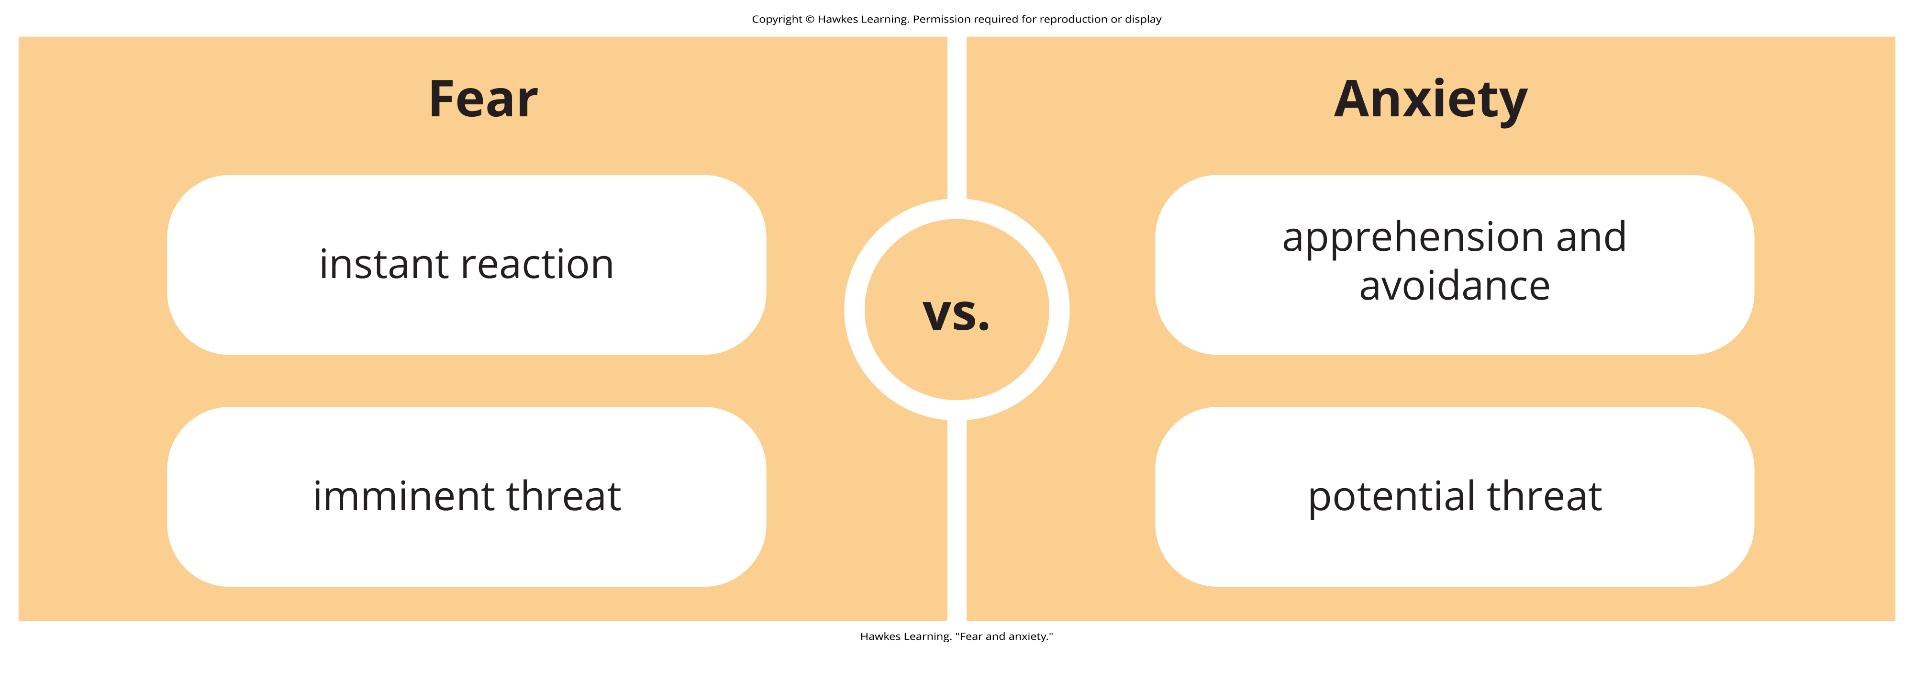
Anxiety And Fear
Everyone experiences anxiety from time to time.
Although anxiety is closely related to fear, the two states possess important differences.
Figure 1

Slide 3
Importance Of Anxiety
Anxiety is important to one's health, safety, and well-being.
  Anxiety motivates people to take actions, such as preparing for an exam.
  Anxiety motivates people to avoid certain activities, such as not engaging in illegal actions.

Slide 4
Magnitude Of Anxiety
Most individuals' level and duration of anxiety approximates the magnitude of the potential threat they face.
  Example: A 38-year-old who wants to marry but is concerned about the possibility of having to settle for a spouse who is less attractive and educated would feel more anxiety than a 21-year-old college student who is having trouble finding a date for an event.

Slide 5
On Your Own₁
What causes you daily anxiety? Make a list of four occurrences that cause you anxiety and rank them from most to least anxiety-inducing.

Slide 6
Definition And Prevalence Of Anxiety Disorders
Anxiety disorders are "any of a group of disorders that have as their central organizing theme the emotional state of fear, worry, or excessive apprehension" (APA, 2022).
These disorders are more common in women.
They are also the most frequently occurring class of mental disorders.
Anxiety disorders are often comorbid with each other and other mental disorders, such as depression.

Slide 7
Definition Of Specific Phobia
A person diagnosed with a specific phobia (formerly known as simple phobia) experiences excessive, distressing, and persistent fear or anxiety about a specific object or situation (APA, 2022).
  People with a specific phobia might fear animals, enclosed spaces, or elevators.
Even if people realize their level of fear and anxiety is irrational, some people with a specific phobia may go to great lengths to avoid the phobic stimulus.

Slide 8
Specific Phobias₁
The fear and anxiety a phobic stimulus elicits is disruptive to the person's life.
  Example: A person with a phobia of flying might refuse to accept a job that requires frequent air travel, thus negatively affecting their career.
Some specific phobias include:
  Fear of heights (acrophobia)
  Fear of snakes (ophidiophobia)
  Fear of injections (trypanophobia)

Slide 9
Reflection Question₁
What would your life be like if you had a severe phobia of elevators?

Slide 10
Specific Phobias₂
In the United States, 5 to 10% of the population meet the criteria for a specific phobia at some point in their lifetime.
Agoraphobia is characterized by intense fear, anxiety, and avoidance of situations in which it might be difficult to escape or receive help if one experiences symptoms of a panic attack.
  Example: A person might fear public transportation, parking lots, stores, crowds, or being outside of the home alone.

Slide 11
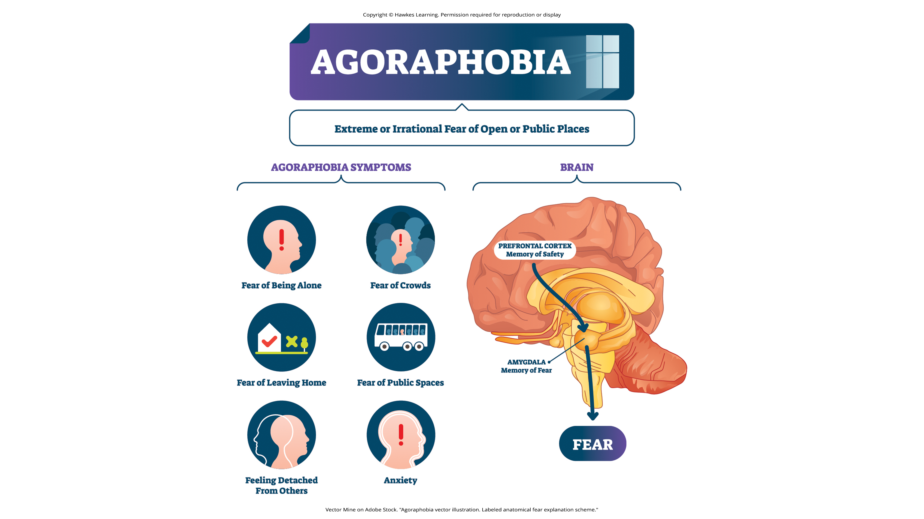
Lesson 15.4 Figure 2
Caption: Agoraphobia is the extreme fear of places or situations that might induce panic or helplessness.

Slide 12
Acquisition Of Phobias Through Classical Conditioning
Classical conditioning is a form of learning in which a previously neutral stimulus is paired with an unconditioned stimulus (UCS) that reflexively elicits an unconditioned response (UCR).
Over time, the neutral stimulus (now the conditioned stimulus or CS) elicits the same response (i.e., the conditioned response or CR) through its association with the unconditioned stimulus.

Slide 13
Example Of Phobia Through Classical Conditioning
A child who has been bitten by a dog may fear dogs due to their past association with pain.
  The dog bite is the UCS, and the fear it elicits is the UCR.
  Because a dog was associated with the bite, any dog may come to serve as a conditioned stimulus, thereby eliciting fear.
  The fear the child experiences around dogs then becomes a CR.

Slide 14
Acquisition Of Phobias Through Vicarious Learning
A person might learn a phobia by modeling another's behavior.
  Example: A child who observes their older cousin react fearfully to spiders may later express the same fears, even though spiders have never presented any danger to them.

Slide 15
Acquisition Of Phobias Through Verbal Transmission
A person might learn a phobia from being told about a fearful stimulus or situation.
  Example: A child whose parents, siblings, friends, and classmates constantly tell them how disgusting and dangerous snakes are may acquire a fear of snakes.

Slide 16
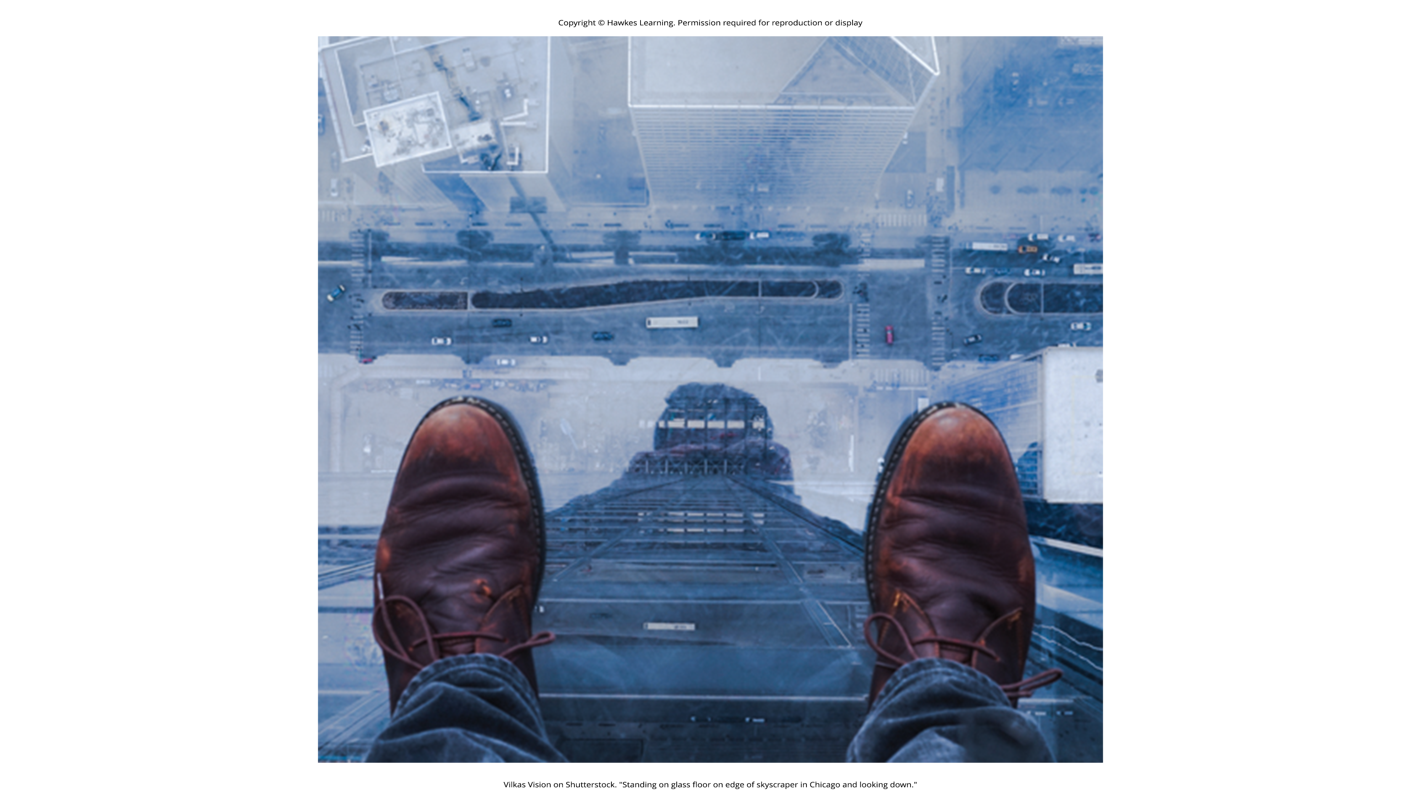
Lesson 15.4 Figure 3
Caption: Fear is theorized as an evolutionary response to dangerous situations.

Slide 17
Development Of Specific Phobias
The human brain is evolutionarily predisposed to more readily associate certain objects or situations with fear.
Our ancestors associated certain stimuli, such as snakes and heights, with potential danger.
Over time, the mind became adapted to more readily develop fears of these things compared to others.
Experimental evidence has consistently demonstrated that conditioned fears develop more readily for fear-relevant stimuli than to fear-irrelevant stimuli (Öhman & Mineka, 2001).

Slide 18
Prepared Learning Theory
This prepared learning has been shown to occur in monkeys (Cook & Mineka, 1989).
Monkeys watched videotapes of model monkeys reacting fearfully to either fear-relevant stimuli (toy snakes or a toy crocodile) or fear-irrelevant stimuli (flowers or a toy rabbit).
The observer monkeys developed fears of the fear-relevant stimuli but not the fear-irrelevant stimuli.

Slide 19
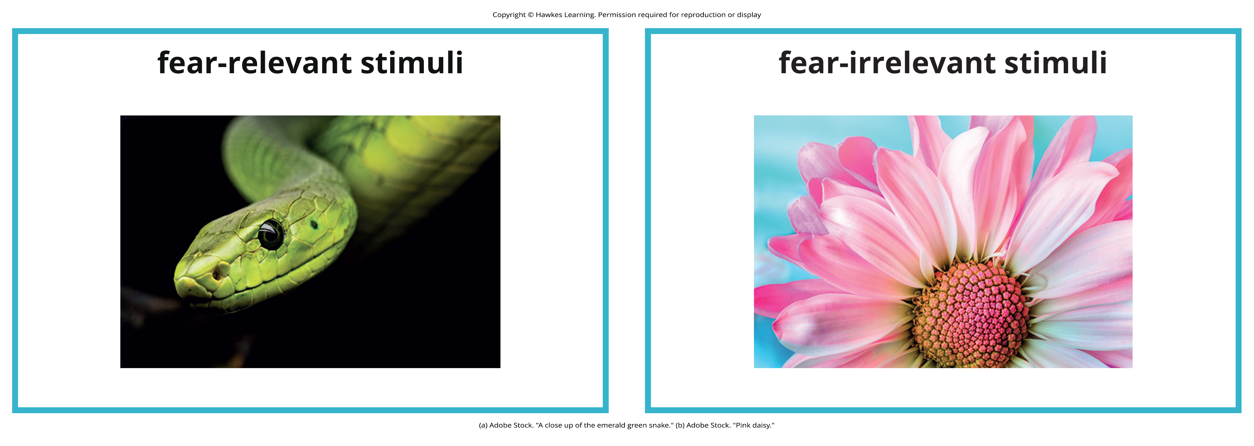
Lesson 15.4 Figure 4
Caption: Snakes would be considered fear-relevant stimuli because they can pose an actual threat. Flowers, on the other hand, are not as dangerous and would be considered fear-irrelevant stimuli.

Slide 20
Social Anxiety Disorder
Social anxiety disorder is characterized by extreme and persistent fear or anxiety and avoidance of social situations in which the person could potentially be evaluated negatively by others (APA, 2022).
People are concerned they may act in humiliating or embarrassing ways, such as appearing foolish, showing symptoms of anxiety, or offending others.

Slide 21
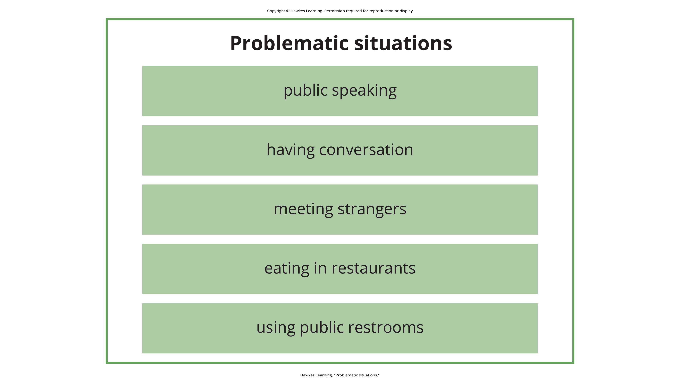
Lesson 15.4 Figure 5
Caption: Problematic situations can include public situations, which might elicit fear or panic.

Slide 22
Group Activity₁
We all have moments of social anxiety, whether it be fear of an upcoming speaking engagement or jitters about meeting new people.
How can you know if your feelings of social anxiety qualify as a disorder? Discuss in a small group with your classmates.

Slide 23
Impacts Of Social Anxiety Disorder
Although many people become anxious in social situations like public speaking, the fear, anxiety, and avoidance experienced in social anxiety disorder are highly distressing and lead to serious impairments in life.
Adults with this disorder are more likely to experience lower educational attainment and lower earnings, perform poorly at work, and report greater dissatisfaction with their family lives, friends, leisure activities, and income.

Slide 24
Social Anxiety Disorder: Safety Behaviors
When people with social anxiety disorder are unable to avoid situations that provoke anxiety, they may engage in safety behaviors, which are mental or behavioral acts that reduce anxiety in social situations by reducing the chance of negative social outcomes.
These actions usually exacerbate the problem because they do not allow the individual to disconfirm their negative beliefs, often eliciting rejection and other negative reactions from others.

Slide 25
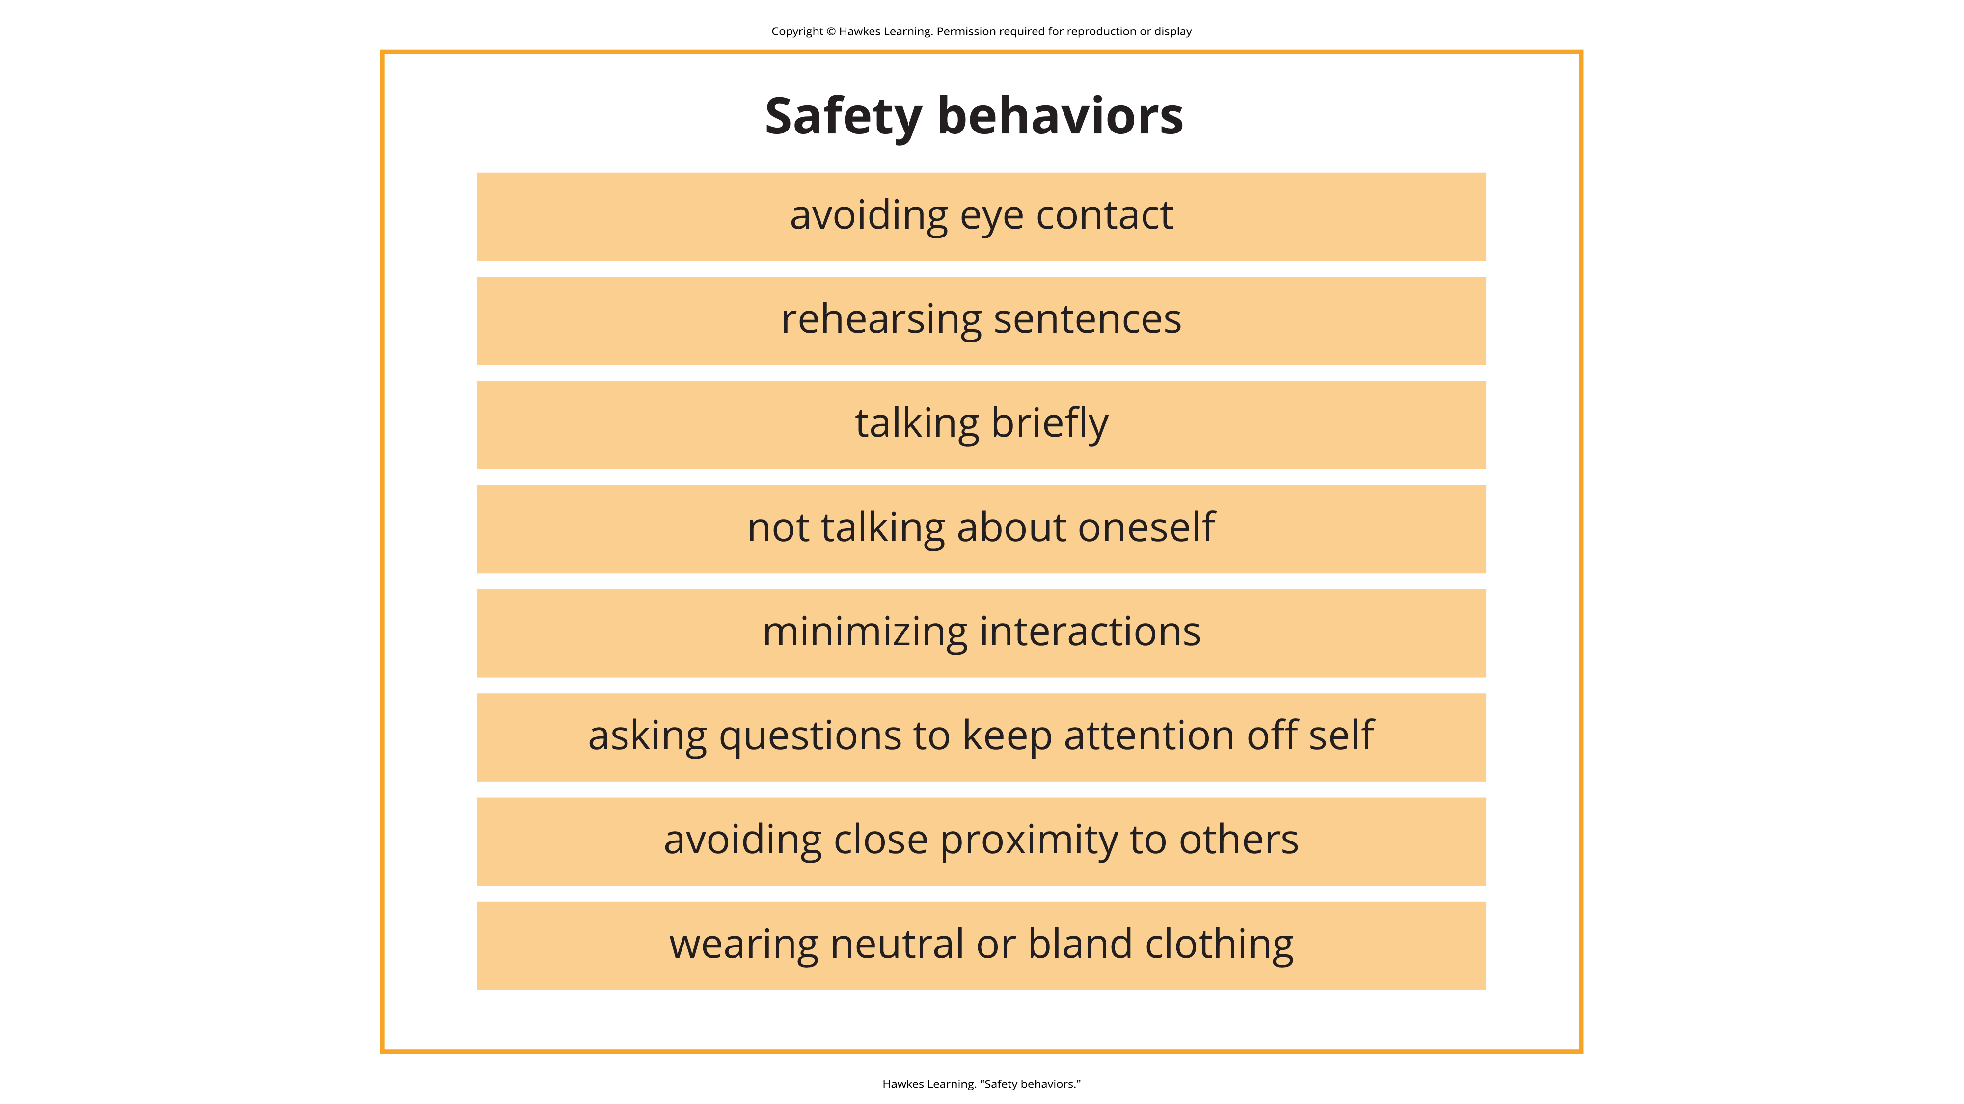
Lesson 15.4 Figure 6
Caption: Safety behaviors are behaviors that individuals with social anxiety disorder engage in to lessen the anxiety.

Slide 26

Social Anxiety Disorder: Self-Medication
People with social anxiety disorder may resort to self-medication, such as drinking alcohol, to reduce their anxiety in social situations.
Research shows a high rate of comorbidity between social anxiety disorder and alcohol use disorder, especially in men.
Figure 7

Slide 27
Development Of Social Anxiety Disorder
Fears related to social anxiety disorder can develop through conditioning experiences.
  Example: A child who is subjected to early unpleasant social experiences (e.g., bullying at school) may develop negative social images of themselves that become activated later in anxiety-provoking situations.

Slide 28
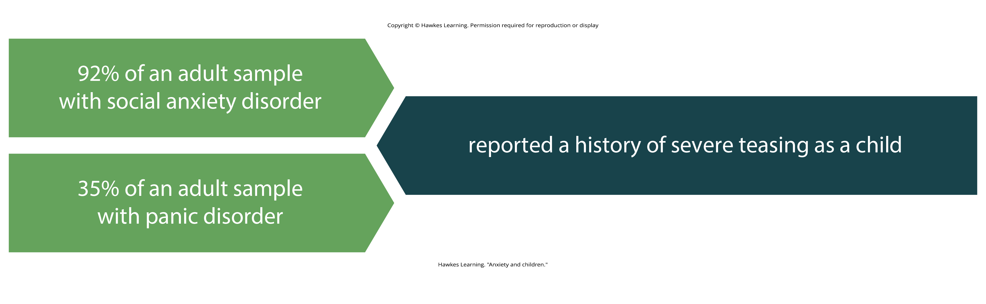
Lesson 15.4 Figure 8
Caption: It seems that severe teasing as a child can lead to conditioning that develops into social anxiety disorder or panic disorder.

Slide 29
Risk Factors Of Social Anxiety Disorder
One risk factor for developing social anxiety disorder is behavioral inhibition which is characterized by a consistent tendency to show fear and restraint when presented with unfamiliar people or situations.
Behavioral inhibition is displayed early in life in toddlerhood and childhood.
A recent statistical review of studies demonstrated that behavioral inhibition was associated with an increase in the risk of developing social anxiety disorder.

Slide 30
Panic Disorder
People with panic disorder experience recurrent (more than one) and unexpected panic attacks.
These individuals also experience at least 1 month of persistent concern about additional panic attacks, worry over the consequences of the attacks, or self-defeating changes in behavior related to the attacks.

Slide 31
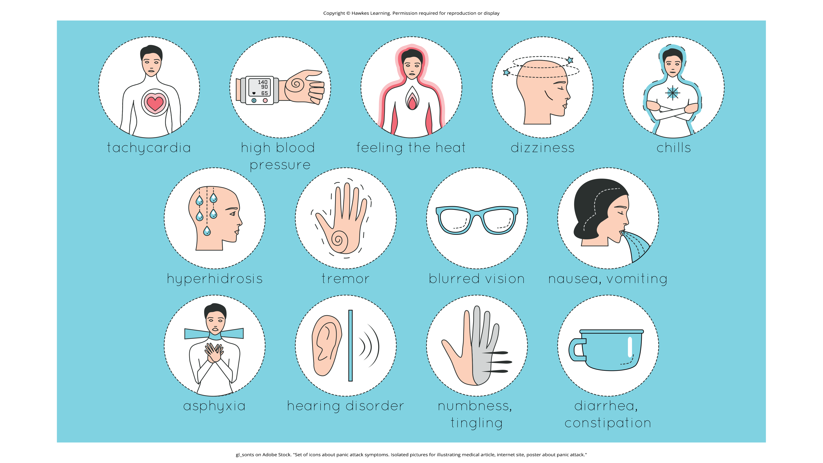
Lesson 15.4 Figure 9
Caption: Some of the physical manifestations of a panic attack are shown. People may experience sweating, trembling, feelings of faintness, or a fear of losing control, among other symptoms.

Slide 32
Panic Attack
A panic attack is defined as a period of extreme fear or discomfort that develops abruptly and reaches a peak within 10 minutes.
Symptoms include accelerated heart rate, sweating, trembling, choking sensations, hot flashes or chills, dizziness or lightheadedness, fears of losing control or going crazy, and fears of dying (APA, 2022).
A person must experience unexpected panic attacks to qualify for a diagnosis of panic disorder.

Slide 33
Confusion Related To Panic Attacks
Individuals with panic disorder often misinterpret panic attacks as a sign that something is intensely wrong internally.
  Example: The person might think that their pounding heart represents an impending heart attack.

Slide 34
Reflection Question₂
Have you ever experienced a panic attack or sudden extreme fear that made your heart race? How did you calm yourself after that event?

Slide 35
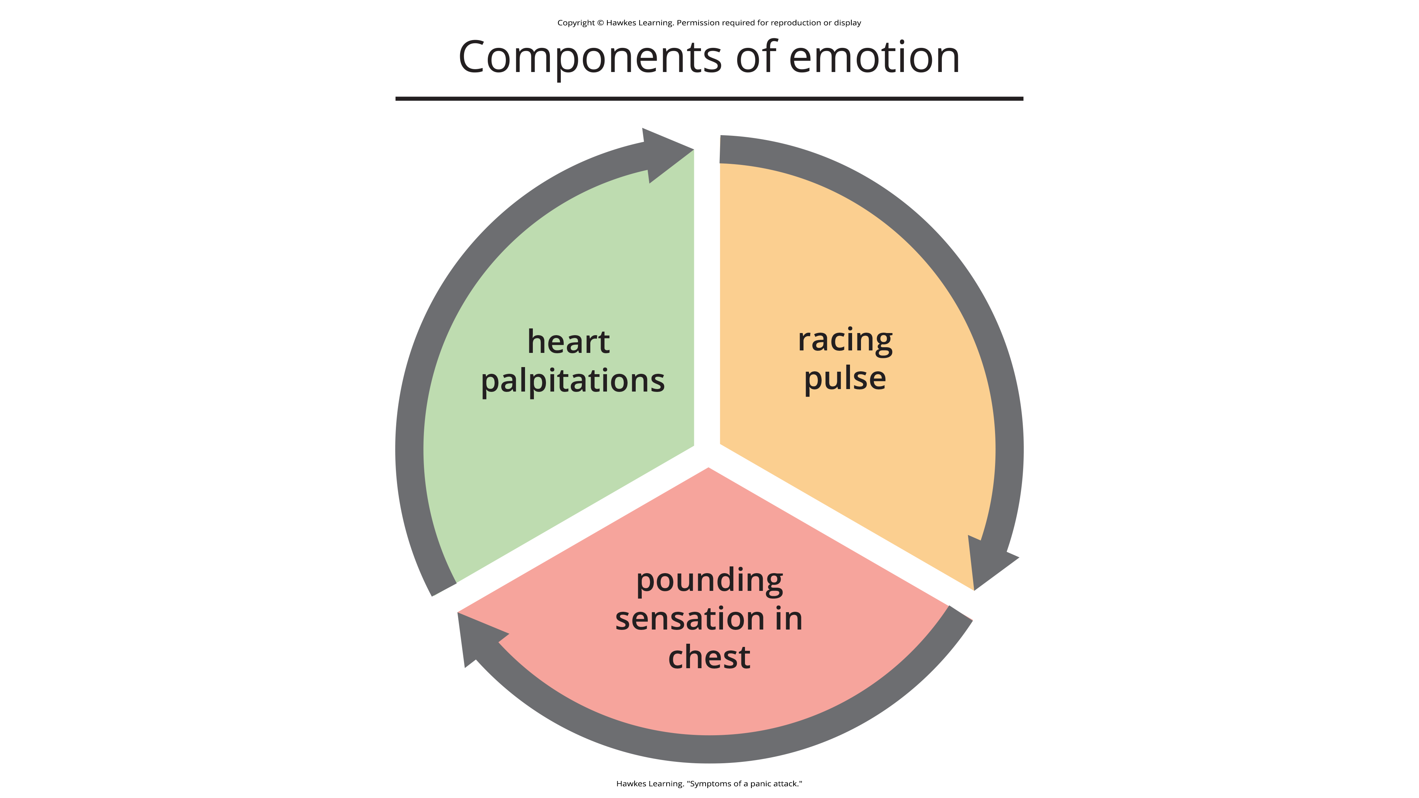
Lesson 15.4 Figure 10
Caption: The symptoms of a panic attack and a heart attack are similar.

Slide 36
Fear Of Future Panic Attacks
Those with panic disorder fear future attacks and may become preoccupied with modifying their behavior to avoid future panic attacks.
Panic attacks themselves are not mental disorders.
Many people with panic disorder develop agoraphobia, which is marked by fear and avoidance of situations in which escape might be difficult or help might not be available if one were to develop symptoms of a panic attack.

Slide 37
Causes Of Panic Disorder: Biological₁
Children are at a higher risk of developing panic disorder if their parents have the disorder.
Family and twin studies indicate that the heritability of panic disorder is around 43%.

Slide 38
Causes of Panic Disorder: Biological₂
A region of the brain called the locus coeruleus may play a role in this disorder.
Located in the brainstem, the locus coeruleus is the brain's major source of norepinephrine, a neurotransmitter that triggers the body's fight-or-flight response.
Panic disorder may be caused by abnormal norepinephrine activity in the locus coeruleus.

Slide 39
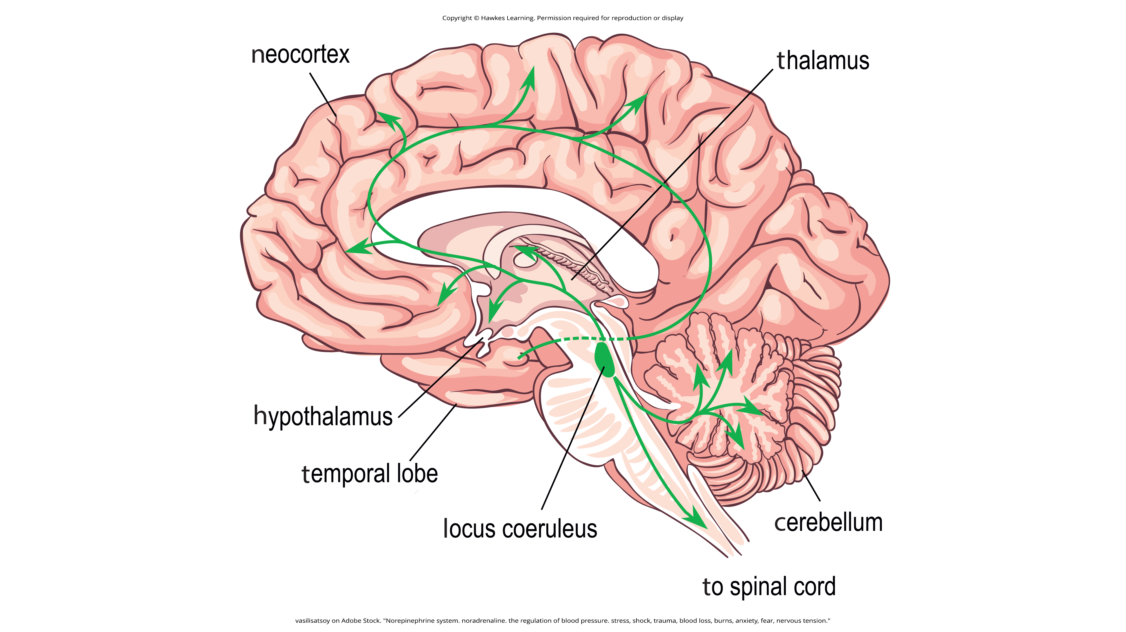
Lesson 15.4 Figure 11
Caption: The locus coeruleus is the brain’s major source of norepinephrine.

Slide 40
Group Activity₂
In a small group, discuss why it makes sense that the locus coeruleus is known as an "alarm center."

Slide 41
Causes Of Panic Disorder: Conditioning
Panic attacks may be classical conditioning responses to subtle bodily sensations resembling those normally occurring when one is anxious or frightened.
  Example: A child who experiences an asthma attack may later experience subtle symptoms that resemble the frightening symptoms of earlier asthma attacks (such as shortness of breath after climbing stairs), and they may become anxious, fearful, and then experience a panic attack.
In this situation, the subtle symptoms would represent the conditioned stimulus.
The panic attack would be the conditioned response.

Slide 42
Causes Of Panic Disorder: Cognitive
Cognitive theories argue that those with panic disorder are prone to interpret ordinary bodily sensations catastrophically.
These fearful interpretations may trigger panic attacks.
  A person might detect bodily changes from getting up from a seated position (dizziness) and interpret these subtle bodily changes catastrophically.
  These interpretations create fear and anxiety, which may subsequently trigger a panic attack.

Slide 43
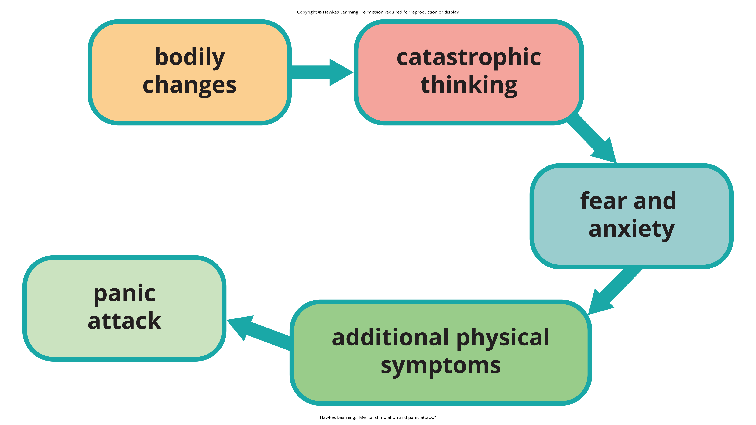
Lesson 15.4 Figure 12
Caption: There are physical and mental stimulations that can result in a panic attack.

Slide 44
Generalized Anxiety Disorder
Generalized anxiety disorder is a relatively continuous state of excessive, uncontrollable, and pointless worry and apprehension.
  Example: Alex's wife was late from picking up their son from a soccer game, and when Alex could not reach her cell phone, he eventually called the police because he was worried that they were in a car accident.
  Example: A person may worry about their health and finances without having any legitimate reasons for doing so.

Slide 45

Lesson 15.4 Figure 13
Caption: Worry is a defining feature of generalized anxiety disorder.

Slide 46
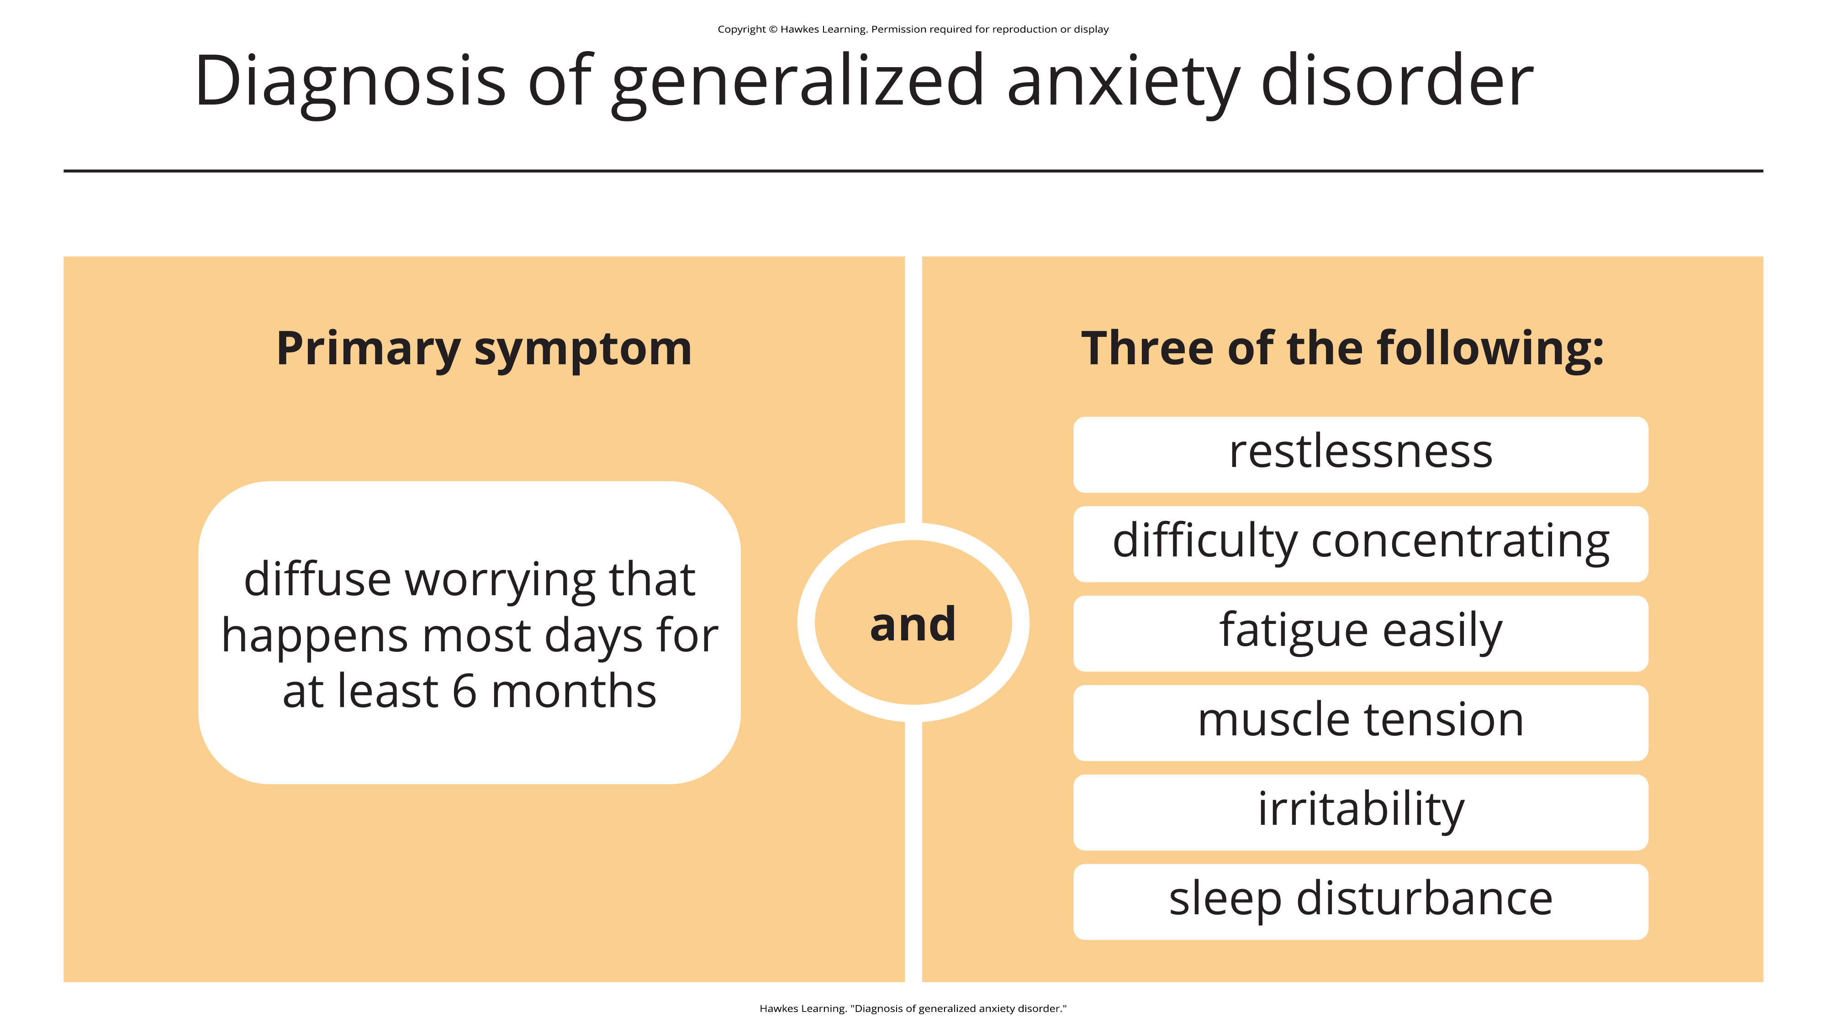
Lesson 15.4 Figure 14
Caption: Worry must occur consistently for a period of 6 months, and additional symptoms must occur to be diagnosed with a generalized anxiety disorder.

Slide 47
Prevalence Of Generalized Anxiety Disorder
Roughly 3.1% of the U.S. population has generalized anxiety disorder (The Recovery Village, 2022).
Women are two times as likely to experience the disorder compared to men.
This disorder is often comorbid with major depressive disorder, PTSD, and substance-related disorders.

Slide 48
Causes Of Generalized Anxiety Disorder
Genetic factors play a modest role in the disorder.
Cognitive theories suggest that worry represents a mental strategy to avoid more powerful negative emotions.
  Worrying might distract someone from remembering painful childhood experiences.

Slide 49

Obsessive-Compulsive And Related Disorders
Obsessive-compulsive and related disorders are a group of overlapping disorders that involve intrusive, unpleasant thoughts and repetitive behaviors.
These unwanted thoughts and repetitive behaviors are so intense that they disrupt daily life.
Figure 15

Slide 50
Obsessive-Compulsive Disorder
People with obsessive-compulsive disorder (OCD) experience thoughts and urges that are intrusive and unwanted (obsessions) and/or the need to engage in repetitive behaviors or mental acts (compulsions).
Obsessions are persistent, unintentional, and unwanted thoughts and urges that are highly intrusive, unpleasant, and distressing.
Compulsions are repetitive and ritualistic acts that are typically carried out primarily to minimize the distress that obsessions trigger or to reduce the likelihood of a feared event.

Slide 51

Example Of Obsession And Compulsion
A person might have concerns about germs and feel their hands still have germs on them (obsession), so they wash their hands excessively (compulsion).
Figure 16

Slide 52
Prevalence Of Obsessive-Compulsive Disorder
Approximately 2.3% of the U.S. population will experience OCD in their lifetime.
People with first degree relatives with the disorder are more likely to have the disorder themselves.

Slide 53
Body Dysmorphic Disorder
A person with body dysmorphic disorder is preoccupied with a perceived flaw in their physical appearance that is either nonexistent or barely noticeable to others.
The preoccupation with imagined physical flaws drives the person to engage in repetitive and ritualistic behavioral and mental acts.
  A person with this disorder may constantly look in the mirror or try to hide the offending body part.

Slide 54
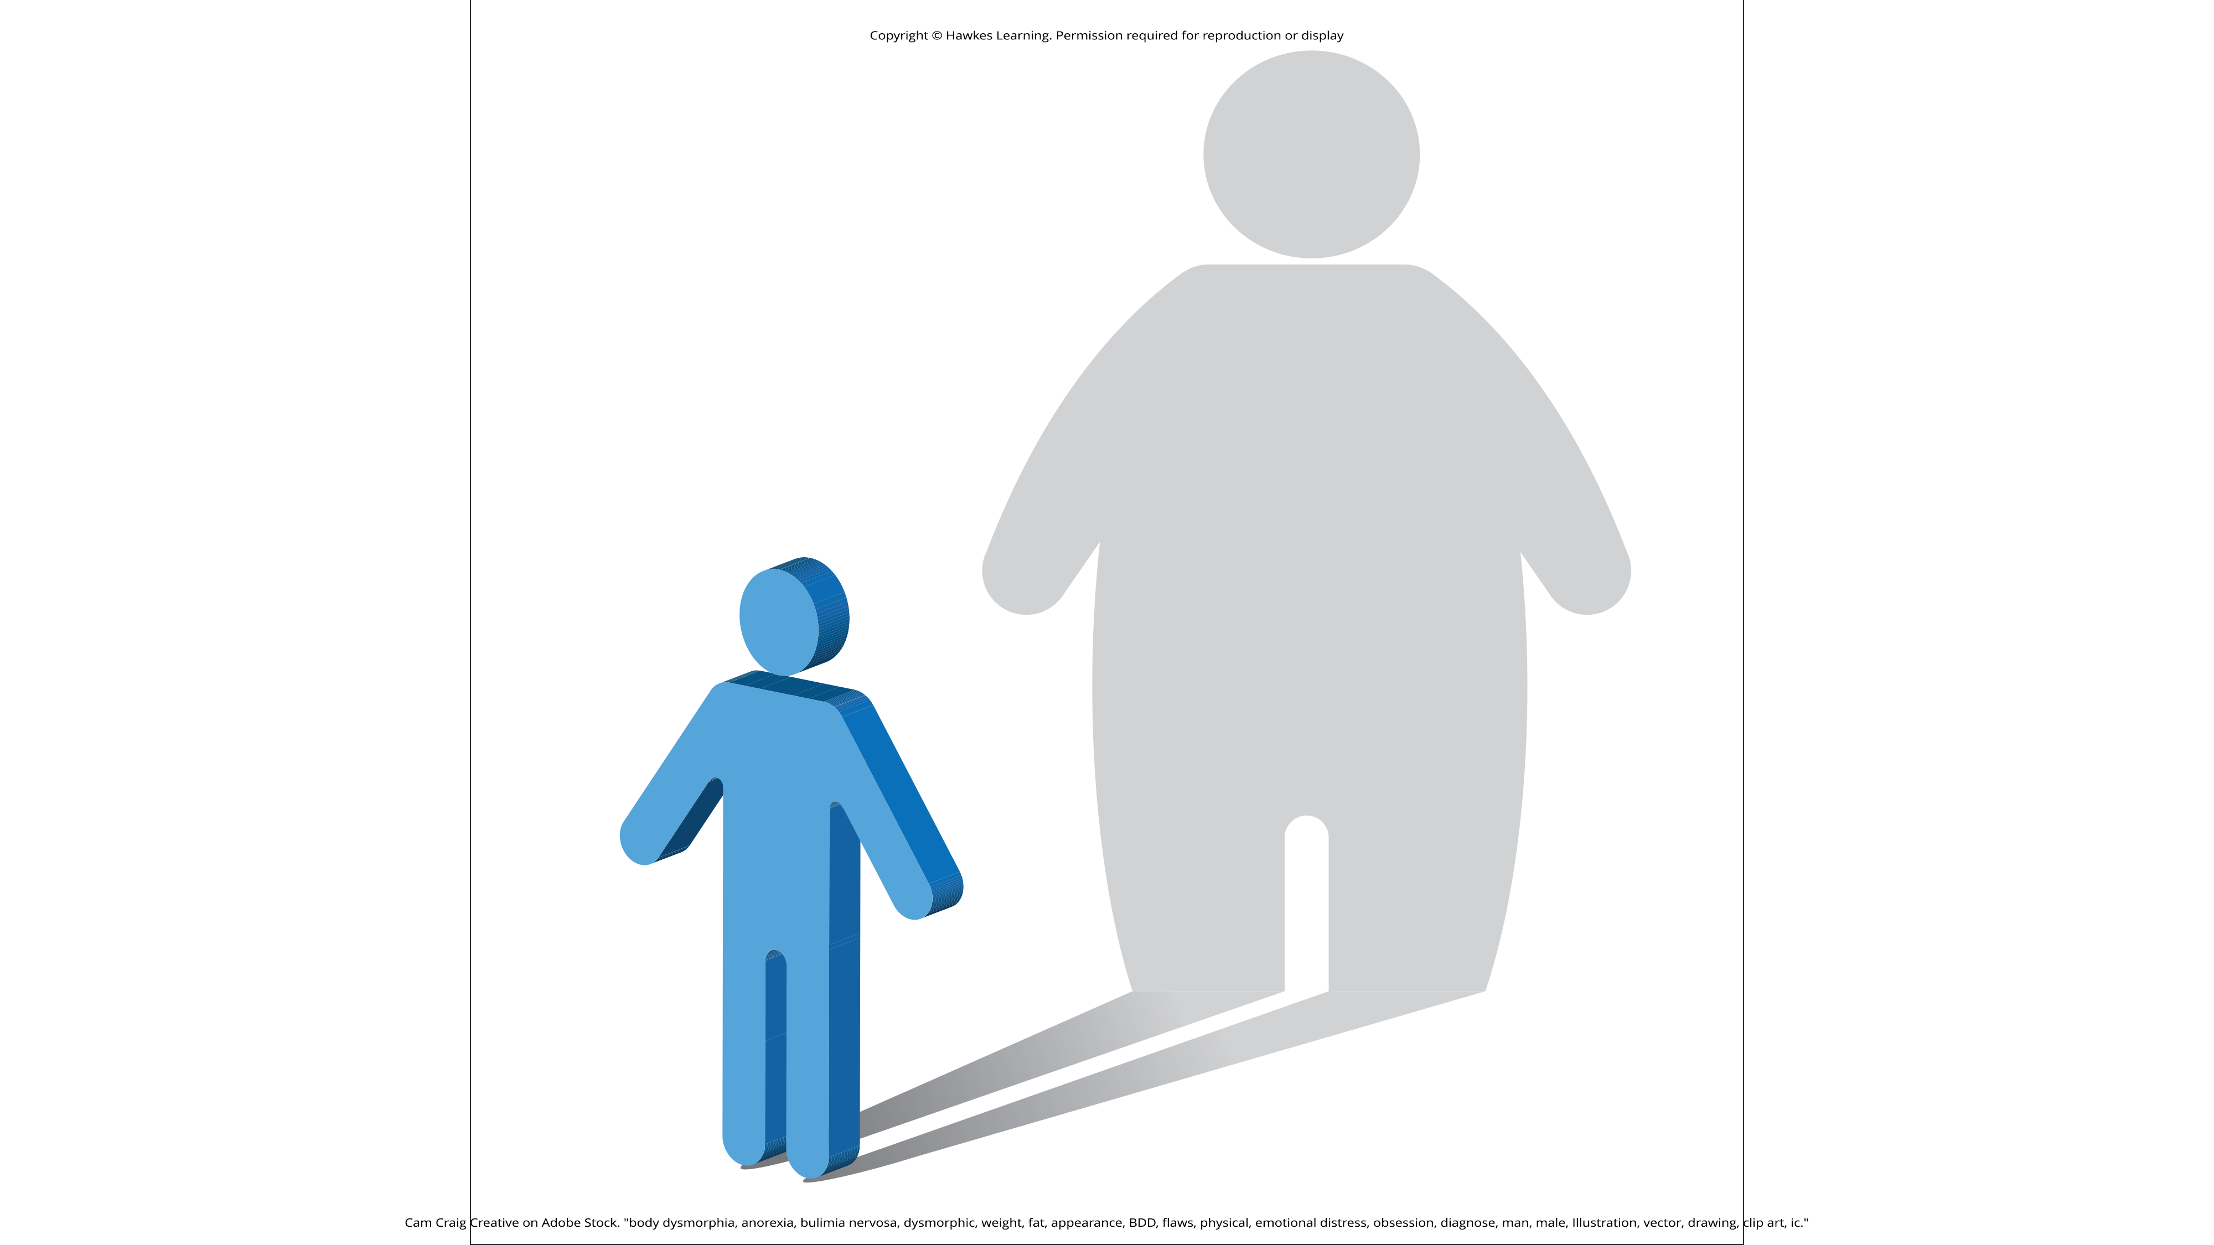
Lesson 15.4 Figure 17
Caption: Physical flaws are disproportionately magnified or fabricated for people who suffer from body dysmorphic disorder.

Slide 55
Reflection Question₃
What do you think is the difference between an individual who has body dysmorphic disorder and someone who is just very concerned with how they look?

Slide 56

Hoarding Disorder
People with hoarding disorder cannot bear to part with personal possessions, regardless of how valueless or useless these possessions are.
Often, these individuals accumulate excessive amounts of worthless items such that their living spaces are unusable.
Figure 18

Slide 57
Reflection Question₄
How do you think hoarding disorder relates to OCD?

Slide 58
Causes Of OCD
OCD has a moderate genetic component.
Studies indicate the possible involvement of two dozen potential genes, which regulate the neurotransmitters serotonin, dopamine, and glutamate.
The orbitofrontal cortex, an area of the frontal lobe involved in learning and decision-making, is part of a series of brain regions that is called the OCD circuit.
This circuit consists of several interconnected regions that influence the perceived emotional value of stimuli and the selection of behavioral and cognitive responses.

Slide 59
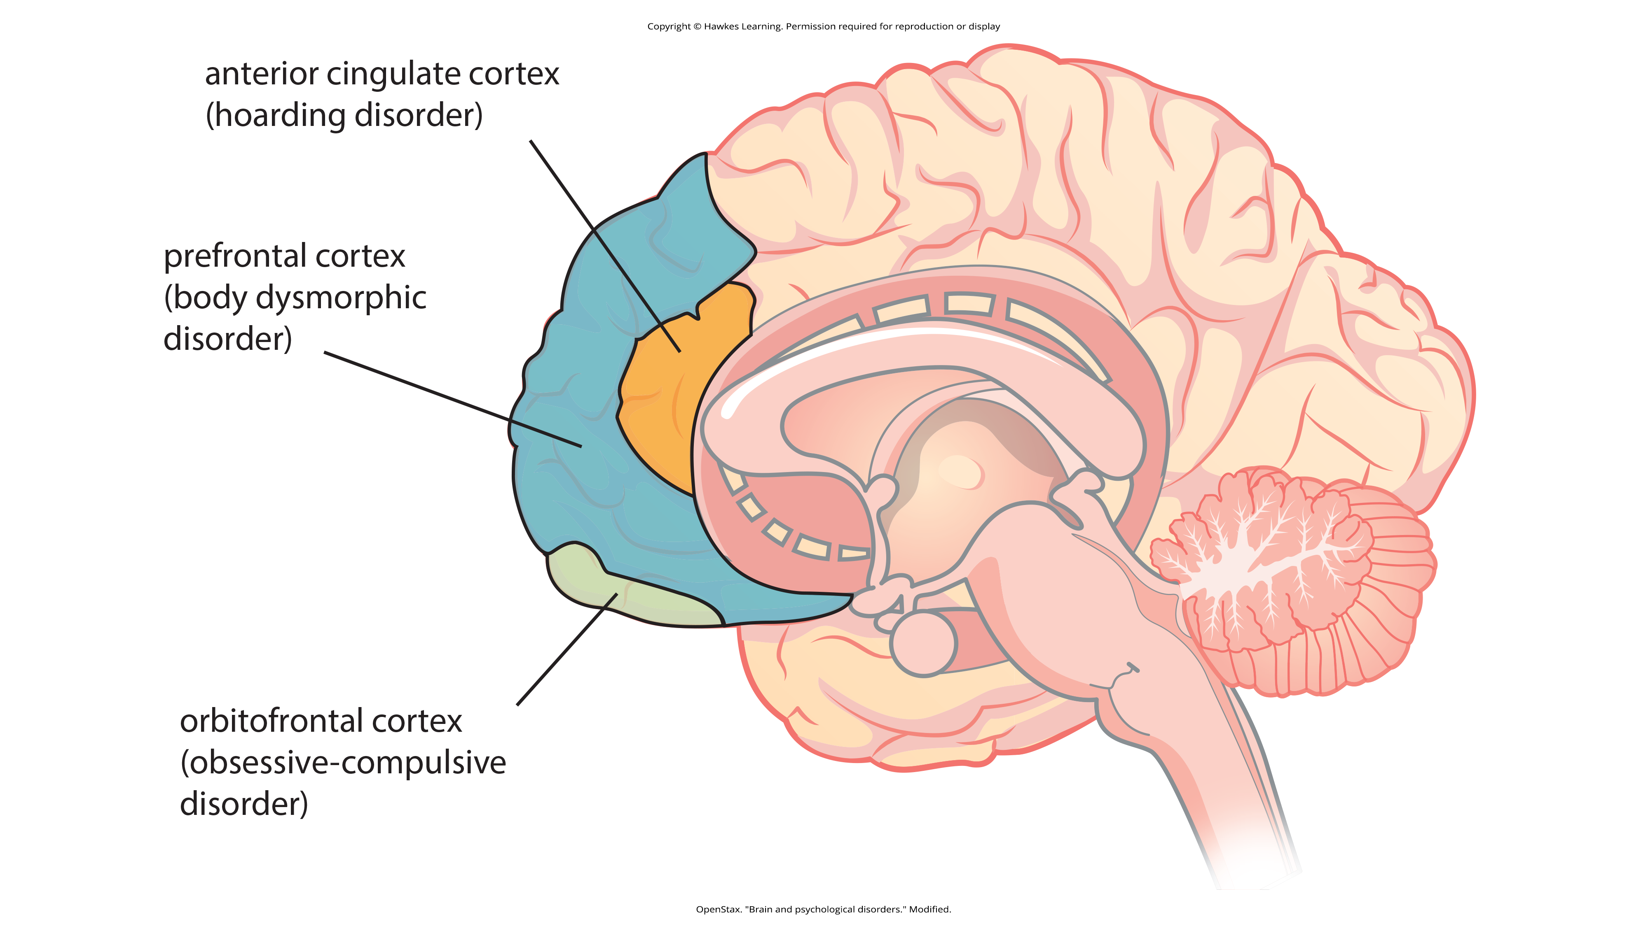
Lesson 15.4 Figure 19
Caption: Different regions of the brain may be associated with different psychological disorders.

Slide 60

Posttraumatic Stress Disorder
Extremely stressful or traumatic events, such as combat, natural disasters, and terrorist attacks, may result in the development of psychological disorders such as posttraumatic stress disorder (PTSD).
Figure 21

Slide 61
A Broader Definition Of PTSD
PTSD is currently listed among the Trauma-and-Stressor-Related disorders in the DSM-5-TR.
For a person to be diagnosed with PTSD, they must be exposed to actual or threatened death, serious injury, or sexual violence.
These experiences can include directly experiencing the traumatic event, witnessing a traumatic event that happens to others, learning about a traumatic event that happened to someone close to them, or experiencing repeated exposure to traumatic events.

Slide 62
Symptoms of PTSD
Symptoms include:
  Intrusive and distressing memories of the event
  Flashbacks (in which the individual relives the event and behaves as if the event is occurring in the moment)
  Avoidance of stimuli connected to the event
  Persistently negative emotional states
  Feelings of detachment from others
  Irritability
  Proneness toward outbursts
  Exaggerated startle response (jumpiness)

Slide 63
Prevalence Of PTSD
Roughly 7% of adults in the United States, including 9.7% of women and 3.6% of men, experience PTSD in their lifetime.
Higher rates exist among groups of people who are exposed to mass trauma or whose jobs are related to trauma exposure.
  First responders, like police officers and firefighters, are at greater risk.

Slide 64
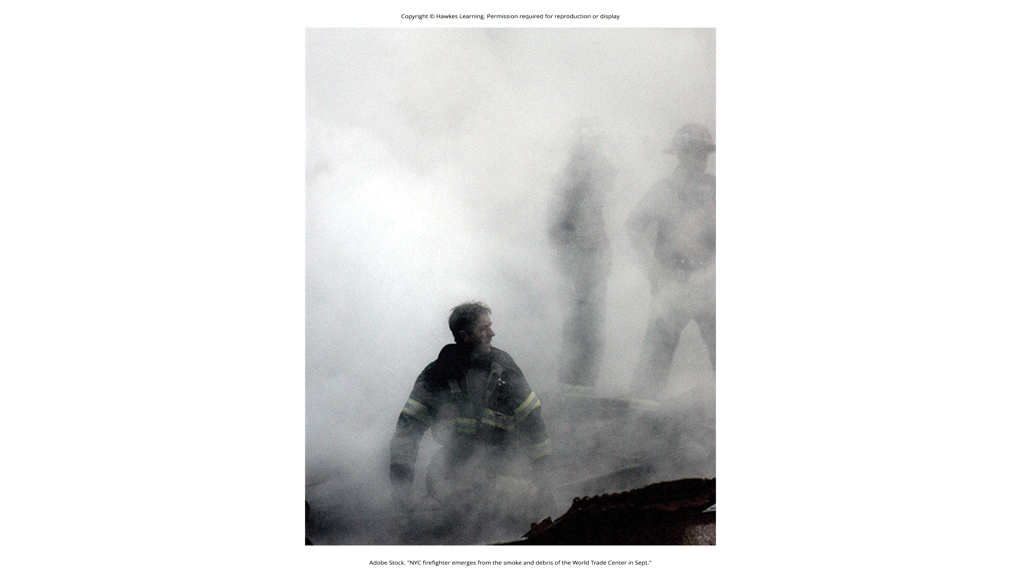
Lesson 15.4 Figure 22
Caption: Here a NYPD firefighter is shown at Ground Zero after the 9/11 terrorist attacks.

Slide 65
Risk Factors for PTSD₁
Various factors can increase the risk of developing PTSD:
  Greater trauma severity
  Lack of immediate social support
  More subsequent life stress
  Less involvement with the community
  Experiencing traumatic events that involve harm by others
  Gender (women are more likely)

Slide 66
Risk Factors for PTSD₂
Various factors can increase the risk of developing PTSD:
  Low socioeconomic status
  Low intelligence
  Personal history of mental disorders
  History of childhood adversity
  Family history of mental disorders

Slide 67
Reflection Question₅
Why do you think women are more likely to receive a PTSD diagnosis than men?

Slide 68

Support For Sufferers Of PTSD
Social support, such as comfort, advice, and assistance, can reduce the likelihood of PTSD after a traumatic event.
Individuals who become involved in the community are less likely to develop PTSD.
Community involvement promoted remission of PTSD as well.
Figure 23

Slide 69
Development Of PTSD And Classical Conditioning
Some symptoms of PTSD are developed and maintained through classical conditioning.
The traumatic event may act as an unconditioned stimulus that elicits an unconditioned response characterized by extreme fear and anxiety.
Cognitive, emotional, physiological, and environmental cues accompanying the event are conditioned stimuli.
These traumatic reminders evoke conditioned responses of extreme fear and anxiety.

Slide 70
Examples Of Classical Conditioning In PTSD
Health care workers during COVID-19 have been diagnosed with PTSD due to the trauma they endured while caring for patients.
Patients during COVID-19 who were in the ICU and intubated are at a higher risk for developing PTSD because of the trauma of the illness itself and the treatment.

Slide 71

Lesson 15.4 Figure 24
Caption: Mental health professionals are seeing a rise in PTSD diagnoses for patients and health care workers alike following traumatic experiences with the COVID-19 pandemic.

Slide 72
Learning And The Development Of PTSD
Some people who experience traumas do not form coherent memories of the trauma.
Instead, memories are poorly encoded and are fragmented, disorganized, and lacking in detail which means these individuals are unable to remember the event in a way that gives it meaning and context.
  Example: A rape victim may be haunted by intrusive fragments of memory that are triggered by stimuli associated with the event.

Slide 73
On Your Own₂
Explain why a combat veteran would get PTSD from the classical conditioning perspective and based on the model that focuses on memory disturbance and negative appraisals of the event.

Slide 74
Summary
Anxiety disorders are a group of disorders in which a person experiences excessive, persistent, and distressing fear and anxiety that interferes with normal functioning.
Obsessive-compulsive and related disorders are a group of disorders that each involve intrusive thoughts and/or repetitive behaviors.
PTSD is defined as a disorder in which the experience of a traumatic or profoundly stressful event, such as combat, sexual assault, or natural disaster, produces a constellation of symptoms that must last for 1 month or more.

Slide 75
End of Hawkes Learning PowerPoint

