Slide 1
Lesson 15.5
Mood Disorders

Slide 2
Definition Of Mood Disorders
Mood disorders are characterized by severe disturbances in mood and emotions.
Examples:
  Blake cries all day and feels he is worthless.
  Crystal stays up all night, talks rapidly, and went on a shopping spree where she spent $3,000 she cannot afford.
  Maria recently had a baby and feels overwhelmed, teary, anxious, and believes she is a terrible mother.

Slide 3

Mood Disorders
Individuals with mood disorders experience mood fluctuations that are extreme, distort their outlook on life, and impair their ability to function.
The DSM-5-TR separates mood disorders: bipolar and related disorders and depressive disorders.
Figure 1

Slide 4
Depressive Disorders
Depressive disorders are a group of disorders in which depression is the main feature.
Depression refers to an intense and persistent sadness.
People with depression feel sad, discouraged, and hopeless.
These individuals lose interest in activities once enjoyed, often experience a decrease in drives such as hunger and sex, and frequently doubt personal worth.

Slide 5
Bipolar And Related Disorders
Bipolar and related disorders are a group of disorders in which mania is the defining feature.
Mania is a state of extreme elation and agitation.
When people experience mania, they may become extremely talkative, behave recklessly, or attempt to take on many tasks simultaneously.

Slide 6
Definition Of Major Depressive Disorder
The defining symptoms of major depressive disorder include "depressed mood most of the day, nearly every day" (feeling sad, empty, hopeless, or appearing tearful to others), and loss of interest and pleasure in usual activities that impair daily functioning (APA, 2022).
People with depression will no longer show interest or enjoyment in activities that previously were gratifying, such as hobbies, sports, sex, or social events.
  Example: An avid tennis player who develops major depressive disorder may no longer play tennis.

Slide 7

Major Depressive Disorder Diagnosis
Diagnosis of major depressive disorder requires the individual to experience five or more symptoms for at least 2-weeks.
Symptoms must cause significant distress or impair normal functioning.
The person must be experiencing either depressed mood or lose of interest in activities that normally provide pleasure in addition to other symptoms.
Figure 2

Slide 8
Additional Symptoms of Major Depressive Disorder₁
Other symptoms include:
  Significant weight loss (when not dieting) or weight gain and/or significant decrease or increase in appetite
  Difficulty falling asleep or sleeping too much
  Psychomotor agitation, such as being fidgety and jittery, or psychomotor retardation, such as moving and talking slowly

Slide 9
Additional Symptoms of Major Depressive Disorder₂
Other symptoms include:
  Fatigue or loss of energy
  Feelings of worthlessness or guilt
  Difficulty concentrating and indecisiveness
  Suicidal ideation: thoughts of death (not just fear of dying), thinking about or planning suicide, or making an actual suicide attempt

Slide 10
Incidence Of Major Depressive Disorder
Major depressive disorder is considered episodic.
Its symptoms are typically present at their full magnitude for a certain time period and then gradually abate.
Although the episodes can last for months, around 70% of people with major depression recover within a year.
Around 12% show serious signs of impairment associated with major depressive disorder after 5 years.

Slide 11

Results Of Major Depressive Disorder
Major depressive disorder is a serious and incapacitating condition that can severely impact one's life.
The disorder can impact one's ability to work and may require hospitalization on occasion.
Depression is a risk factor for the development of heart disease in healthy patients, as well as adverse cardiovascular outcomes in patients with preexisting heart disease.
Figure 3

Slide 12
Prevalence Of Major Depressive Disorder
Around 10.4% of the U.S. population experiences major depressive disorder each year.
Approximately 20.6% will experience the disorder during their lifetime.
It is more common among women than among men.
Lifetime rates of major depressive disorder tend to be highest in North and South America, Europe, and Australia; they are considerably lower in Asian countries.

Slide 13
Risk Factors Of Major Depressive Disorder
Risk factors for major depressive disorder include:
  Unemployment
  Earning less than $20,000 a year
  Living in urban areas
  Being separated, divorced, or widowed

Slide 14
Subtypes Of Major Depressive Disorder
The DSM-5-TR lists various subtypes of depression that are not their own specific disorders but, instead, are labels used to indicate specific patterns of symptoms or specify time periods where symptoms may be present.
  Seasonal pattern depression applies to situations when a person experiences symptoms of depression on during a particular time of the year, such as fall or winter.

Slide 15
Peripartum Onset Depression
Another subtype, peripartum onset (commonly referred to as postpartum depression), applies to women who experience major depression during pregnancy or in the 4 weeks following the birth of their child (APA, 2022).
These women often feel very anxious and may even have panic attacks.
They may feel guilty, agitated, and be weepy.
They may not want to hold or care for their newborn, even in cases in which the pregnancy was desired and intended.

Slide 16

Example Of Peripartum Onset Depression
In extreme cases, the mother may want to harm herself or her child(ren).
  Example: Andrea Yates suffered from extreme peripartum-onset depression, and she drowned her five children in a bathtub.
Most women with this type of depression do not harm their children, but most have difficulty being adequate caregivers.
Figure 4

Slide 17
Persistent Depressive Disorder
People with persistent depressive disorder experience depressed moods most of the day nearly every day for at least 2 years, as well as at least two of the other symptoms of major depressive disorder.
People with this disorder are chronically sad and melancholy but do not meet all the criteria for major depression.
However, episodes of full-blown major depressive disorder can occur during persistent depressive disorder.

Slide 18
Bipolar And Related Disorders₁
Individuals with bipolar I disorder or bipolar II disorder often experience mood states that vacillate between depression and mania.
Although these alternations are a trademark of the disorders, individuals with bipolar I or bipolar II disorders do not rotate between these episodes quickly.

Slide 19
Reflection Question₁
What do you think might be a challenge in helping a friend or family member with bipolar disorder?

Slide 20
Bipolar Disorder Diagnosis₁
To be diagnosed with bipolar disorder, a person must have experienced at least one manic episode, which is when the individual experiences abnormal and persistent mood changes that feel elevated, expansive, and irritable.
People may also experience increased levels of energy during the episode, lasting at least 1 week.
Some become euphoric and talk excessively.
Others become excessively irritable and complain or make hostile comments.

Slide 21
Bipolar Disorder Diagnosis₂
The person may talk loudly and rapidly, exhibiting a flight of ideas, abruptly switching from one topic to another.
These individuals are easily distracted, which can make conversation difficult.
They may exhibit grandiosity, in which they experience inflated but unjustified self-esteem and self-confidence.

Slide 22

Bipolar I and II Disorders₁
Unlike bipolar I disorder where major depressive episodes are not required for a diagnosis, bipolar II disorder is diagnosed when the individual has a hypomanic episode and a major depressive episode, either currently or previously.
A hypomanic episode is like a manic episode in that it includes elevated moods and increased energy, but it only has to last 4 consecutive days instead of 1 week.
Figure 5

Slide 23
Bipolar I and II Disorders₂
Some patients with bipolar disorder will experience a rapid-cycling subtype, which is characterized by at least four manic episodes (or some combination of at least four manic and major depressive episodes) within 1 year.
People with bipolar disorder usually experience depression following mania.
Around 36% of individuals with bipolar disorder attempt suicide once in their life, and approximately 15 to 19% complete it.

Slide 24
Prevalence Of Bipolar Disorder
In the U.S., one out of every 167 people meets the criteria for bipolar disorder each year.
One in 100 will meet the criteria within their lifetime.
The rates are higher in men than in women, and onset is usually before the age of 25.

Slide 25
Biological Basis Of Mood Disorders: Genetics
Relatives of those with major depressive disorder have double the risk of developing major depressive disorder, whereas relatives of patients with bipolar disorder have over 9 times the risk.
The rate of concordance for major depressive disorder is higher among identical twins than fraternal twins (50% vs. 38%, respectively), as is that of bipolar disorder (67% vs. 16%, respectively), suggesting that genetic factors play a stronger role in bipolar disorder than in major depressive disorder.

Slide 26
Biological Basis Of Mood Disorders: Chemical Imbalances
People with mood disorders often have imbalances in neurochemicals, such as norepinephrine and serotonin.
Medications that are used to treat major depressive disorder typically boost serotonin and norepinephrine activity.
Lithium, which is used in treatment of bipolar disorder, blocks norepinephrine activity.

Slide 27
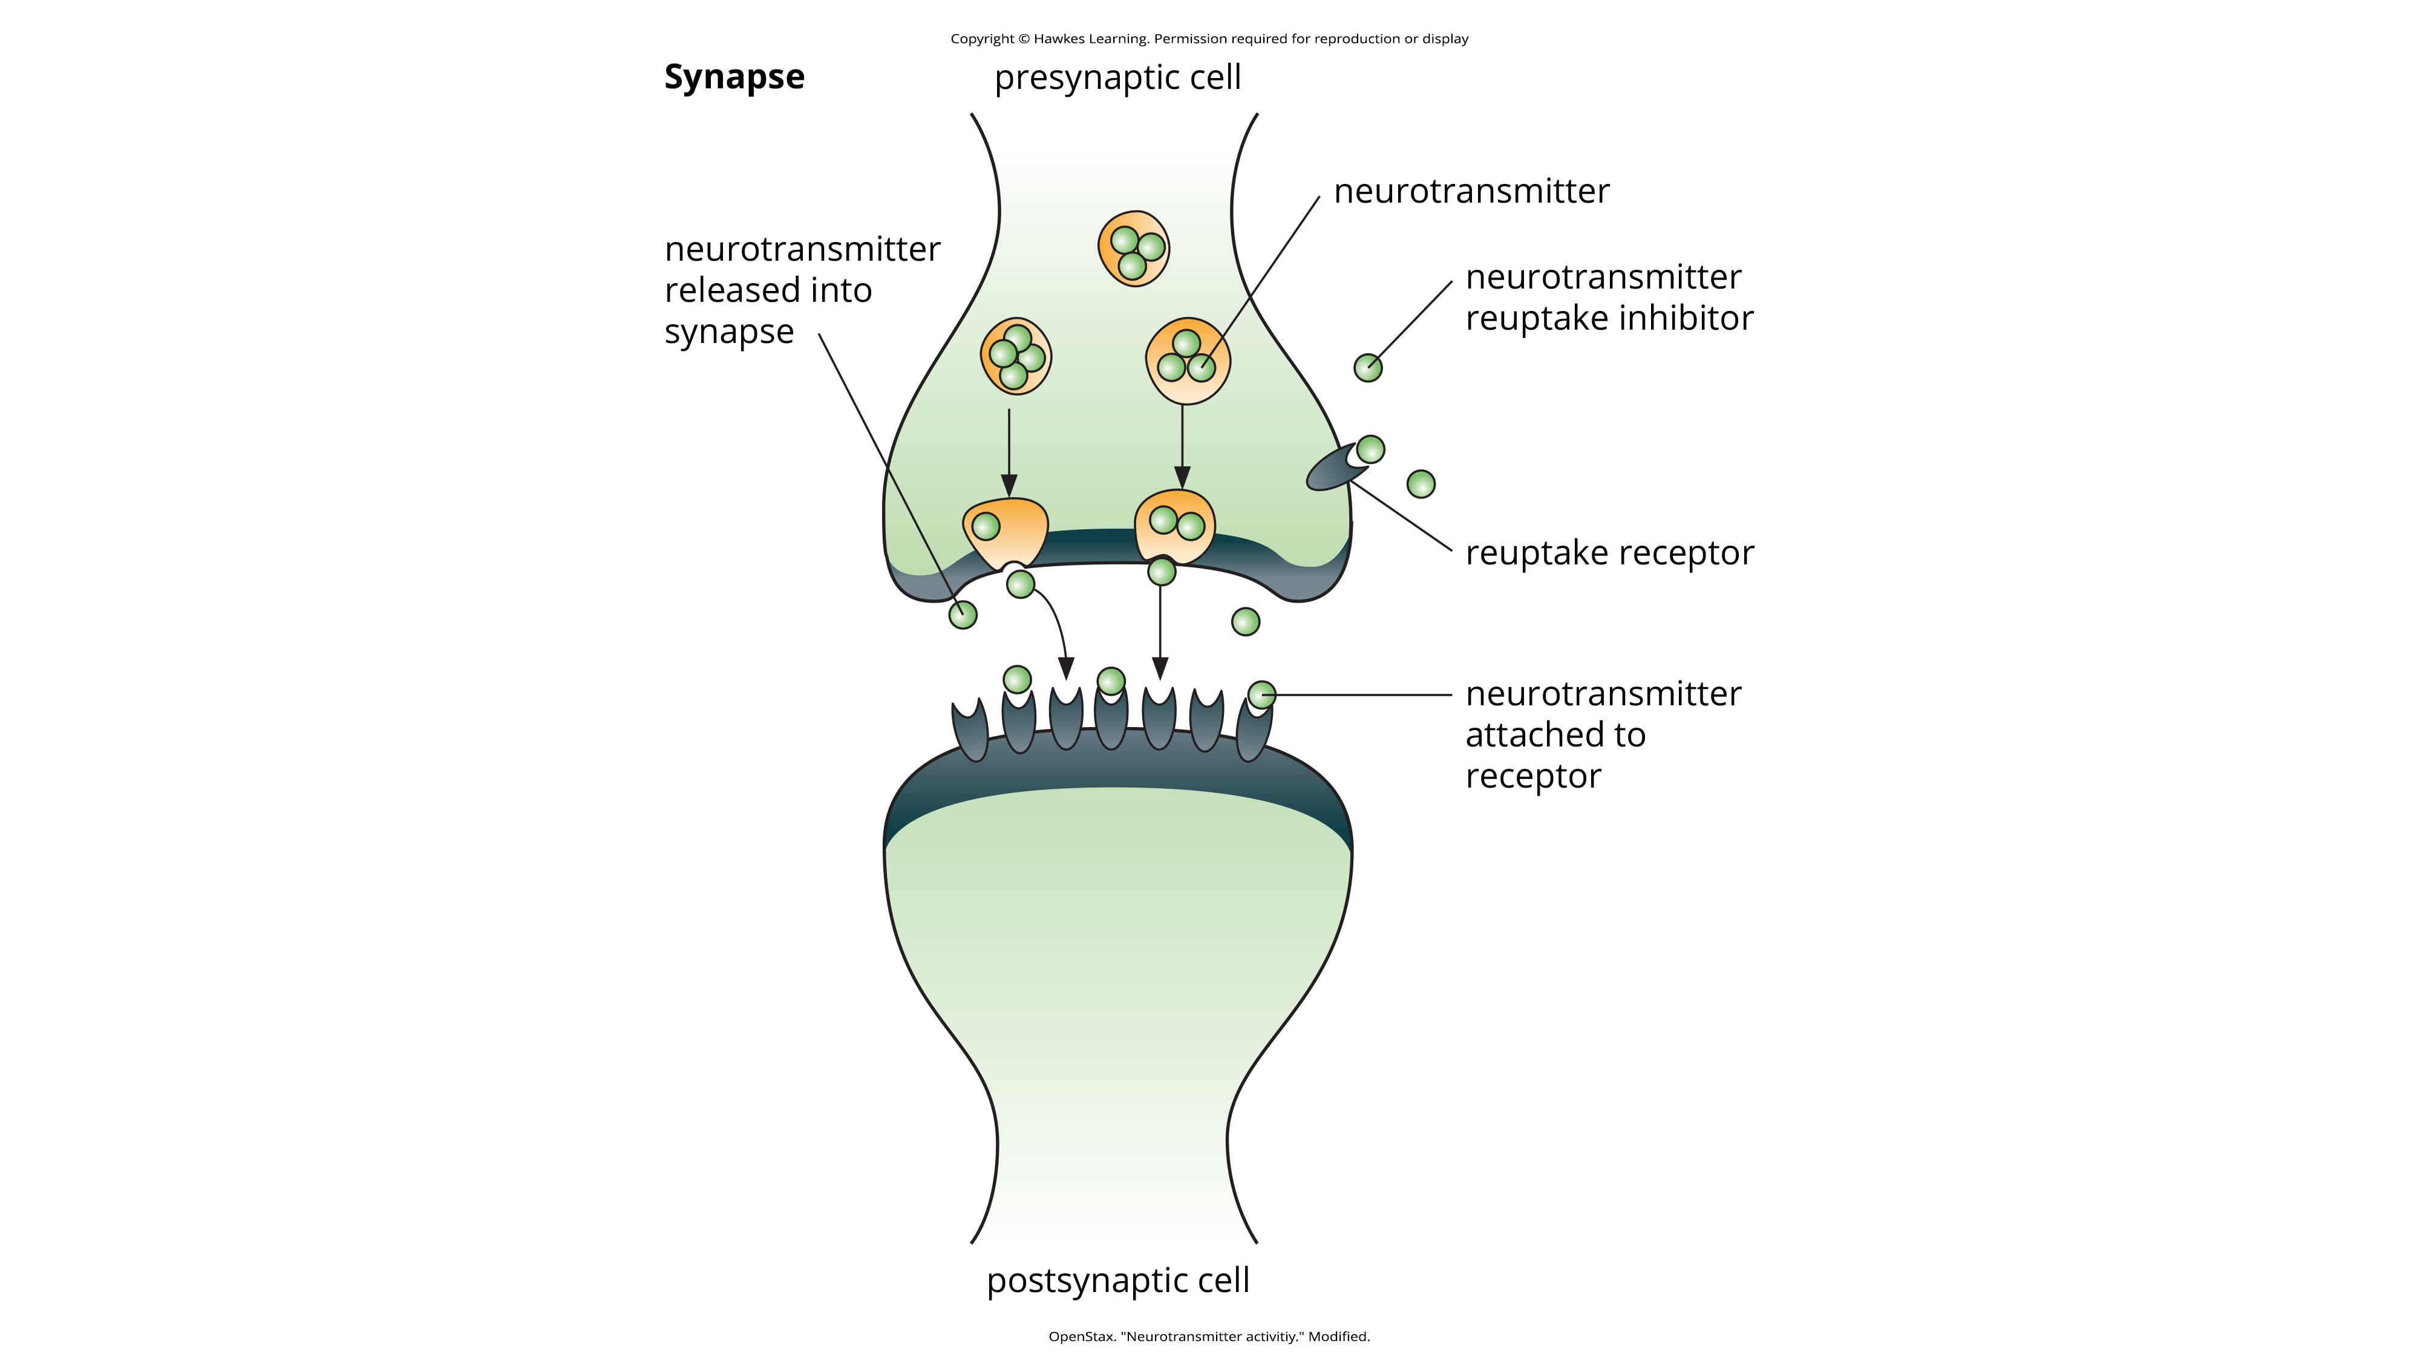
Lesson 15.5 Figure 6
Caption: Many medications designed to treat mood disorders work by altering neurotransmitter activity in the neural synapse.

Slide 28

Depression And Brain Abnormalities
Depressed individuals show elevated amygdala activity, especially when presented negative emotional stimuli.
Depressed individuals also exhibit less activation in the prefrontal cortex, particularly on the left side.
Decreased activation of the prefrontal cortex may allow negative mood states to persist.
Figure 7

Slide 29
Depression And Cortisol
Depressed individuals have abnormal levels of cortisol, a stress hormone released into the blood by the neuroendocrine system during stress.
Many people with depression show elevated cortisol levels, especially those reporting a history of early life trauma, such as the loss of a parent or abuse during childhood.
High levels of cortisol are a risk factor for future depression, and cortisol activates activity in the amygdala while deactivating activity in the prefrontal cortex.

Slide 30
A Diathesis-Stress Model And Major Depressive Disorders
Stressful events, such as the death of a loved one, divorce or separation, and serious health or money problems, can trigger depression.
Exit events, instances in which an important person departs, are likely to trigger depression.
Exit events are especially likely to trigger depression if these happenings occur in a way that humiliates or devalues the individual.

Slide 31
A Diathesis-Stress Model And Major Depressive Disorders: Examples
  People who experience the breakup of a relationship initiated by the other person develop major depressive disorder at a rate more than 2 times that of people who experience the death of a loved one.
  People who experienced traumatic stress in childhood are more likely to develop depression at some point in their lives.
  Studies suggest that stressful events alter the way a specific gene regulates serotonin activity, which may initiate depressive symptoms.

Slide 32
Cognitive Theories Of Depression
Cognitive theories of depression take the view that depression is triggered by negative thoughts, interpretations, self-evaluations, and expectations.
These diathesis-stress models propose that depression is triggered by a "cognitive vulnerability" (negative and maladaptive thinking) and by precipitating stressful life events.

Slide 33
Beck's Theory Of Depression₁
Depression-prone people possess depressive schemas, or mental predispositions to think about most things in a negative way.
Depressive schemas contain themes of loss, failure, rejection, worthlessness, and inadequacy.
Depressive schemas prompt dysfunctional and pessimistic thoughts about the self, the world, and the future.
This dysfunctional style of thinking is maintained by cognitive biases, or errors in how we process information about ourselves, which lead us to focus on negative aspects of experiences, interpret things negatively, and block positive memories.

Slide 34
Reflection Question₂
Have you ever had a negative view about something that may not have been accurate? What was it? Why do you think you didn't look at it positively?

Slide 35
Beck's Theory of Depression₂
  Example: A person whose depressive schema consists of a theme of rejection might be overly attentive to social cues of rejection (more likely to notice another's frown), and they might interpret this cue as a sign of rejection and automatically remember past incidents of rejection.
A preexisting tendency to engage in a negative, self-defeating style of thinking—when combined with life stress—over time predicts the onset of depression.

Slide 36
Reflection Question₃
If you were a therapist, how would you challenge the following statement?
"I am always going to fail, no matter how hard I try."

Slide 37
Hopelessness Theory Of Depression₁
A style of negative thinking leads to a sense of hopelessness, which then leads to depression.
Hopelessness is an expectation that unpleasant outcomes will occur or that desired outcomes will not occur, and there is nothing one can do to prevent such outcomes.
Those who demonstrate hopelessness perceive negative life events as having stable and global causes.

Slide 38
Hopelessness Theory Of Depression: Example
  Example: A student who wishes to go to law school does poorly on an admissions test.
    If the student infers negative life events as having stable and global causes, they may believe that their poor performance has a stable and global cause ("I lack intelligence, and it's going to prevent me from ever finding a meaningful career.").

Slide 39
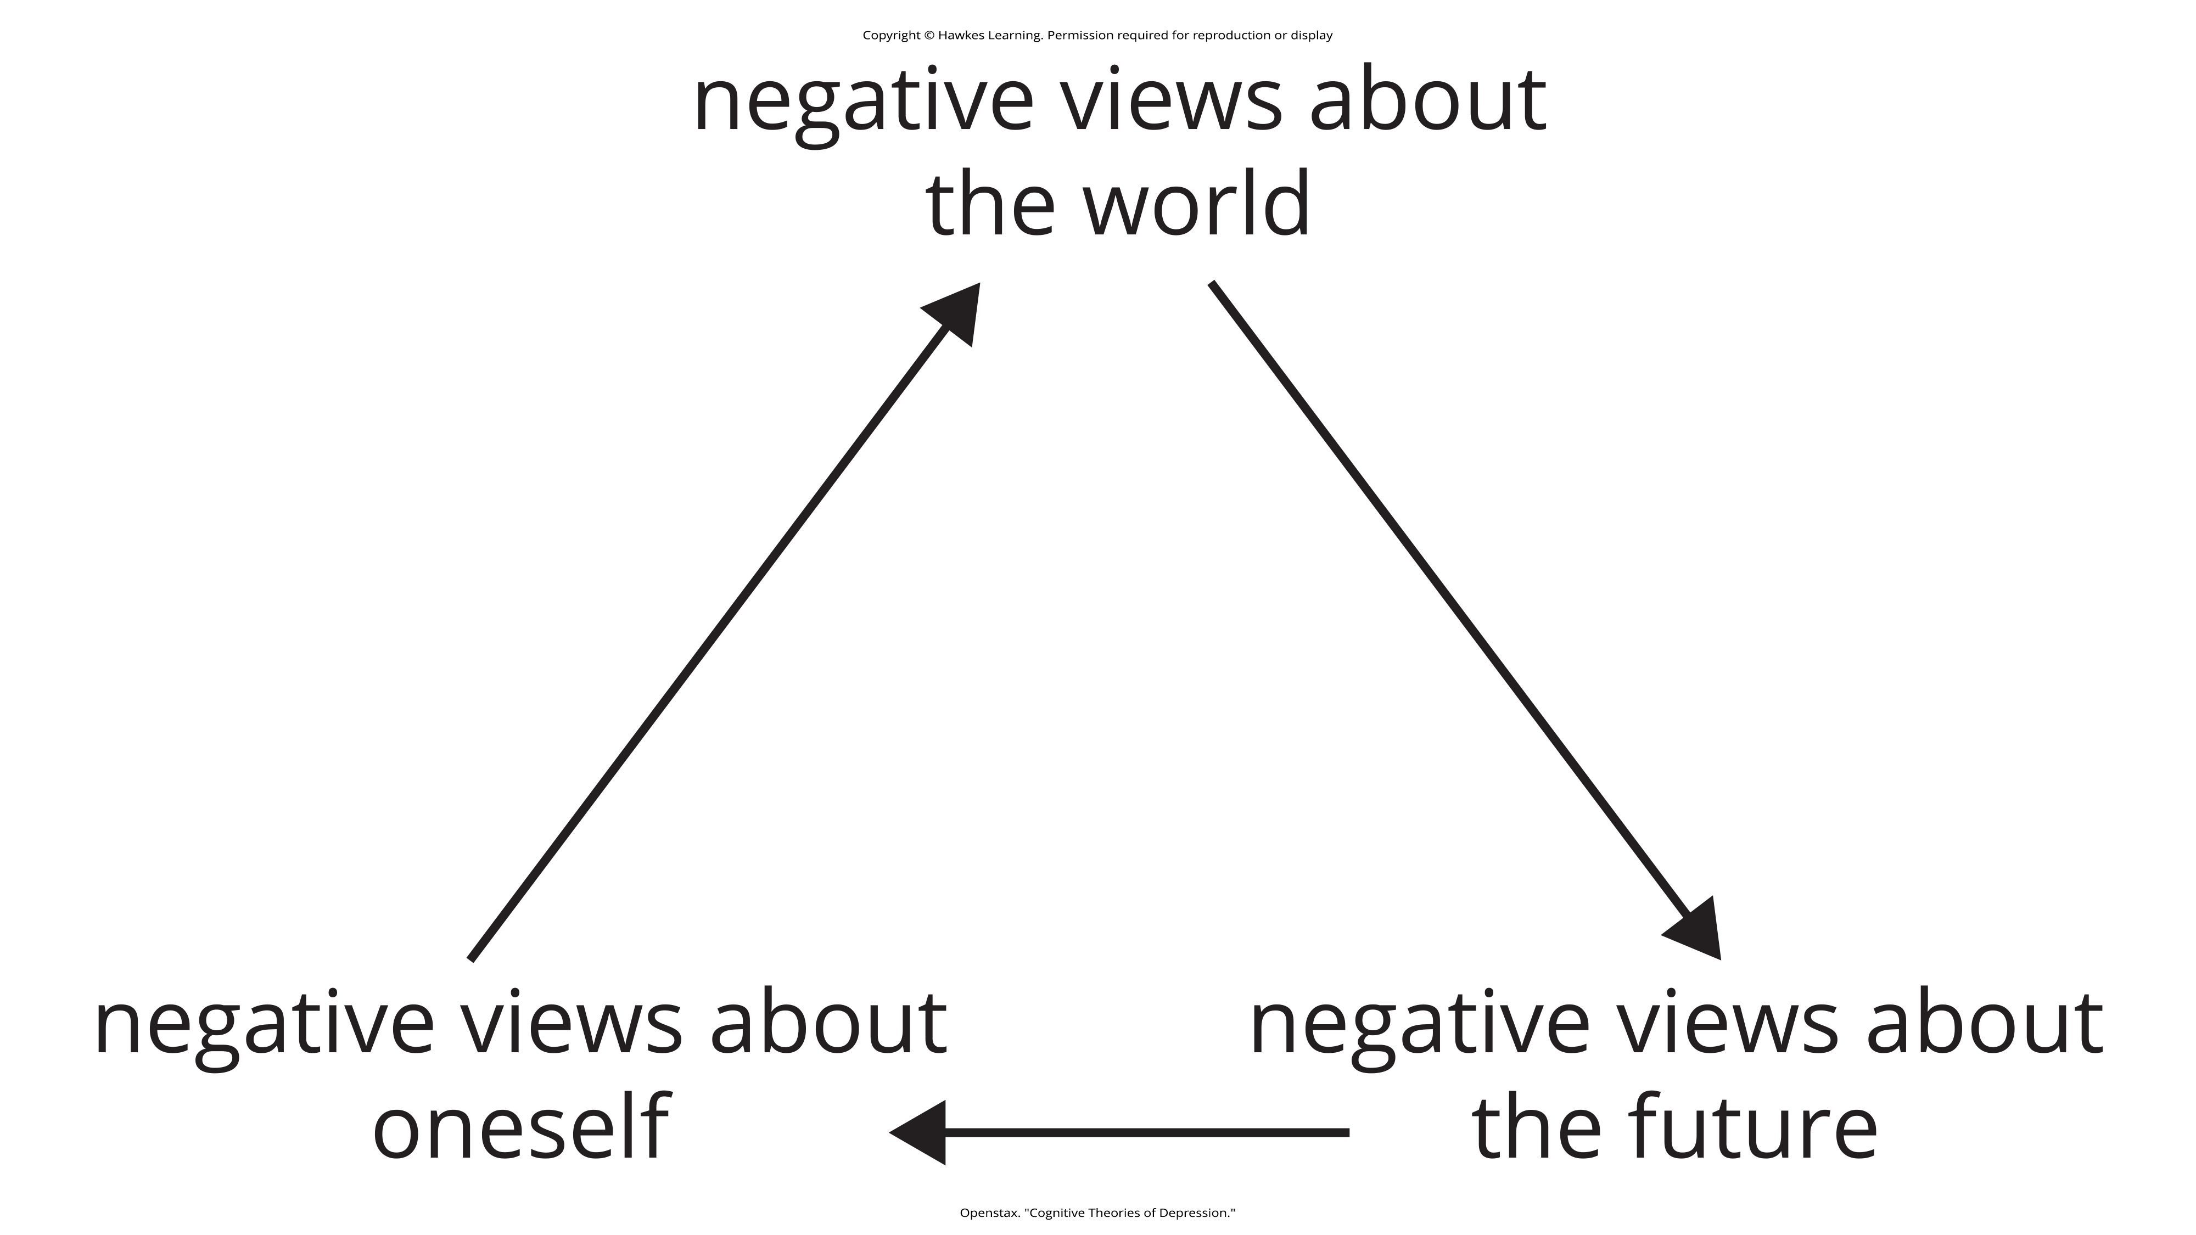
Lesson 15.5 Cognitive Theories Of Depression

Slide 40

Hopelessness Theory Of Depression₂
People who exhibit this cognitive style in response to undesirable life events will view such events as having negative implications for their future and self-worth.
These feelings will increase the likelihood of hopelessness—the primary cause of depression.
One study testing hopelessness theory measured the tendency to make negative inferences for bad life effects in participants who were experiencing uncontrollable stressors.
  Over 6 months, those with scores reflecting high cognitive vulnerability were 7 times more likely to develop depression compared to those with lower scores (Kleim et al., 2011).
Figure 8

Slide 41

Rumination And Depression
Rumination is the repetitive and passive focus on the fact that one is depressed and dwelling on depressed symptoms.
The tendency to ruminate is associated with increases in depression symptoms, a heightened risk of major depressive episodes, and chronicity of such episodes.
Figure 9

Slide 42
Suicide
Suicide is defined by the National Institute of Mental Health as "death caused by self-directed injurious behavior with intent to die as the result of the behavior" (2022).
Suicide is not listed as a disorder in the DSM-5-TR.
Suffering from a mental disorder poses the greatest risk for suicide.
It is estimated that 90% of those who have completed suicides have at least one mental health disorder, which mood disorders being more frequent.

Slide 43

Some Facts About Suicide
Suicide was the ninth leading cause of death for individuals 10 to 64 years of age in 2020 and was the second leading cause of death for children ages 10 to 14 and adults ages 25 to 34 (CDC, 2023).
There were 48,183 suicides in 2021 in the United States (CDC, 2023).
12.3 million Americans thought seriously about suicide, 3.5 million Americans planned a suicide attempt, and 1.7 million attempted suicide (CDC, 2023).
The highest rates of suicide within the United States are among American Indians/Alaskan natives and non-Hispanic Whites (CDC, 2023).
Figure 10

Slide 44
Reflection Question₄
Why do you think individuals of some races are more likely to commit suicide than others?

Slide 45
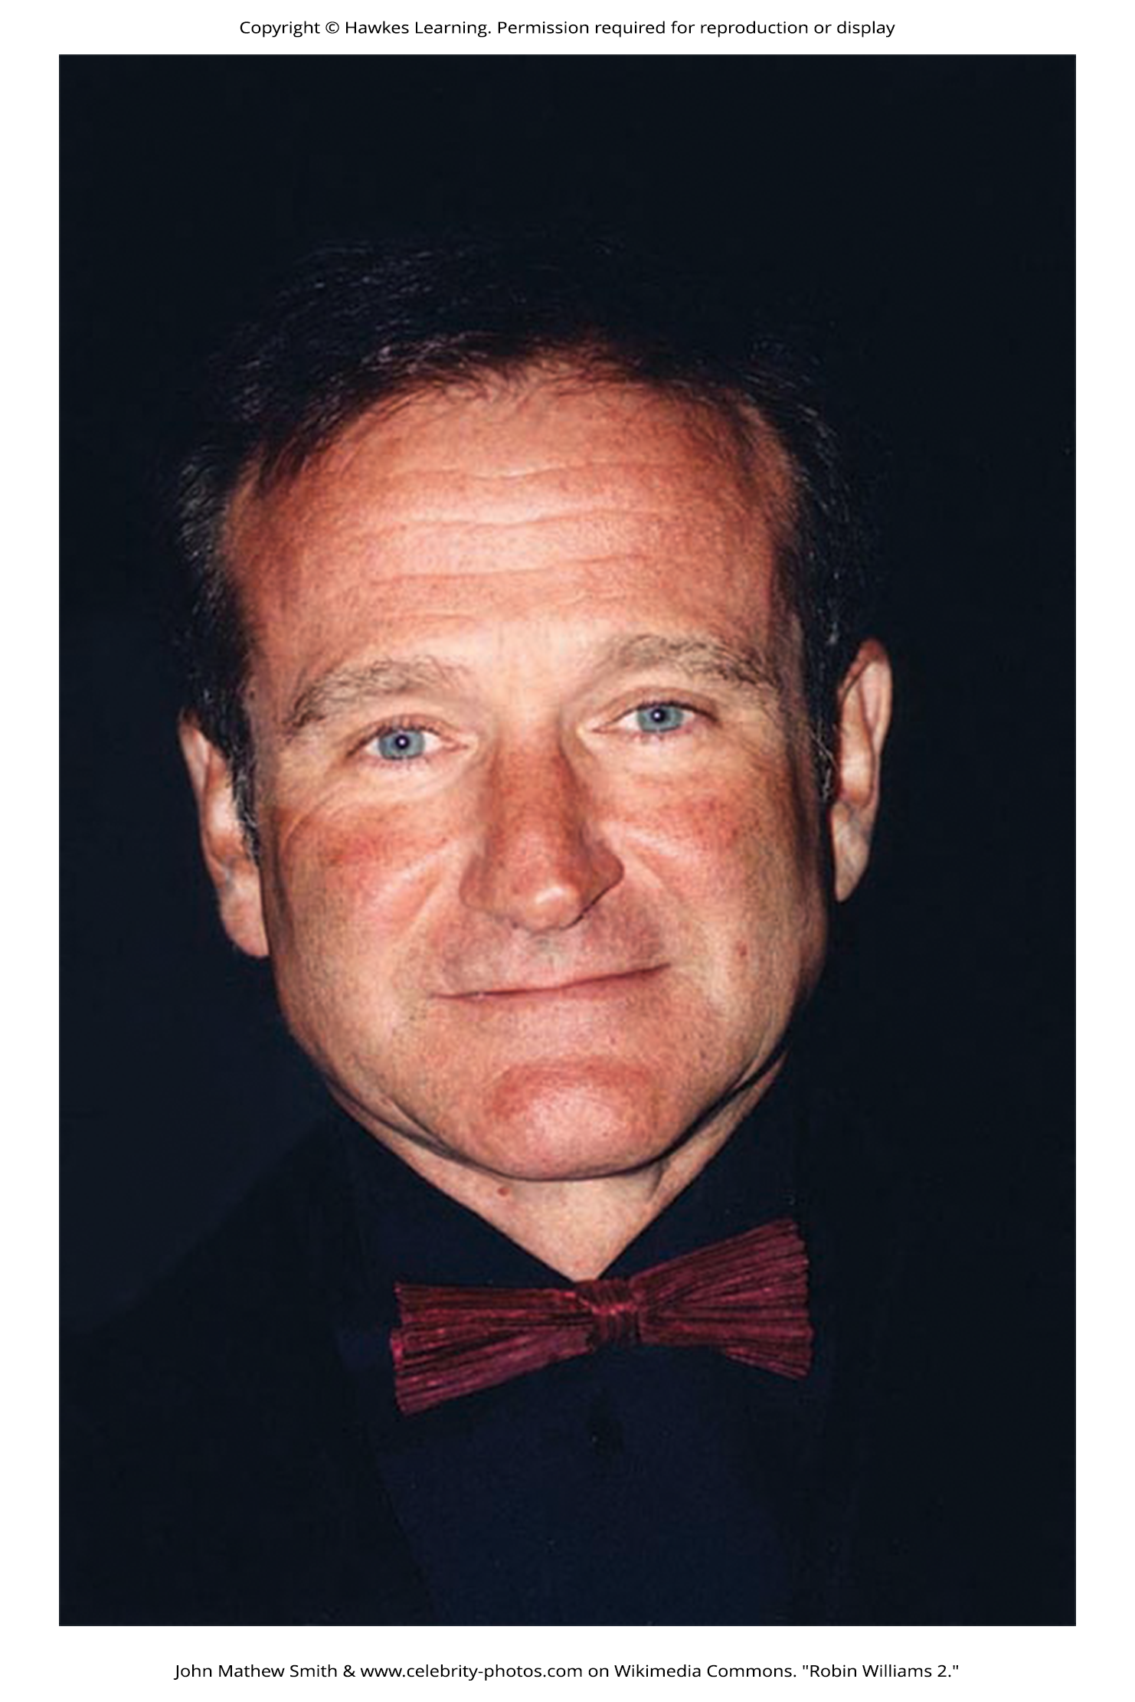
Risk Factors For Suicide
Risk factors for suicide include:
  Substance use problems, such as alcohol and opiates
  History of depression or feelings of hopelessness
  Increased feelings of depression and loneliness
  Withdrawal from social relationships, feeling like a burden to others, and risk-taking behavior
  Feeling trapped or unable to escape one's misery
  Being a victim of bullying or cyberbullying
  A family member has previously committed suicide
Figure 11

Slide 46
Copycat Suicides
Widely publicized suicides tend to trigger copycat suicides in some people.
A review of 42 studies concluded that media coverage of celebrity suicides is more than 14 times more likely to trigger copycat suicides than noncelebrity suicides (Stack, 2000).

Slide 47
Reflection Question₅
Why do you think there is a relationship between media coverage of suicides and suicide rates? Do you think it is a coincidence? Why or why not?

Slide 48

Suicide And Brain Chemistry
Low levels of serotonin predict future suicide attempts and suicide completions, and low levels have been observed post-mortem among suicide victims (Mann, 2003).
Low levels of serotonin have also been linked to aggression and impulsivity (Stanley et al., 2000).
Patients with major depressive disorder who had low levels of serotonin attempted suicide more frequently and more violently than did patients with higher levels (Asberg et al., 1976; Mann, 2003).
Figure 12

Slide 49
Reflection Question₆
What do you think are the most important factors that lead someone who is depressed to consider suicide?
What are some things we can do to support someone who may be experiencing those factors?

Slide 50
Summary₁
Mood disorders, including depressive and bipolar and related disorders, are those in which the person experiences severe disturbances in mood and emotion.
Depressive disorders include major depressive disorder, which is characterized by episodes of profound sadness and loss of interest or pleasure in usual activities and other associated features, and persistent depressive disorder, which is marked by a chronic state of sadness.
Bipolar disorder is characterized by mood states that vacillate between sadness and euphoria.

Slide 51
Summary₂
Mood disorders appear to have a genetic component, with genetic factors playing a more prominent role in bipolar disorder than in depression.
Both biological and psychological factors are important in the development of depression.
People who suffer from mental health problems, especially mood disorders, are at heightened risk for suicide.

Slide 52
End of Hawkes Learning PowerPoint

