Slide 1
Lesson 15.6
Schizophrenia

Slide 2
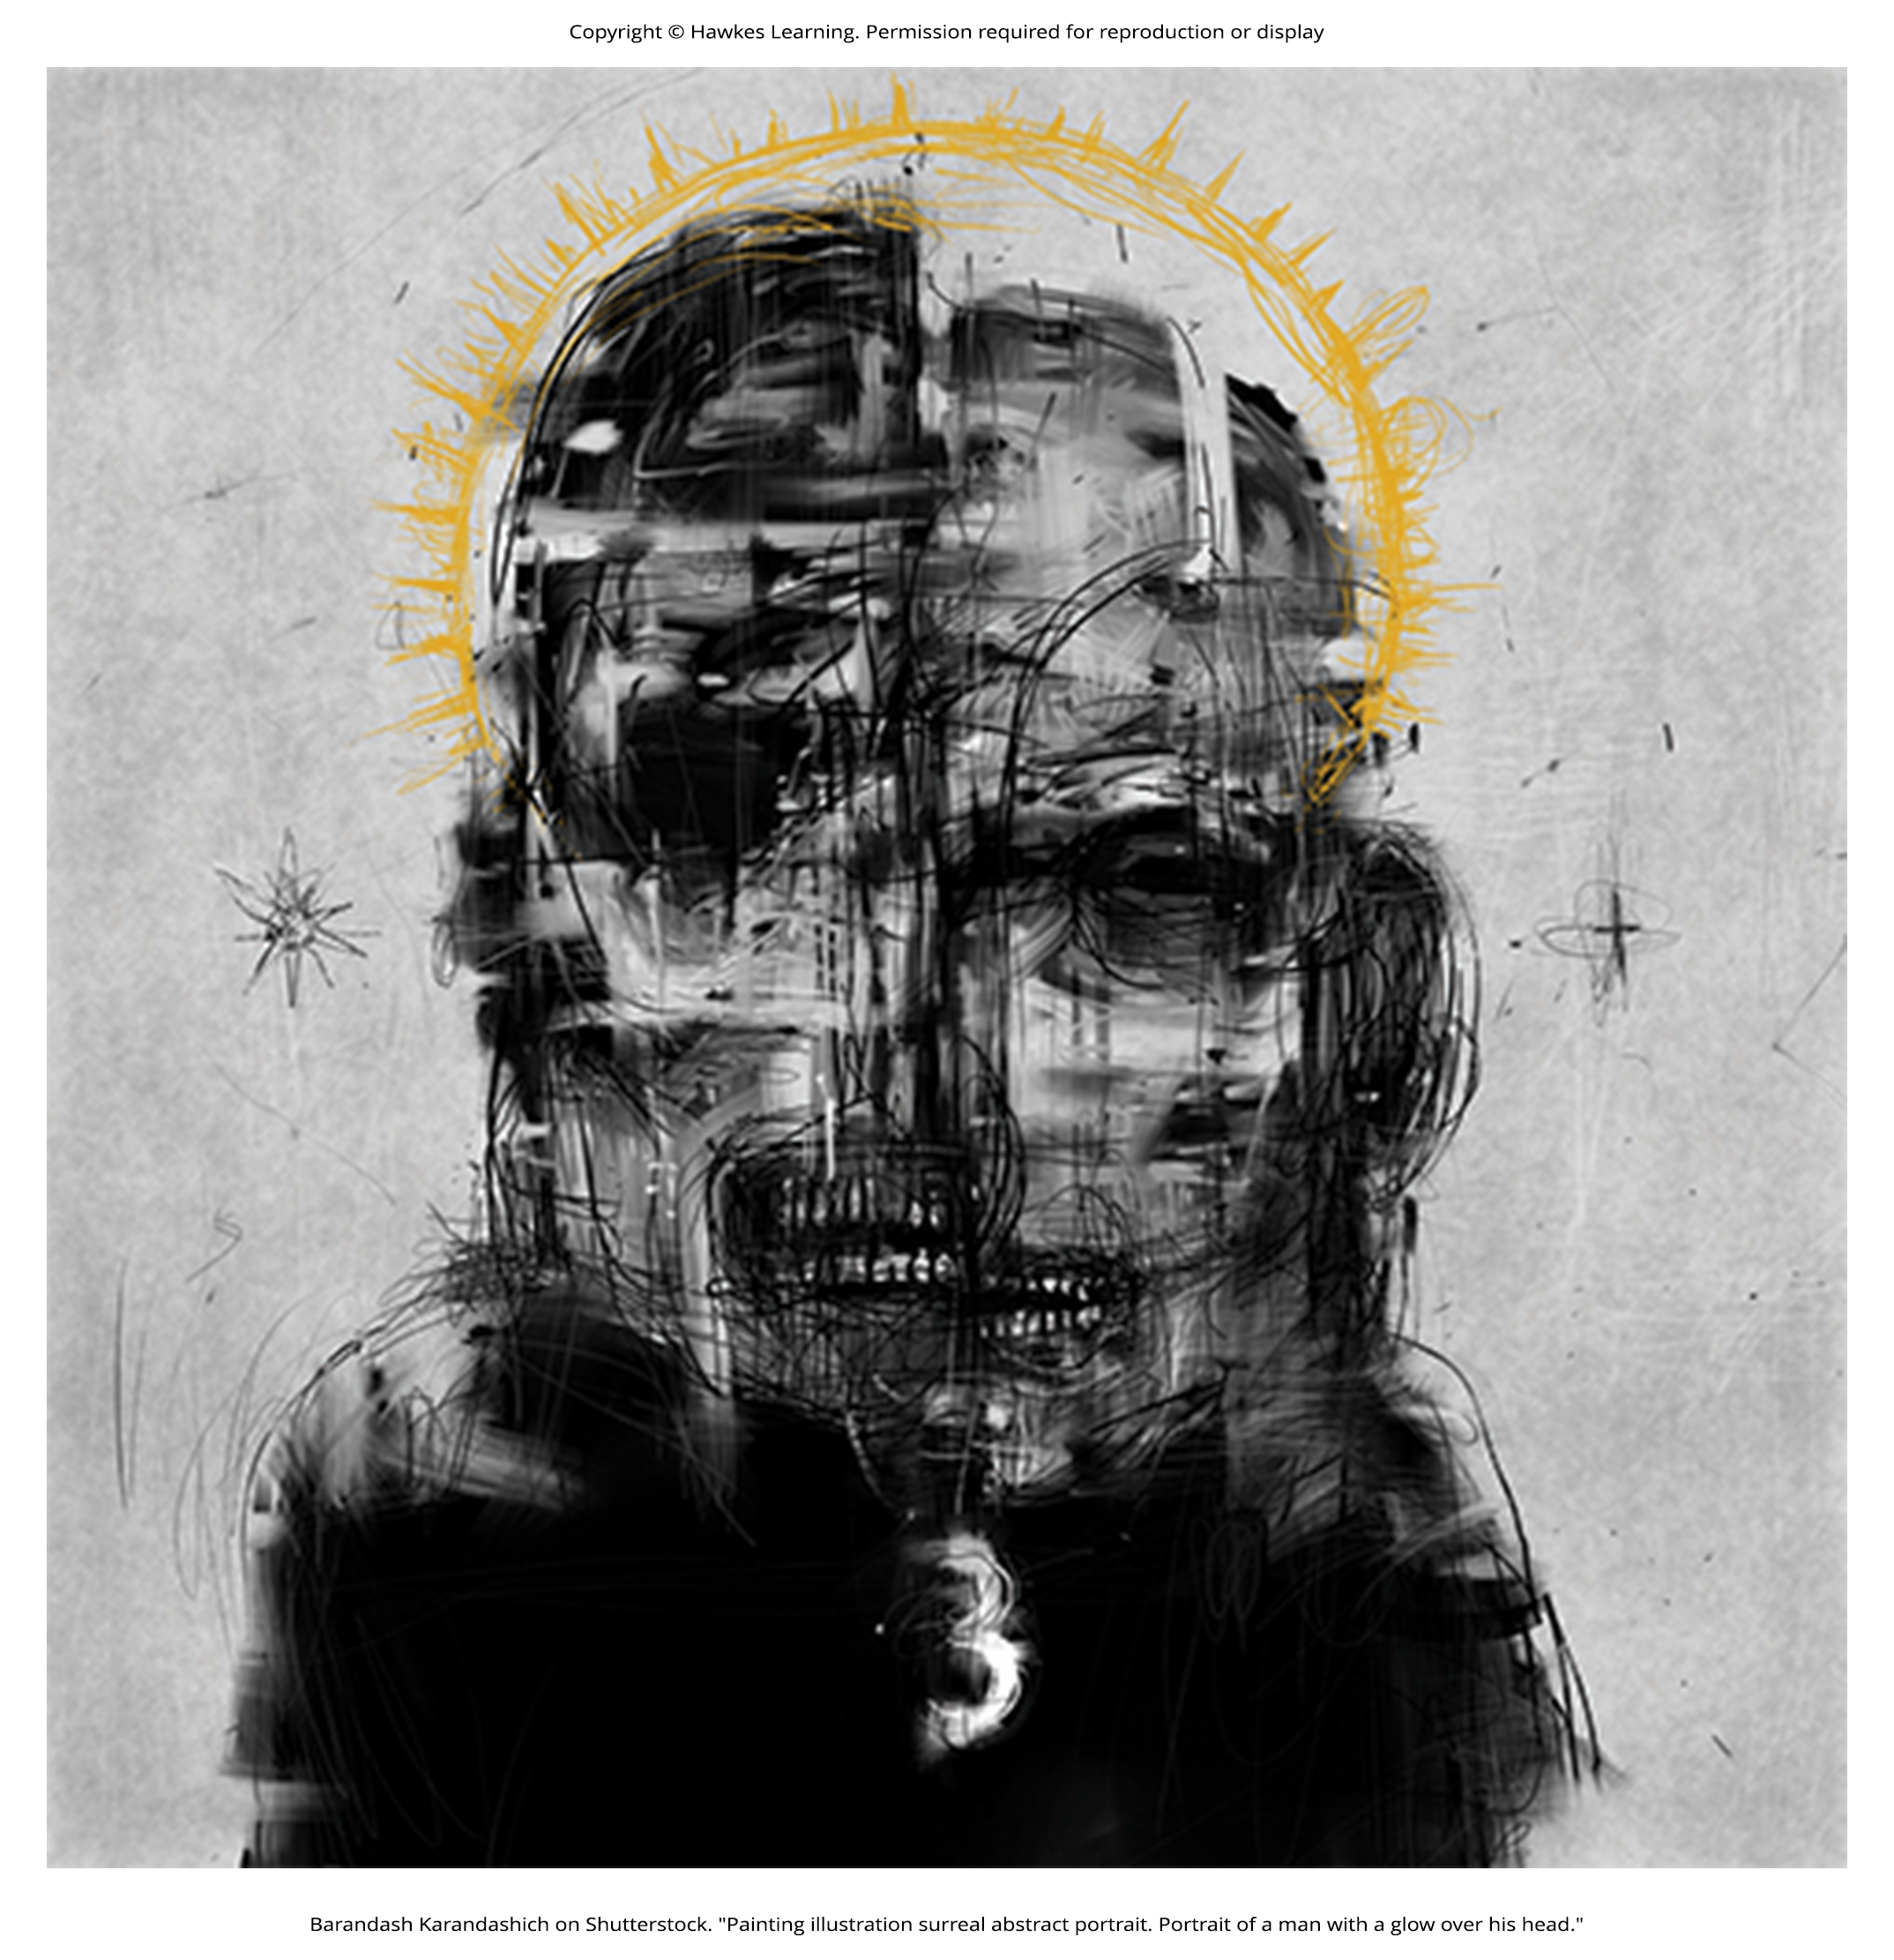
Defining Schizophrenia
Schizophrenia is a devastating psychological disorder that is characterized by major disturbances in thought, perception, emotion, and behavior (APA, 2022).
Schizophrenia is often confused with dissociative identity disorder which involves multiple personalities.
Figure 1

Slide 3
About Schizophrenia
About 1% of the population experiences schizophrenia in their lifetime.
The disorder is usually diagnosed in early adulthood.
Those with schizophrenia experience significant difficulties in day-to-day activities, such as holding a job, paying bills, and maintaining relationships.
Schizophrenia is a psychotic disorder in which the person's thoughts, perceptions, and behaviors are impaired to the point where they are not able to function normally in life.

Slide 4
Symptoms Of Schizophrenia
The main symptoms of schizophrenia include hallucinations, delusions, disorganized thinking, disorganized or abnormal motor behavior, and negative symptoms.
A hallucination is a perceptual experience that occurs in the absence of external stimulation.
  Auditory hallucinations are most common.
  Individuals may have visual or olfactory hallucinations.

Slide 5
Symptoms Of Schizophrenia: Delusions₁
Delusions are beliefs that are contrary to reality and are firmly held even in the face of contradictory evidence.
Paranoid delusions involve false beliefs that other people or agencies are plotting to harm the person.
  Example: A person with schizophrenia may believe that their mother is plotting with the FBI to poison their coffee, or that their neighbor is an enemy spy who wants to kill them.

Slide 6
Symptoms Of Schizophrenia: Delusions₂
Grandiose delusions involve false beliefs that one holds special power, unique knowledge, or is extremely important.
  Example: Someone who claims to be Jesus Christ who is not, or who claims to have specific knowledge going back 5,000 years, or who claims to be the great philosopher Socrates is most likely experiencing grandiose delusions.

Slide 7

Symptoms of Schizophrenia: Delusions₃
Other delusions include the belief that one's thoughts are being removed (thought withdrawal) or being placed inside one's head (thought insertion).
Somatic delusion is the belief that something highly abnormal is happening to one's body.
  Example: A person might believe their kidneys are being eaten by cockroaches.
Figure 2

Slide 8
Symptoms Of Schizophrenia: Disorganized Thinking₁
Disorganized thinking refers to disjointed and incoherent thought processes—usually detected by what a person says.
The person might ramble, exhibit loose associations (jump from topic to topic), or talk in a way that is so disorganized and incomprehensible that it seems as though the person is randomly combining words.
Disorganized thinking is also exhibited by blatantly illogical remarks.
  Example: "Fenway Park is in Boston. I live in Boston. Therefore, I live at Fenway Park."

Slide 9

Symptoms Of Schizophrenia: Disorganized Thinking₂
The person may also demonstrate tangentiality: responding to others' statements or questions by remarks that are either barely related or unrelated to what was said or asked.
  Example: If a person diagnosed with schizophrenia is asked if they are interested in receiving special job training, they might state that they once rode on a train somewhere.
Figure 3

Slide 10
Symptoms Of Schizophrenia: Disorganized Motor Behavior₁
Disorganized or abnormal motor behavior refers to unusual behaviors and movements.
These behaviors may include becoming unusually active, exhibiting silly child-like behaviors, engaging in repeated and purposeless movements, or displaying odd facial expressions and gestures.

Slide 11
Symptoms Of Schizophrenia: Disorganized Motor Behavior₂
The person might exhibit catatonic behaviors, which show decreased reactivity to the environment.
  Example: A person may engage in posturing where they maintain a rigid and bizarre posture for long periods of time.
  Example: A person might display catatonic stupor which is a complete lack of movement and verbal behavior.

Slide 12
Symptoms of Schizophrenia: Negative Symptoms
Negative symptoms are those that reflect noticeable decreases and absences in certain behaviors, emotions, or drives (Green, 2001).
  Example: A person shows no emotion in their facial expressions, speech, or movements, even when such expressions are normal or expected.
Some may experience avolition or a lack of motivation to engage in self-initiated meaningful activity.
Others may experience asociality, which is social withdrawal and lack of interest in engaging with others.
A final negative symptom, anhedonia, refers to an inability to experience pleasure.

Slide 13
On Your Own
Imagine you are a clinical psychologist who was referred a patient whose mother thinks he may have schizophrenia. Write five questions you would ask the mother about her son's behavior and indicate why you would ask that question.

Slide 14

Causes of Schizophrenia: Genetics
The risk of developing schizophrenia is nearly 6 times greater if one has a parent with schizophrenia than if one does not (Goldstein et al., 2010).
One's risk of developing schizophrenia increases as genetic relatedness to family members diagnosed with schizophrenia increases (Gottesman, 2001).
Adoption studies have consistently reported that for adoptees who are later diagnosed with schizophrenia, their biological relatives have a higher risk of schizophrenia than do adoptive relatives (Shih et al., 2004).
Figure 4

Slide 15
Causes Of Schizophrenia: Diathesis-Stress₁
Schizophrenia likely arises from a combination of genetic and environmental factors.
In a study, adoptees whose mothers had schizophrenia (high genetic risk) and who had been raised in a disturbed family environment were much more likely to develop schizophrenia or another psychotic disorder (36.8%) than were adoptees whose biological mothers had schizophrenia but who had been raised in a healthy environment (5.8%).

Slide 16
Causes Of Schizophrenia: Diathesis-Stress₂
Adoptees who were at high genetic risk were likely to develop schizophrenia only if they were raised in a disturbed home environment.
This study supports a diathesis-stress interpretation of schizophrenia—both genetic vulnerability and environmental stress are necessary for schizophrenia to develop.

Slide 17
Causes Of Schizophrenia: Neurotransmitters₁
Drugs that increase dopamine levels can produce schizophrenia-like symptoms, and medications that block dopamine activity reduce the symptoms (Howes & Kapur, 2009).
The dopamine hypothesis proposed that an overabundance of dopamine or too many dopamine receptors are responsible for the onset and maintenance of schizophrenia (Snyder, 1976).

Slide 18
Causes of Schizophrenia: Neurotransmitters₂
Overabundance of dopamine in the limbic system may be responsible for hallucinations and delusions.
Low levels of dopamine in the prefrontal cortex may be responsible for the negative symptoms.

Slide 19
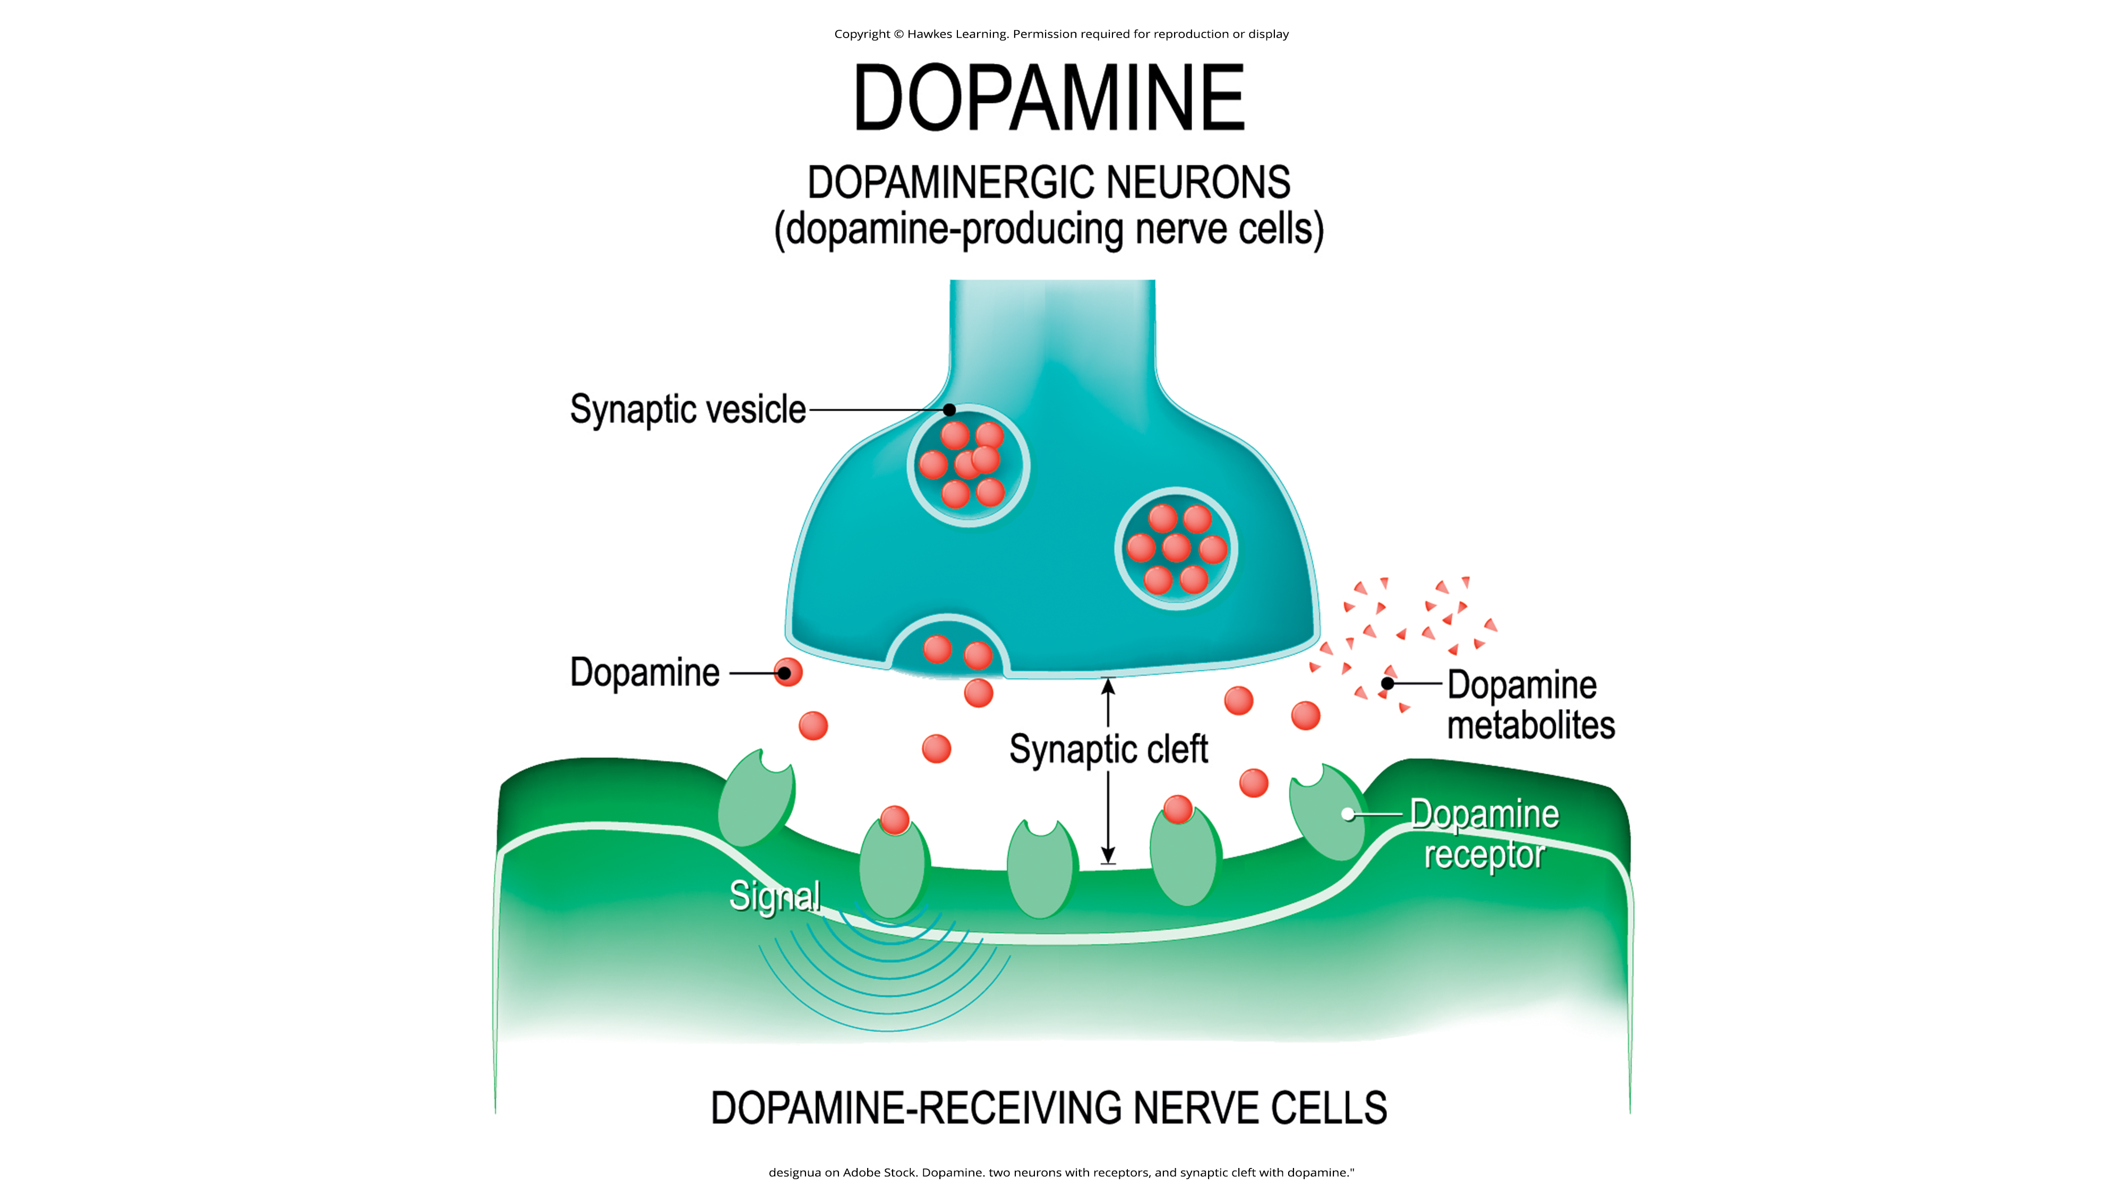
Lesson 15.6 Figure 5
Caption: An overabundance of dopamine is a possible factor that influences schizophrenia onset and maintenance.

Slide 20
Causes Of Schizophrenia: Brain Anatomy₁
Brain imaging studies reveal that people with schizophrenia have enlarged ventricles, the cavities within the brain that contain cerebral spinal fluid (Green, 2001).
This enlargement suggests various brain regions are reduced in size, which can be associated with a loss in brain tissue.
Many people with schizophrenia display a reduction in gray matter (cell bodies of neurons) in the frontal lobes (Lawrie & Abukmeil, 1998).

Slide 21
Causes Of Schizophrenia: Brain Anatomy₂
Many with schizophrenia show less frontal lobe activity when performing cognitive tasks (Buchsbaum et al., 1990).
The frontal lobes are important in a variety of complex cognitive functions, such as planning and executing behavior, attention, speech, movement, and problem solving.

Slide 22
Causes Of Schizophrenia: Prenatal Events
High rates of obstetric complications in the births of children who later developed schizophrenia have been reported (Amoretti, 2022).
People are at an increased risk for developing schizophrenia if their mother was exposed to influenza during the first trimester of pregnancy (Brown et al., 2004).
A mother's emotional stress during pregnancy may increase the risk of schizophrenia in offspring.

Slide 23
Reflection Question₁
Based on what you know about pregnancy and schizophrenia, what can mothers do to reduce their child's risk of developing schizophrenia?

Slide 24

Causes Of Schizophrenia: Marijuana
There is a substantially increased risk of schizophrenia and other psychotic disorders in people who had used marijuana, with the greatest risk in the most frequent users (Moore et al., 2007).
Researchers have hypothesized that early marijuana use may disrupt normal brain development during important early maturation periods in adolescence (Trezza et al., 2008).
Figure 6

Slide 25
Reflection Question₂
Do you think the link between marijuana use and schizophrenia should be considered by legislators who are considering legalizing marijuana? Why or why not?

Slide 26
Early Warning Signs
Individuals may show prodromal symptoms, such as unusual thought content, paranoia, odd communication, delusions, problems at school or work, or a decline in social functioning.
Individuals are more likely to develop a psychotic disorder if there is genetic risk, recent deterioration in functioning, high levels of unusual thought content, high levels of suspicion or paranoia, poor social functioning, and a history of substance abuse (Fusar-Poli et al., 2013).

Slide 27
Summary₁
Schizophrenia is a severe disorder characterized by a complete breakdown in one's ability to function in life.
People with schizophrenia experience hallucinations and delusions, and they have extreme difficulty regulating their emotions and behavior.
Thinking is incoherent and disorganized, behavior is bizarre, emotions are flat, and motivation to engage in most basic life activities is lacking.

Slide 28
Summary₂
Schizophrenia is influenced by both genetic and environmental factors.
Neurotransmitter and brain abnormalities, which may be linked to environmental factors such as obstetric complications or exposure to influenza during the gestational period, have also been implicated.

Slide 29
End of Hawkes Learning PowerPoint

