Slide 1
Lesson 15.7
Dissociative Disorders

Slide 2
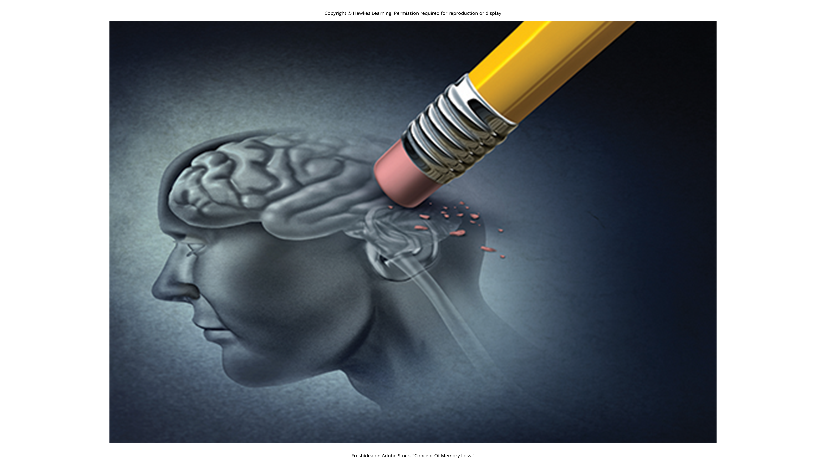
Dissociative Disorders
Dissociative disorders are characterized by an individual's memory or identity becoming disturbed.
The DSM-5-TR lists dissociative amnesia, depersonalization/derealization disorder, and dissociative identity disorder.
Figure 1

Slide 3
Dissociative Amnesia
Dissociative amnesia is a symptom of dissociative disorders where an individual is unable to recall important personal information.
This experience usually occurs after an extremely stressful or traumatic event or after being a victim of violence.
Dissociative fugue is when an individual wanders away from their home due to confusion about their identity.
Most fugue episodes last only a few hours or days, but some can last longer.

Slide 4
Reflection Question
Why do you think people have dissociative amnesia?

Slide 5
Depersonalization Disorder
Depersonalization/derealization disorder is characterized by recurring episodes of depersonalization, derealization, or both.
Depersonalization involves experiences outside of reality, feelings of detachment, or feeling as if you are observing yourself from the outside.
A person feels as if their thoughts or feelings are not their own.
A person feels robotic as if they lack control over their body.

Slide 6
Derealization Disorder
Derealization involves experiences outside of reality or feelings of detachment to the surroundings or environment.
A person feels they are in a dream and the surrounding world is not real.

Slide 7
Dissociative Identity Disorder
Dissociative identity disorder involves having two or more separate personalities or identities, each well-defined and distinct from one another.
Individuals experience memory gaps for the times in which the other personality is in charge.
A person finds unfamiliar items among their possessions.

Slide 8
Controversy over Dissociative Identity Disorder₁
Dissociative identity disorder is a highly controversial diagnosis because of its portrayal in the media.
Example: Kenneth Bianchi, a serial killer, pled not guilty due to insanity, claiming he had a different personality that committed the murders.
He was shown to be faking the disorder.

Slide 9
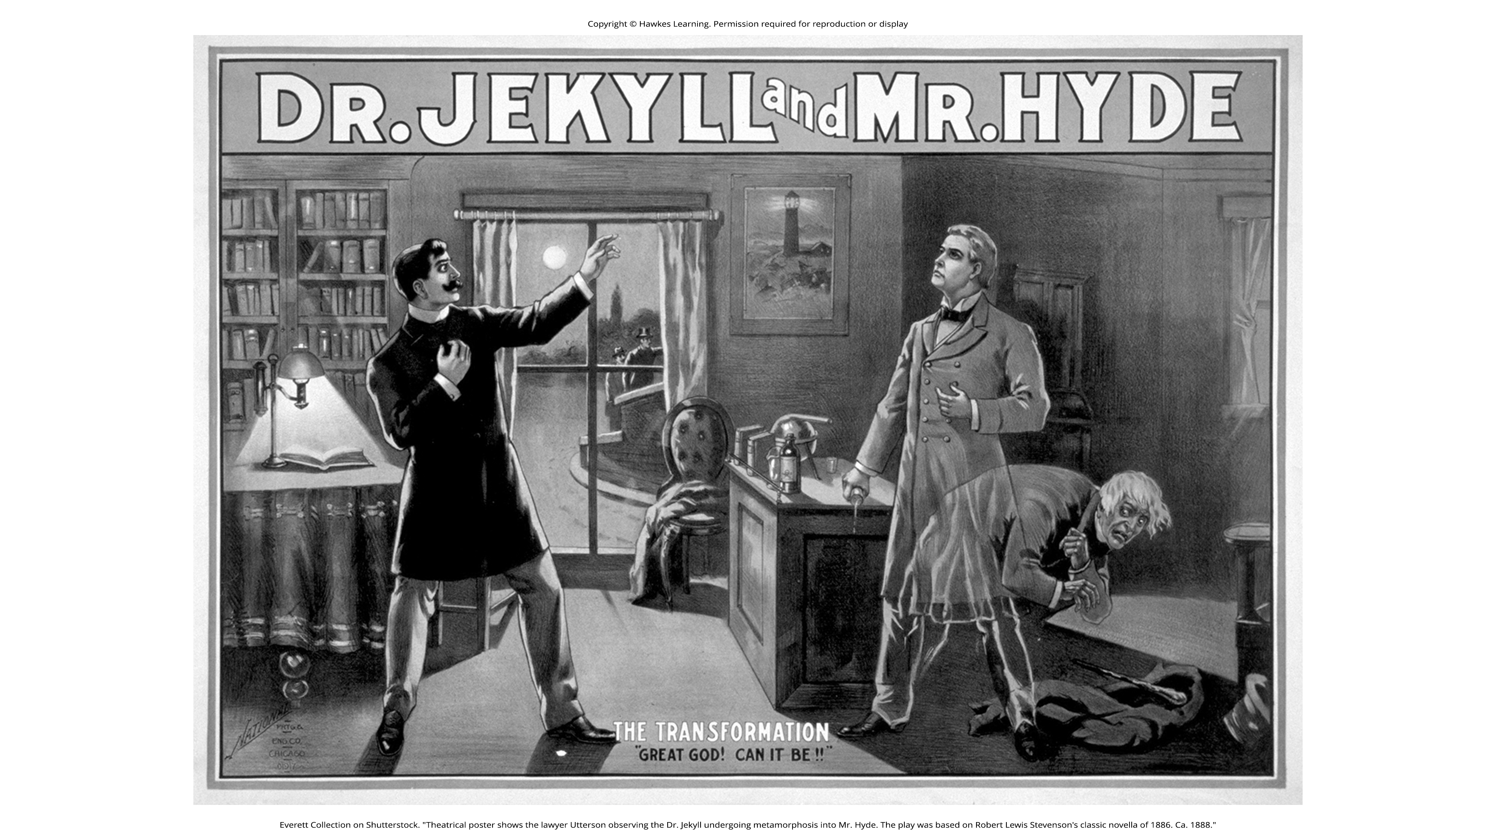
Controversy over Dissociative Identity Disorder₂
Example: The movie and book Sybil, portraying a woman with 16 different personalities, may have prompted a clinician's increase of diagnoses for the disorder.
Despite controversy, dissociative identity disorder is accepted as a legitimate disorder.
Figure 2

Slide 10
Summary₁
The main characteristic of dissociative disorders is that people become dissociated from their sense of self, resulting in memory and identity disturbances.
The DSM-5-TR includes dissociative amnesia, depersonalization/derealization disorder, and dissociative identity disorder.
A person with dissociative amnesia is unable to recall important personal information, often after a stressful or traumatic experience.

Slide 11
Summary₂
Depersonalization/derealization disorder is characterized by recurring episodes of depersonalization (i.e., detachment from the self) and/or derealization (i.e., detachment from the world).
A person with dissociative identity disorder exhibits two or more well-defined and distinct personalities or identities, as well as memory gaps for the times during which another identity was present.

Slide 12
End of Hawkes Learning PowerPoint

