Slide 1
Lesson 15.8
Personality Disorders

Slide 2
Personality Disorders
Personality refers loosely to one's stable, consistent, and distinctive way of thinking about, feeling, acting, and relating to the world.
A person with a personality disorder has a personality style that differs from cultural expectations, is pervasive and inflexible, begins in adolescence or early adulthood, and causes distress or impairment.
Personality disorders occur in about 10 to 13% of the population worldwide; roughly 9% of Americans suffer from a personality disorder (The Recovery Village, 2022).

Slide 3
Impacts Of Personality Disorder
Personality styles are extremely troubling and often create problems for the person or those around them.
Maladaptive personality styles frequently bring the person into conflict with others and disrupts their ability to develop and maintain social relationships.
These disorders may also prevent the person from accomplishing realistic life goals.

Slide 4
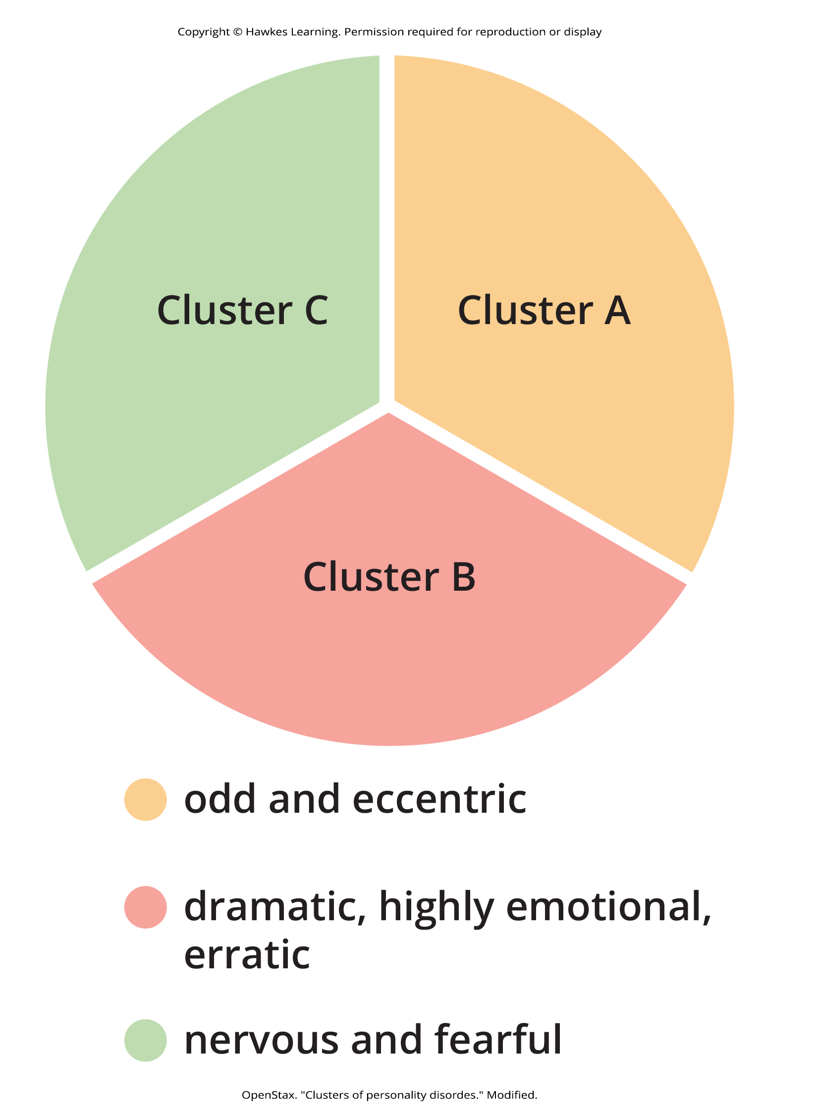
Clusters Of Personality Disorders
The DSM-5-TR recognizes 10 personality disorders that are organized into three different clusters.
Cluster A includes odd and eccentric personality styles.
Cluster B includes impulsive, dramatic, emotional, and erratic personality styles.
Cluster C includes nervous and fearful personality styles.
Figure 1

Slide 5
Cluster A: Paranoid Personality Disorder
Characteristics of paranoid personality disorder:
Harbors a pervasive and unjustifiable suspiciousness and mistrust of others
Reluctant to confide in or become close to others
Reads hidden demeaning or threatening meaning into benign remarks or events
Takes offense easily and bears grudges
Not due to schizophrenia or other psychotic disorders

Slide 6
Cluster A: Schizoid Personality Disorder
Characteristics of schizoid personality disorder:
Lacks interest and desire to form relationships with others
Aloof and shows emotional coldness and detachment
Indifferent to approval or criticism of others
Lacks close friends or confidants
Not due to schizophrenia or other psychotic disorders, not an autism spectrum disorder

Slide 7
Cluster A: Schizotypal Personality Disorder
Characteristics of schizotypal personality disorder:
Exhibits eccentricities in thought, perception, emotion, speech, and behavior
Shows suspiciousness or paranoia
has unusual perceptual experiences
Speech is often idiosyncratic
Displays inappropriate emotions
Lacks friends or confidants
Not due to schizophrenia or other psychotic disorder, or to autism spectrum disorder

Slide 8
Cluster B: Antisocial Personality Disorder
Characteristics of antisocial personality disorder:
Continuously violates the rights of others
History of antisocial tendencies prior to age 15
Often lies, fights, and has problems with the law
Impulsive and fails to think ahead
Can be deceitful and manipulative
Irresponsible and often fails to hold down a job or pay financial debts
Lacks feelings for others and remorse over misdeeds

Slide 9
Cluster B: Histrionic Personality Disorder
Characteristics of histrionic personality disorder:
Excessively overdramatic, emotional, and theatrical
Feels uncomfortable when not the center of attention
Behavior is often inappropriately seductive
Speech is highly emotional but vague and diffuse
Emotions are shallow and often shift rapidly
May alienate friends with demands for constant attention

Slide 10
Cluster B: Narcissistic Personality Disorder
Characteristics of narcissistic personality disorder:
Overinflated and unjustified sense of self-importance and preoccupied with fantasies of success
Believes they are entitled to special treatment from others
Shows arrogant attitudes and behaviors
Takes advantage of others
Lacks empathy

Slide 11
Cluster B: Borderline Personality Disorder
Characteristics of borderline personality disorder:
Unstable in self-image, mood, and behavior
Cannot tolerate being alone and experiences chronic feelings of emptiness
Unstable and intense relationships with others
Behavior is impulsive, unpredictable, and sometimes self-damaging
Shows inappropriate and intense anger
Makes suicidal gestures

Slide 12
Cluster C: Avoidant Personality Disorder
Characteristics of avoidant personality disorder:
Socially inhibited and oversensitive to negative evaluation
Avoids occupations that involve interpersonal contact because of fears of criticism or rejection
Avoids relationships with others unless guaranteed to be accepted unconditionally
Feels inadequate and views self as socially inept
Unwilling to take risks or engage in new activities if they may prove embarrassing

Slide 13
Cluster C: Dependent Personality Disorder
Characteristics of dependent personality disorder:
Allows others to take over and run their life
Is submissive, clingy, and fears separation
Cannot make decisions without advice and reassurance from others
Lacks self-confidence
Cannot do things on their own
Feels uncomfortable or helpless when alone

Slide 14
Cluster C: Obsessive-Compulsive Personality Disorder₁
Characteristics of obsessive-compulsive personality disorder:
Pervasive need for perfectionism that interferes with the ability to complete tasks
Preoccupied with details, rules, order, and schedules
Excessively devoted to work at the expense of leisure and friendships

Slide 15
Cluster C: Obsessive-Compulsive Personality Disorder₂
Characteristics of obsessive-compulsive personality disorder:
Rigid, inflexible, and stubborn
Insists things be done their way
Miserly with money

Slide 16
Symptoms Of Borderline Personality Disorder₁
Borderline personality disorder is characterized by:
Instability in interpersonal relationships, self-image, and mood
Marked impulsivity
Inability to be alone
Frantic efforts to avoid real or imagined abandonment

Slide 17
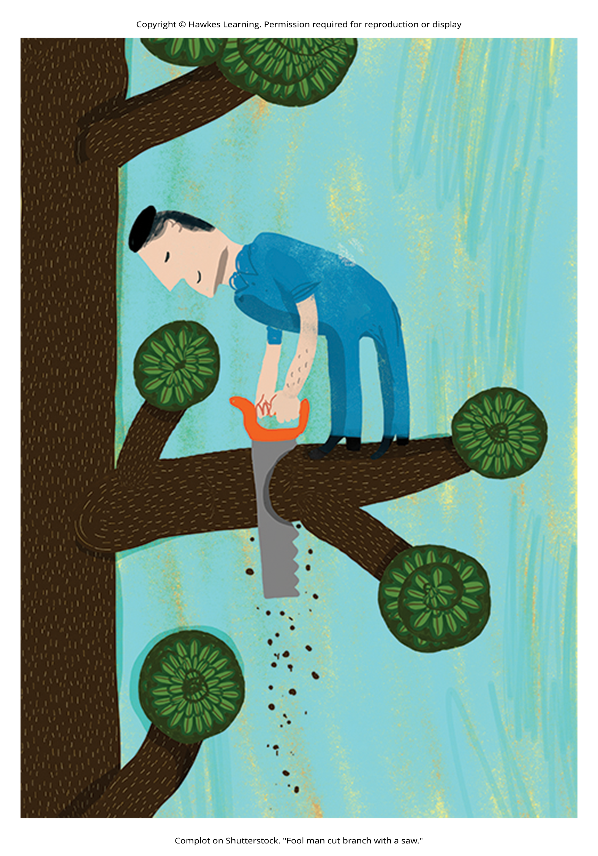
Symptoms Of Borderline Personality Disorder₂
Borderline personality disorder is characterized by:
Intense and unstable relationships
Reckless and self-destructive behaviors
Chronic feelings of emptiness
Inappropriate, intense anger
Figure 2

Slide 18
Borderline Personality Disorder
People with this disorder have an unstable view of the self and may show sudden shifts in attitudes, interests, career plans, or choice of friends.
Example: A law student who has invested a great deal of time and energy into school may consider dropping out and pursing an entirely different career path.

Slide 19
Self-Destructive Behaviors
People with borderline personality disorder may be highly impulsive and engage in reckless and self-destructive behaviors.
Example: A person with this disorder gambles excessively, spends irresponsibly, drives recklessly, uses substances, and engages in unsafe sexual practices.

Slide 20
Prevalence Of Borderline Personality Disorder
The prevalence of borderline personality disorder in the U.S. population is estimated to be around 1.6%.
Rates are higher among those who use mental health services.
Approximately 10% of mental health outpatients and 20% of psychiatric inpatients meet the criteria for diagnosis (APA, 2013).

Slide 21
Causes Of Borderline Personality Disorder₁
Core personality traits that characterize this disorder, such as impulsivity and emotional instability, have high heritability (Livesley, 2008).
Rates of borderline personality disorder among relatives of people with this disorder have been found to be as high as 24.9% (White et al., 2003).

Slide 22
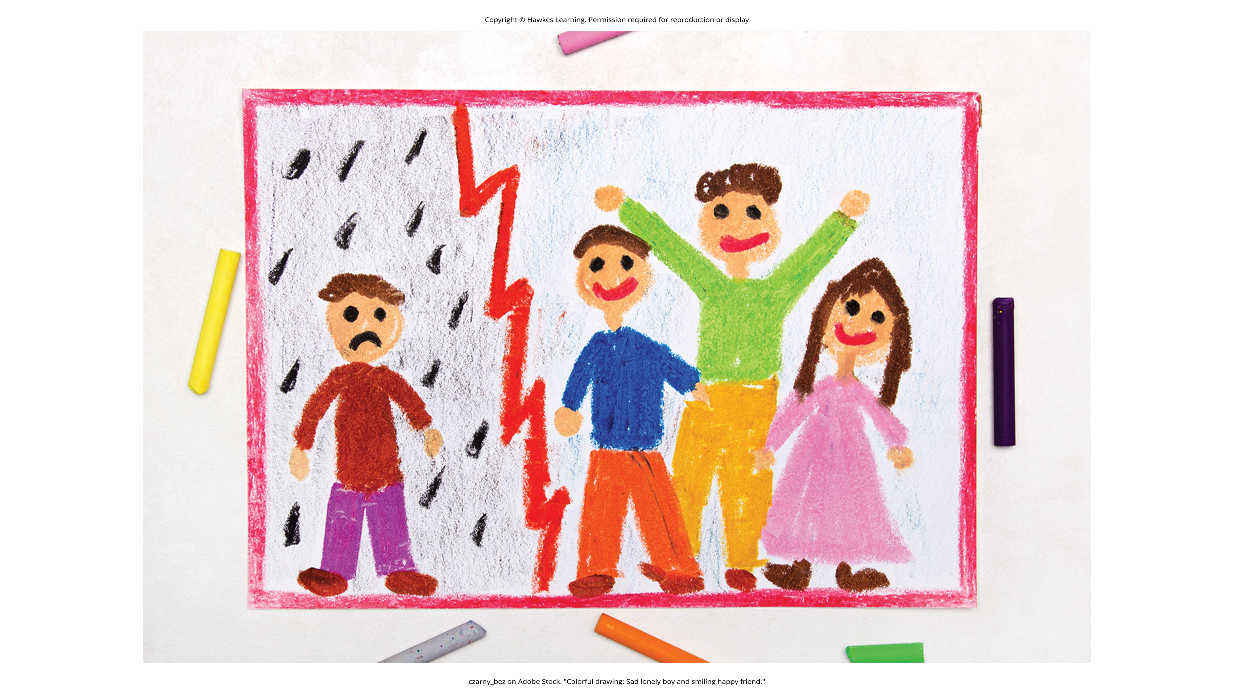
Causes Of Borderline Personality Disorder₂
Individuals with borderline personality disorder report experiencing childhood physical, sexual, and/or emotional abuse at rates far greater than those observed in the general population (Afifi et al., 2010).
Borderline personality disorder may be determined by an interaction between genetic factors and adverse environmental experiences.
Figure 3

Slide 23
Antisocial Personality Disorder
Antisocial personality disorder is exhibited in a variety of ways, including:
Having no regard for other's feelings or rights
Repeatedly performing illegal acts
Lying to or conning others
Impulsivity and recklessness
Irritability and aggressiveness toward others
Failure to act in a responsible way

Slide 24
Reflection Question₁
How would your life differ if you had antisocial personality disorder?
What rules and regulations do you follow daily that may mean less to you with this disorder?

Slide 25
Characteristics of Antisocial Personality Disorder₁
People with antisocial personality disorder seem to view the world as self-serving and unkind.
They think that they should use whatever means necessary to get by in life.
They view others not as living, thinking, feeling beings but rather as pawns to be used or abused for a specific purpose.

Slide 26
Characteristics of Antisocial Personality Disorder₂
They often have an over-inflated sense of themselves and can appear extremely arrogant.
They lack empathy and are incapable of understanding the emotional point-of-view of others.
They frequently display superficial charm.
Example: Without really meaning it, they might say exactly what they think another person wants to hear.

Slide 27
Behavioral Outcomes Of Antisocial Personality Disorder
Possible behavioral outcomes of antisocial personality disorder include:
Becoming involved in illegal enterprises
Showing cruelty to others
Leaving jobs with no plans for a new one
Having multiple sexual partners
Repeatedly getting into fights
Having a reckless regard for self and others

Slide 28
Conceptualizing Antisocial Personality Disorder₁
The disorder can be seen in three major concepts: disinhibition, boldness, and meanness (Patrick et al., 2009).
Disinhibition includes impulse control problems, lack of planning and forethought, insistence on immediate gratification, and inability to restrain behavior.

Slide 29
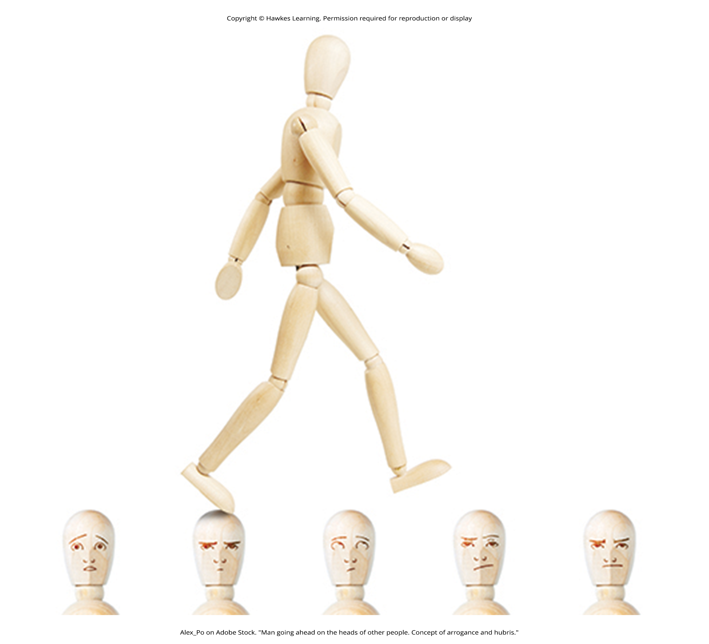
Conceptualizing Antisocial Personality Disorder₂
Boldness describes remaining calm in threatening situations, high self-assurance, a sense of dominance, and a tendency toward thrill-seeking.
Meanness is defined as "aggressive resource seeking without regard for others" and is signaled by a lack of empathy, disdain for and lack of close relationships with others, and a tendency to accomplish goals through cruelty (Patrick et al., 2009, p. 913).
Figure 4

Slide 30
Reflection Question₂
If a person with antisocial personality disorder commits a crime, do you feel the person is less responsible for the crime?

Slide 31
Prevalence Of Antisocial Personality Disorder
Antisocial personality disorder is observed in about 3.9% of the population.
The disorder is much more common among males, with a 3 to 1 ratio of men to women.
It is more likely to occur in men who are younger, widowed, separated, divorced, of lower socioeconomic status, or live in urban areas and the western United States.

Slide 32
Antisocial Behaviors In Men
Men with antisocial personality disorder are more likely than women with the disorder to:
Do things that could easily hurt themselves or others
Receive three or more traffic tickets for reckless driving
Have their driver's license suspended
Destroy others' property
Start a fire on purpose
Make money illegally
Do anything that could lead to arrest
Hit someone hard enough to injure them
Hurt an animal on purpose

Slide 33
Antisocial Behaviors In Women
Women with antisocial personality disorder are more likely than men with the disorder to:
Run away from home overnight
Frequently miss school or work
Lie frequently
Forge someone's signature
Get into a fight that comes to blows with an intimate partner
Live with others besides their family for at least 1 month
Harass, threaten, or blackmail someone

Slide 34
Causes Of Antisocial Personality Disorder
Family, twin, and adoption studies suggest that both genetic and environmental factors influence the development of antisocial personality disorder.
Example: One investigation found that adoptees of biological parents with antisocial personality disorder were more likely to exhibit adolescent and adult antisocial behaviors if they were raised in adverse adoptive family environments than if they were raised in a more stable adoptive environment (Cadoret et al., 1995).

Slide 35
The Environment And Antisocial Personality Disorder
Several studies have investigated environmental influences on the development of antisocial personality disorder.
Risk factors can be from family, peer, and community sources.

Slide 36
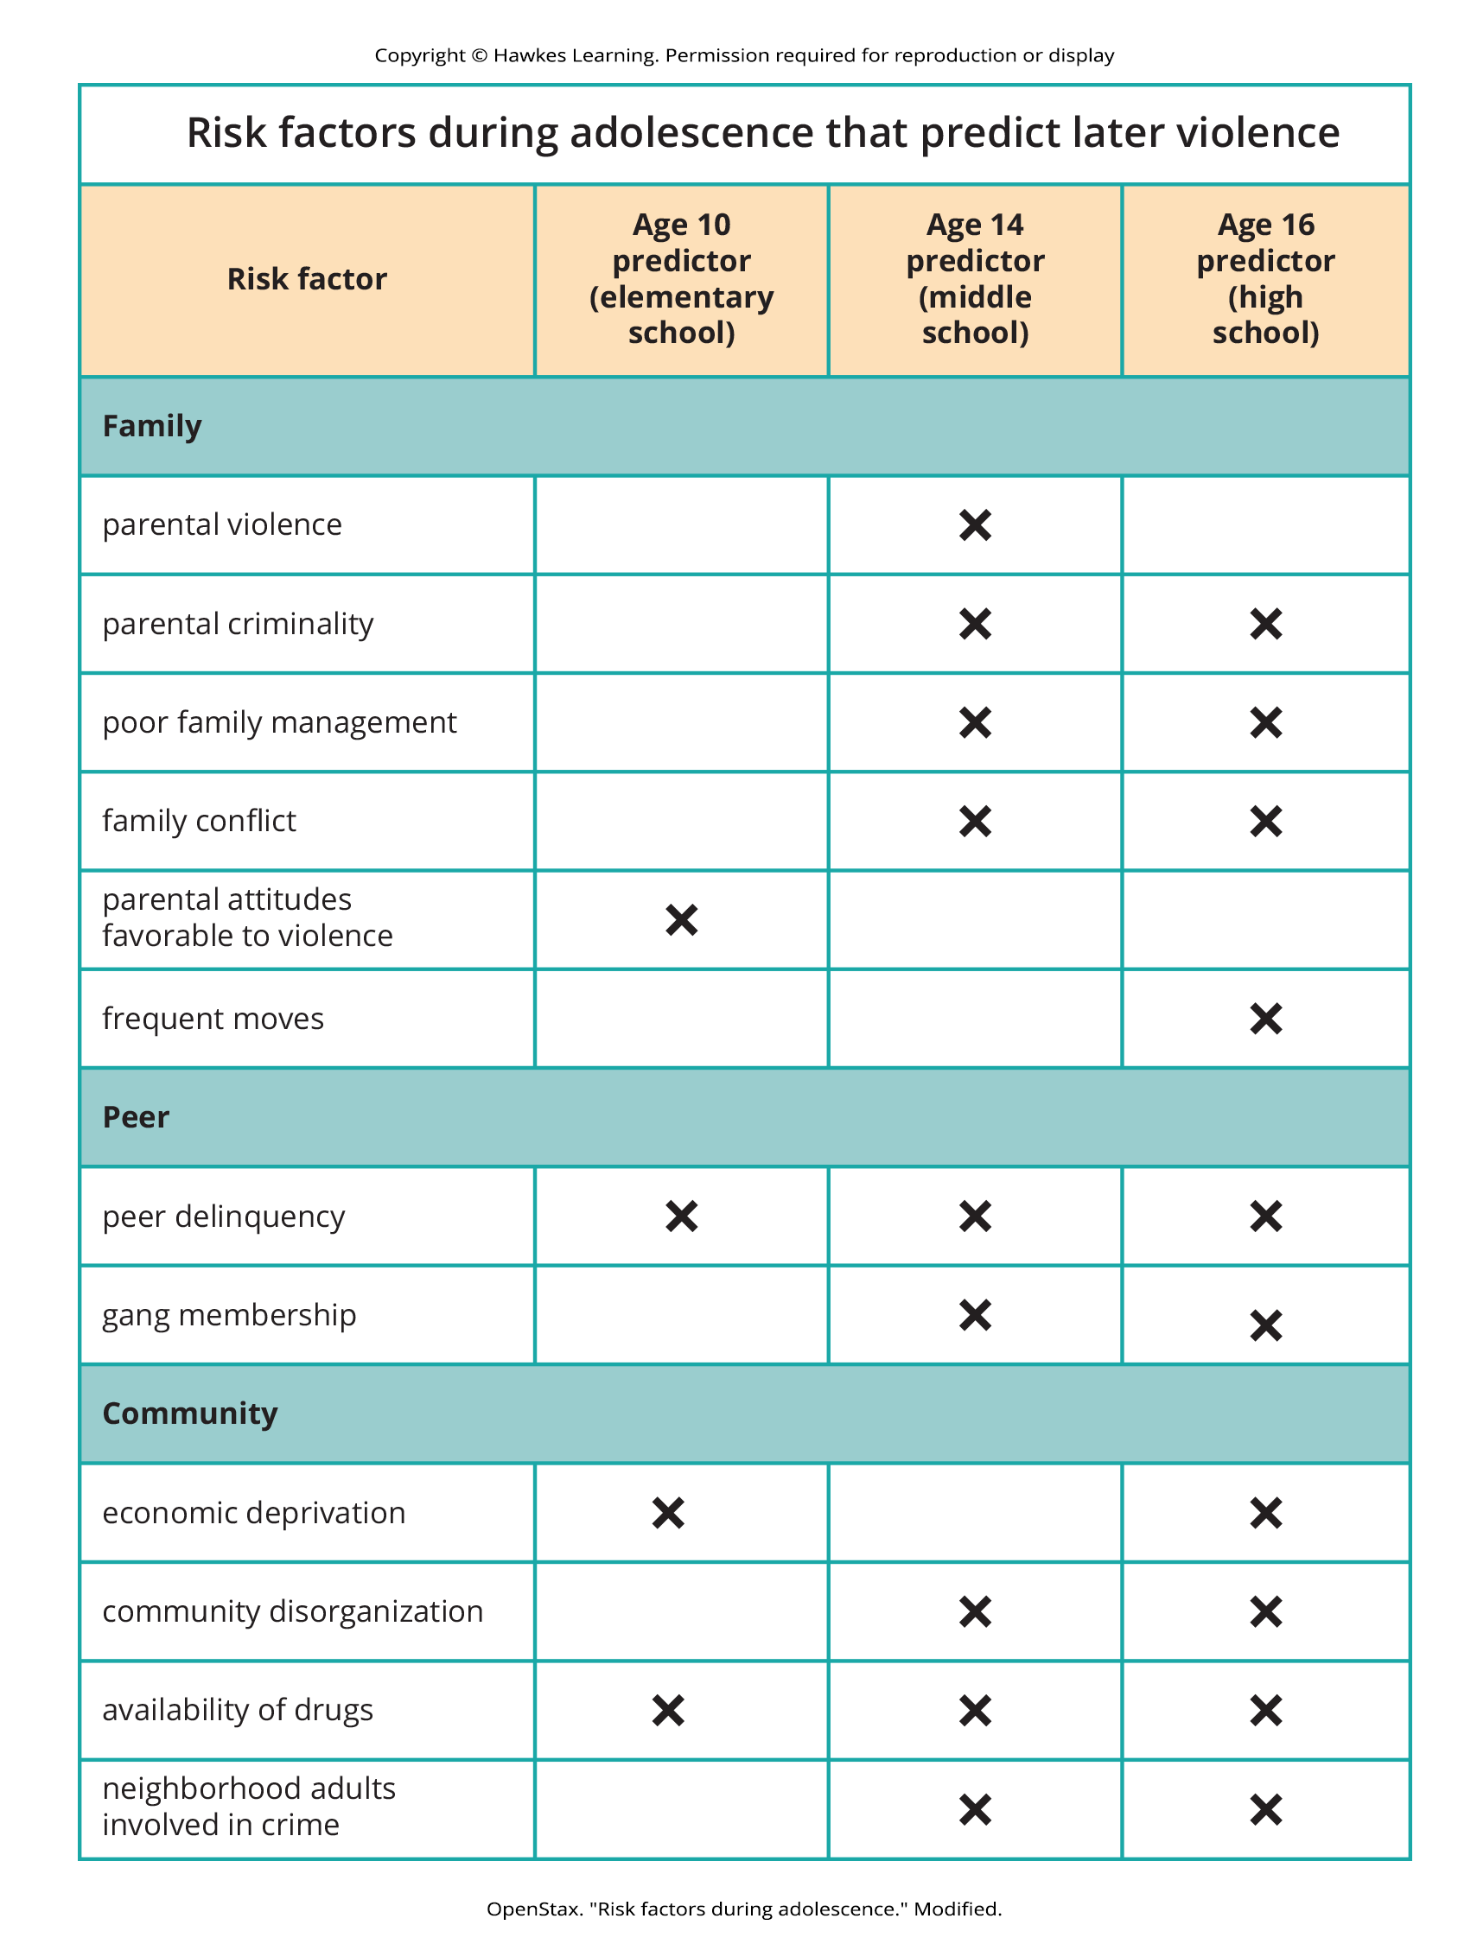
Lesson 15.8 Figure 5
Caption: Longitudinal studies have helped to identify risk factors for predicting violent behavior.

Slide 37
Emotions In Antisocial Personality Disorder₁
Those with antisocial tendencies do not seem to experience emotions the way most other people do.
They fail to show fear in response to environment cues that signal punishment, pain, or noxious stimulation.
Example: They show less skin conductance (sweatiness on hands) in anticipation of electric shock than do people without antisocial tendencies (Hare, 1965).

Slide 38
Emotions In Antisocial Personality Disorder₂
For those with antisocial personality disorder, a lack of skin conductance may indicate the presence of characteristics such as emotional deficits and impulsivity that underlie the propensity for antisocial behavior and negative social relationships (Fung et al., 2005).

Slide 39
Empathy In Antisocial Personality Disorder
Individuals with antisocial personality disorder may be less able to experience empathy.
Example: Eighty prisoners were shown photos of people being intentionally hurt by others while undergoing brain imaging (Decety et al., 2013).
Prisoners who scored high on antisocial tendencies showed less activation in brain regions involved in the experience of empathy and feeling concerned for others.
Prisoners who scored high on the antisocial test showed greater activation in a brain area involved in self-awareness, cognitive function, and interpersonal experience.

Slide 40
Summary₁
Individuals with personality disorders exhibit a personality style that is inflexible, causes distress and impairment, and creates problems for themselves and others.
The DSM-5-TR recognizes 10 personality disorders, organized into three clusters.
Cluster A includes odd and eccentric personality styles.
Cluster B includes impulsive, dramatic, highly emotional, and erratic personality styles.
Cluster C includes nervous and fearful personality styles.

Slide 41
Summary₂
Two Cluster B personality disorders are especially problematic.
People with borderline personality disorder show marked instability in mood, behavior, and self-image, as well as impulsivity.
People with antisocial personality display a lack of regard for the rights of others; they are impulsive, deceitful, irresponsible, and unburdened by any sense of guilt.

Slide 42
End of Hawkes Learning PowerPoint

