Slide 1
Lesson 15.9
Disorders in Childhood

Slide 2

Disorders In Childhood
Disorders in childhood are diagnosed early in childhood, often before the time a child enters school, and persist through adulthood.
These conditions are listed in the DSM-5-TR as neurodevelopmental disorders, and they involve developmental problems in personal, social, academic, and intellectual functioning.
Figure 1

Slide 3
Attention-Deficit/Hyperactivity Disorder
Example: Diego is always active and often in trouble with his teachers, parents, and other adults.
  He accidentally breaks things, and he can never seem to sit still.
  He never finishes anything he starts, although his teachers consider him to be a smart child.
Diego likely has attention-deficit/hyperactivity disorder (ADHD) which is a constant pattern of inattention and/or hyperactive and impulsive behavior that interferes with normal functioning.

Slide 4
Signs Of Inattention
Some signs of inattention in a child with ADHD include:
  Difficulty with sustained attention
  Failure to follow instructions
  Disorganization
  Lack of attention to detail
  Becoming easily distracted
  Forgetfulness

Slide 5
Signs Of Hyperactivity
Some signs of hyperactivity in a child with ADHD include:
  Excessive movement
  Blurting out responses
  Difficulty waiting
  Interrupting others
  Hastiness, impulsivity

Slide 6
On Your Own
Which of the previous symptoms of inattention and hyperactivity do you have (even if only on occasion)?

Slide 7
Prevalence of ADHD
ADHD is diagnosed in roughly 9.8% of children ages 3 to 17 years (CDC, 2022).
Boys are 3 times more likely to have ADHD than are girls.
  These findings might reflect the greater propensity of boys to engage in aggressive and antisocial behavior.

Slide 8
Impacts Of ADHD
Individuals with ADHD face severe academic and social challenges, including:
  Lower grades
  Lower standardized scores
  More expulsions
  Being held back in school
  Dropping out of school
  Rejection from peers

Slide 9

Duration Of ADHD
ADHD was thought to fade away by adolescence.
Instead, research shows that ADHD is a chronic problem, one that can persist into adolescence and adulthood.
A study found that 29.3% of adults who had been diagnosed with ADHD decades earlier still showed symptoms (Barbaresi et al., 2013).
  This study also reported that nearly 81% of those whose ADHD persisted into adulthood had experienced at least one other comorbid disorder.
Figure 2

Slide 10

Life Problems From ADHD
Research has shown that individuals diagnosed with ADHD suffer from the following long-term effects:
  Worse educational attainment
  Lower socioeconomic status
  Held less prestigious occupational positions
  More likely to be unemployed
  Made less in salary
  Scored worse on measures of occupational and social functioning
  More likely to be divorced
  More likely to have non-alcohol substance abuse
Figure 3

Slide 11
Substance Use And ADHD
Longitudinal studies show that children diagnosed with ADHD are at higher risk for substance abuse problems.
One study reported that childhood ADHD predicted later drinking problems, daily smoking, use of marijuana, and use of illicit drugs (Molina & Pelham, 2003).
The risk of substance abuse problems appears to be even greater for those with ADHD who also exhibit antisocial tendencies (Marshal & Molina, 2006).

Slide 12
Genetic Causes Of ADHD
The median rate of concordance for identical twins was .66, whereas the median concordance rate for fraternal twins was .20 (Burt, 2009).
  The median concordance rate for unrelated (adoptive) siblings was .09.
Another review of studies concluded that the heritability of inattention and hyperactivity were 71% and 73%, respectively (Nikolas & Burt, 2010).

Slide 13
Neurochemicals And ADHD
The specific genes involved in ADHD are likely important in the regulation of the neurotransmitter dopamine (Gizer et al., 2009).
Medications used in the treatment of ADHD have stimulant qualities and elevate dopamine activity.
  Both Ritalin and Adderall, two common pharmaceuticals for ADHD management, both increase dopamine activity.
People with ADHD show less dopamine activity in key regions of the brain, especially those associated with motivation and reward (Volkow et al., 2009.

Slide 14
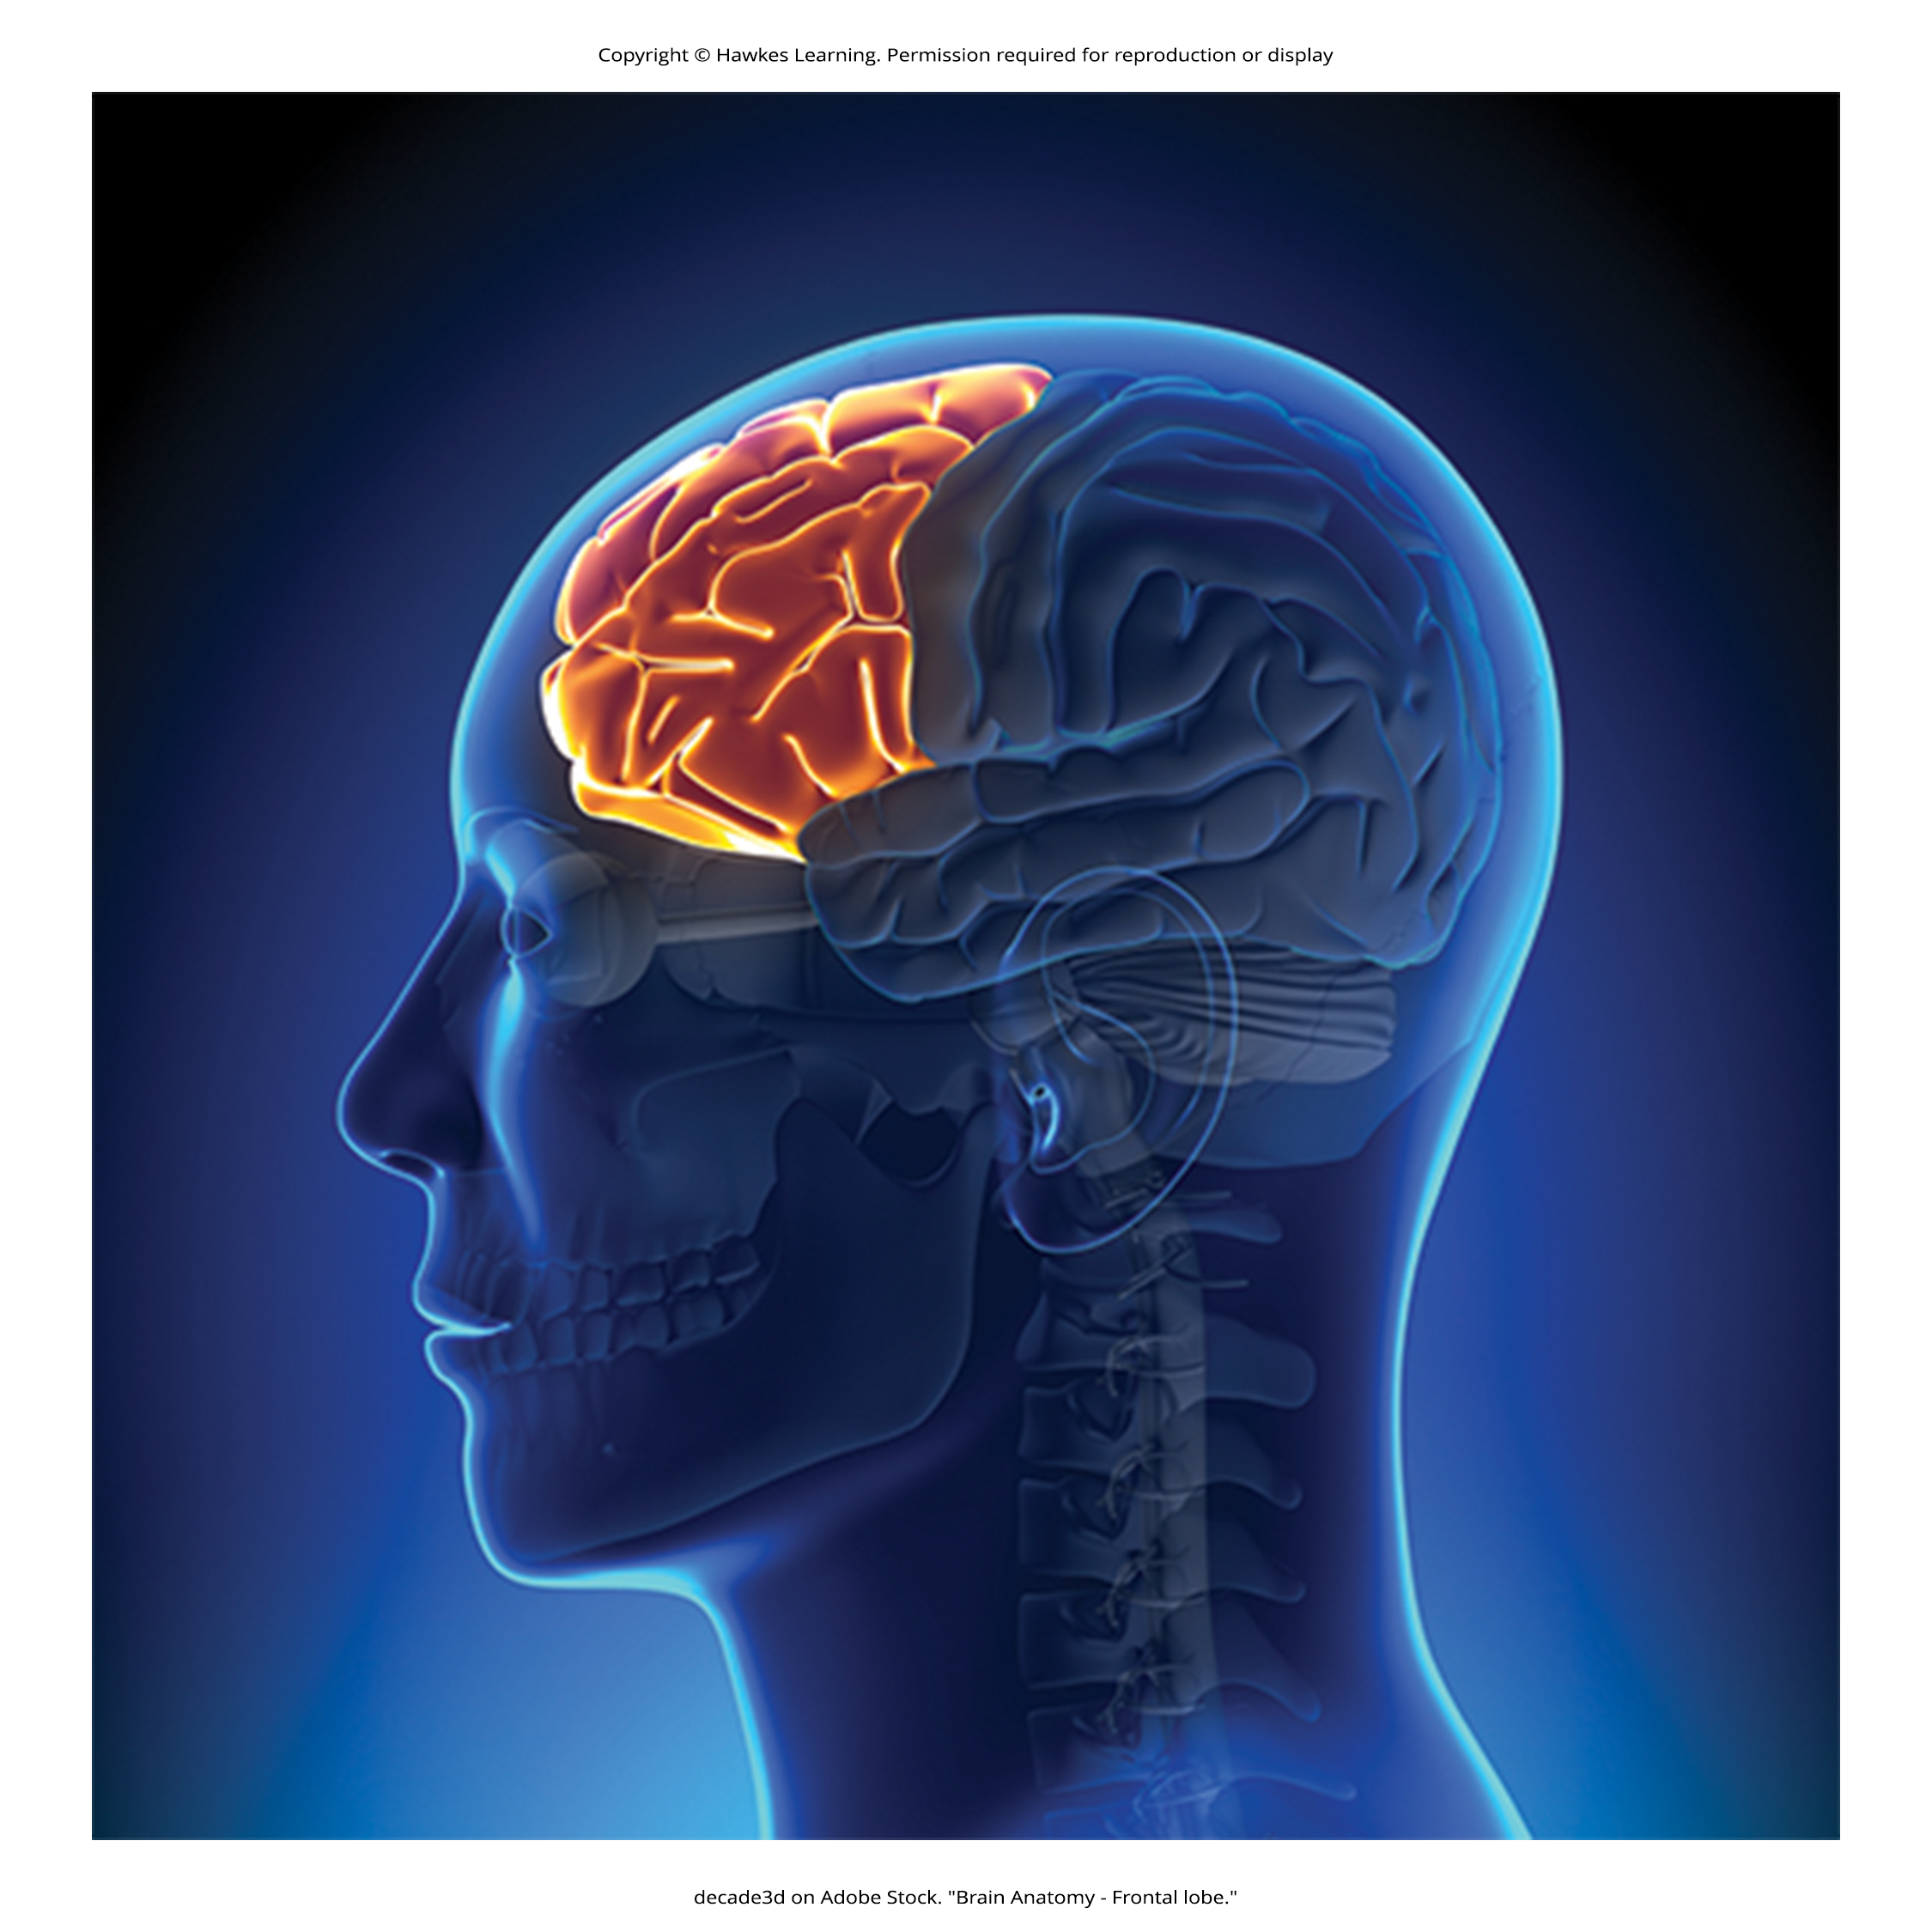
Brain Abnormalities And ADHD
Brain imaging studies have shown that individuals with ADHD exhibit abnormalities in their frontal lobes.
Individuals with ADHD appear to have smaller frontal lobe volume, and they show less frontal lobe activation when performing mental tasks.
Figure 4

Slide 15
Nutrition And ADHD
In the 1970s, people believed that hyperactivity was caused by sugar and food additives.
  Although food additives have been shown to increase hyperactivity in non-ADHD children, the effect is rather small (McCann et al., 2007).

Slide 16
Reflection Question₁
Why do you suppose the idea that ADHD is caused by sugar consumption persists?

Slide 17
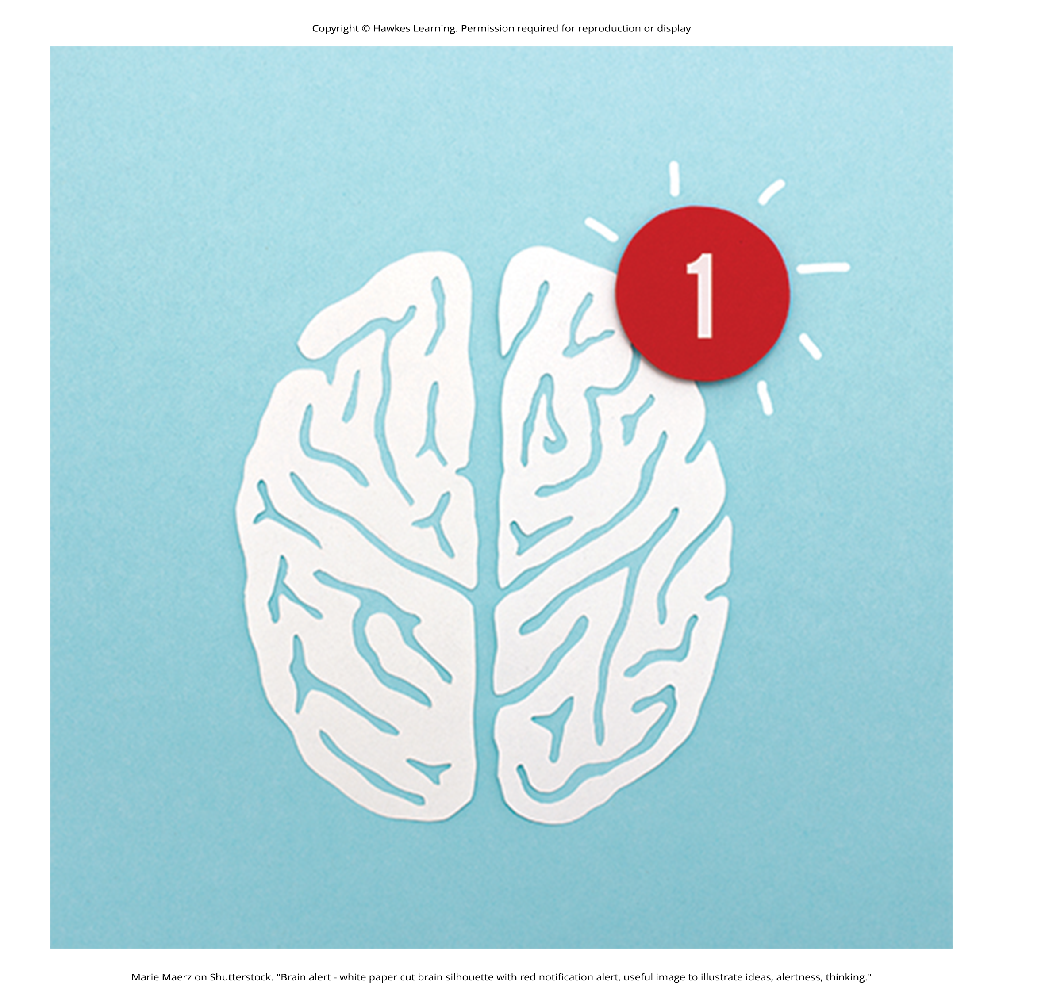
Environmental Factors And ADHD
Numerous studies have shown a significant relationship between exposure to nicotine in cigarette smoke during the prenatal period and ADHD (Linnet et al., 2003).
Maternal smoking during pregnancy is associated with the development of more severe symptoms of the disorder (Thakur et al., 2013).
Figure 5

Slide 18

Autism Spectrum Disorder
Autism spectrum disorder is characterized by an inability to form close emotional ties with others, speech and language abnormalities, repetitive behaviors, and an intolerance for minor changes in the environment and in normal routines.
Figure 6

Slide 19
Some Symptoms Of Autism Spectrum Disorder
An individual with autism spectrum disorder might exhibit deficits in social interaction.
  A person with autism spectrum disorder may not initiate conversations with other people or turn their head away when spoken to.
These individuals may not make eye contact with others and oftentimes prefer engaging in activities alone rather than with others.

Slide 20
Communication Deficits Of Autism Spectrum Disorder₁
Communication deficits can range from a complete lack of speech, to one-word responses, to echoed speech, to difficulty maintaining a conversation because of an inability to reciprocate others' comments.
  A person with autism spectrum disorder may say "Yes" or "No" when replying to questions or statements that require additional elaboration.

Slide 21
Communication Deficits Of Autism Spectrum Disorder₂
Individuals who are classified as Level 1 severity, needing support but are considered high functioning, may not have any delays or impacts to their speech (APA, 2022a).
These deficits can also include problems in using and understanding nonverbal cues (e.g., facial expressions, gestures, and postures) that facilitate normal communication.

Slide 22
Repetitive Behaviors In Autism Spectrum Disorder₁
The individual might engage in stereotyped, repetitive movements.
  A person might rock, head-bang, or repeatedly drop an object and then pick it up).
People with this disorder may show great distress at small changes in routine or the environment.
  The child might throw a temper tantrum if an object is not in its proper place or if a regularly scheduled activity is rescheduled.

Slide 23
Repetitive Behaviors In Autism Spectrum Disorder₂
The person with autism spectrum disorder might show highly restricted and fixated interests that appear to be abnormal in their intensity.
  The person might learn and memorize every detail about something even though doing so serves no apparent purpose to a neurotypical individual.
Autism spectrum disorder is not the same thing as intellectual disability although these two conditions can be comorbid.

Slide 24
The DSM And Autism Spectrum Disorder
The classification of autism has varied.
Currently, the qualifier spectrum is used to indicate that individuals with the disorder can show a range, or spectrum, of symptoms that vary in their magnitude and severity.
  Some individuals, particularly those with better language and intellectual skills, can live and work independently as adults.

Slide 25
Reflection Question₂
What impact does the idea that autism is a spectrum have on the prevalence of diagnosis?

Slide 26

Prevalence Of Autism Spectrum Disorder
Estimates indicate that nearly 1 in 59 children in the United States has autism spectrum disorder.
The disorder is 4 times more common in boys (1 out of 37) than girls (1 out of 151) (CDC, 2018).
Rates of autism spectrum disorder have increased dramatically since the 1980s.
  It is possible that the rise in prevalence is the result of the broadening of the diagnosis, increased efforts to identify cases in the community, and greater awareness and acceptance of the diagnosis.
Figure 7

Slide 27
Genetic Causes Of Autism Spectrum Disorder
Autism appears to be strongly influenced by genetics.
Identical twins show concordance rates of 60 to 90%.
Concordance rates for fraternal twins and siblings are 5 to 10% (Autism Genome Project Consortium, 2007).
Among the genes implicated are those important in the formation of synaptic circuits that facilitate communication between different areas of the brain (Gauthier et al., 2011).

Slide 28
Environmental Causes of Autism Spectrum Disorder
A number of environmental factors are also thought to be associated with an increased risk for autism spectrum disorder, at least in part, because they contribute to new mutations.
These factors include exposure to pollutants, such as plant emissions and mercury, urban versus rural residence, and vitamin D deficiency (Kinney et al., 2009).

Slide 29

Child Vaccinations And Autism Spectrum Disorder₁
In the 1990s, a fraudulent article claimed there was a relationship between the MMR vaccine and the development of autism.
Despite retraction of the article, concerns about vaccinations and autism persisted.
There is no scientific evidence that a link exists between autism and vaccinations (Hughes, 2007; Plotkin et al., 2009).
Figure 8

Slide 30
Child Vaccinations and Autism Spectrum Disorder₂
A 2013 study compared the vaccination histories of 256 children with autism spectrum disorder with that of 752 control children (DeStefano et al., 2013).
Investigators examined medical records to determine if those children who received more immunogens were at greater risk for developing autism spectrum disorder.
The results clearly demonstrate that the quantity of immunogens from vaccines received during the first 2 years of life were not at all related to the development of autism spectrum disorder.

Slide 31
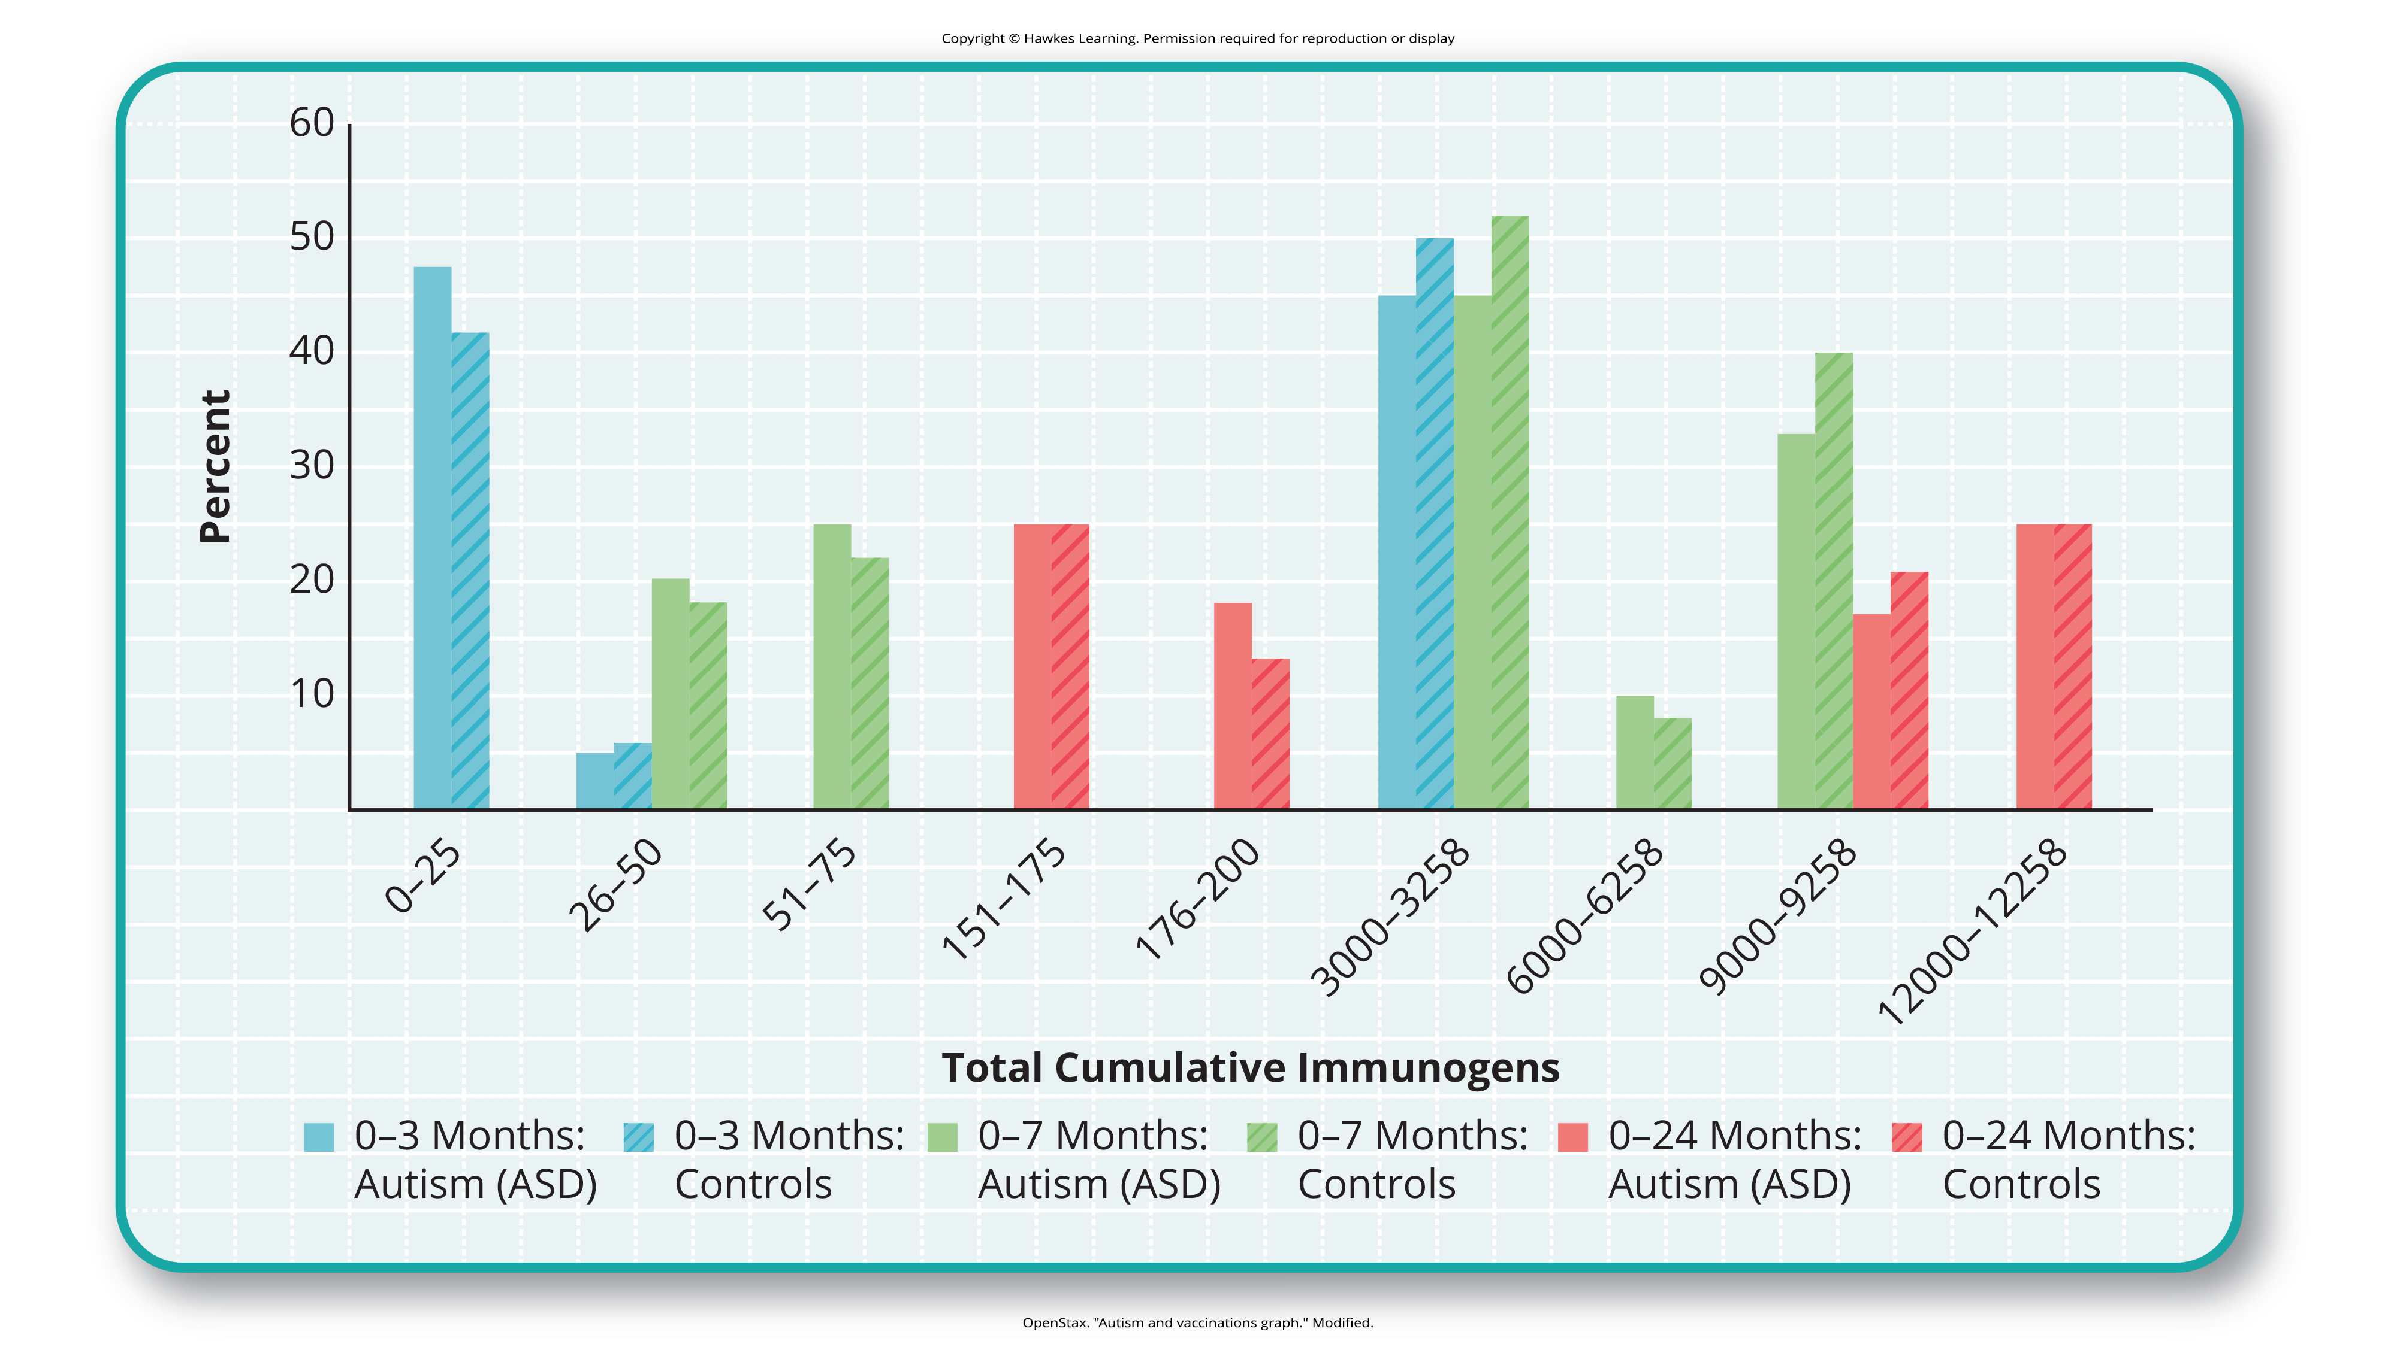
Lesson 15.9 Figure 9
Caption: In terms of their exposure to immunogens in vaccines, overall, there is not a significant difference between children with autism spectrum disorder and their age-matched controls without the disorder (DeStefano et al., 2013).

Slide 32
Group Activity₁
With two or three classmates, discuss ways in which you could help change public opinion about the false relationship between vaccinations and autism.

Slide 33
Child Vaccinations And Autism Spectrum Disorder₃
The study that fueled the controversy regarding the MMR vaccine and autism reported that eight out of 12 children developed autism symptoms shortly after receiving a vaccination.
To conclude that vaccines cause autism spectrum disorder on this basis, as many did, is clearly incorrect for several reasons.
  Correlation does not imply causation.

Slide 34
Child Vaccinations And Autism Spectrum Disorder₄
  Children receive many vaccinations around their second birthday, which is the earliest age at which a child can be diagnosed with autism spectrum disorder.
  The series of vaccinations at a child's 2-year well appointment are given around the time diagnosis is approved by the American Psychiatric Association.

Slide 35
Group Activity₂
Consider the following statement:
"to conclude that vaccines cause autism spectrum disorder on this basis . . . was clearly incorrect for a number of reasons."
Discuss those reasons with two or three classmates.

Slide 36
Summary
Neurodevelopmental disorders are a group of disorders that are typically diagnosed during childhood and are characterized by developmental deficits in personal, social, academic, and intellectual realms; these disorders include attention-deficit/hyperactivity disorder (ADHD) and autism spectrum disorder.
ADHD is characterized by a pervasive pattern of inattention and/or hyperactive and impulsive behavior that interferes with normal functioning.
  Genetic and neurobiological factors contribute to the development of ADHD, which can persist well into adulthood and can be associated with poor long-term outcomes.
The major features of autism spectrum disorder include deficits in social interaction and communication and repetitive movements or interests.
  As with ADHD, genetic factors appear to play a prominent role in the development of autism spectrum disorder; exposure to environmental pollutants such as mercury has also been linked to the development of this disorder.
  Although it is believed by some that autism is triggered by the MMR vaccination, evidence does not support this claim.

Slide 37
End of Hawkes Learning PowerPoint

